Slide 1
RF baseline, options & open issues
(200 MHz, 400 MHz, 800 MHz, possible wideband feedback system, crab cavities …)
Erk Jensen
CERN, BE-RF
3rd Joint HiLumi LHC-LARP Annual Meeting, 12-Nov-2013, Daresbury Lab.
Gratefully acknowledging: P. Baudrenghien, R. Calaga, W. Höfle, T. Mastoridis, E. Shaposhnikova for preparing this presentation … and many other contributors!

Slide 2
Outline
LHC Main RF System, ACS400:
  power limitations
  the solution: phase modulation
Crab Cavities, “ACF400”
High harmonic system (800 MHz)
Wideband transverse damper system (HBTFB)
ACN200 – the originally planned NC capture system
A new fundamental RF system? (“ACS200”)

Slide 3
The Main RF System, ACS400

Slide 4
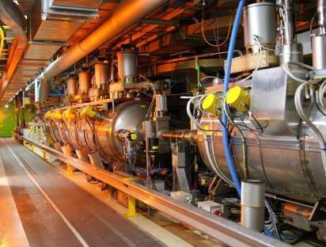
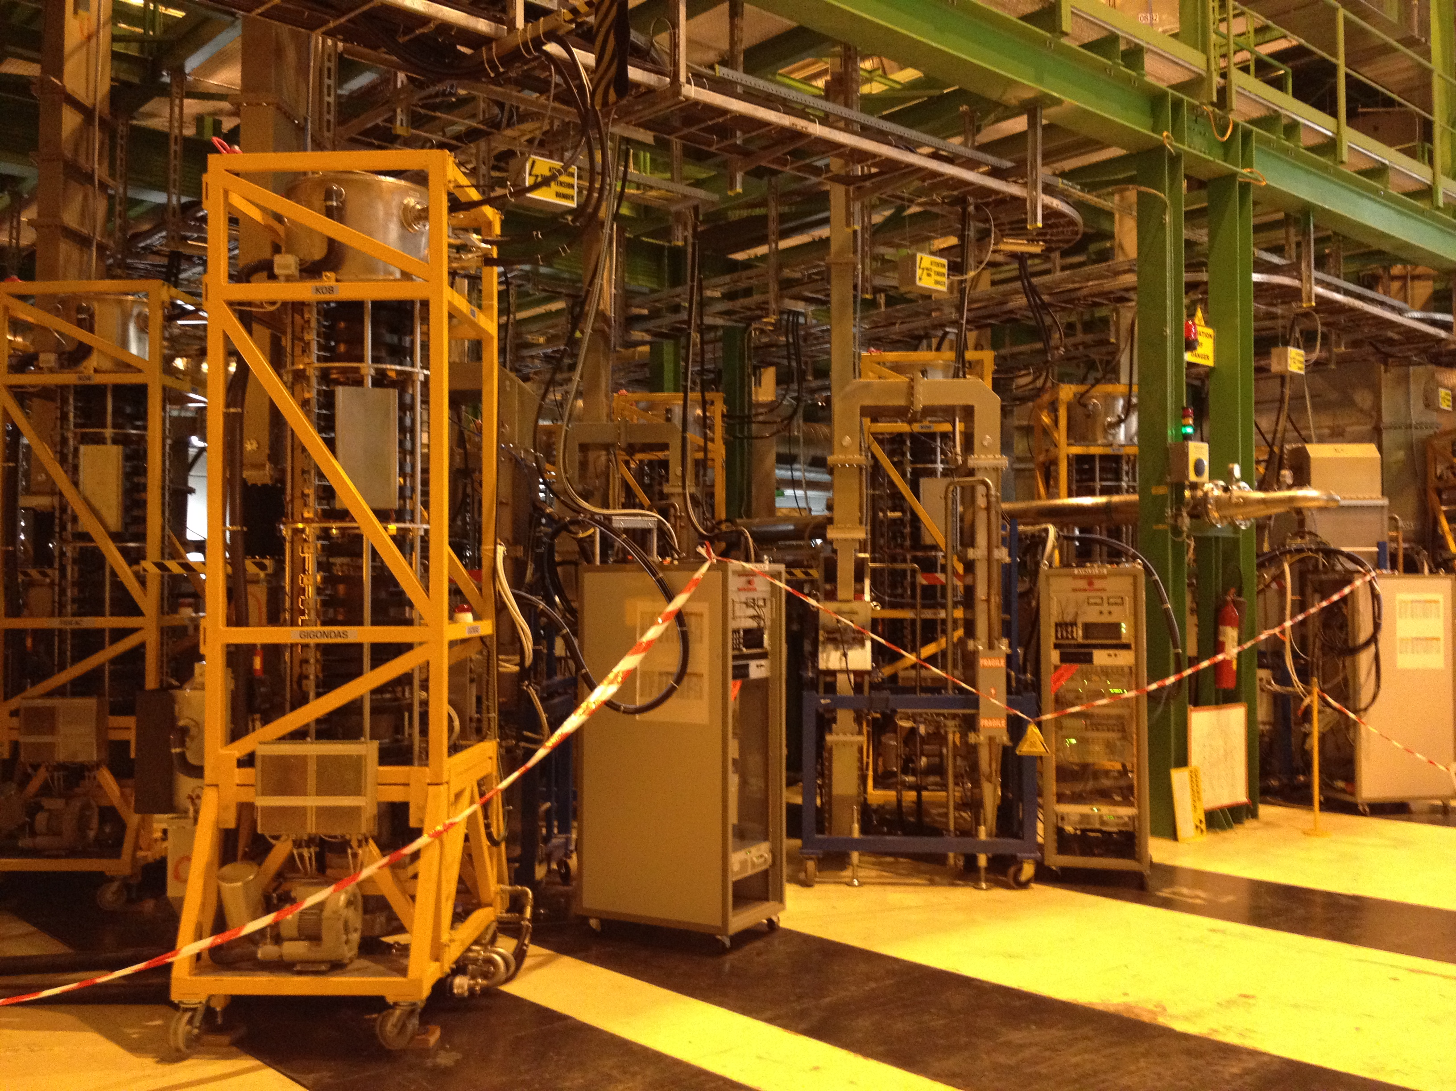
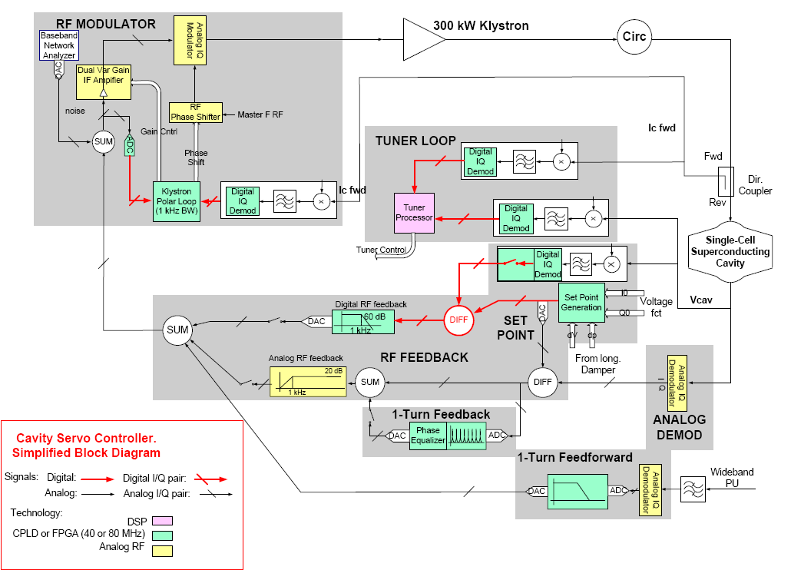
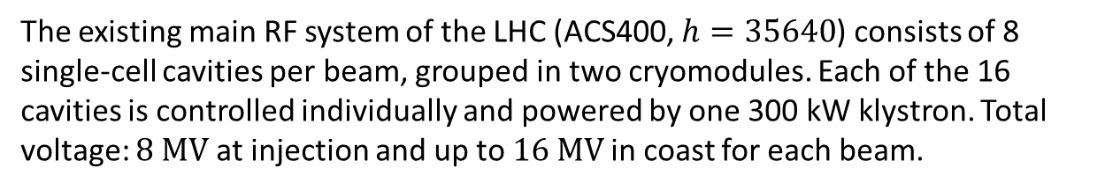
LHC Main RF System, ACS400
The existing main RF system of the LHC (ACS400, $h=35640$) consists of 8 single-cell cavities per beam, grouped in two cryomodules. Each of the 16 cavities is controlled individually and powered by one 300 kW klystron. Total voltage: $8 MV$at injection and up to $16 MV$in coast for each beam.

Slide 5
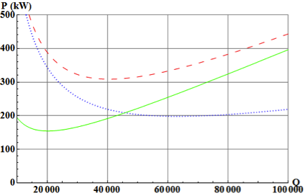
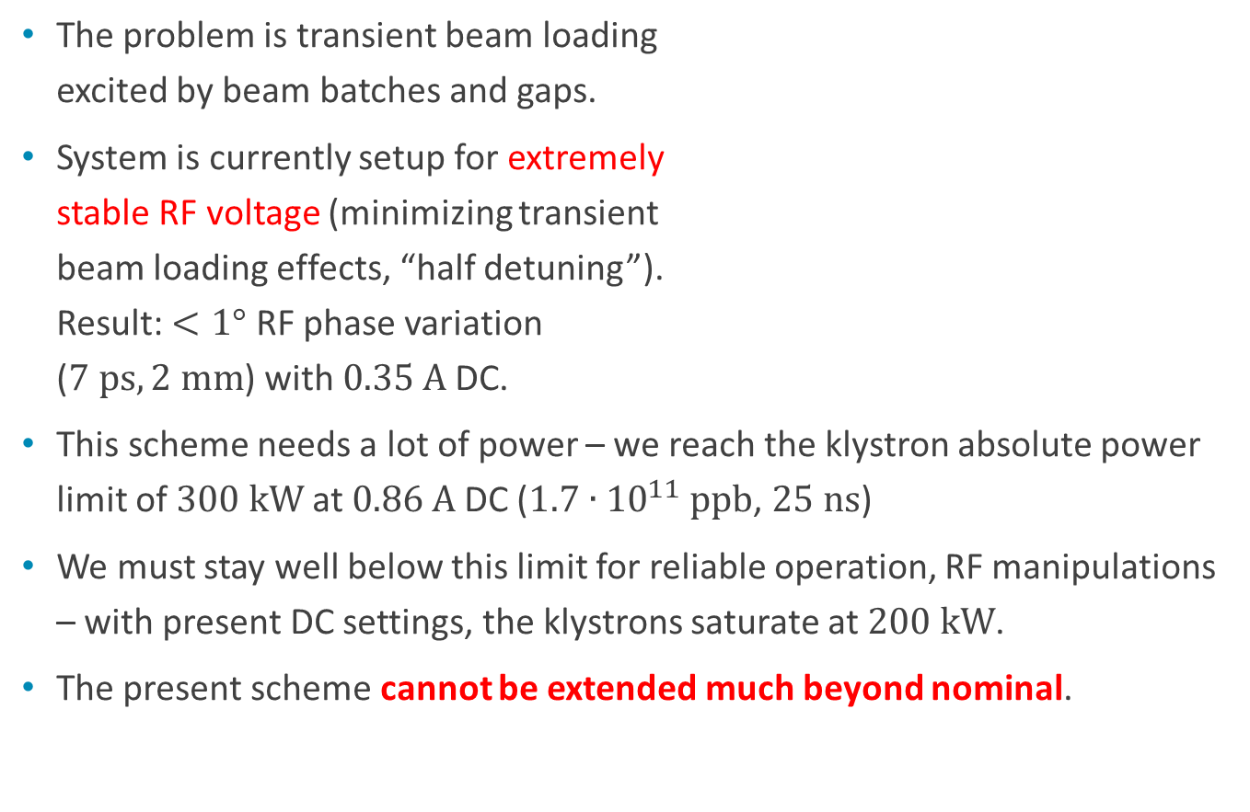

ACS400, power limit of present scheme
Required klystron power
The problem is transient beam loading
excited by beam batches and gaps.
System is currently setup for extremely
stable RF voltage (minimizing transient
beam loading effects, “half detuning”).
Result: $<1°$ RF phase variation
($7 ps, 2 mm$) with $0.35 A$DC.
This scheme needs a lot of power – we reach the klystron absolute power limit of $300 kW$at $0.86 A$DC ($1.7∙{10}^{11}$ ppb, $25 ns$)
We must stay well below this limit for reliable operation, RF manipulations – with present DC settings, the klystrons saturate at $200 kW$.
The present scheme cannot be extended much beyond nominal.
1.7e11 ppb, 25 ns, 7 TeV
1.7e11 ppb, 25 ns, 450 GeV
1.15e11 ppb, 25 ns, 7 TeV
$$Q_{ext}$$

Slide 6
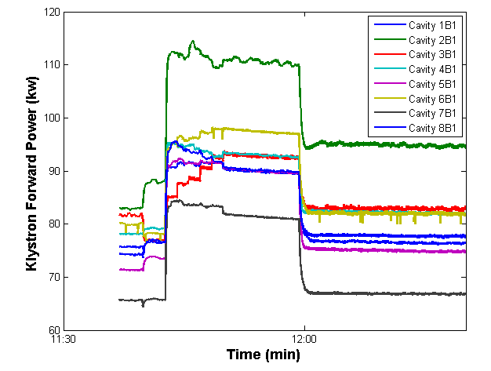
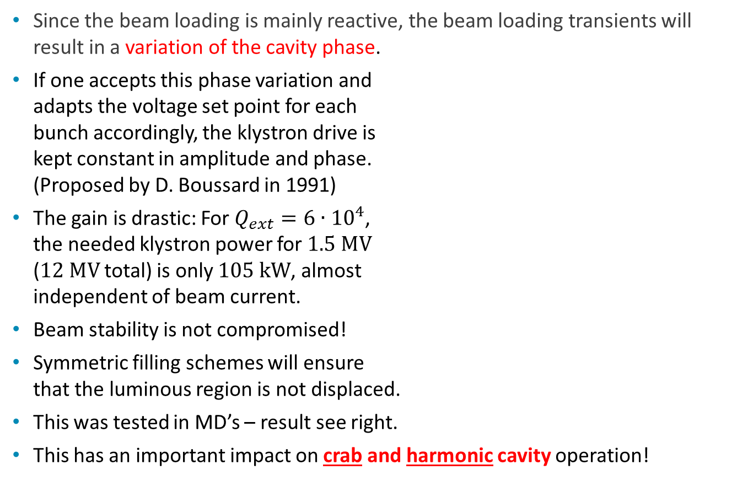
The idea: accept RF phase modulation
Since the beam loading is mainly reactive, the beam loading transients will result in a variation of the cavity phase.
If one accepts this phase variation and
adapts the voltage set point for each
bunch accordingly, the klystron drive is
kept constant in amplitude and phase.
(Proposed by D. Boussard in 1991)
The gain is drastic: For $Q_{ext}=6∙{10}^{4}$,
the needed klystron power for $1.5 MV$
($12 MV$total) is only $105 kW$, almost
independent of beam current.
Beam stability is not compromised!
Symmetric filling schemes will ensure
that the luminous region is not displaced.
This was tested in MD’s – result see right.
This has an important impact on crab and harmonic cavity operation!
Filling
Switch Phase Modulation ON
No beam
Phase Modulation OFF
Klystron power (8 stations)

Slide 7
Crab Cavities

Slide 8
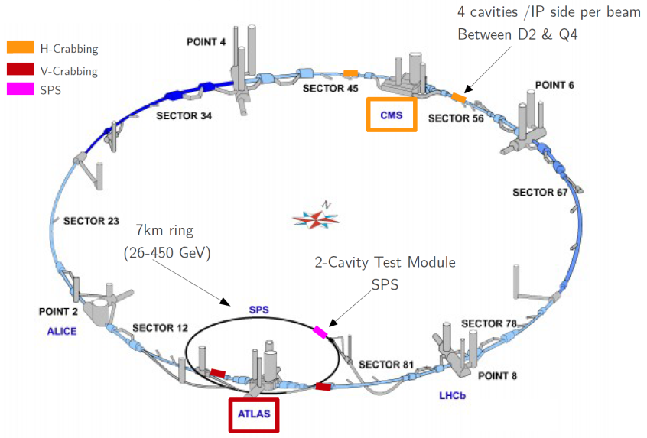
The LHC Crab Cavity Scheme

Slide 9
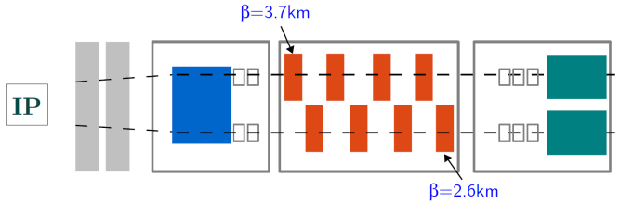
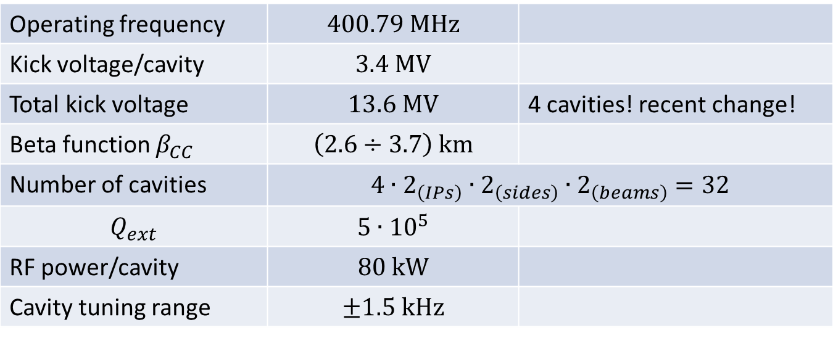
Some Basic Parameters
Operating frequency | $$400.79 MHz$$
Kick voltage/cavity | $$3.4 MV$$
Total kick voltage | $$13.6 MV$$ | 4 cavities! recent change!
Beta function $β_{CC}$ | $$\left(2.6÷3.7\right) km$$
Number of cavities | $$4∙2_{\left(IPs\right)}∙2_{\left(sides\right)}∙2_{\left(beams\right)}=32$$
$$Q_{ext}$$ | $$5∙{10}^{5}$$
RF power/cavity | $$80 kW$$
Cavity tuning range | $$±1.5 kHz$$

Slide 10
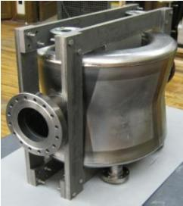
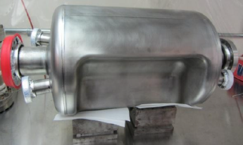
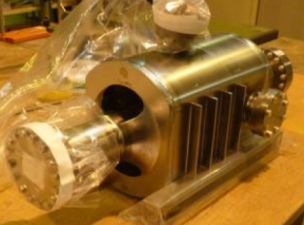
Technology Choice
Three valid Nb prototypes exist – very compact concepts to allow for their integration in LHC
Double ¼-wave | RF Dipole | 4-rod

Slide 11
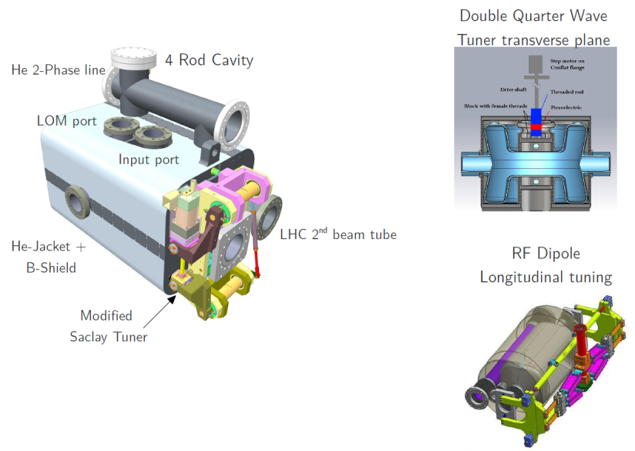
Dressed Cavity Concepts – well advanced

Slide 12
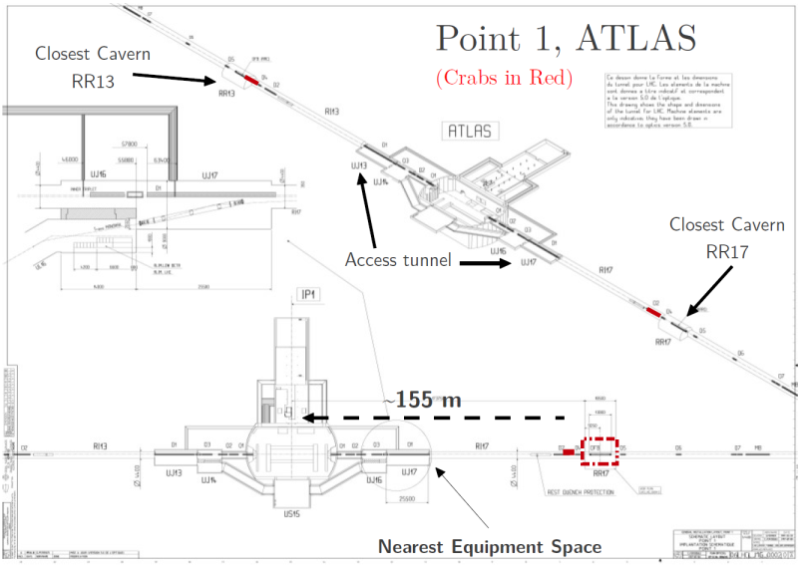
Integration in LHC IP1

Slide 13
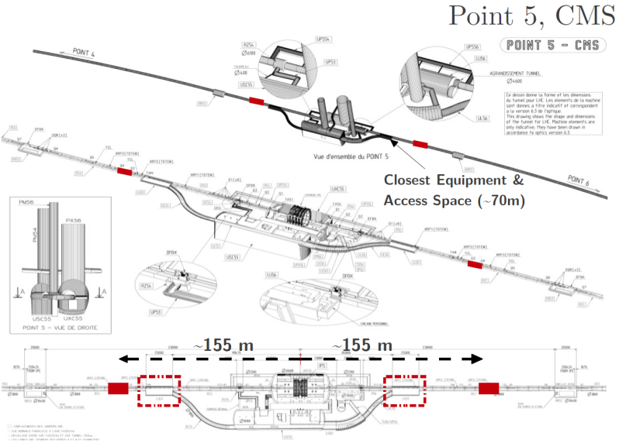
Integration in LHC IP5

Slide 14
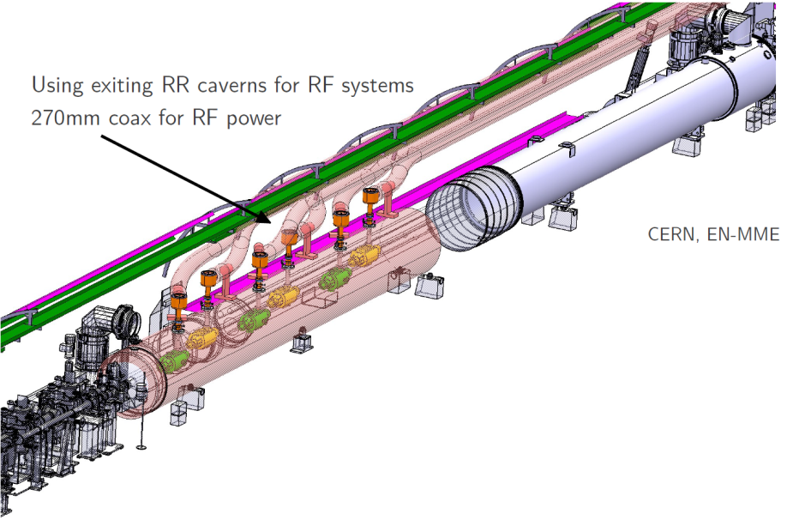
LHC Integration
Using existing RR caverns for RF systems
8x 270 mm coaxial lines for RF power

Slide 15

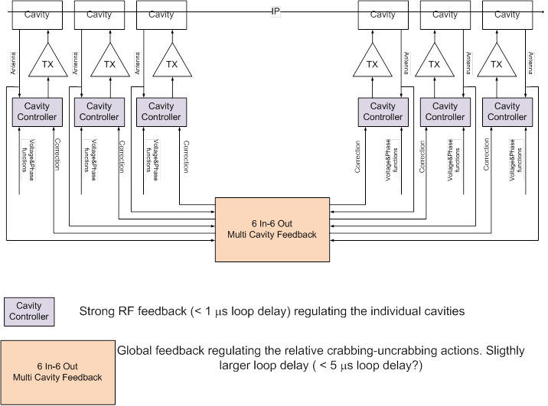

RF system conceptual layout
8 in – 8 Out Multi-cavity Feedback
8 in – 8 Out Multi-cavity Feedback
https://cds.cern.ch/record/1557219

Slide 16
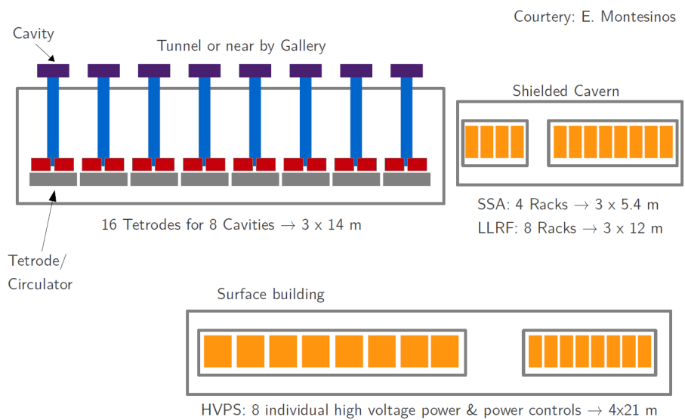
Peripherals – space required
More details on integration by P. Fessia later today

Slide 17
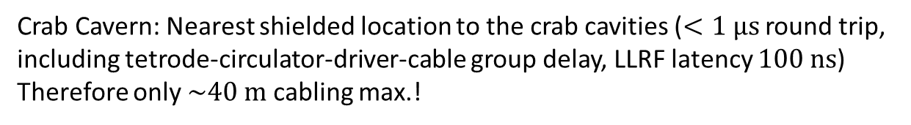
Required space: summary table
What? | Where? | Required space | # /IP /side
Cryomodule | tunnel | 10 m /IP/side | 8 cavities
Cryo jumpers | tunnel | integrated with QRL | 8 jumpers
RF amplifiers | tunnel/cavern | 3 m x 14 m | 8 tetrodes
Circulators & loads | tunnel/cavern | included above | 8
Drivers & controls | shielded cavern | 3 m x 5.4 m | 8 racks
LLRF racks | shielded cavern | 3 m x 12 m | 8+1 racks
LLRF central rack | exp. cavern | 3 m x 10 m | 5+1 racks
Slow controls | exp. cavern | 3 m x 5 m | 3 racks
Remote alignment | exp. cavern
HV supply | surface building | 4 m x 16 m | 8
Crab Cavern: Nearest shielded location to the crab cavities ($<1 μs$ round trip,
including tetrode-circulator-driver-cable group delay, LLRF latency $100 ns$)
Therefore only $\sim 40 m$ cabling max.!

Slide 18
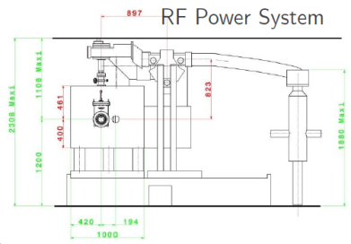
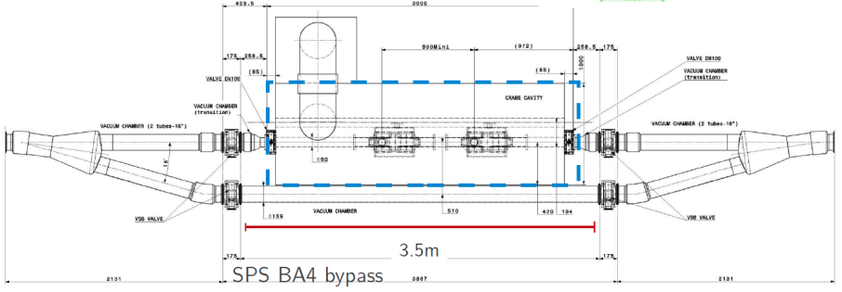
SPS Test Module
Proof of principle demonstration with protons
Important beam tests:
  Technology validation, performance, stability,
  Effects on the beam, cavity failure modes, radiation
Preparation/integration in full swing – more details by A. Macpherson tomorrow.

Slide 19
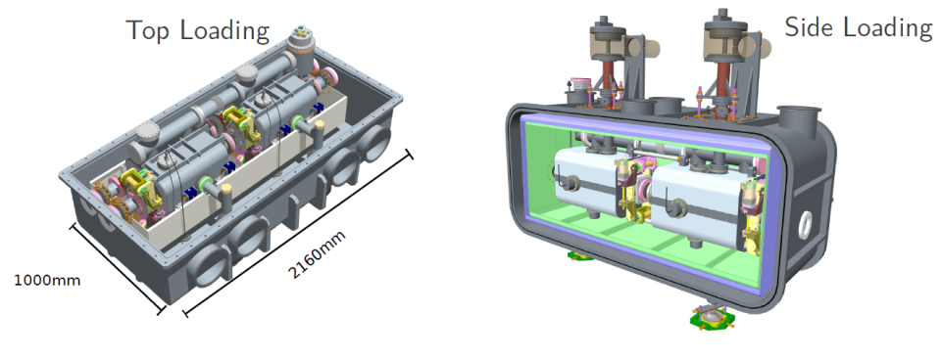
Cryostat proposal for SPS tests (4-rod)
S. Pattalwar, T. Jones
Simplified cryostat for easy assembly/access/maintenance,
but with relevant features of the LHC system (2 cavity cryostat, alignment, 2nd beam tube …)
Very advanced! - more details by S. Pattalwar tomorrow

Slide 20
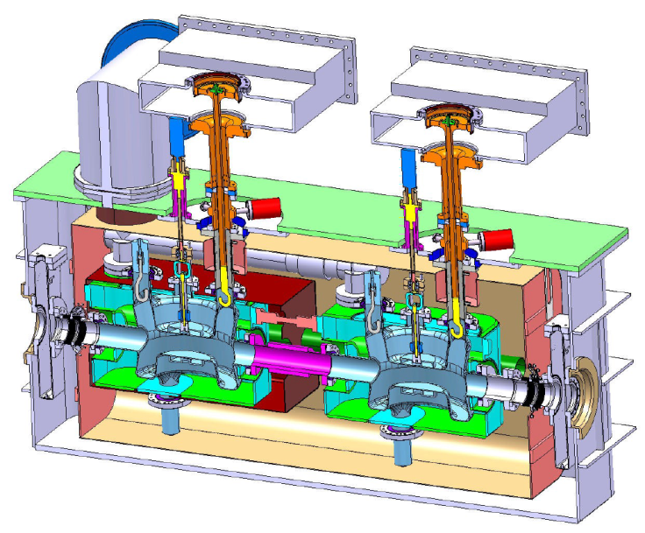
Alternative Cryostat for SPS test (DQW)
Courtesy: BNL & CERN EN-MME

Slide 21
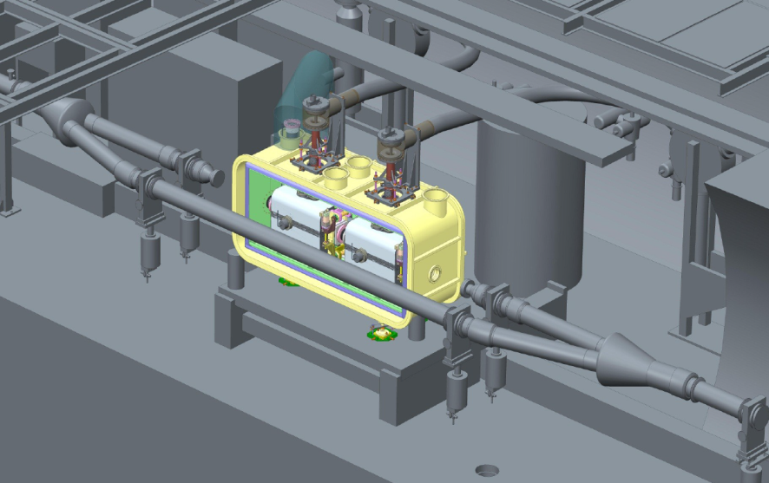
SPS Integration (e.g.: 4-rod

Slide 22
Draft of an updated schedule ^{*)}
now
^{*)} Attention: This is assumed – not approved
Notes:
For this estimate I took the summary slide from Steve’s summary talk after the RLIUP Workshop

Slide 23
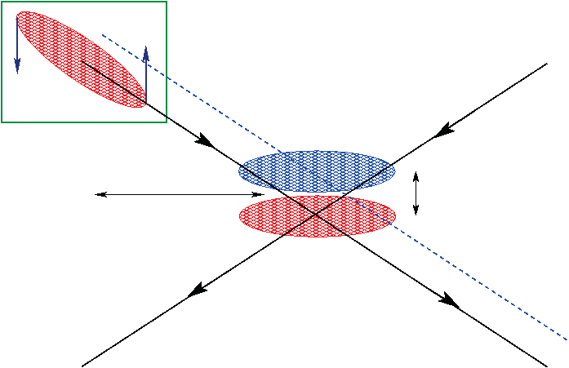
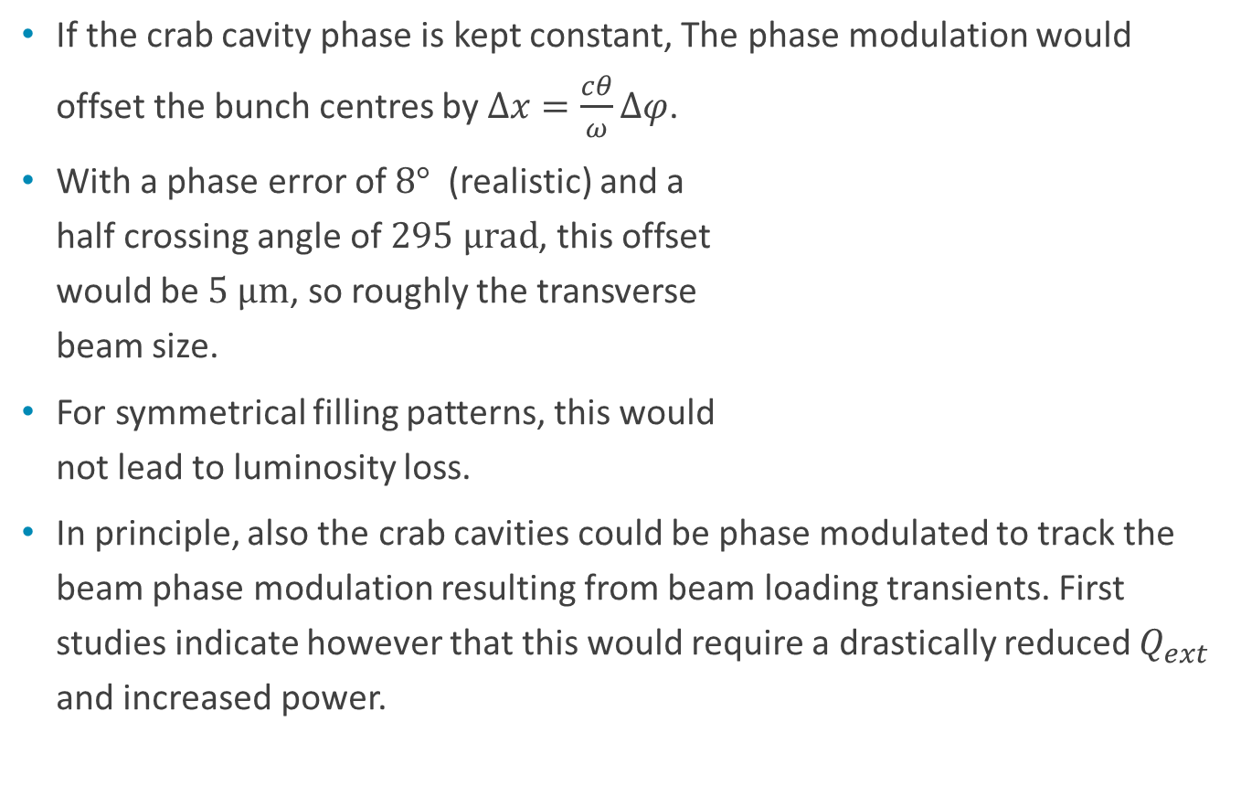
Phase modulation and crab cavities
If the crab cavity phase is kept constant, The phase modulation would offset the bunch centres by $Δx=\frac{cθ}{ω}Δφ$.
With a phase error of $8°$ (realistic) and a
half crossing angle of $295 μrad$, this offset
would be $5 μm$, so roughly the transverse
beam size.
For symmetrical filling patterns, this would
not lead to luminosity loss.
In principle, also the crab cavities could be phase modulated to track the beam phase modulation resulting from beam loading transients. First studies indicate however that this would require a drastically reduced $Q_{ext}$ and increased power.
phase error
ideal phase

Slide 24
High Harmonic RF System

Slide 25
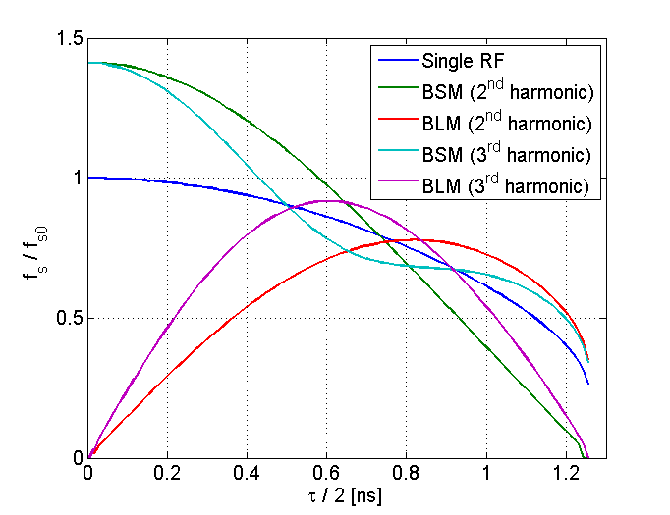
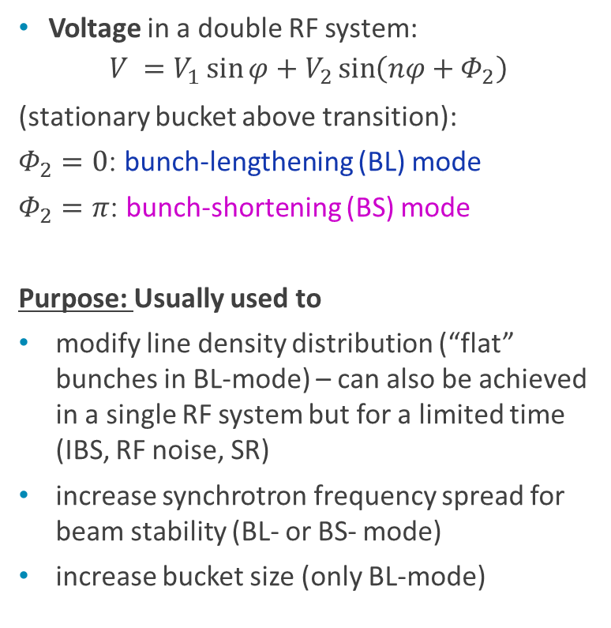
High harmonic RF system
Voltage in a double RF system:
$$V =V_{1}\sin{φ}+V_{2}\sin\left(nφ+Φ_{2}\right)$$
(stationary bucket above transition):
$Φ_{2}=0$: bunch-lengthening (BL) mode
$Φ_{2}=π$: bunch-shortening (BS) mode
Purpose: Usually used to
modify line density distribution (“flat” bunches in BL-mode) – can also be achieved in a single RF system but for a limited time (IBS, RF noise, SR)
increase synchrotron frequency spread for beam stability (BL- or BS- mode)
increase bucket size (only BL-mode)
Synchrotron frequency distribution inside the bunch

Slide 26
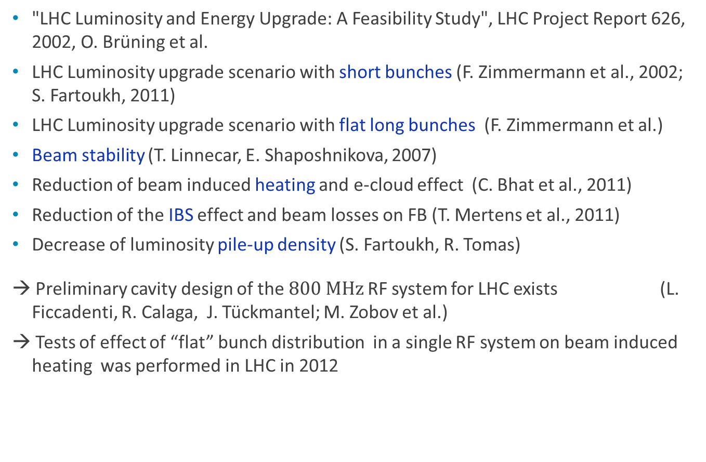
LHC high harmonic system studies:
"LHC Luminosity and Energy Upgrade: A Feasibility Study", LHC Project Report 626, 2002, O. Brüning et al.
LHC Luminosity upgrade scenario with short bunches (F. Zimmermann et al., 2002; S. Fartoukh, 2011)
LHC Luminosity upgrade scenario with flat long bunches (F. Zimmermann et al.)
Beam stability (T. Linnecar, E. Shaposhnikova, 2007)
Reduction of beam induced heating and e-cloud effect (C. Bhat et al., 2011)
Reduction of the IBS effect and beam losses on FB (T. Mertens et al., 2011)
Decrease of luminosity pile-up density (S. Fartoukh, R. Tomas)
→ Preliminary cavity design of the $800 MHz$RF system for LHC exists (L. Ficcadenti, R. Calaga, J. Tückmantel; M. Zobov et al.)
→ Tests of effect of “flat” bunch distribution in a single RF system on beam induced heating was performed in LHC in 2012

Slide 27
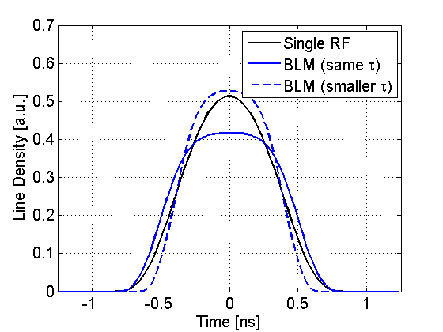
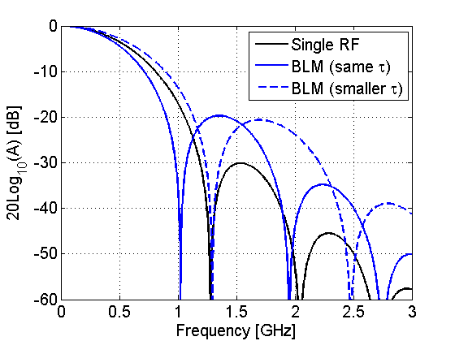



400 MHz ($V$) + 800 MHz ($V/2$)
Bunch profile
Single RF: $τ=1.5 ns, ε=4 eVs$
Double RF: $τ=1.5 ns, ε=3.2 eVs$
$τ=1.25 ns, ε=1.65 eVs$
Power spectrum
At the same bunch length:
improvement below 1.2 GHz
degradation above
For shorter $τ$: larger values at all frequencies

Slide 28
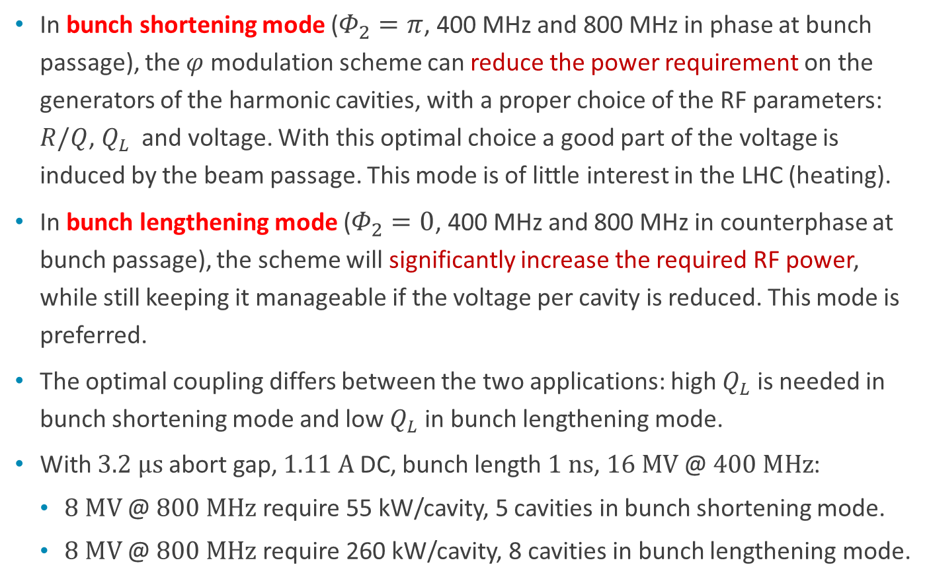
Phase modulation & harmonic cavity
In bunch shortening mode ($Φ_{2}=π$, 400 MHz and 800 MHz in phase at bunch passage), the $φ$ modulation scheme can reduce the power requirement on the generators of the harmonic cavities, with a proper choice of the RF parameters: $R/Q$, $Q_{L}$ and voltage. With this optimal choice a good part of the voltage is induced by the beam passage. This mode is of little interest in the LHC (heating).
In bunch lengthening mode ($Φ_{2}=0$, 400 MHz and 800 MHz in counterphase at bunch passage), the scheme will significantly increase the required RF power, while still keeping it manageable if the voltage per cavity is reduced. This mode is preferred.
The optimal coupling differs between the two applications: high $Q_{L}$ is needed in bunch shortening mode and low $Q_{L}$ in bunch lengthening mode.
With $3.2 μs$ abort gap, $1.11 A$DC, bunch length $1 ns$, $16 MV$@ $400 MHz$:
  $8 MV$@ $800 MHz$ require 55 kW/cavity, 5 cavities in bunch shortening mode.
  $8 MV$@ $800 MHz$ require 260 kW/cavity, 8 cavities in bunch lengthening mode.

Slide 29
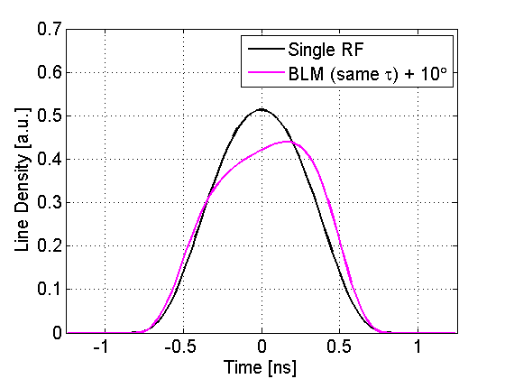
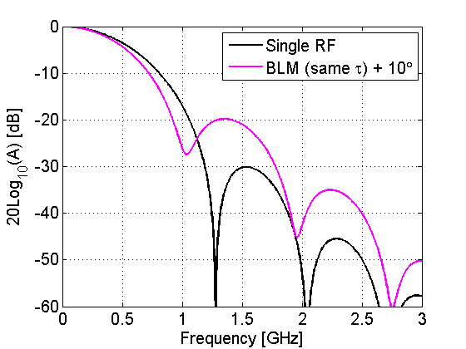

Phase modulation leads to tilted bunches
Bunch profile
Single RF: $τ=1.5 ns, ε=4 eVs$
Double RF: $τ=1.5 ns, ε=3.2 eVs$
Power spectrum
No significant improvement for tilted bunches

Slide 30
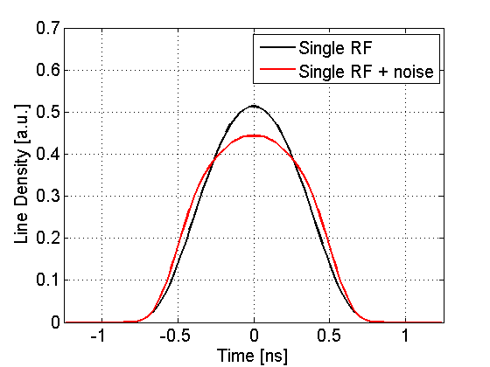
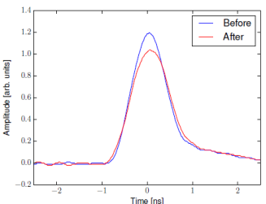
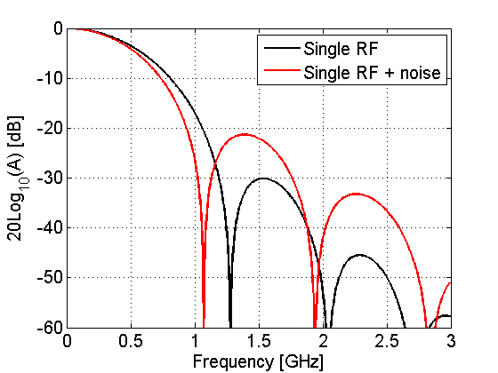
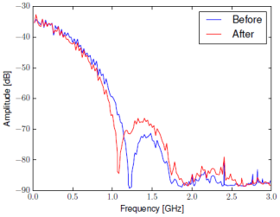
Flat bunches with a single RF system
Simulations
Measurement (LHC MD 2012)
Bunch
profile
Spectrum

Slide 31
Wideband Transverse Damper (HBTFB)

Slide 32
Wideband Transverse Damper
Applicable to LHC injectors and LHC proper
Intra-bunch GHz transverse feedback system
stabilize beam against e-cloud and impedance driven intra-bunch oscillations
Proof of principle system being developed with LARP for SPS
Full SPS implementation included in SPS upgrades (US2)
Complementary to existing rigid bunch transverse feedbacks
supported by:
US-LARP (SLAC, LBNL)
LNF-INFN (kicker study)
CERN SPS LIU Project
See also LIU review 2013: http://indico.cern.ch/conferenceDisplay.py?confId=260522
BPM
Kicker
Beam
Active closed loop
GHz Feedback
Analog
Front
End
ADC
Signal
Processing
DAC
Analog Back
End
Power Amp
transverse
position
pre-processed
sampled
position
“slices”
calculated
correction data
correction
signal
pre-distortion
drive signal
Notes:
Slide 1: Shows an overview of the generic intra-bunch transverse feedback.

Slide 33
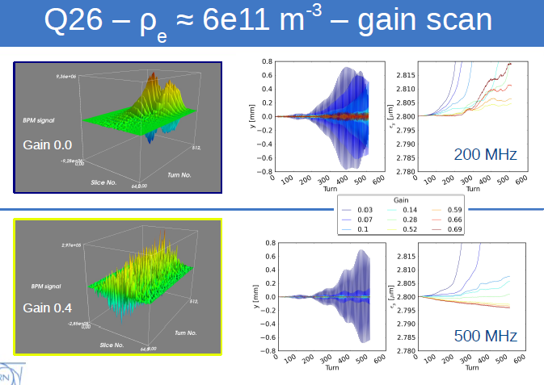
Ongoing work for SPS system - simulations
Kevin Li
Simulations for SPS during the ramp and Q20 optics ongoing (CERN-ABP)
Optimization of controller design (bandwidth, FIR filters) ongoing (SLAC)
Notes:
Slide 2: Shows simulations with headtail demonstrating how the ecloud instability in the SPS at 26 GeV and Q26 can be surpressed by such a system, ongoing work for Q20 optics and optimized feedback algorithmn

Slide 34
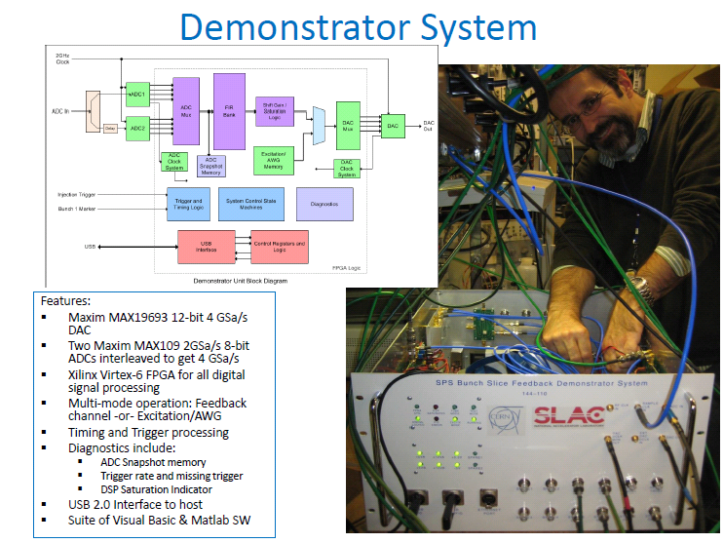
SPS experimental demonstrator
Notes:
Slide 3: Shows hardware built with LARP (SLAC) for the electronic part

Slide 35
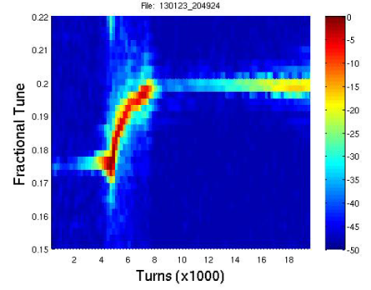
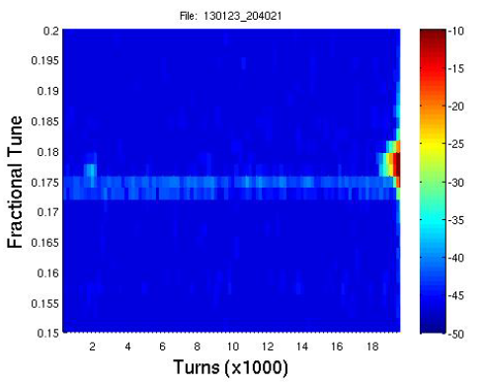
SPS single bunch tests
single bunch, 26 GeV, charge ~1E11
These studies use a 200 MHz stripline pickup as kicker.
Chromaticity ramped down
(close to zero)
Chromaticity ramped down
(close to zero)
File: 130123_204924
File: 130123_204021
Instability
Fractional Tune
Tune shift due to Beam loss
Fractional Tune
Feedback switched OFF
Feedback off
Feedback active
Instability
Turns (x1000)
Turns (x1000)
Feedback stabilizes the bunch !
clearly working for dipole mode, limitation now is bandwidth of kicker
confirms high sensitivity of receiver circuit
confirms feedback possible with the very small kick strength of ~1 kV [transverse]
Notes:
Slide 4: Shows results of a successful damping test in the SPS using a 200 MHz kicker on a single bunch made artificially unstable; more bandwidth in the kicker is required

Slide 36
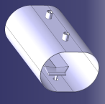
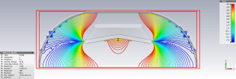
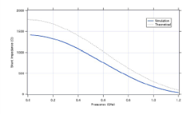




Kick design: Strip-line and Faltin Type
Strip-line
Installation of strip-line for SPS in LS1 !
Shunt-impedances → 1.2 GHz
E
total
Faltin type
(Strip/Slot-line)
B
B
E
J. Cesaratto (SLAC)
S. De Santis (LBNL)
M. Zobov (INF-LNF)
E. Montesinos (CERN)
et al.
Design Report:
http://slac.stanford.edu/pubs/slacreports/reports18/slac-r-1037.pdf
More details by J. Fox on Thursday & special FB session on Fri
Notes:
Slide 5: Shows the work on kicker design (report completed) and mechanical design of strip-line launched

Slide 37
ACN200

Slide 38



ACN200
The 2004 LHC Design Report¹⁾ foresaw the staged
installation of a capture cavity system, ACN200.
J. Tückmantel estimated in 1999²⁾ that injection of
$ε>1 eVs$, assuming beam phase and energy errors,
would lead to unacceptable capture losses in LHC
without the capture cavity.
But even with ACN200, the recapture in 400 MHz
would still be limiting.
In real life we were lucky this time – the error estimates
turned out to be pessimistic, RF systems of the SPS were
improved (LLRF, 800 MHz), SPS impedance was reduced
and the LHC capture voltage was increased and the 400 MHz
system was used as longitudinal damper.
With present experience we can firmly state that
ACN200 will not be used.
Should one reconsider one day to improve transfer SPS→LHC, other solutions should be favoured (further SPS improvement, larger SPS voltage, lower $h$ in LHC)
https://edms.cern.ch/file/445835/4/Vol_1_Chapter_6.pdf
http://cds.cern.ch/record/397578
E. Ciapala in Chamonix 2010: http://indico.cern.ch/conferenceDisplay.py?confId=67839
P. Baudrenghien in Chamonix 2011: http://indico.cern.ch/conferenceDisplay.py?confId=103957

Slide 39
A 200 MHz Main RF System?
preliminary

Slide 40
Motivation for a 200 MHz Main RF system
  It would soften the present limit of injected intensity
  It would provide longer bunches
  Together with the existing 400 MHz, RF, it can be used for luminosity levelling
  It would improve IBS, beam induced heating and e-cloud effect.
  It could be beneficial for ions and an envisaged momentum slip-stacking scheme in the SPS.

Slide 41

200 MHz main RF system (ACS200)
Ramp
Flat top
3 MV is enough to accelerate 1.5 eVs and
3 MV is also enough to transfer 3 eVs to 400 MHz @ 7 TeV
Bunch length @ 7 TeV:
Reference: in 2012, we had 1.25 ns with 2.2 eVs and 12 MV.
To have the same bunch stability, we would need
    3 eVs with a single 400 MHz system,
    4 eVs with a single 200 MHz system,
    → one could use both harmonics for future higher intensity

Slide 42

ACS200: beam parameters at 7 TeV
$ε_{long}$ [eVs] | $V_{acc}$ @ $200 MHz$ [MV] | $V_{acc}$ @ $400 MHz$ [MV] | double RF operation | bunch length [ns]
3.0 | 0.0 | 16.0 | - | 1.17 | present scheme
3.0 | 3.0 | 0.0 | - | 2.1
3.0 | 3.0 | 1.5 | BSM | 1.83
3.0 | 3.0 | 1.5 | BLM - flat | 2.41
3.0 | 16.0 | 0.0 | - | 1.34
3.0 | 16.0 | 8.0 | BSM | 1.14
3.0 | 16.0 | 8.0 | BLM – flat | 1.8
2.0 | 6.0 | 0.0 | - | 1.68
2.0 | 6.0 | 3.0 | BSM | 1.44
2.0 | 6.0 | 3.0 | BLM | 2.07

Slide 43


ACS200 vs. ACS400: beam stability
200 MHz RF
400 MHz RF
loss of Landau damping
loss of Landau damping
coupled bunch instab. limit
coupled bunch instab. limit
for nominal intensities

Slide 44





ACS200 – A possible cavity shape?
existing ACS400
possible ACS200
 | ACS400 | ACS200
Voltage | $$2 MV$$ | $$2 MV$$
Frequency | $$400.79 MHz$$ | $$200.4 MHz$$
Gap length | $$377 mm$$ | $$134 mm$$
$$R/Q$$ | $$43.4 Ω$$ | $$45 Ω$$
$$E_{pk}$$ | $$12.5 MV/m$$ | $$29 MV/m$$
$$B_{pk}$$ | $$30 mT$$ | $$68 mT$$
Aperture | $$300 mm$$ | $$168 mm$$
Cavity envelope | $$344 mm$$ | $$284 mm$$
R. Calaga
These are just first ideas, details need study (FPC, HOM, MP, tuning)
The power source at 200 MHz may be simpler (Diacrode?)
Synergy with other 200 MHz systems (SPS, ICTF, LANL…)

Slide 45

ACS200, possible issues & concerns
  Very low synchrotron frequency – susceptible to noise
  Should be used together with the ACS400 system (as a high harmonic system) to preserve beam stability (for the same longitudinal emittance, the stability threshold scales as $h^{2}$, so it would be 4x lower)
  In a double RF system (BL-mode): limit on the bunch length (3.4 ns) to avoid loss of Landau damping
  Full-detuning scheme most probably would also be needed → tilted bunches (if required bunch positions are not the same) and reduced beam stabilisation
  Crab cavities at 200 MHz (?)

Slide 46

Conclusions
ACS400:
  At present power-limited at slightly above nominal beam current; could be remedied by
    klystron power increase, phase modulation, a combination of the above
Compact crab cavities:
  Prototypes of 3 geometries exist, tests ongoing – promising results
  LHC Integration:
    RR caverns (baseline) result in large waveguides through tunnel, large $τ_{g}$ limits performance, limited shielding
    Option: New caverns! This would allow for requested $τ_{g}<1 μs$, reduce radiation and ease maintenance
LHC high harmonic system:
  Would allow bunch longitudinal profiling, reduce heating, improve pile-up density
  not really compatible with phase modulation (tilted bunches) – need more study!
Wideband transverse damper:
  Could alleviate e-cloud problem!
  Good progress in SPS with demonstrator
ACN200: history!
New 200 MHz main RF system? Looks very interesting – requires more study!

