Slide 1



Stuart Henderson
Associate Laboratory Director for Accelerators
Fermilab
HiLumi LHC-LARP Meeting, Nov 11-15, 2013
The US Effort for High Luminosity LHC

Slide 2
US Context
The US HEP Community plays a substantial role in the scientific productivity of the LHC
Substantial US involvement in the construction of detectors and the accelerator
  The US contributed $164 million to the construction of the ATLAS detector and $167 million to the construction of the CMS detector.
  The US contributed $200 million to the construction of the Large Hadron Collider.

Slide 3
US Context
Approximately 2,000 scientists, students, engineers and technicians from 96 US institutions participate in the LHC.
  23 percent of the ATLAS collaboration members come from American institutions
  33 percent of the CMS collaboration members come from American institutions.
  Since 2008, the work on the ATLAS and CMS experiments resulted in about 230 doctorate degrees for US students.
The United States provides 23 percent of the computing power for the ATLAS experiment and 40 percent of the computing power for the CMS experiment.

Slide 4
US Planning Activities
Department of Energy Scientific Facilities
“Snowmass” Community Summer Study
Particle Physics Project Prioritization Panel (P5)

Slide 5
DOE/HEPAP Facilities Subpanel Report
Facilities Subpanel considered large scale scientific user facilities for High Energy Physics
Regarding Energy Frontier Facilities:
LHC Upgrades
Science questions drive the need to upgrade luminosity and detectors at the LHC
  Accelerator and upgrades of both detectors are absolutely central to world-wide goals of particle physics
    Proposed US roles in accelerator and detector upgrades are compatible with US leadership areas, although actual roles have yet to be determined
    Contributions to both ATLAS and CMS upgrades are essential to maintain ongoing US participation

Slide 6
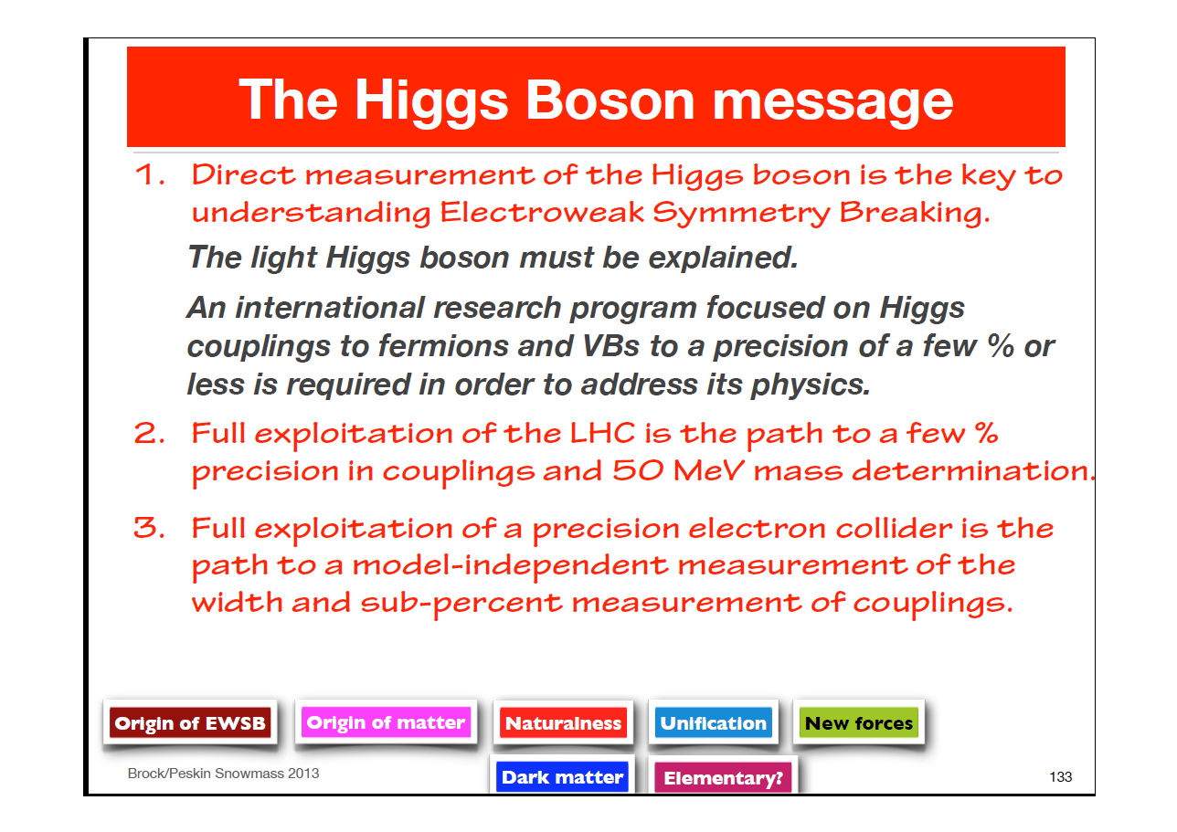
Snowmass: The Higgs
Chip Brock, Snowmass Energy Frontier Report

Slide 7
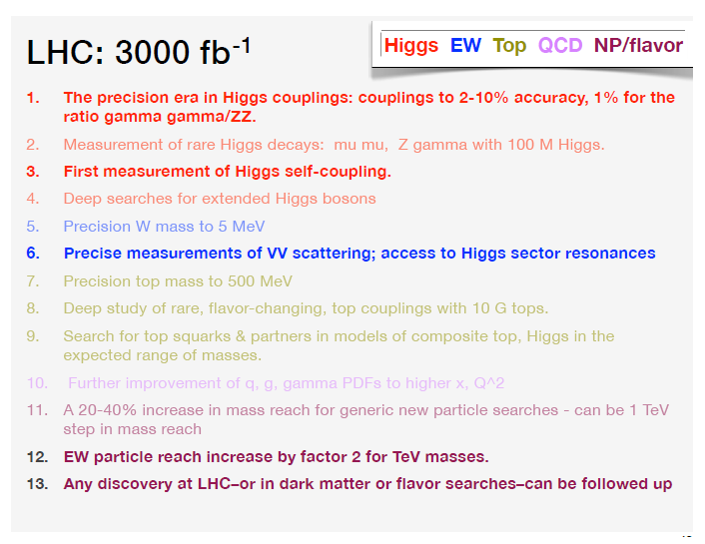
Snowmass: LHC Upgrades
(excerpted from “Snowmass 2013 Energy Frontier Working Group Report – HEPAP Sept. 5, 2013)

Slide 8
Snowmass Report
(excerpted from “Planning the Future of U.S. Particle Physics, Report of the 2013 Community Summer Study”)
We find the case for the high-luminosity stage of the LHC compelling.
  This plan to deliver 3000 fb-1 has been listed in the European Strategy for Particle Physics as the highest priority accelerator project in Europe for the 2020's.
  We find that it will provide a significant additional step in the search for new particles, and that it will provide other important capabilities.
  The most important of these is the beginning of the era of precision Higgs boson measurements, to few-percent precision.
  It is likely to give the first evidence of the Higgs boson self-coupling.
  It will provide a program of precision measurement in the SM that will dramatically tighten our knowledge of the W boson and the top quark, with measurements sensitive to the predictions of a variety of new physics models.
We have already noted that the additional luminosity will significantly enhance the capability of the LHC to search for new heavy particles.

Slide 9
Particle Physics Project Prioritization Panel (P5) Charge
The P5 Process has just begun, and is expected to answer the following charge by the Spring:
“…develop an updated strategic plan for U.S. HEP that can be executed over a 10 year timescale, in the context of a 20-year global vision for the field.”
“…examine current, planned, and proposed US research capabilities and assess their role and potential for scientific advancement; assess their uniqueness and relative scientific impact in the international context; and estimate the time and resources (the facilities, personnel, research and development and capital investments) needed to achieve their goals.”

Slide 10
P5 Charge
“Your report should provide recommendations on the priorities for an optimized high energy physics program over the next ten years (FY14-23), under…three scenarios.”
“The report should provide a detailed perspective on whether and how the pursuit of possible major international partnerships (such as LHC upgrades, Japanese-hosted ILC, LBNE, etc.) might fit into the program you recommend in each of the scenarios.”

Slide 11
Potential US (Accelerator) Involvement in High Luminosity LHC

Slide 12
LHC Accelerator Research Program (LARP) History & Evolution
The US LHC Accelerator Research Program (LARP) was formed in 2003 to coordinate US R&D related to the LHC accelerator and injector chain
  partnership of Brookhaven Lab, Lawrence Berkeley Lab and Fermilab
  SLAC joined shortly thereafter
  Has also had some involvement from Jefferson Lab, Old Dominion University and UT Austin
LARP contributed to the initial operation of the LHC, but much of the program has been focused on future upgrades
The program is currently funded at a level of about
$12-13M/year, divided among:
  Magnet research (~half of program)
  Accelerator research (Crab cavities, WBFS, Collimators, e-hollow lens,..)
  Programmatic activities, including support for personnel at CERN
Recent Evolution (2012 onward)
  Initial convergence on deliverables for HL-LHC
  Program now transitioning to a project-approach
  Giorgio Apollinari has taken the lead as LARP Director

Slide 13
Potential US Involvement in HL-LHC:
A Preliminary Look
Several candidate scope elements have been under development
  150 mm aperture Nb₃Sn quadrupoles
  Crab Cavities
  High Bandwidth Feedback System
  Collimation and hollow e-beams
  11 T Nb₃Sn dipoles
  Large Aperture NbTi D2 separator magnets
Process of convergence among CERN-DOE-U.S. Labs-LARP initiated in Dec ‘2012
Initial consensus on core Priorities which makes good use of US accelerator expertise, and which makes critical contributions to LHC luminosity:
  Committed to a major stake in Nb₃Sn quads
  Crab cavities up to the SPS test and possibly beyond to production
  High bandwidth feedback was seen as a high impact contribution for modest resources.
Back up options:
  11 T dipoles
    Proper “hand-off” if not continued in US
  Hollow electron beams for halo removal
    Support some modest R&D into this effort in the event that circumstances allow its inclusion
Lower priority:
  There was not much interest in pursuing the D2 separators.

Slide 14
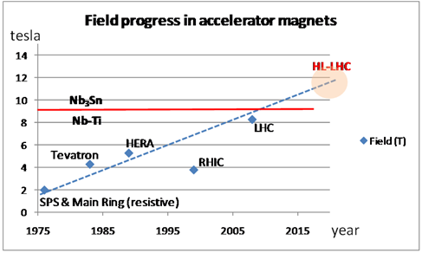
Increase Luminosity: High Field SC Magnets
Quads for inner Triplets
  Decision 2012 for low-β quads
  Aperture ∅ 150 mm – 140 T/m
  B_{peak} ≈12.3 T, LHC: 8T, 70 mm
More focus strength,
  β* as low as 15 cm
  LHC: 55 cm
Dipoles for beam recombination/separation:
  capable of 6-8 T with 150-180 mm aperture (LHC: 1.8 T, 70 mm)
Dipoles 11 T for LS2 (presently not part of plans as a US deliverable)

Slide 15
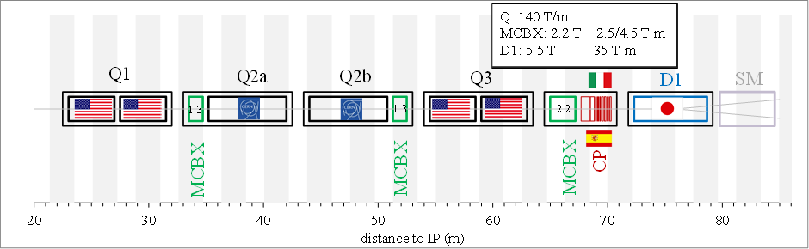
HL-LHC Nb₃Sn Magnets
Interaction Region Magnets
  4 Q1 and 4 Q3 (2 per IR) plus 1 spare each from US
    Q1 and Q3 will probably contain 2 ~4.5 m long magnets each, for a total of ~20 quadrupoles
  4 Q2a and 4 Q2b from CERN
    Option still open on the length of Q2.
E. Todesco

Slide 16
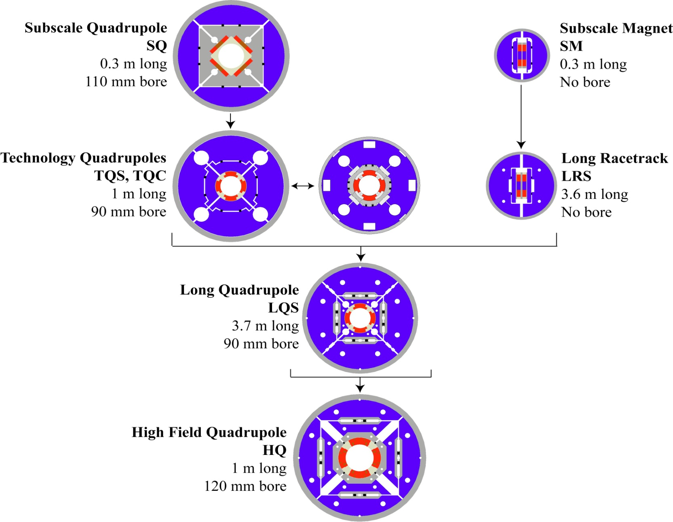
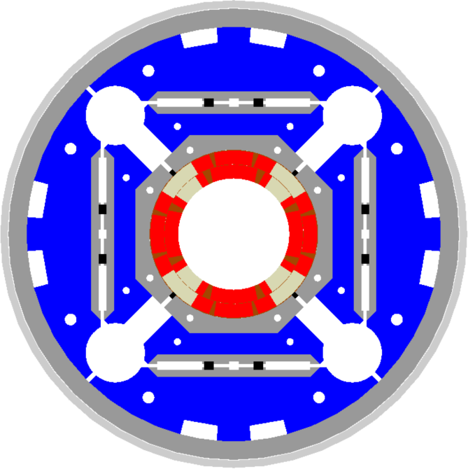
LARP Magnet Development Tree
SQ Series: 19 coils, 11-12 T
SQ02: 54/61 MJR J_{c}>1800
97% at 4.3/4.5 K
97% at 1.8 K
LR Series: xx coils, ~12 T
LRS02: 54/61 RRP J_{c}>2700
96% at 4.5 K
TQ Series: 33 coils, 12-13 T
TSQ02: 54/61 RRP J_{c}>2800
88% to 97% at 4.3
“Erratic” @ 1.9 K
TQS03: 108/127 RRP J_{c}>2800
93% at 4.3 K
93% at 1.9 K
LQ Series: 19 coils, ~12 T
LSQ01: 54/61 RRP J_{c}>2700
93% at 4.5 K
Marginal Increase at lower T
LQS03: 108/127 RRP J_{c}>2800
91% at 4.6 K
No increase at lower T
HQ Series: 25 coils, 13-15 T
HQ01e: 54/61 and 108/127 RRP
85% at 4.5 K
No Increase at lower T
HQ02: 108/127 RRP J_{c}>2800
98% at 4.5 K
Not fully trained at lower T
US SQXF Series: 13/18 Coils
2 or 3 1m long models
2014-2016
US LQXF Series: 18 Coils,
3 ~4.3 m Long Models
2015-2017
High Field Quadrupole
SQXF/LQXF
1 m / 4 m long
150 mm bore

Slide 17
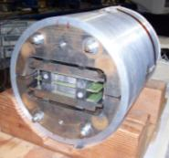
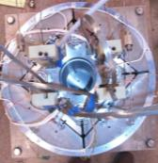
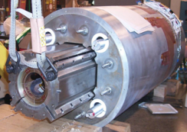
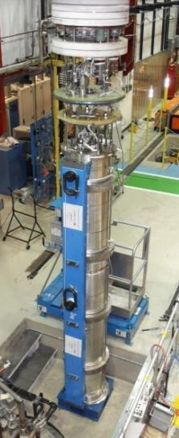
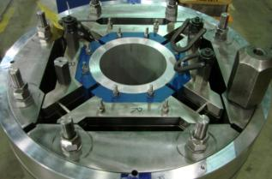
LARP Quadrupole Magnet Development
SM
SQ
TQS
LQS-4m
HQ
Very Preliminary !

Slide 18
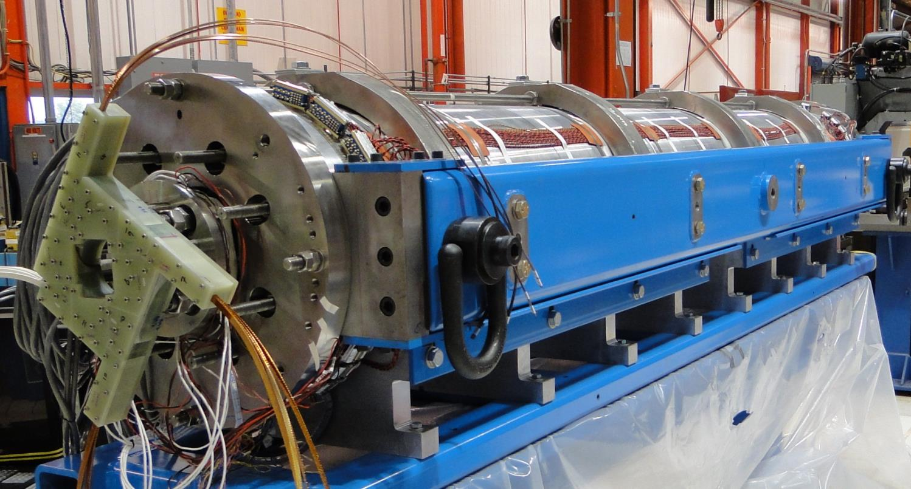
Long Magnets: LQS of LARP
3.3 m coils, 90 mm aperture
Goal: 200 T/m at 1.9 K
LQS01a: 202 T/m at 1.9 K
LQS01b: 222 T/m at 4.6 K
227 T/m at 1.9 K
LQS02: 198 T/m at 4.6 K 150 A/s
208 T/m at 1.9 K 150 A/s
limited by one coil
LQS03: 208 T/m at 4.6 K
210 T/m at 1.9 K
1st quench: 86% s.s. limit

Slide 19
Evolution of the Magnet Plan
Original plan
  Follow HQ with 4m x 120 mm LHQ
  Use this to demonstrate technology for 120 mm prototype as part of large scale construction project
Recent Developments
  In June 2012, CERN chose 150 mm as the aperture for the HL-LHC
  July 2012 LARP review recommends abandoning LHQ to pursue 150 mm prototype
New plan
  Curtail 120 mm program to long ¼ magnet “mirror” tests
    We feel there are still important things to learn
  Begin working with CERN on 150 mm prototype as part of an integrated production plan for Nb₃Sn quads in LS3.

Slide 20
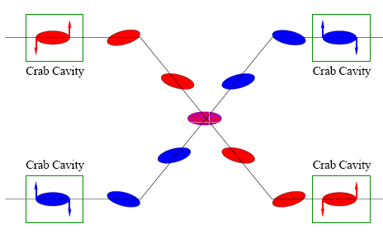
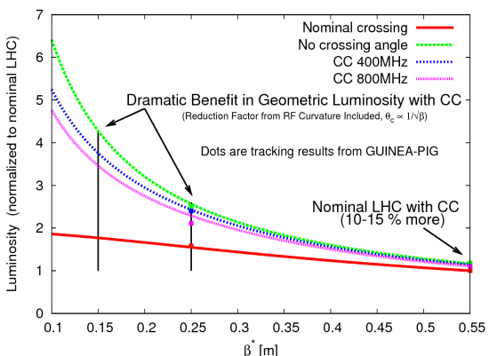
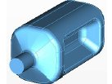
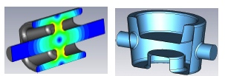
Crab Cavities
Without some compensation for crossing angle,
Reducing the β* will only increase luminosity by ~75% !
“Piwinski Angle”
Technical Challenges
  Crab cavities have only barely been shown to work.
    Never in hadron machines
  LHC bunch length requires low frequency (400 MHz)
  19.4 cm beam separation needs “compact”
  (exotic) design
Additional benefit
  Crab cavities are an easy way to level luminosity!
Currently aiming for:
  Down-select ~next year
  Aiming for SPS test in 2015
UK
LARP

Slide 21
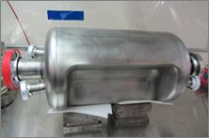
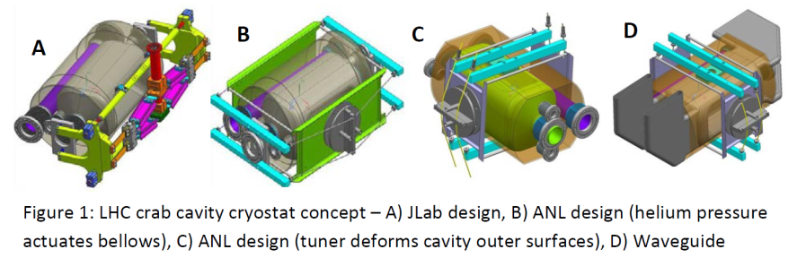
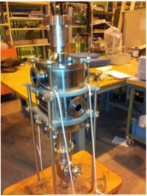
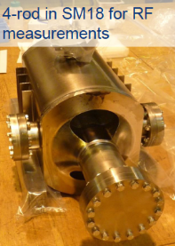
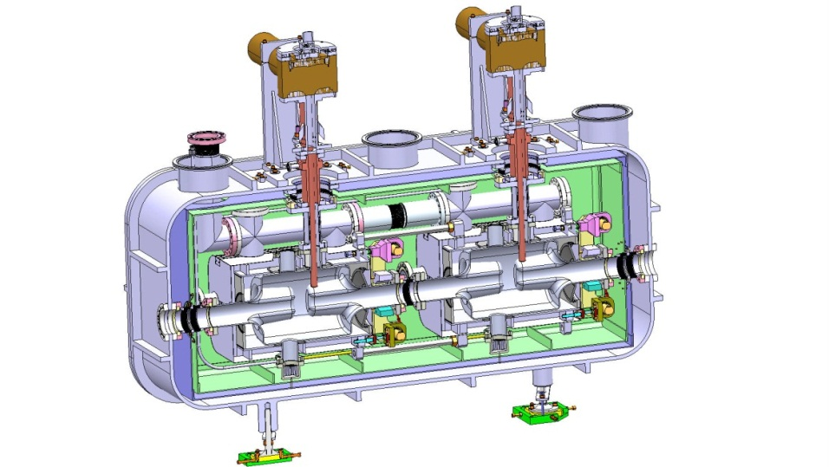
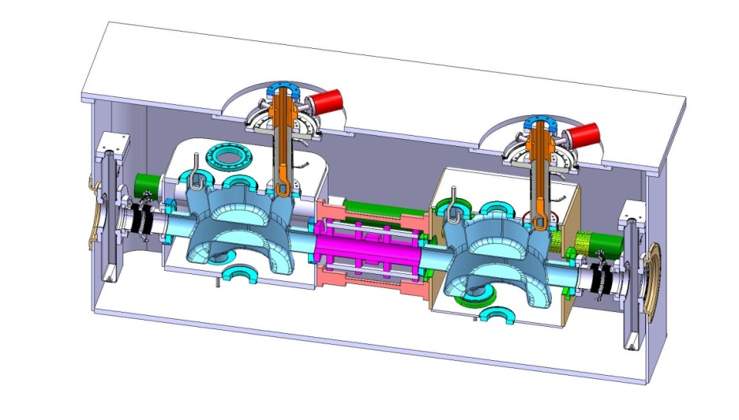
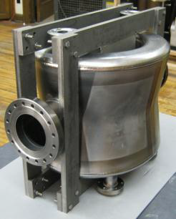
Crab Cavities and Cryomodules
RF-Dipole Nb prototype
UK Concept
BNL Concept
DQWR prototype
17-Jan-2013

Slide 22
First test of CC (ODU-SLAC at J-LAB)

Slide 23
High Bandwidth Feedback System
The high bandwidth feedback system is a proposed feedback system for the SPS, which leverages LARP experience with the LHC LLRF system, to address intra-bunch instabilities
Proposal
  LARP will continue R&D related to the system.
  The deliverable would be a functional feedback system the SPS, for which
    The US contribution would be the complete, full-function, instability control system hardware, firmware and software necessary to operate at the SPS (and potentially LHC, PS).
    The CERN contribution will include the vacuum structures (pickup(s) and kicker(s)) and all tunnel related cable plant.

Slide 24
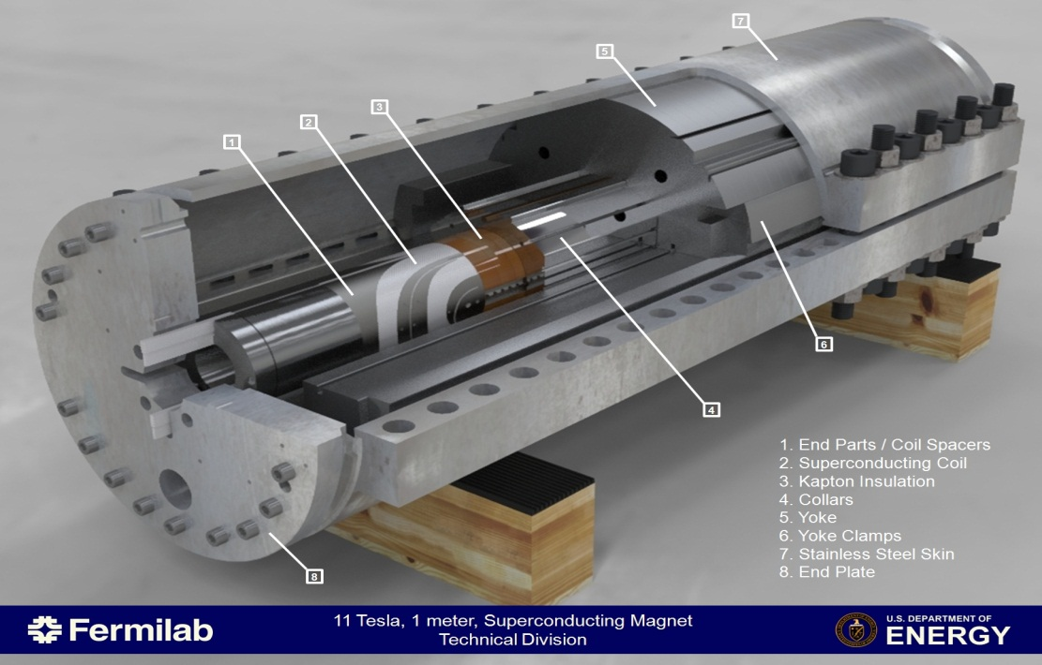
11 T Development
Not LARP
Create space for additional collimators by replacing 8.33 T MB with 11 T Nb₃Sn dipoles compatible with LHC lattice and main systems.
  119 Tm @ 11.85 kA (in series with MB)
At this time not proposed as a US in-kind contribution. Intellectually relevant as R&D program toward high field, accelerator quality, dipoles and, consequently, HE-LHC

Slide 25
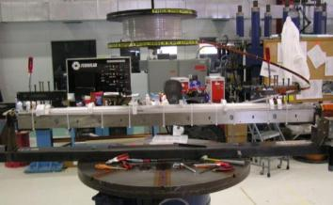
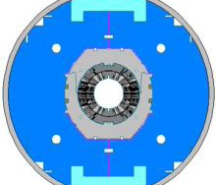
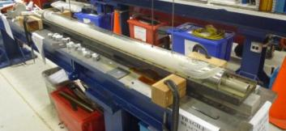
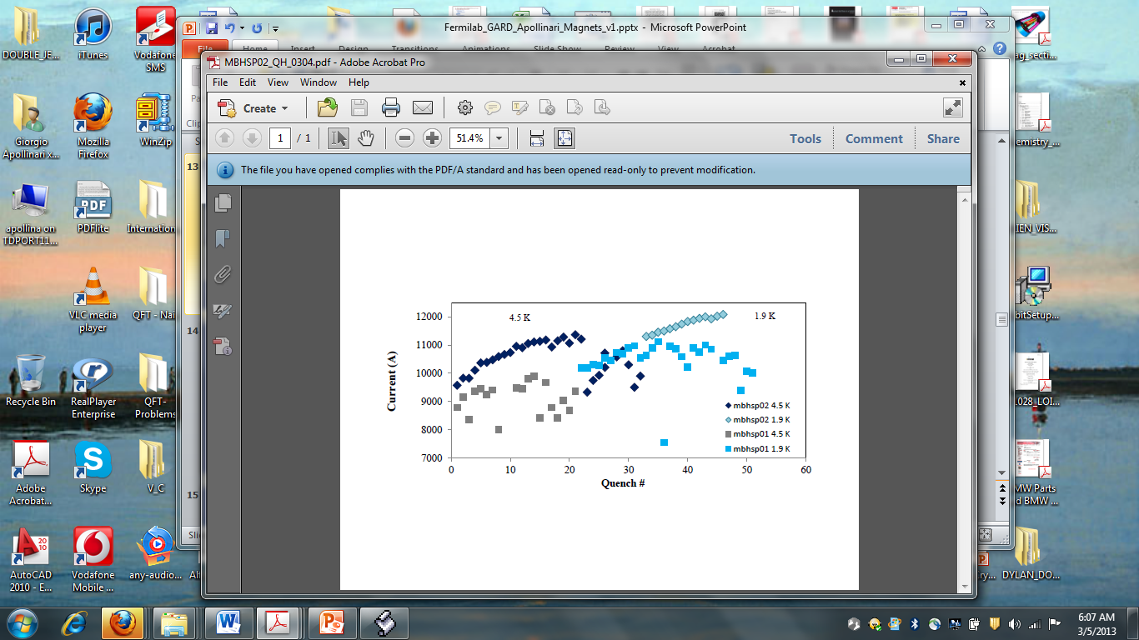
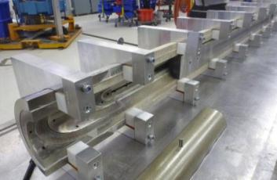

11T Dipole R&D
Not LARP
Single aperture model
Twin aperture model
Second Nb₃Sn Accelerator Quality Dipole (1m long) – Dec ‘12
Success !

Slide 26
Summary
The importance of the High Luminosity LHC Physics potential has been recognized in ongoing US Planning activities
The assessment of the P5 Panel will be an important element in establishing the scale of US involvement in HL-LHC
LARP is focusing on the Development of technology which is critical to increasing the luminosity of the LHC
LARP has laid the groundwork for critical contributions in Nb3Sn magnet technology for IR quadrupoles
LARP is developed crab cavity and feedback systems
The US community is committed to realizing the full potential of the Large Hadron Collider
The US community is committed to realizing the full potential of the Large Hadron Collider

Slide 28
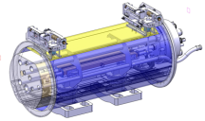
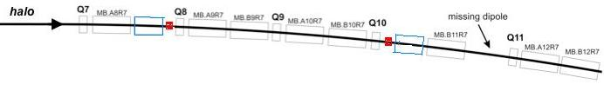
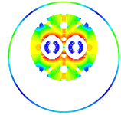
Collimators and 11T Dipoles
Create space for additional collimators by replacing 8.33 T MB with 11 T Nb₃Sn dipoles compatible with LHC lattice and main systems.
119 Tm @ 11.85 kA
(in series with MB)
MB.B8R/L
MB.B11R/L
11 T Nb₃Sn
15,66 m
LS2 : IR-2
  4 MB => 8 x 5.5 m CM + spares
LS3 : IR-1,5 and Point-3,7
  4 x 4 MB => 32 x 5.5 m CM + spares
5.5 m Nb₃Sn
5.5 m Nb₃Sn
3 m Collim
5.5 m Nb₃Sn
5.5 m Nb₃Sn
3 m Collim
Focus of joint R&D program aimed at Accelerator Quality Magnets between CERN and US. R&D program to be completed in US with conclusion of Short (1m) Models.

