Slide 1
The ground motion mitigation concept of CLIC with focus on the beam orbit feedback
Jürgen Pfingstner
5th of July 2013

Slide 2
Overview
Today’s talk:
The problem of ground motion
Ground motion mitigation strategy in CLIC (4 methods)
4. Performance of the mitigation methods (simulation results)
Orbit feedback design (1 of the 4 methods)

Slide 3
1. The problem of ground motion

Slide 4


Effect of ground motion (GM) at the IP
Beam-beam offset:
Beam size growth:
CLIC is very sensitive to ground motion:
σ*y,CLIC = 1nm while σ*y,LHC = 16.7μm or σ*y,ILC = 5.7nm

Slide 5
Main effects for beam offset and beam size growth due to GM
Beam oscillations:
Particle filamentation:
Misaligned QP applies dipole kick to beam
Beam oscillates along the accelerator and creates beam-beam offset at IP
Particles with different energies oscillate differently fast
This creates a beam size growth due to chromatic dilutions

Slide 6
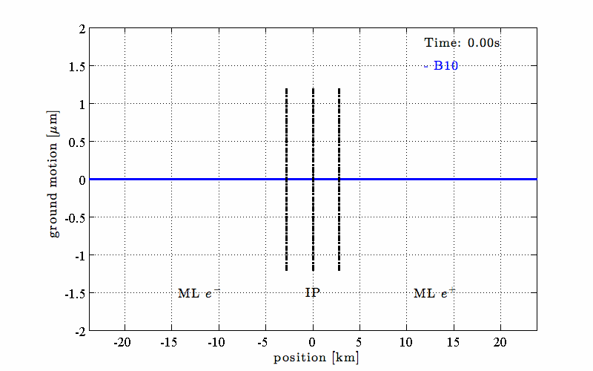
Example of GM misalignment of CLIC (simulations, model B10)

Slide 7
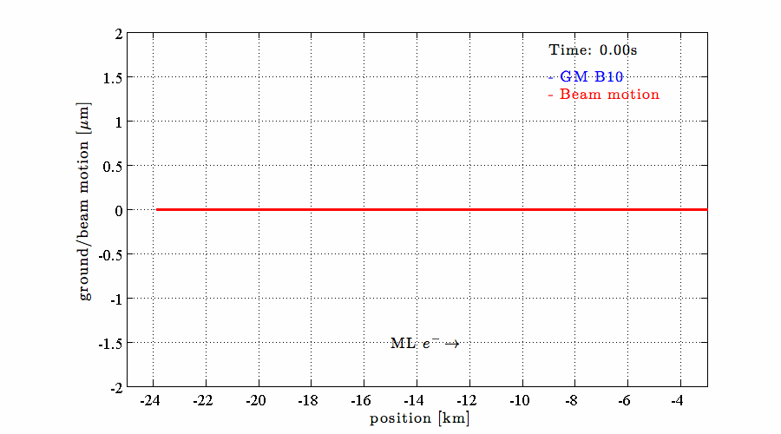
Beam oscillation due to ground motion

Slide 8
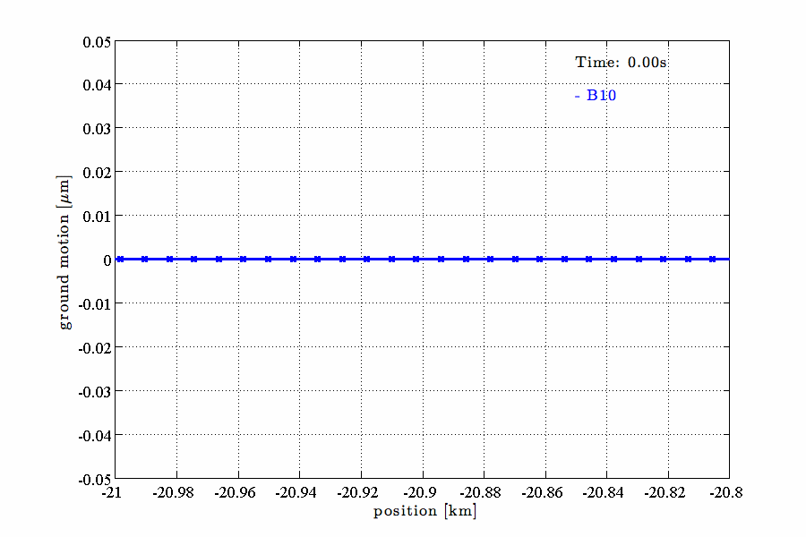
Beam oscillation due to ground motion (zoom)

Slide 9
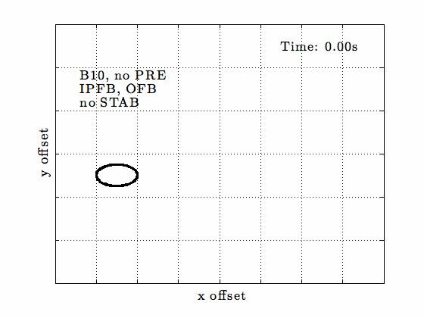
Beam-beam offset without fast mitigation methods

Slide 10
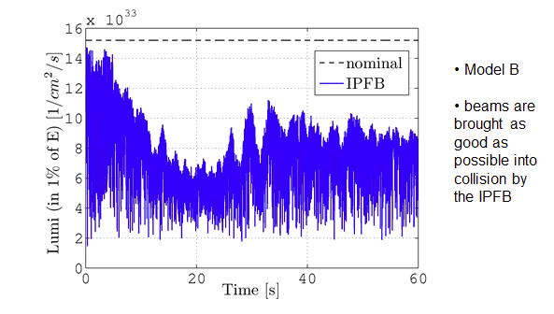
Luminosity with only one mitigation method

Slide 11
2. Ground motion mitigation strategy in CLIC

Slide 12
The two tasks of the mitigation methods
Beam-beam offset:
Beam size growth:
Localized at the IP
Can be still cured at the IP
Fortunately, there is an additional physical quantity that is related to the beam-beam offset: beam-beam kick
Created distributed all along the machine
Mechanism: dipole kicks (misaligned QPs, WF) and filamentation
Effect cannot be cured at the IP anymore
Four mitigation methods have been design do address these two problems

Slide 13
Method 1: beam orbit feedback
1. Purpose: Reduce the emittance growth along the accelerator
2. Strategy: Measure the beam oscillations along the accelerator and steer the beam back into the centre of the BPMs.
Note: This also reduces beam-beam offset (for low frequencies).
3. Hardware:
Sensors: 2122 BPMs
Actuators: 2114 QP stabilisation systems
Distribution system (very high demands on the control system)
One central controller (computer)
4. Complications:
BPM noise: measurement cannot be fully trusted
System sensitivity: beam is sensitive to the shape of the misalignment
5. Limitations:
Beam arrives only every 20ms
According to Shannon’s sampling theorem: only frequencies till f_{N} = 25Hz resolvable
Digital feedback is only effective up to approx. f_{N}/10, due to stability reasons
=> high frequency ground motion still to strong => Second system is necessary

Slide 14
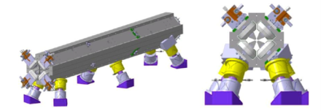
Method 2: quadrupole stabilisation
1. Purpose: Reduce the emittance growth from high frequencies
2. Strategy: Measure the mechanical motion of a quadrupole and stabilise it by moving it. This is a local strategy (each quadrupole stab. independent).
3. Hardware (per QP):
Motion sensor: Seismometer or Geophone
Actuator: Piezoelectric tripod system
Additional distance sensors for relative positioning
Local controller hardware
4. Complications and Limitations:
Limitations of available sensors in transfer functions and noise
System also has to be robust against external forces directly on the QP (soft vs. hard support).
Courtesy of the CERN stabilisation group

Slide 15
Method 3: IP feedback
1. Purpose: Reduce the beam-beam offset at the IP
2. Strategy: A beam-beam offset creates a beam-beam kick that creates a beam deflection (kick). Hence the transversal beam offset downstream is connected to the beam-beam offset:
Measurement downstream of IP can be used to steer next two trains on each other.
Note: In baseline feedback acts only train-to-train but not bunch-to-bunch (intra-train feedback is reserve)
3. Hardware:
Sensor: 1 BPM
Actuators: 1 kicker
Controller hardware
4. Limitations:
Same as orbit feedback, since beam-based
Taken from J. Resta-Lopez
Controller

Slide 16
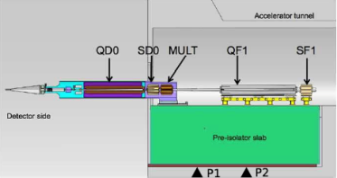
Method 4: the pre-isolator
1. Purpose: Last two quadrupoles (QF1 and QD0) are very sensitive to beam-beam offset. Beam motion is 1-to-1 with final doublet motion. Tolerance as small as a few tenth of nm’s (covalent radius of a sulphur atom is 0.104 nm)
The action of quadrupole stabilisation (baseline) and IP feedback are not sufficient to limit the beam-beam offset for high frequencies.
2. Strategy: But final doublet one a huge, passive mass-spring system to damp ground motion very efficient.
3. Hardware:
100 tones concrete block (mass)
10 air-springs (springs and damper)
Note: There are also plans to make an active system out of it, to make it more effective.
Now we should have covered all problems.
Lets see!!!
Picture taken from F. Ramos

Slide 17
Overview of the four methods

Slide 18
Modelling of ground motion effects
For the design and verification of the mitigation method, we us in general two types of tools
1. Simple analytic models
Separate models
No single big model available yet
Used for design
Model types (not covert)
Ground motion models
Model of GM effects on beam parameters
2. Full-scale simulation
Includes
Beam tracking: PLACET
Beam-beam: GUINEAPIG
Ground motion generator
Controller in Octave
Includes also all four mitigation methods
Used to verify the design made with simple models
Double check

Slide 19
Full-scale simulations for the verification of the design

Slide 20
3. Orbit feedback design

Slide 21

The system to be controlled
Large multi-input multi-output system (MIMO)
2122 outputs (BPMs)
2114 inputs (QPs)
Simple internal structure
Connection via simple matrix multiplication: orbit response matrix R (see last lecture)
Only dynamic comes from the time delay given by the beam repetition rate
Discrete-time system: due to beam repetition rate
Mathematical description (time domain)
Mathematical description (frequency domain)
The frequency representation for discrete-time systems is not given by the Fourier transform, but by the so called z-transform.

Slide 22

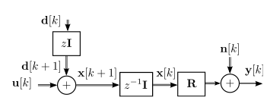
The same model in control engineering style
Accelerator model as a formula
Accelerator model as a signal flow graph
k … time step
y[k] … BPM reading
n[k] … BPM noise
x[k] … QP position
d[k] … ground motion
u[k] … feedback actuation
z⁻¹ … time shift operator
R … orbit resp. matrix
I … unity matrix

Slide 23
Excurse: Signal flow graphs
Often used in control engineering, but unusual in physics applications
Graphical representation of signals and systems and the according formulas
Advantages compared to only formulas:
Preserves the physical setup as systems (controller, accelerator) and the signal flow between the systems
Complexity of systems can be hidden in black boxes (high level view of complex systems)
Complex systems can be “drawn” before solving the according equations, which can be a very difficult task

Slide 24
Principles used for the controller design
Decoupling of the inputs and outputs
Simplification of design
Frequency filtering
One controller for all decoupled channels is defined
This is a good start point for ground motion compensation
Reduce the number of open parameters
Optimisation of the decoupled loops
Optimise the balancing between ground motion compensation and BPM noise suppression for each loop

Slide 25
Principle of decoupling
Accelerator system is very large => Simplifications necessary
One popular method in control engineering : Simplification via decoupling of the in- and outputs
After decoupling one can use standard methods for SISO design (e.g. loop shaping)
Rich theory on decoupling
In general difficult to find filters
But for us … it is easy!
u1
y1
MIMO
un
ym
-
-
-
-
u1
SISO 1
y1
u1
pre-
filter
post-
filter
y1
.
MIMO
.
-
-
.
un
ym
-
-
un
SISO n
yn

Slide 26





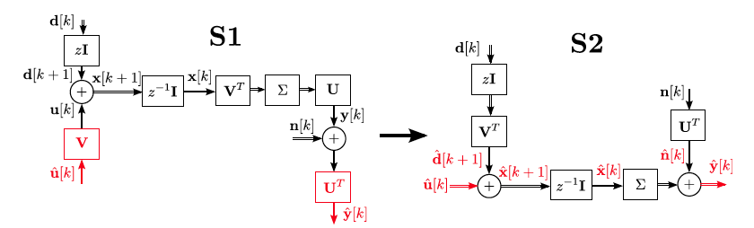
Decoupling via SVD of R
Decoupling can be achieved with the singular value decomposition (SVD) of the matrix R
U and V are orthonormal matrices, and the si are the singular values of R
If the system is pre-multiplied with V and post-multiplied with U^{T} , the combined system is diagonal and hence decoupled.
For the accelerator system, the decoupling achieved for all frequencies!!!

Slide 27
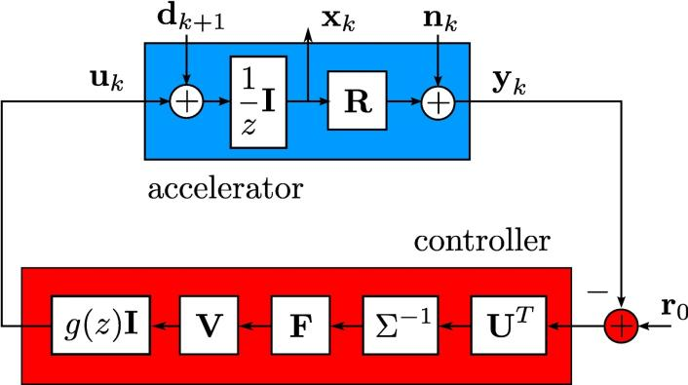
Structure of the beam orbit feedback system
r0 … Reference trajectory R⁻¹=VΣ⁻¹U^{T}

Slide 28





Design of one the basic SISO controller g(z)
The filter g(z) is used by all decoupled channels and is designed with the loop-shaping method:
Integrator: base element of the controller
Motivated physically: ATL-law
If g(z)=I(z) and fi=1
=> Dead-beat controller
Amplification around 0.3 Hz
QP- and “final doublet”-stabilisation have different frequency responses
Mismatch has to be counteracted by a better correction of the L-FB around 0.3 Hz
Low pass to demagnify high frequencies
Improvement of the controller behaviour for measurement noise and high frequent ground motion
Design based on a continuous low pass which is transformed to a discrete system
Phase margin, due to I(z), L(z) and P(z) insufficient.
Phase lift element: Phase margin is lifted at the cut-through frequency fc = 4.4 Hz to 36.3º

Slide 29
Problem of mismatch of QP stabilisation and pre-isolator
Mismatch of the transfer functions of the QP stabilisation and the pre-isolator
Beam gets into the FD with an offset
Dispersion and uncorrected geometric aberrations (sextupoles) cause strong beam size growth
Solutions:
Strength the orbit feedback at these frequencies (we do that)
Harmonise the peaks of the two stabilisation systems

Slide 30
Modification of the quadrupole stabilisation function
Due to these observations, the quadrupole stabilisation team proposed new stabilisation function.
Peak is at higher frequency
Both problems: amplification of micro-seismic peak and mismatch with pre-isolator are solved
Luminosity preservation works much better
Sensor is cheaper
New sensor development was triggered.
Message: 1nm at 1Hz for the stabilisation function is only a good starting point
In the end the perfect shape depends also on the other systems and shape of the ground motion PSD.

Slide 31
Modification of the quadrupole stabilisation function
Due to these observations, the quadrupole stabilisation team proposed new stabilisation function.
Peak is at higher frequency
Both problems: amplification of micro-seismic peak and mismatch with pre-isolator are solved
Luminosity preservation works much better
Sensor is cheaper
New sensor development was triggered.
There is no single specification for the transfer function as 1nm @ 1Hz
Message: 1nm at 1Hz for the stabilisation function is only a good starting point
In the end the perfect shape depends also on the other systems and shape of the ground motion PSD.

Slide 32
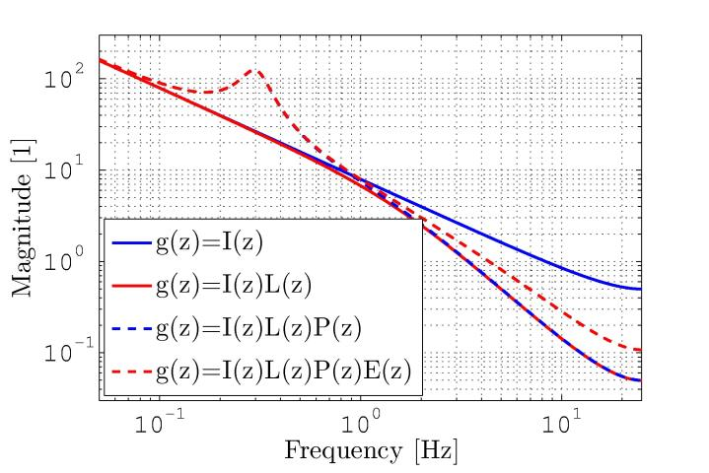
Magnitude of the open control loop (for f_{i}=1)

Slide 33
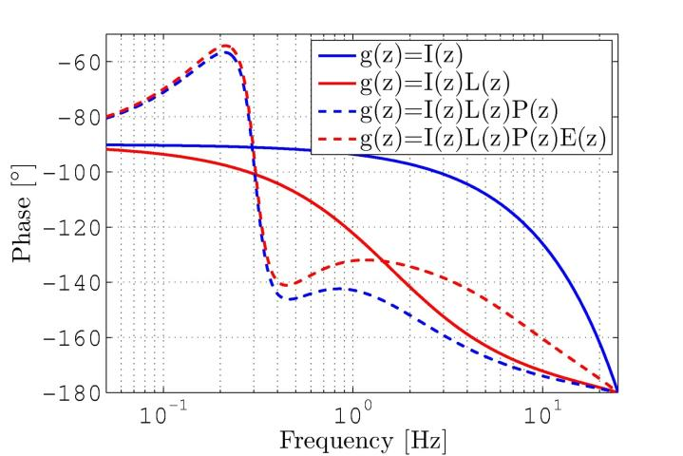
Phase of the open control loop (for f_{i}=1)

Slide 34
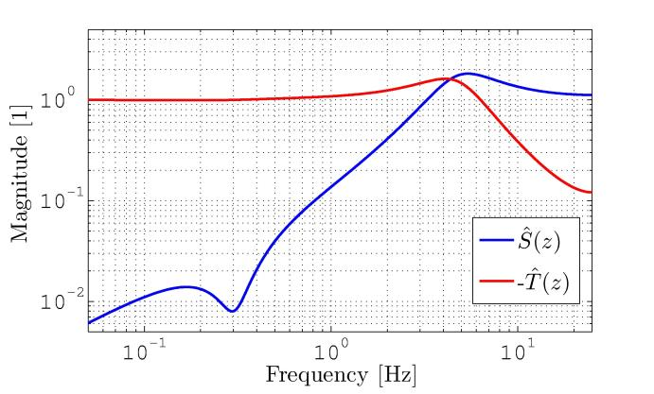
Magnitude of the sensitivity and noise frequency response of S(z) and –T(z) of the closed control loop (for f_{i}=1)

Slide 35



Optimization of each individual channel for beam oscillations
Complete controller of the i^{th} decoupled control loop has the form
Idea: f_{i} is chosen such that the output signal y[k,i] is minimised
PSD of y[k,i]
… Controller frequency response to ground motion
P(ω, i) ….................. PSD of the ground motion
…................ Controller frequency response to BPM noise
N(ω, i) …................... PSD of the PBM noise
P(ω, i) and N(ω, i) can be determined analytically or numerically.
Minimisation performed in the frequency domain (Parseval‘s Theorem)

Slide 36
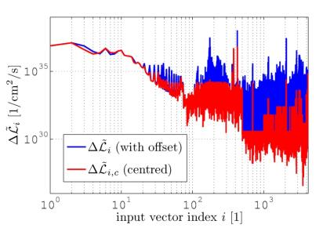




Optimization of each individual channel for beam luminosity
Result can be improved by using a different target function
Idea: Minimise a signal prop. to the luminosity loss (and not the beam oscillations)
Two components of the lumi. loss
Beam size growth
Beam-beam offset
Signals are weighted with their relevance for the luminosity loss
… ground motion frequency response of the IP-FB
Luminosity optimised minimisation problem

Slide 37
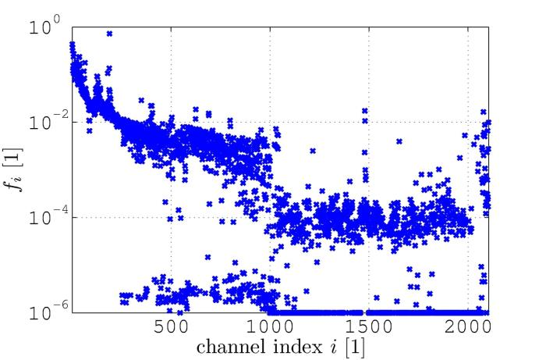
The final parameters f_{i}

Slide 38
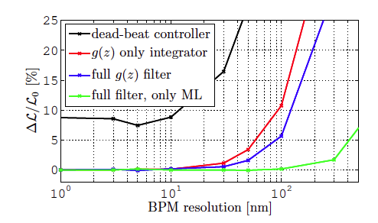
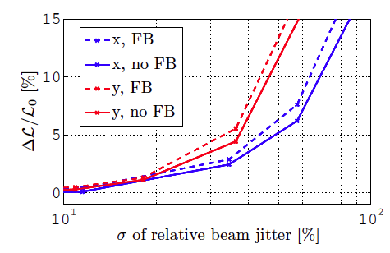
Robustness studies
Influence of imperfections is often difficult to evaluate
Studies via simulations
Many imperfections tested:
BPM resolution
Energy imperfections
Actuator noise
Initial beam jitter
BPM scaling errors
Actuator scaling errors
…
Resume: it seems to be fine!
But still some test are remaining

Slide 39
5. Performance of the mitigation methods (simulation results)

Slide 40
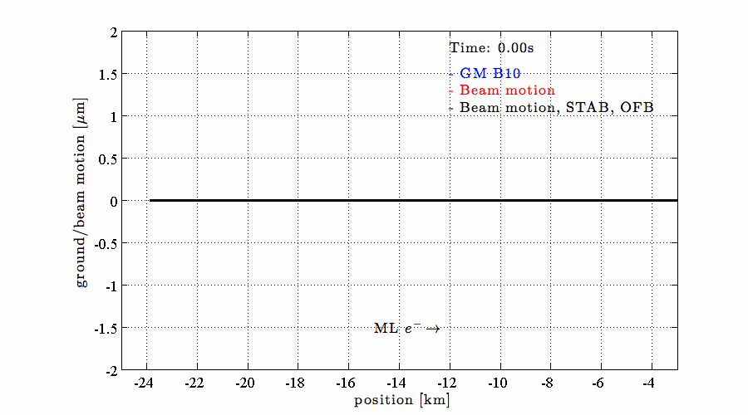
Beam oscillations with mitigation methods

Slide 41
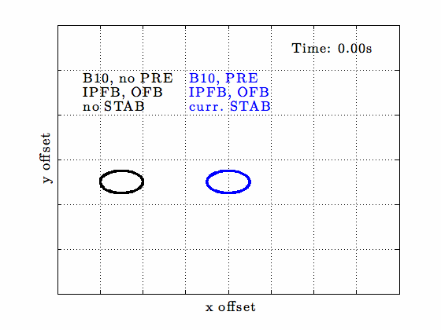
Beam-beam offset with mitigation methods

Slide 42
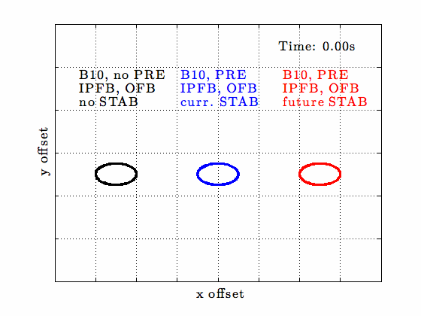
Beam-beam offset with mitigation methods

Slide 43
Luminosity loss with mitigation methods
Ground motion model B10
Without mitigation methods there is hardly any luminosity from the first train on
IP-FB stops the beam from drifting apart, but high jitter
Pre-Isolator reduces beam jitter

Slide 44
Luminosity loss with mitigation methods
Quadrupole stabilisation function V1 is used
QP stabilisation reduces incoming beam jitter, but amplifies micro-seismic peak -> beam size growth
Orbit feedback finally also steers beam correctly
Luminosity 108.3%
Only a combination of all four mitigation methods works sufficiently!

Slide 45
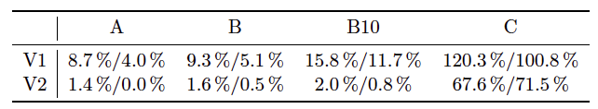
Final luminosity results
Luminosity loss (from 120%) due to
Ground motion models A, B, B10 an C
Quadrupole stabilisation function V1 and V2
Hand-tuned and automated orbit feedback coefficients

Slide 46
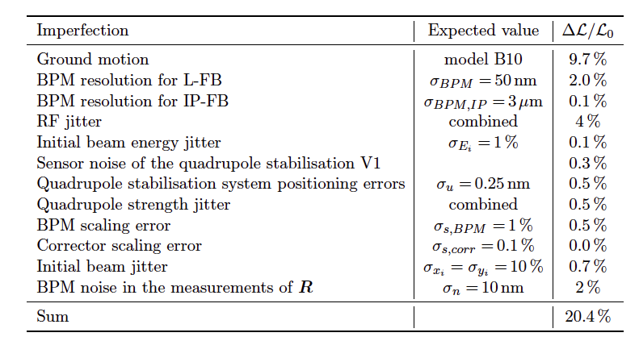
Robustness studies and imperfection budget
Comment: New stabilisation function will improve results strongly!

Slide 47
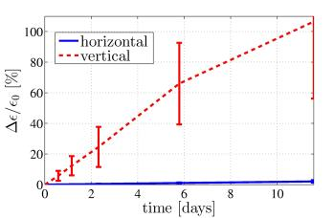
Recent activities and future work
After solving the principle problem, we are right now in a second phase:
cure secondary effects over longer time scales
cost reduction
deal with imperfect system knowledge
experimental verification of methods
Long-term studies
Main linac: on-line dispersion
free steering (DFS)
BDS: on-line IP tuning (future work )
Experimental verification of DFS at FACET
Experimental test of a new QP stabilisation system (cost reduction) at ATF2 (in cooperation with quadrupole stabilisation team).

Slide 48
Thank you for your attention!

