Slide 1



Frontier Capabilities
Working Group Summary
Mark Palmer
for the Study Group Conveners
as presented to the U.S. HEPAP (Sep 5, 2013)
October 16, 2013

Slide 2
Outline
Study Group Structure for Accelerator-based Facilities Convener: W. Barletta
Accelerator Capabilities Overview
a Summary
In advance: My acknowledgments particularly to Bill, as well
as the sub-group conveners and various contributors to the
Frontier Capabilities Group

Slide 3
Accelerator Capabilities
Convener: Bill Barletta (MIT, USPAS)
Sub-groups
  Proton Colliders
    M. Battaglia (UCSC), M. Klute (MIT), S. Prestemon (LBNL), L. Rossi (CERN)
  Lepton Colliders
    M. Klute (MIT), M. Battaglia (UCSC), M. Palmer (FNAL), K. Yokoya (KEK)
  Intensity Frontier Protons
    J. Galambos (ORNL), M. Bai (BNL), S. Nagaitsev (FNAL)
  Intensity Frontier Electrons and Photons
    G. Varner (Hawaii), J. Flanagan (KEK), J. Byrd (LBNL)
  Accelerator Technology:
    G. Hoffstaetter (Cornell), W. Gai (ANL), M. Hogan (SLAC), V. Shiltsev (FNAL)

Slide 4
Accelerator-Based Facility Summary

Slide 5
The HEP Accelerator “Big Questions”
The Following Questions Are Inherently Long Term
How would one build a 100 TeV scale hadron collider?
How would one build a lepton collider at >1 TeV?
How would one generate 10 MW of proton beam power?
Can multi-MW targets survive? If so, for how long?
Can plasma-based accelerators achieve energies & luminosities relevant to HEP?
Can accelerators be made 10x cheaper per GeV? Per MW?

Slide 6
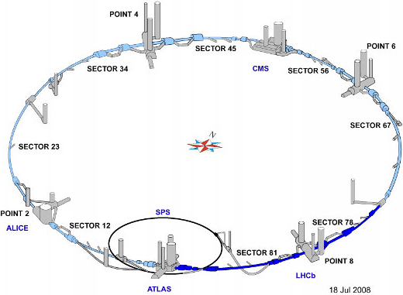
Energy Frontier Proton Colliders I
The Key Questions
What luminosity is possible for the LHC?
  Strategies for increased integrated luminosity
  Avoid impaired data and degradation of the detectors
What energy can be achieved in the LHC tunnel?
What is the future for the Energy Frontier Hadron Colliders beyond the LHC?
  What are the challenges of a 100 TeV collider?
What is the accelerator R&D roadmap for LHC and post-LHC capabilities?
The Near-Term Priorities – Full Exploitation of the LHC
Continue a strong LHC Accelerator R&D Program a Hi Lumi LHC Construction Project
Develop the technologies required for a High Energy LHC a Achieve Engineering Readiness
  Next generation Nb₃Sn magnets (~15T scale)
  Advanced beam control technology
  Represents the most critical near-/mid-term development effort for higher energy hadron colliders
However, the high energy reach of the LHC is limited…
  without magnet engineering materials beyond Nb₃Sn (high temperature SC development being pursued)
  with challenges in managing synchrotron radiation
  a Focused engineering is not a substitute for innovative R&D

Slide 7
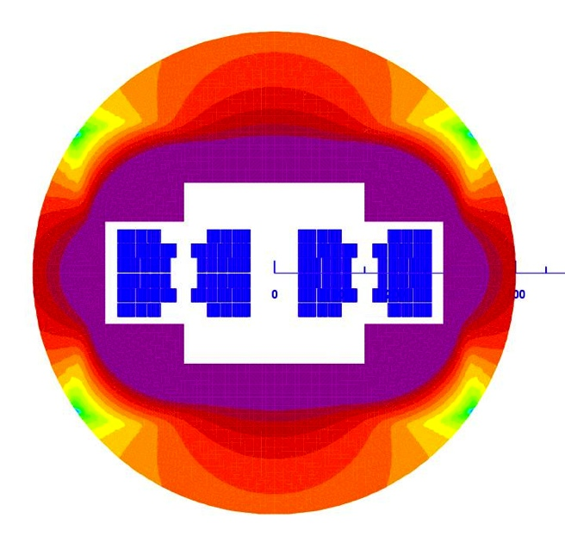
Energy Frontier Proton Colliders II
Long-Term Options Beyond the LHC
Extensive interest was expressed at Snowmass in a 100 TeV pp collider
  US-led VLHC study (~2001) still valid a updated with a Snowmass whitepaper
  Interest at CERN (coupled to TLEP study)
  US participation in a new design study would help inform plans for future technology R&D
  a Participation in such a study is recommended
Accelerator R&D Roadmap: LHC Upgrades a post-LHC
Advanced magnets
  New engineering conductors (e.g., small filament HTS)
  Improved temperature margin, stress management techniques, magnet protection, and structural materials
Beam dynamics
  Effects of marginal synchrotron radiation damping
  Beam physics of the injection chain
  Control of beam halo
  Noise & ground motion effects
Machine protection & beam abort dumps (multi-GJ beams)
Interaction Region design & technology options
NOTE: Strong technology overlap with muon / intensity machines
HE-LHC Magnet Concept

Slide 8
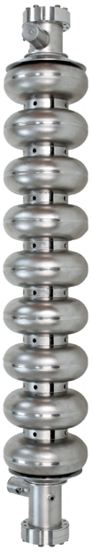
Energy Frontier Lepton & Photon Colliders I
The Key Questions
Can ILC & CLIC designs be improved using new technologies?
  Can they be constructed in stages? what is a staging plan?
  What would be the parameters of a Higgs factory as a first stage?
Higgs factories
  Could a Higgs factory be constructed in the LHC tunnel?
  What would be parameters of a photon collider Higgs factory
  Could one build a µ+µ- collider as a Higgs factory?
Could one design a multi-TeV µ+µ- collider?
What is the accelerator R&D roadmap?
Excitement & boundary conditions are driven by the Higgs discovery
The Japanese Initiative – Proposal to Host the ILC
The Japanese initiative is welcomed
With the release of the TDR by the ILC Global Design Effort,
the ILC technical design is ready for a decision
  Major US contributions to and leadership roles in machine physics & technology:
  SRF, high power targetry (e+ source), beam delivery, damping rings, and beam dynamics
  Importance of an upgrade path to higher energy (> 500 GeV) & luminosity (> 10³⁴ cm⁻²s⁻¹) has been emphasized
The US accelerator community is capable of contributing…
As supported by the physics case and as part of a balanced program
The US can offer an experienced & ready team

Slide 9
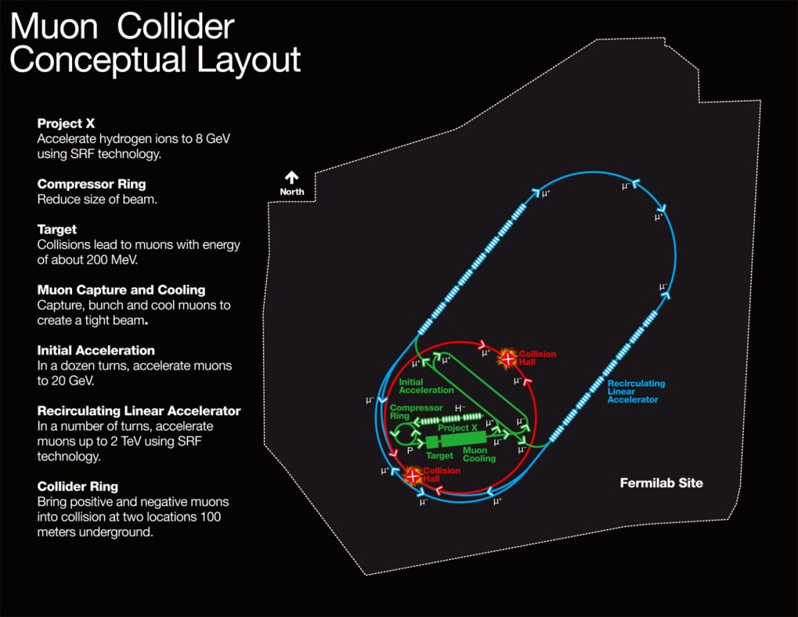
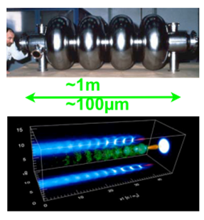
Energy Frontier Lepton & Photon Colliders II
Alternative Higgs Factory Approaches
e⁺e⁻ ring in a very large tunnel (50-100km circumference)
  Significant extrapolation, but from large experience base
  Energy reach & luminosity are very strongly coupled
    Largest luminosity at Z peak, falling rapidly √s increases
  Tunnel could support a 100 TeV proton collider option
Muon collider – Feasibility assessment underway
  Options for Higgs Factory (s-channel H production) a 10 TeV collider - on Fermilab site
Photon collider
  Options for add-on to a linear collider and for a standalone facility presented
  Builds on US expertise in high power lasers (overlap with laser wakefield accelerator needs)
Muon Collider Concept
on Fermilab Site
HF Concepts span
a broad range of
technical readiness
Accelerator R&D Roadmap: Research For a Compact Multi-TeV Collider
Motivated by lower cost, smaller footprint, and higher energy capability
Support the integrated US R&D program toward demonstrating muon collider feasibility (MAP)
  Enable completion of the feasibility assessment near the end of this decade
  Closely connected with intensity frontier & intense neutrino sources
  Strong magnet synergies with LHC energy upgrades
Stay involved in high gradient, warm linac approach (CLIC)
  Practical energy reach: wakefield control, accelerating gradient
  Industrialization path to be developed
Continue R&D in wakefield accelerators (plasmas & dielectric)
  Fruitful physics programs with high intellectual content
  Feasibility issues: Positron acceleration, multi-stage acceleration, control of beam quality,
  plasma instabilities at 10’s of kHz rep rate
  All variants require an integrated proof-of-principle test
Maximizing RF Efficiency is Crucial!

Slide 10
High Intensity Proton Sources I
The Key Questions
What secondary beams are needed for IF experiments?
What proton beams are needed to generate these?
  > 1 MW , flexible timing structure
Can these be made by existing machines?
What new facilities are needed to deliver 1) ?
What accelerator / target R&D is needed to realize 4?
Approach to Setting Priorities – Intensity Frontier a Diversity
Survey of anticipated particle physics requirements for secondary beams (i.e. neutrino, kaon, muon, neutron,…)
  19 secondary beam requests filled out by experiment advocates
Derived primary proton beam characteristics
Common characteristics of required beams
  High average power (> 1 MW)
  Flexible time structure
Compared with existing proton beam characteristics
  20 existing proton beam lines + 14 planned upgrades
a Conclusion: Next generation of intensity frontier experiments will require proton beam intensities & timing structures beyond the capabilities of any existing accelerators

Slide 11
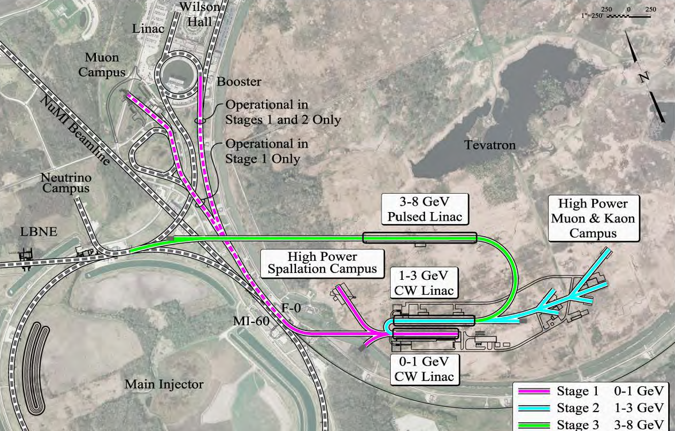
High Intensity Proton Sources II
Project X – Can Provide a World-Leading Facility for Intensity Frontier Research
Based on a modern multi-MW SCRF proton linac
  Flexible “on-demand” beam structure
Could serve multiple experiments over broad energy range
  Supports 0.25 – 120 GeV
Platform for future muon accelerator facilities:
IF/ν Factory (NuMAX) & EF/Muon Collider
Complete, integrated concept Reference Design Report
  arXiv:1306.5022
R&D program underway to mitigate risks in Reference Design
  Undertaken by 12 U.S. & 4 Indian laboratories and universities
a Construction could be initiated in the last half of this decade
Capabilities with Narrower Experimental Scope
DAEδALUS: Decay At Rest anti-neutrinos – short baseline ν oscillations
  3 multi-MW H₂⁺ cyclotrons/target stations located ~2-20km from experiment large hydrogenous detector
  First stage: IsoDAR – compact cyclotron 15 m from Kamland
  International collaboration with strong industry connection
nuSTORM: Neutrinos from STORed Muons
  Supports sterile neutrino & neutrino cross-section experimental program using existing accelerator technology - also muon accelerator R&D
  Muon storage ring sends well-characterized beams to near & far detectors at 50 m & 1900 m
  Potential first step towards a long baseline neutrino factory capability

Slide 12
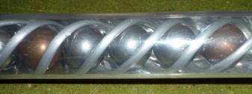
High Intensity Proton Sources III
Intensity Frontier Accelerator R&D Issues
High quality, high current injection systems
  Low emittance, high current ion sources
  Effective beam chopping
  Space charge control
SCRF acceleration (Project X, muons)
Multi-MW cyclotrons DAEδALUS
Radiation resistant magnets
Very high efficiency extraction
& Understanding and controlling beam loss
  Efficient collimation
  Beam dynamics simulations of halo generation
  Large-dynamic-range instrumentation
High Power
Target Design
High Power Targetry – A Particularly Challenging R&D Issue
Displacements & gas production are the main underlying damage mechanisms
  Particulars depend on primary beam characteristics, material, …
  Can not simply scale from nuclear power experience
Targets are difficult to simulate
  Radiation effects need validating (inhomogeneous, time-varying)
  Thermo-mechanical models complex
  Poorly understood failure criteria (classical limits may be too conservative)
Need controlled, instrumented in-beam tests & Need a source before you can test materials
  Takes a long time to build up data (accelerated testing)
Requires a structured R&D program a International RADIATE collaboration has been formed

Slide 13
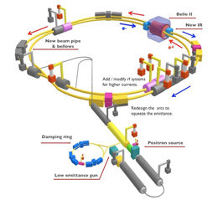
High Intensity Electron and Photon Beams I
The Key Questions
What additional accelerator capabilities at heavy flavor factories are required to realize the full range of physics opportunities?
What new or existing accelerator-based facilities provide opportunities for dark sector / axion searches ?
What are new physics opportunities using high power electron and photon physics?
What accelerator and laser R&D is required to realize the physics opportunities in these areas?
Capabilities Desired For Heavy Flavor Factories
Super B-Factory (SuperKEKB):
  Important US contributions to design by both labs & universities
  Participation in commissioning & machine studies desirable
  Luminosity upgrades (needs physics case)
  Polarized beams (refine physics case)
    Technical feasibility
Tau-charm Factory beyond BEPC-II
  What kind of facility would be interesting? (needs physics case)
  What luminosity is needed? Is polarization necessary?
Factory machines require BOTH high intensity & low emittance beams
a Many areas of overlap with LC damping ring & light source R&D efforts
History of fruitful international collaborations/cooperation

Slide 14
High Intensity Electron and Photon Beams II
Opportunities for HEP Using FEL Facilities
“Flashlight through a wall” experiments using high-intensity photon beams in strong magnetic fields
  JLab/MIT: Dark Light axion search
Search parameters are unconstrained
  Use existing facilities
keV level searches can use X-ray FELs
More speculative: Generating low emittance muon beams from intense positron beams
Accelerator Development Roadmap for e⁺e⁻ Intensity Frontier Machines: Exploit synergy with light sources
Beam stability & control
  Examples: Electron cloud & fast ion instabilities
Coherent Synchrotron Radiation issues with short bunches
High-rate injection
  High top-up rate to compensate for low lifetimes
  Timing jitter, and attendant energy jitter
Low-emittance beam issues
Beam instrumentation
Presents an ongoing opportunity for collaboration across a broad accelerator community

Slide 15
Accelerator Technology Test Beds I
The Charge
Identify broad range of test capabilities existing or needed
Category 1: Provides testing beam physics / accelerator components to manage technical risks in planned projects
Category 2: Integrates proof-of-practicality tests
Category 3: Provides tests of physics feasibility of concepts / components
Identified Capabilities
35 existing facilities were identified
  Beam / no-beam
  US & overseas

Slide 16
Hadron Colliders: LHC Lumi & Energy Upgrades, VLHC
Technical Challenges | Existing Capabilities | Planned Capabilities
High performance SC wire | Critical industry couplings
High Field SC magnets | LBNL, FNAL, BNL, CERN
SR and photon stops | Electron storage rings
Collimation | LHC, RHIC, FNAL-MI
Injectors - SCRF | SNS (limited) | PXIE@FNAL
Injectors – Space charge | FNAL-Booster, AGS, PS | ASTA@FNAL
Beam cooling (optical, coherent) |  | ASTA@FNAL, RHIC Cool
Injector studies need new, dedicated facilities
Lepton Colliders: ILC and Beyond
Risk Reduction Areas | Existing Capabilities | Planned Capabilities
ILC: SRF-system no beam | JLab, Cornell, Industry
ILC: SRF system with beam | DESY, KEK, Cornell, LLNL | ASTA@FNAL
ILC: FF, Damping Rings, e+ Production | KEK, Cornell, LLNL
Practicality/Feasibility Tests | Existing Capabilities | Planned Capabilities
CLIC NCRF 2-beam | CERN
Muon Colliders – technical components | MuCool Test Area (MTA@FNAL)
Muon Colliders – 4D/6D ionization Cooling | MICE@RAL | nuSTORM
Wakefield accelerators – acceleration demo/staging | SLAC, LBNL, ANL | Upgrades to existing facilities
Wakefield accelerators – luminosity / beam control |  | Needs integrated testbed
Energy reach beyond the ILC will need new test capabilities

Slide 17
Intensity Frontier Accelerators: Includes Project X, DAEδALUS, Neutrino Factory
Technical Challenges | Existing Capabilities | Planned Capabilities
Project X: H⁻ source & chopping | SNS | PXIE@FNAL
Project X: CW SC RF (low beta) | Atlas@ANL | PXIE@FNAL
Project X: Pulsed SC RF, space charge |  | ASTA@FNAL
DAEδALUS: H₂⁺ source | LNS Catania
DAEδALUS: Multi-MW cyclotrons | PSI, RIKEN, ORNL, Best
Neutrino Factory | See Muon Collider
Instabilities, collimation, extraction | FNAL, RHIC
Dedicated high power targetry |  | Critical Need
A new generation of IF machines needs new test facilities
Intensity Frontier Accelerators: Flavor Factories and Electron-Ion Colliders
Technical Challenges | Existing Capabilities | Planned Capabilities
Beam instabilities, Interaction region optics | Existing Rings
IP designs, collimation | BNL, CERN
Non-standard beam-beam |  | Needed
Intense polarized e⁻ source | JLab, BNL, Cornell
CW SRF (β = 1) | Cornell, JLab, BNL, KEK | CERN
Heavy ion sources | MSU, LBNL
Good test facility basis for technical design of HEP machines

Slide 18
Accelerator Capabilities: Summary
A broad range of accelerator-based capabilities has been reviewed
Key goals for the US Planning Process:
Fully exploit LHC capabilities and its upgrade path
  Complete its physics program
  Support the R&D for the next steps
The Japanese initiative to host a linear collider as a Higgs Factory is welcome
  The US accelerator community is capable of making significant contributions
  A clear upgrade path to higher energy and luminosity is necessary
The next generation of Intensity Frontier experiments require proton intensities and timing structures which are beyond current capabilities
  Project X can provide a world-leading facility to satisfy these needs
  Facilities with more narrowly defined scope may also have a role to play
Intensity Frontier colliders and photon sources have strong synergies with other parts of the accelerator community (eg, light sources)
Support for key R&D is required
  Participate in planning for a 100 TeV Collider
  Continue the R&D efforts toward a more compact multi-TeV lepton collider capability: Muon Collider, LC technologies (warm RF, wakefield)
  Dedicated test facilities will be required to develop future HEP capabilities

Slide 19
A FEW Comments on TLEP:
My views ONLY!

Slide 20
Some Personal Comments
The TLEP concept was generally viewed as very interesting, but still in the preliminary stages
  Considerable interest among HEP physicists, based on the potential cost and performance points
  The coupling to an Energy Frontier pp machine lends this option considerable weight
  There is a strong desire to let the Japanese Initiative proceed and then the situation can be re-evaluated
  Moving towards a large tunnel should not be allowed to interfere with taking full advantage of the LHC
  A full CDR is required
Thus more detailed consideration after seeing how events of the next few years unfold, and while a full CDR is developed, seems reasonable…

Slide 21
Thank YOu

