Slide 1
TLEP power consumption and luminosity optimization
M. Koratzinos,
TLEP6 workshop
CERN, 17 October 2013

Slide 2
Contents
TLEP power consumption: news since the last TLEP workshop
TLEP luminosity optimization: theoretical limits and how to approach them

Slide 3
TLEP power consumption
TLEP is an efficient Higgs factory, as we will see
Although there are limitations on instantaneous power consumption, the real figure of merit is not power consumption. It is either
  Energy per Higgs produced
  Power per luminosity
(Even more relevant is taking into account the ‘grey energy’ consumed for the whole project, the only viable estimate of which is the total project cost)

Slide 4
TLEP power consumption
Nevertheless, the TLEP power consumption was the subject of intense debate over the summer.
Initial power figures were given at the TLEP paper submitted to IPAC: M. Koratzinos et al., TLEP: A High-Performance Circular e+e- Collider to study the Higgs Boson (http://arxiv.org/pdf/1305.6498.pdf)
A comment on these figures was published in the arXiv: M. Ross, Wall-plug (AC) power consumption of a very high energy e+/e- storage ring collider (http://arxiv.org/pdf/1308.0735.pdf)
An explanatory note was also produced by TLEP and submitted to the arXiv: A. Blondel et al., Comments on "Wall‐plug (AC) power consumption of a very high energy e+/e- storage ring collider" by Marc Ross [arXiv:1308.0735] (http://arxiv.org/pdf/1308.2629.pdf )

Slide 5
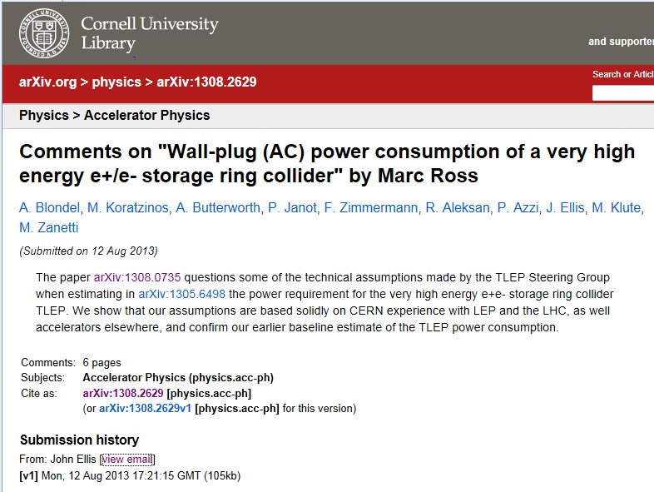

Slide 6
Points addressed
TLEP has estimated that the wall-plug power consumption for TLEP at Ecm = 350 GeV would be about 280 MW
M. Ross estimated about 416 MW. The main differences between the two power estimates arise from different assumptions about klystron operation, cryo­‐plant efficiency and heat removal.
Our conclusions:
  Our technical assumptions concerning these and other issues raised are based solidly on CERN experience with LEP and the LHC, as well accelerators elsewhere.
  We see no reason to modify significantly the wall-‐plug power consumption for TLEP.

Slide 7
Klystron operation
M. Ross argues that we cannot run the klystrons in ‘saturated’ operation, resulting in lower efficiency (55% instead of the claimed 65%). But LEP2 run clystrons at saturation. Our efficiency figure of 65% for the klystron efficiency is, we believe conservative and will be the subject of intense r&d

Slide 8
Cryo-plant efficiency
We are using the figure achieved by the LHC (900W/W). The ILC TDR assumes 700W/W, so our figure is actually conservative

Slide 9
Cooling and ventilation
Ventilation system: Contrary to M. Ross’ statement, CERN has not decided to use transversal tunnel ventilation (with the possible exception of CLIC) – so our estimate stands
Water cooling: this critically depends on a specific implementation.
Nevertheless, for cooling and ventilation we have assumed a figure which is about 10% of the total power dissipation. LEP achieved 13%, so we believe that a careful design would bring us to the value stated in the paper.

Slide 10
Electrical distribution network
in our estimate we did not include any electrical network losses, as they are dependent on the exact implementation of the electrical distribution system.
Efforts will be made to ensure that the main electrical power consumers (the RF systems) will be located close to local utility high‐voltage interconnect points. We consider that 5% is on the conservative side and we strive to achieve a figure closer to 3% for the electrical distribution network (8MW).

Slide 11
Power consumption: recap
The design study will have as a goal to match and improve on the following numbers:
 | TLEP 120 | TLEP 175
RF systems | 173-185 MW
cryogenics | 10 MW | 34 MW
top-up ring | 3 MW | 5 MW
Total RF | 186-198 MW | 212-224 MW
(overall efficiency 54 to 59%)
Power consumption | TLEP 175
RF including cryogenics | 224MW
cooling | 5MW
ventilation | 21MW
magnet systems | 14MW
general services | 20MW
Total | ~280MW
For the most pessimistic scenario
Dominated by the RF efficiency where most effort will be devoted

Slide 12
TLEP figure of merit
TLEP | 120GeV | 175GeV
Total power | 260MW | 280MW
luminosity | 4.8×10³⁴ | 1.3×10³⁴
experiments | 4 | 4
Luminosity per MW | 7.4×10³² | 1.8×10³²
This is very competitive compared to other electron-positron collider projects
Energy consumed per Higgs produced: 6GJ or 2MWh

Slide 13
Luminosity optimization
What does the luminosity of a circular collider depend on?
It turns out that to first order it depends on very few parameters
It depends linearly on:
  The power consumption (the SR power pore specifically)
  The size of the ring
  The maximum achievable beam-beam parameter
We then need to find parameters that can get as close as possible to these values

Slide 14
A step back: Major limitations
The major limitations of circular colliders are:
Power consumption limitations that affect the luminosity
Tunnel size limitations that affect the luminosity and the energy reach
Beam-beam effect limitations that affect the luminosity
Beamstrahlung limitations that affect beam lifetimes (and ultimately luminosity)

Slide 15
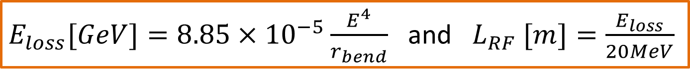
Energy reach
In a circular collider the energy reach is a very steep function of the bending radius. To make a more quantitative plot, I have used the following assumptions:
  RF gradient: 20MV/m
  Dipole fill factor: 90% (LEP was 87%)
I then plot the energy reach for a specific ratio of RF system length to the total length of the arcs
$E_{loss}[GeV]=8.85×{10}^{−5}\frac{E^{4}}{r_{bend}}$ and $L_{RF} [m]=\frac{E_{loss}}{20MeV}$

Slide 16
Energy reach
Assumptions: 20mV/m, 90% dipole fill factor.
The three curves are for different ratio of RF length to total arc length
TLEP175 sits comfortably below the 1% line
LEP2 had a ratio of RF to total arc length of 2.2%

Slide 17
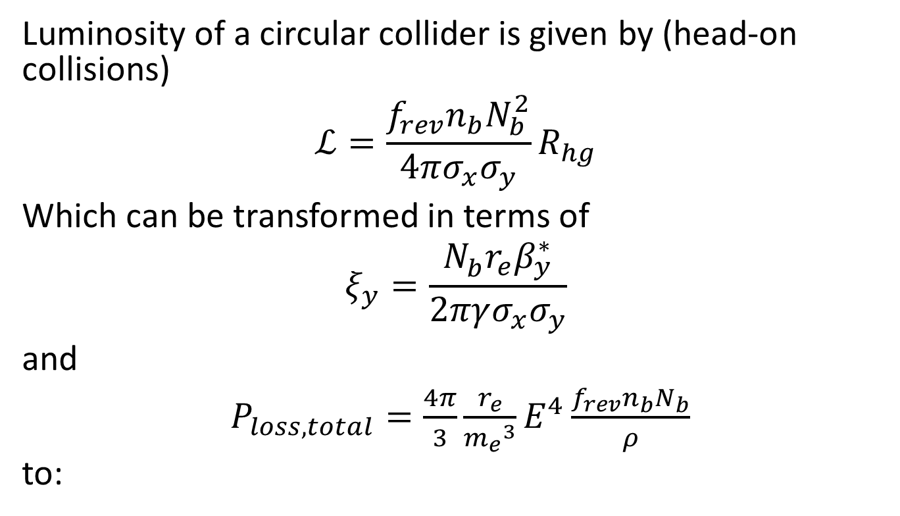
Luminosity of a circular collider
Luminosity of a circular collider is given by (head-on collisions)
$$ℒ=\frac{f_{rev}n_{b}N_{b}^{2}}{4πσ_{x}σ_{y}}R_{hg}$$
Which can be transformed in terms of
$$ξ_{y}=\frac{N_{b}^{}r_{e}β_{y}^{∗}}{2πγσ_{x}σ_{y}}$$
and
$P_{loss,total}=\frac{4π}{3}\frac{r_{e}}{{m_{e}}^{3}}E^{4}\frac{f_{rev}n_{b}N_{b}}{ρ}$
to:
Head-on collisions

Slide 18
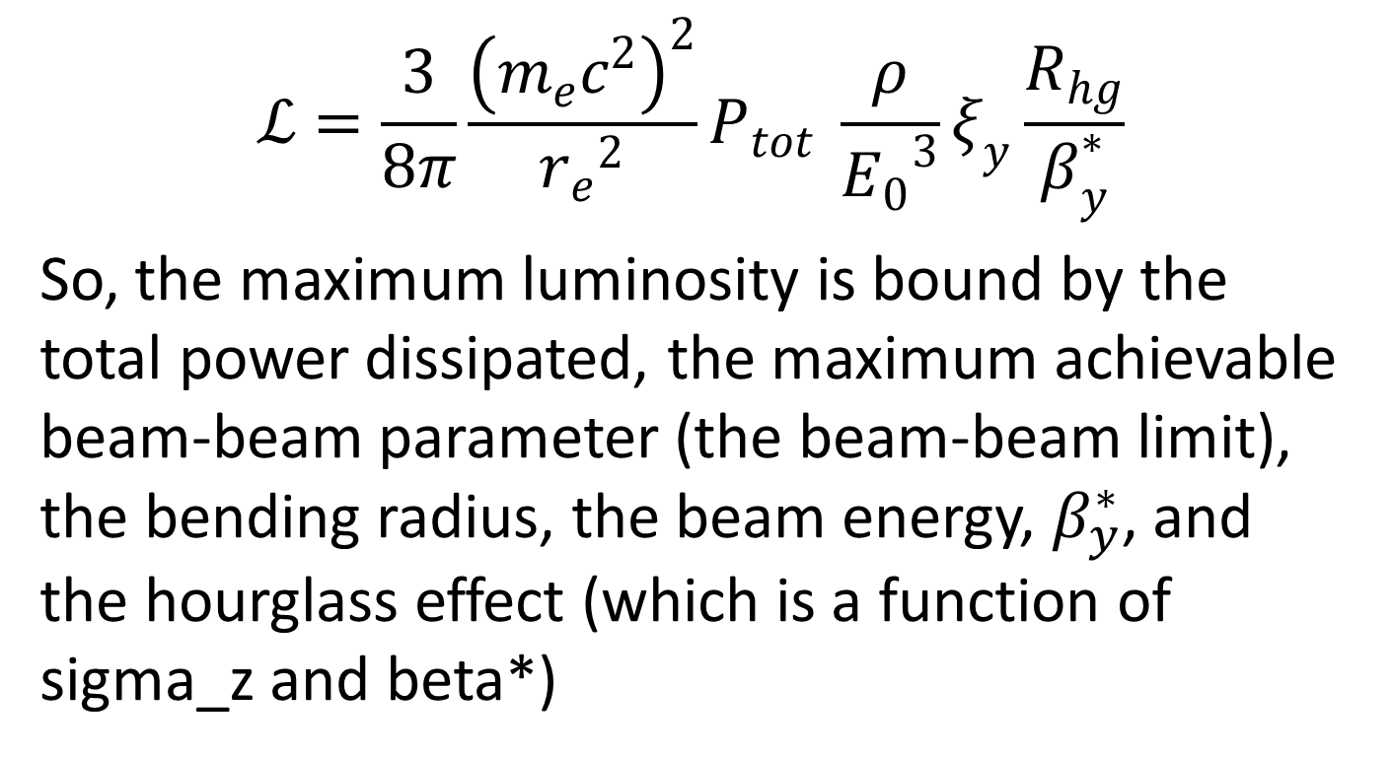
Luminosity of a circular collider
$$ℒ=\frac{3}{8π}\frac{{\left(m_{e}c^{2}\right)}^{2}}{{r_{e}}^{2}}P_{tot} \frac{ρ}{{E_{0}}^{3}}ξ_{y}\frac{R_{hg}}{β_{y}^{∗}}$$
So, the maximum luminosity is bound by the total power dissipated, the maximum achievable beam-beam parameter (the beam-beam limit), the bending radius, the beam energy, $β_{y}^{∗}$, and the hourglass effect (which is a function of sigma_z and beta*)

Slide 19
Beamstrahlung
Analytical formula by Telnov used so far.
Single-turn Guinnea-Pig simulation used which found the Telnov approximation pessimistic
See talk of Anton BOGOMYAGKOV this morning
Beamstrahlung gets worse at high energies, so they impact the design of TLEP-120 and TLEP-175

Slide 20
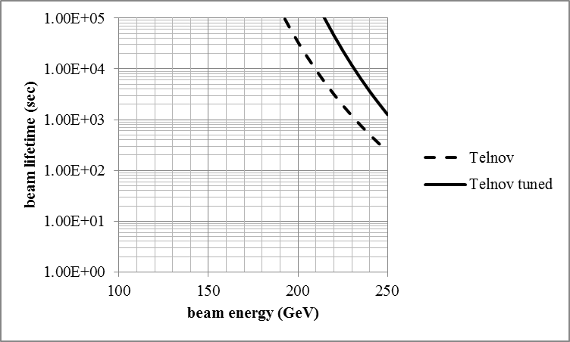
Beamstrahlung limitation
Plot on left is if we run with a value of the beam-beam parameter of 0.1
Above ~180 GeV is difficult to run without opting for a more modest beam-beam parameter value (which would reduce the luminosity)
TLEP Latest parameter set, mom. acceptance 2.2%
Can even run at 250GeV with a beam-beam parameter of 0.05

Slide 21
Beta* and hourglass
We are opting for an aggressive but I hope realistic β*_{y} value of 1mm. σ_{z} beam sizes vary from 1mm to 3mm. In this range the hourglass effect is between 0.9 to 0.6
Self-consistent sigma_z at different energies (latest values)

Slide 22
Beta* and hourglass
Squeezing more gives a moderate improvement in luminosity, despite the bigger hourglass effect
For beam sizes of 2mm, squeezing from 1mm to 0.7mm improves luminosity by 24%
Squeezing less to 1.5mm drops luminosity by -24%

Slide 23
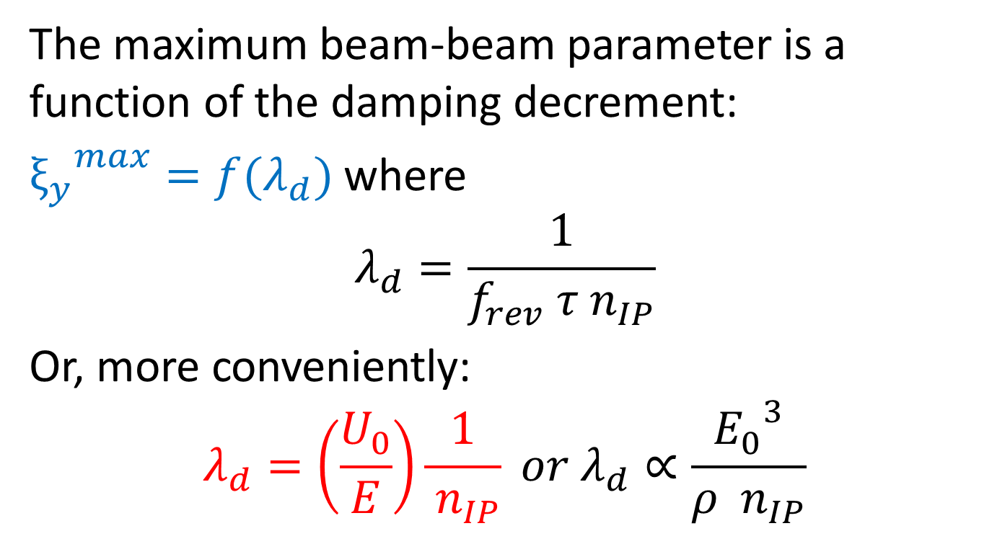
Beam-beam parameter
The maximum beam-beam parameter is a function of the damping decrement:
${ξ_{y}}^{max}=f(λ_{d})$ where
$$λ_{d}=\frac{1}{f_{rev} τ{ n}_{IP}}$$
Or, more conveniently:
$$λ_{d}=\left(\frac{U_{0}}{E}\right)\frac{1}{{ n}_{IP}} or{ λ}_{d}∝\frac{{E_{0}}^{3}}{ρ { n}_{IP}}$$

Slide 24
Expected luminosity vs energy
Single IP luminosity of a circular collider of 9000m bending radius as a function of energy. Power loss is 100MW.

Slide 25
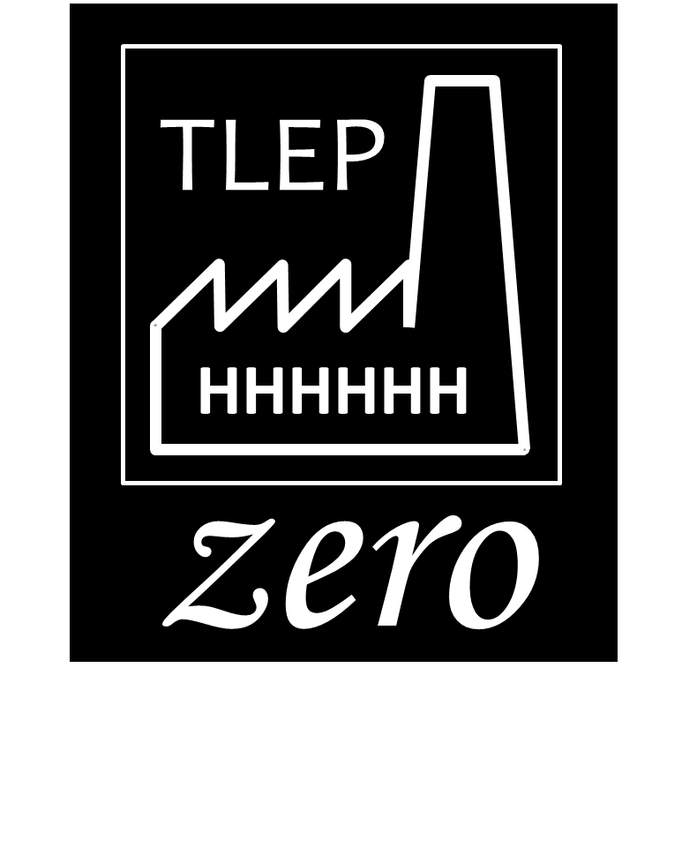
Can we do better?
Is there any way to increase the luminosity above the limits mentioned up to now?
Crab waist scheme (but only effective at TLEP-Z?)
Other solution: charge compensation!
  Charge compensation: colliding beams with zero net charge (colliding 4 beams)
CC was tried in the seventies without success
It is time to revisit charge compensation and, if promising, keep it as an upgrade possibility
Potential: increase luminosity limits by factors of 3 to 10 (this is a wish! Unsubstantiated)

Slide 26
One or two beam pipes?
My input to the discussion of one vs two beam pipes:
Charge compensation needs two beam pipes and also needs the ability to flip the magnetic field of one of the two rings
Low energy, many bunches
High energy, few bunches
Magn. field
TLEP dipole magnet
TLEP dipole magnet
Electrons
only
Positrons
only
Electrons
positrons
Electrons
positrons

Slide 27
Strategy for lumi optimization
Start from a specific ring diameter , power consumption figure and energy
This defines the total current of the machine
Define emittances, beta* values, sigma_z
Compute number of bunches to be on the beam-beam limit (at low energies, increase emittances to avoid too many bunches)
If beam lifetimes are below 100s, re-itterate by increasing the number of bunches

Slide 28
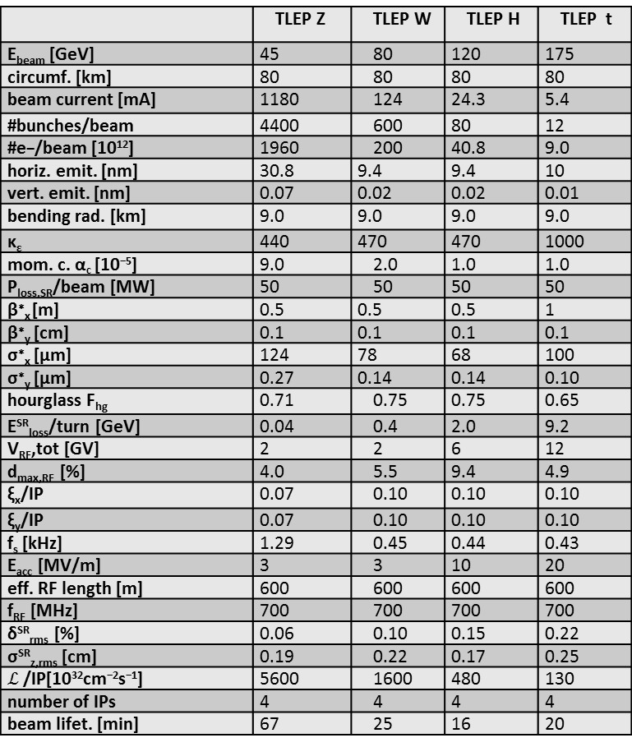
Published parameter set
 | TLEP Z | TLEP W | TLEP H | TLEP t
E_{beam} [GeV] | 45 | 80 | 120 | 175
circumf. [km] | 80 | 80 | 80 | 80
beam current [mA] | 1180 | 124 | 24.3 | 5.4
#bunches/beam | 4400 | 600 | 80 | 12
#e−/beam [10¹²] | 1960 | 200 | 40.8 | 9.0
horiz. emit. [nm] | 30.8 | 9.4 | 9.4 | 10
vert. emit. [nm] | 0.07 | 0.02 | 0.02 | 0.01
bending rad. [km] | 9.0 | 9.0 | 9.0 | 9.0
κ_{ε} | 440 | 470 | 470 | 1000
mom. c. α_{c} [10⁻⁵] | 9.0 | 2.0 | 1.0 | 1.0
P_{loss,SR}/beam [MW] | 50 | 50 | 50 | 50
β∗_{x} [m] | 0.5 | 0.5 | 0.5 | 1
β∗_{y} [cm] | 0.1 | 0.1 | 0.1 | 0.1
σ∗_{x} [μm] | 124 | 78 | 68 | 100
σ∗_{y} [μm] | 0.27 | 0.14 | 0.14 | 0.10
hourglass F_{hg} | 0.71 | 0.75 | 0.75 | 0.65
E^{SR}_{loss}/turn [GeV] | 0.04 | 0.4 | 2.0 | 9.2
V_{RF},tot [GV] | 2 | 2 | 6 | 12
d_{max,RF} [%] | 4.0 | 5.5 | 9.4 | 4.9
ξ_{x}/IP | 0.07 | 0.10 | 0.10 | 0.10
ξ_{y}/IP | 0.07 | 0.10 | 0.10 | 0.10
f_{s} [kHz] | 1.29 | 0.45 | 0.44 | 0.43
E_{acc} [MV/m] | 3 | 3 | 10 | 20
eff. RF length [m] | 600 | 600 | 600 | 600
f_{RF} [MHz] | 700 | 700 | 700 | 700
δ^{SR}_{rms} [%] | 0.06 | 0.10 | 0.15 | 0.22
σ^{SR}_{z,rms} [cm] | 0.19 | 0.22 | 0.17 | 0.25
$ℒ$ /IP[10³²cm⁻²s⁻¹] | 5600 | 1600 | 480 | 130
number of IPs | 4 | 4 | 4 | 4
beam lifet. [min] | 67 | 25 | 16 | 20
By definition, in a project like TLEP, from the moment a set of parameters is published it becomes obsolete and we now already have an improved set of parameters.
The new parameter set contains improvements to our understanding, but does not change the big picture.
IPAC13 TUPME040, arXiv:1305.6498 [physics.acc-ph]

Slide 29
Modifying the parameters
The strategy we have adopted calls for a stable parameter set which would be modified, according to new knowledge, at not too regular intervals (twice a year?)
Time is ripe for a new set of TLEP parameters (which from the day published would again become obsolete…)

Slide 30
parameter set to be modified
 | TLEP Z | TLEP W | TLEP H | TLEP t
E_{beam} [GeV] | 45 | 80 | 120 | 175
circumf. [km] | 80 | 80 | 80 | 80
beam current [mA] | 1180 | 124 | 24.3 | 5.4
#bunches/beam | 4400 | 600 | 80 | 12
#e−/beam [10¹²] | 1960 | 200 | 40.8 | 9.0
horiz. emit. [nm] | 30.8 | 9.4 | 9.4 | 10
vert. emit. [nm] | 0.07 | 0.02 | 0.02 | 0.01
bending rad. [km] | 9.0 | 9.0 | 9.0 | 9.0
κ_{ε} | 440 | 470 | 470 | 1000
mom. c. α_{c} [10⁻⁵] | 9.0 | 2.0 | 1.0 | 1.0
P_{loss,SR}/beam [MW] | 50 | 50 | 50 | 50
β∗_{x} [m] | 0.5 | 0.5 | 0.5 | 1
β∗_{y} [cm] | 0.1 | 0.1 | 0.1 | 0.1
σ∗_{x} [μm] | 124 | 78 | 68 | 100
σ∗_{y} [μm] | 0.27 | 0.14 | 0.14 | 0.10
hourglass F_{hg} | 0.71 | 0.75 | 0.75 | 0.65
E^{SR}_{loss}/turn [GeV] | 0.04 | 0.4 | 2.0 | 9.2
V_{RF},tot [GV] | 2 | 2 | 6 | 12
d_{max,RF} [%] | 4.0 | 5.5 | 9.4 | 4.9
ξ_{x}/IP | 0.07 | 0.10 | 0.10 | 0.10
ξ_{y}/IP | 0.07 | 0.10 | 0.10 | 0.10
f_{s} [kHz] | 1.29 | 0.45 | 0.44 | 0.43
E_{acc} [MV/m] | 3 | 3 | 10 | 20
eff. RF length [m] | 600 | 600 | 600 | 600
f_{RF} [MHz] | 700 | 700 | 700 | 700
δ^{SR}_{rms} [%] | 0.06 | 0.10 | 0.15 | 0.22
σ^{SR}_{z,rms} [cm] | 0.19 | 0.22 | 0.17 | 0.25
$ℒ$ /IP[10³²cm⁻²s⁻¹] | 5600 | 1600 | 480 | 130
number of IPs | 4 | 4 | 4 | 4
beam lifet. [min] | 67 | 25 | 16 | 20
This is a personal choice!
IPAC13 TUPME040, arXiv:1305.6498 [physics.acc-ph]

Slide 31
Conclusions
TLEP power figures will be scrutinized thoroughly during the study, but seem to be in the right ballpark
A simple formula for the maximum achievable luminosity has been presented
Beamstrahlung seems that can be mitigated up to 175GeV, but complete simulation studies are needed
Much more work is needed for a design proper.
Exotic schemes might offer even more luminosity, so they should be pursued at an early stage, as might have repercussions on the design

Slide 32
Thank you
end

