Slide 1
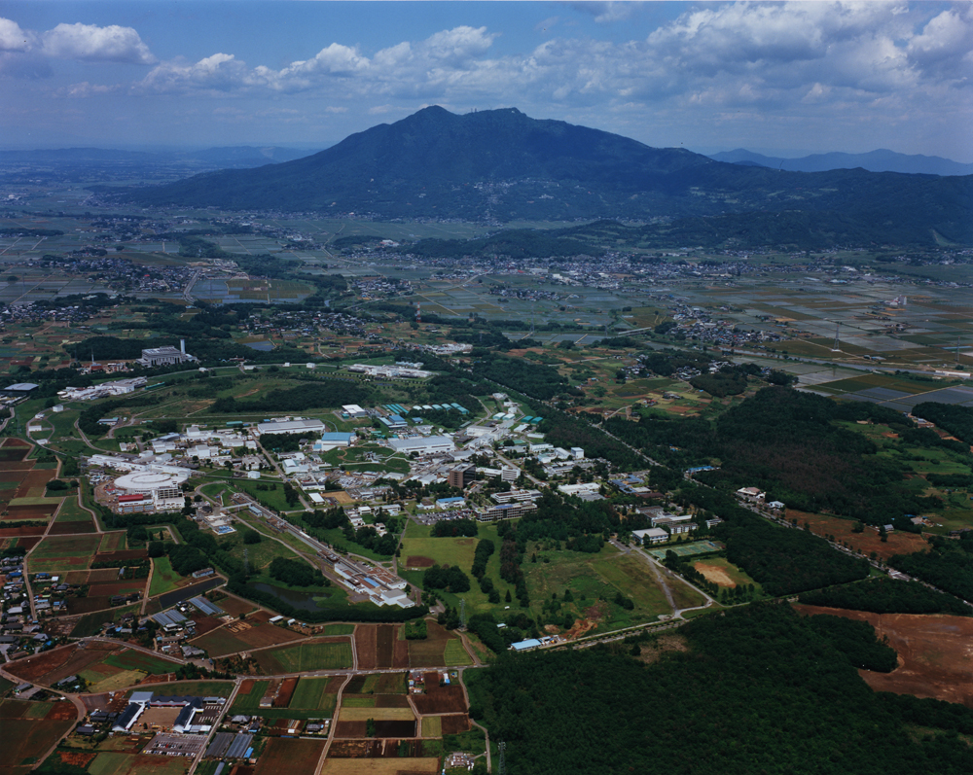
Pushing Luminosity of e+e- Colliders: the SuperKEKB project
Y. Funakoshi
KEK
Oct. 17 2013 6th TLEP workshop@CERN

Slide 2
Concept of SuperKEKB

Slide 3
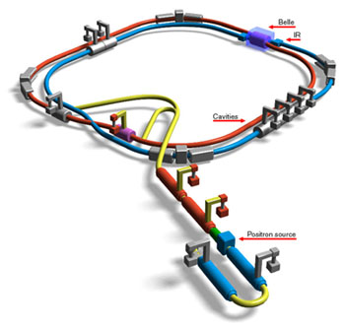
KEKB B-Factory
Crab cavities
1 for each ring
Superconducting cavities (HER)
Belle detector
e-
KEKB B-Factory
♦World-highest Peak Luminosity
    2.11 x 10³⁴cm⁻²s⁻¹
    Twice as high as design value
e+
ARES copper cavities (HER)
ARES copper cavities (LER)
TRISTAN tunnel
♦World-highest Integrated Luminosity
  Total: 1041fb⁻¹ as of June 30th 2010
8 GeV e- 3.5 GeV e+ Linac
e+ target
♦Crab crossing (φ = 11 mrad)
♦Skew-sextupole magnets
The KEKB operation was terminated at the end of June 2010 for the
upgrade toward SuperKEKB. Operation of SuperKEKB will start in Jan. 2015.

Slide 4
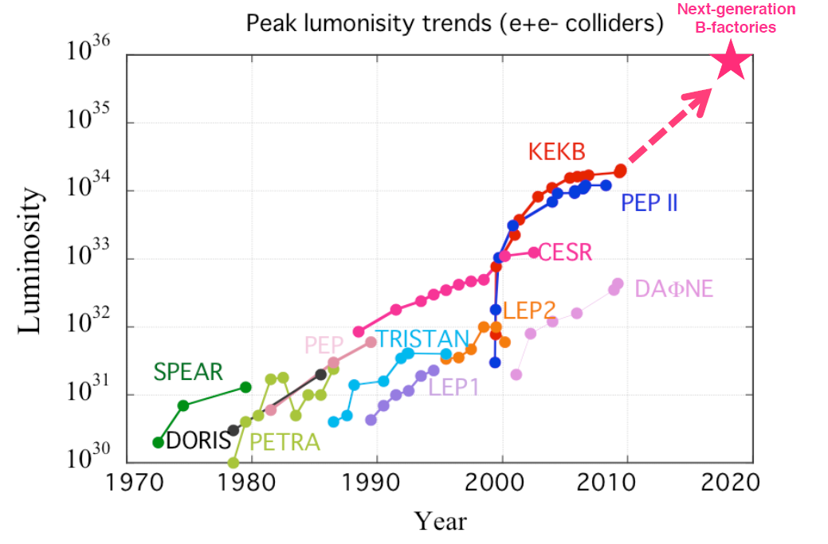
SuperKEKB Luminosity Target
SuperKEKB
8x10³⁵ cm⁻²s⁻¹
2x10³⁴ cm⁻²s⁻¹
x40 !!
Notes:
As you can see in this trend plot, the target luminosity of SuperKEKB is about 2 order higher than the current B factories.
But how can it be achieved?

Slide 5
Luminosity of KEKB and SuperKEKB
 | KEKB Acieved |  | SuperKEKB Nano-Beam
 | LER | HER | LER | HER
Ibeam [A] | 1.6 | 1.2 | 3.6 | 2.6
βy* [mm] | 5.9 | 5.9 | 0.27 | 0.30
ξy | 0.09 | 0.12 | 0.088 | 0.081
Luminosity [cm⁻² s⁻¹] | 2.1 x 10³⁴ |  | 8.0 x 10³⁵
Factor 2
Factor 20
Almost same
40 times higher

Slide 6
Collision Scheme
P. Raimondi
KEKB head-on (crab crossing)
Nano-Beam Scheme SuperKEKB
5-6 mm
10-12 μm
100-150 μm
d
2 φ = 83mrad
6-7 mm
Half crossing angle: φ
overlap region = bunch length
overlap region << bunch length
Hourglass requirement
~ 6 mm
~ 300 μm
Vertical beta function at IP can be squeezed to ~300μm.
Need small horizontal beam size at IP.
→ low emittance, small horizontal beta function at IP.
No crab waist scheme has
been assumed at SuperKEKB

Slide 7
Machine Design Parameters
parameters |  | KEKB |  | SuperKEKB |  | units
 |  | LER | HER | LER | HER
Beam energy | Eb | 3.5 | 8 | 4 | 7.007 | GeV
Half crossing angle | φ | 11 |  | 41.5 |  | mrad
# of Bunches | N | 1584 |  | 2500
Horizontal emittance | εx | 18 | 24 | 3.2 | 4.6 | nm
Emittance ratio | κ | 0.88 | 0.66 | 0.27 | 0.28 | %
Beta functions at IP | βx*/βy* | 1200/5.9 |  | 32/0.27 | 25/0.30 | mm
Beam currents | Ib | 1.64 | 1.19 | 3.6 | 2.6 | A
beam-beam param. | ξy | 0.129 | 0.090 | 0.088 | 0.081
Bunch Length | σz | 6.0 | 6.0 | 6.0 | 5.0 | mm
Horizontal Beam Size | σx∗ | 150 | 150 | 10 | 11 | um
Vertical Beam Size | σy∗ | 0.94 |  | 0.048 | 0.062 | um
Luminosity | L | 2.1 x 10³⁴ |  | 8 x 10³⁵ |  | cm⁻²s⁻¹

Slide 8
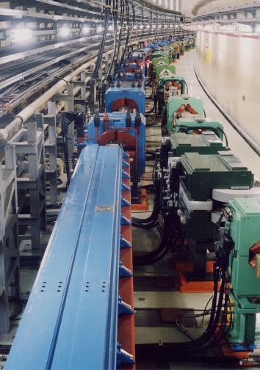
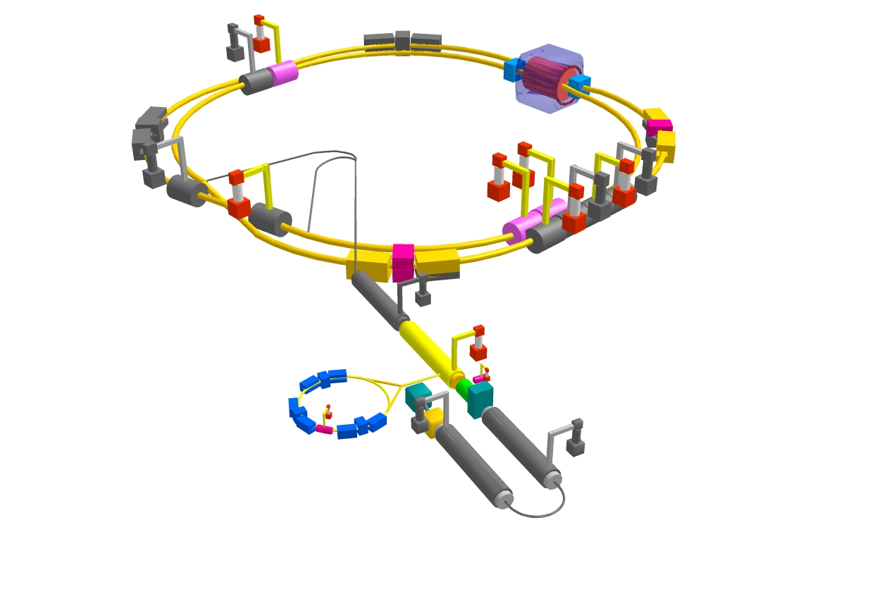
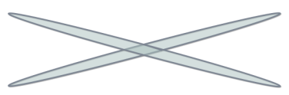
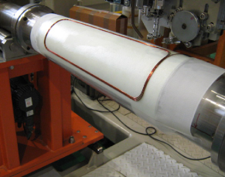
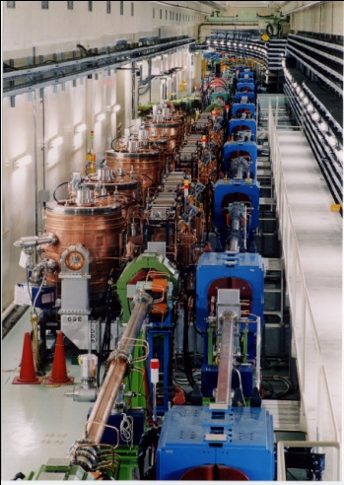


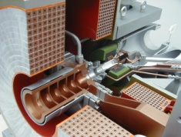
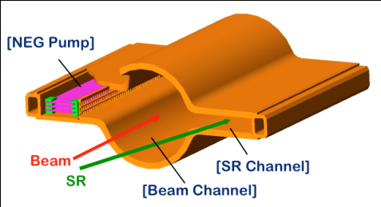
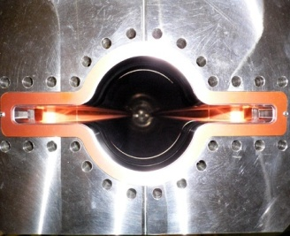

What’s new at SuperKEKB
Belle II
e⁺ 4GeV 3.6 A
Colliding bunches
New IR
e⁻ 7GeV 2.6 A
New superconducting final focusing quads near the IP
New beam pipe
& bellows
SuperKEKB
Replace short dipoles with longer ones (LER)
Add / modify RF systems for higher beam current
Low emittance positrons to inject
Positron source
Redesign the lattices of LER to squeeze the emittance
Damping ring
New positron target / capture section
TiN-coated beam pipe with antechambers
Low emittance gun
Low emittance electrons to inject
Target: L = 8x10³⁵/cm²/s

Slide 9
The construction works are in full swing at SuperKEKB.
However, in this talk, instead of describing the construction status, I will focus on issues for SuperKEKB.

Slide 10
Issues
IR design and dynamic aperture
Low emittance tuning
Magnet alignment strategy
Beam-beam related issues
IP orbit control
Beam loss and beam injection
Electron clouds
Detector beam background

Slide 11
IR design and dynamic aperture
This is one of the key issues at SuperKEKB
  Success of SuperKEKB largely depends on how low values of IP beta-functions will be achieved with enough dynamic aperture.

Slide 12
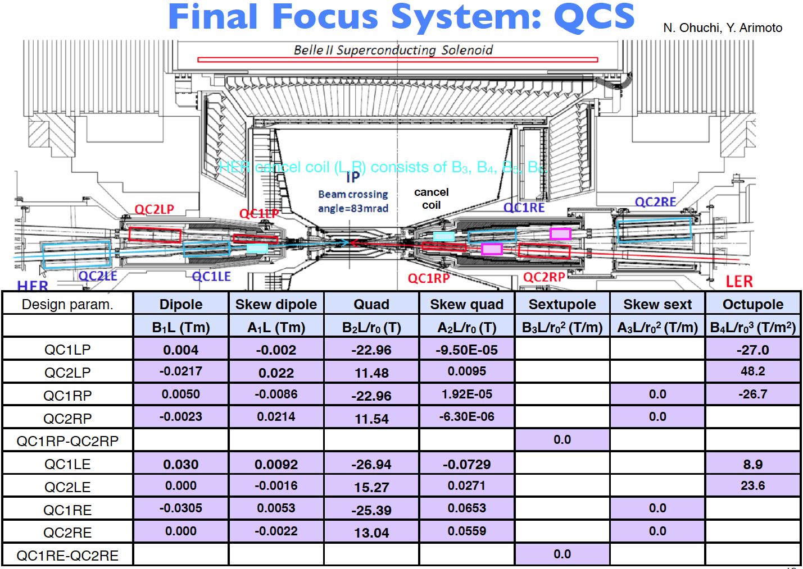
Y. Ohnishi

Slide 13
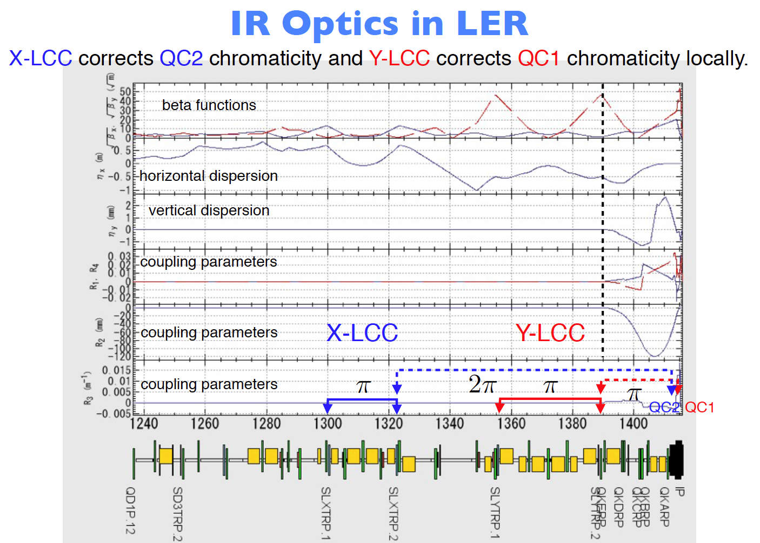
Y. Ohnishi

Slide 14
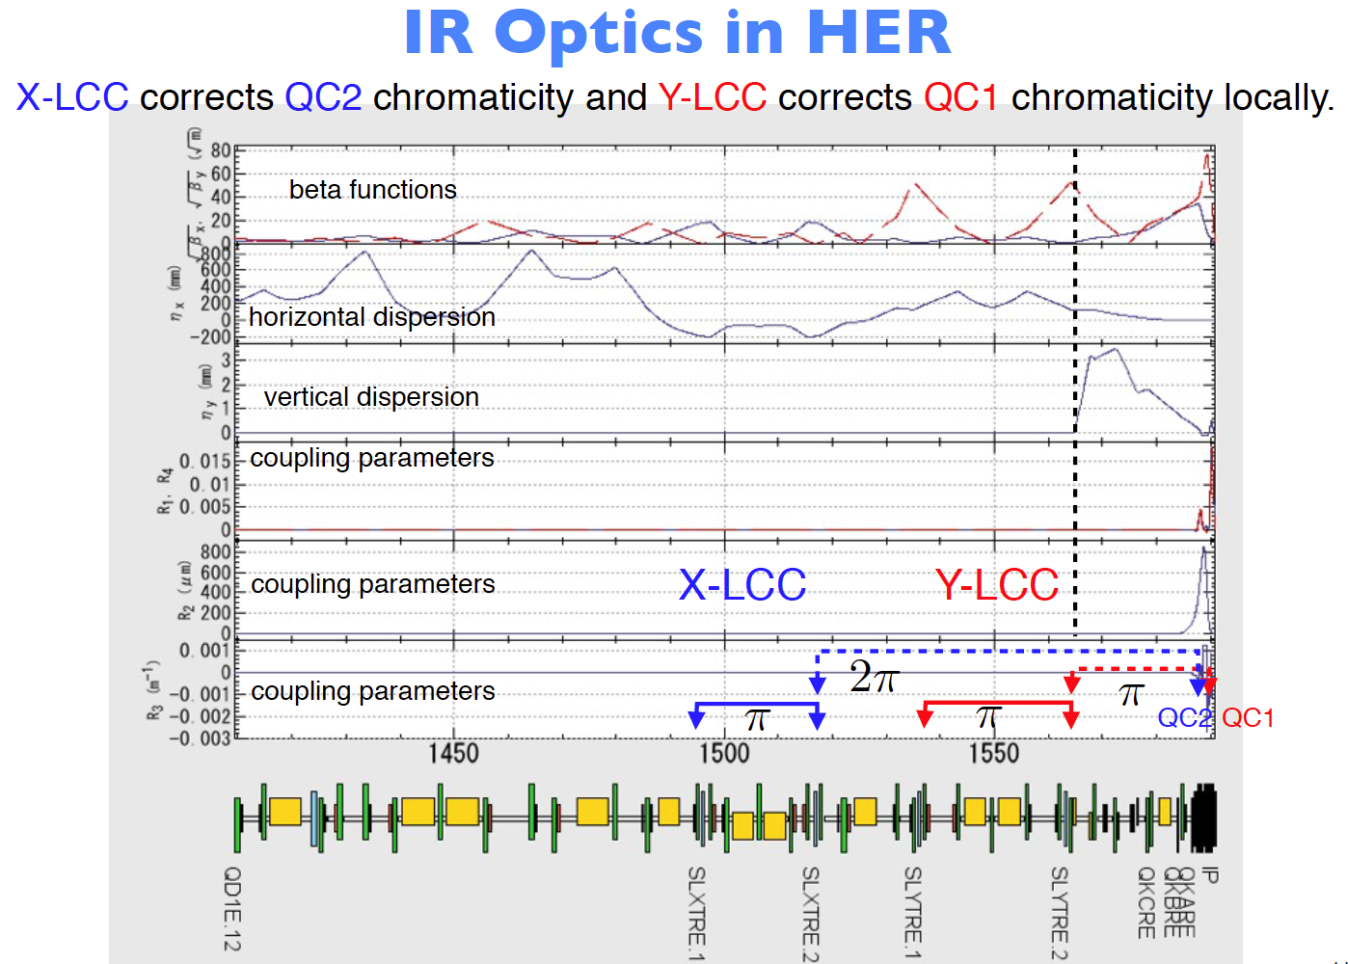
Y. Ohnishi

Slide 15
Corrector coils
Dipole and skew dipole coils make a beam-line geometry and correct dispersions.
Skew quadrupole coils correct x-y couplings.
Sextupole and skew sextuple coils correct error field due to a misalignment of quadrupole coils. This error field affects the dynamic aperture significantly.
Octupole coils at QC1 and QC2 enlarge a transverse aperture.
HER cancel coils correct sextupole, octupole, decapole and dodecapole leakage field from QC1P in LER.

Slide 16
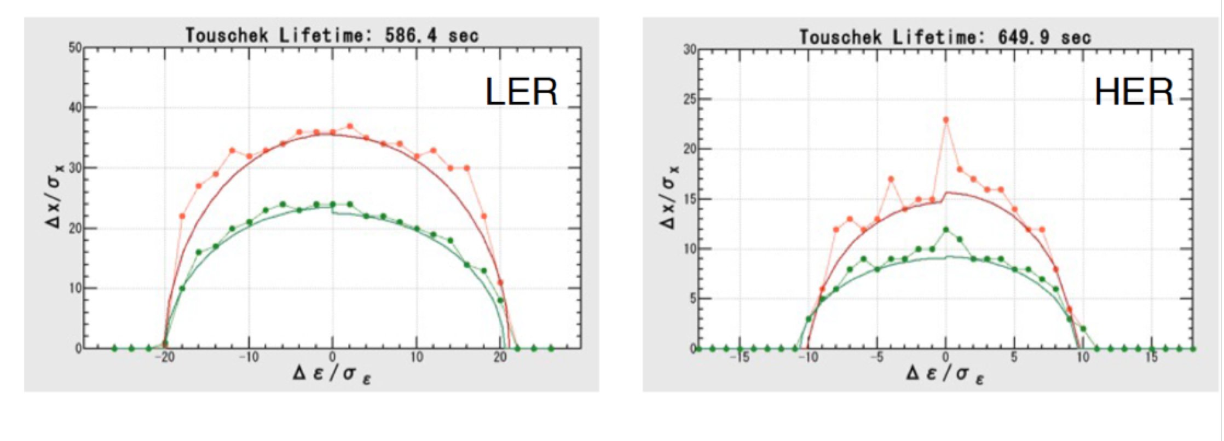
Touschek Lifetime
Touschek lifetime depends on dynamic aperture.
Efforts to widen dynamic aperture
  Careful design of QCS magnets to minimize higher multipoles etc.
  Careful IR design: LCC, x-y coupling correction etc.
  Optimization of octupoles, ARC sextupoles, skew-sextupoles
w/o machine errors
Y. Ohnishi

Slide 17
Low emittance tuning
The design vertical emittance of SuperKEKB is very small compared to those of existing colliders.
The low vertical emittances have been achieved in SR machines. However, low emittance tuning in colliders is much more difficult.
One of the key tuning issues at SuperKEKB will be low emittance tuning.

Slide 18
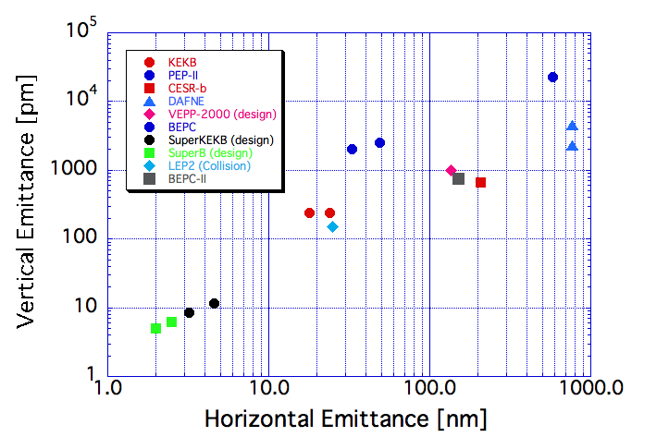
Comparison of emittances of colliders
Future colliders
LEP3
Existing colliders
TLEP-H
From Beam Dynamics Newsletter No. 31
Courtesy of F. Zimmermann, H. Burkhardt and Q. Qin

Slide 19
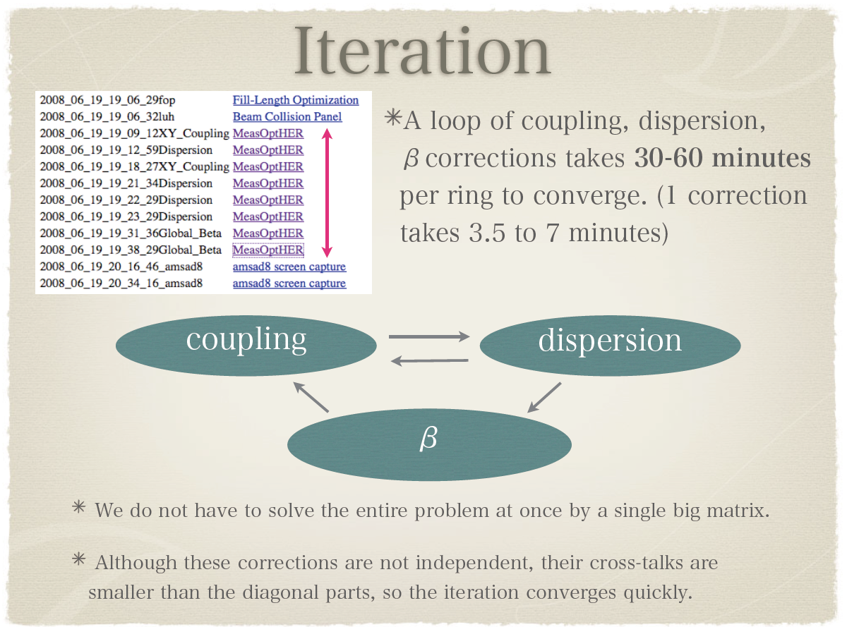
KEKB method of optics correction
SVD solver

Slide 20
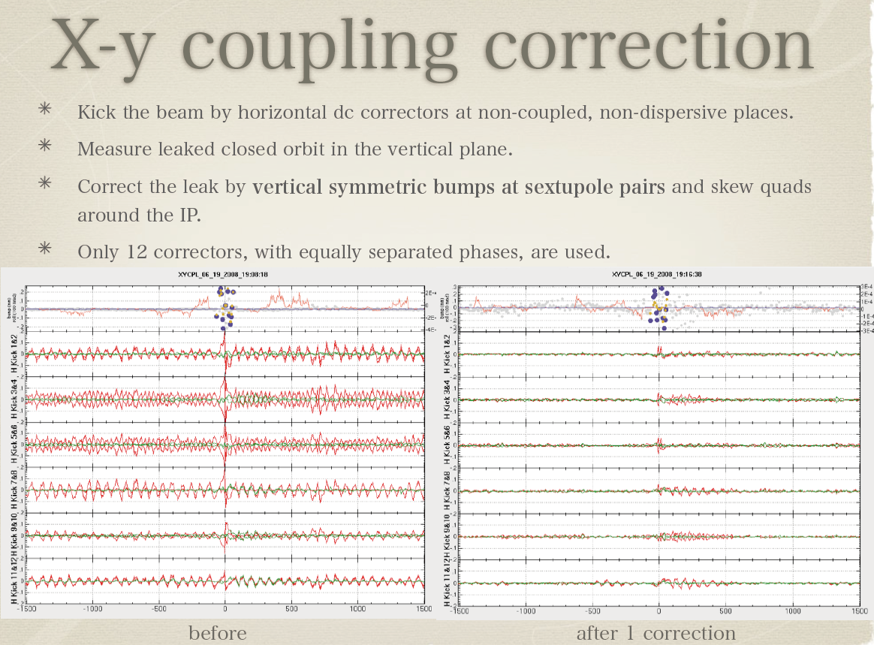
At SuperKEKB we will use skew-quad winding at sextuples instead of bumps.

Slide 21
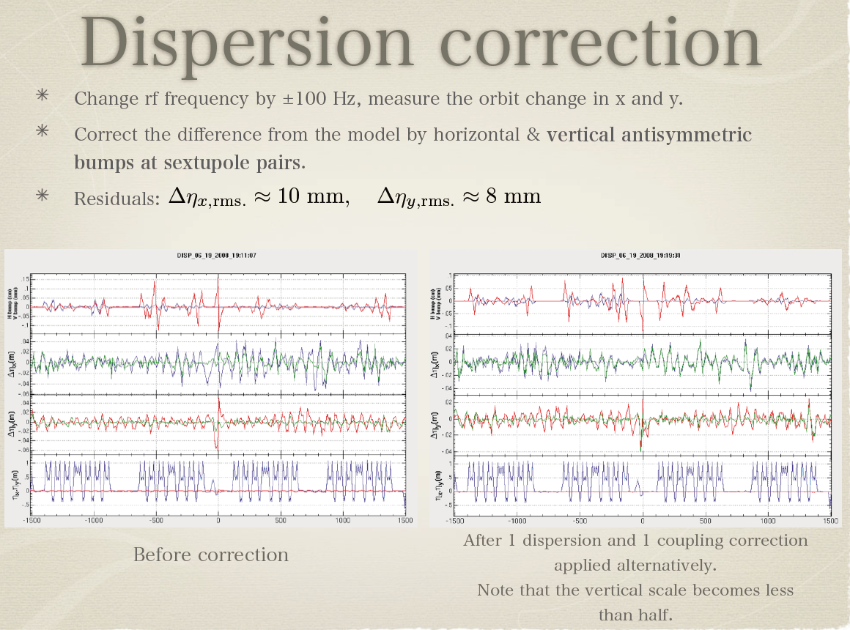
At SuperKEKB we will use skew-quad winding at sextuples instead
of bumps.

Slide 22
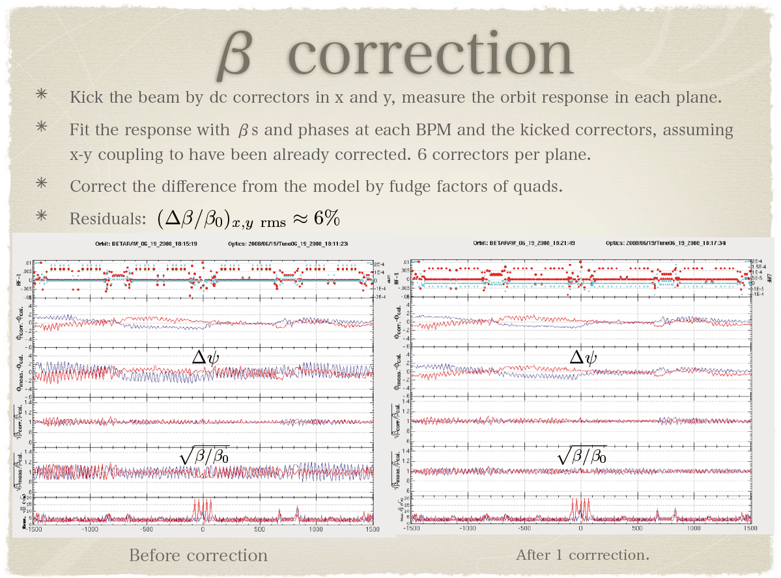

Slide 23
Simulation for SuperKEKB with machine errors
Simulation was done by H. Sugimoto in case of HER.
Assumed machine errors
Corrections
  Closed orbit, x-y coupling, beta-beat, dispersions (KEKB methods)
    SVD threshold = 10⁻²
 | σ_{x} = σ_{y} [μm] | σ_{θ} [μrad] | ΔK/K
Normal Quad | 100 | 100 | 2.5 x 10⁻⁴
Sextu. | 100 | 100 | 2.5 x 10⁻⁴
Bend. | 0 | 100 | 0
QC1, QC2 | 100 | 0 | 0
BPM | 0 | 10 x 10³ | 2μm (resolution)
Machine errors are created randomly with gaussian distributions.

Slide 24
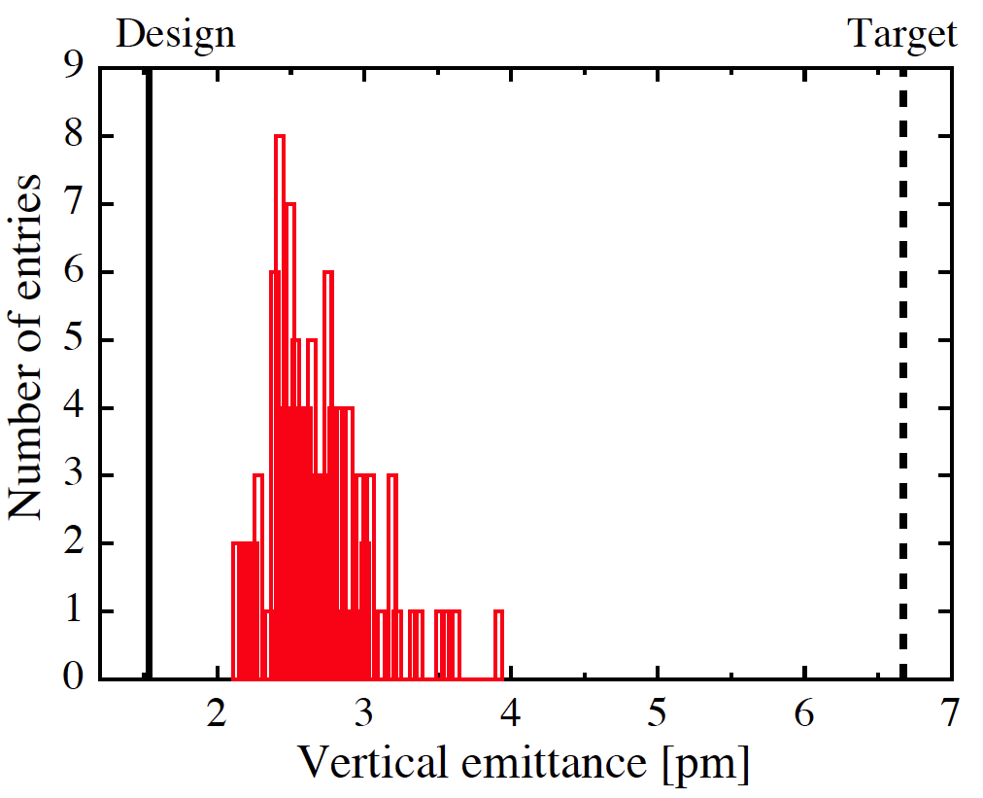
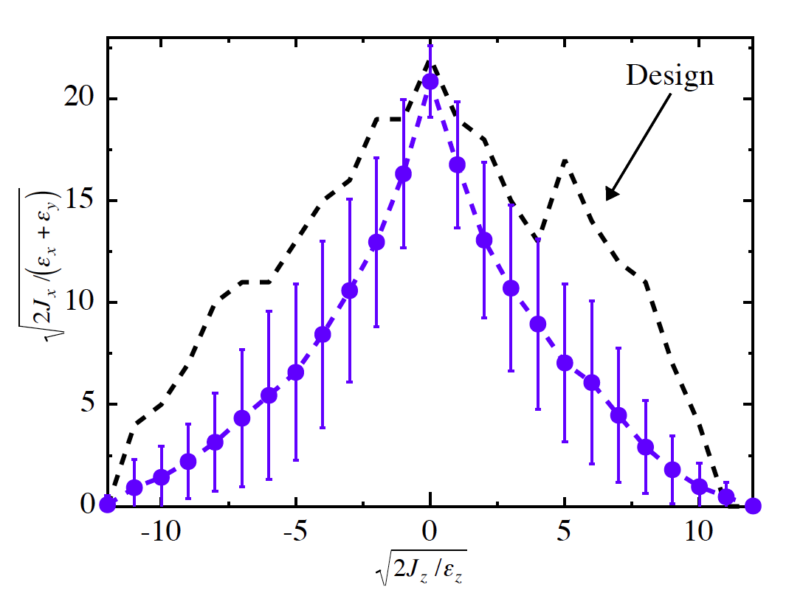
Results of simulation
No errors
100 samples
Vertical emittance distribution after LET
Dynamic aperture after LET.
H. Sugimoto

Slide 25
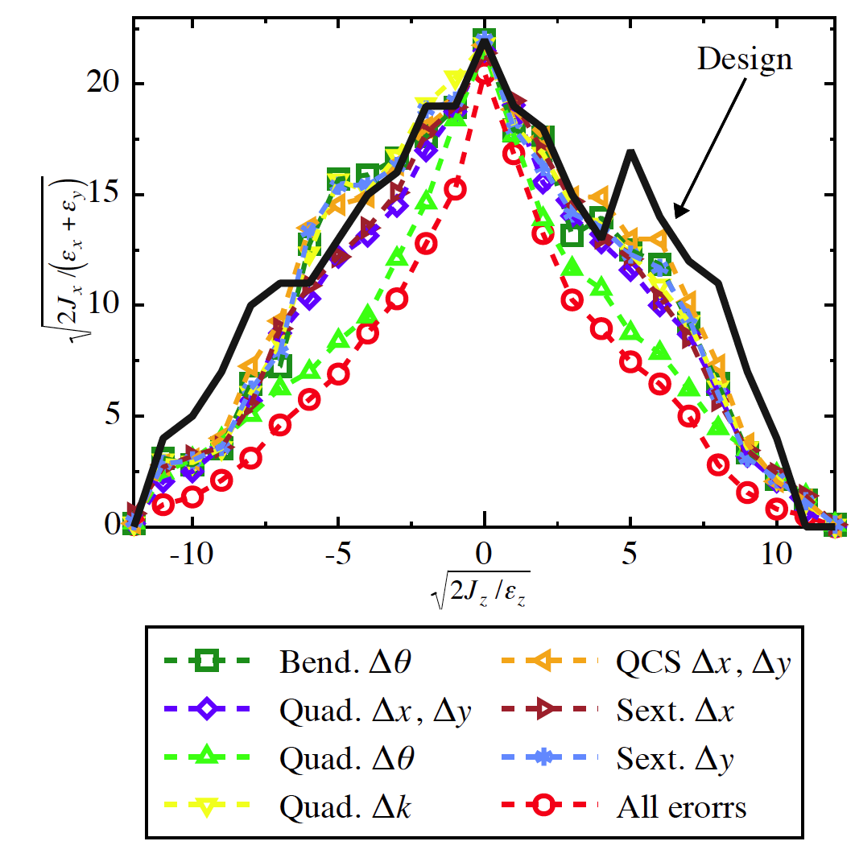
Dynamic aperture with different types of errors
No errors
Rotation errors of quadruples
seems most dangerous.
Each sextuple has a skew
quadrupole corrector coil.
We may have to rethink
tolerance of rotation errors
of normal quadrupoles.
H. Sugimoto

Slide 26
Magnet alignment strategy at SuperKEKB
The target positions of the initial alignment of SuperKEKB is a smoothed curve made from present (2013 )magnet positions (not on a plane).
The tolerance of magnets alignment around the target curve is the same as KEKB.
  Position error: 100 μm (1 σ)
  Rotational error: 100 μrad (1 σ)
    We have to rethink about this?
We will need special care for the alignment of the magnets around the local chromaticity correction.

Slide 27
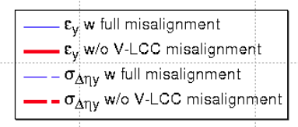
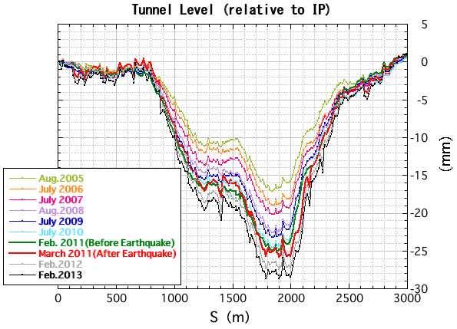
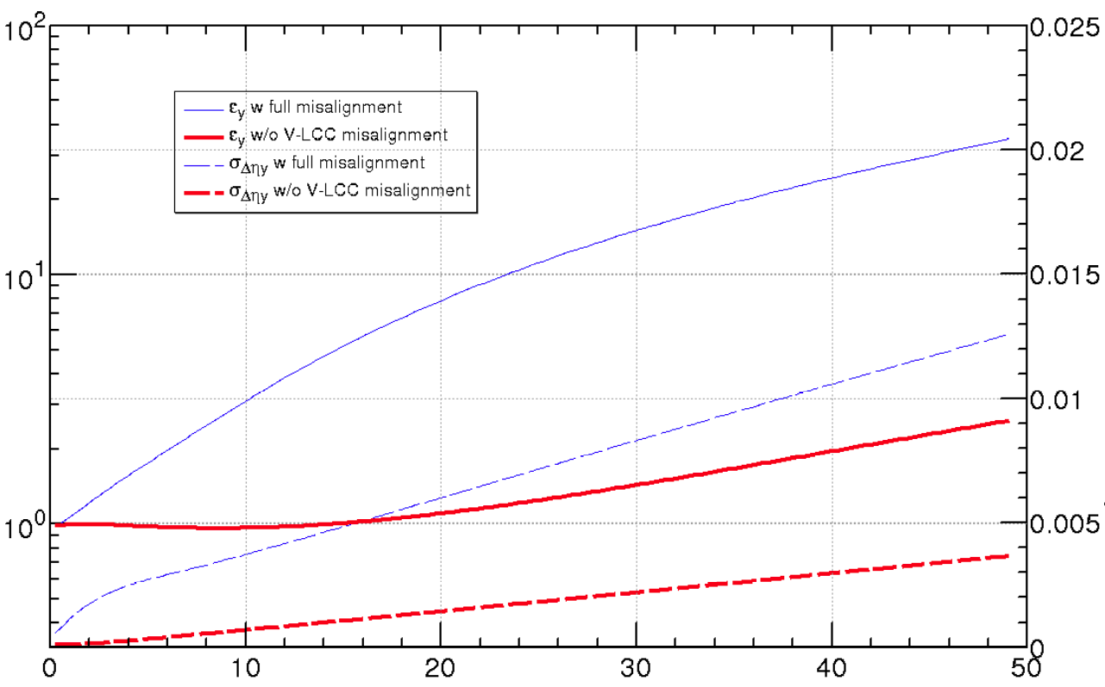



Effects of Tunnel deformation at SuperKEKB HER
Target (7.8pm)
A. Morita
Vertical emittance
-If the alignment error around the V-LCC
(vertical local chromaticity correction) area
is excluded, the vertical emittance can be
preserved well below the target value with
optics corrections.
- As for the alignment error of V-LCC, we
will need a special care. This is a remaining
problem.
Tunnel deformation observed at KEKB
- A large subsidence has been observed:
~ 2mm/year and still in progress.
- In the construction period of KEKB (1998),
all magnets were aligned on the same plane.

Slide 28
Beam-beam related issues
Beam lifetime shortening with beam-beam
Luminosity degradation
  The design luminosity was determined based on the strong-strong beam-beam simulation.
  Beam-beam + lattice nonlinearity and space charge effect

Slide 29
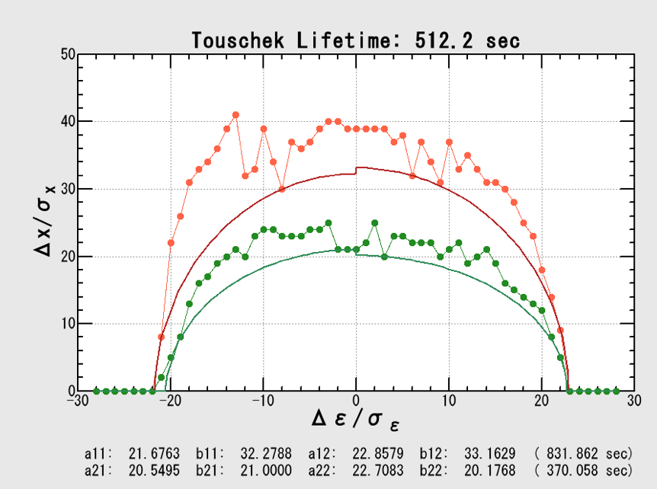
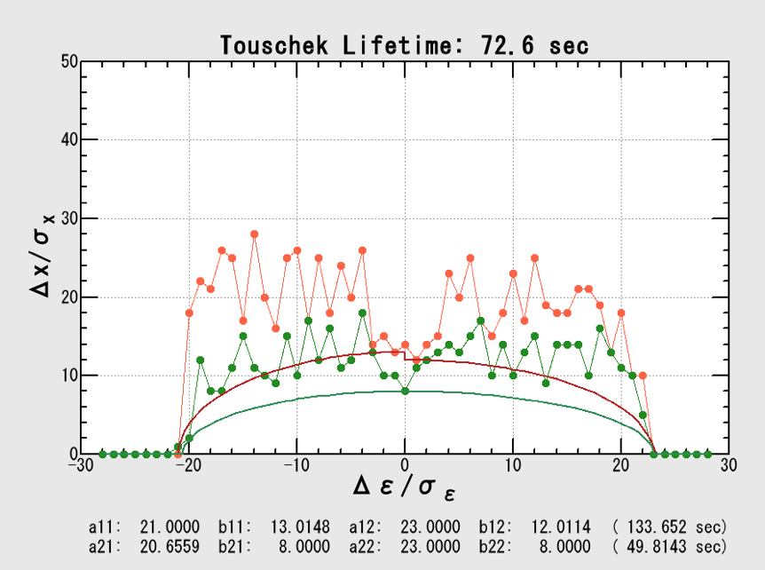
LER Dynamic Aperture
beam-beam
aperture
lost
Y. Ohnishi

Slide 30
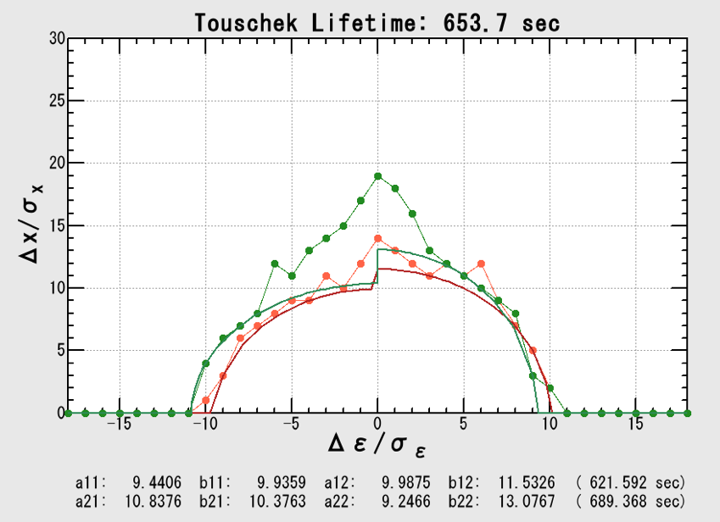
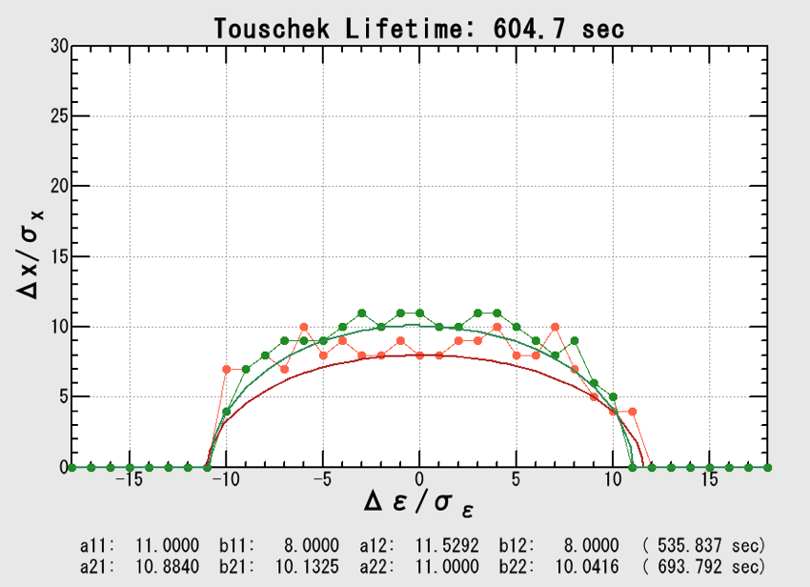
HER Dynamic Aperture
beam-beam
aperture
lost
Y. Ohnishi

Slide 31
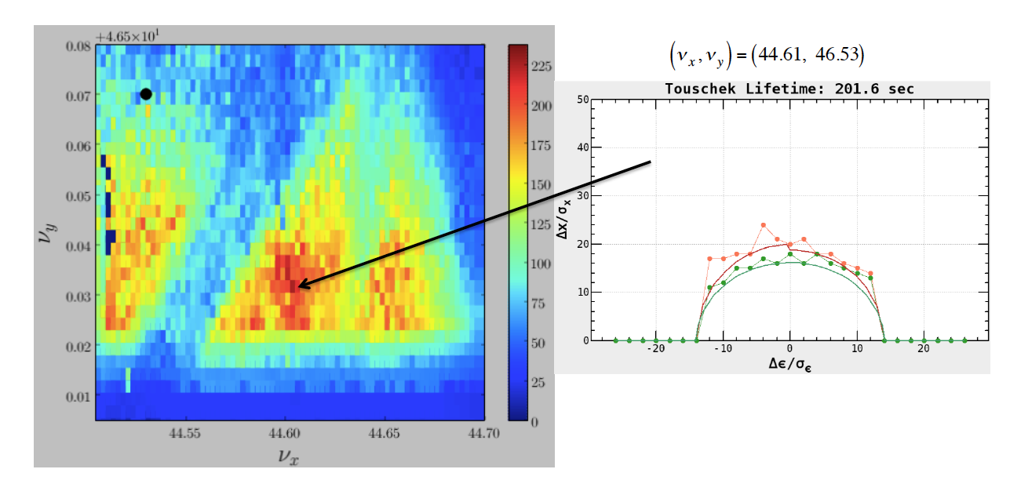
Tune survey (LER)
H. Sugimoto

Slide 32
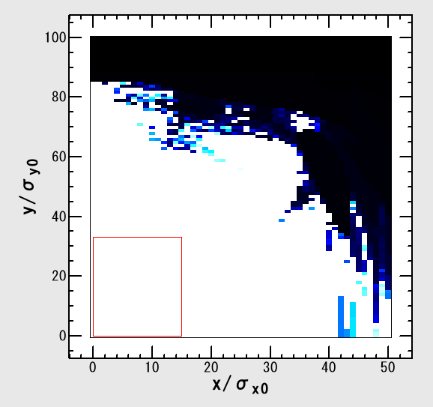
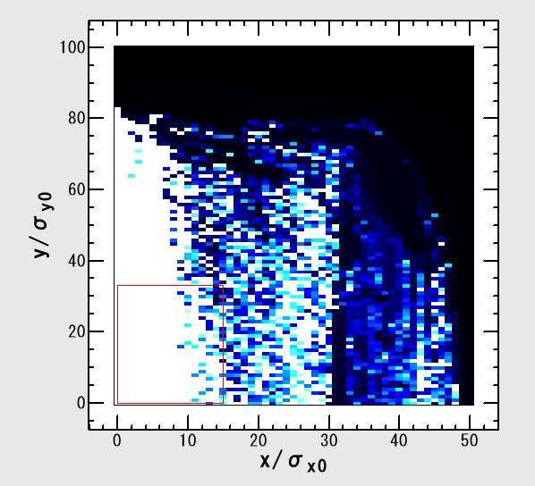
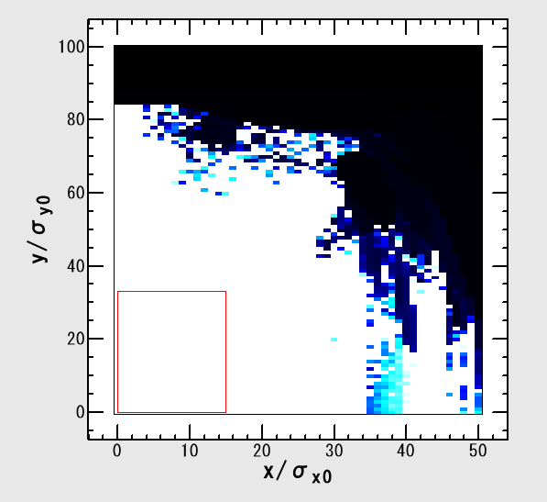
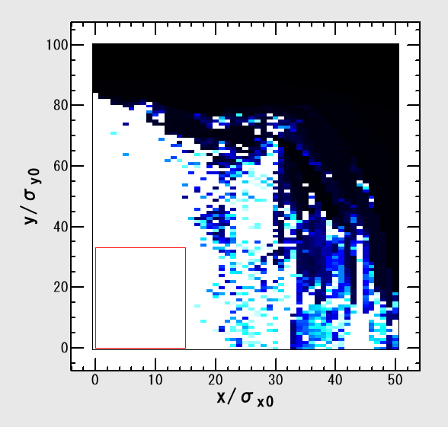
LER Dynamic Aperture
beam-beam
On-momentum
White > 1000turns
Black < 1 turn
w/ damping
w/o rad. Excitation
w/ synchrotron
motion
crab waist
(simple map
at IP)
full
half
Y. Ohnishi

Slide 33
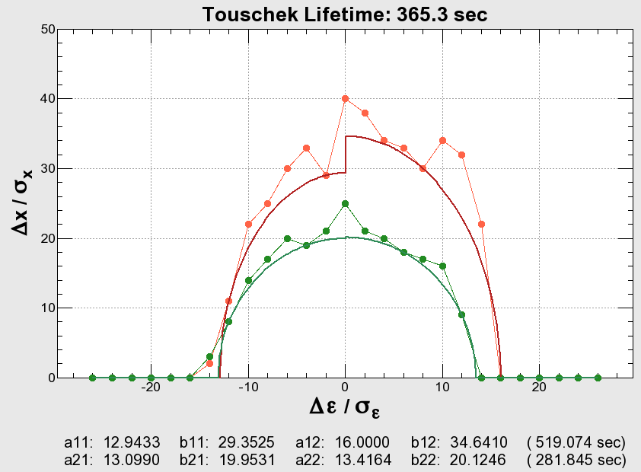
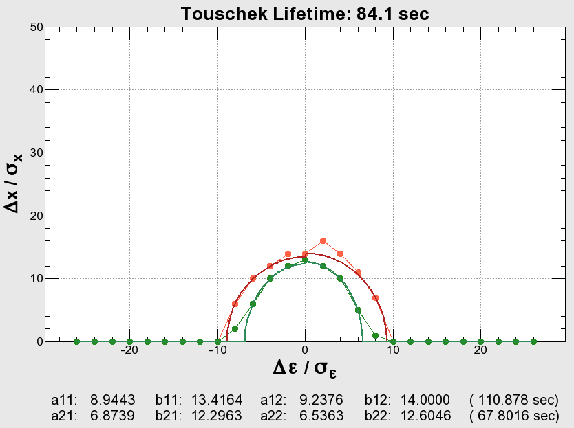
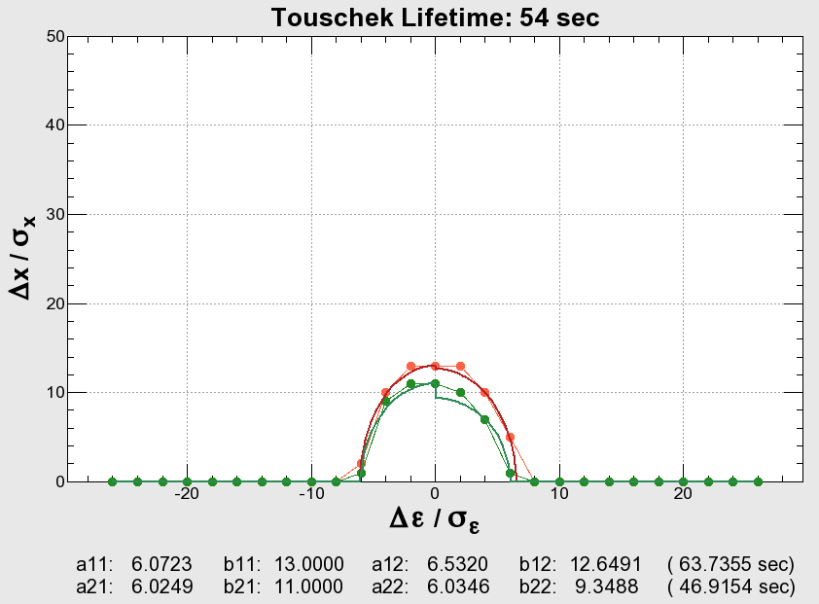
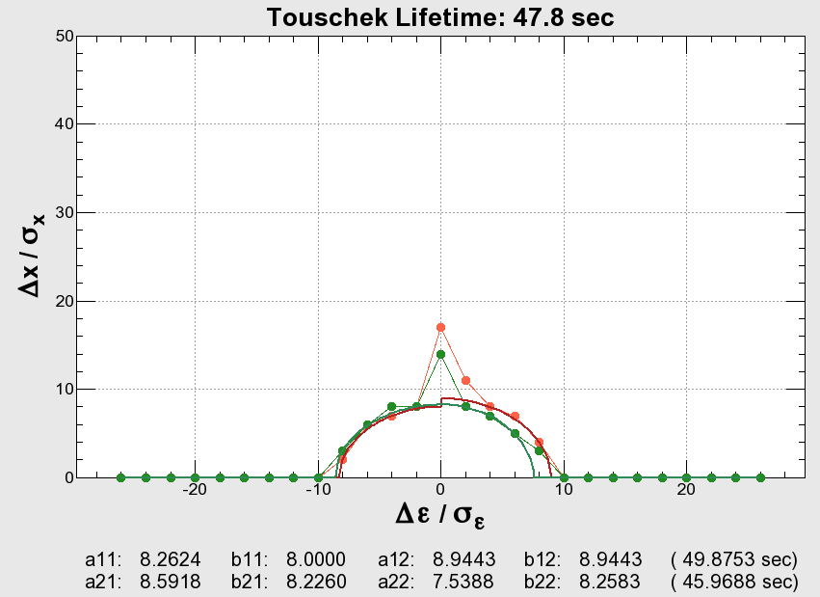
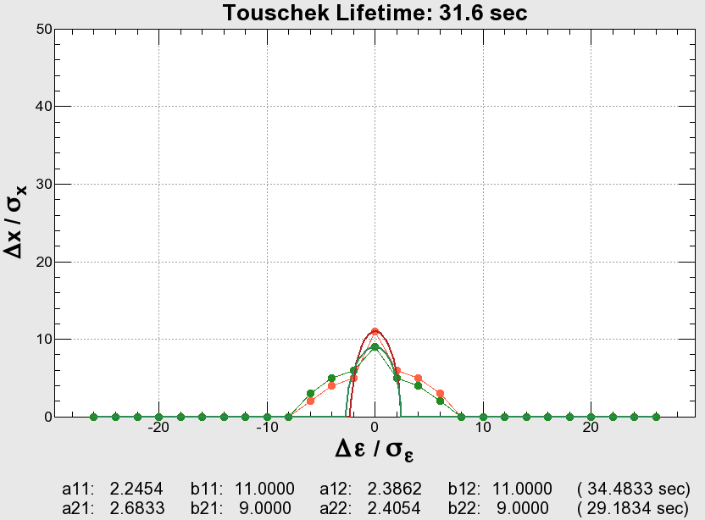
Preliminary results on dynamic aperture study with sextupoles for crab waist
0%
50%
100%
with optimization
with optimization
H. Koiso
50%
100%
before optimization
before optimization
We have considered that the crab waist scheme can not be used at SuperKEKB due
to the degradation of dynamic aperture. Now, we have started to study this scheme
more seriously.
We are collaborating with people in BINP.

Slide 34
SuperKEKB beam-beam simulation
SuperKEKB design
 | LER | HER
ε_{x} [nm] | 3.2 | 4.6
ε_{y} [pm] | 8.64 | 11.5
κ [%] | 0.27 | 0.25
SuperKEKB design luminosity
Strong-strong method (PIC)
For the long-rage force, the gaussian
distribution was assumed.
Smaller (single beam ) vertical emittance gives higher luminosity.
Much lower vertical emittance than the design (about half) will be needed to achieve the design luminosity.
K. Ohmi

Slide 35
Strong-weak simulation (tune survey)
D. Zhou

Slide 36
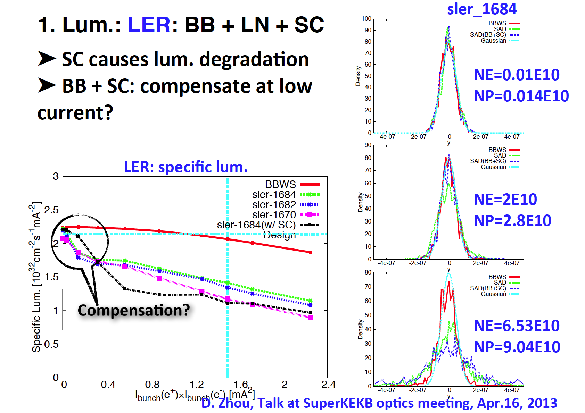

Slide 37
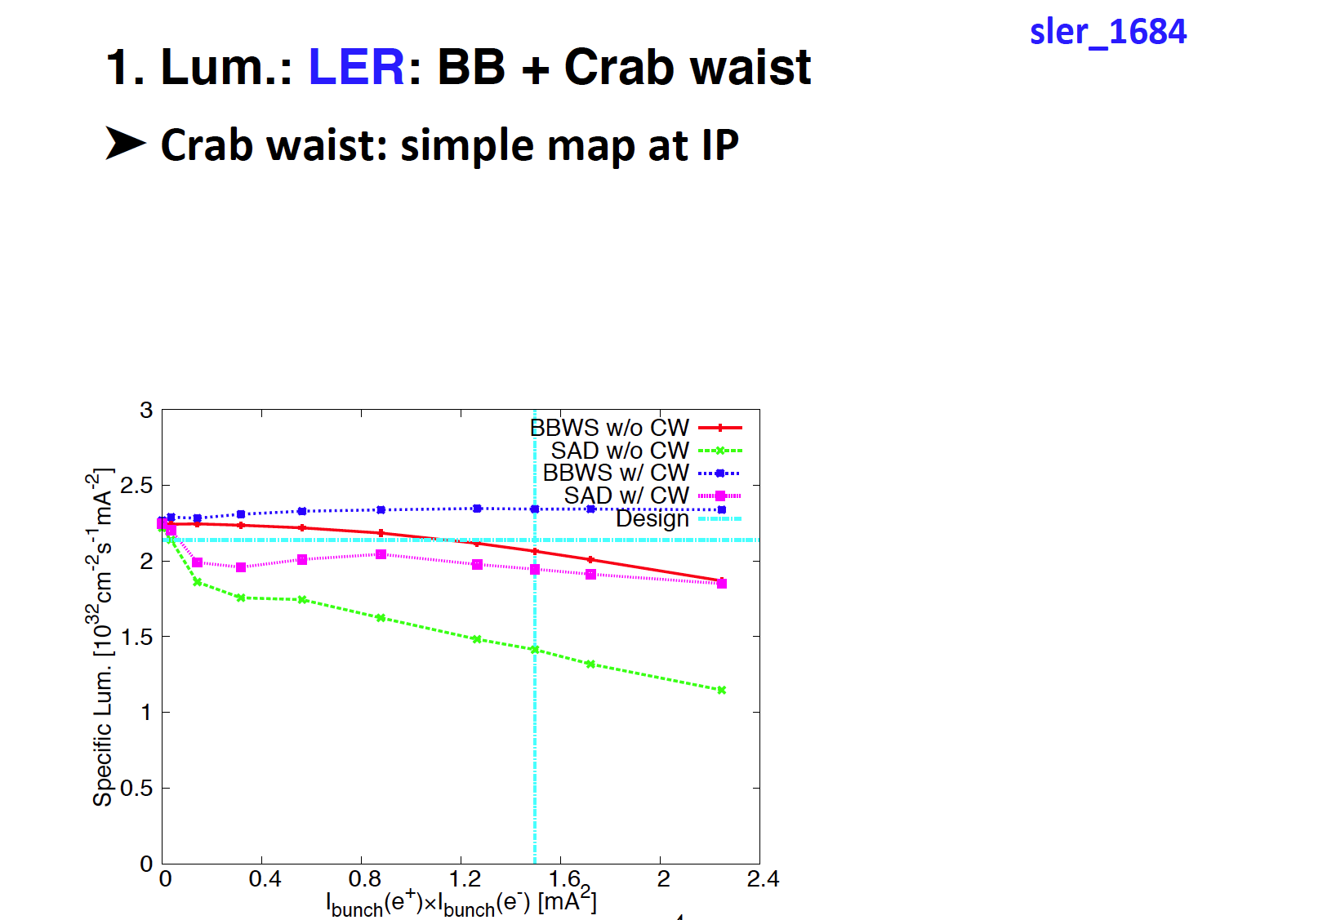
Crab waist seems to be effective to
recover also the luminosity.
D. Zhou

Slide 38
IP orbit control
The IP orbit control to maintain an optimum beam collision is more difficult than the KEKB case.
IP orbit is very sensitive to the vibration of QCS (QC1, QC2) magnets.
 | KEKB | SuperKEKB
ε_{y} | 150pm | ~8.6pm (LER)
β_{y}* | 5.9mm | 0.27mm(LER)
σ_{y}* | 940nm | 45nm

Slide 39
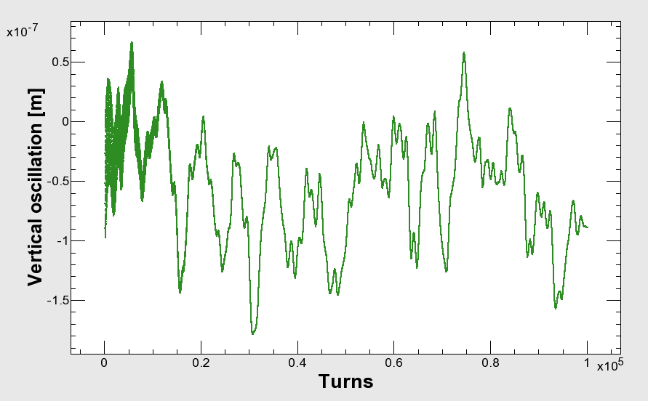
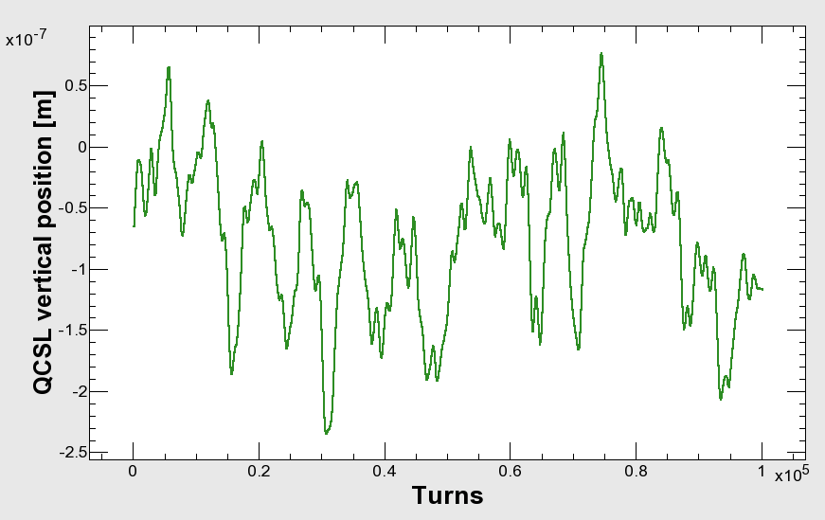
QCSL vertical position oscillation (measurement) and orbit change (tracking) : SuperKEKB HER
Vertical orbit at IP
(simulation)
QCSL vertical position
(measurement)
-> QC1L (HER)
200nm -> ~4σ_{y}*
If the QC1L magnets of SuperKEKB vibrates with the same amplitude
of the QCSL of the KEKB, the orbit change at IP amounts to 4σ_{y}*.

Slide 40
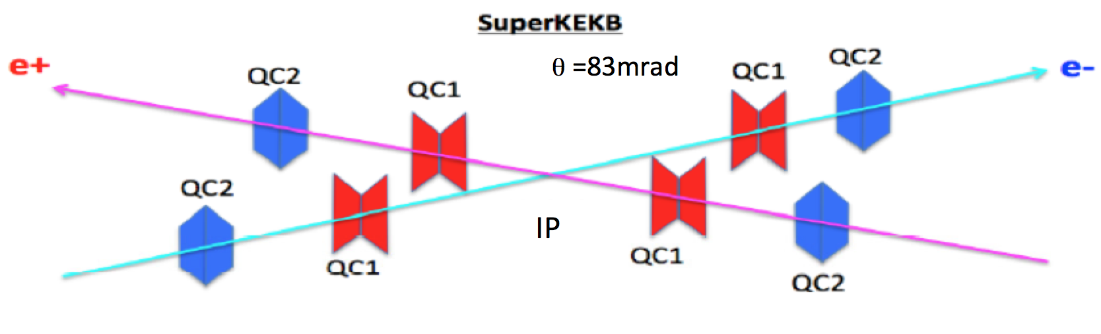
Countermeasures
Reinforcement of supports for QCS magnets
Rely on the coherency of the oscillation of QC1P and QC1E (QC2P and QC1E).
Fast orbit feedback

Slide 41
Orbit change at IP with 1μm offset of QCS magnets
Old optics
 |  | K1 (/m) | Distancefrom IP [m] | β_{Q} [m] | β_{IP}[mm] | Δψ_{y}/2π | COD@IPfor 1μm Q-offset [μm] (New optics)
QC1L | LER | -1.717 | 0.912 | 2504.3 | 0.27 | 0.24995 | -0.706 (-0.7339)
 | HER | -1.142 | 1.390 | 5462.4 | 0.3 | 0.24997 | -0.731 (-0.7684)
QC1R | LER | -1.712 | 0.912 | 2567.7 | 0.27 | 0.24996 | -0.713 (-0.7362)
 | HER | -1.070 | 1.430 | 5592.6 | 0.3 | 0.24997 | -0.693 (-0.7299)
QC2L | LER | 0.84161 | 1.9099 | 962.2 | 0.27 | 0.25004 | 0.2145
 | HER | 0.65023 | 2.6799 | 1923.3 | 0.3 | 0.25030 | 0.2470
QC2R | LER | 0.83924 | 1.9760 | 924.6 | 0.27 | 0.25005 | 0.2097
 | HER | 0.55577 | 2.9449 | 1806.9 | 0.3 | 0.25004 | 0.2046
>
>
>
>
COD
If QCS magnets for both rings move coherently, orbit difference of the two beam becomes much smaller (1/10 ~ 1/20) than non-coherent case.

Slide 42
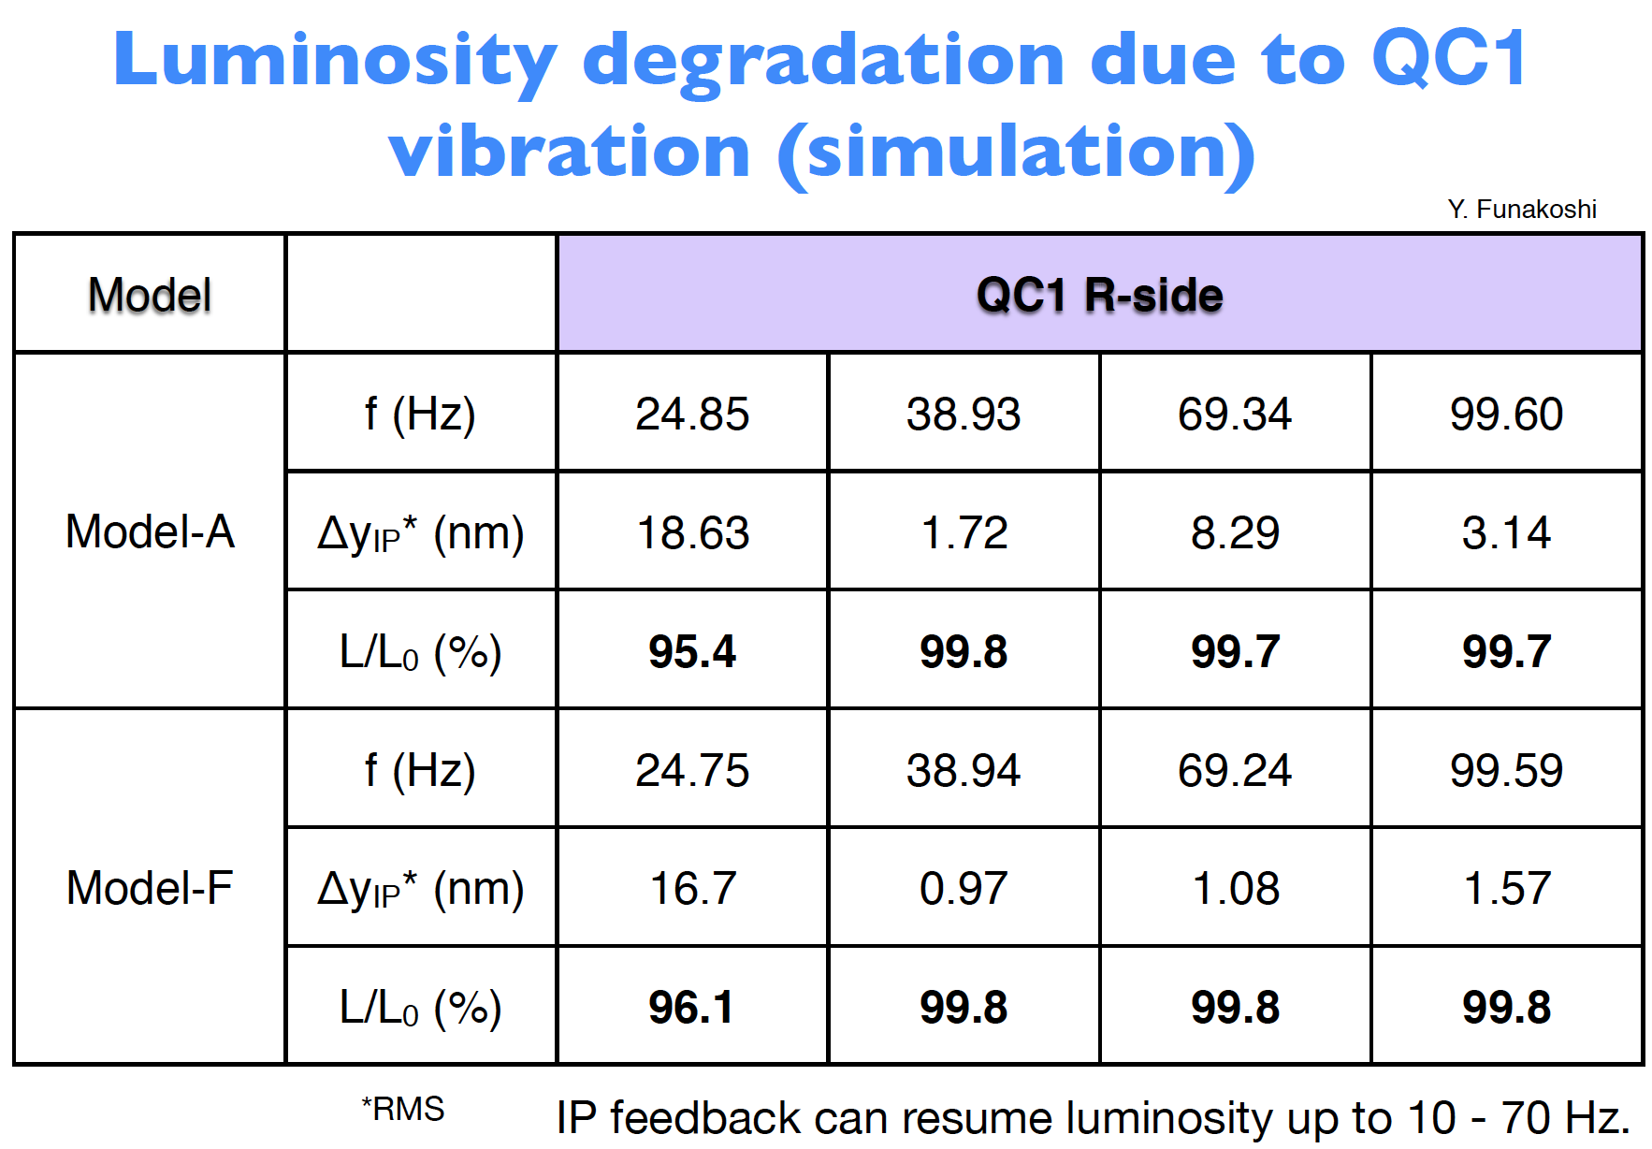

Slide 43
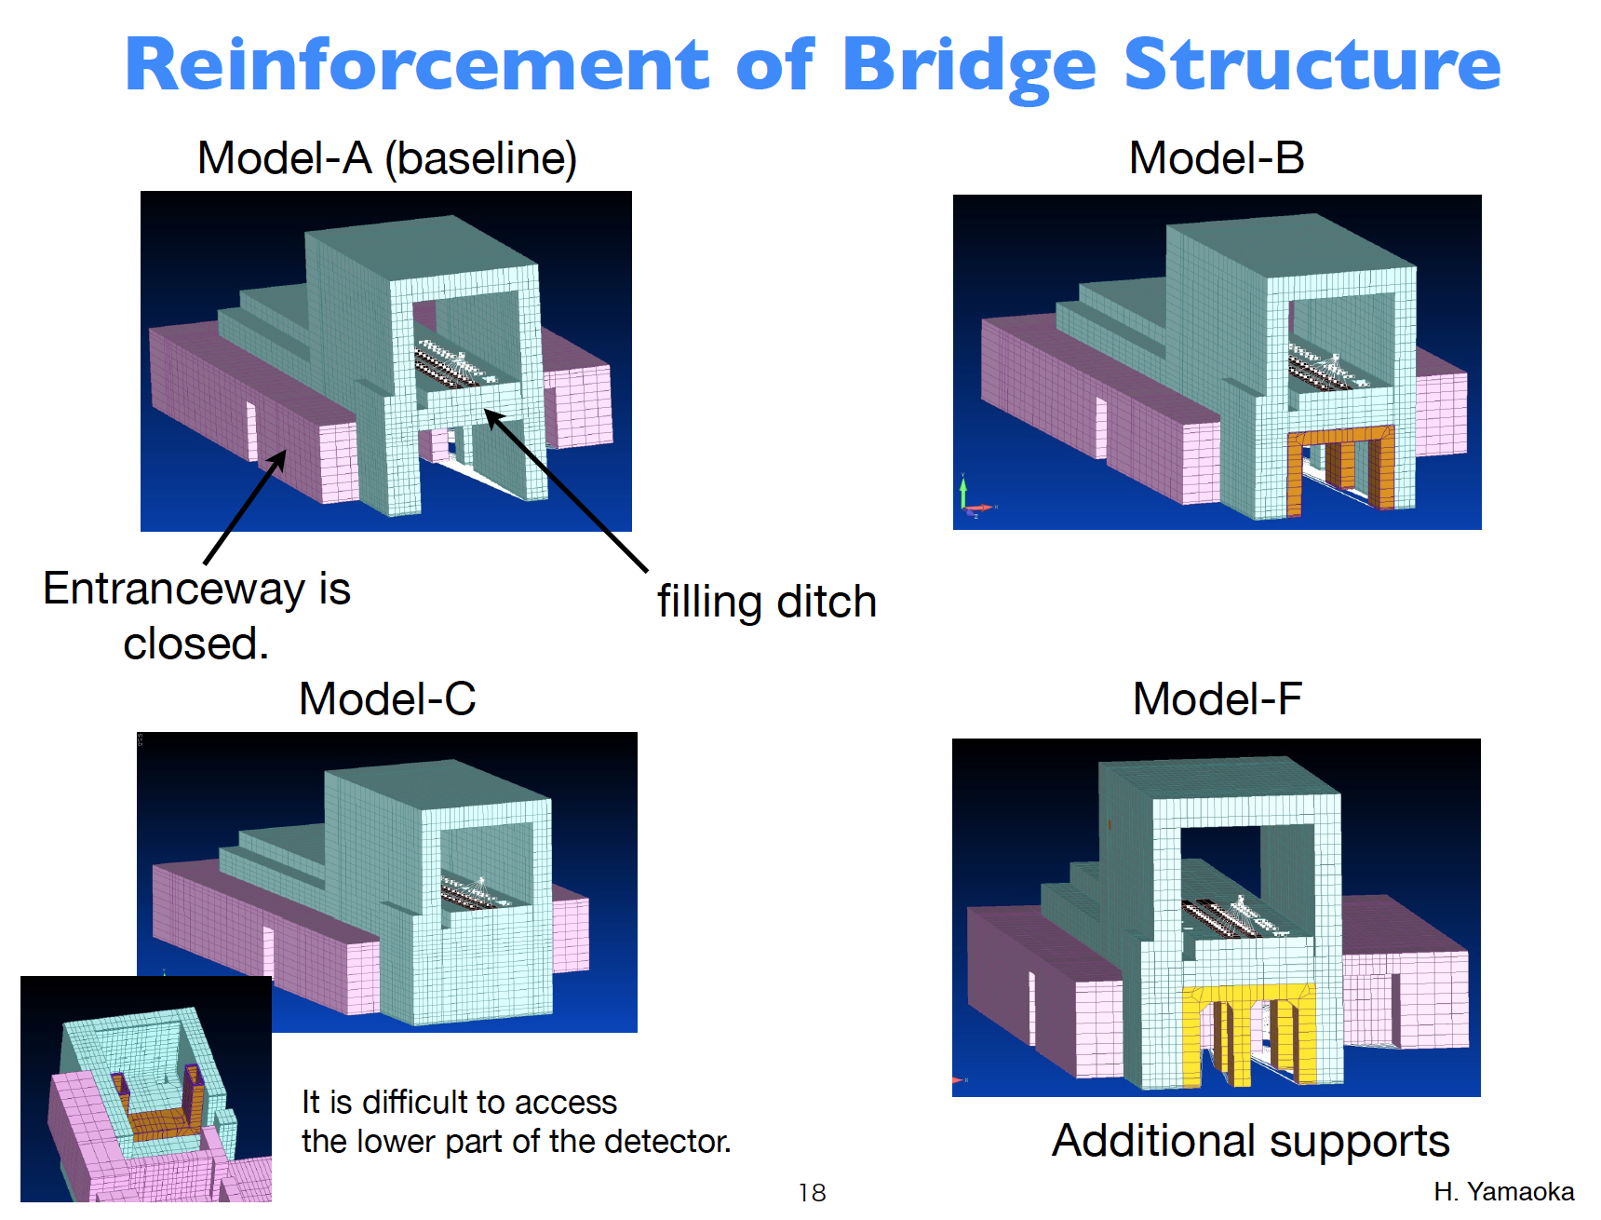

Slide 44
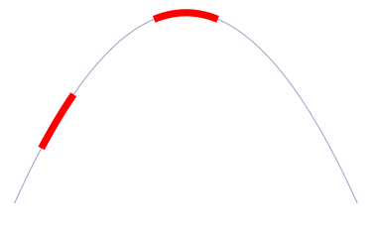
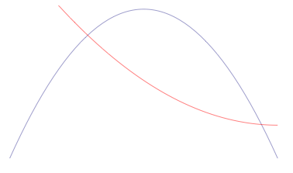
Orbit feedback at IP :Algorism
Beam-beam deflection (SLC, KEKB vertical)
Luminosity feedback (dithering)(PEP-II)
Beam size feedback (KEKB horizontal)
Δy at IP=
~5nm ~1/10σ_{y}*
BPM
Δy at BPM= ~1.3μm
IP
SupeKEKB case
BPM
When we shake the beam at around the peak of
the luminosity, there appears twice of the
frequency of the dithering frequency.
Luminosity
y
Luminosity
At KEKB before installation of crab cavities,
the vertical beam of LER was used for the
horizontal orbit feedback at IP.
Beam size
σ_{y} (LER)
x

Slide 45
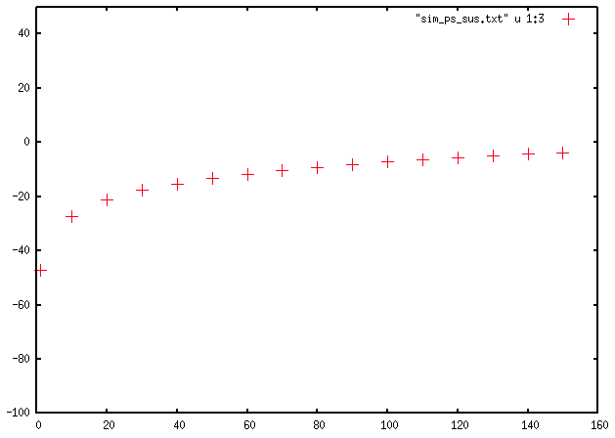
Rejection gain by fast orbit feedback
dB
~10dB@70Hz
-17.8dB@30Hz
Hz
H. Fukuma

Slide 46


Electron cloud issues
Y. Suetsugu
The single bunch instability is main concern.
  Leads to increase in emittance
  Coupled bunch instabilities will be cured by feedback system.
Simulation and calculation by Ohmi, et al.
K. Ohmi , KEK Preprint 2005-100 (2006)
Threshold of density
  Here,
E [GeV] | = 4.0
γ | = 7828 | N_{b} | = 6.25E+10
ν_{s} | = 0.026 | Q_{b}[C] | = 1.4E-08 | (1.4 mA/bunch)
 |  | S_{b} [m] | = 1.2 | (4ns)
σ_{z} [m] | = 6.E-03 | λ [C/m] | = 5.2E+12 | (Q_{b}/2/σ_{z})
c [m/s] | = 3.E+08 | σ _{y} [m] | = 2.E-05
K | = 11 | σ _{x} [m] | = 2.E-04
Q | = 7
r_{e} [m] | = 2.80E-15 | ω_{e} | = 5.46E+11 | K = ω_{e} σ_{z}/c
β _{y} [m] | = 25 | ω_{e} σ_{z}/c | = 10.9 | Q = Min(Q_{nl}, ω_{e} σ_{z}/c)
L [m] | = 3016 |  |  | Q_{nl} ~7
ρ_{th} [e⁻/m³] =1.59E11
Target: 1E11

Slide 47
Latest simulation result on the threshold value of instability
Simulation with PEHTS2 by D. Zhou and K. Ohmi
  With uniform beta functions and uniform electron cloud density along the ring, the threshold for electron cloud density is about 5.E11 m⁻³.
  With realistic beta functions and uniform electron cloud density along the ring, the threshold reduces to about 1.6E11 m⁻³.
  With realistic beta functions and estimated s-dependent electron cloud density along the ring, the threshold is about 5.E11 m⁻³.

Slide 48
Countermeasures
Y. Suetsugu
For the upgrade of the vacuum system for SuperKEKB, the electron cloud is a key issue.
Countermeasures are carefully chosen based on the various studies.
Drift section | Antechamber +Solenoid +TiN Coating
Q and Sx mag. | Antechamber +Solenoid +TiN Coating
Bend section | Antechamber +Groove+ TiN Coating
Wiggler section | Antechamber +Electrode (Cu)

Slide 49



Countermeasures for electron clouds
Groove
Drift section: Antechamber + TiN coating
Inside view
Wiggler section:
Antechamber + Clearing electrode
Electrode
Y. Suetsugu

Slide 50

Expected electron density
Y. Suetsugu
n_{e} after applying countermeasures: estimated from experiments (Red)
Compared with results of CLOUDLAND (Blue)
  δ_{max}=1.2, Solenoid field=50G (→n_{e}=0), Antechamber; photoelectron yield =0.01 (1/10)
n_{e} of approx. 1/5 of the target value is expected.
Condition | ne [m⁻³]
Circular Cu chamber [KEKB beam pipe] | 5.2E12
+Solenoid at Drift (1/50) | 4.7E11
+Antechamber (1/5)+TiN (3/5) | 5.7e10
+Electrode in Wiggler (1/100) | 3.5e10
+Groove in Bend (1/4) | 2.0E10
Target value for ne: ~1x10¹¹
KEKB~3x10¹¹
If the latest simulation result on the threshold is true, there is a margin of a factor 25!

Slide 51
Beam lifetime
 | KEKB (design) |  | KEKB (operation) |  | SuperKEKB
 | LER | HER | LER | HER | LER | HER
Radiative Bhabha | 21.3h | 9.0h | 6.6h | 4.5h | 28min. | 20min.
Beam-gas | 45h^{a)} | 45h^{a)} |  |  | 24.5min.^{b)} | 46min. ^{b)}
Touschek | 10h | - |  |  | 10min. | 10min.
Total | 5.9h | 7.4h | ~133min. | ~200min. | 6min. | 6min.
Beam current | 2.6A | 1.1A | 1.6A | 1.1A | 3.6A | 2.6A
Loss Rate | 0.12mA/s | 0.04mA/s | 0.23mA/s | 0.11mA/s | 10mA/s | 7.2mA/s
a) Bremsstrahlung
b) Coulomb scattering, sensitive to collimator setting
As for loss rate, beam loss accompanied with the beam injection should be added.

Slide 52



Slide 53


Continuous injection
At SuperKEKB, the continuous injection (top-up injection) is indispensable, since the beam lifetime is very short.
  Max. 50 Hz (e- + e+)
  Azimuthal VETO (at KEKB not azimuthal 3.5msec after injection)
8 hours
8 hours
Before continuous injection
After continuous injection
Gain in integrated luminosity at KEKB: ~30%

Slide 54





Beam background
At SuperKEKB with x40 larger Luminosity, beam background will also increase drastically.
  Touschek scattering
  Beam-gas scattering
  Synchrotron radiation
  Radiative Bhabha event: emitted γ
  Radiative Bhabha event: spent e+/e-
  2-photon process event: e+e-→e+e-e+e-
  etc…
Beam-origin
Luminosity dependent
e⁺
e⁻
e⁻
Notes:
In this slide, I have listed up variety of possible beam background sources at SuperKEKB.
Among these background sources, so-called “Touschek scattering” will be the most difficult one to cope with, which I will explain in more detail in the following slides.

Slide 55

Collimators
Vertical collimator
Horizontal collimators are effective to reduce Touschek BG in IR area
To reduce IR loss of beam-gas Coulomb BG, very narrow (~2mm half width) vertical collimator is required
TMC instability is an issue, low-impedance design of collimator head is important
Should withstand ~100GHz loss (tungsten)
Precise control of collimator width is important (otherwise IR loss rapidly increase)
Life time | Touschek | Beam-gas Coulomb | Rad. Bhabha
LER | 10 min. | 25 min | 28 min.
HER | 10 min. | 46 min. | 20 min.
IR loss |s|<4m | Touschek | Beam-gas Coulomb | Rad. Bhabha
LER | 250 MHz | 90 MHz | 0.6GHz*
HER | 30 MHz | <10 MHz | 0.5GHz*
*Effective rate

Slide 56

Tungsten shield inside QCS cryostat
QC2RE
QC1RE
QC1RP
QC2RP
Put as much tungsten as possible around the beam pipe
to stop showers generated by beam loss

Slide 57
Impact on detector
Assuming design luminosity, BG impact on detector performance(occupancy, tracking/PID performance etc..) is tolerable.
Assuming 10 years operation at design luminosity, most of our detector components are safe for radiation damage/neutron flux.
  except for TOP PMT photocathode lifetime, which needs further x2 reduction.
Gammas in BGshower reach TOP quartz bar and generate electrons by Compton scattering and etc.. Those electrons emit Cerenkov photons and those photons reach PMT photocathode.
TOP: Time-of-Propagation counter, detect ring image Cerenkov radiation for particle ID

Slide 58
Schedule

Slide 59

Notes:
The construction works for SuperKEKB is in full swing.

Slide 60

SuperKEKB luminosity projection
Goal of Belle II/SuperKEKB
Integrated luminosity
(ab⁻¹)
9 months/year
20 days/month
Commissioning starts
in early 2015.
Shutdown
for upgrade
Peak luminosity
(cm⁻²s⁻¹)
Calendar Year

Slide 61
Backup slides

Slide 62


Slide 63

Skew-sextupoles

Slide 64


Slide 65


Slide 66


Slide 67


Slide 68


Slide 69


Slide 70


Slide 71


Slide 72


Slide 73


Slide 74


Slide 75


Slide 76


Slide 77


Slide 78


Slide 79


RF Gun Development
RF Gun for Low-emittance Electron Beam
Ir₅Ce
Photo cathode : stability, longer life, efficiency
  At first LaB₆, then Ir₅Ce → 5nC / bunch
Laser : higher power, pulse width control
  Nd:YAG medium, LD excitation → ~1.5mJ / 30ps / pulse at 266nm
  Polarization control for slant irradiation
  In parallel, fiber laser is under development
Cavity : better focusing field, higher gradient
  DAW (Disk and washer) type cavity
  Development of quasi-travelling-wave side-coupled cavity as well
Test stands
  RFgun at A-1 will be constructed this autumn for SuperKEKB
  RFgun at 3-2 was used to inject into PF with proper synchronization
  Long-period demonstration will be carried during this autumn
DAW

Slide 80

Comparison of emittances of colliders [cont’d]
Future colliders
Existing colliders
LEP3
TLEP-H

Slide 81

R. Bartolini

Slide 82
Difference between SR rings and colliders
IR
  Detector solenoid and its compensation
  Low beta insertion
  Local chromaticity correction
Size of rings
  In larger rings, orbit drift tends to be large.
    Accuracy of optics measurement with orbit drifts
Beam-beam interaction
  Beam-beam blowup
  Restriction on choice of working point

Slide 83
Belle II Detector
KL and muon detector:
Resistive Plate Counter (barrel)
Scintillator + WLSF + MPPC (end-caps)
EM Calorimeter:
CsI(Tl), waveform sampling (barrel)
Pure CsI + waveform sampling (end-caps)
Particle Identification
Time-of-Propagation counter (barrel)
Prox. focusing Aerogel RICH (fwd)
electron (7GeV)
Beryllium beam pipe
2cm diameter
Vertex Detector
2 layers DEPFET + 4 layers DSSD
positron (4GeV)
Central Drift Chamber
He(50%):C2H6(50%), Small cells, long lever arm, fast electronics

Slide 84





Model-A
R側
L側
Oscillation phases of
QC1RP and QC1RE.
25nm@20Hz
14nm@50Hz

Slide 85


f =24.75Hz (Model F)

Slide 86



24.75Hz (Model A)
The average luminosity is about 95.4%
of the case w/o QCS vibration.

Slide 87
IP machine parameters
 | KEKB |  | SuperKEKB
 | LER | HER | LER | HER
ε_{x} | 18nm | 24nm | 3.2 | 5.0
ε_{y} | 0.15nm | 0.15nm | 8.6pm | 13.5pm
κ | 0.83 % | 0.62% | 0.27% | 0.25%
β_{x}* | 120cm | 120cm | 32mm | 25mm
β_{y}* | 5.9mm | 5.9mm | 0.27mm | 0.31mm
σ_{x}* | 150μm | 150μm | 10μm | 11μm
σ_{x}’* | 120μrad | 120μrad | 450μrad | 320μrad
σ_{y}* | 0.94 μm | 0.94μm | 48nm | 56nm
σ_{y}’* | 0.16mrad | 0.16mrad | 0.18mrad | 0.22mrad
iBump horizontal offset |  | +/- 500μm |  | +/- 30μm?
iBump vertical offset |  | +/- 150μm |  | +/- 7.5μm?
iBump vertical angle |  | +/- 0.4mrad |  | +/- 0.4mrad?
~1/4
~1/4.5
~1/20

Slide 88
Facilities
88
M. Ono
Storage and staging areas needed for magnet and vacuum components.
Need increased cooling water for klystrons and magnets:
  24 klystrons for ARES cavities, 8 klystrons for SCC
  Magnet cooling water needs double (4 plants -> 8)
Electricity:
Electricity Consumption: June-09
KEKB/KEK total
(Design option) | KEKB:MW | ΔMW | KEK:MW | ΔMW
Present(Average) | 45 |  | 64
Nano Beam: June-09 | 70.7 | 24.3 | 96 | 32
Upgrade: Feb.-09 | 94.8 | 49.8 | 120 | 56
Super: ‘07-July | 102.6 | 57.6 | 128 | 64
Recent Design(Feb.-10): Add 2 ARES units--> +(3~4)MW

Slide 89
Overall budget (original)
Budget
  Total construction budget is 314 Oku-Yen for Rings, Injector, and Belle-II.
  Most of the budget comes year-by-year based.
  Operation budget is expected in FY2014 and later.
JFY2010
JFY2011
JFY2012
JFY2013
JFY2014
JFY2015
JFY2016
Very Advanced Research SP (100 Oku-Yen)
SuperKEKB commissioning
Other budgets for construction (214 Oku-Yen)
We are here
Operation budget (continues - - - )
Unit: Oku-Yen (~1.1M$)
JFY2010 | JFY2011 | JFY2012 | JFY2013 | JFY2014 | Total
75.0 | 10.5 | 14.5 | 0 | 0 | 100.0
0 | 41.6 | 40.2 | 61.6 | 46.7 | 190.0
0 | 4.5 | 12.4 | 7.2 | 0 | 24.1
75.0 | 56.6 | 67.1 | 68.8 | 46.7 | 314.1
Supplied | Supplied | Supplied
VARSP
Others
Buildings
Total
Status

Slide 90

Effect of mis-alignment of SX and Q
HER(Quad rotation)
  Coupling term: .0010816287630558967
  Dispersion term: 3.748599954860665e-05
HER(Sextu vertical misalignment)
  Coupling term: .044995709319378976
  Dispersion term: .0045765442050508375
Notes:
（３）南アークはPSの建物の下を通っている。他は開削して埋め戻しているがここは添付資料にあるようについたてをつくって埋め戻している（添付資料の１頁目：IWAA2012山岡さんの発表より）。
トンネルの下にちゃんと埋め戻し土が入って行かなかったのではないか。

Slide 91


Slide 92


Slide 93


