Slide 1
Comments on CLIC Phase Stability
D. Schulte

Slide 2
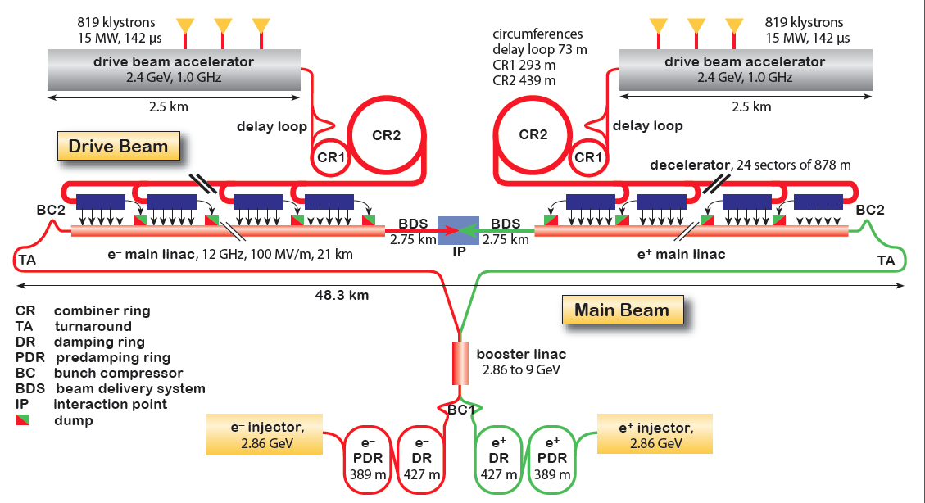
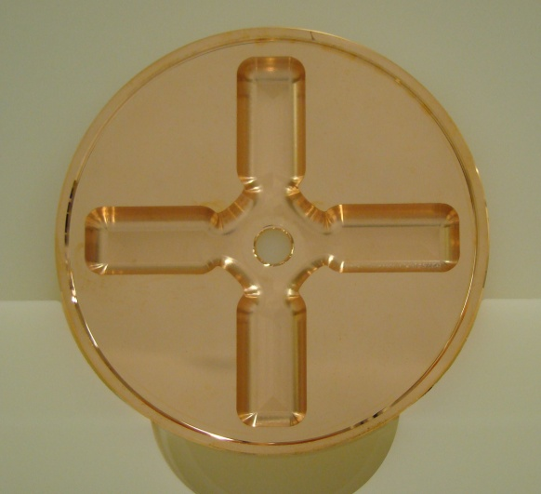
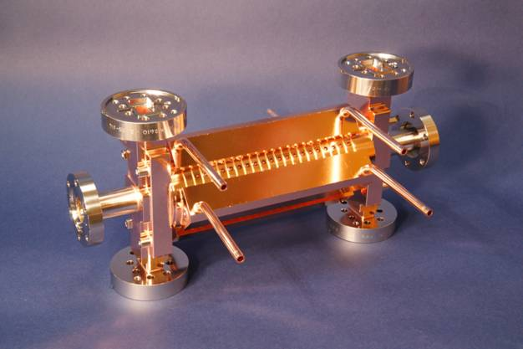
CLIC Layout at 3 TeV
Drive Beam Generation Complex
Drive beam time structure - initial
Drive beam time structure - final
240 ns
240 ns
5.8 μs
140 μs train length - 24 × 24 sub-pulses
4.2 A - 2.4 GeV – 60 cm between bunches
24 pulses – 101 A – 2.5 cm between bunches
Main Beam Generation Complex

Slide 3
Main Beam to Main Beam Phase Error
Most important jitter source is BC2 RF -> need phase alignment over 50km (<0.6° for 1% luminosity loss, 42μm, 140fs)
Equivalent to 0.4° over 25km (assuming central clock is master)

Slide 4
Drive Beam Phase Tolerance
Main to drive beam timing error
14μm (0.2°, 50fs) coherent error along the whole main linac
40μm (0.6°, 150fs) if jitter changes from from decelerator sector to decelerator sector

Slide 5
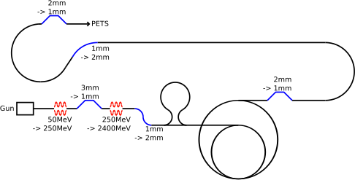
Drive Beam Requirements
Emittance ε_{x,y} ≤ 150μm
Transverse jitter ≤ 0.3σ
Current stability 0.75 •10⁻³
Phase stability 0.2° @ 12GHz
Bunch length stability 1%
RF power stability 0.2%
RF phase stability 0.05°
Phase stability 2.5° @ 12GHz
0.2° @ 1GHz

Slide 6
Main Beam Phase Reference
Compare and correct drive beam phase with respect to outgoing main beam

Slide 7
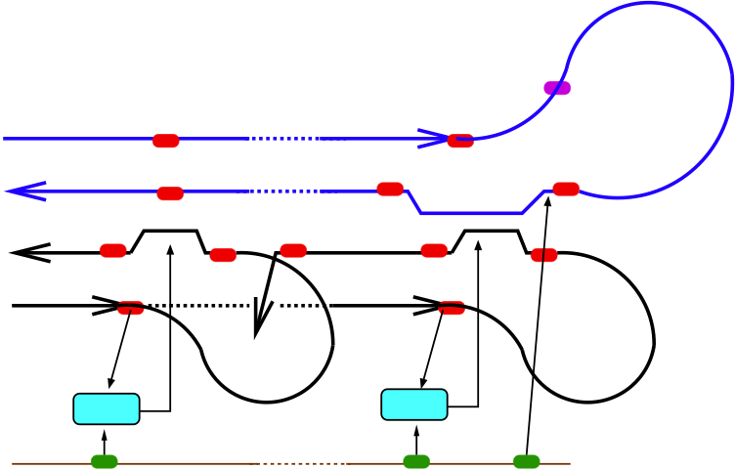
External Phase Reference
Compare a correct drive beam phase with respect to external reference system

Slide 8

External Phase Reference II
Pulse-to-pulse feedback adjusts the setpoints for the feed forward

Slide 9
External Reference System
Chain of reference lines
Random walk error propagation along the line
Additional local extraction error
DESY demonstrated 3μm over ~800m (RF to RF)
Require σ≤3μm phase drift per 900m segment
Main beam to main beam error ~7σ=21μm
Relevant main to drive beam offset ~3-5σ=9-15μm (larger RF phase at the end of the linac)
Direct optical-to-optical transition might be better

Slide 10
Main Hardware Components
RF systems
Measurements of errors
Modelling of errors
Improvements
Feedbacks/feedforwards
Lattice designs
Component design (phase monitor, kickers amplifiers)
Component and beam tests
Timing reference system
Local system shown in EUROTeV
Coupled clock system to be developed

Slide 11
Activities
Past activities
Development of local phase reference
Ongoing activities
Beam phase jitter measurements in CTF3
Klystron phase jitter measurements at different locations
Modelling of expected modulator jitter
Feedforward test in CTF3
Phase monitors
Fast kickers and amplifiers
Beam test
Development of phase stabilisation concept, beam dynamics studies
Foreseen activities
Distributed phase reference system

Slide 12
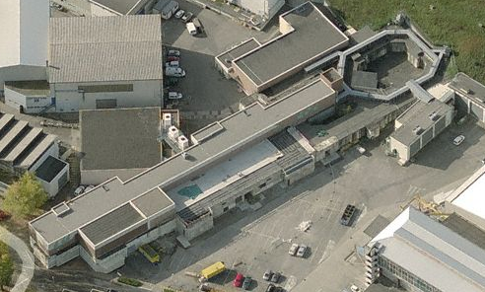
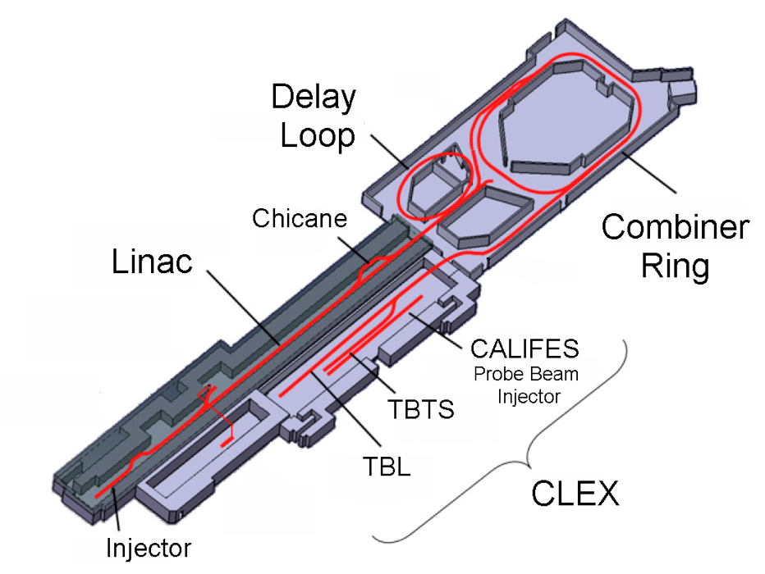
CLIC Test Facility (CTF3)
Operation of isochronous lines and rings
4 A, 1.4us
120 MeV
30 A, 140 ns
120 MeV
High current, full
beam-loading operation
Beam recombination and current multiplication by RF deflectors
12 GHz power generation by drive beam deceleration
High-gradient two-beam acceleration
30 A, 140 ns
60 MeV
Bunch phase coding

Slide 13
Reserve

Slide 14
RF Plan
CTC-RF (E. Jensen)
Task3: DB LLRF design
Design of LLRF system for DB with optimization for phase and amplitude stability; Designs, measurements at other plants, modelization tools 2011-2016
Will this be enough to cover other LL RF stability issues?
RF-DESIGN (A.Grudiev, I. Syratchev)
Task 5: Design of X-band crab cavity RF system
Design of crab cavity and the corresponding high power RF system 2012-2016
Does this cover crab cavity low level RF?

Slide 15
Lattice Design/Beam Physics Plans
CD-DR Damping (Yannis Papaphilippou)
Task 2: Correction techniques
Determine dynamic tolerances and requirements for the feedback; report 2011-2016
Should make sure this contains phase stability
CD-RTML (Andrea Latina)
Main beam jitter sources
Bunch compressors (with RF)
Main beam feedback/feedforward implementation
CD-DRV (Bernard Jeanneret)
Drive beam jitter sources
Bunch compressors
Drive beam feedback/feedforward implementation
CD-BDS (Rogelio Tomas)
Crab cavity phasing
Integration with RF studies?

Slide 16
Timing Reference Plans
CTC-CO (M. Draper)
Task1: Timing reference, timing distribution and 10 fs synchronization
Review of specifications, design of fine-timing system, first practical demonstration
Specifications, Designs, Lab set-up of master-clock and distribution system
Timing reference for CTF3?
Provide models for integrated studies 2012-2014
Are both timing system options covered?

Slide 17
Test Plan (and Components)
CTF3-002 Drive Beam phase feed-forward and feedbacks (P. Skowronski)
Task 1: Drive Beam phase monitors
Understand sources of drive beam phase jitter
Used in feedbacks and feed-forward test
Drive Beam phase monitor prototype, phase monitor small series (2-3), electronics and acquisition; Monitor proto 2011 – 4Q, Monitor series: 2013 – 2Q
Task 2: Feed-forward kickers
Two strip-line kickers; 2012 – 4Q
Task 3: Feed-forward pulsers
Fast amplifiers for the two kickers
Fast electronics; 2013 – 4Q ?
Task 4: Infrastructure and operation
Cabling, infrastructure, controls, operational support; distributed 2012-2016

Slide 18
Integration Plans
WP: CD-LUMI, Feedback Design (DS)
Task 1: Determination of feedback layout
Integrate area feedback systems into one coherent set of feedback systems; Baseline feedback layout 2011-2016
Task 2: Controller design
Develop, adjust and optimise controller for performance, cost and risk; 2011-2016
Task 6: Phase and amplitude stability
Objective: Develop an integrated concept to mitigate drive and main beam phase and amplitude errors Description: Determine the impact of hardware on beam phase and amplitude stability In collaboration with hardware experts identify critical hardware and required R&D
Identify and follow relevant beam tests
Design feedback and feed-forward systems
Optimise beam line design for stability

Slide 19
Instrumentation Plans
CTC-BDI: (T. Lefevre)
Task 3b: Longitudinal Emittance measurements
Development of 20fs time resolution longitudinal profile monitor using EO techniques. Prototype of each monitor End 2014
Development and test of cheap high resolution bunch length monitor based on Coherent Diffraction Radiation Prototype of each monitor End 2016
Only bunch length but not phase covered in BDI
Energy measurements to be checked

Slide 20
Main Cause of Beam Phase Jitter
RF errors and bunch compression

Slide 21
Main Timing Tolerances
Main beam to main beam timing error
40μm (0.6°, 150fs) [=20μm shift of collision point]
Main to drive beam timing error
14μm (0.2°, 50fs) coherent error along the whole main linac
40μm (0.6°, 150fs) if jitter changes from from decelerator sector to decelerator sector
Crab cavity to crab cavity timing error
0.8μm (0.01°, 3fs)
Each tolerance leads to 1% luminosity
loss, so would like even better values

Slide 22
Main Beam Tolerances
 | MB ref. | Ext. ref.
Energy jitter from damping ring | 2x10⁻⁴ | 4x10⁻⁴
Phase jitter from damping ring | 0.2° | 0.35°
Phase error of BC1 RF @4GHz | 0.08° | 0.14°
Gradient error booster linac | 1x10⁻³ | 1x10⁻³
Phase error of BC2 RF @ 12GHz | 0.2° | 0.2°
Could gain a factor if main beam is used as a reference if we use a collision waist feedforward

