Slide 1
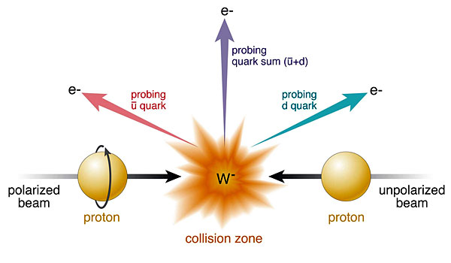



Transverse single-spin asymmetries in W± and Z⁰ bosons production in p+p collisions at RHIC
Salvatore Fazio (Brookhaven National Lab)
for the STAR Collaboration
DIS 2014 – April 28 to May 2 2014

Slide 2
Plan of the talk
Physics motivations
The W± selection and A_{N} measurement
The Z⁰ selection and A_{N} measurement
Future plans
Conclusions

Slide 3
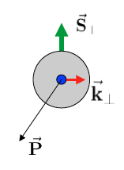
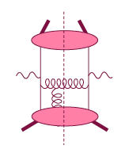
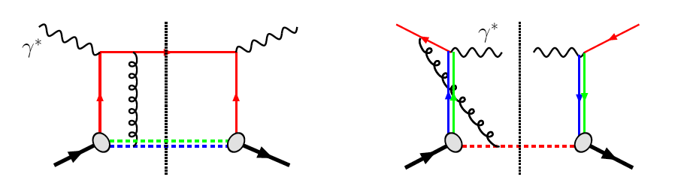
The much discussed sign change of the Sivers’ function
Motivations
Intermediate Q_{T}
Q>>Q_{T}/p_{T}>>Λ_{QCD}
Transverse
momentum
dependent
Q>>Q_{T}>=Λ_{QCD}
Q>>p_{T}
A_{N}
Collinear/
twist-3
Q,Q_{T}>>Λ_{QCD}
p_{T}~Q
Efremov, Teryaev;
Qiu, Sterman
Sivers fct.
Λ_{QCD}
<<
Q_{T}/P_{T}
<<
Q
Q_{T}/P_{T}
A_{N}(direct γ) measures the sign change through Twist-3
QCD:
DIS: γq scattering
attractive FSI
pp: annihilation
repulsive ISI
TMDs need 2 scales Q² and p_{t}
Remember pp: most observables one scale
Exception: DY, W/Z
Twist-3 needs only 1 scale Q² or p_{t}
But
should be of reas. size.
Applicable to most pp observables A_{N}(π⁰/γ/jet)
Sivers_{DIS} = - Sivers (DY or W or Z)
critical test for our understanding of TMD’s and TMD factorization
Goal: measure sign change and pin down TMD-evolution by measuring A_{N} for γ, W±, Z⁰, DY

Slide 4
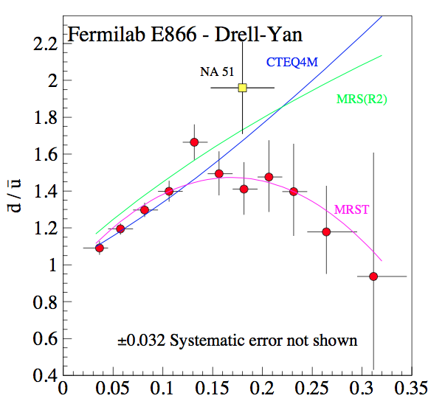
Motivations
Unpolarized asymmetries: Quantitative calculation of Pauli blocking does not explain ratio
→ Non-pQCD effects are large for sea quarks
Polarized asymmetries: valence quarks distributions well determined from DIS measurements
x
The W±/Z⁰ transverse asymmetry:
Very high Q²-scale (~ W/Z boson mass)
No fragmentation function
Asymmetry from lepton-decay is diluted
→ Full kin. reconstruction of the boson needed
Processes:
W → e v_{e}
Z⁰ → e⁺ e⁻

Slide 5
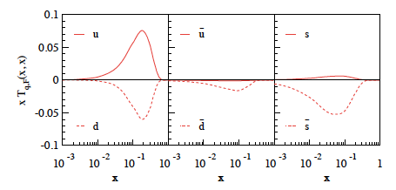
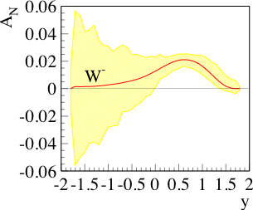
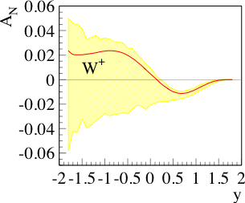
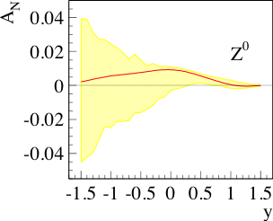
Motivations
Uncertainties not shown
Z⁰ easy to reconstruct (but small cross section)
W kin. can be reconstructed from the hadronic recoil (first time at STAR)
HERMES, COMPASS and JLab data not very sensitive to the sea quark Sivers because of their limited x-range
W± data can constrain the sea-quark Sivers
Sea quarks are mostly unconstrained
but they can give a relevant contribution!
M. G. Echevarria, A. Idilbi, Z-B Kang, and I. Vitev arXiv:1401.5078
Error bands use positivity bounds for the sea quarks
0 < p_{T} <3 GeV

Slide 6
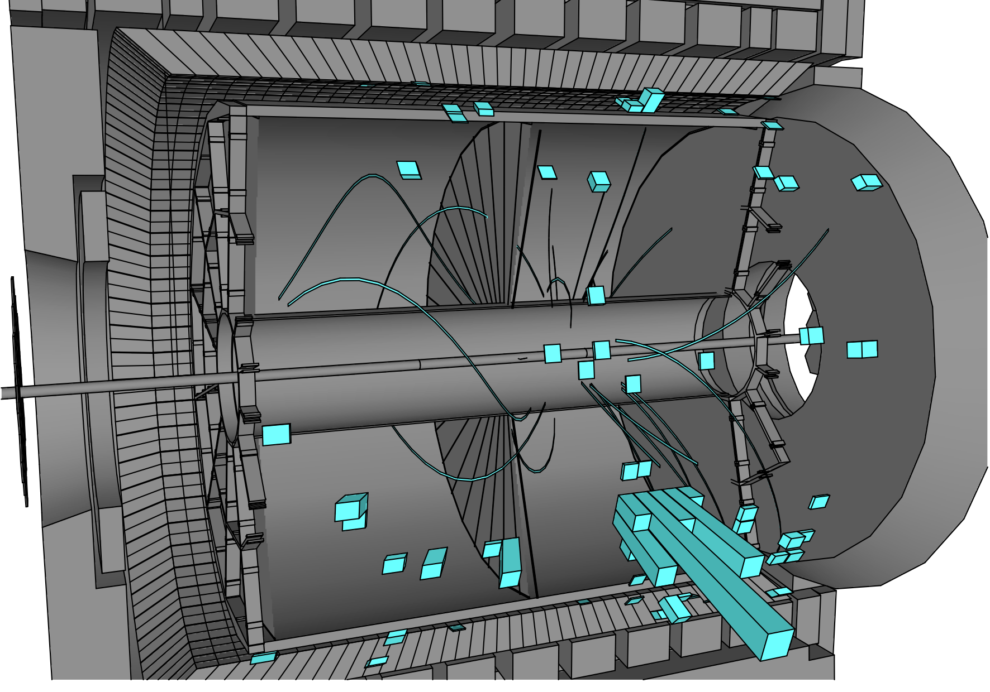
The STAR detector @ RHIC
Time Projection Chamber
(|η| < 1.4)
Barrel EMCAL
(|η| < 1)
Solenoid Magnet (0.5 T)

Slide 7
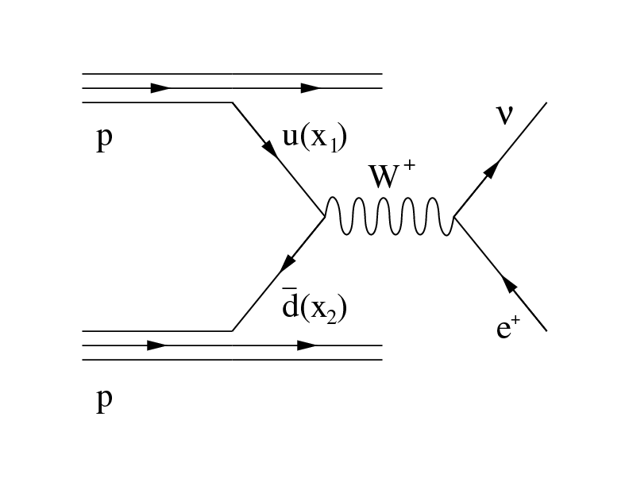
Strategy
Ingredients for the analysis
Isolated electron
Ingredients for the analysis
Ingredients for the analysis
Isolated electron
neutrino (not measured directly)
Ingredients for the analysis
Isolated electron
neutrino (not measured directly)
Hadronic recoil
Select events with the W-signature
  Isolated high P_{T} > 25 GeV electron
  Hadronic recoil with total P_{T} > 18 GeV
Neutrino transverse momentum is reconstructed from missing P_{T}
Neutrino’s longitudinal momentum is reconstructed from the decay kinematics

Slide 8
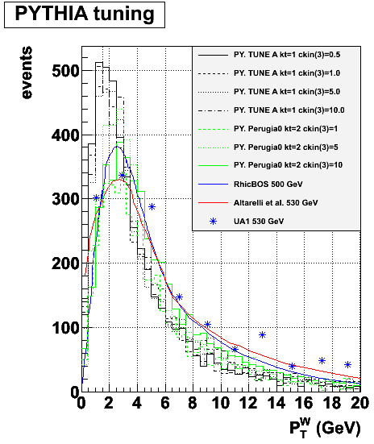
Data & MC
Monte Carlo
PYTHIA reconstructed trough GEANT simulated STAR detector
Perugia tune with hard P_{T} > 10 GeV
PYTHIA embedded into real zero-bias pp events
Data sample
pp – transverse (collected in 2011)
@ √500 GeV
Luminosity: ~ 25 pb⁻¹
Events triggered in Barrel EMCAL
Signal
W → ev_{e}
Background
W → tv_{t} → ev_{e}v_{t}
Z → ee
QCD events

Slide 9
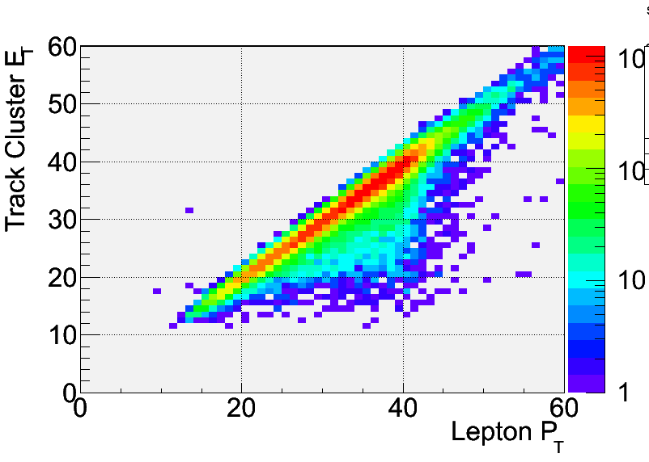
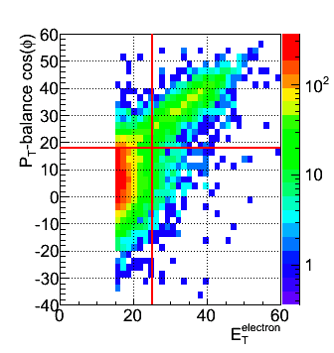
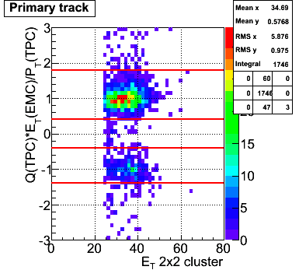
Electron identification
Isolation: (P^{track}+E^{cluster}) / Σ[P^{tracks} in R=0.7 cone] > 0.8
Imbalance: no energy in opposite cone (E<20 GeV)
E_{T} > 25 GeV
Track |η| < 1
|Z-vertex|<100 cm
Charge separation (avoids charge misidentification):
0.4 < |Charge (TPC) x E_{T} (EMC) / P_{T} (TPC)| < 1.8
Signed P_{T} balance > 18 GeV (rejects QCD Background)
We calculate energy from the cluster
MC
DATA
SIGNAL
QCD

Slide 10
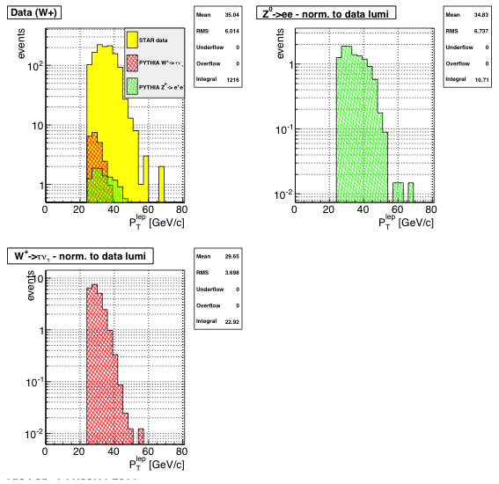
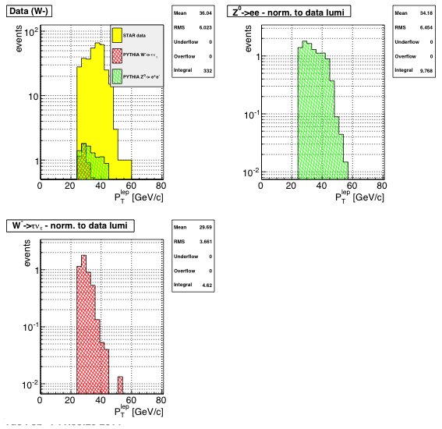
Background estimation
Background estimated via MC normalized to data lumi
Positive-charge signal 1216 events
Z → ee
W⁺ → tv_{t}
Negative-charge signal 332 events
Z → ee
W⁻ → tv_{t}
W⁺ sample
Z⁰ -> ee = 10.71 events [B/S = 0.88%]
W⁺ -> tv_{t} = 22.92 events [B/S = 1.88%]
W⁻ sample
Z⁰ -> ee = 9.77 events [B/S = 2.94%]
W⁻ -> tv_{t} = 4.62 events [B/S = 1.39%]

Slide 11
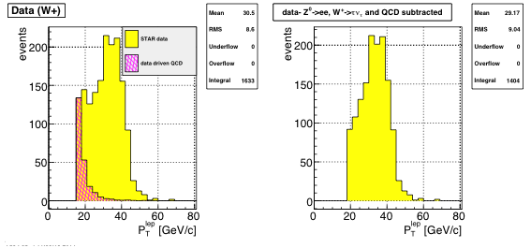
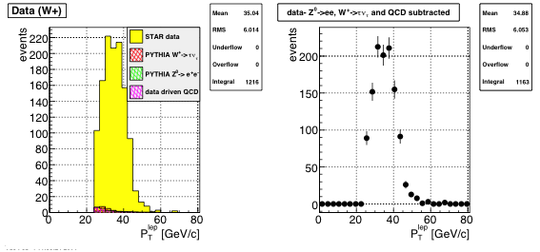
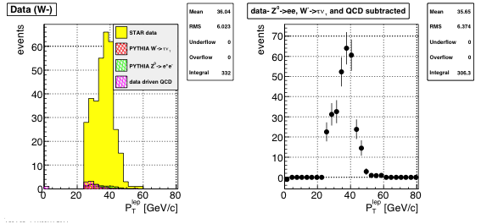
QCD background estimation
Data-driven QCD background estimation
Reverse of P_{T}-balance cut [PT-balance < 15 GeV] → Selects QCD events
Plot lepton-P_{T} > 15 GeV
QCD sample normalized to the first P_{T}-bin [15-19 GeV]
W⁺ sample
QCD = 19.37 events
[B/S = 1.59%]
W⁻ sample
QCD = 11.30 events
[B/S = 3.40%]
COMMENTS:
Backgrounds under control!
Z -> e⁺ e⁻ expected to have a comparable asymmetry
final sample
P_{T} > 25 GeV
final sample
P_{T} > 25 GeV

Slide 12
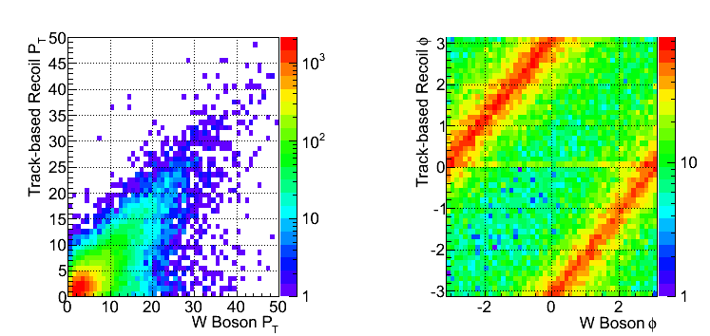
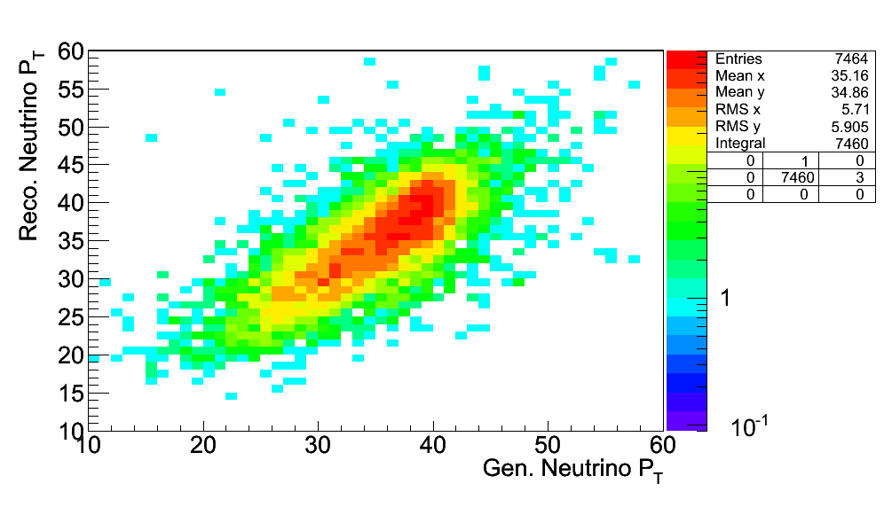
W P_{T} reconstruction
We calculate the recoil summing up all tracks and trackless electromagnetic clusters
Matching track is a track which extends to the BEMC and matches a firing tower (< 7 cm)
Trackless tower is a firing tower in the BEMC with no matching tracks and Energy > 200 MeV
Recoil is calculated summing the momenta of all tracks which do not belong to the electron candidate + all firing trackless towers
In transverse plane:
Recoil reconstructed using tracks and towers:
Part of the recoil not within STAR acceptance → MC correction applied

Slide 13
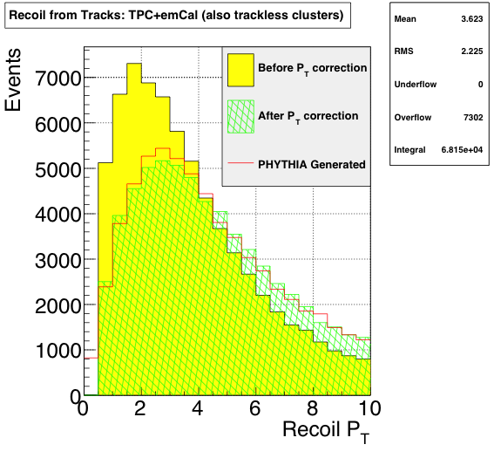
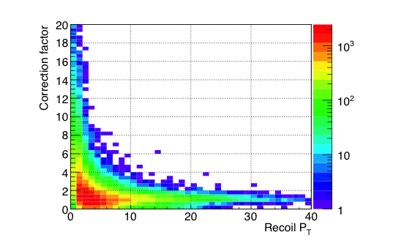
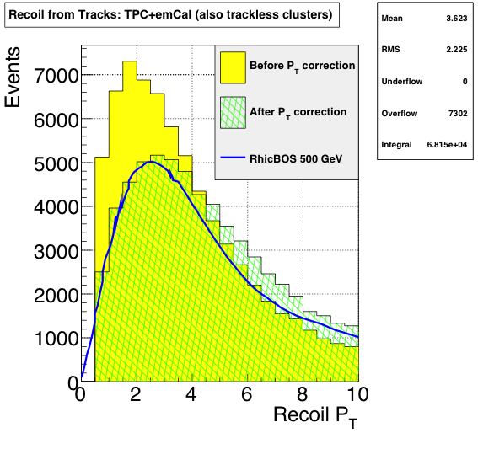
Monte Carlo correction
The Correction method –
Read recoil P_{T} bin from data
Project correction factor for corresponding P_{T}-bins
Normalize the projection distribution to 1
Pick a correction value sampled from the projection distribution
MC test:
After MC correction
→ very good agreement with RhicBOS and PYTHIA predictions
MC

Slide 14
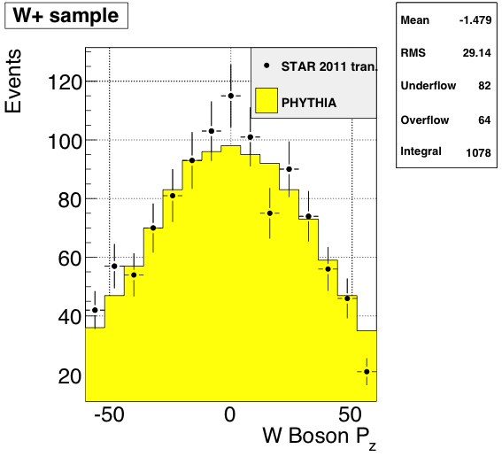
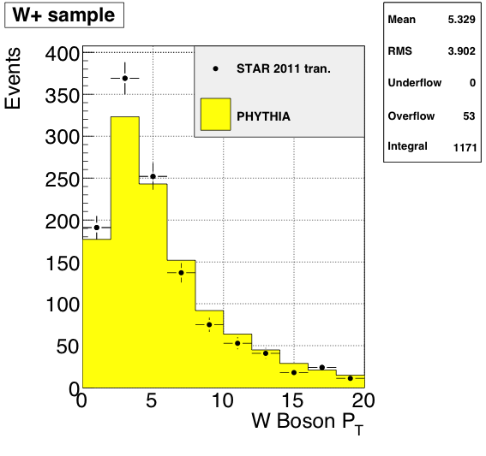
W P_{T} – Data/MC
We add to our selection:
Track-P_{T} in the recoil > 0.2 GeV
Total recoil-P_{T} > 0.5 GeV
GOOD data/MC agreement after P_{T} correction

Slide 15
W P_{Z} reconstruction
W longitudinal momentum (along z) can be calculated from the invariant mass. Currently we assume constant M_{W} (for W produced on shell)
Neutrino longitudinal momentum component from quadratic equation
Two solutions!
Smaller |Pz| → first solution
Larger |Pz| → other solution
BOTH the first and the other solution can have misreconstructed events!

Slide 16
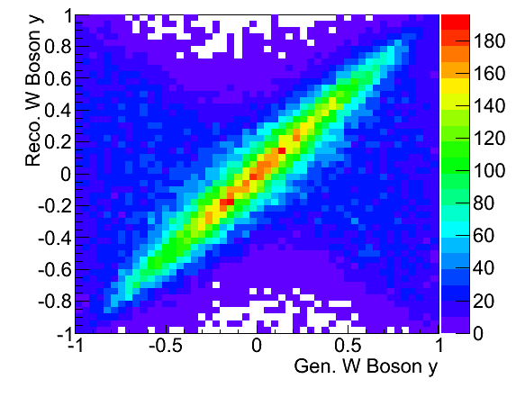
FIRST SOLUTION for Pz
We select the first solution → better Fraction of correctly reconstructed events
|P_{L}| < 50 GeV → < 40 % misreconstructions
How do we estimate the fraction?
Answer: we take the # events where Pz is reconstructed within +/- 30 GeV
NOTE: We only use the first solution. This can be improved at a later stage.
We cut at |Pz| < 50 GeV → |W-y| < 0.6 to minimize misreconstructions

Slide 17
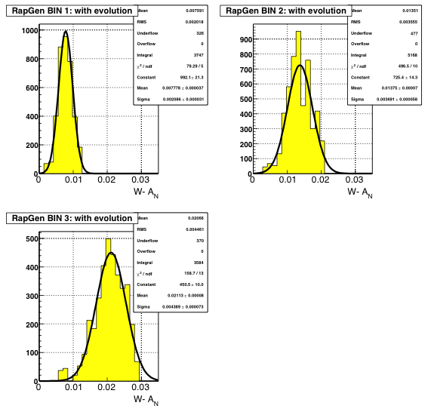
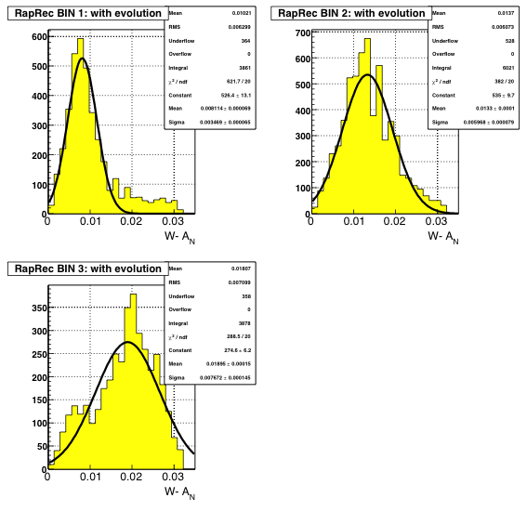
MC challenge - systematics
Tables (W rapidity-P_{T} bins) for A_{N} prediction with evolution given by Z-B Kang [arXiv:1401.5078]
Use PYTHIA MC prediction for W⁻ (the A_{N} prediction is always positive)
Assign each prediction value from the tables according to the generated values of W-rapidity and P_{T}
After the event is fully reconstructed we look at the P_{T} distributions of A_{N}
Generated
Reconstructed
-0.2 < y < 0.2
-0.2 < y < 0.2
We fit a Gaussian distribution and compare the means
We rely on the fact that the input asymmetry has the same dependence as the data
The same is done for W-P_{T}

Slide 18
W Asymmetry
First we calculate the asymmetries for each beam separately
Then we combine the two asymmetries
We fit sin(ϕ) modulation with phase = π/2
Average RHIC polarization for 2011 transverse p-p data → P = 53%
We use the “square root formula” to cancel dependencies on geometry and luminosity
Asymmetries measured:
Signal sample asymmetry
In backup slides:
Geometrical effects asymmetry
Luminosity effects asymmetry

Slide 19

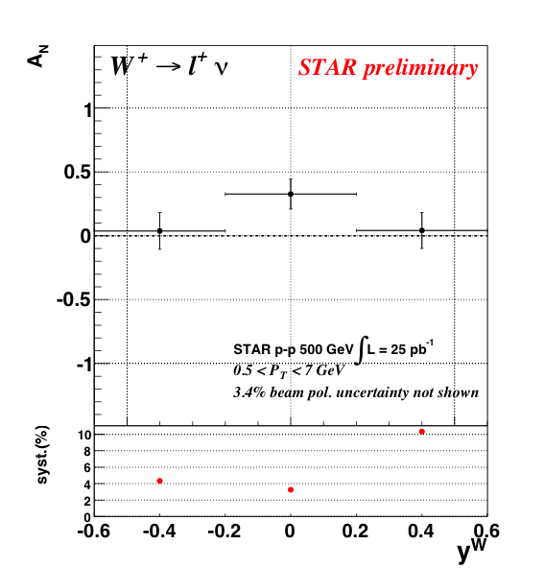
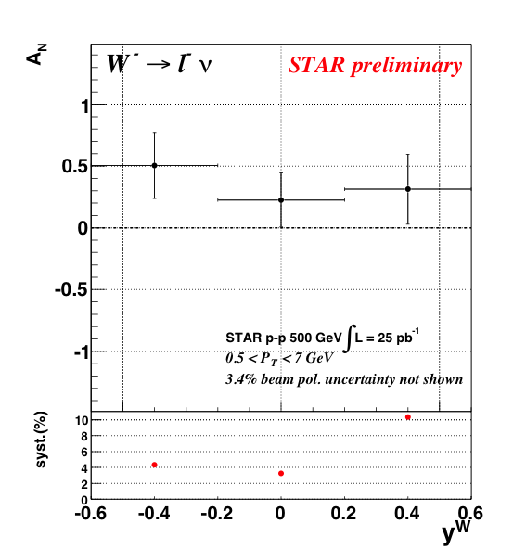
A_{N} vs W-rapidity

Slide 20
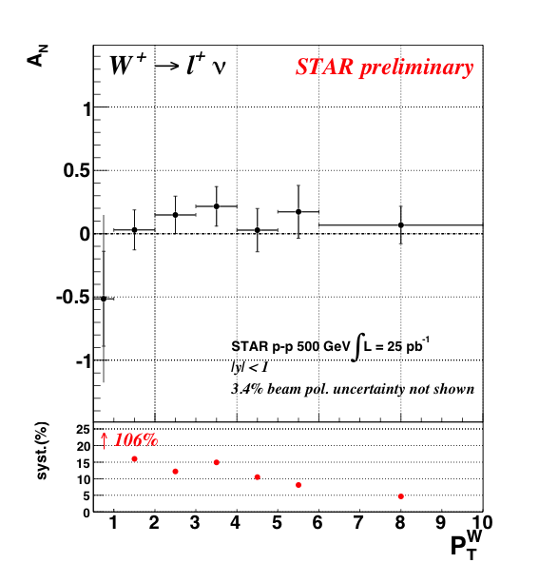
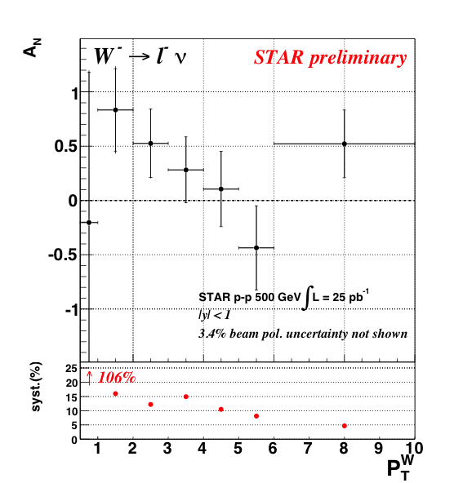
A_{N} vs W-P_{T}

Slide 21
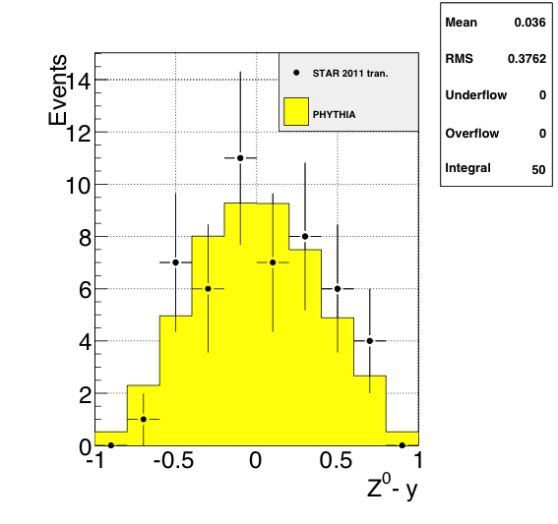
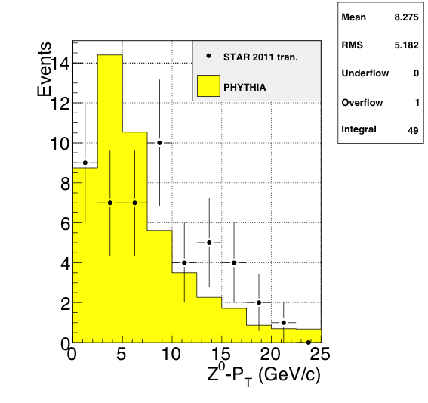
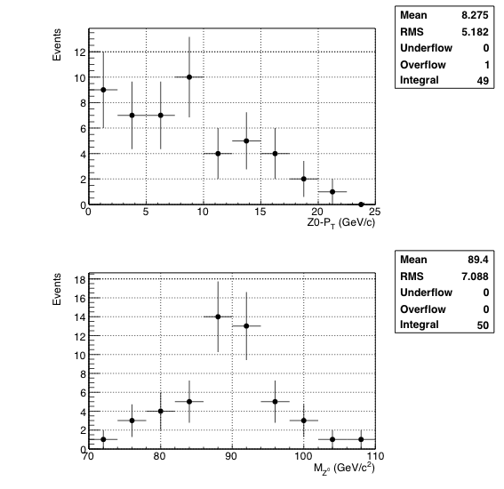
Z⁰ production
Clean experimental momentum reconstruction
Negligible background
electrons rapidity peaks within tracker accept. (|η|< 1)
Statistics limited
Z⁰ boson selection criteria
Two tracks each pointing to a cluster (no isolation requirements)
E_{T} > 25 GeV for both candidates
The two candidate tracks have opposite charge
|Zvertex|< 100 cm
Invariant Mass within ± 20% from the nominal M_{Z}
2011 pp-tran. ~25 pb⁻¹: 50 events survive the selection

Slide 22
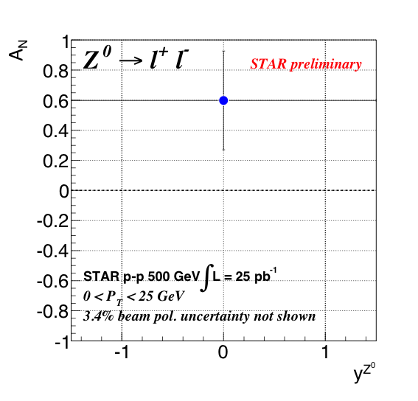
Z⁰ Asymmetry
A_{N} measured in a single y, P_{T} bin

Slide 23
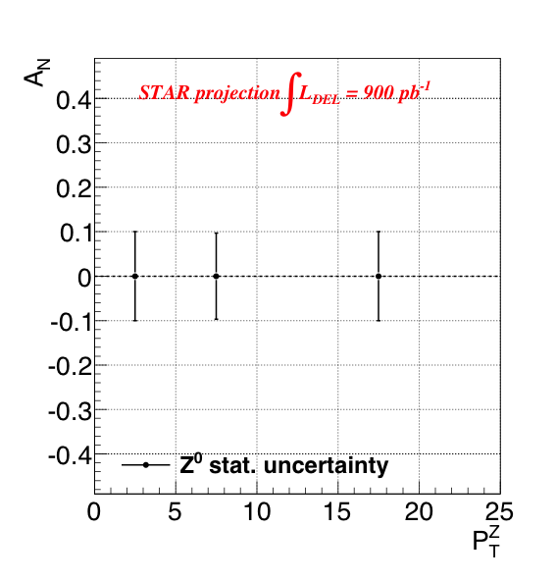
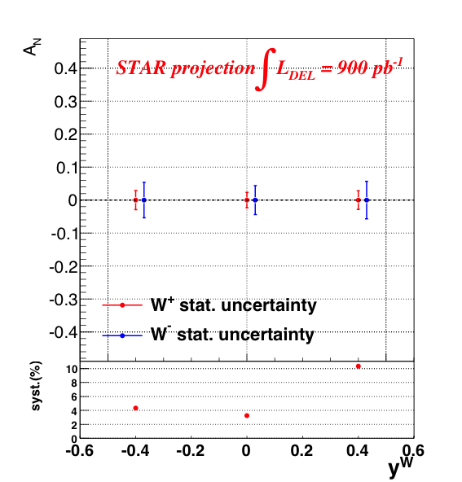
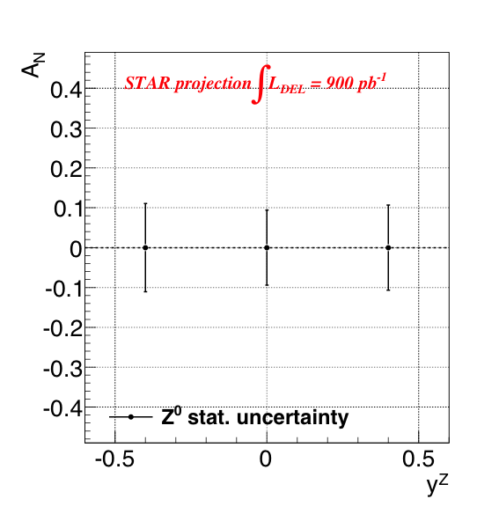
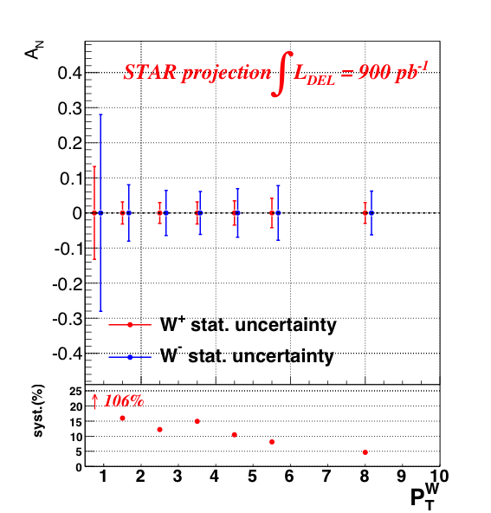
...and the future?
RHIC is capable of delivering
~900 pb⁻¹ transverse p-p
in 2016
Possibility for significantly measure A_{N} for Ws within a few % in several W-P_{T}, y bins.
Syst. from 2011 analysis rely on predictions and can be improved with more data
Possibility to measure the very clean Z⁰ channel.
Goal: measure sea-quark Sivers and pin down TMD-evolution
How?
  Measure A_{N} for γ, W±, Z⁰, DY
  DY and W±, Z⁰ give Q² evolution
  W± give sea-quark Sivers
  All three A_{N} give sign change

Slide 24
Summary
First measurement of A_{N} for W± and Z⁰ production at RHIC by reconstruction of the boson kinematics, using a sample of 25 pb⁻¹ transverse p-p data @ √500 GeV collected by STAR
Systematic uncertainties are constrained within < 15%
A_{N} in the Z⁰ boson channel → clean & background free, but need lumi
We have a proof-of principle → A_{N} for Ws can be measured at STAR, new RHIC data (can deliver up to L~900 pb⁻¹) can give statistical significance to test the Sivers’ sign change and pin down TMD evolution
RHIC run 2016: STAR can have access to A_{N} for γ, W±, Z⁰, DY in a single experiment, simultaneously!

Slide 25
BACKUP

Slide 26
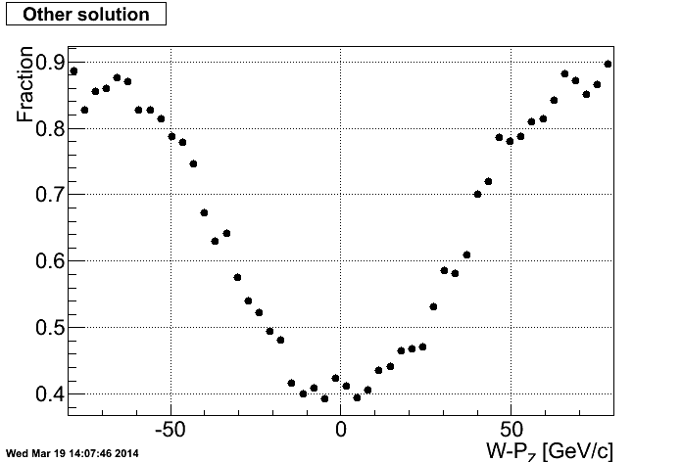
W P_{Z} reconstruction
Determine the fraction for correctly reconstructed events (for both solutions)
FIRST SOLUTION
OTHER SOLUTION

Slide 27
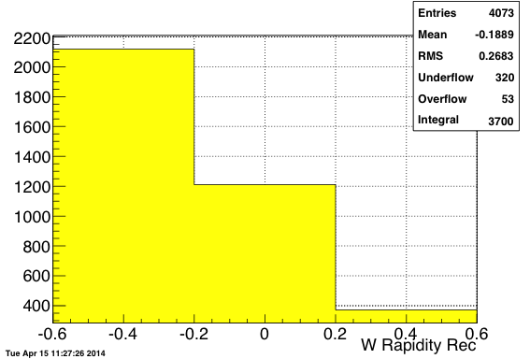
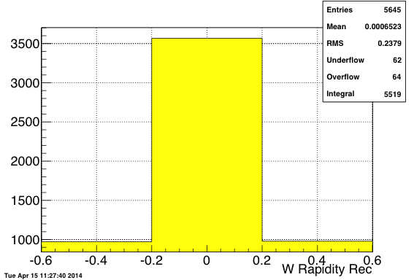
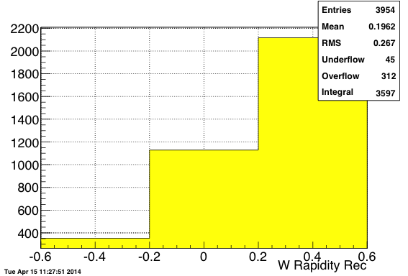
Rapidity binning
Distributions of y-Reco in each bin of y-Gen
Three W-y bins = {-0.6; -0.3; 0.3; 0.6}
bin1 survival probability = 52%
bin2 survival probability = 63%
bin3 survival probability = 54%
~11% of reco. events
migrate more than one y-bin
~2% of reco. events
migrate more than one y-bin
~11% of reco. events
migrate more than one y-bin

Slide 28
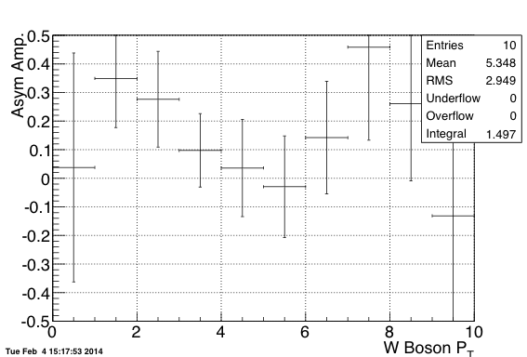
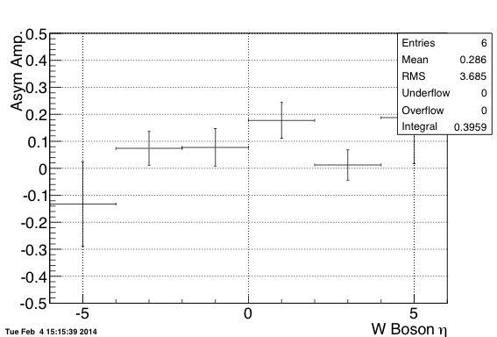
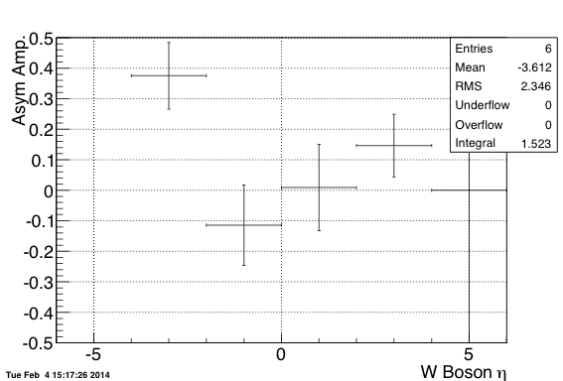
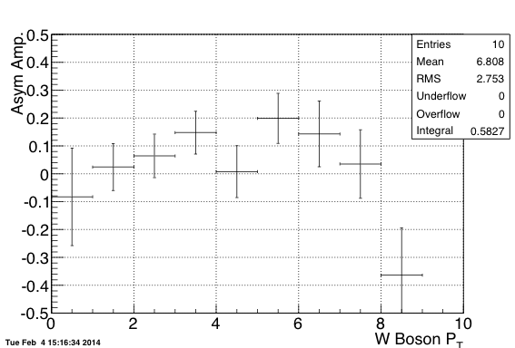
W plain asymmetry
W+
W-
W+
W-

Slide 29

Z⁰ plain asymmetry
-6 < η < 6

Slide 30




Geometrical Asymmetry
W+
W-
W+
W-

Slide 31




Luminosity Asymmetry
W+
W-
W+
W-

Slide 32


Z⁰ lepton candidates
Lepton candidate go to central rapidity and have large P_{T}

