Slide 1
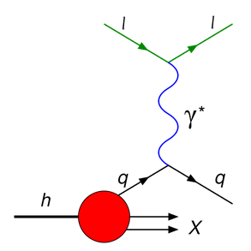




Exclusive J/ψ and ψ(2S) vector meson production
Outline
LHCb Experiment
Central Exclusive Production (CEP)@LHCb
Current Results
Summary
On behalf of the LHCb Collaboration
Tomasz Szumlak AGH-UST
XXII International Workshop on Deep-Inelastic Scattering (DIS)
28/04 – 02/05/2014, Warsaw, POLAND
1

Slide 2
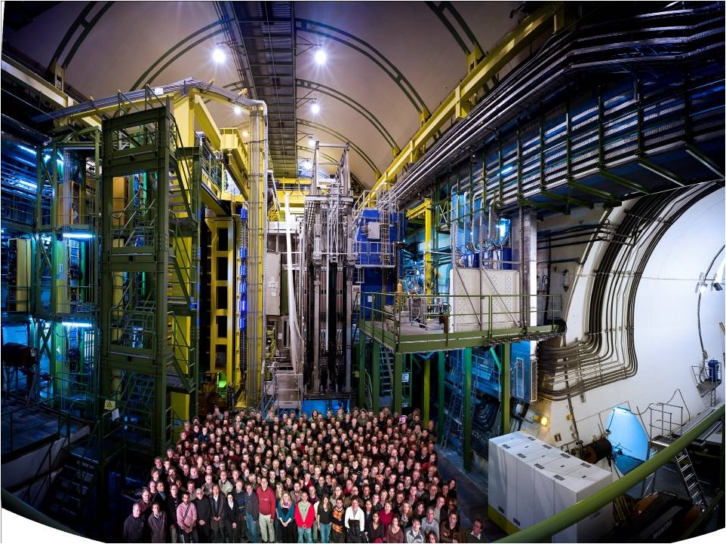
LHCb Experiment

Slide 3

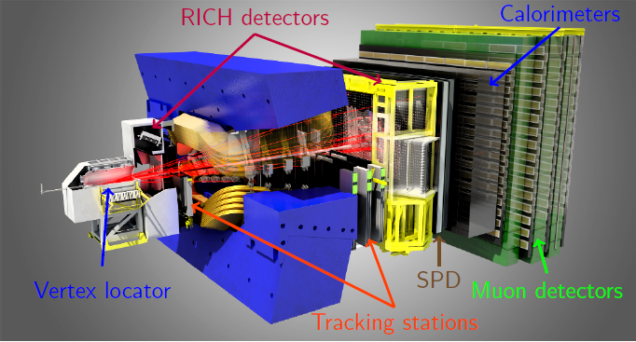
LHCb is a dedicated flavour experiment with the main focus on CP-violation and New Physics in b- and c-mesons
Performs indirect searches using quantum loops, complementary to energy frontier experiments ATLAS & CMS)
Must provide: excellent position, vertex and momentum resolution & PID
A forward spectrometer is sufficient for the LHCb physics programme since produced b-bbar pairs are strongly correlated and forward peaked

Slide 4
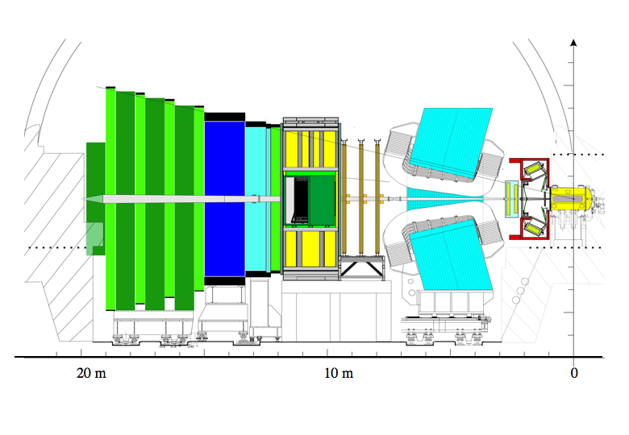
Muon system
TT+IT (Silicon Tracker)
300(H)/250(V) mrad
OT
Calorimeters
Dipole magnet
Vertex
Locator
15mrad
Interaction
Point
OT – Outer Tracker
IT – Inner Tracker
TT – Trigger Tracker
RICH detectors
Single arm spectrometer geometry
Fully instrumented in pseudorapidity range 2 < η <5
Capable of reconstructing backward tracks (-4 < η < -1.5)
Well suited for performing QCD measurements!
The LHCb detector at LHC (JINST 3 2008 S08005)

Slide 5
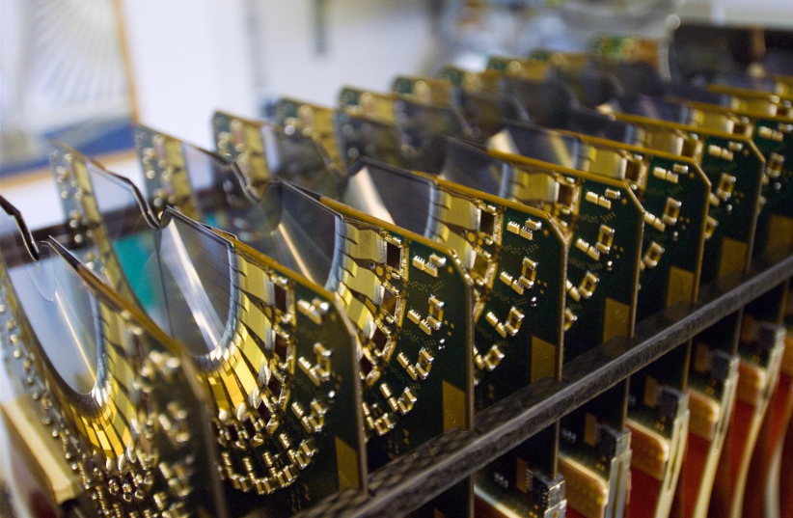
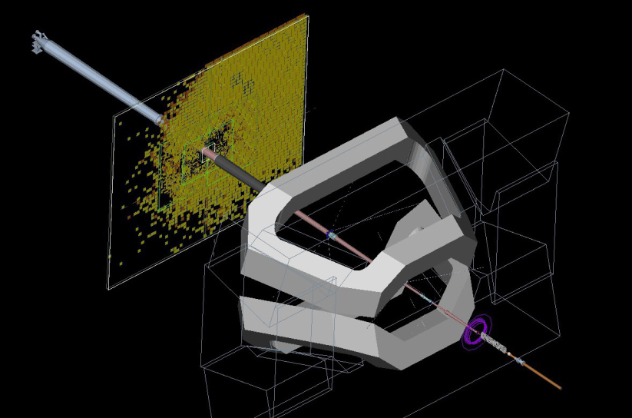
Two of the subsystems are especially vital for the CEP studying @ LHCb
VErtex LOcator (VELO)
  84 micro-strip silicon sensors close to the IR
  Precise track and vertex reconstruction
  The best single hit spatial resolution at LHC
  Allows for backward track reconstruction
  No momentum information for backward tracks
Scintillator Pad Detector (SPD)
  Part of the LHCb calorimeter system
  Tagging electric charge
  Provides vital input to hardware trigger
  Used primarily as multiplicity detector

Slide 6

Central Exclusive Production (CEP) at LHCb
CEP – definition
Central exclusive production can be denoted qualitatively as follows
Interacting hadrons do not undergo any „catastrophic process” (such
dissociation) instead they interact via exchanging a colourless object
and remain intact
However, they lose energy in order to produce only the final system X
that can be observed in the detector
„⊕” denotes symbolically the rapidity gaps
  Only the central system is produced, apart from that there should
  be no activity otherwise, thus, exclusive process
In principle four-momenta of the scattered hadrons (protons) can be
measured by very forward detectors
In case of the LHCb both protons remain un-tagged

Slide 7
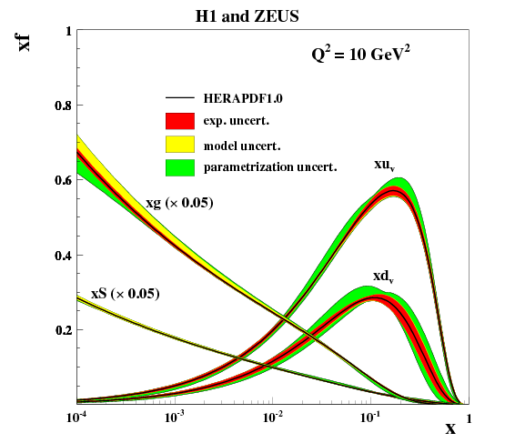
CEP – physics motivation
Exclusive processes are at the heart of QCD
May help improve understanding of soft scale (non-perturbative) QCD
  Actually almost all interesting things happen here (composite
  hadrons we observe)
Studying pomeron (odderon) interactions
Improve knowledge on low-x behavior of parton
PDF
  Sharp rise of gluon PDF for decreasing x
  LHCb is sensitive to the gluon PDF down to x ~ 5·10⁻⁶
  Studying saturation (BFKL evolution)
  Help understand in general processes such gg → X (gg → H)

Slide 8
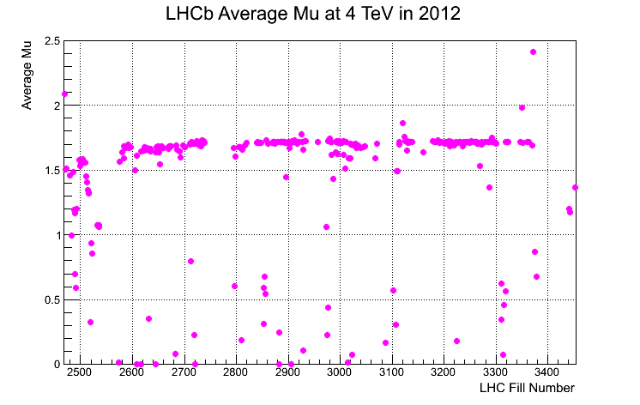
CEP@LHCb
Not a part of the „initial” core physics programme of the LHCb
Superb tracking performance of the spectrometer and its forward
geometry (rapidity reach up to η ≈ 5) made the study feasible
  VELO and SPD detectors essential for detecting rapidity gap
  (establishing exclusivity of a given event)
Flexible software trigger allows to select events with low pile-up
  Single interaction per crossing (~ 20% of collected luminosity)
  Simpler signal selection
  High sensitivity to low p/p_{T} particles

Slide 9
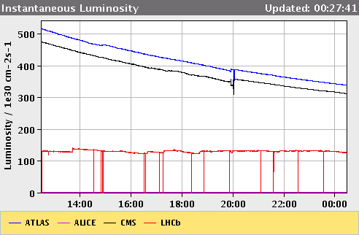
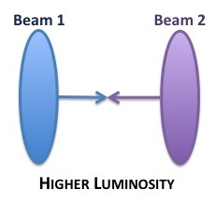
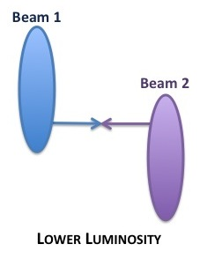
CEP@LHCb
For now we study only di-muon final states (no hadronic)
  analyses with hadronic final states ongoing
Luminosity leveling with displaced p-p beams
  Stable conditions throughout data taking runs

Slide 10


CEP@LHCb
Ah, and such events are very, very unusual for LHCb…
LHCb trigger system is amazing enough to select both types…
(Example copied from Paula Collins talk – thanks!)
„Regular” LHCb event
… and a CEP one

Slide 11
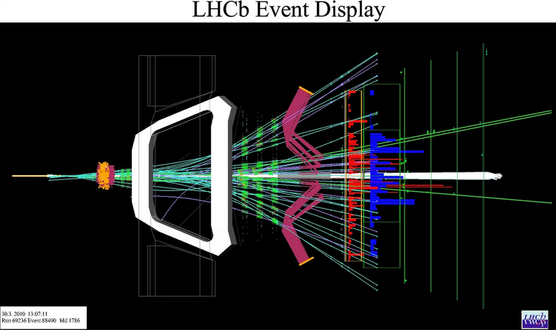
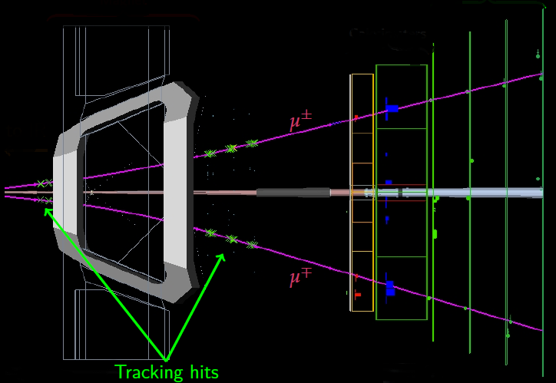
CEP@LHCb
Ah, and such events are very, very unusual for the LHCb…
LHCb trigger system is amazing enough to select both types…
„Regular” LHCb event
… and a CEP one

Slide 12
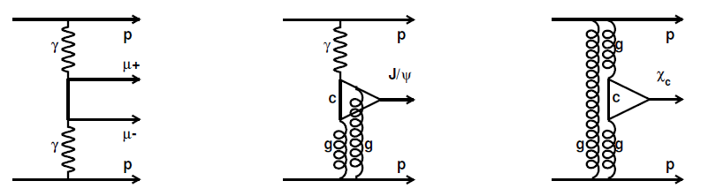
CEP with di-muon final state
Elastic scattering with intact and un-tagged protons
Proceed via exchange of colourless objects (γ, pomeron)
Studied in detail by theorists
  LPAIR (A.G Shamov and V.I Telnov, NIM A, 494 (2002), 51)
  STARlight (S.R. Klein and J. Nystrand, Phys. Rev. Lett., 92 (2004), 142003)
  SuperChiC (L.A. Harland-Lang, V.A. Khoze, M.G. Ryskin and W.J. Stirling,
  Eur. Phys. J. C, 65 (2010), 433)

Slide 13
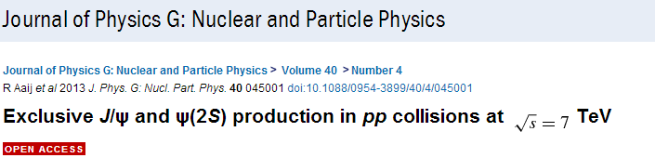
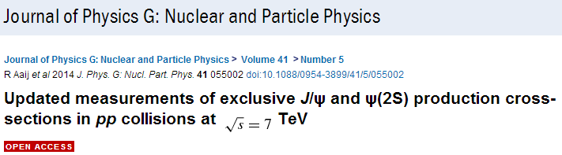
Current results
Published papers
2010 data (~ 37 pb⁻¹)
2011 data (~ 930 pb⁻¹)

Slide 14
Signal selection (highlights)
Low level (hardware) trigger L0
  a muon candidate, p_{T} > 400 MeV
  a di-muon candidate, p_{T} > 80 MeV (each track)
  less than 20 (10 for 2011) SPD hits
Software HLT (High Level Trigger)
  a di-muon candidate p_{T} < 800 MeV
  M(di-muon) > 2.7 GeV
Offline selection
  both muons within LHCb acceptance (2.0 < η < 4.5)
  no photons, no backward tracks (VELO veto)
  mass window for a di-muon ΔM = 65 MeV around expected
  J/ψ or ψ(2S) mass

Slide 15
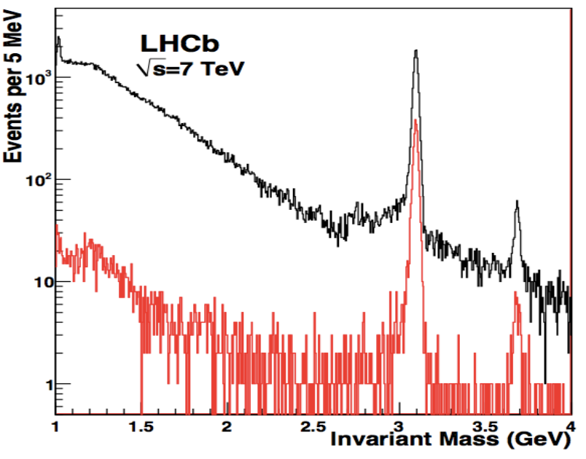
Di-muon mass spectrum before (-) and after selection (-)
LHCb Preliminary
LHCb-CONF-2011-22

Slide 16
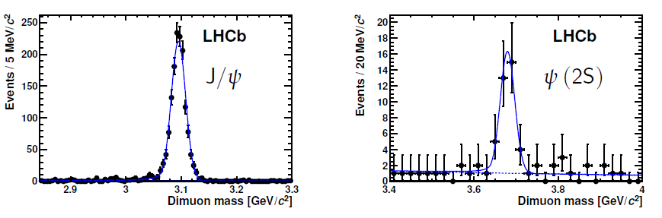
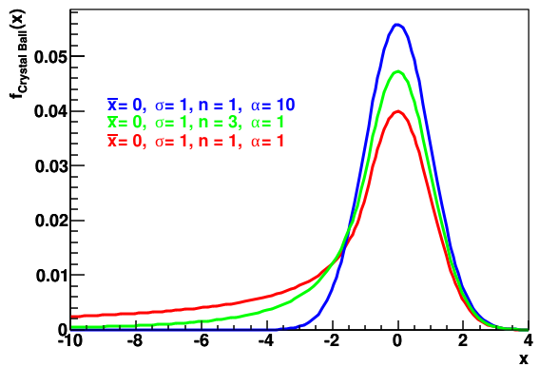
Selected signal (2010)
Model of the mass spectra
  Signal peak – Crystal-Ball
  Background – exponential
Observed events
  1492 exclusive J/ψ and 40 exclusive ψ(2S) – 2010
J. Phys. G 40 (2013) 045001

Slide 17
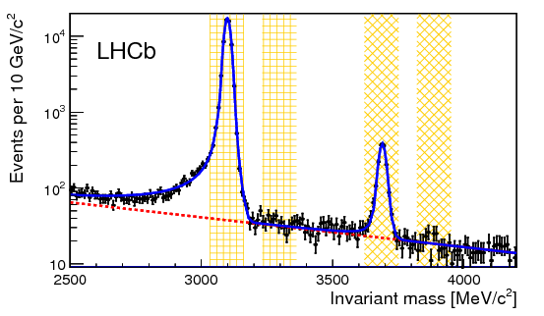
Selected signal (2011) - subsequent discussion related to this data sample
Model of the mass spectra
  Signal peak – Crystal-Ball function
  Background – exponential
Observed events
  55895 exclusive J/ψ and 1565 exclusive ψ(2S) – 2011
Side bands for background modelling
J. Phys. G 41 (2014) 055002

Slide 18

Cross-section measurement (2011)
Differential cross-section times branching fraction
to two muons with pseudorapidity defined by the LHCb
angular acceptance
Measured in bins of meson rapidity y
N_{i} – Number of events in a given rapidity bin
p – Purity:
Non-resonant background
Feed-down backgroun
Inelastic background
ε_{single} – Selection of events with one p-p interaction per crossing
This follows very well the Poisson distribution (~ 21%)
– Sample integrated luminosity
ε_{i} – Efficiency:
Trigger (L0+HLT)
Tracking
Muon PID
Signal selection
Total efficiency varies from 0.66 to 0.89 depending on rapidity bin

Slide 19
Purity estimation: non-resonant component
QED induced interactions that result in di-muon final state
Estimated with signal events that passed all the cuts
apart from mass window one
Assume signal peak is modeled with CB curve and the
continuum events with exponential
  Use sidebands to fit
Background estimated (within the mass window of respective
states):
  (0.8 ± 0.1) % for the J/ψ selection
  (17.0 ± 0.3) % for the ψ(2S) selection

Slide 20
Purity estimation: feed-down component
The source of this background is exclusive production of other
mesons
Mainly problem for selecting J/ψ events
Decays ψ(2S) → J/ψ X, where X is not detected
  Can be significantly suppressed by hard 2 track only cut
  Estimated using STARlight model
  (2.5 ± 0.2) % of selected J/ψ events
Radiative decays χ_{c} → J/ψ γ, where γ goes undetected
  Suppressed by requiring no photons
  Estimated using SuperChiC model
  (7.6 ± 0.9) % of selected J/ψ events
Feed-down to ψ(2S) is expected to be small - coming from X(3872)
  Results based on studies involving photon veto in selection
  algorithm gave (2.0 ± 0.2) % of selected ψ(2S) events

Slide 21
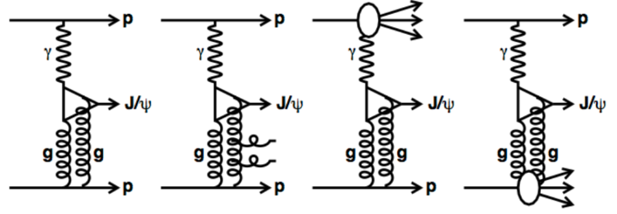
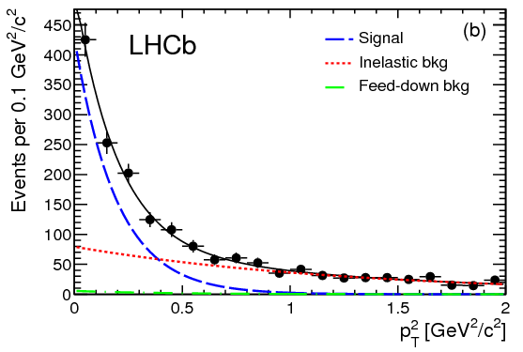
Purity estimation: inelastic scattering
This is the dominant background
In general harder p_{T} spectrum of produced J/ψ is expected
Was estimated using collision data (2011 sample)
  (34 ± 6) % for J/ψ events
  Similar estimate is assumed for ψ(2S)
Overall purities:
  (59.2 ± 1.2) % for J/ψ events
  (52.0 ± 7.0) % for ψ(2S) events
  p_{T} < 0.8 GeV²

Slide 22
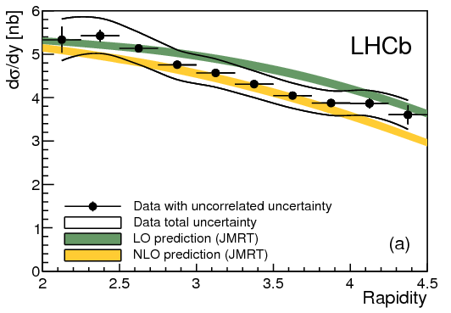
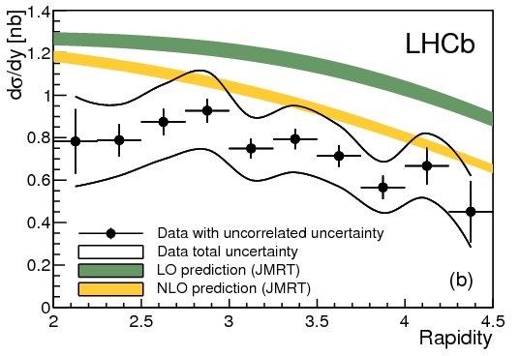
Cross section measurement
Integrated cross-sections
Differential cross-sections
J/ψ
Ψ(2S)

Slide 23
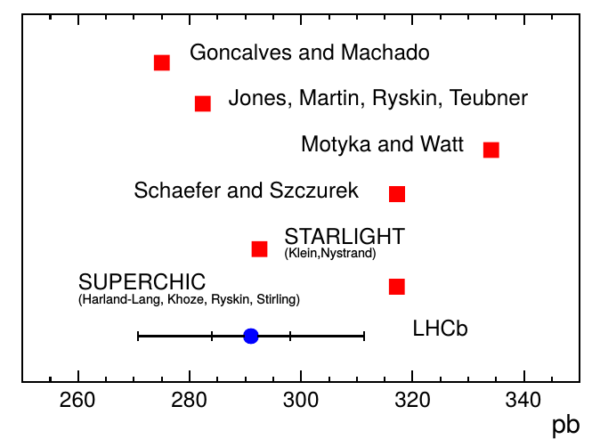
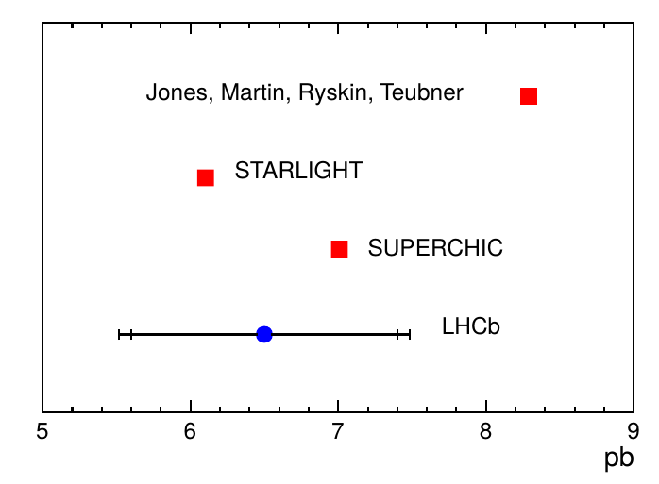
Cross section measurement
Comparison with theoretical predictions – good agreement!
  NLO describes data better than LO based predictions
  better description for J/psi than for psi(2S)
  uncertainties are highly correlated between the bins
J/ψ
Ψ(2S)
Phys. Rev. C84 (2011) 011902 , JHEP 1311 (2013) 085
Phys. Rev. D78 (2008) 014023, Phys. Rev. D76 (2007) 094014
Phys. Rev. Lett. 92 (2004) 142003, Eur. Phys. J. C65 (2010) 433

Slide 24

Comparison with HERA results (differential cross-section)
The LHCb measurement can be related to photoproduction using:
photon flux: Weizsacker-Williams approximation
photon energy
mass of the photon-proton system
Twofold ambiguity for LHCb – for each rapidity bin we have two solutions
(see next slide) for photon-proton c.m. energy
Measured
Extracted

Slide 25
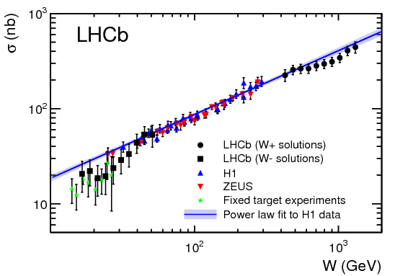
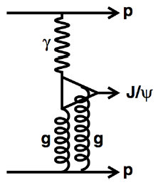
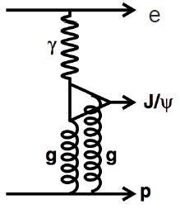
Comparison with HERA results (differential cross-section)
The LHCb measurement can be related to photoproduction using:
Obtained results are compatible with the HERA data!
Some deviation from simple power law prediction (Regge theory) seen
  this may be explained either by saturation or higher order diagrams

Slide 26
Summary
Exclusive J/ψ and ψ(2s) cross-sections have been successfully
measured at LHCb using 2010 and 2011 data samples
Obtained results are consistent with photo-production results
from HERA
Published 2 papers
Still more statistics waiting in 2012 data
Plans for extending analyses concerning exclusive production
  new particles (e.g., χ_{c})
  include also hadronic modes
Detector improvements in order to increase rapidity gap
(installation of scintillator counters to reject inelastic background)
This study may contribute to better understanding of pomeron
and measurement of gluon PDF for very small x
Sensitivity to models including saturation effect

Slide 27
Back-up

Slide 28
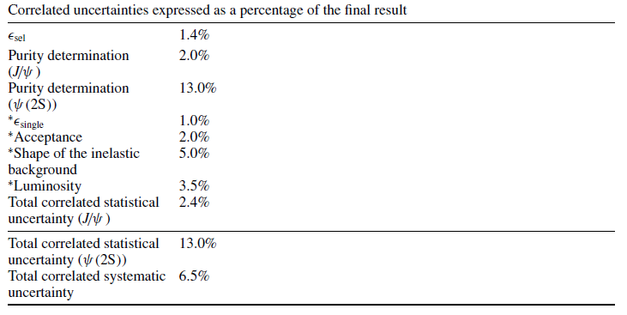

Slide 29
