Slide 1


Adaptative track scheduling to optimize concurrency and vectorization in GeantV
J Apostolakis, M Bandieramonte, G Bitzes, R Brun, P Canal,
F Carminati, J C De Fine Licht, L Duhem, V D Elvira, A Gheata,
S Jun, G Lima, M Novak, R Sehgal, O Shadura, S Wenzel
ACAT 2014
Prague, 1-5 September 2014

Slide 2
Outlook
GeantV: project description
The data model: vectors and baskets
The track dispatching model
Vectorization overheads
Scalability and performance
Optimizing concurrency
Optimizing the model parameters
Notes:
Describe project for those who did not here about it
Go through the components which makes it quite different from standard GEANT
Describe the work that we are doing and which needs to be done to steer efficiently vectors in a multithreaded environment

Slide 3
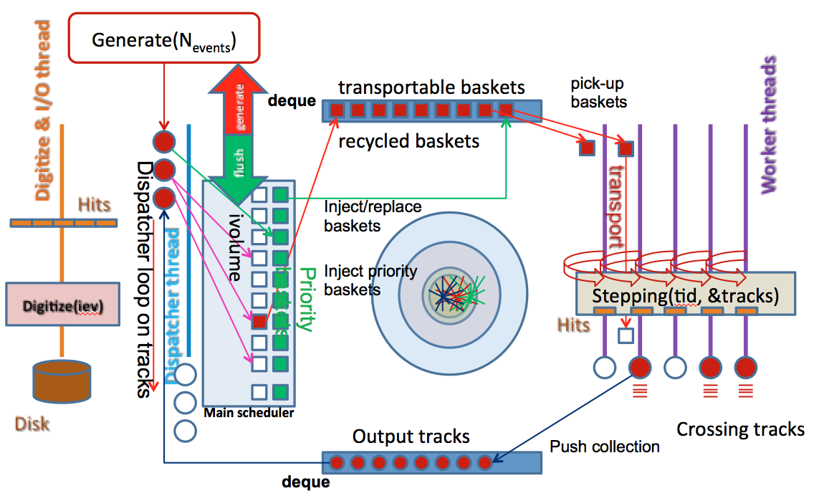
The project goals
Started in 2012
  Prototype a new approach to speedup particle transport simulation
  Most simulation time spent in few percent of volumes
  Enforce locality and vectorization transporting groups of tracks
  Add parallelism on top
  Add new entity to control the workflow
Evolved into an ambitious project exploring many dimensions of performance
  Locality (cache coherence, data structures)
  Parallelism (multi/many core, SIMD)
  Vector dispatching down to algorithms
  Transparent usage of resources (CPU/GPU)
  Algorithm template specializations & generality of code (next talk)
  Physics & geometry algorithm improvements
Notes:
Started as prototype to test a new approach to speedup simulation – most CPU time spent in Run1 in simulation
Observed that locality is an important factor for inefficiency and try to enforce by steering vectors of tracks
End-up with an approach completely different from standard GEANT, with no stack and with a scheduler
Many other benefits of this approach explored afterwards

Slide 4
R&D directions
Data structures, SOA types
Concurrency libraries
Steering code
Base classes, interfaces
Management and configuration
Testing, benchmarking, development tools
Scheduler
Locality by geometry or physics
Dispatch efficient vectors
Manage concurrency and resources
Schedule transportation, user code, I/O based on queues
Optimize model parameters
Transforming existing G4 algorithms into “kernels”
Support for vectorization
Fast tabulated physics
Template specializations
Support for user fast simulation models
Next generation geometry modeling
Template specialized algorithms
Re-usability of inlined “codelets”
CPU/GPU transparent support
Support for vectorization
GeantV kernel
Physics
Geometry
Techniques for efficient algorithm vectorization and beyond: see talk of Sandro Wenzel in this session
geant.web.cern.ch
Notes:
Project evolved in many directions becoming sub-projects, having as core the kernel and the scheduler
Geometry and physics are long term initiatives for optimizing the existing software
A detailed description of this work in Sandro’s talk following

Slide 5
Data structures for vectorization
fBuffer
GeantTrack
GeantTrack_v
00
40
80
C0
00
fEvent
fEvslot
fParticle
fPDG
…
fXpos
fYpos
fZpos
fXdir
fYdir
fZdir
…
Edep
Pstep
Snext
Safety
*fEventV
*fEvslotV
*fParticleV
*fPDGV
…
*fXposV
*fYposV
*fZposV
*fXdirV
*fYdirV
*fZdirV
…
*fEdepV
*fPstepV
*fSnextV
*fSafetyV
vector 1
fEventV
fEvslotV
fParticle
V
fPDGV
…
fXPosV
fYPosV
SOA of fNtracks
fZPosV
…
192 bytes
fNtracks=10 padding=32
fSnextV
fSafetyV
fPathV
fNextpathV
vector 2
*fPath
*fPathV
GeantTrackPool<VolumePath_t*>
*fNextpath
*fNextpathV
Notes:
To start from the beginning, we soon noticed that using SIMD requires special data alignment
SOA container for holding tracks, try to keep it as “fat” as possible throughout transport
Not a dummy container, optimized support for compacting and reshuffling operation (needed as you’ll see)

Slide 6
Track locality criteria
Putting together tracks having some locality criteria -> baskets
  Geometry: particles located in the same detector (logical) volume -> stepper
  Physics: particles matching type/energy range -> physics processes
  Custom: e.g. triggers for fast physics handover
After some processing stage a particle is “stamped” for the next stage
  Produced new particles added to the “basket” output
  Currently stages are chained, in future the particle will be “released” for more efficient re-scheduling
Transport (thread local)
Input
Scheduling (concurrent)
Scheduling (concurrent)
Output
Physics (thread local)
Notes:
Not enough to group together tracks if they cannot be processed together -> locality criteria
Chaining different stages destroy vector quality -> re-scheduling
Enforce the policy: a basket processed by single thread at a time

Slide 7
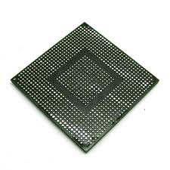
GeantV features
Generator
GeantV scheduler
ACTIONS: inject,
Vector/single, prioritize, digitize, garbage collect
Geometry filter
Logical volume trigger
Physics filter
Particle type, energy trigger
Fast transport filter
Geometry region, particle type, energy
Particles
Monitoring
Triggers, alarms
THREADS
INPUT VECTORS OF PARTICLES
WORK QUEUE
FastSim stepper
GPU broker
Vector
stepper
Physics sampler
User defined param.
VecGeom
navigator
Step sampling
TabXsec
manager
Phys. Process
post-step
(Vector)
physics
Fill output vector
Filter neutrals
Secondaries
Full geometry
Simplified geometry
(Field) Propagator
Tab. Xsec
Compute final state
Step limiter
reshuffle
Tab. final state samples
OUTPUT VECTORS OF PARTICLES
TO SCHEDULER
Notes:
This cartoon illustrates the main features of the model. Scheduler has several roles (*). Filters enforce locality, grouping tracks into vectors, pushed to work on threshold
Baskets put in a concurrent work queue, taken by vector stepper. Sampling physics tabulated cross sections and geometry, then propagated.
Propagated tracks passed to physics sampler, generated secondaries saved as output of the basket and rescheduled
Possibility for custom stepper in the design (fastsim). Vectorizing physics will be possible. GPU broker very important for using extra resources.

Slide 8
GPU Connector to the Vector Prototype
Goals
  Pick up baskets and select only tracks GPU can handle
  Maximize kernel coherence
  Adapt to GPU ‘ideal’ bucket size (very different from CPU)
    Without hanging on to event too long
Implementation
  Stage particles in a set of buckets
    Type(s) of bucket is customizable.
      For example based on particle/energy that have a common (sub)set of physics models likely to apply
      Keep order provided by main scheduler
  Delay the start of a kernel/task until it has enough data or has not received any new data in a while
  Start uploads after each basket processing to maximize overlap (even before the bucket is full) -> asynchronous transfers

Slide 9
Scheduling features
1…N_{volumes}
Automatic threshold-based basket dispatch
Transport queue
empty
TGeoVolume
Push on
threshold
full
Basket pool
Basket manager
transported
Reusage of baskets
current
priority
recycle
Work balancing: FIFO
Prioritize events: LIFO
AddTrack
AddTrack
On-demand event flushing mechanism
Generator
Scheduler
Stepper
1…N_{workers}
1…N_{workers}
Notes:
Geometry is an important locality criterion -> basket managers per volume
Basket getting filled up to threshold, then pushed
Work balancing via FIFO, priority events via LIFO

Slide 10
Challenges for vectorization
Pre-requirement to use vectorized: contiguity and alignment of the track arrays
A
Method(fXposV,…, fNtracks) or
Method(GeantTrack_v &)
Use
fEventV
fParticleV
…
During transport, tracks stop leaving holes in the container
A
Compact
A
fEventV
fParticleV
A
Move
B
fEventV
fParticleV
…
Compact
fEventV
fParticleV
fEventV
fParticleV

Slide 11
Vector dispatching overheads
Track selection according some criteria
A
A
Reshuffle
fEventV
fParticleV
…
fEventV
fParticleV
…
Tracks have to be copied to a receiver during rescheduling
B
A
Copy
fEventV
fParticleV
multithreaded
C
fEventV
fParticleV
…
Copy
fEventV
fParticleV
Notes:
Many overhead operation: is overhead smaller than the gain?

Slide 12
Scheduling actions
The scheduler has to apply policies to:
  Provide work balancing (concurrency)
    Single work queue
  Keep memory under control
    Buffering limited number of events
    Prioritizing events, prioritizing I/O
    Issuing event flushing actions
  Keep the vectors up (most of the time)
    Optimize vector size
      Too large: to many pending baskets
      Too small: inefficient vectorization
    Trigger postponing tracks or tracking with scalar algorithms
Sensors/triggers
  Work queue size thresholds
  Memory threshold
  Vector size threshold
Notes:
Headlines only

Slide 13
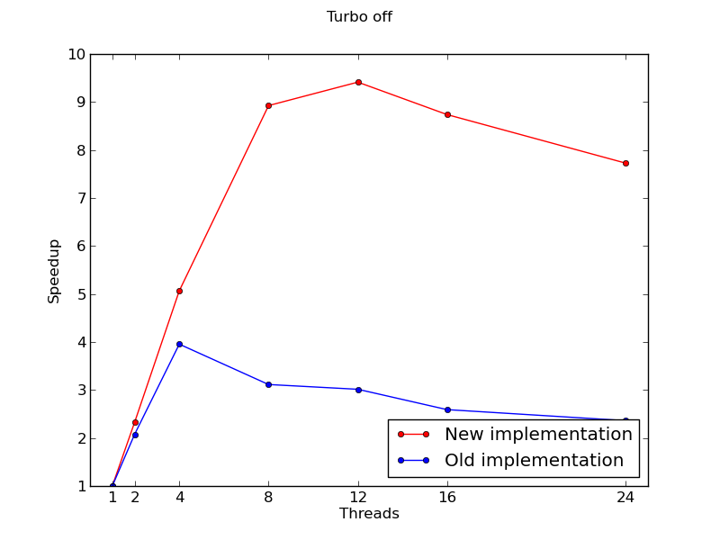
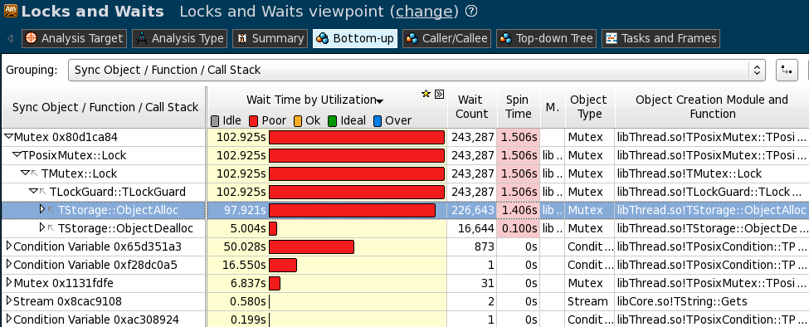
Scalability for MT is challenging
Performance is constantly monitored
  Jenkins module run daily
Allows detecting and fixing bottlenecks
Amdahl still high due to criticity of basket-to-queue dispatching operations
1000 events with 100 tracks each, measured on a 24-core dual socket E5-2695 v2 @ 2.40GHz (IVB).
Bottleneck due to dynamic object allocation of navigation states
Notes:
All this to be done in a fine grain parallel environment-> monitor scalability
Removed a bottleneck due to unnecessary object allocation
Amdahl still high – we have clear ideas on how to improve this using atomics

Slide 14
“Fast” physics and upgrades
Optimizing the performance of GEANT4 physics will have a long path
Goal: compact, simple and realistic physics to study the prototype concepts and behavior
Requirements: reproduce physics well enough to study the prototype behavior
  energy deposit, track length, # steps, # secondary tracks, etc.
Implementation:
  tabulated vales of x-sections(+dE/dx) from any GEANT4 physics list for all particles and all elements over a flexible energy grid (EM and hadronic processes)
  flexible number of final states for all particles, all active reactions, all elements are also extracted from GEANT4 and stored in tables
Status:
  a complete particle transport has been implemented based on these tables both behind the prototype and behind GEANT4
  possible to test new concepts, performance relative to GEANT4 tracking
  individual physics processes can be replaced by their optimized version when ready
GEANT4
Geant4 physics
GEANT4
TabXsec physics
GeantV
TabXsec physics
GeantV
Optimized physics
Notes:
Long path to optimize physics
Compact form of realistic physics to study the prototype needed
Tabulating from a G4 physics list (x-sec) and sampling from final states

Slide 15
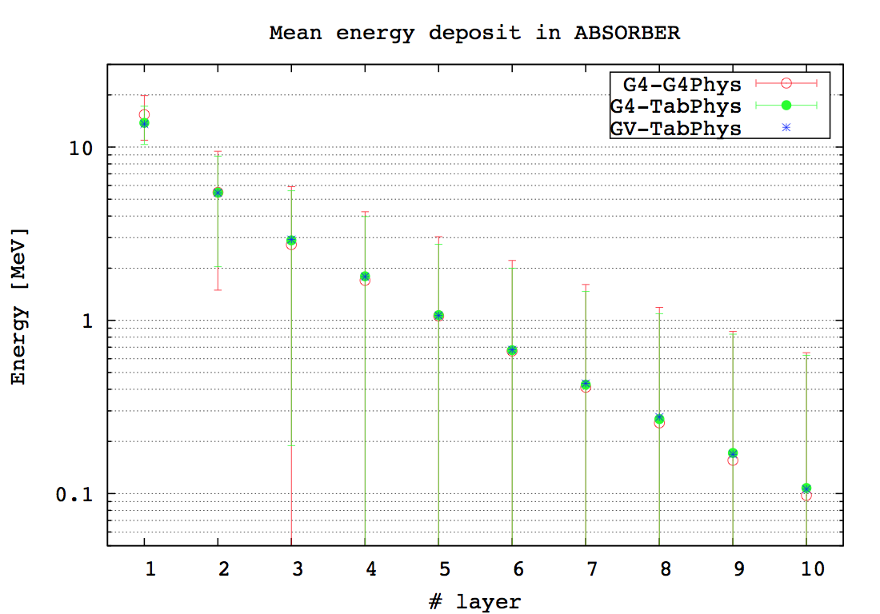
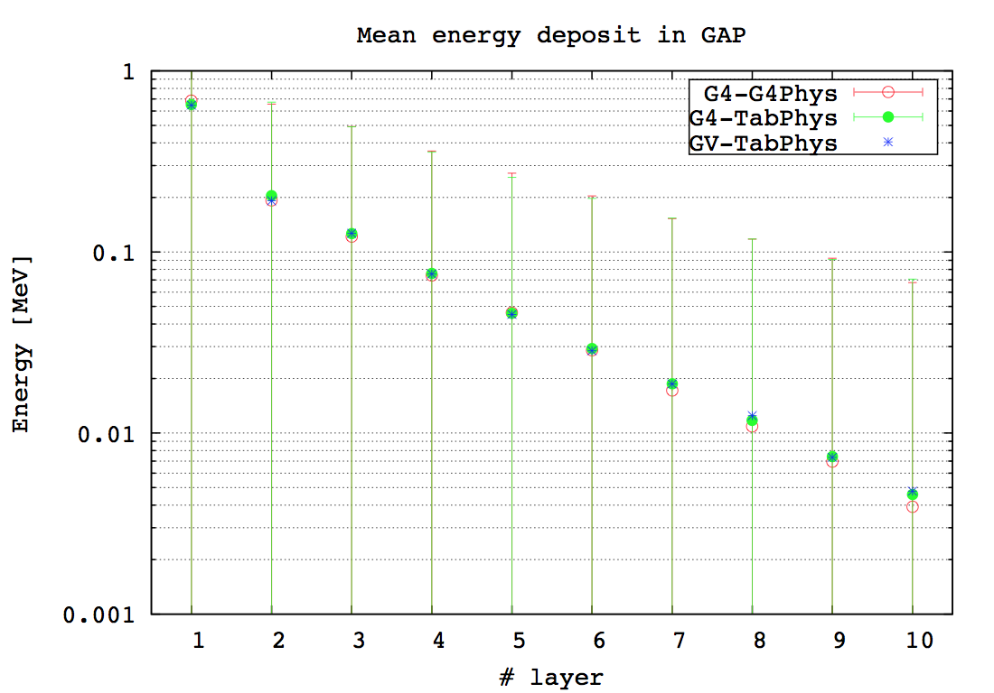
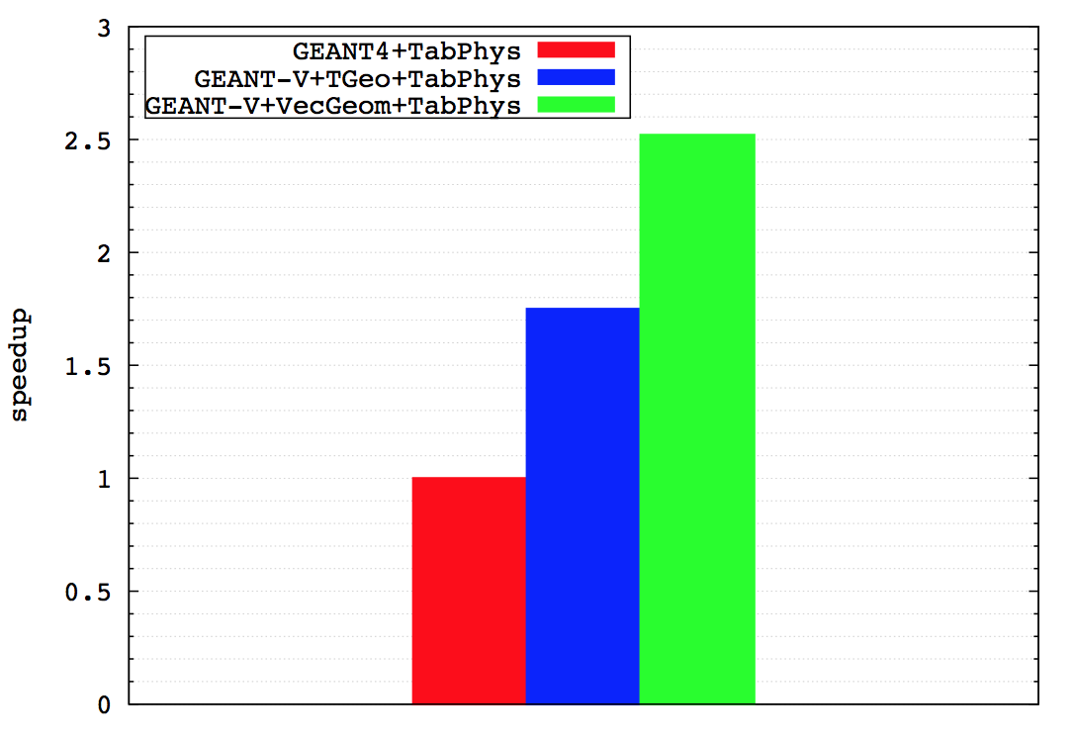
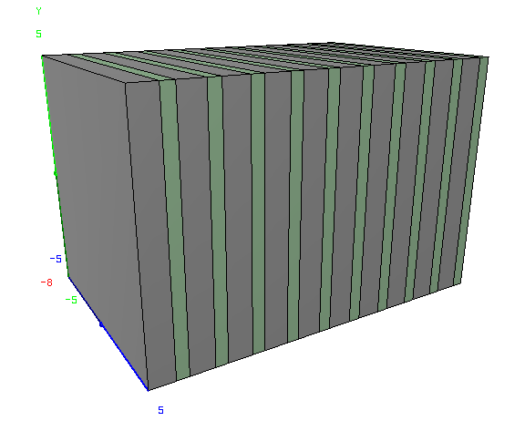
Preliminary performance checks
Is overhead larger than gain?
Simple example imported from GEANT4 novice examples
  Scintillator+absorber calorimeter
  30 MeV to 30 GeV electrons, 100K primaries
  Physics reproduced, small differences to be investigated for the highest energy
Single thread performance expected to increase with the setup complexity
  Evolve the example
ExN03 example
Caching&SIMD - overheads
Pb
Scintillator
Notes:
Focused on simple example which can use vectorized geometry
Shooting electrons in a wide energy range and comparing performance
Performance very likely to increase with complexity of geometry

Slide 16
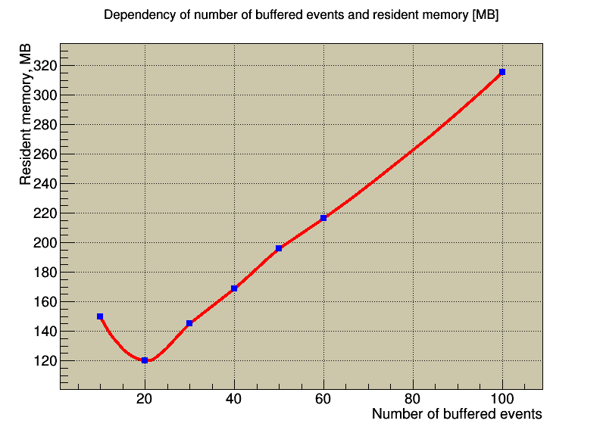
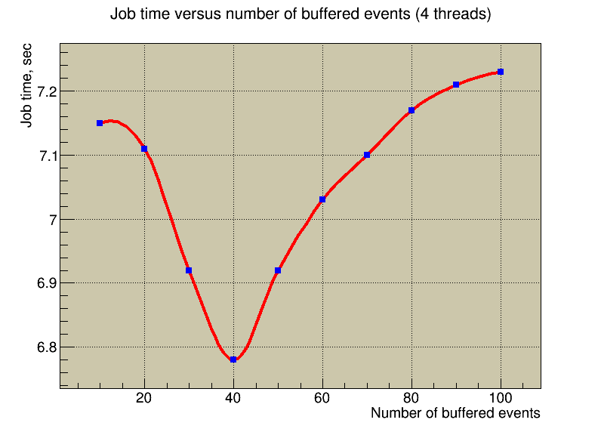
Parameters: memory buffer
Policy: keep fixed number of events in memory
  Inject N_{buff} events at startup (from N_{total} to be simulated)
  As an event gets flushed, inject a new one
Maximum memory has an optimum at N_{buff}/N_{tot}~ 20%
CPU performance is reached at N_{buff}/N_{tot}~ 40%
  Gain for optimum value can reach 10%
Notes:
To control memory and output data flow, we enforce event buffering policy
You can optimize by maximum memory usage or speed, getting different settings
This happens for many model parameters, procedure subject to optimization

Slide 17
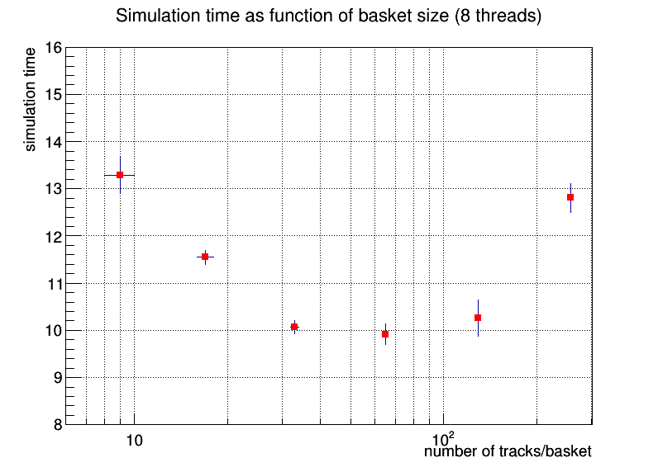
Parameters: basket size
The vector size is a major parameter of the model
  Impacts on vectorization potential
The optimum value depends on many parameters
  Such as geometry complexity, physics
  To be explored for several setups
Small vectors = inefficient vectorization, dispatching becomes an overhead
Large vectors = larger overheads for scatter/gather, more garbage collections (less transportable baskets)
The differences in total simulation time can be as high as 30-40%
  Aiming for an automatic adjustment of vector size per volume
  Performing at least as good as the optimum for fixed vector size
Notes:
Vector size is a important parameter, depending on many parameters
Two extreme scenarios can trigger inefficient transport – probed to be true

Slide 18
GeantV & genetic algorithms
Optimize GeantV scheduler model
  Use genetic algorithms to find the optimum in the parameter space
  Repeat for many setups with different geometry and physics configurations
  Understand the patterns of the model and derive adaptative behavior for parameters (short learning phase followed by parameterized behavior)
Model chromosomes: thresholds for prioritizing events, basket size, number of threads, threshold for switching to single track mode, size of event buffer
Fitness function: minimize simulation time while keeping in predefined memory limits
Currently investigating single parameter space
  Understand the range to be scanned, expected behavior
  Used in order to define the crossover, mutation, or other methods to evolve the genetic population
Notes:
Now investigating methods to optimize the behavior of the model
- One approach we are looking into is the use of GA

Slide 19
Summary
Track scheduling is one of the core components of the GeantV project
  Allowing to achieve performance from locality, fine grain parallelism and vectorization
Vectorization has a cost
  Overheads in vector reshuffling and gather/scatter have to be (much) smaller than the SIMD and locality gains
The preliminary benchmarking shows important performance gains with respect to the classical transport approach
  Simple geometry and physics so far
  The gains expected to increase with the complexity
The scheduling model is complex and its optimization difficult
  Currently understanding the behavior of single parameters
  Started to investigate an approach based on genetic algorithms

