Slide 1
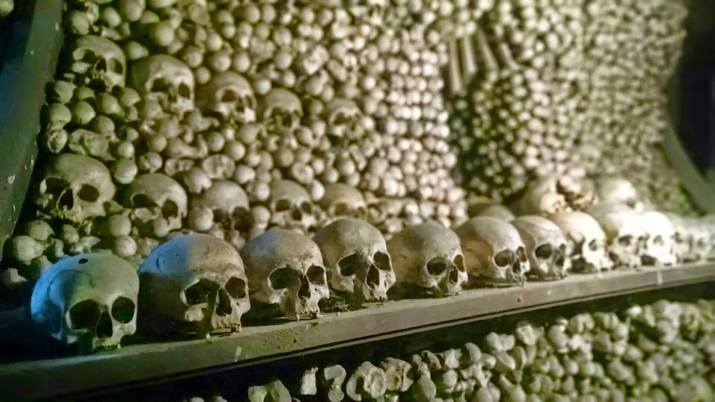
Pidrix: particle identification matrix factorization
Evan Sangaline
Michigan State University
ACAT 2014

Slide 2
Traditional particle identification
Measure things that carry information about particle identity (dE/dx, 1/β, invariant mass, Čerenkov radiation, calorimeter energy, etc)
Painstakingly model these things for each particle type (crystal ball, normal distribution, Student’s t-distribution, etc)
This step is really hard and error prone.
Can we just skip it?
Maximize the likelihood to determine our best estimates of shapes and yields

Slide 3
pidrix
Measure things that carry information about particle identity (dE/dx, 1/β, invariant mass, Čerenkov radiation, calorimeter energy, etc)
Yes!
Maximize the likelihood to determine our best estimates of shapes and yields

Slide 4
The Assumptions
We have a number of different particles that we measure
  π, K, p, e, etc but could also be “background”
For a given particle type each dimension of measurement is uncorrelated
  e.g. ToF measurement error is not correlated with dE/dx measurement error
  Bin on momentum and pseudorapidity to remove physics correlations
Our particle yields follow Poisson statistics
  No yields less than zero

Slide 5



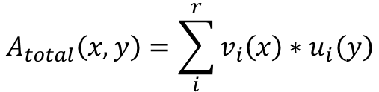



Towards something more mathematical
This means that we expect the observed density to be of the form
$$A_{total}\left(x,y\right)=\sum_{i}^{r}{v_{i}\left(x\right)∗u_{i}\left(y\right)}$$
where
and
are positive semidefinite and real
$$v_{i}\left(x\right)$$
$$u_{i}\left(y\right)$$
Get your bearings:
$$x,y$$
are the measurement variables (dE/dx and 1/ β for instance)
$$A_{total}\left(x,y\right)$$
is a fit function
$$v_{i}\left(x\right)∗u_{i}(y)$$
is the contribution to the fit function for the i^{th} particle
$$r$$
is the number of distinct particle types

Slide 6

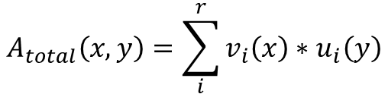
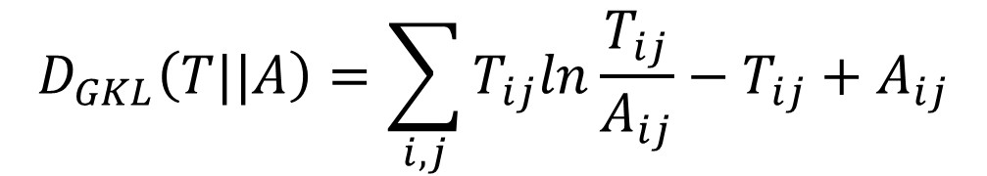
Further…
We use histograms so let’s discretize things
$$A_{total}\left(x,y\right)=\sum_{i}^{r}{v_{i}\left(x\right)∗u_{i}\left(y\right)}$$
becomes
$$A_{m_{x}n}=U_{m_{x}r}V_{r_{x}n}$$
Now say our observation histogram is T,
then maximizing the log-likelihood is equivalent to minimizing the generalized Kullback-Leibler divergence:
$$D_{GKL}\left(T||A\right)=\sum_{i,j}{T_{ij}ln\frac{T_{ij}}{A_{ij}}−T_{ij}+A_{ij}}$$

Slide 7
Now what?
Traditional Fitting
Pidrix
Restrict the space of possible U and V matrices according to our models before minimizing.
e.g. “The columns of U must be Gaussians and the rows of V must be Student’s t-distributions.”
Don’t model anything. Just minimize the KL divergence.
i.e. Skip the hard part.

Slide 8
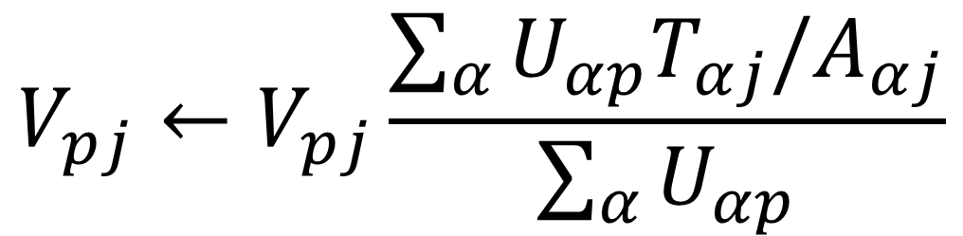
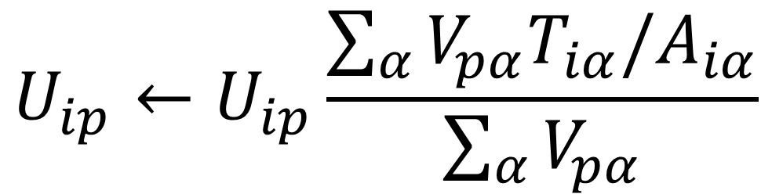
Minimizing the kullback-leibler divergence
These update rules can quickly be seen to be stable when T=A.
Also, if U and V start out positive definite and real then they will also remain so (our non-negative yield constraint).
$$U_{ip}←U_{ip}\frac{\sum_{α}{V_{pα}T_{iα}/A_{iα}}}{\sum_{α}{V_{pα}}}$$
$$V_{pj}←V_{pj}\frac{\sum_{α}{U_{αp}T_{αj}/A_{αj}}}{\sum_{α}{U_{αp}}}$$

Slide 9
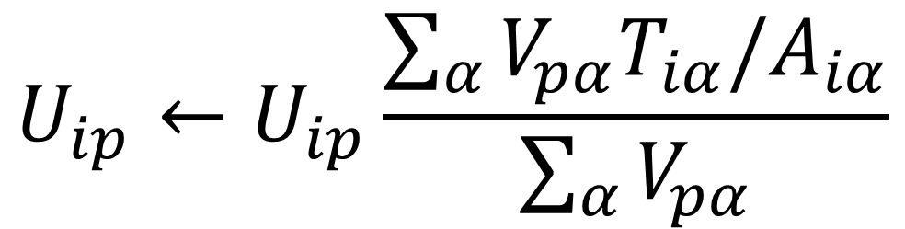
How do they work?
$$U_{ip}←U_{ip}\frac{\sum_{α}{V_{pα}T_{iα}/A_{iα}}}{\sum_{α}{V_{pα}}}$$
First: think of T/A (element-wise) like a residual
  If an entry is less than one then we are underestimating that bin with our approximation, greater than one and we’re overestimating
For a given particle p (proton) we look at a specific i (dE/dx)
Then we take our current normalized ToF distribution (the p^{th} column of V) corresponding to protons and dot that with the row of T/A that corresponds to our current i value (dE/dx value)
If this particle’s ToF distribution has lots of yield where we are underestimating (overestimating) T then we’ll increase (decrease) the dE/dx distribution for this particle at our current i

Slide 10
Now Let’s see it in action
We’ll start with random distributions and see how well they converge…

Slide 11
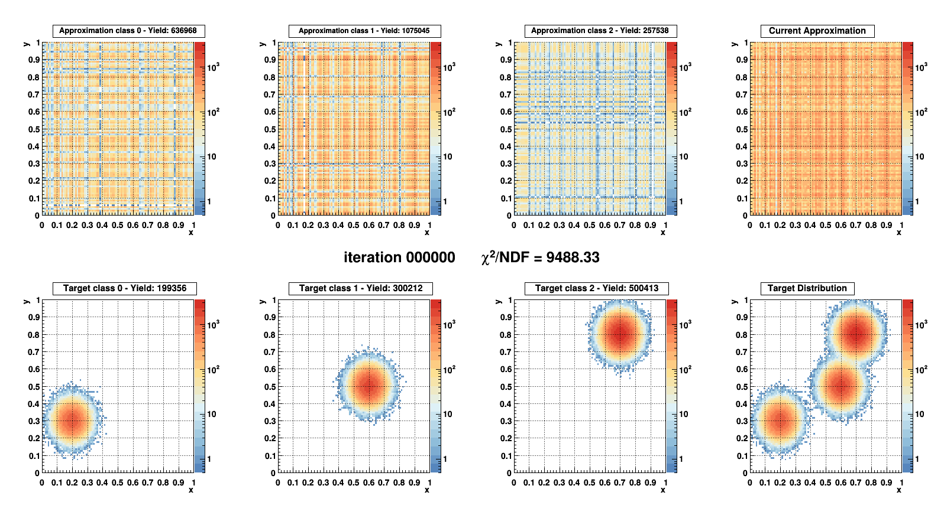

Slide 13
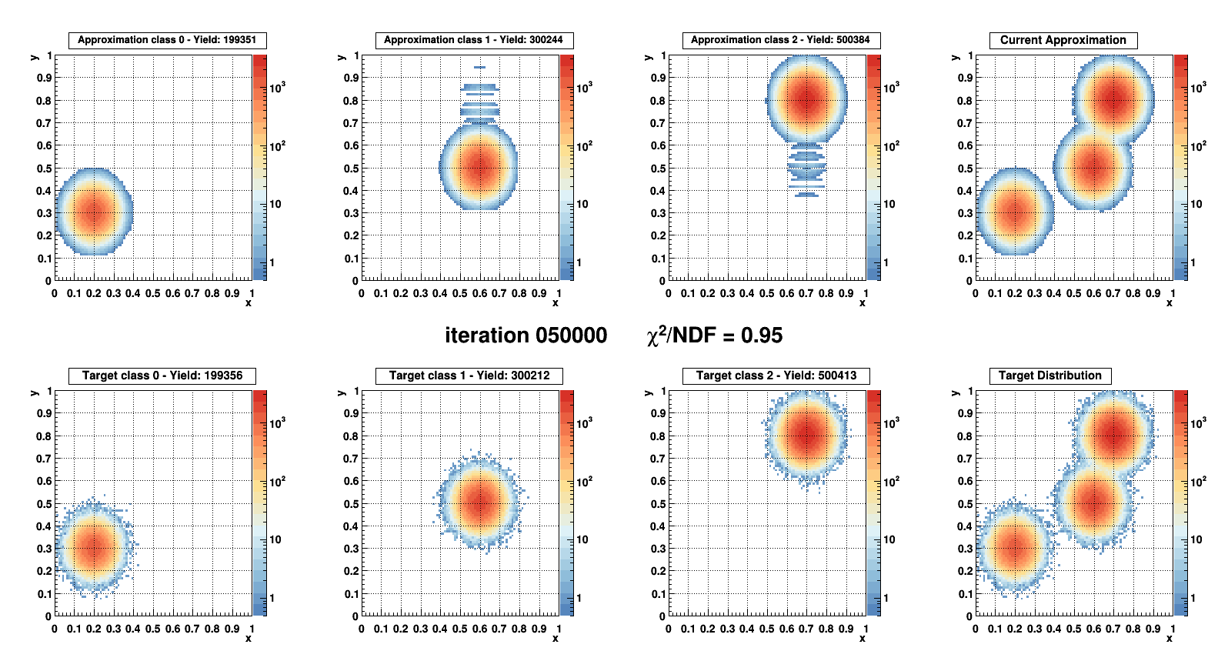
Spot on!
Not too shabby!

Slide 14
That one was too easy!
Modeling separated Gaussians is trivial,
what about more complicated distributions?

Slide 15
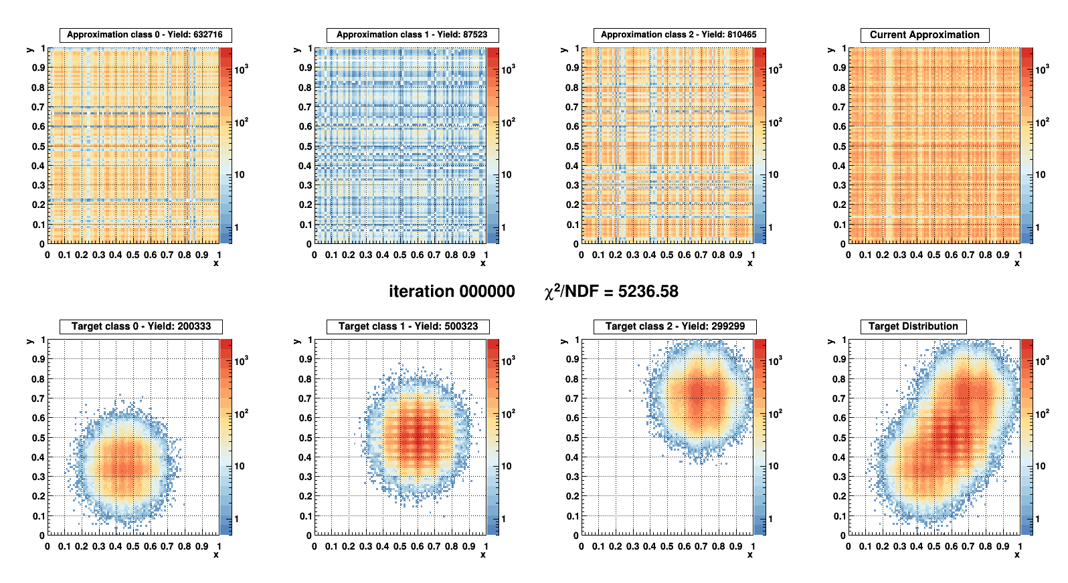

Slide 17
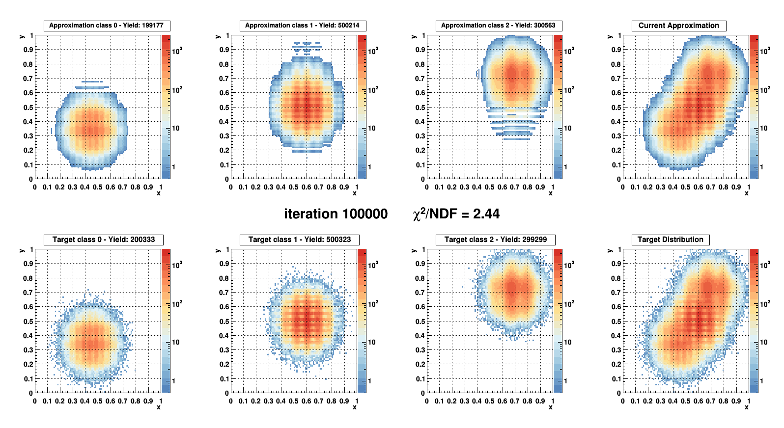

Slide 18
Better… but still unrealistic
How does it perform with less contrived examples?

Slide 19
Simulated dataset: 1 Billion tracks
π/K/p momentum spectra approximates those from Au+Au 62.4 GeV
Time-of-Flight and dE/dx measurements are made for each particle
  Non-Gaussian Shapes
  Landau distribution for 15-45 dE/dx hits with highest 30% of measurements rejected for each track
  Possibility of similar momentum tracks merging and having higher dE/dx measurements
  Possibility of ToF measurement mistmatches between different particles
  Student’s t-distribution for ToF measurement resolution
Momentum has limited resolution (2% on curvature)
Finite momentum bin width size (50 MeV bins)
It’s dirty, it’s messy, and it’s realistic

Slide 20
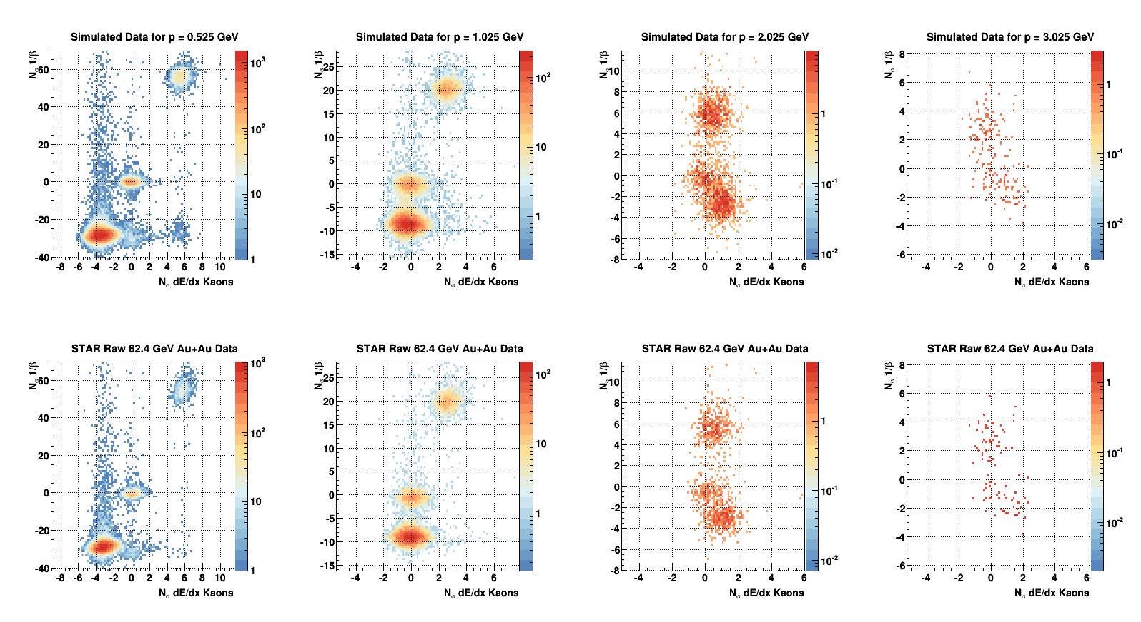
Pretty similar, I’m not trying to brush anything under the rug here.

Slide 21
Now we’ll compare…
We’re about to look at the ratio of Gaussian model fits and Pidrix fits over the true yields from simulations.

Slide 22

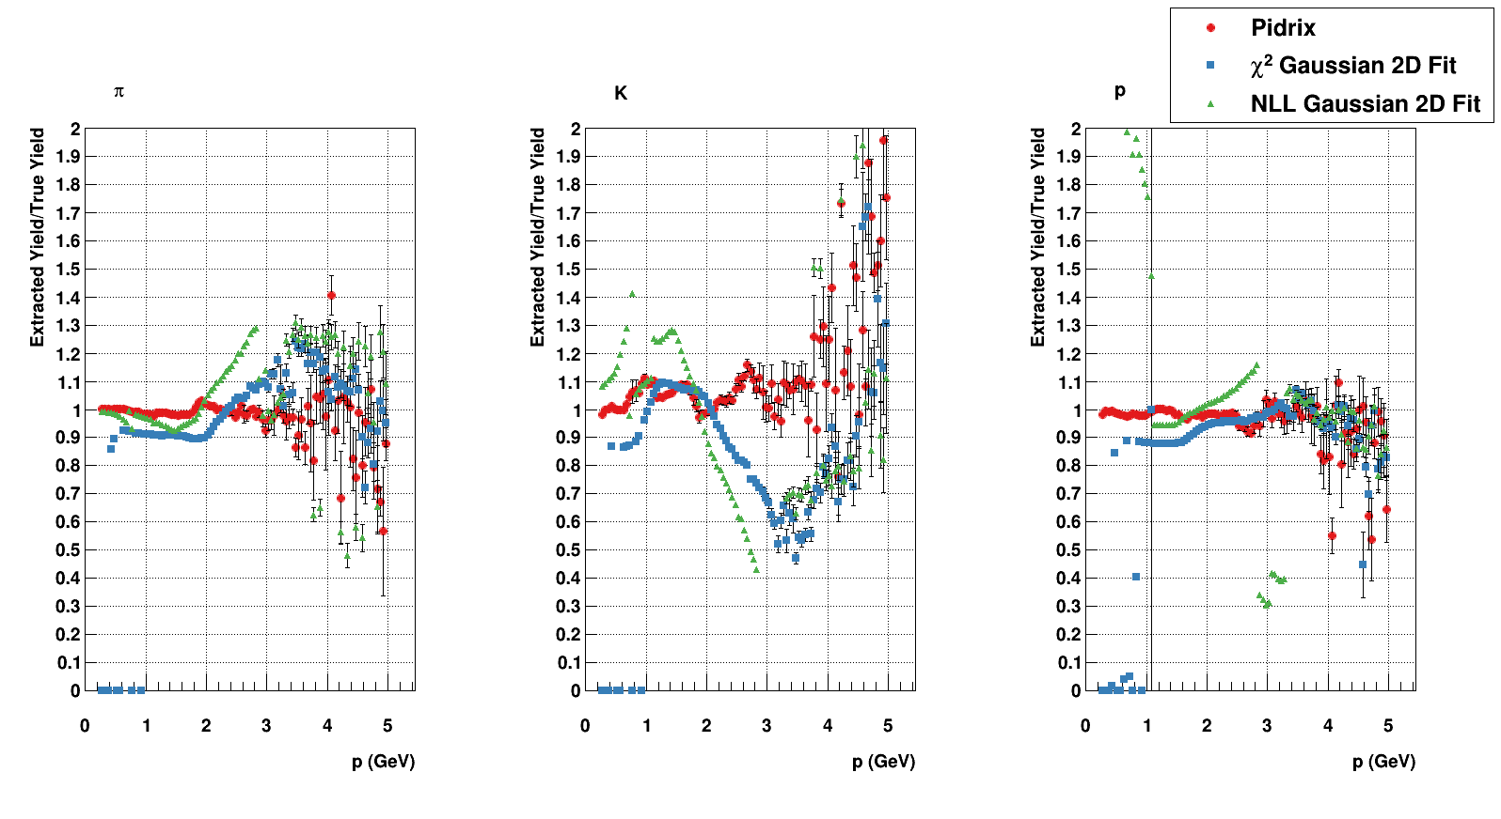
Off the charts!
Yuck, failed fits. What do we have to fudge to get these to work?
Pidrix outperforms the model fits, especially at high p
We don’t realize when we make this mistake because the spectra still looks realistic.

Slide 23
What about errors?
Perform Gibb’s sampling on elements of U and V
  Interpolate between neighboring elements to set scale of fluctuations (to enforce symmetry of the transition)
    Add one to interpolation to avoid zeros from propagating
  Add Gaussian value with width of 10% of the fluctuation scale
  Reject negative values
Use k-means clustering between samples to associate particles
  Various norms (‘means and yields’, symmetrized Kullback-Leibler, etc)
This results in likelihood distributed U and V matrices
  Directly compute standard deviations of yields, means, single particle distributions, or whatever you want

Slide 24
How do they compare?
What factor would the yield error have to be multiplied by to be correct?
Pidrix Chi-squared Log-likelihood
π 4.6 750000 77
K 7.2 230000 160
P 4.2 270000 360
Minuit errors don’t mean much when the model isn’t exactly right.
Pidrix gives far more accurate errors though still not great.
Small errors aren’t better if they’re wrong!

Slide 25
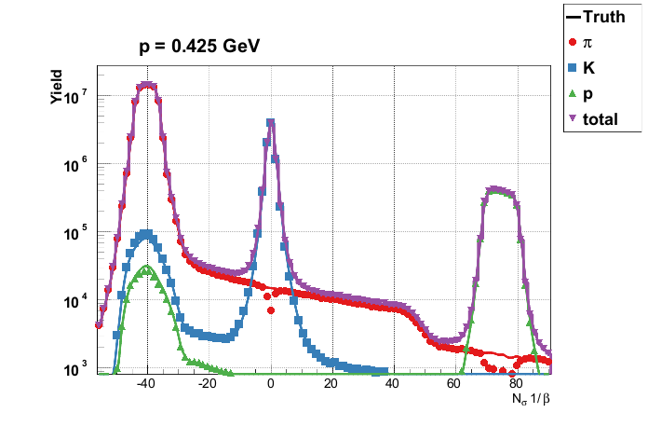
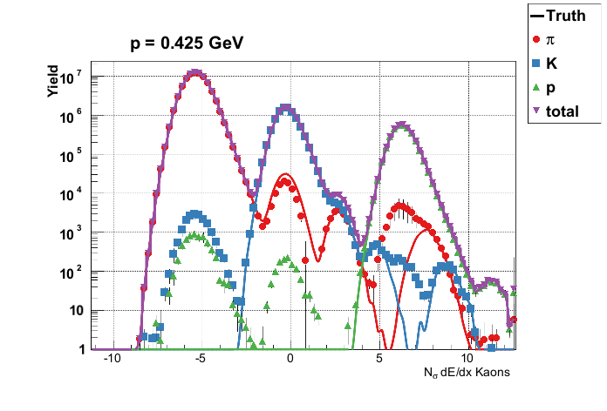
Back to U and V…
Their columns and rows have physical meaning.

Slide 26
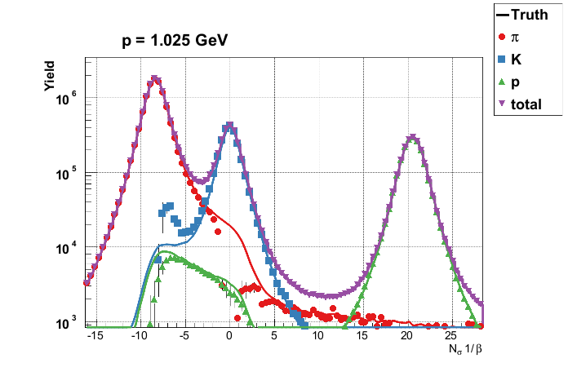
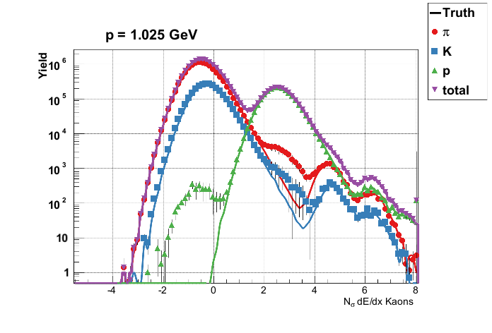
Sometimes Minor Mixing issues under peaks
Is sampling not fully exploring the space?
Or does momentum smearing drive this?

Slide 27
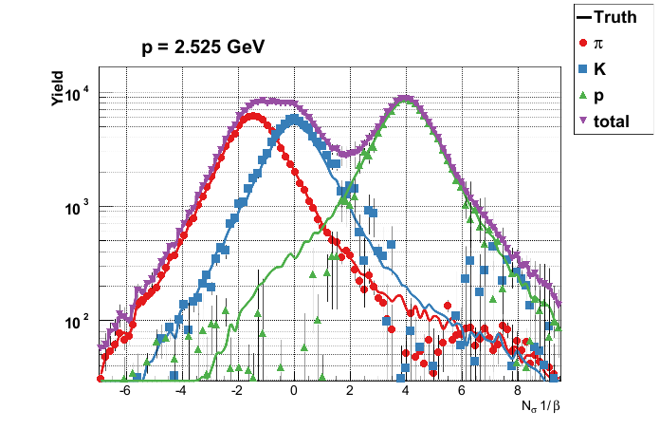
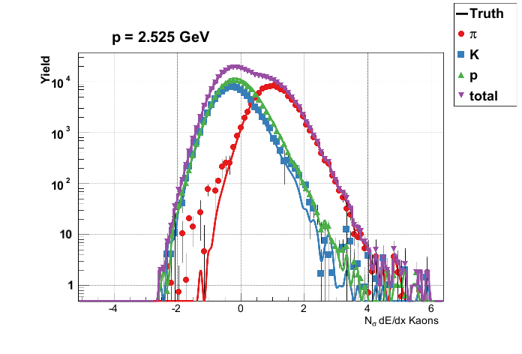
PIDRIX particularly excels at high p
This region is extremely difficult to model.

Slide 28
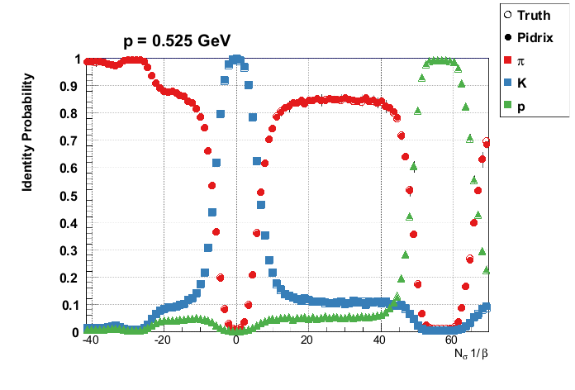
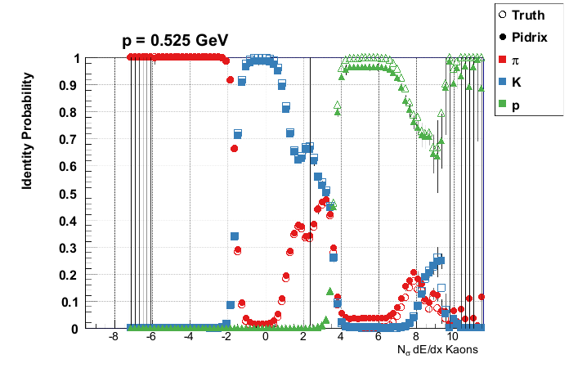
Purity and efficiency
Want some help picking your cuts for high purity?

Slide 29
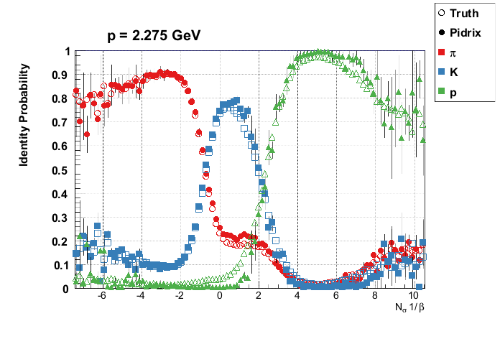
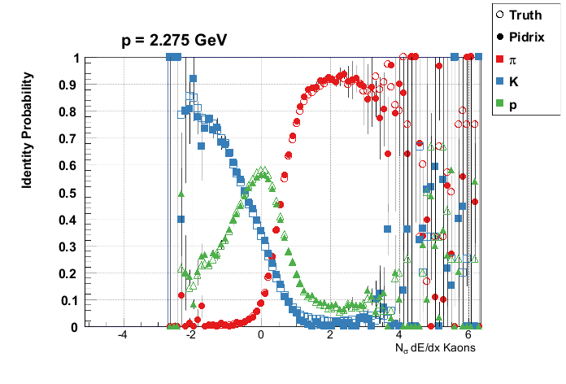
Purity and efficiency
Or calculating what your cut efficiency is?

Slide 30
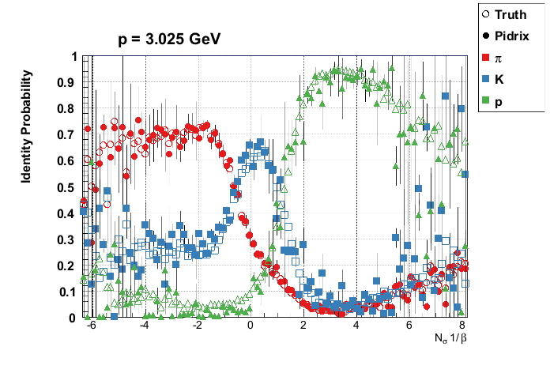
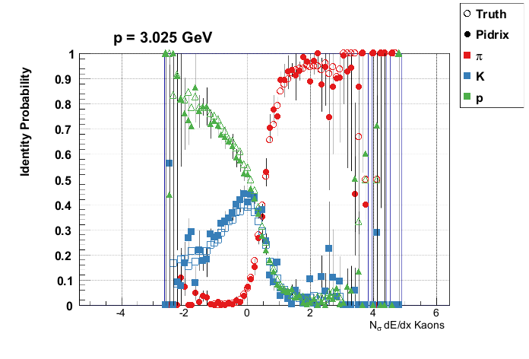
Purity and efficiency
These can be extracted directly from U and V.

Slide 31
Reiteration
We’re doing a negative log-likelihood minimization
  Just not using a model and being clever about how we do this
The worst assumption is that the measurements are uncorrelated
  Even when this is broken by momentum resolution and finite bin width it still works
  Progress is being made to accommodate breaking this assumption
The same code applies to different cuts, binnings, and even experiments
  No model means no model tuning
It seems to work very well!

Slide 32
Less is more?
A new method for particle identification has been described
  Faster, easier, and less assumption oriented than model based fitting
  Extremely promising accuracy observed so far
FOSS library is available:
  https://github.com/sangaline/pidrix
  Documentation is lacking… examples coming soon
Interested in using this method?
  Please email esangaline@gmail.com
  Especially if your experiment has >2 PID measurements for each track!

