Slide 1
CENF EHN1

Slide 2
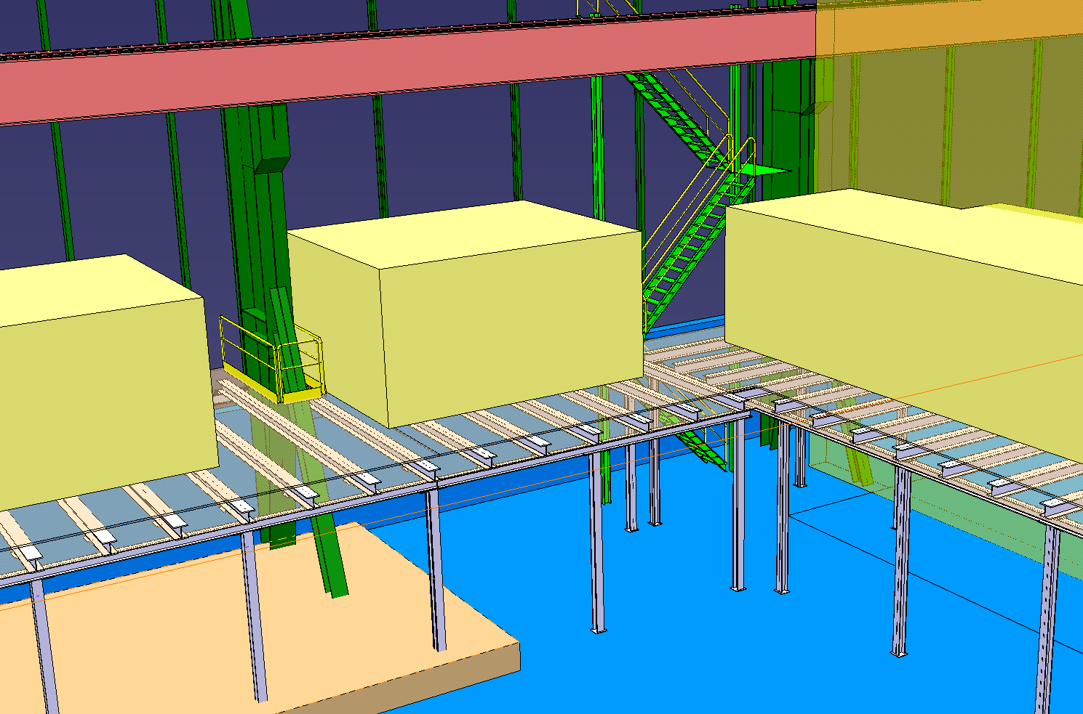
Modelisation des infrastructures par Vincent:

Slide 3
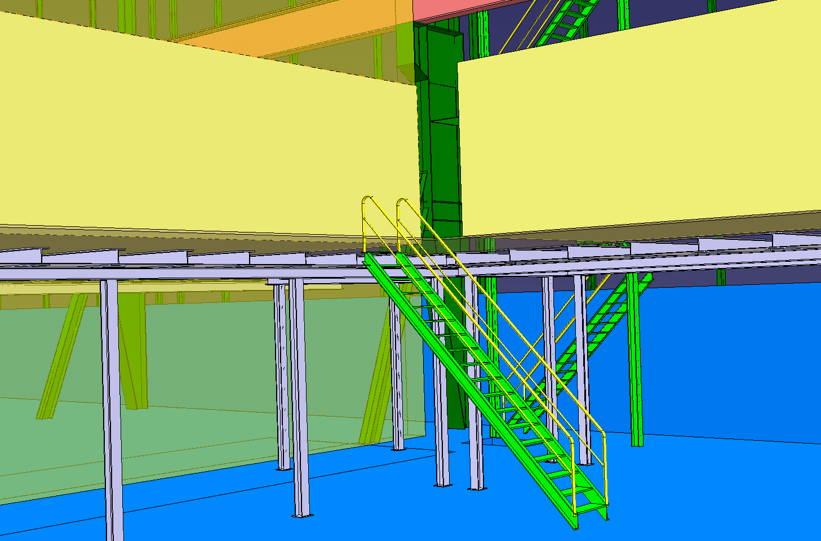
Modelisation des infrastructures par Vincent:

Slide 4
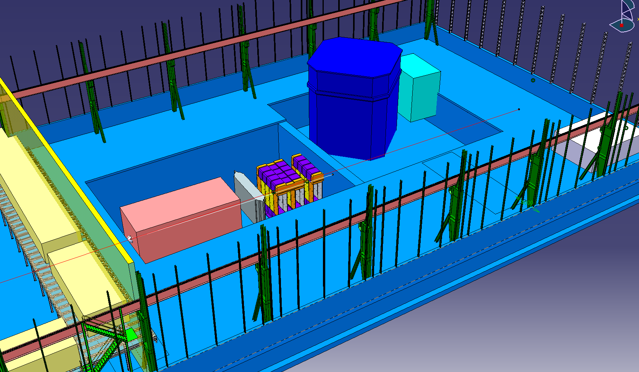

Slide 5
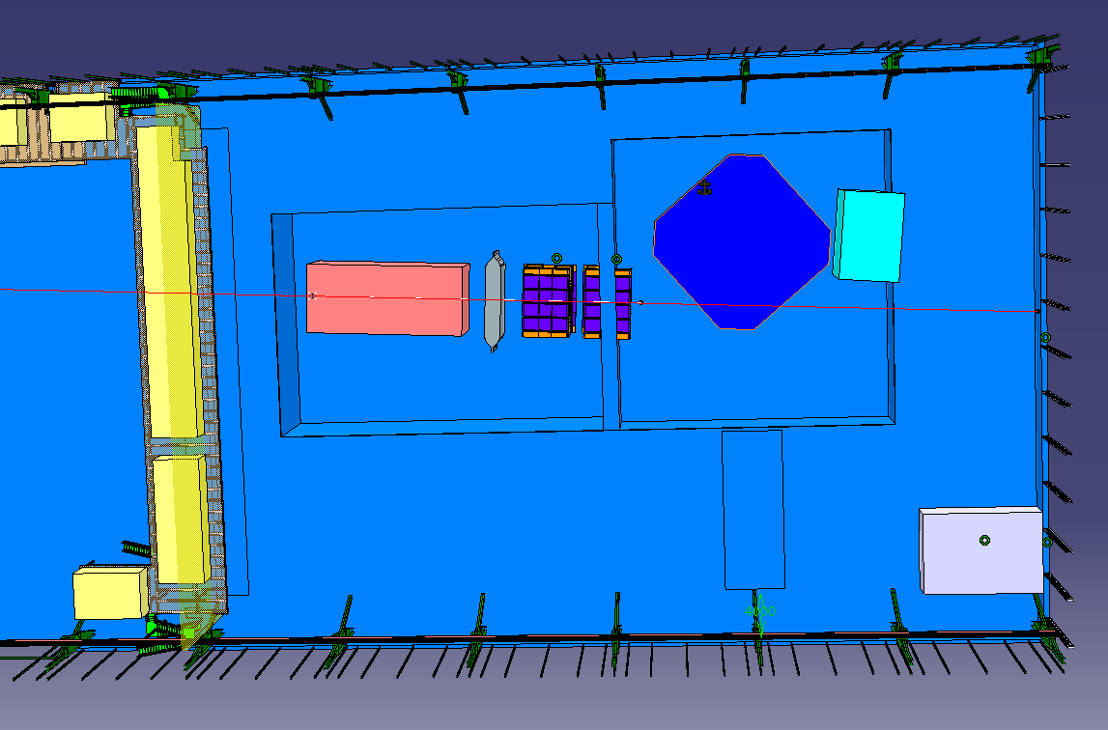

Slide 6
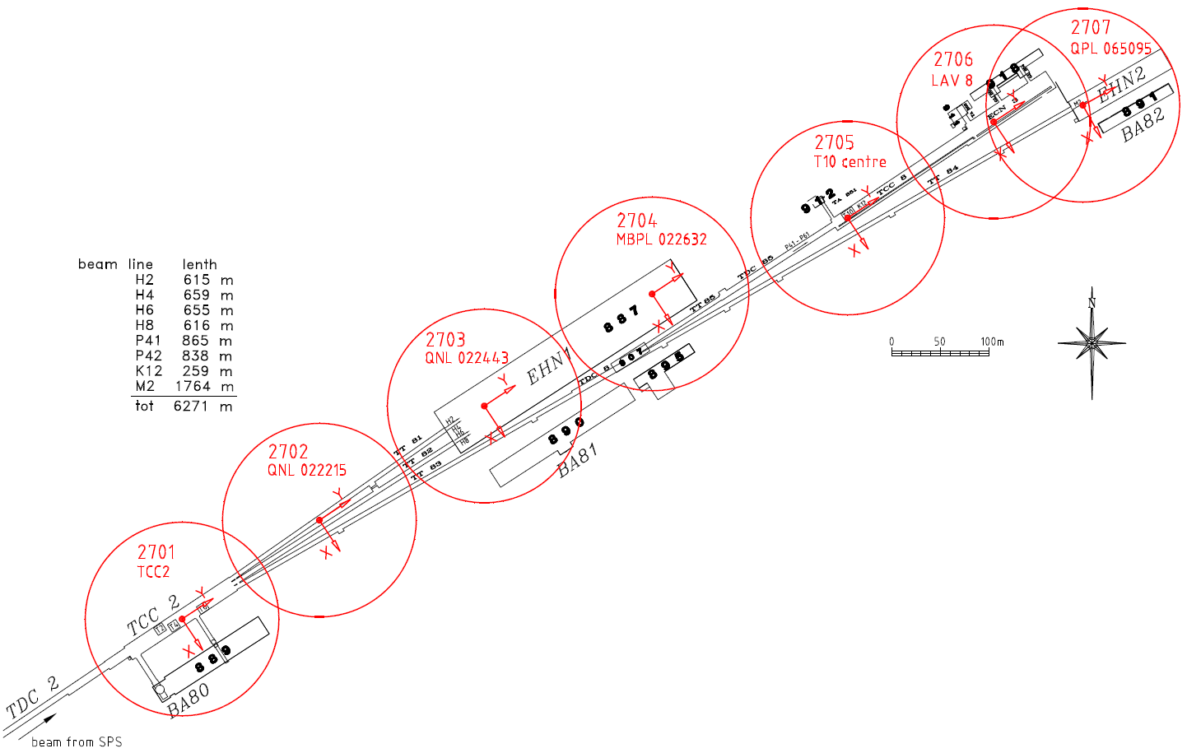
New origins proposal for north area
Rayon: 100 m

Slide 7
SCANS
EHN1 scans, TrueViews done(T. Dobers):
\\cern.ch\dfs\Support\SurveyingEng\Instruments\LaserScanner\TrueViews\EHN1
Post processing to be done → ptu into cern global system

