Slide 1
CENF: Electrical Integration
J. Devine Current status presentation 18/06/13
Contents:
Update on distribution infrastructure & principles – TE/EPC feedback
Load Schedule – Near Detectors
General power requirements

Slide 2
Distribution infrastructure: 1.0
Transfer Line:
Power Converters
Target + Support Building: General Services
Near Detector: General Services
Far Detector: General Services
7MVA RMS
BA80 Building
BA81 Building
BA82 Building
Machine/Pulsed
BE91 Building
Stable Network
Secure Network

Slide 3
Distribution infrastructure: 2.0
Transfer Line:
Power Converters
Target + Support Building: General Services
Near Detector: General Services
Far Detector: General Services
7MVA RMS
BA80 Building
BA81 Building
BA82 Building
Machine/Pulsed
BE91 Building
Stable Network
Secure Network

Slide 4
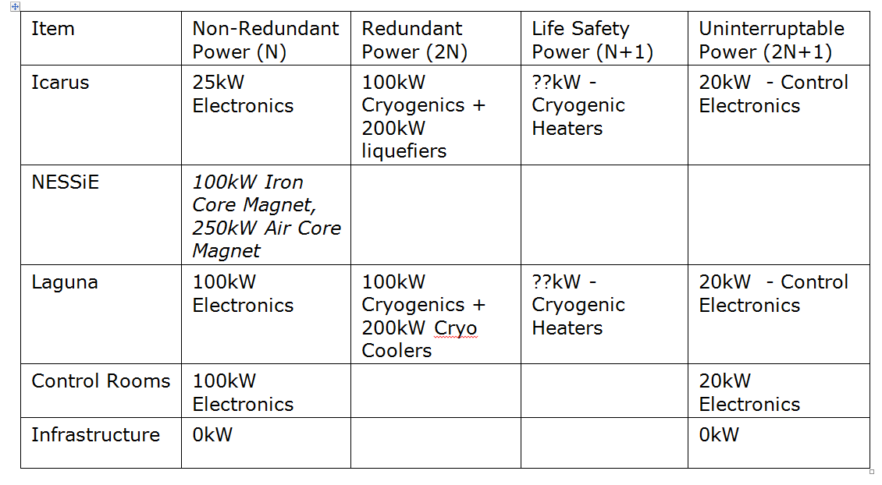
Near Detector: Power requirements
Pulsed/Machine: 350kW, BA81
Stable Loads (General): ~2MW – 1x2MVA/2x2MVA?
Infrastructure: EHN1, LV link to BA81

Slide 5
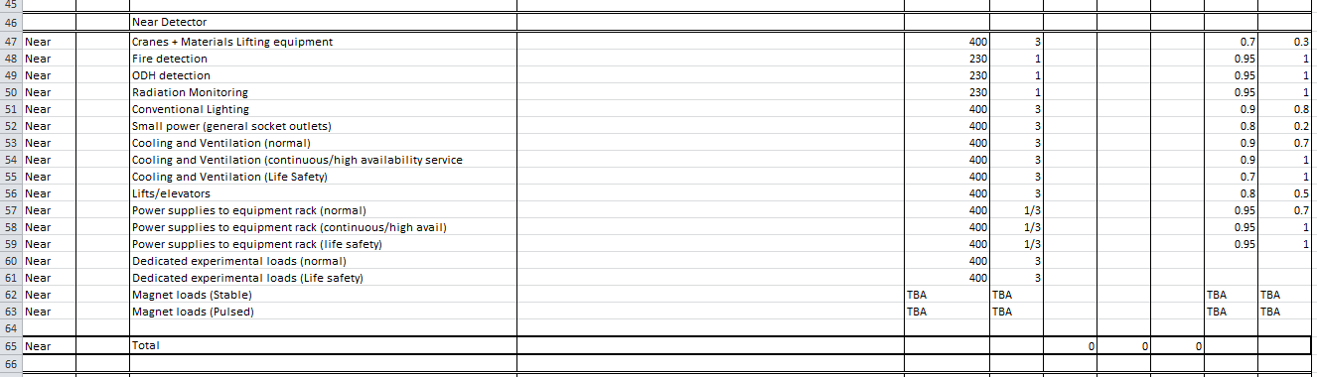
General Power requirements
Please fill in – basis for detailed LV network design.
Load:KW/KVA/MVA
Power factor: 0-1
Diversity: 0-1 (1 = always on)

