Slide 1
General plans and Updates:
Recycling of OPERA SpectroMeters (SM) → to be used both in the NEAR/FAR detectors
Two SMs per site instead one
Decreased single SM z-dimension
Decreased SMs Y-dimensions
Decreased pit depth
Decreased floor load
Decreased NEAR width (X)
Increased the distance between ICARUS NESSiE
Overall SM z footprint increased → ~3.5 m

Slide 2
Space amount , footprints:
NESSiE NEAR site:
Height (along y): 5.47 m
Length (along z): 10.06 m
Transverse (along x): 9.75 m
We need the PIT 3 m longer along Z as a consequence of two ICM instead of one, therefore the surfaces we require in the PITs are:
FAR site PIT (dedicated to NESSiE) → z=18 m, x=20m → 360 m2
NEAR site PIT (dedicated to NESSiE) → z=15 m, x=20m →300 m2
in order to work smoothly and comfortably.
We are going to hear about some updates on Laguna Prototype (LP).
We would like to know the latest numbers coming from LP including the spectrometer → Space between NESSiE and LP
NESSiE FAR site:
Height (along y): 6.65 m
Length (along z): 10.06 m
Transverse (along x): 13.5 m
The most updated 3D drawing will be available in time for the meeting of 27 June.

Slide 3
Power requirement
NEAR (FAR)
ACM
ICM
ICM
L =10 m
3-phase
400 V
233 kW (450 kW)
3-phase
380 V
56 kW (56 kW)
Cooling:
(copper and aluminium circuits)
3-phase, 380 V
Single-phase, 220 V
Racks and PCs:
Single-phase, 220 V

Slide 4
Estimated power consumption including cooling, racks and PCs :
*We consider PS 20 m far from ACM in the following numbers
Power in kW | NEAR | FAR
ACM | 292 | 547
ICM | 81 | 81
TOTAL | 373 | 628
The more the distance between PS and ACM, the more power to be consumed. e.g. increasing from 20 m to 100 m, the power consumption increase from 377 kW to 424 kW in NEAR site.
Two points will be investigated further:
Power needed for the ACM cooling
Power lost in the line between the ACM PS and the ACM input

Slide 5
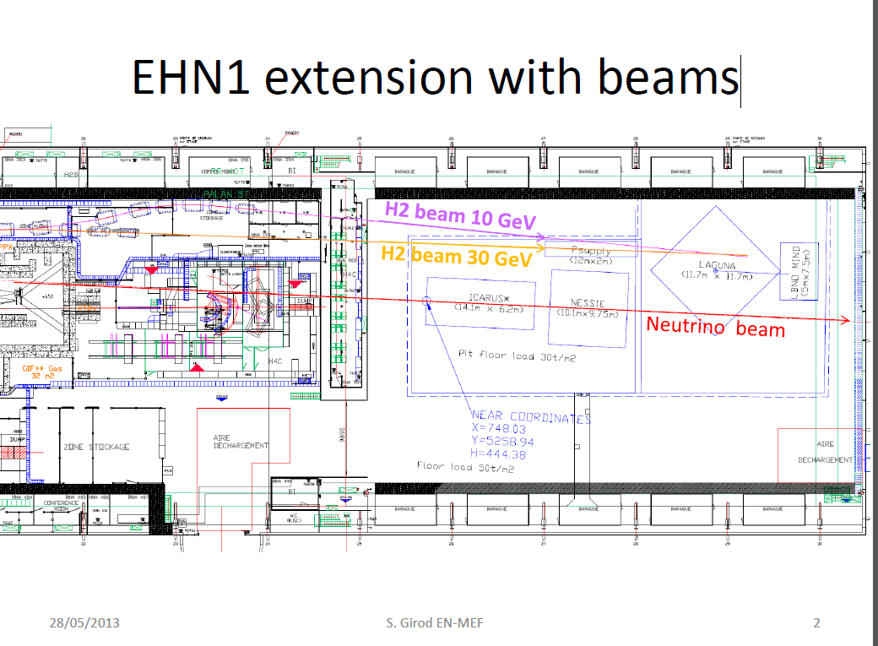
We need to have a space about 14 x 2 m² (a little bit smaller in the NEAR site ) for PS close to ACM!!

Slide 7
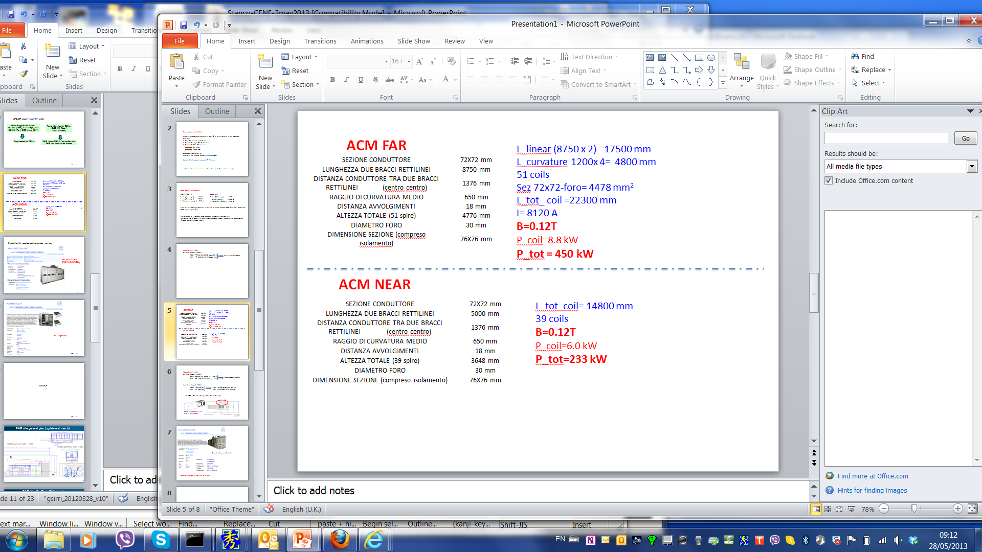
Power Supplies (PS) I:
Air Core Magnets (ACMs):
NEAR → 233 kW, 8120 Amps, 29 V
FAR → 450 kW, 8120 Amps, 55 V
Requirement to CERN
The overall power will few % more, let’s say 5%, to take into account the power loss in the supply inline.

Slide 8
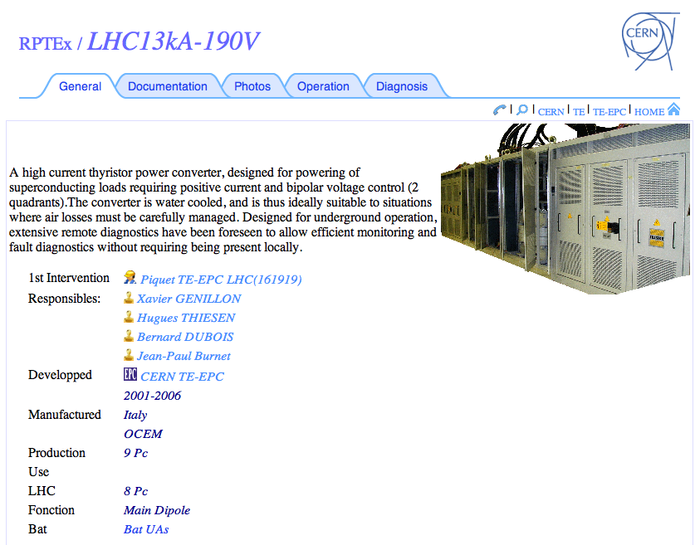
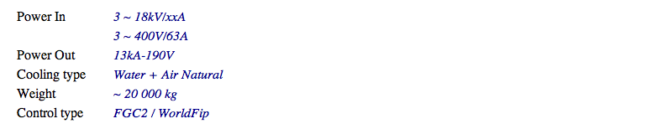
Original setup considered…
Power supply type is foreseen to be used

