Slide 1
First observation of electroluminescence in liquid xenon within THGEM holes: towards novel Liquid Hole-Multipliers
L. Arazi, A. Breskin, A. Coimbra*,
R. Itay, H. Landsman, M. Rappaport, D. Vartsky
Weizmann Institute of Science
* On leave from Coimbra Univ.
A. Breskin RD51 Zaragoza July 2013

Slide 2
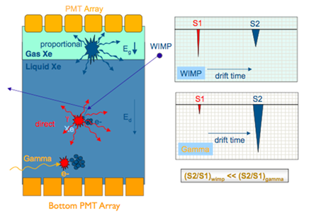
CLASSICAL DUAL-PHASE NOBLE-LIQUID TPC
Present:
XENON100, ZEPLIN, LUX….
Under design:
XENON1ton
Future:
MULTI-TON (e.g. Darwin):
COST
STABILITY
THRESHOLD
A two-phase TPC. WIMPs interact with noble liquid; primary scintillation (S1) is detected by bottom PMTs immersed in liquid. Ionization-electrons from the liquid are extracted under electric fields (E_{d}, and E_{g}) into the saturated-vapor above liquid; they induce electroluminescence in the gas phase – detected with the top PMTs (S2). The ratio S2/S1 provides means for discriminating gamma background from WIMPs recoils, due to the different scintillation-to-ionization ratio of nuclear and electronic recoils.

Slide 3
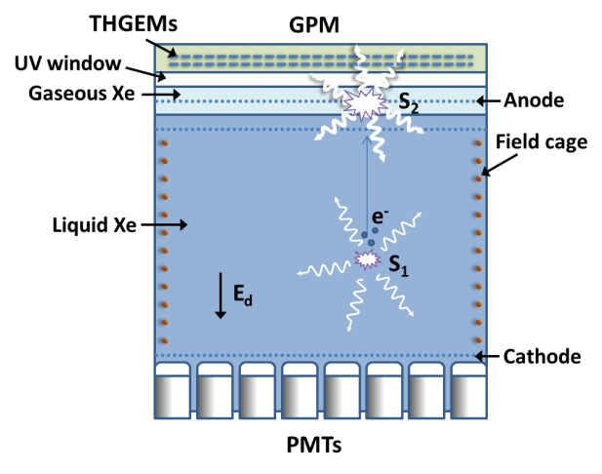
Dual-phase TPC with GPM* S2 sensor
GPM
*GPM: Gaseous Photomultiplier
R&D in course @ WIS
Within DARWIN
A proposed concept of a dual-phase DM detector. A large-area Gaseous Photo-Multiplier (GPM) (operated with a counting gas) is located in the saturated gas-phase of the TPC; it records, through a UV-window, and localizes the copious electroluminescence S2 photons induced by the drifting ionization electrons extracted from liquid. In this concept, the feeble primary scintillation S1 signals are preferably measured with vacuum-PMTs immersed in LXe.

Slide 4
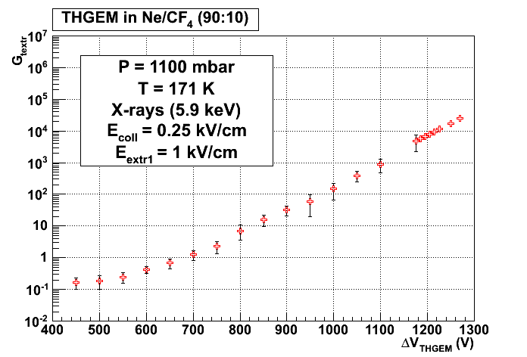
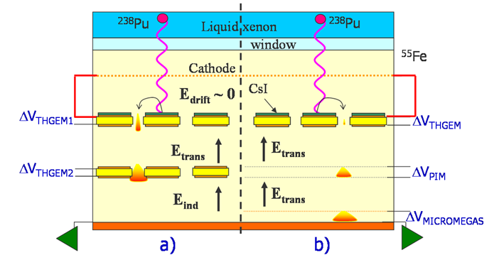
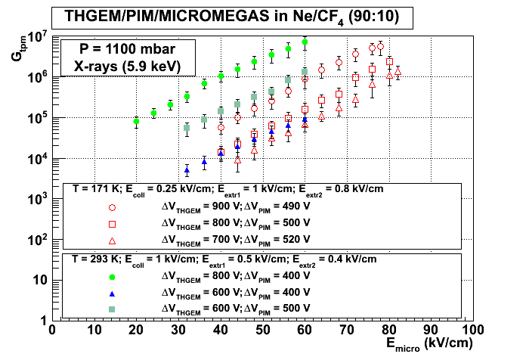
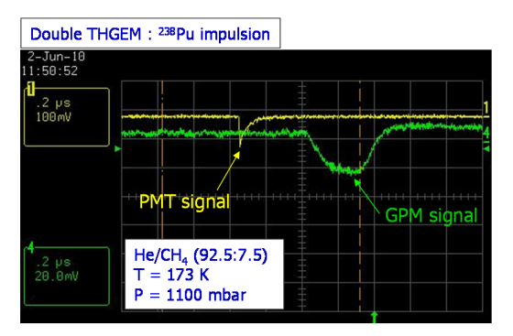
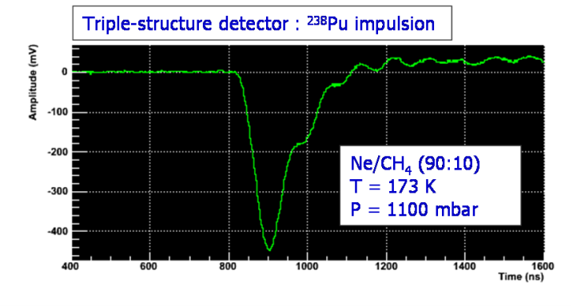
LXe-TPC/GPM
Nantes/Weizmann
1-THGEM
10⁴
171K
RT
10⁷
171K
173K, 1100mbar
Duval 2011 JINST 6 P04007

Slide 5
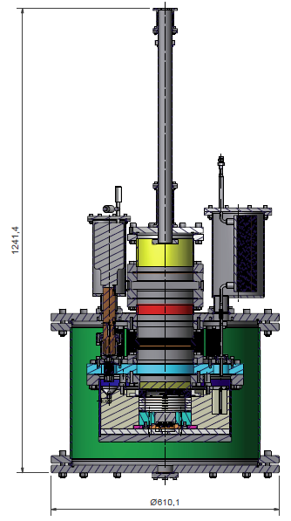
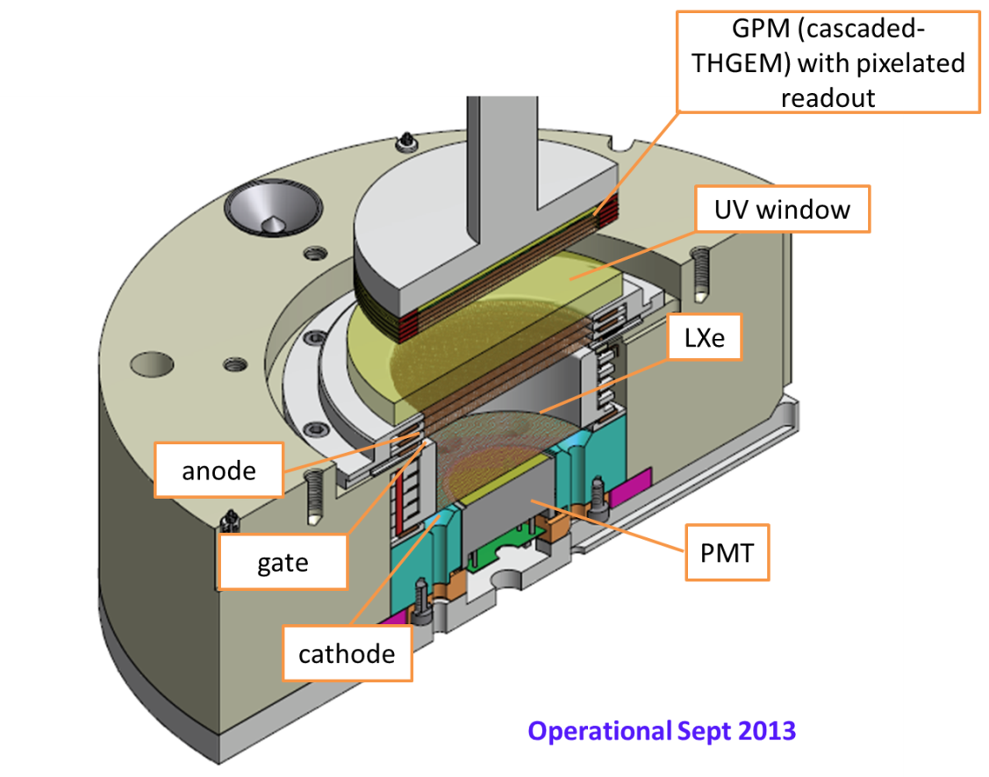
WIS Liquid Xenon (WILiX) R&D facility
GPM guide, gas, cables
Basic consideration: allow frequent modifications in GPM without breaking the LXe equilibrium state
GPM load-lock
Xe liquefier
Xe heat exchanger
GPM
TPC
Inner chamber (LXe)
Vacuum insulation
A. Breskin RD51 Zaragoza July 2013

Slide 6
Towards single-phase TPCs?
Technically simpler?
Sufficient signals?
Lower thresholds?
Cheaper?
Resolutions?
How to record best scintillation & ionization S1, S2?

Slide 7
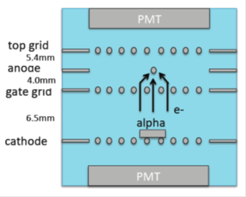
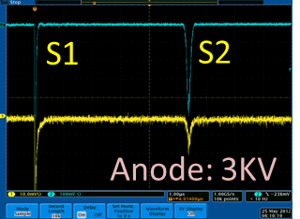
Single-phase detector ideas
S1 & S2 with UV-PMTs: S2 from multiplication on wires in liquid.
Early works, 70’s, on wire multiplication: T. Doke Rev. NIM196(1082)87;
recent R&D E. Aprile @ Columbia
private communication
2012
S1 & S2 with Spherical TPC : S1 p.e. from CsI and S2 electrons multiplied in GEMs in the liquid
idea: P. Majewski, LNGS 2006
S1 & S2 with GPMs/CsI: S2 from multiplication on wires in liquid.
idea: K. Giboni, KEK Seminar Nov 2011
S1 & S2 with cascaded Liquid Hole-Multipliers (LHM): S1 & S2 multiplication in CsI-coated cascaded THGEMs (or GEMs, MHSPs etc.).
idea: A.B. Paris TPC2012 Workshop; arXiv:1303.4365
R&D LHM/LXe - in course

Slide 8
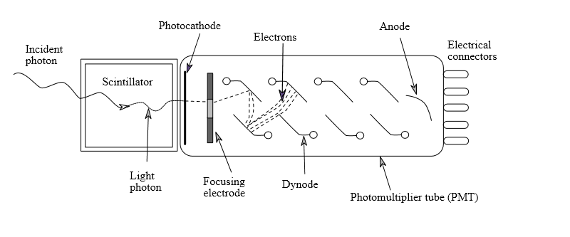
S1 & S2 with single Liquid Hole-Multiplier LHM
Light amplification in cascaded hole-multipliers in the LIQUID
A.B. Paris TPC2012 Workshop; arXiv:1303.4365
High light gain➔
GPM readout
GPM
L
PADS
Noble liquid
sufficient charge➔
PAD readout
CsI
Holes:
Small- or no charge-gain
Electroluminescence (optical gain)
S2 Ionization
electrons
S1 photons
Feedback-photons from
final avalanche
or/and electroluminescence
BLOCKED by the cascade
Similar to PMT dynodes…

Slide 9
LHM: the process
A.B. Paris TPC2012 Workshop; arXiv:1303.4365
Modest charge multiplication + Light-amplification in sensors immersed in the noble liquid, applied to the detection of both scintillation UV-photons (S1) and ionization electrons (S2).
S1 UV-photons impinge on CsI-coated THGEM electrode;
extracted photoelectrons from CsI are trapped into the holes, where high fields induce electroluminescence (+possibly small charge gain);
resulting photons are further amplified by a cascade of CsI-coated THGEMs.
Similarly, drifting S2 ionization electrons are focused into the hole and follow the same amplification path.
Prompt S1 and delayed S2 signals are recorded optically by an immersed GPM (or PMT, GAPD…) or by charge collected on pads.
ONE DETECTOR RECORDS BOTH S2 and S1!

Slide 10
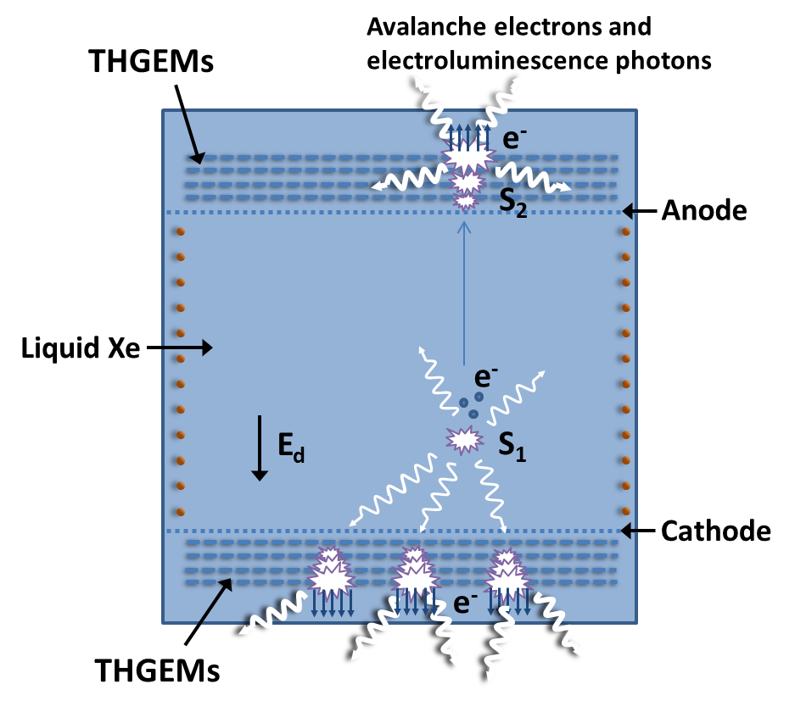
LHM-TPC
Detects S1&S2
Detects S1
A single-phase TPC DM detector with THGEM-LHMs.
The prompt S1 (scintillation) and the S2 (after ionization-electrons drift) signals are recorded with immersed CsI-coated cascaded-THGEMs at bottom and top.

Slide 11
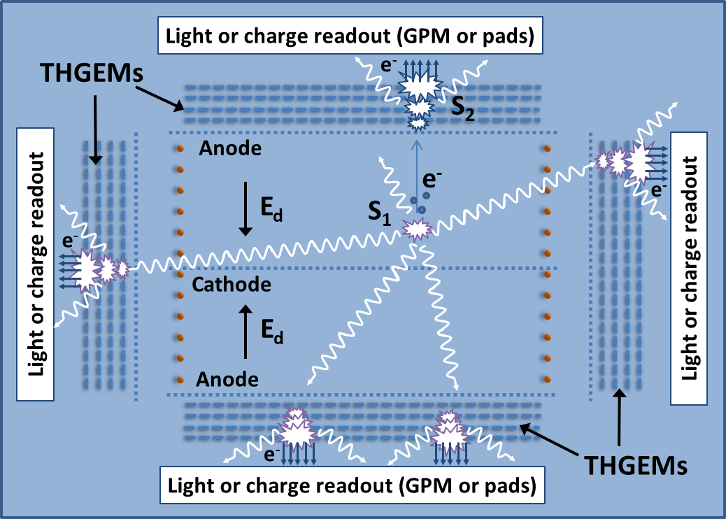
4-π LHM-TPC
Detects S1&S2
Detects S1&S2
A dual-sided single-phase TPC DM detector with top, bottom and side THGEM-LHMs.
The prompt S1 scintillation signals are detected with all LHMs. The S2 signals are recorded with bottom and top LHMs.
Highlights:
Higher S1 signals ➔ lower expected detection threshold
Shorter drift lengths➔ lower HV applied & lower e- losses

Slide 12
A CSCADED LHM-TPC
L
LHM
C
LHM
E
C
LHM
S1, S2
C
LHM
S1
C
LHM
LOW HV for large-volume
Relaxed electron lifetime
Need: low radioactivity and pad-readout
A. Breskin RD51 Zaragoza July 2013

Slide 13
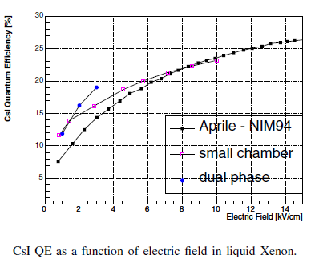
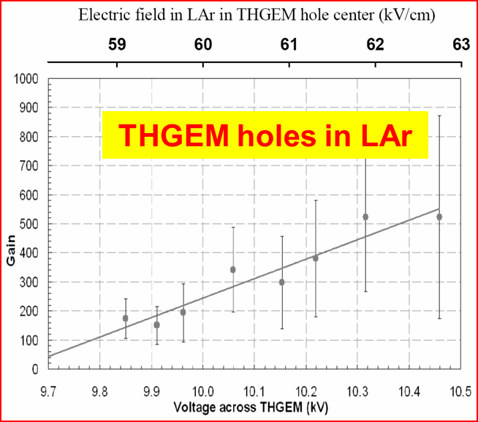
“Prior Art”
High QE from CsI in LXe
Data in LXe with thin wires
QE~25%
Electroluminescence threshold: ~400 kV/cm
on wires
e-avalanche threshold : ~1 MV/cm on wires
Doke NIM 1982
Maximum charge gain measured 200-400
on wires, strips, spikes…
Aprile IEEE ICDL 2005, p345
Electroluminescence from THGEM holes in LAr
~500 UV photons/e⁻ over 4π
measured with gAPD/WLS
Lightfoot, JINST 2009
~60kV/cm electroluminescence threshold
confirmed in THGEM/LAr
Buzulutskov JINST 2012
But: LAr purity unknown

Slide 14
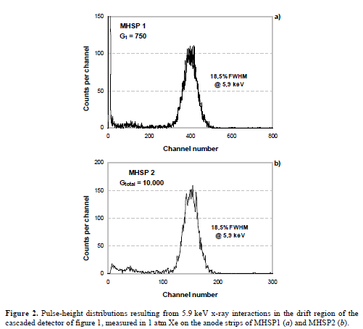
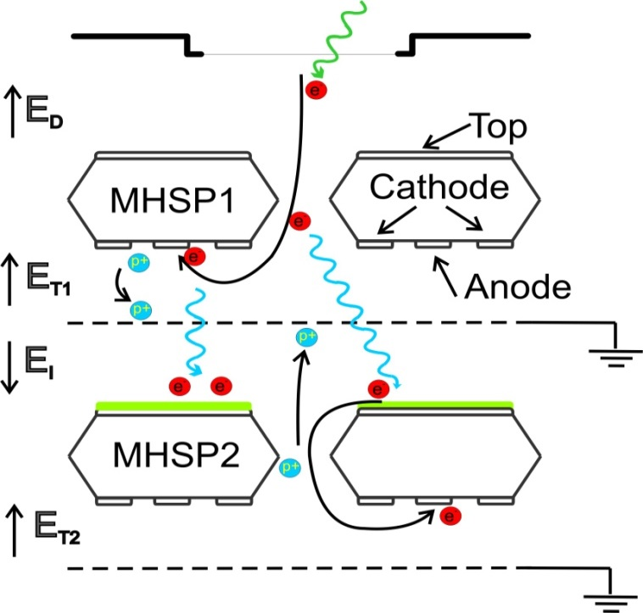
An Optical ion Gate
Aveiro/Coimbra/Weizmann
Radiation-induced electrons are multiplied in a first element
Avalanche-induced photons create photoelectrons on a CsI-coated multiplier
The photoelectrons continue the amplification process in the second element
No transfer of electrons or ions between elements: NO ION BACKFLOW
Avalanche-ions from first elements: blocked with a patterned electrode
For higher gains, the second element can be followed by additional ones
radiation
1 bar Xe
Charge gain
In MHSP 1
V_{hole}
Grounded mesh blocks the ions
Photon-induced
Charge gain
In MHSP 2
RESOLUTION MAINTAINED
Scintillation light converted to photoelectrons on a CsI photocathode
VELOSO et al. 2006 JINST 1 P08003
Similar idea
Buzulutskov & Bondar
2006 JINST 1 P08006
Photon gain in 1 bar Xe ~ 1000
A. Breskin RD51 Zaragoza July 2013
14
IEEE TRANs NS, VOL. 56, NO. 3, JUNE 2009

Slide 15
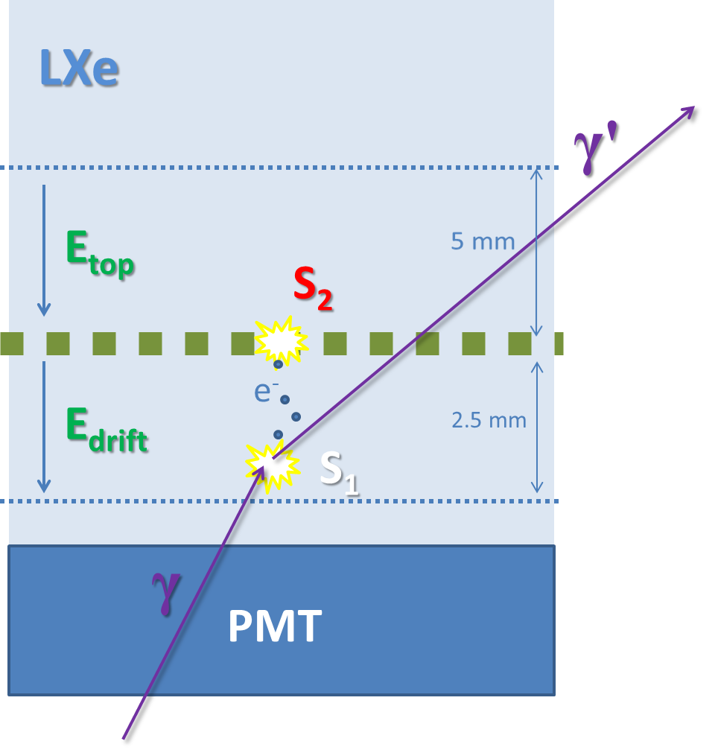
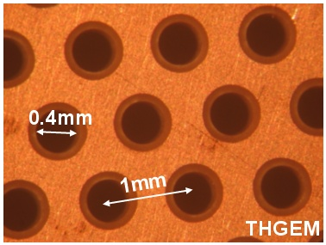

Single-THGEM in LXe: Gammas setup
Thickness 0.4mm
Mesh
THGEM:
t=0.4, d=0.3, a=1, h=0.1
THGEM
Mesh
S₁
A. Breskin RD51 Zaragoza July 2013
15

Slide 16
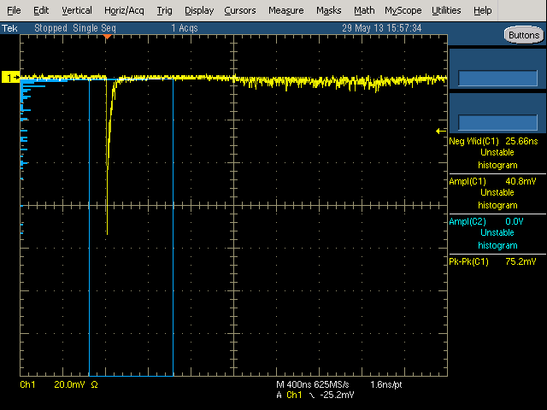
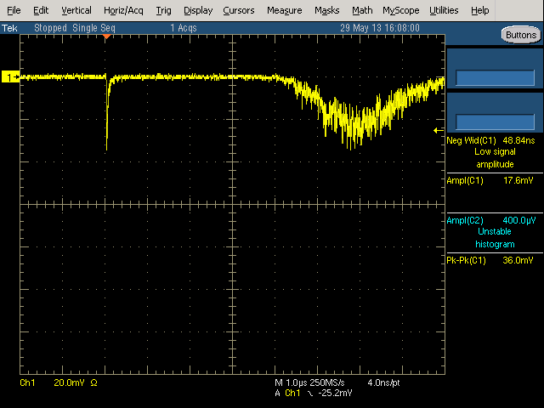
THGEM immersed in LXe:
First electroluminescence events - Gammas
May 29 2013
S1
S2
S1
S2
THGEM 2.5 kV
E_{top} = 0, E_{drift} = 1 kV/cm
THGEM 3.0 kV
E_{top} = 0, E_{drift} = 1 kV/cm
THGEM: t=0.4, d=0.3, a=1, h=0.1
E_{THGEM}~70kV/cm
LXe purity unknown
A. Breskin RD51 Zaragoza July 2013
16

Slide 17
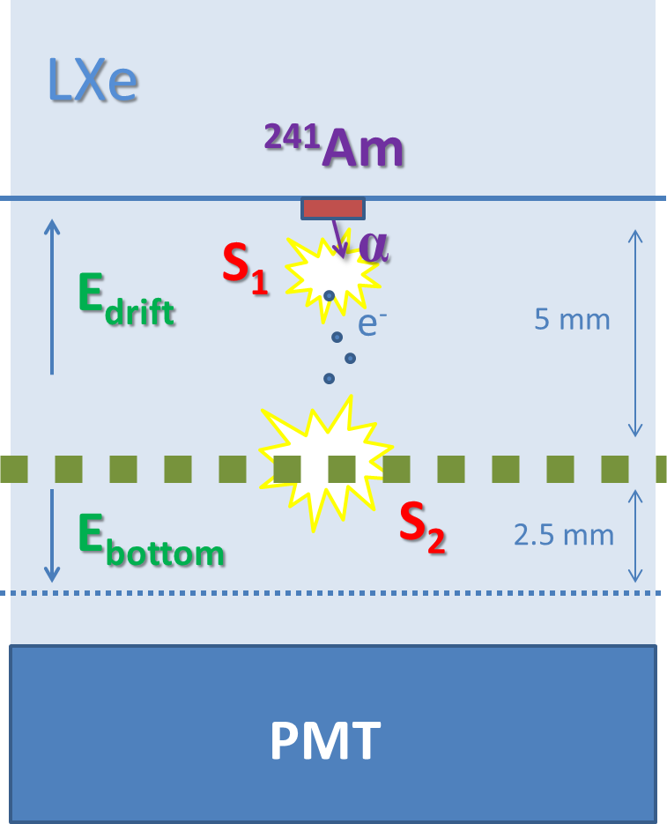
Single-THGEM in LXe: Alphas setup
Cathode
THGEM
Mesh
Hamamatsu
R6041-06 2” dia
A. Breskin RD51 Zaragoza July 2013
17

Slide 18
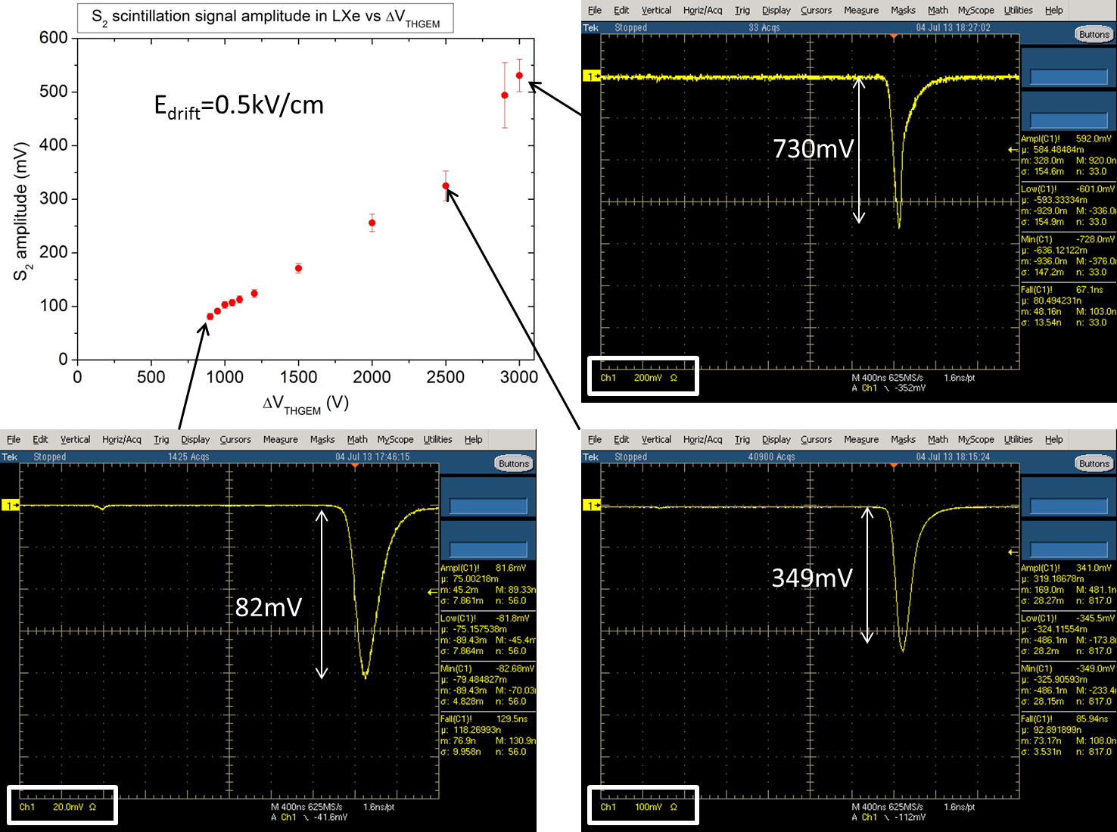
THGEM immersed in LXe: Alphas
July 4, 2013
S1
S2
E_{THGEM}~70kV/cm
S1
S1
S2
S2
LXe purity unknown

Slide 19
Summary & To-do list
A revived interest in single-phase Noble Liquid Detectors for large-volume systems.
A new concept proposed: scintillation (S1) & ionization (S2) recording with single immersed Liquid Hole Multipliers – LHM
First S1 & S2 signals recorded with γ and α in THGEM in LXe (unknown purity)
Applications beyond DM searches!
Concept needs validation:
Purity effects
THGEM charge & light Gain in LXe vs. hole-geometry
Electron collection efficiency into holes in liquid phase
Photon & electron yields in CsI-coated cascaded THGEM
Resolutions: E, t
Feedback suppression
S1/S2 Readout: pads vs. optical (GPM, others)
Radio-clean electrodes
Intense R&D in course on both GPM & LHM
Wonderful opportunities for the younger generation!

