Slide 1
Construction of and experience with a 2.4 x 1 m² micromegas chambers
Givi Sekhniaidze
On behalf of the Micromegas community

Slide 2
Outlook
Mechanical issues
Electrical issues
First results
Conclusions and future plans

Slide 3

Exploded view of the drift/ro panels
FR4 skin
Honeycomb
Al frame
Drift/RO PCB

Slide 4

Drift panel frame
Mesh frame support
Gas manifold
External frame
Honeycomb
Gas In/Out
Mesh frame

Slide 5
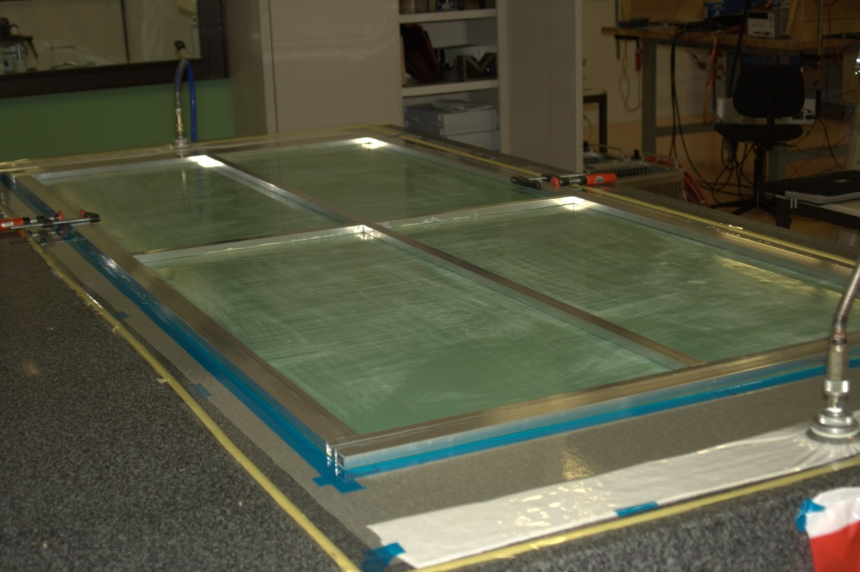
Drift panel preparation
On the 2.8 x 2.8 m² granite table was placed thin plastic mesh for pressure distribution
Covered with 175 μm thick mylar foil with ø3 mm holes
The FR4 skins were placed on the mylar and sucked

Slide 6
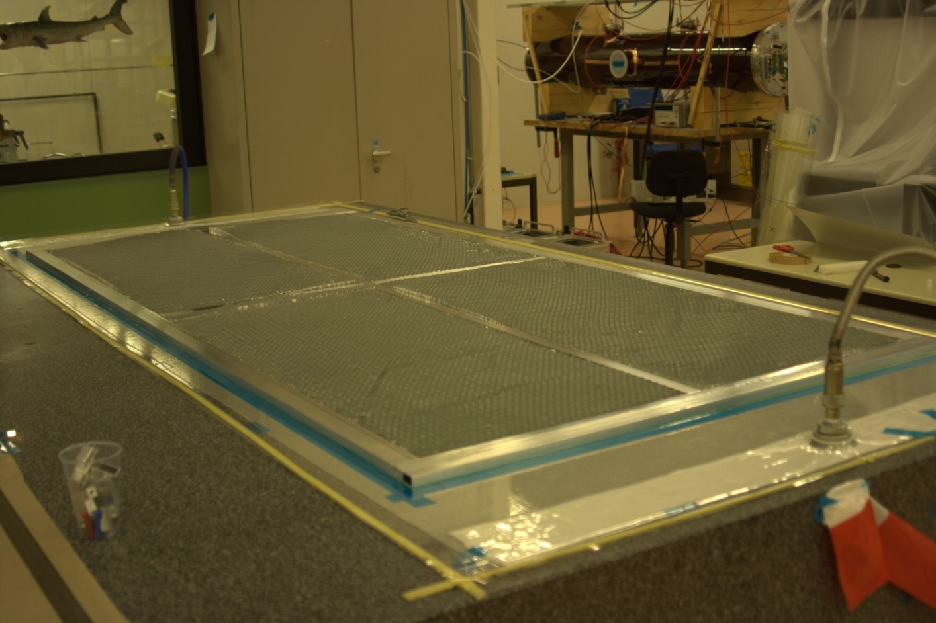
Drift panel preparation – honeycomb
On the skin surface has been applied expansive glue (PB250/SD5604)
The honeycomb pieces were placed on the skin

Slide 7


Drift panel preparation – stiff-back
Clarinet gas
Vacuum
X 12
Vacuum
Vacuum
PCB
Skin
Expansive glue
Precise shim

Slide 8
Drift panel preparation – stiff-back
25x50 mm cross-bars – 1.2 m
50x80 mm long bars – 2.5 m
Glued with Araldite 2011
4-5 sucking heads per bar

Slide 9
Drift panel preparation – Mesh frame
Cyanoacrylate
Mesh
Araldite 2011
Drift PCB

Slide 10
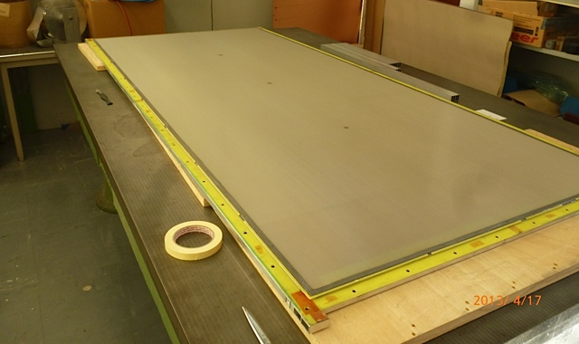
Drift panel preparation – Mesh
4.9 mm thick Aluminum frame mounted on the panel
Mesh stretched and glued on the frame
3 special inserts for drift/read-out panel interconnection

Slide 11
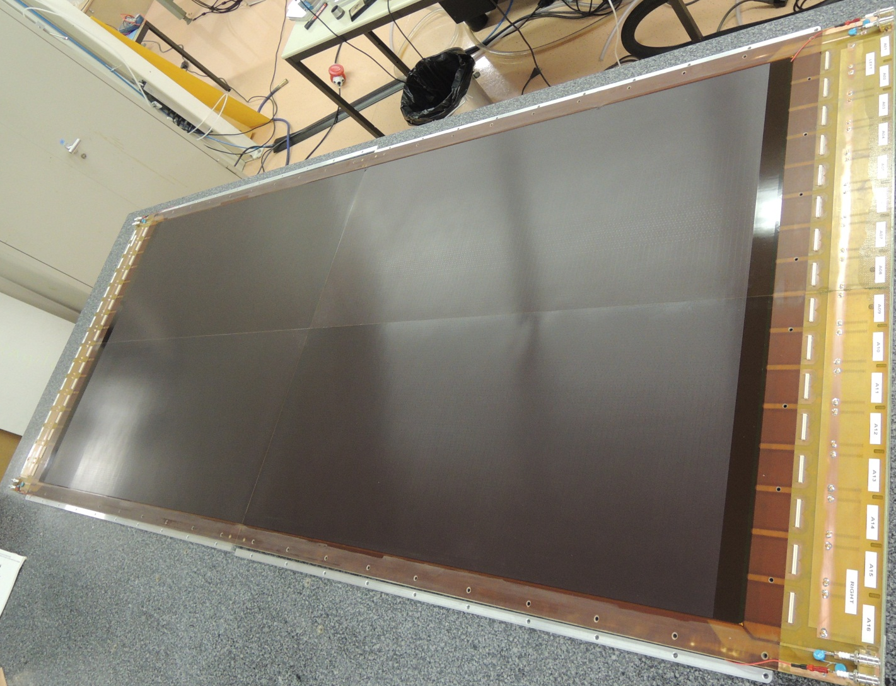
Read-out panel
0.5 mm thick FR4 external skin
10 mm thick Aluminum honeycomb
External Aluminum frames

Slide 12
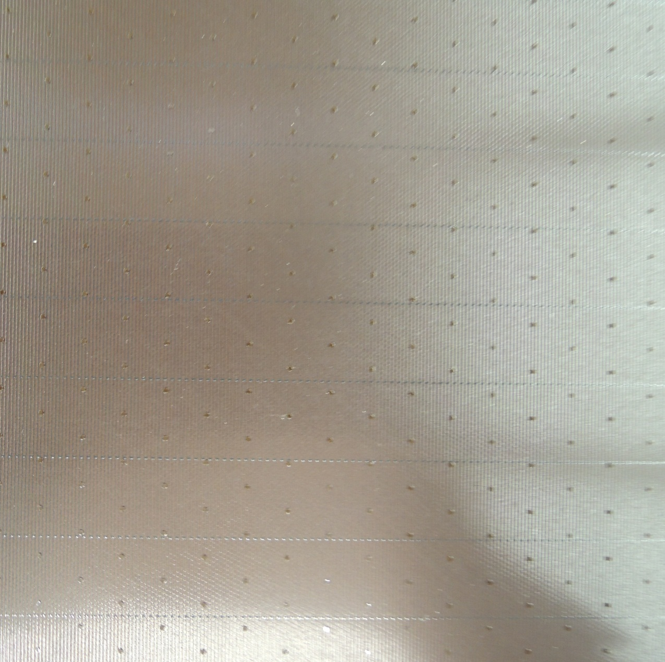
Mechanical issues – Read-out panel
Pillars
Shortcuts between
resistive strips

Slide 13
Chamber assembling
Drift panel
5 mm spacer
APV25 board
Read-out panel

Slide 14
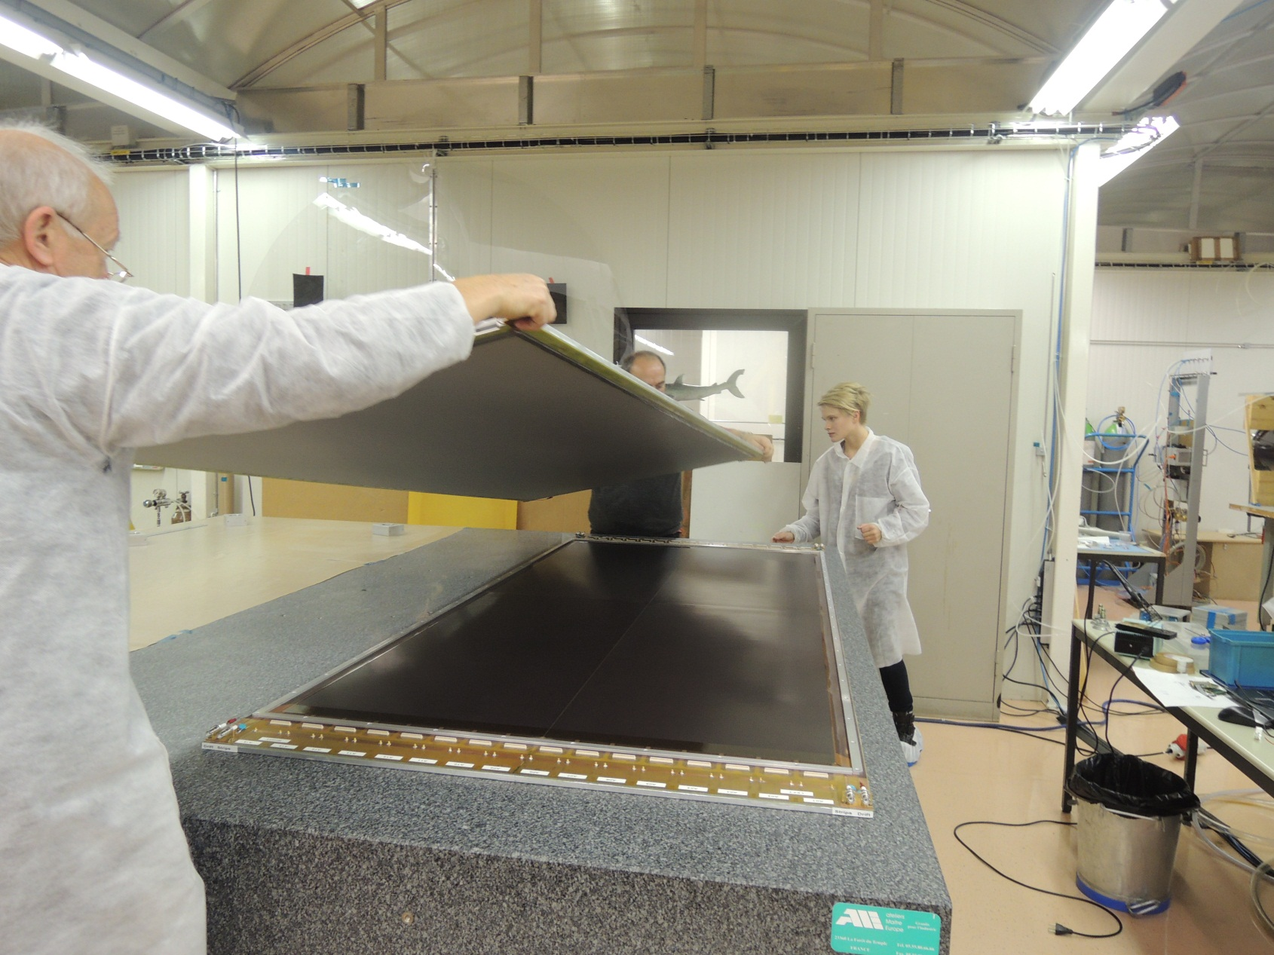
Chamber assembling

Slide 15
Chamber assembling – interconnection
Drift panel
O-ring
Pillars
Insert
Mesh
M3 screw
Read-out panel

Slide 16
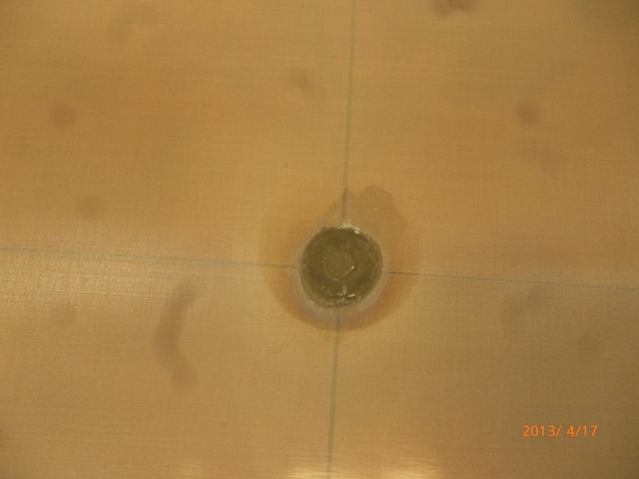
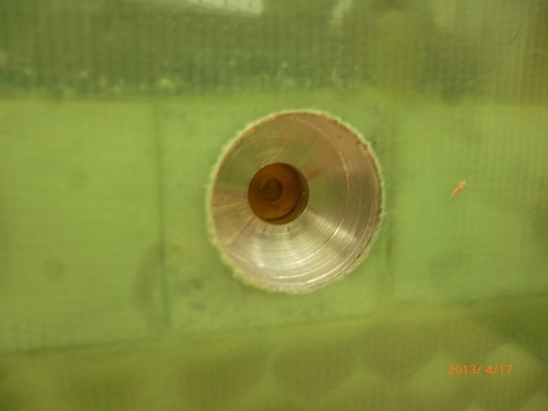
Drift panel preparation – Inserts

Slide 17
Electrical issues
L2/L3 chamber – all read-out parts are working well
L2 chamber – one read-out board had a problem: short between a resistive strip and read out strip below; the read out strip was identified and disconnected from connector, problem disappeared
Initially there was a current on the drift electrode and it was identified as a leak on the O-ring surface – HV connection was insulated with kapton tape and problem disappeared
Typical current between resistive strips and mesh 0 -20 nA
HV up to 580 V the sparks are not observed

Slide 18
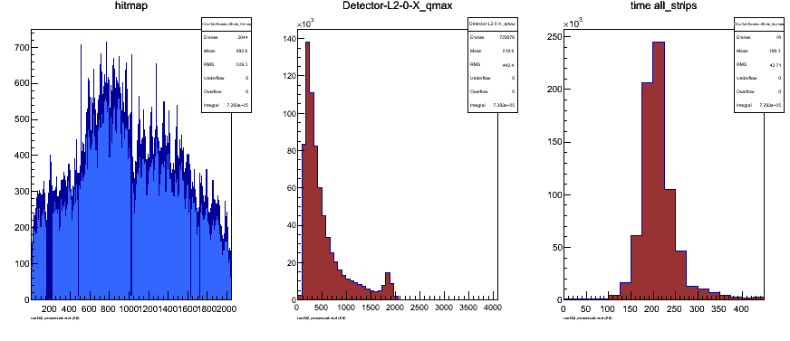
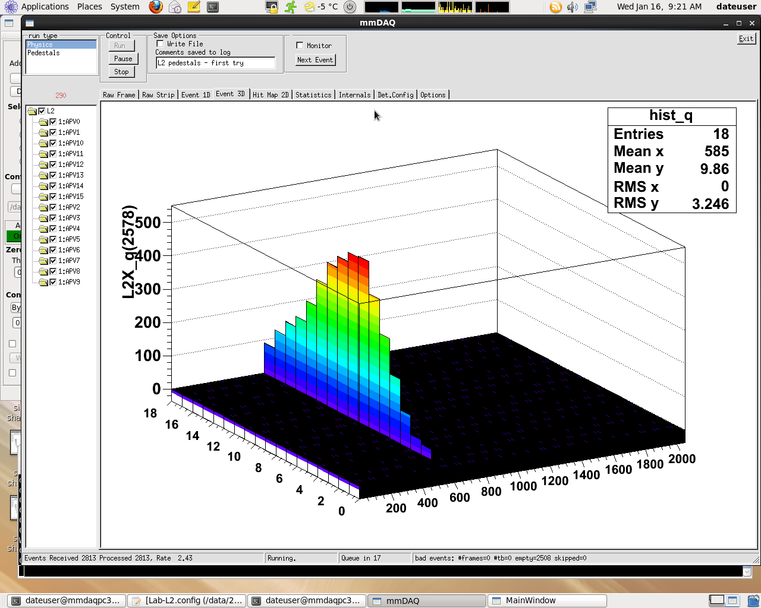
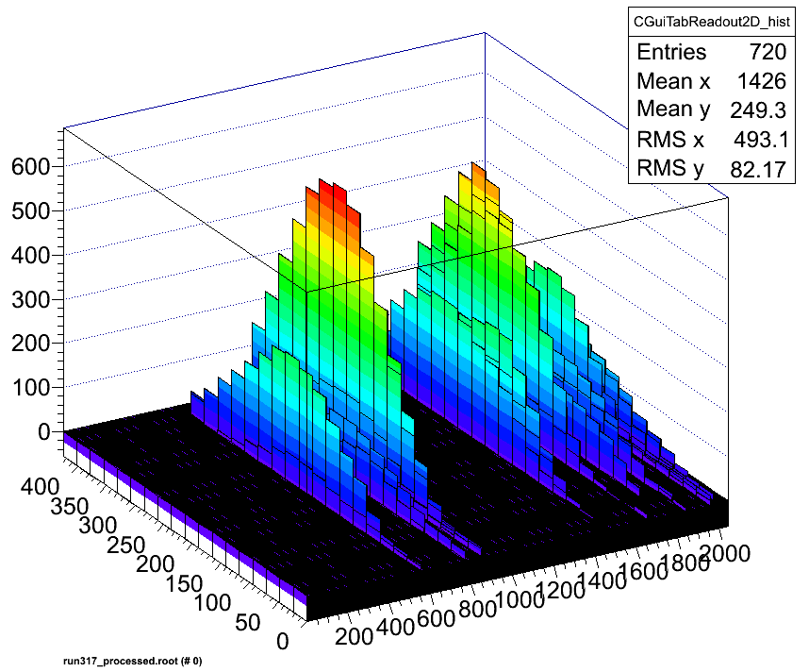
Preliminary results
Summary plot from
Event browser
Single event
Shower event

Slide 19
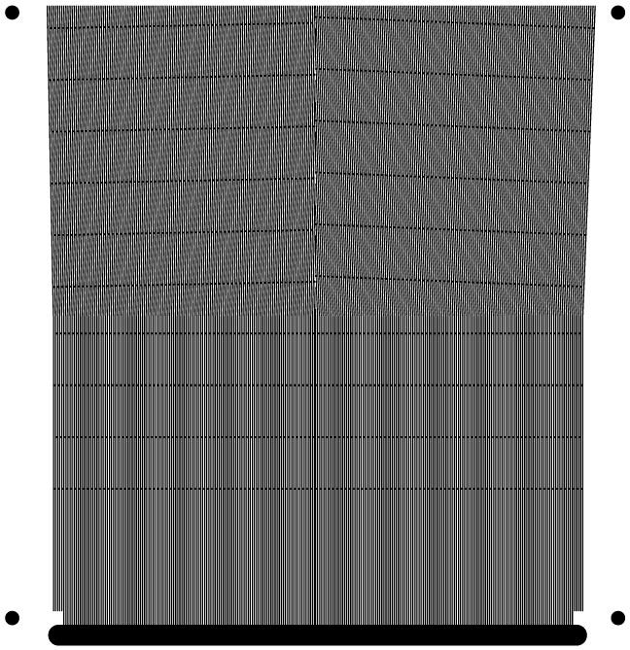
TQF1 Resistive Strips Layout
4
3
1
Resistive strips aligned with the read out strips
2
Resistive strips shifted by a half pitch, w.r.t. the readout strips
3
Resistive strips rotated by -2°, w.r.t. the read out strips , crossing every cm
1
2
4
Resistive strips rotated by 1°, w.r.t. the read out strips , crossing every
2cm

Slide 20
Desy Setup for TQF1 studies
Fully acquired 3X and 3Y APV each
46.0
46.0
T_{mm6}
Al
T_{mm5}
T₈
Al
T₃
T₂
Al
TQF!
T_{mm3}
Al
T_{mm2}
2
2
2
2
2
2
2
2
10
10
10
10
Electron Beam
5
5
5
5
5
5
5
5
200
100
200
517.5
597.5
321
301
222
202
20
0 mm
Tmm6
Tmm5
T₈
T₃
T₂
TQF1
Tmm3
Tmm2
Not acquired
Notes:
Digressione sull’unificazione di elettricita’ e magnetismo nell’elettromagnetismo
Maxwell
Weinberg premio nobel per “unificazione” elettrodebole

Slide 21
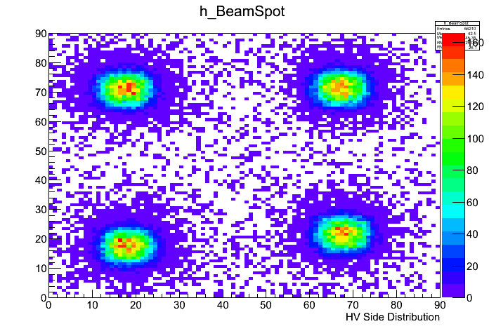
Beam Spot from Tmm2
4
3
1
2
HV Distribution Side

Slide 22
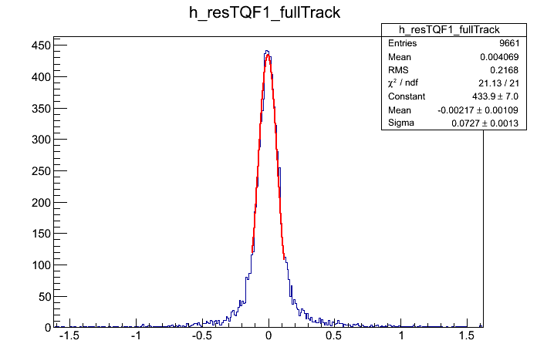
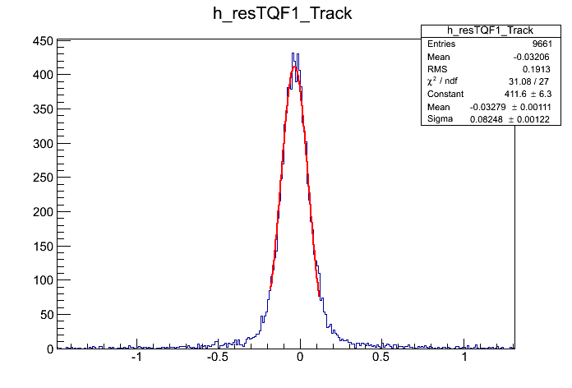
Resolution
Residual from the “Standard” corner
σ = 76.8 µm
Residual using also TQF1
Residual without TQF1
Standard Corner | Half pitch Shift | 2° rotation | 1° rotation
76.8 µm | 82 µm | 86 µm | 81.2 µm

Slide 23
Future plans – L2/L3 chambers
L2/L3 chambers – gas leak reparation work in progress, we’re trying to use another type of the O-rings (bigger diameter, rectangular shape, …)
L3 chamber – we have to open chamber to understand the problems with one of the read-out PCB
L3 chamber – more precise scan of the surface to understand the behavior of the interconnection places

Slide 24
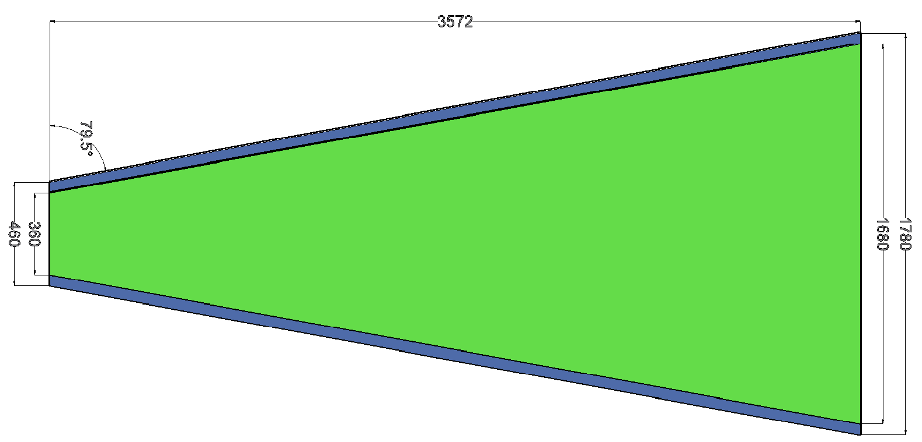
Future plans – Full wedge chambers
Full-wedge small sector quadruplet
  Eta and stereo doublet
Drift gap spacers: 5 mm
Total thickness: 70–80 mm
Gas distribution
Mesh?

Slide 25
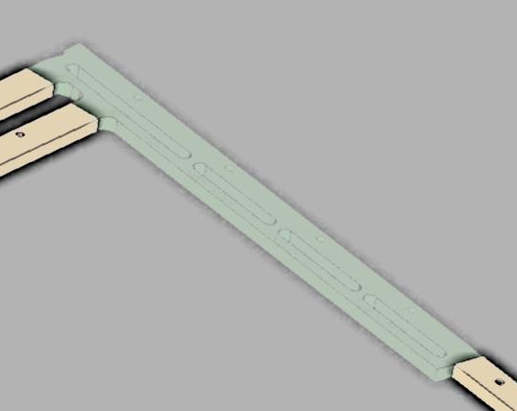
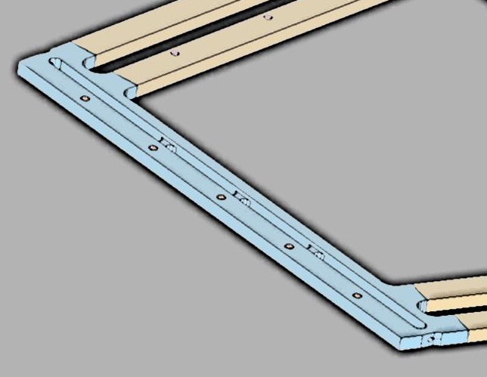
Future plans – Full wedge chambers
All panels of equal thickness: 11-12 mm
Standard Al profiles of t=10 mm as frames with special angular inserts
  Skins = 0.5 mm (FR4)
  Foam panel of t=10 mm
  plastic mesh of t=100-200µm
  glue Araldite AY-103/AH-991

Slide 26
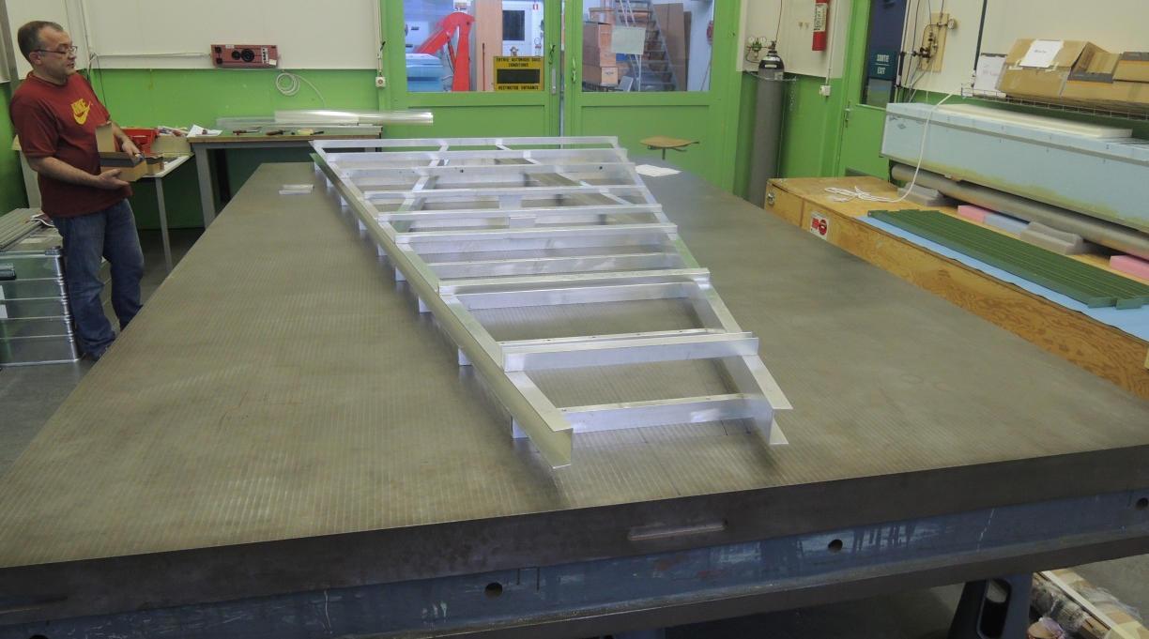
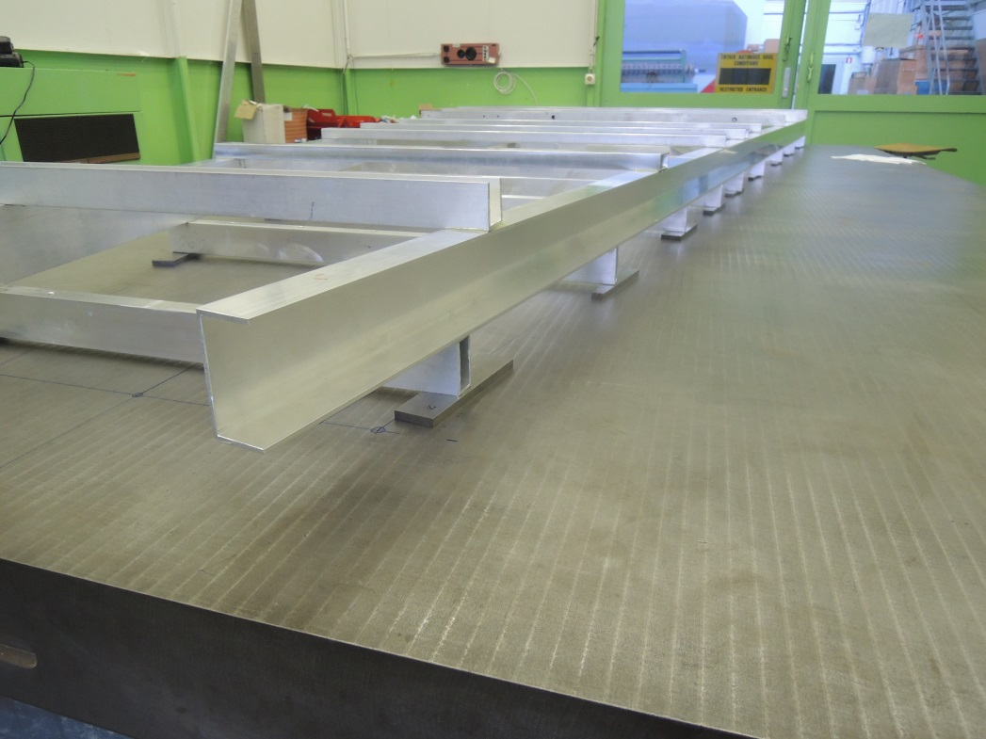
Future plans – Full wedge chambers
We got the space with
4 x 2.5 m² table (153-R-030)
Stiff-back structure has been glued, preparation work in progress
FR4 skins are prepared

Slide 27
Conclusions
We have constructed a 1 x 2.4 m² Micromegas chambers with 0.45 mm strip pitch and 4096 read-out channels, the worldwide largest MicroMegas chambers so far
The drift and read-out panels were made from four PCBs glued to a stiffener without dead space
Separate (floating) single mesh covering the full area.
The L2 chamber is working smoothly and shows reasonably uniform response over the full detector area
No signal reduction over the 1m strip length has been observed
A second 1 x 2.4 m² has been constructed (where a few of the shortcomings of the first one have been fixed); it is working smoothly as well and is now under study
The space, flat table, materials, man-power are ready for the full-wedge mechanical prototype production

