Slide 1
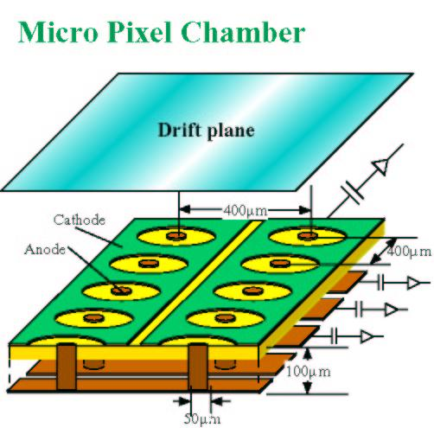
Micro Pixel Chamber (μ-PIC) with resistive electrodes for spark reduction
Atsuhiko Ochi
Kobe University
2/7/2013 3rd International MPGD conference

Slide 2
Outline
Design of the detector
Performance of spark reduction
Operation mode without AC coupling
Remaining problems to be solved
Conclusion

Slide 3
Properties of the μ-PIC
Drift plane
Fine position/timing resolution, high rate capability, … those basic properties are same as other type of MPGDs.
It has no floating structures (wire, foil, mesh…).
  It is important properties for making seamless large detector.
  Almost all production processes are commercially available. (PCB / FPC production process )
Cathode
400 μm
Anode
400 μm
100 μm
Requirements for more stability
50 μm
More stabilities and robustness is needed for high ionized particle (HIP)
  The electron density may excess the Raether limit (10⁷⁻⁸)
To avoid the destruction of the electrodes due to spark, μ-PIC with resistive electrodes has been designed.
The resistive u-PIC design allow us to read all signal without AC coupling

Slide 4
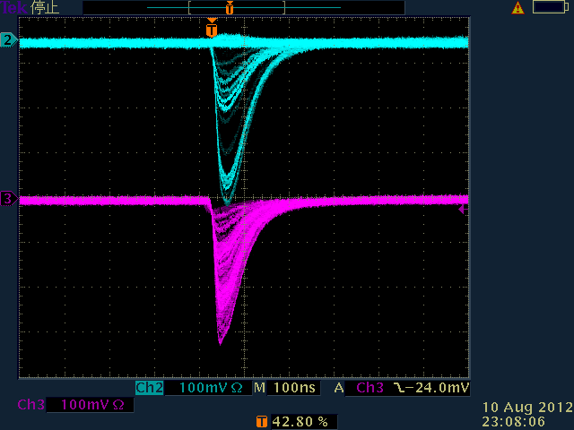
μ-PIC with resistive cathode and capacitive readout
Drift plane
Detector design
  All cathodes are made from carbon-polyimide
  Pickup electrodes are lied under cathodes and insulator
  We have two dimensional signals
Resistive cathode (-HV)
400 μm
Anode
Thin
substrate
Pickup electrode
Thick substrate
50 μm
Cathode (pickup)
300mV
Anode
Cathode signal on oscilloscope is inverted
Two dimensional signal is induced
on opposite sign.
Not charge shareing.
Va = 660V, Gain ~ 20000

Slide 5
Process for manufacturing
(g) Polishing the surface
(h) Plating the anode pin
(i) Etching the metal layer
(j) Adhering the thick layer
(k) Laser drilling for anode pin
(l) Plating anode pin
Start from double sided kapton
(b) Thick plating on surface (~ 50μm)
(c) Exposure using double side mask
(d) Developing resist
(e) Etching for the pattern
(f) Fill the resistive polyimide & cure

Slide 6
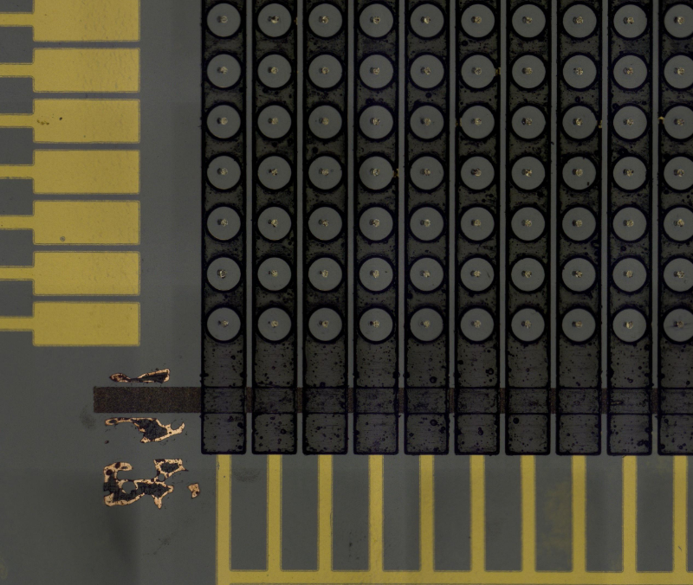
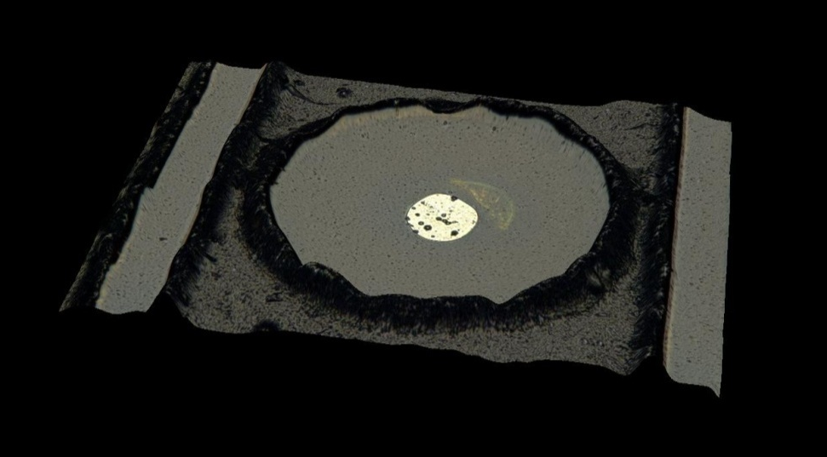
Micro scope picture of a prototype (RC27)
Delivered at July 2012
Very good accuracy (compared with previous samples)
Surface resistivity
  About 50MΩ / strip (10cm)

Slide 7
Outline
Design of the detector
Performance of spark reduction
Operation mode without AC coupling
Remaining problems to be solved
Conclusion

Slide 8
Gain curve
Conditions
  Drift field = 3.3kV/cm
  ⁵⁵Fe (5.9keV)
  Using the signal from cathode pickup electrodes
Results
  High gain (>60000) was achieved, and operation was stable
  (in case of Ar:C2H6=7:3)
  There found small discharges over the maximum gain in right figure.
  However, no big sparks have been found around maximum gain.
Gain
Anode voltage [V]

Slide 9
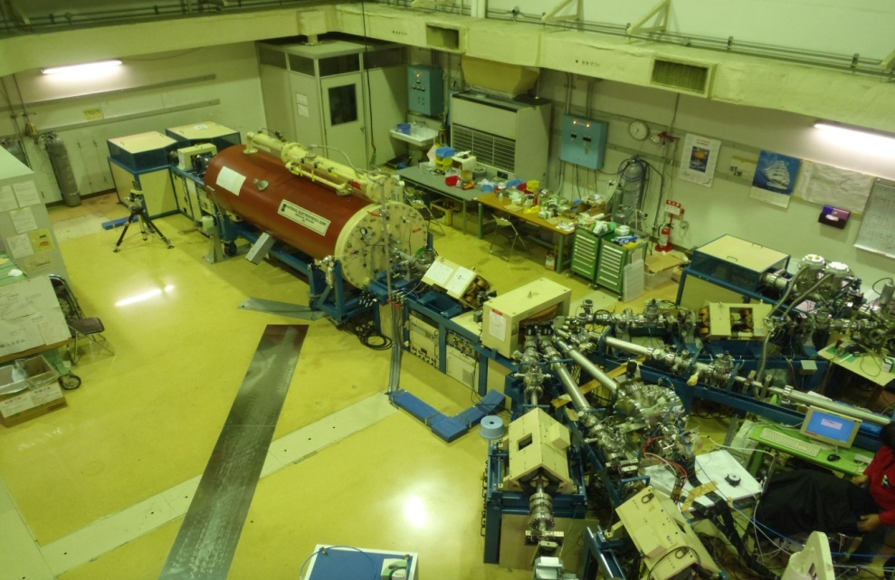
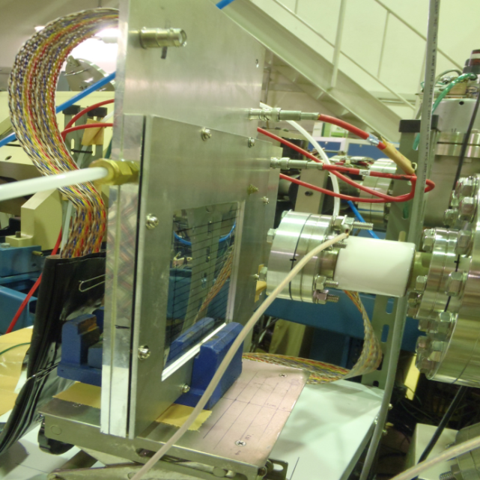
Spark test using fast neutron
A few MeV – few tenth MeV neutron will produce recoiled nucleon inside detectors
  That produce great amount of energy deposit (a few MeV/mm²) in gaseous volume.
The concerned problem for gas detector
  “Raether limit” … the electron cluster more than 10⁷⁻⁸ cause the detector to discharge.
We can evaluate the spark probability for HIP by measuring the spark rate dependencies on neutron irradiation
Neutron source
  Tandem nucleon accelerator (3MeV deuteron) + Beryllium target.
  (Kobe University, Maritime dept.)
  d+ ⁹Be → n + ¹⁰B
  Neutron energy: mainly 2MeV

Slide 10
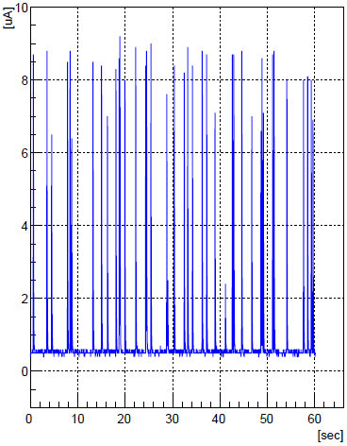
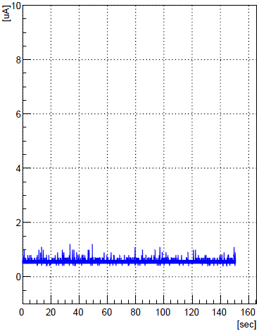
Spark probability measurements
neutron
-HV
(~1kV)
Drift
HV current on anodes are monitored while neutrons are irradiated
We found strong spark reduction using resistive cathode !!
Cathode
= 0V
Anode
+HV
(~600V)
A
Voltage
recorder
[μA]
10
8
6
4
2
0
[μA]
10
8
6
4
2
0
Normal μ-PIC (metal cathodes)
Gain = 15000
Irradiation: 2.4×10³ neutron/sec
Resistive cathode μ-PIC
Gain = 15000
irradiation: 1.9×10⁶ neutron/sec

Slide 11
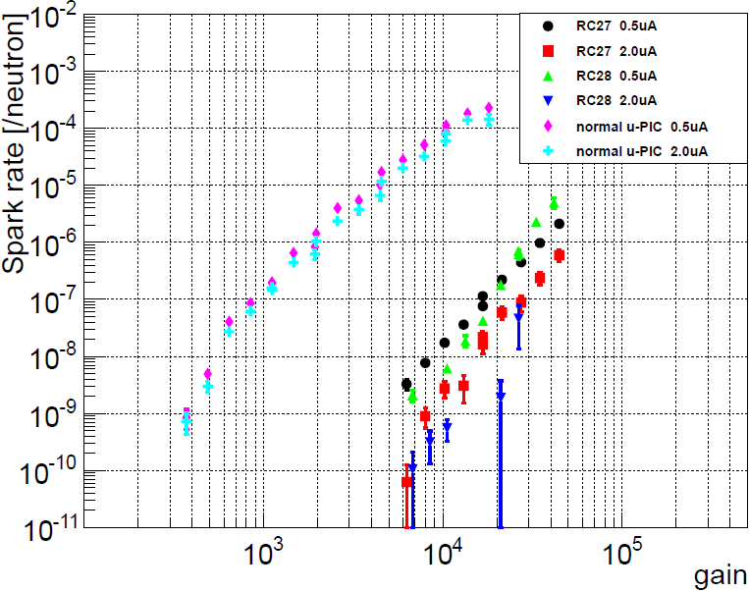
Spark probability for fast neutron (~2MeV)
Conditions
  Gas: Ar+C₂H₆ (7:3)
  Drift field: 3.3kV/cm
  Definition of the sparks:
    Current monitor of HV module shows more than 2μA or 0.5μA.
  Spark probability = [Spark counts] / neutron
  The spark rates on normal μ-PIC are are also plotted as comparison (cyan, magenta plots).
Results
  Reduction of sparks are obviously found. The rate was 10³⁻⁵ times less than normal μ-PIC case at same gas gain.
Spark reduction

Slide 12
Outline
Design of the detector
Performance of spark reduction
Operation mode without AC coupling
Remaining problems to be solved
Conclusion

Slide 13
Novel Operation condition with applying HV to resistive cathode
(0V)
Previous operation
Potential of electrodes:
  Cathodes (resistive): 0V → Negative HV
  Anodes : Positive HV → 0V
No HV on anodes
  AC coupling capacitors and HV resistors are not needed
+HV(~600V)
R
-HV(~-600V)
New operation
Direct connection to readout

Slide 14
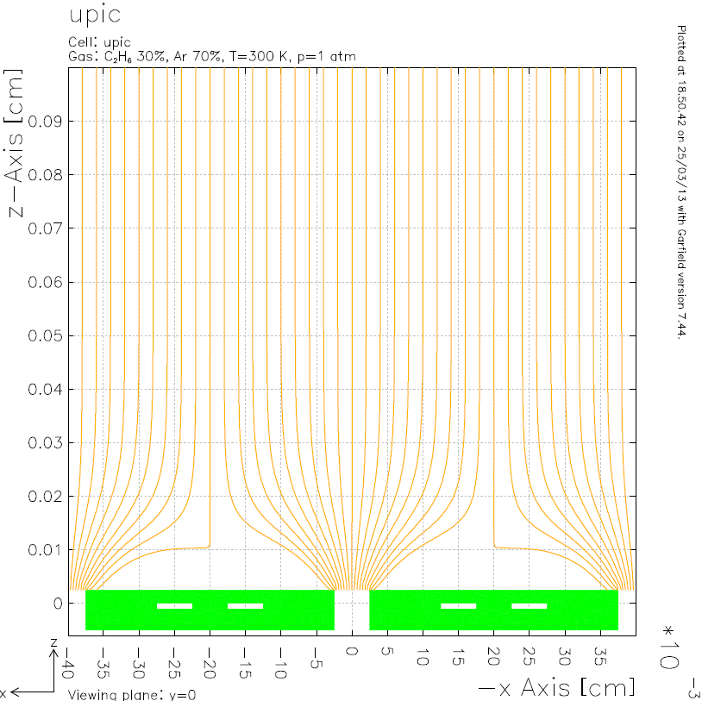
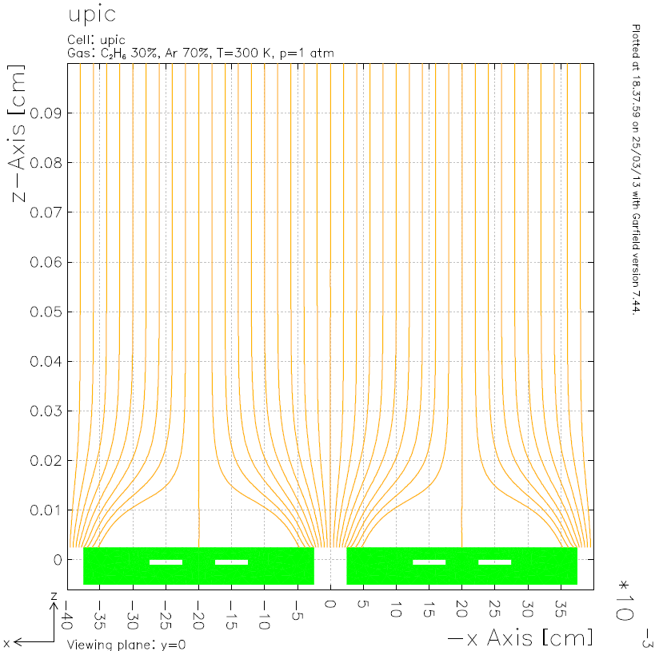
Electron drift line for both operations
Maxwell 3D + Garfield simulation
Anode = +620V 印加
Cathode = -580V
There is no significant difference

Slide 15
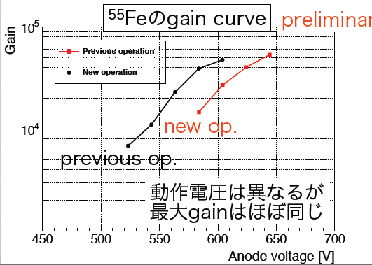
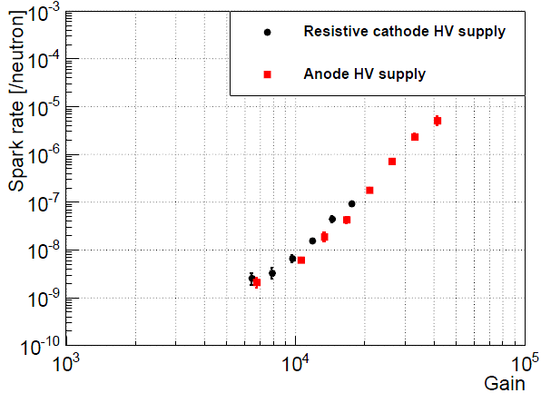
Operation test results
Gain curve and spark proberbility
Operation gas … Ar:C2H6=7:3
Gain curve using 55Fe
  A little bit higher operation ( ~ +10%) voltage is needed.
  However, maximum attained gain is almost same.
Spark probability under fast neutron
  Almost same in both mode.
Spark probability under fast
(~2MeV) neutron irradiation
Gain curve using ⁵⁵Fe
Maximum gain is almost same

Slide 16
Outline
Design of the detector
Performance of spark reduction
Operation mode without AC coupling
Remaining problems to be solved
Conclusion

Slide 17
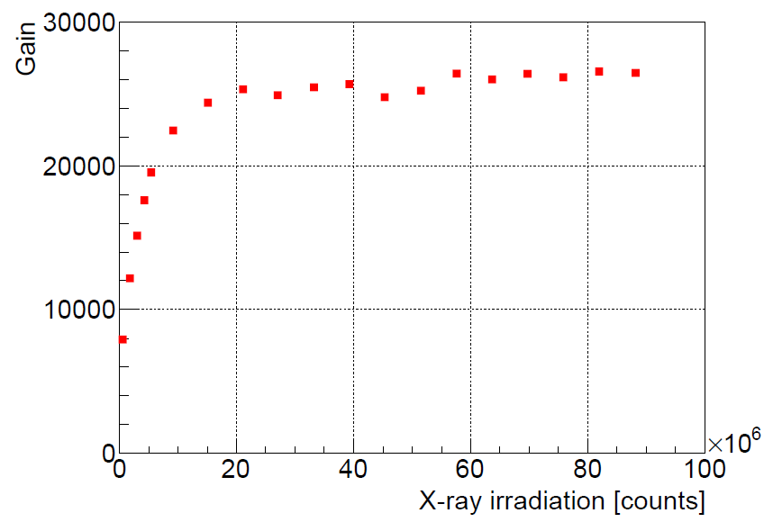
Operation test results
Gas gain variation
⁵⁵Fe (5.9keV) is irradiated
At the beginning, gain is about 8000.
The gain is growing up to 25000 in same operation voltage.
After irradiation of 2×10⁷ counts/cm² , the gain is stable at maximum.
  It is thought that the gain variation is caused from charging up effect.

Slide 18
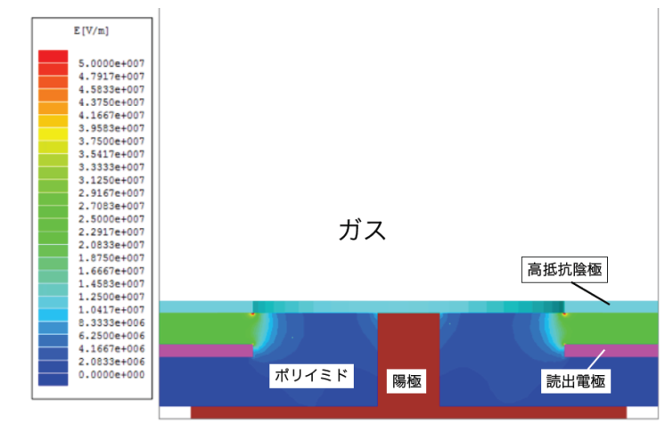

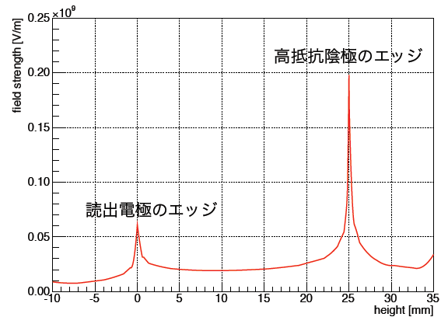
Remaining problem
-- withstand HV of substrate --
We have check three prototypes, and two of them are broken when HV applying.
  Breakdowns are occurred between resistive cathode and pickup electrodes.
  This point is inside the substrate.
Electric field simulation (using Maxwell 3D)
  The substrate thickness is 25μm polyimide.
  The withstand voltage of polyimide is around 300kV/mm
  By the simulation of the electric field, there is extreme high electric field at the edge of resistive cathode and of pickup electrodes.
  In the simulation, it is reached at 200kV/mm in our conditions. There is a slight margin.
  Now we are making thicker substrate (37 μm) as a next sample.
Edge of resistive cathode
Edge of pickup electrodes

Slide 19
Future prospects
Liftoff process with sputtering
Photo resist
(reverse pattern of
surface strips)
Material of resistive electrodes
Polyimide with carbon black → Sputtered carbon
  Fine patterning is available
  No need to cure (high temperature) process
  Large size production is available
  Principle operation test has been done
    Using sputtered carbon as resistive anode on MicroMEGAS
    Details will be shown on Poster, and RD51 meeting.
Substrate (polyimide)
Metal/Carbon sputtering
Substrate (polyimide)
Developing the resists
Substrate (polyimide)

Slide 20
Conclusion
μ-PIC with resistive cathodes and capacitive readout is developed and tested.
More than 60000 of gas gain is achieved stably using 55Fe source under Ar(70%)+ethane(30%) gas.
Sparks are reduced strongly.
  The spark rate under fast neutron (2MeV) is suppressed 10⁵ times smaller than that of normal μ-PIC.
Using capacitive readout, two-dimensional readouts without AC coupling are realized, and tested.
More improvement of the production is needed.
  Substrate should hold high tolerance for high electric field.
  New production method will improve the quality of the detector
These researches are supported by
Japan MPGD Basic R&D Team.
Grant-in-Aid for Scientific Research (No.23340072)
RD51 collaboration

