Slide 1
Introduction to Trigger/DAQ challenges at CERN
Niko Neufeld, CERN/PH
Many stimulating, fun discussions with my T-DAQ friends in ALICE, ATLAS, CMS and LHCb, and with a lot of smart people in CERN/IT (openlab) and industry are gratefully acknowledged

Slide 2
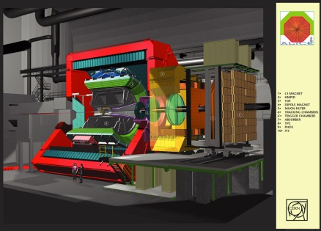
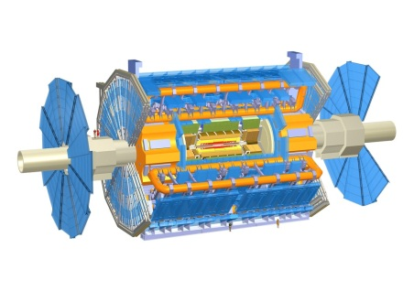
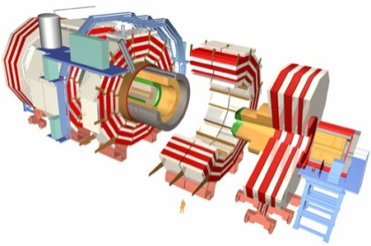
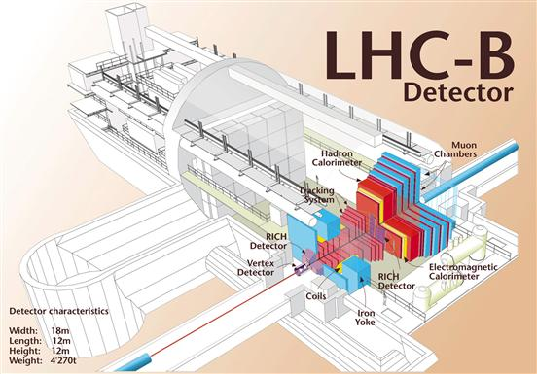
The LHC Experiments today
ALICE – “A Large Ion Collider Experiment”
  Size: 26 m long, 16 m wide, 16m high; weight: 10000 t
  35 countries, 118 Institutes
  Material costs: 110 MCHF
ATLAS – “A Toroidal LHC ApparatuS”
  Size: 4 6m long, 25 m wide, 25 m high; weight: 7000 t
  38 countries, 174 institutes
  Material costs: 540 MCHF
CMS – “Compact Muon Solenoid”
  Size: 22 m long, 15 m wide, 15 m high; weight: 12500 t
  40 countries, 172 institutes
  Material costs: 500 MCHF
LHCb – “LHC beauty” (b-quark is called “beauty” or “bottom” quark)
  Size: 21 m long, 13 m wide, 10 m high; weight: 5600 t
  15 countries, 52 Institutes
  Material costs: 75 MCHF
Regular upgrades … first 2013/14 (Long Shutdown 1)
1 CHF ~ 1 USD

Slide 3
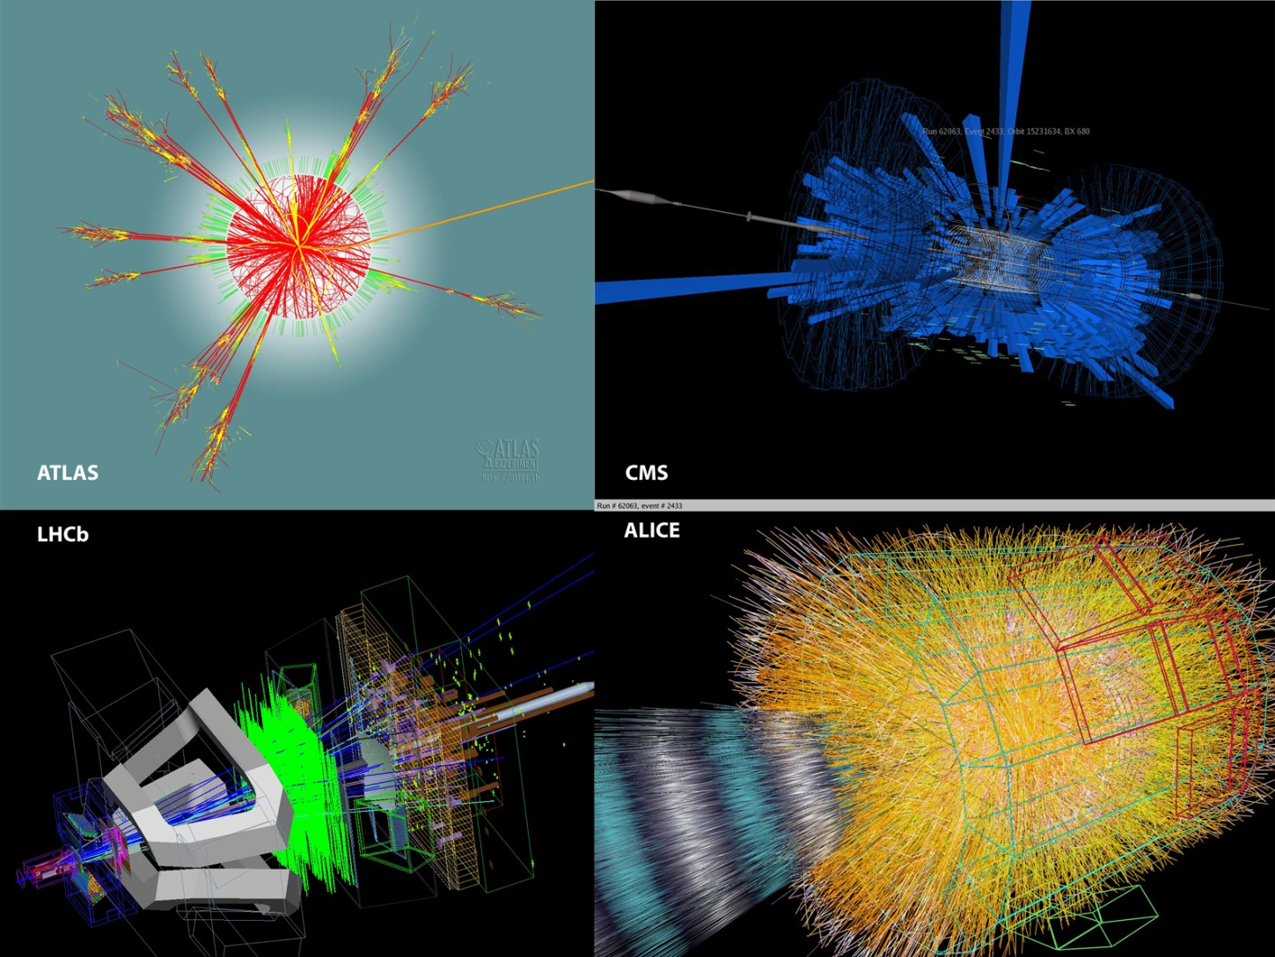
What do Events Look Like?
Notes:
Upper left ATLAS look along beampipe .. Inner part are tracks … green bars represent energy measured in ECAL … “trees” – energy in HCA: … leaving at right: Myon
Upper right: CMS: bars represent energy dumped in calorimeters.
Bottom left: hits and tracks in LHCb
Bottom right ALICE: tracks in a heavy ion collision

Slide 4
The needle in the hay-stack: pp Collisions at 14 TeV at 10³⁴ cm⁻²s⁻¹
σ(pp) = 70 mb --> >7 x 10⁸ /s (!)
In ATLAS and CMS* 20 – 30 min bias events overlap
H→ZZ
Z →μμ
H→ 4 muons:
the cleanest
(“golden”)
signature
And this
(not the H though…)
repeats every 25 ns…
^{*)}LHCb @4x10³³ cm⁻²-1 isn’t much nicer and in Alice (PbPb) is even more busy

Slide 5
Data Rates
Particle beams cross every 25 ns (40 MHz)
  Up to 25 particle collisions
  per beam crossing
  Up to 10⁹ collisions
  per second
Basically 2 event filter/trigger levels
  Data processing starts at readout
  Reducing 10⁹ p-p collisions per second
  to O(1000)
Raw data to be stored permanently: >15 PB/year
Physics Process | Events/s
Inelastic p-p scattering | 10⁸
b | 10⁶
W → eυ ; W → µυ ; W → τυ | 20
Z → ee ; Z → µµ ; Z → ττ | 2
t | 1
Higgs boson (all; m_{H} = 120GeV) | 0.04
Higgs boson (simple signatures) | 0.0003
Black Hole (certain properties) | 0.0001
 | Incoming data rate | Outgoing data rate | Reduction factor
Level1 Trigger (custom hardware) | 40000000 s⁻¹ | 10^5 – 10^6 s⁻¹ | 400-10,000
High Level Trigger (software on server farms) | 2000-1000000 s⁻¹ | 1000 -10000 s⁻¹ | 10-2000

Slide 6
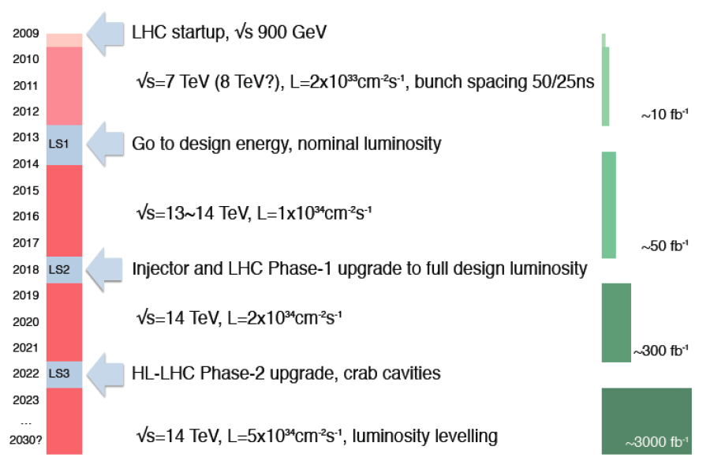
LHC planning
CMS: Myrinet → InfiniBand / Ethernet
ATLAS: Merge L2 and
EventCollection infrastructures
Long Shutdown 2 (LS2)
ALICE continuous read-out
LHCb 40 MHz read-out
CMS & ATLAS track-trigger

Slide 7
Future DAQs in numbers
 | Event-size [kB] | Rate of events into HLT [kHz] | HLT bandwidth [Gb/s] | Year [CE]
ALICE | 20000 | 50 | 8000 | 2019
ATLAS | 4000 | 200 | 6400 | 2022
CMS | 2000 | 200 | 3200 | 2022
LHCb | 100 | 40000 | 32000 | 2019
40000 kHz == collision rate
→ LHCb abandons Level 1 for an all-software trigger
It’s a good time to do DAQ
CMS and ATLAS numbers are growing as we speak…

Slide 8
Challenge #1
The first level trigger

Slide 9
Level 1 Trigger
The Level 1 Trigger is implemented in hardware: FPGAs and ASICs → difficult / expensive to upgrade or change, maintenance by experts only
Decision time: ~ a small number of microseconds
It uses simple, hardware-friendly signatures → looses interesting collisions
Each sub-detector has its own solution, only the uplink is standardized →

Slide 10
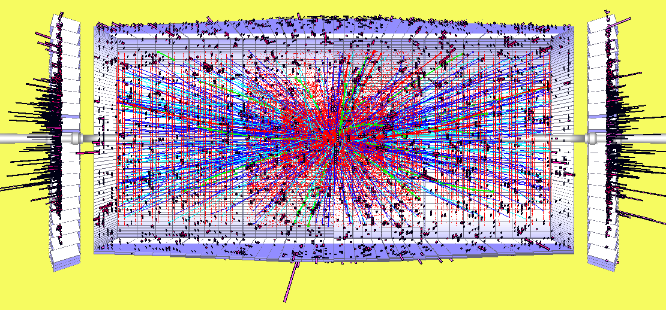


A Track-Trigger at 40 MHz 2020++
Goals:
  Resolve up to 200÷250 collisions per bunch crossing
  Maintain occupancy at the few % level
  Maintain overall L1 rate within 100 KHz
  Keep latency within ~ 6 μs (ECAL pipeline 256 samples = 6.4 μs)
      The current limit is the Tracker
L1 tracking trigger data combined with calorimeter & muon trigger data
    With finer granularity than presently employed.
Physics objects made from tracking, calorimeter & muon trigger data transmitted to Global Trigger.
Intro to Trigger/DAQ challenges at CERN - N. Neufeld

Slide 11
Level 1 challenge
Can we do this in software?
Maybe in GPGPUs / XeonPhis → studies ongoing in the NA62 experiment
We need low and – ideally – deterministic latency
Need an efficient interface to detector-hardware: CPU/FPGA hybrid?
Or forget about the whole L1 thing altogether and do everything in HLT → requires a lot of fast, low-power, low-cost links, did anybody say Si-photonics?

Slide 12
Challenge #2
Data Acquisition

Slide 13

Data Acquisition (generic example)
Every Readout Unit has a piece of the collision data
All pieces must be brought together into a single compute unit
The Compute Unit runs the software filtering (High Level Trigger – HLT)
Detector
10000 x
Readout Units
~ 1000 x
DAQ network
GBT: custom radiation- hard link from the detector 3.2 Gbit/s
DAQ (“event-building”) links – some LAN (10/40/100 GbE / InfiniBand)
Links into compute-units: typically 10 Gbit/s (because filtering is currently compute-limited)
100 m rock
~ 3000 x
Compute Units

Slide 14
Key Figures – Example LHCb
Minimum required bandwidth: > 32 TBit/s
Number of 100 Gbit/s links: > 320
Number of compute units: > 4000
Event size: 100 kB
Number of events per seconds: 10 – 40 Millions per second
Number of events retained for permanent storage: 20k – 30k per second
  storage allows to “defer” the decision at the cost of disks and tapes

Slide 15
Design principles
Minimize number of expensive “core” network ports
Use the most efficient technology for a given connection
  different technologies should be able to co-exist (e.g. fast for building, slow for end-node)
  keep distances short
Exploit the economy of scale → try to do what everybody does (but smarter ☺)

Slide 16
The evolution of NICs
PCIe Gen4
expected
PCIe Gen3
available
EDR (100 Gb/s) HCA
expected
100 GbE NIC
expected
Chelsio T5 (40 GbE
and Intel 40 GbE
expected
Mellanox FDR
Mellanox 40 GbE NIC

Slide 17
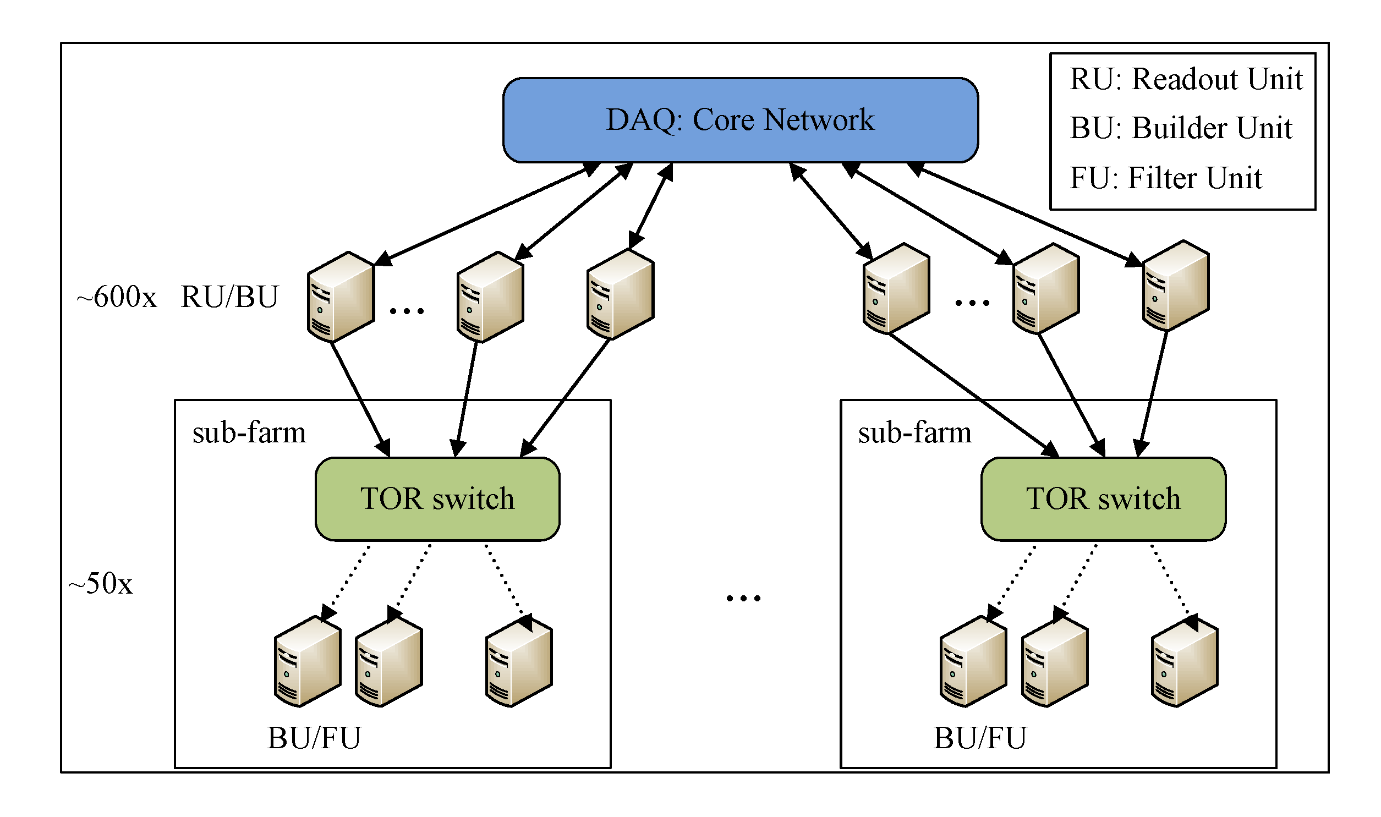
A realistic DAQ / HLT for LHC
100 Gb/s
bi-directional
These 2 not necessarily the same technology
10 GBaseT

Slide 18
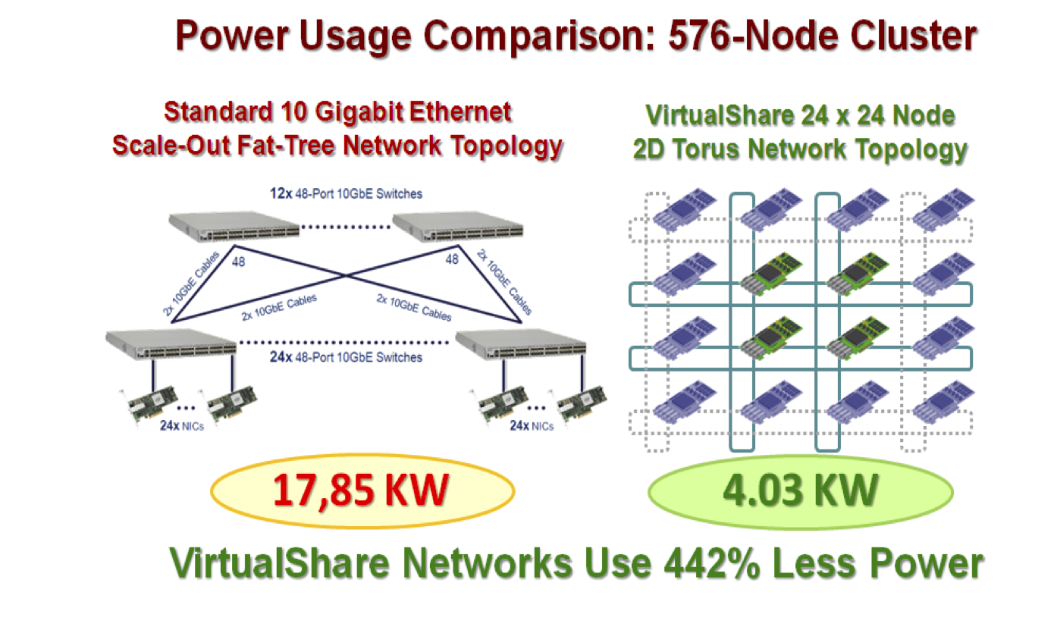
Keep an eye on the fringe
There is always the temptation to remove the switch altogether → merge fabric and network
Modern versions of an old idea (token-ring, SCI)
  PCIe based (for example VirtualShare Ronniee a 2D torus based on PCIe, creates a large 64 bit shared memory space over PCIe)
  IBM blue-gene interconnect (11 x 16 Gb/s links integrated on chip – build a 5N torus)
Notes:
Mention Billi, get some info on Blue-gene interconnect, check cray

Slide 19
DAQ challenge
Transport multiple Terabit/s reliably and cost-effectively
Integrate the network closely and efficiently with compute resources (be they classical CPU or “many-core”)
Multiple network technologies should seamlessly co-exist in the same integrated fabric (“the right link for the right task”)

Slide 20
Challenge #3
High Level Trigger

Slide 21
High Level Trigger: Key Figures
Existing code base: 5 MLOC of mostly C++
Almost all algorithms are single-threaded (only few exceptions)
Currently processing time on a X5650 per event: several 10 ms / process (hyper-thread)
Currently between 100k and 1 million events per second are filtered online in each of the 4 experiments

Slide 22
Online Trigger Farms at the end of Run 1
 | ALICE | ATLAS | CMS | LHCb
# cores (+ hyperthreading) | 2700 | 17000 | 13200 | 15500
# servers (mainboards) | ~ 500 | ~ 2000 | ~ 1300 | 1574
total available cooling power [ kW] | ~ 500 | ~ 820 | 800 | 525
total available rack-space (Us) | ~ 2000 | 2400 | ~ 3600 | 2200
CPU type(s) | AMD Opteron, Intel 54xx, Intel 56xx, Nvidia GPU | Intel 54xx, Intel 56xx | Intel 54xx, Intel 56xx Intel E5-2670 | Intel 5450, Intel 5650, AMD 6220
Massive upgrades foreseen for Run 2

Slide 23
HLT needs for the future: 2018+
 | Event-size [kB] | Rate of events into HLT [kHz] | HLT bandwidth [Gb/s] | Year [CE]
ALICE | 20000 | 50 | 8000 | 2019
ATLAS | 4000 | 200 | 6400 | 2022
CMS | 2000 | 200 | 3200 | 2022
LHCb | 100 | 40000 | 32000 | 2019
Up a factor 10 to 40 from current rates - with much more complex events

Slide 24
Coprocessors and all that
Many core co-processors (Xeon/Phi, GPGPUs) are currently very much in fashion in the HPC world
  Lots of interest in HEP, but few successful applications so far: ALICE, NA62
It might be that it will be most efficient to include them directly in the event-building network (i.e. receive data directly on the GPGPU/XeonPhi rather than passing through the main CPU)– this is supported today using IB by both Intel and Nvidial
The “co-processor” could become an independent unit on he network → this will clearly require very high-speed network interfaces (>>100 Gb/s to make sense over PCIe Gen3)

Slide 25
High Level Trigger compared to HPC
Like HPC:
  full ownership of the entire installation → can choose architecture and hardware components
  single “client” / “customer”
  have a high-bandwidth interconnect
Unlike HPC:
  many independent small tasks which execute quickly ➔ no need for check-pointing (fast storage)
  ➔ no need for low latency
  data driven, i.e. when the LHC is not running (70% of the time) the farm is idle → interesting ways around this (deferal, “offline usage)
  facility is very long-lived, growing incrementally

Slide 26
High Level Trigger challenge
Make the code-base ready for multi/many-core (this is not Online specific!)
Optimize the High Level Trigger farms in terms of cost, power, cooling
Find the best architecture integrating “standard servers”, many-core systems and a high-bandwidth network

Slide 27
Summary
LHC “online” computing needs to acquire move and process huge amounts of data in real-time
Level 1 trigger challenge: replace custom by industry-standard hardware; move more data with less power
Data acquisition challenge: very high bandwidth, low-overhead networks, tightly integrated with computing resources
High Level Trigger challenge: make most out of the CPU power (parallelisation), find the most power- and cost-efficient way to provide as much computing power as possible for extracting the most interesting physics

Slide 28
More material

Slide 29
Challenge 4: I/O on x86 servers

Slide 30
The evolution of PCs
PCs used to be relatively modest I/O performers (compared to FPGAs), this has radically changed with PCIe Gen3
Xeon processor line has now 40 PCIe Gen3 lanes / socket
Dual-socket system has a theoretical throughput of 1.2 Tbit/s(!)
  Tests suggest that we can get quite close to the theoretical limit (using RDMA at least)
This is driven by the need for fast interfaces for co-processors (GPGPUs, XeonPhi)
For us (even in LHCb) CPU will be the bottle-neck in the server - not the LAN interconnect – 10 Gb/s by far sufficient

Slide 31
Keep distances short
Multi-lane optics (Ethernet SR4, SR10, InfiniBand QDR) over multi-mode fibres are limited to 100 (OM3) to 150 (OM4) meters
Cable assemblies (“direct-attach) cables are either
  passive (“copper”, “twinax”), very cheap and rather short (max. 4 to 5 m), or
  active – still cheaper than discreet optics , but as they use the same components internally they have similar range limitations
For comparison: price-ratio of 40G QSFP+ copper cable assembly, 40G QSFP+ active cable, 2 x QSFP+ SR4 optics + fibre (30 m) = 1 : 8 : 10

Slide 32
The evolution of lane-speed
All modern interconnects are multiple serial: (x something SR)
Another aspect of “Moore’s” law is the increase of serialiser speed
Higher speed reduces number of lanes (fibres)
Cheaper interconnects also require availability of cheap optics (VCSEL, Silicon-Photonics)
VCSEL currently runs better over MMF (OM3, OM4 for 10 Gb/s and above) → per meter these fibres are more expensive than SMF
Current lane-speed 10 Gb/s (same as 8 Gb/s, 14 Gb/s)
Next lane-speed (coming soon and already available on high-end FPGAs) is 25 Gb/s (same as 16 Gb/s) → should be safely established by 2017 (a hint for GBT v3 ☺?)

Slide 33
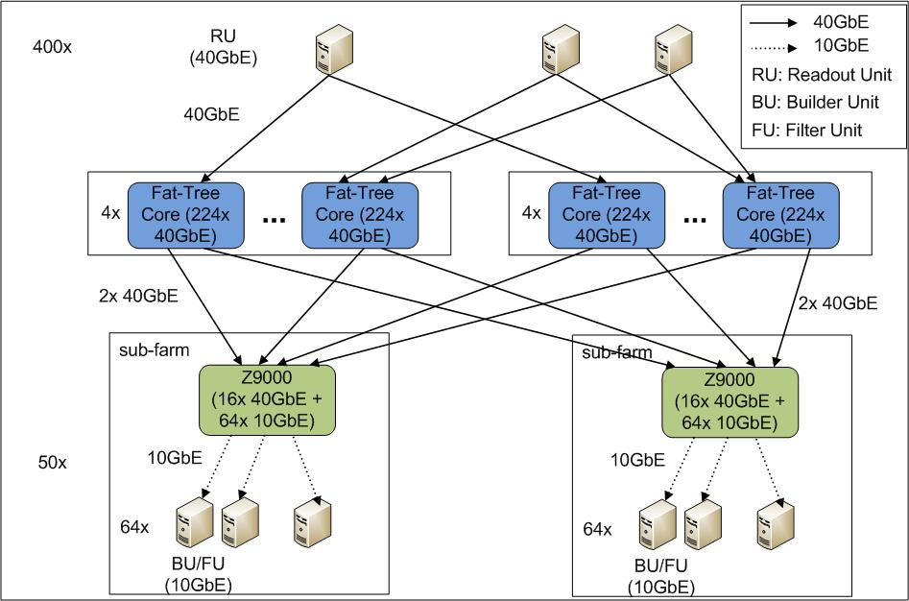
Classical fat-core event-builder
About 1600 core ports

