Slide 1
LHCb Trigger and DAQ in view of upcoming Intel technology
Niko Neufeld, CERN
Intel/CERN Big Data workshop, Jul 10th 2013

Slide 2
Intro
These slides are an abridged and somewhat re-interpreted version of a summary of the LHCb upgrade Trigger and DAQ given in May 2013
Apologies for the poor (graphical) quality of the slides

Slide 3
Introduction – the task
As of 2019 the total amount of data from the detector will be == 38400 Gbit/s == 4.8 TB/s
These data needs to be collected and filtered
A hardware trigger (Low Level Trigger) should reduce the rate to something we can afford in terms of CPU power
The proposed system should be reliable, operated for 10 years by a small crew, scalable and as cost-effective as possible

Slide 4
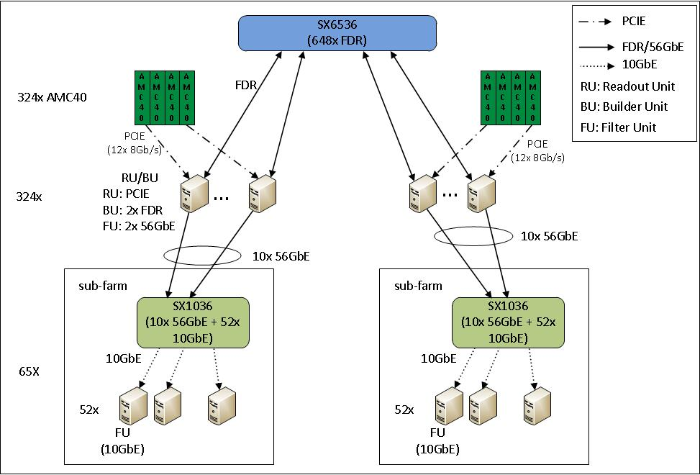
Uniform event-builder network
FDR → Storm Lake
LLT
LLT decision
10 GbE →Storm Lake

Slide 5
Using Intel technologies
  RU connecting to detector stays a PCIe Gen 3 card in a Xeon-server
  Event-building network uses Storm Lake 2
  Filter Units become a mixture of Xeon/Phi and Xeon connected with Storm Lake (1 or 2)
  Low Level Trigger currently planned to be implemented in Stratix V/10 FPGAs
  The (simple) algorithms could be re-implemented on Xeon/Phi or other programmable logic → data will need to be buffered for the latency of this calculation → depending on size lots of RAM might be required

Slide 6
Original Planning
Under the assumption that we need to be ready to take data in 2019
  LS2 shifts → so do we
  System for SD-tests ready whenever needed → minimal investment
2013: DAQPIPE ready, tests of 40 GigE and IB, PC I/O technology, PCIe performance
2013 – 16: technology following (PC and network)
2014 - 15: Large scale IB and Ethernet tests
2015 – 2016: mass production of FGPA cards for LLT
2016: TDR & tender preparations
2017: Acquisition of minimal system to be able to read out every GBT (at some speed)
  Acquisition of modular data-center
2018: Acquisition and Commissioning of full system
  starting with network
  farm as needed

Slide 7
Modified Planning
Under the assumption that we need to be ready to take data in 2019
  LS2 shifts → so do we
  System for SD-tests ready whenever needed → minimal investment
2013: DAQPIPE ready, tests of 40 GigE and IB, PC I/O technology, PCIe performance
2014 - 15: Demonstrator of Storm Lake 1 event-building / cooperation with FPGA acquisition card
2014 – 2016: Development of alternative LLT (non-FPGA)
2014 – 2018: R&D on Xeon/Phi for High Level Trigger
2016
  Decision between FPGA and Xeon/Phi implementation of LLT
  Decision on network technology (Storm Lake / Ethernet)
  Preparation of call for tenders
2017: Acquisition of minimal system to be able to read out every GBT (at some speed)
  Acquisition of modular data-center
2018: Acquisition and Commissioning of full system
  Decision on initial ratio of Xeon/Phi and Xeon
  starting with network
  computing resources as needed

Slide 8
Not covered != not interesting
I could not think of any immediate use of non-volatile memory other than a hard-disk replacement (power, reliability) → but this is probably due to lack of imagination: often ideas come with the availability of technology
Just as an example how much memory would be needed. Assume of the initial 40 MHz of events 500 kHz are stored for closer scrutiny after some lengthy calibration (say 1 hr). Then we need
5 x 10^5 x 100 x 3600 kB = 180 TB of space

