Slide 1
CENF EHN1

Slide 2
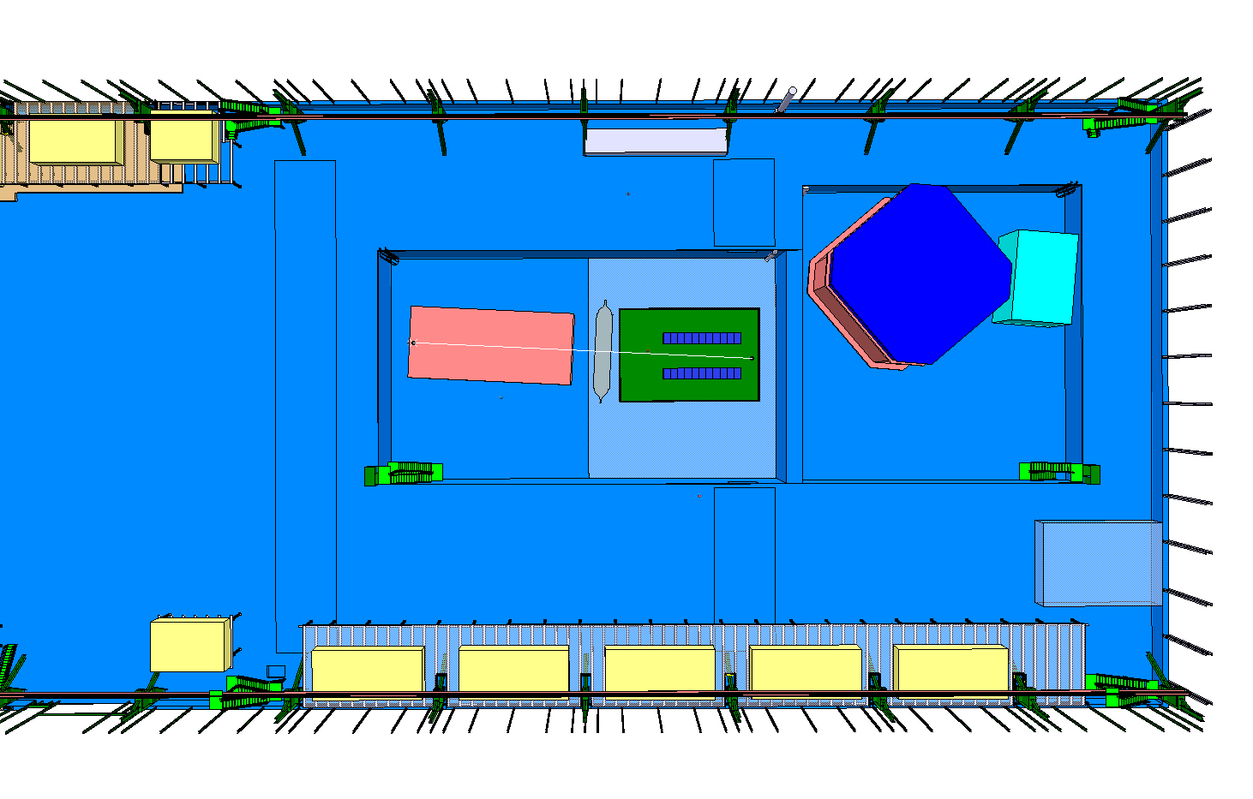
P supply
LAGUNA
ICARUS
NESSIE 20X17 m²
Handling
area

Slide 3
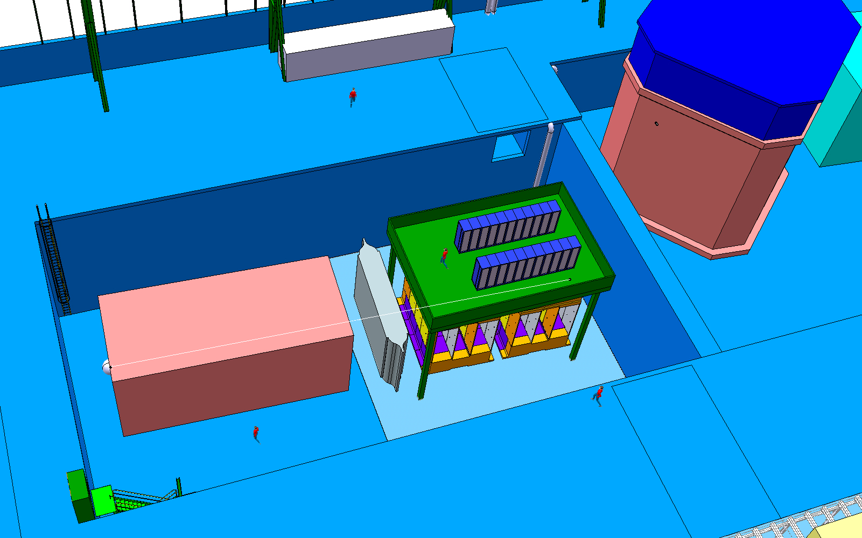

Slide 4
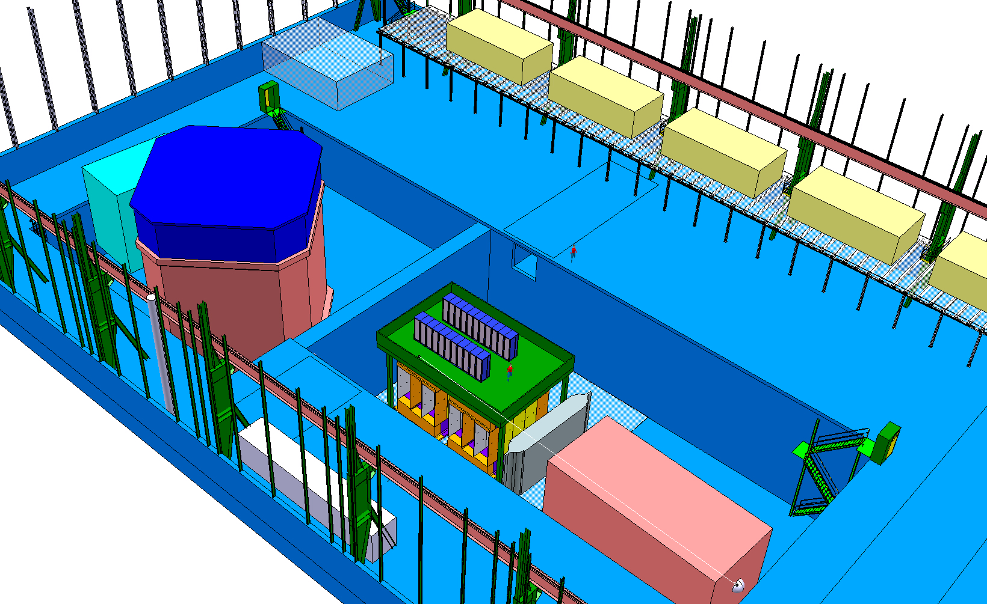

Slide 5
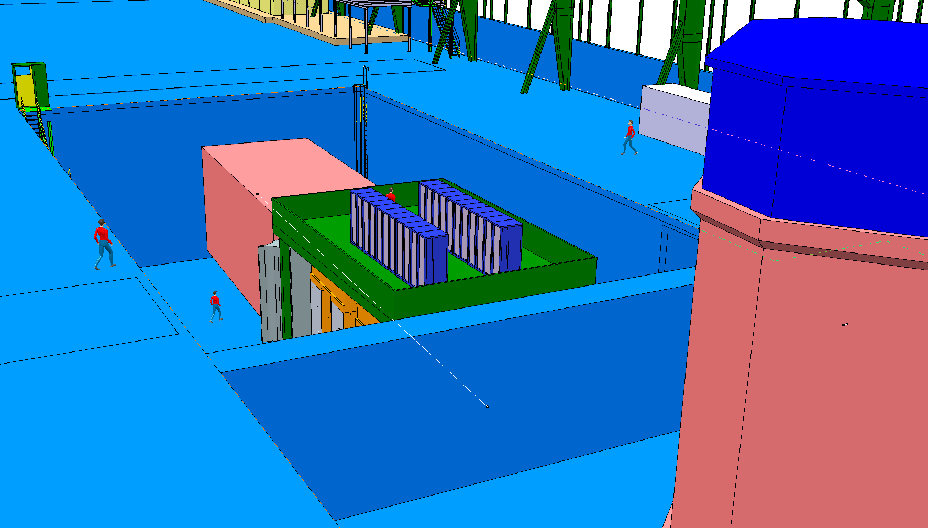

Slide 6
