Slide 1
Heavy Ion Plans: Experiments Perspective
Heavy Ion Physics Highlights from Run 1
Heavy Ion Parameters and Schedule for Run 2
Upgrades and Perspective after LS2

Slide 2
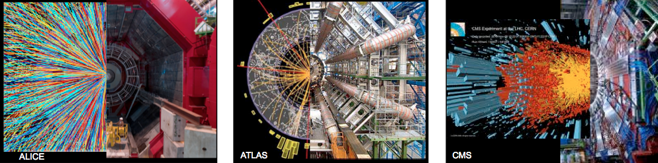
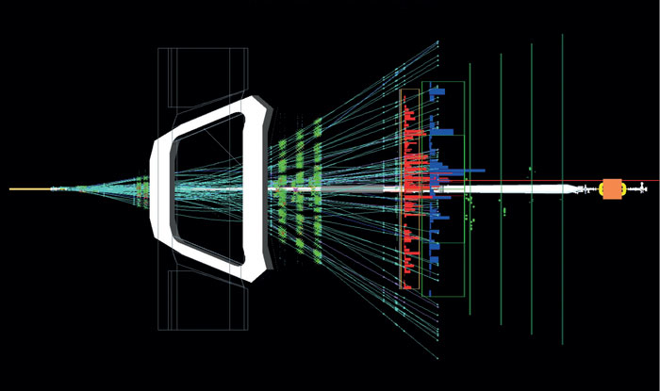
Highlights from the HI Physics Program
LHCb

Slide 3
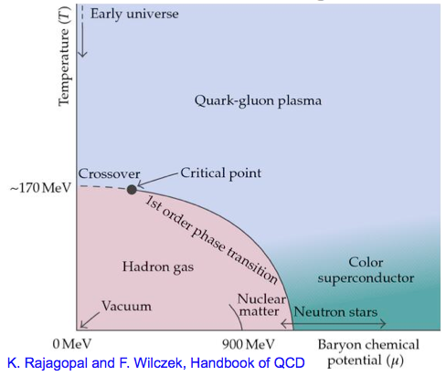
Heavy Ion Physics
QGP: what is it
  A theoretical model of the phase of matter where partons are not (completely) confined
  Produced in High-energy nucleus-nucleus interactions
  Large energy density (~15 GeV/fm³ at LHC) over a large volume (~ 5000 fm3 at LHC)
  Very high equivalent temperature (T~300 MeV)
  Strongly interacting
How it is studied
  Jets: energy loss mechanism - collective effects in QCD, medium density
  Heavy flavour: mass dependence of energy loss - probe the medium transport properties
  Quarkonium: quarkonium dissociation and regeneration - probes deconfinement and medium temperature
  Low-mass di-leptons: thermal radiation γ (àe+e-) - to map temperature and evolution
  Proton-Ion: collective effects
pp physics probes quarks and gluons as “free particles”
Nuclear physics studies the bound states
HI physics studies the intermediate phases of QCD matter which prevailed shortly after the big-bang

Slide 4
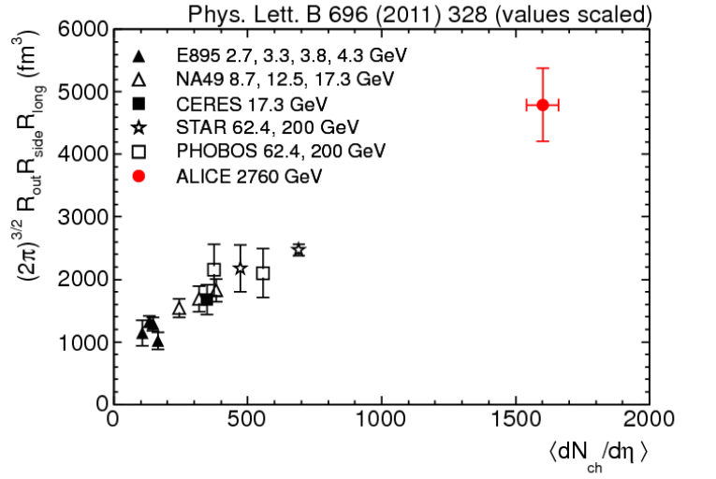
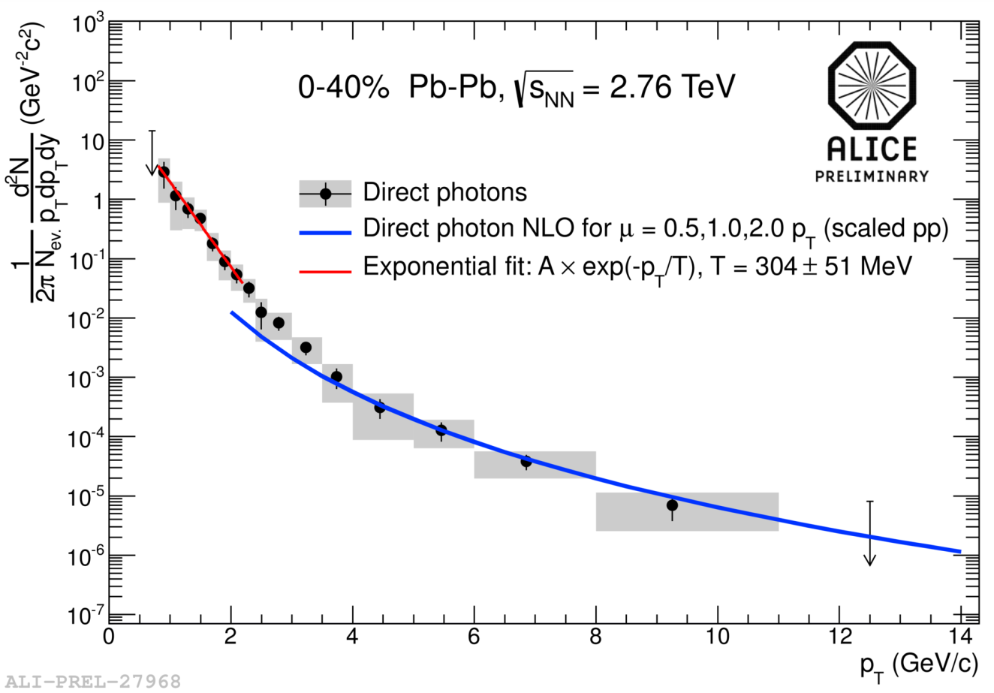
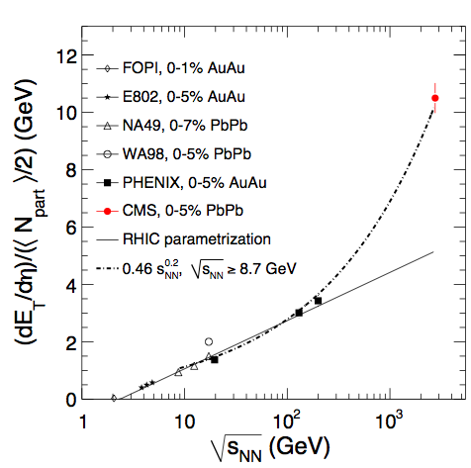
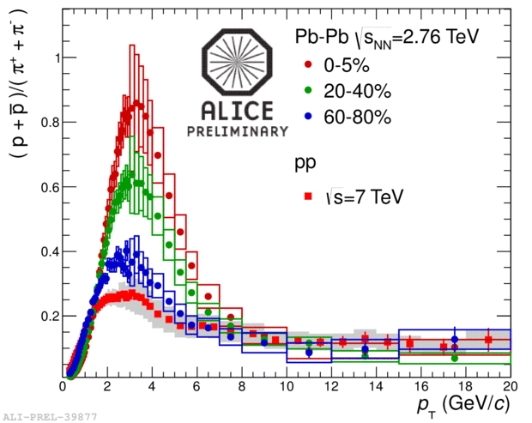
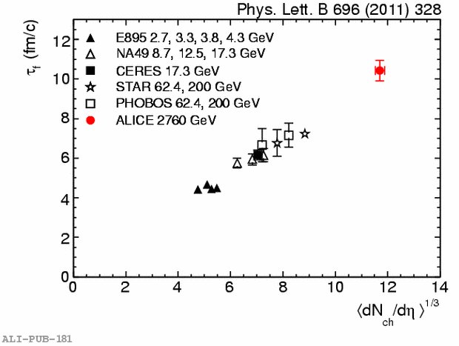
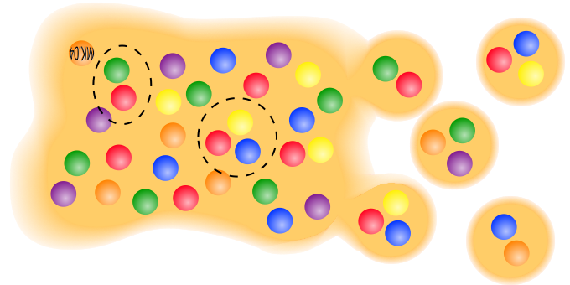
Global Properties of QGP
Energy density
3 x RHIC (≈ 12 GeV/fm3)
T ≈ +30% (≈ 300 MeV)
Volume ≈ 2 x RHIC (≈ 5000 fm3)
Lifetime ≈ +20% (≈ 10 fm/c)
Hadron yields suggest hadronization occurs from a system with partonic degrees of freedom
Baryon(3q)/Meson(2q) ratios (e.g. p/π)
enhanced at intermediate pT

Slide 5
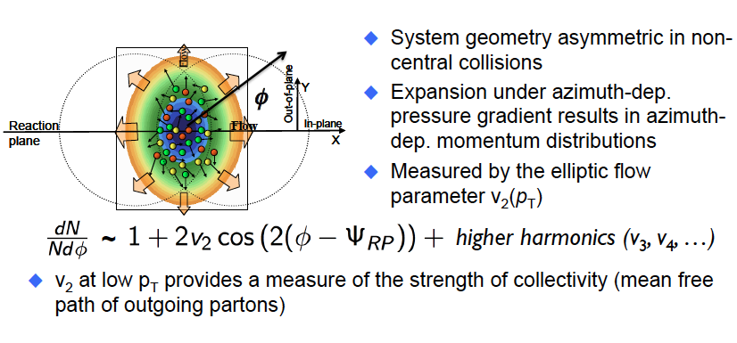
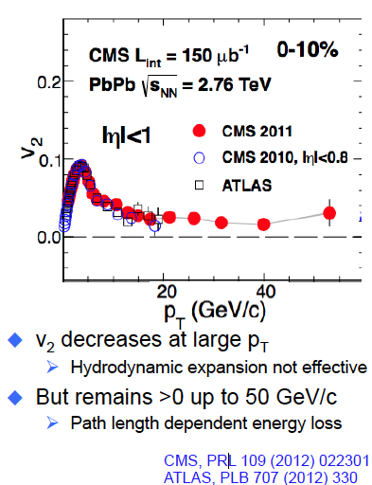
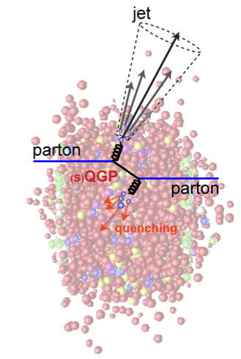
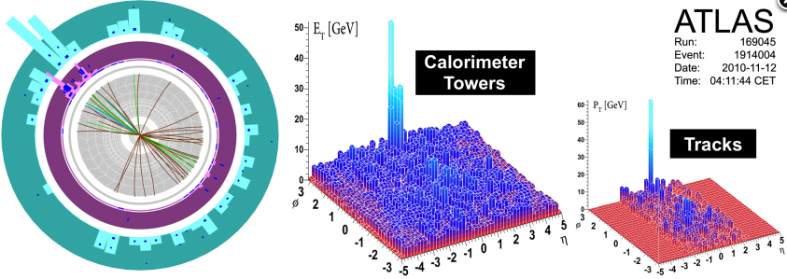
Hydrodynamic Properties
Features of medium: anisotropy
Features of medium: opacity/viscosity
Parton Energy Loss by
medium-induced gluon radiation
collisions with medium gluons
p' = p − ΔE(ε medium )

Slide 6
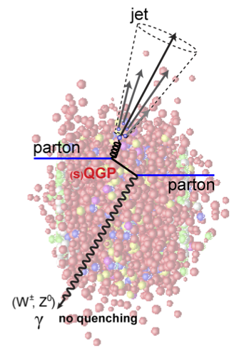
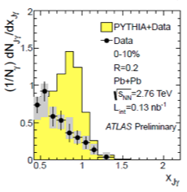
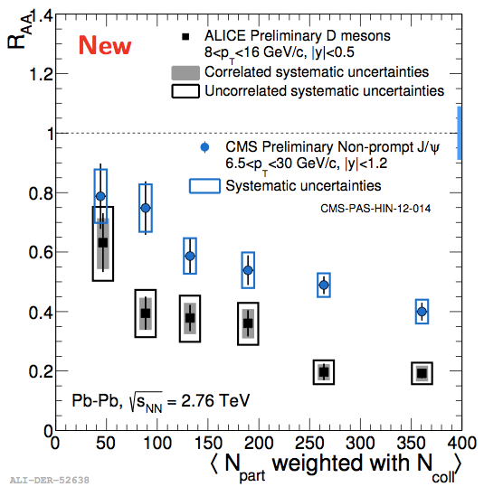
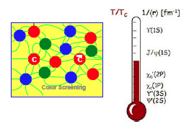
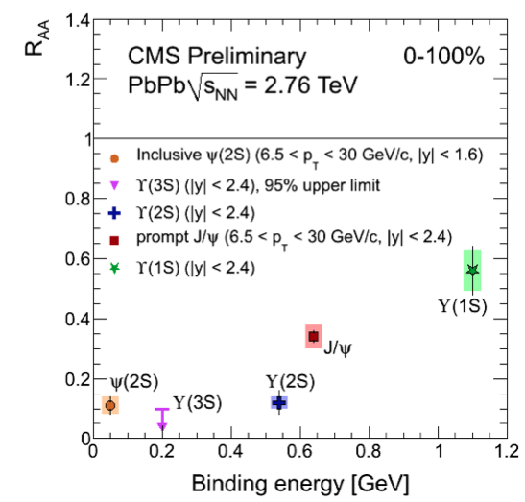
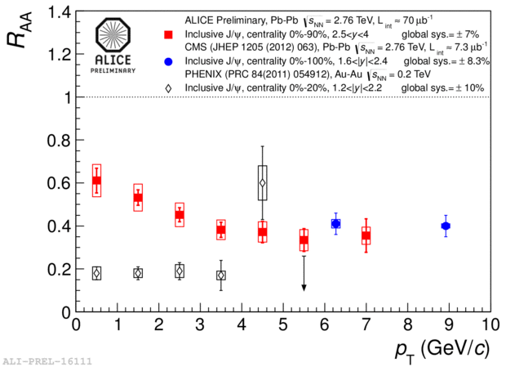
Experimental Techniques
jet-boson (γ, Z) correlation
High statistics:
Precise measurement of the medium-modified fragmentation function
Differential studies as a function of event geometry
Heavy quark probes
Energy loss expected to depend on parton mass
First indication at LHC:
R_{AA} B (CMS) > R_{AA} D (ALICE)
Low-Pt charmonium…
Regeneration?
Quarkonium sequential dissociation:
direct probe of deconfinement and of
the medium temperature – “melting” of bound states

Slide 7
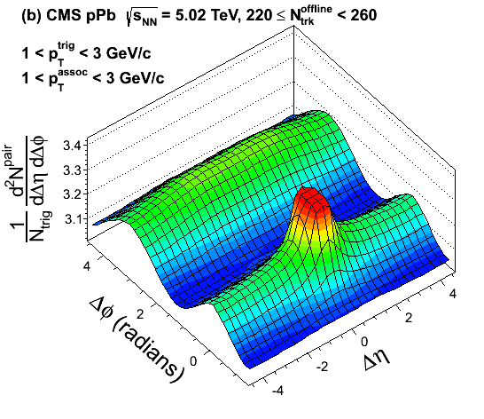
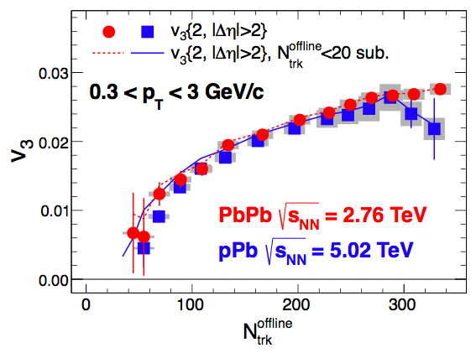
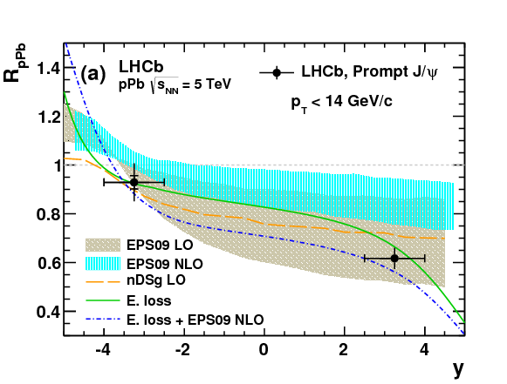
pPb: a Control Experiment
Motivation for pPb running:
  Reference for the PbPb data
  Study the effects of the initial state without the presence of the hot medium
    nuclear PDFs
    Cold Nuclear Matter effects
But also shows exciting new phenomena:
  Long range Δη correlations
  Surprisingly similar multipole harmonics
  (v2, v3) in pPb and PbPb at the same multiplicity
Hydrodynamic expansion of a strongly coupled medium presently the only theory that explains this observation
Important constraints on expected “cold nuclear matter” effects

Slide 8
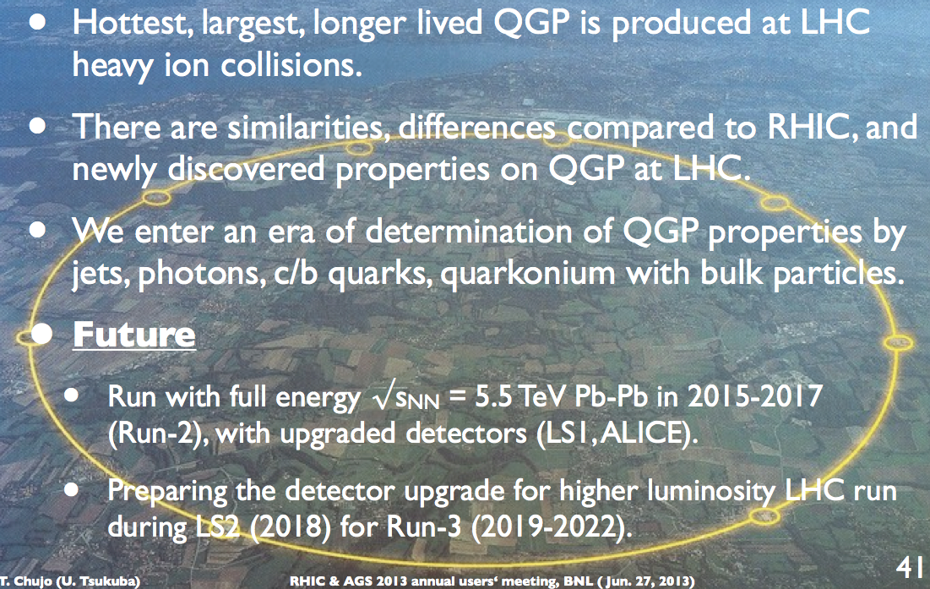
In a nutshell
Thanks to this:

Slide 9
Heavy ION Parameters for Run 2

Slide 10
Machine Summary
(J.Jowett, Chamonix 2012 and later, with edits by EM)
In a total of about 8 weeks of LHC operation in the two Pb-Pb runs of 2010-11, the following milestones have been achieved:
  The peak luminosity has reached twice the design.
  We have already achieved 15-18% (depending on the experiment) of the overall long-term Pb-Pb luminosity goal of 1 nb^{1}
We learned a lot from 2011 Pb-Pb run and have a better understanding of the performance limits of the LHC as a heavy-ion collider
We have proven the operation of the LHC as a proton-Lead collider and the performance in this configuration has exceeded expectations
As prospects for exceeding the design luminosity L>10²⁷ cm⁻²s⁻¹ after LS1 now appear very good and ALICE is considering an upgrade in LS2 to handle peak luminosities L ~ 6 10²⁷ cm⁻²s⁻¹ it will be important to study upgrade measures that may achieve these luminosities in 2019
A missing factor 2-3 in peak luminosity might be achieved if we can increase the number of bunches in the ring (reducing the minimum spacing to 50 ns, for example). Alternatively, all, or some fraction, of such an increase could come from measures taken in the LHC, e.g. reduced β* in collision
The option of running with different ion species will become available

Slide 11
Physics goals
Differential studies of jets, b-jets, di-jets, γ/Z-jet at very high pT (focus of ATLAS and CMS)
Flavour-dependent in-medium fragmentation functions (focus of ALICE)
Low-pT heavy flavour production and elliptic flow of several HF hadron species (focus of ALICE)
B and b-jets (focus of ATLAS and CMS)
Low-pT charmonia and elliptic flow (focus of ALICE)
Multi-differential studies of Υ states (focus of ATLAS and CMS)
(Very) low-pT and low-mass di-electrons and di-muons (ALICE)
Large integrated luminosity pPb to disentangle QGP effects from cold nuclear matter effects, and to reduce the experimental uncertainty and enable classification of theoretical predictions (focus of LHCb, among others)

Slide 12
Run 2: ALICE
Year | System | Luminosity
2015 | pp – min bias (24 weeks) | 10²⁹-10³⁰ cm⁻²s⁻¹
 | Pb Pb – 4 weeks | 10²⁷ cm⁻²s⁻¹ - leveled
2016 | pp – rare triggers (24 weeks) | 5-10 10³⁰ cm⁻²s⁻¹
 | Pb Pb – 4 weeks | 10²⁷ cm⁻²s⁻¹ - leveled
2017 | pp – rare triggers (24 weeks) | 5-10 10³⁰ cm⁻²s⁻¹
 | p Pb – min bias (2 weeks) | 0.5-1 10²⁸ cm⁻²s⁻¹ - leveled
 | p Pb – rare triggers (2 weeks) | 1 10²⁹ cm⁻²s⁻¹ - leveled
2018 | LS 2
For 2015 pp need 5 orders of magnitude luminosity reduction in IP2
  no filling scheme tricks available at 25ns ~all bunches collide in ALICE (except effect of abort gap)
  Larger β* not an option due to aperture issues in IP2
  A separation of order 5σ seems to be needed
  Would the level of background in IP2 be lower than signal? Will depend on quality of vacuum
ALICE studied the beam-gas background conditions in LSS2-L assuming a 5 10⁻⁹ vacuum.
  the result is a rather strong MB trigger contamination (~50%) at L=1 10²⁹. on the other hand the contamination at L=1 10³⁰ is ~10%, but a pileup of 10 in the TPC is the price to pay.
  Further studies of optimization will be performed based on these results
Notes:
LHCb: Cogging would make the other experiments unhappy, moving LHCb not popular… so… could be done geometrically by shifting one beam
Would reduce luminosity (out of time bunch collision..) – must be stable !

Slide 13
Run 2: ATLAS/CMS
ATLAS
  Assume a HI run @ the end of each year as in the baseline LHC schedule
    A leap of one year, although not desirable, could be acceptable if helping with overall efficiency
  2015-2016: PbPb (5 TeV) and corresponding intermediate energy reference pp data – they will also be useful for pPb
    Ultimate goal is to collect 2-3 nb-1 before LS3.
  pPb: No strong preference - Definitely one run @ 8.2 TeV before LS3
CMS
  2015 PbPb at √sNN = 5 TeV
  2016 PbPb at √sNN = 5 (5.5?) TeV
    Consider having the second high luminosity PbPb run at same energy as the first one, depending on the impact on setup time and achievable instantaneous luminosity
  2017 pPb at √sNN = 5 (8.2?) TeV, high luminosity
    pPb running at the same cms energy as PbPb instead of the top energy possibly preferable: minimize the number of pp reference data sets needed. More studies to balance the gain in high p_{T} statistics vs availability of reference data
ATLAS + CMS
  Intermediate energy pp: Pb+Pb equivalent pp-data set is absolutely required (needed pp integrated lumi is ~3-4⋅10⁴ the Pb-Pb one): needs to be kept in sync with Pb+Pb ∫Ldt “steps” --- not possible to concentrate all pp data taking in a single period during 2015-2022 running

Slide 14
Run 2: LHCb
Due to the huge track multiplicity in Pb-Pb collisions in the forward direction (2 < η < 5), LHCb plans to participate only in a pPb run, as in 2013.
LHCb would appreciate if the p-Pb run comes not at the end of the HI program of Run II . . .
Experience has shown that a pp data sample at the corresponding pPb energies is important, i.e. at 5 TeV and 8.2 TeV.
LHCb would like to get at least 10x the integrated luminosity they had in 2013.
  In 2013 took data at ~5x10²⁷/cm²/s.
  Assuming another p-Pb run would last also about 4 weeks, a luminosity greater than 5x10²⁸/cm²/s should be provided to LHCb
To be verified if this is compatible with machine limitations in the pPb scheme

Slide 15
Run 2 Beam Parameters Summary
Beam Energy: one clear advantage in choosing a single value of √sNN is the pp reference sample just keeps adding up
  All experiments seem to consider running PbPb again at 5 TeV acceptable
  Should the lower energy also be considered for the next pPb run? Physics considerations vs. advantages for reference pp samples…
ALICE requires leveling during PbPb and pPb running
  ATLAS/CMS might need to be also leveled to guarantee constant luminosity to ALICE in the presence of large burn-off
  Same luminosity for all IPs (slightly penalizing for IP1/5)
The request of LHCb for a factor 10 more luminosity in IP8 requires squeezing of the 4 IPs
  Not clear how technically difficult this is
  Other options to be considered ?

Slide 16
Schedule of HI Run 2
  All experiments agree that HI run periods cannot be grouped(*)
Goal is (clearly) as large as possible integrated luminosity for PbPb and pPb
Run 2: The general goal is to collect at least 1 nb⁻¹
  One HI run period per year 2015-LS2
  PbPb and pPb only before LS2(**)
The generally agreed schedule:
  2015: PbPb at 5.0(2) TeV
  2016: PbPb at 5.0(2) (5.5) TeV (***)
  2017: pPb at 5.0(2) (8.2) TeV (***)
  ArAr…
All but ALICE consider reference pp data at equivalent energy a must
  ∫Ldt(pp) = 3-4 10⁴ × ∫Ldt(PbPb) is considered necessary/sufficient
  ALICE not against pp runs if they do not reduce the allocated time for the HI runs. If there is conflict, their priority would be to collect HI data.
(*) ATLAS considers a one year gap acceptable if proven beneficial for the general program
(**) ATLAS has a slight preference for a possible ArAr run before LS2 – In any case no request for different species during the same year
(***) The benefit of higher p_{T} statistics vs availability of reference data and setup time must be balanced in considering the beam energies for 2016/17

Slide 17
Run 2: Questions to be Addressed
ALICE operation at very low luminosity during pp
  Separation
  Noise level, vacuum quality
Compatibility of leveled vs. non-leveled operation in IP2 and, respectively 1,5 w.r.t. luminosity lifetime
pPb: can LHCb get 10 times more luminosity ?
E-YETS 2016 vs. LS1.5: how does this reflect on the HI schedule ?
pp reference data taking in Run2: scheduling issues to be addressed
Need for ALICE polarity reversals

Slide 18
BEYOND LS2

Slide 19
The Race for 10 nb⁻¹
Experiments Plans
ALICE will install its major detector upgrade during LS2 in 2018
  The upgrade aims at precision measurements of the Quark Gluon Plasma, with a factor 100 gain in statistics (x10 luminosity, x10 via pipelined readout)
CMS L1 trigger upgrade implemented during LS1 will enable the experiment to tolerate an interaction rate of up to ~50kHz for PbPb
ATLAS/CMS Would like to run at the highest possible instantaneous luminosity for PbPb and pPb
  No lumi leveling – to be verified if this is compatible with ALICE running leveled
  Support going to a 100ns bunch spacing to increase inst. Luminosity - as early as possible, as long as the development of the SPS injection kickers does not distract from pp upgrades
LHCb: detector upgrade in LS2 – community interested in HI (pA) physics still small, might build up during Run2
General Expectations
Collect 2-3 nb⁻¹ before LS3.
The HI community has strong interest and a physics case for ≥ 10 nb⁻¹

Slide 20
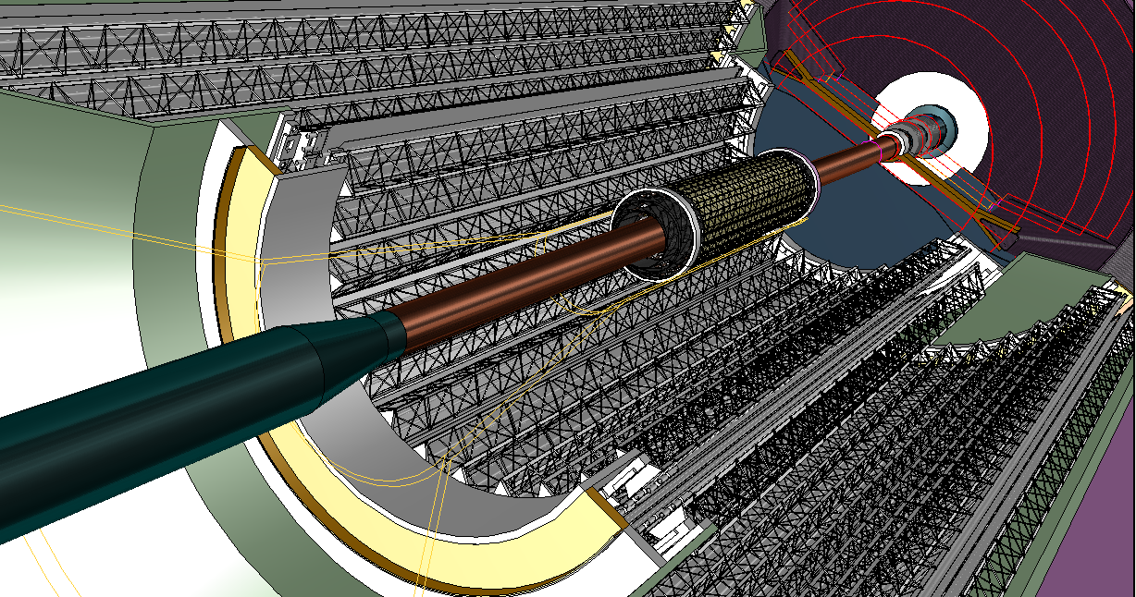
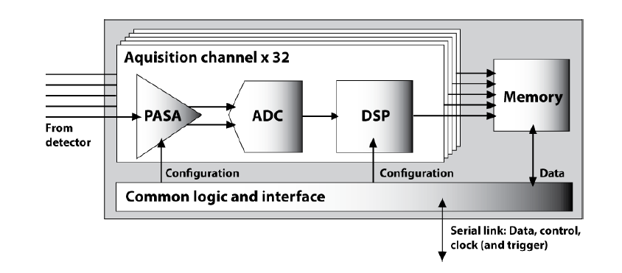


The ALICE upgrade in a nutshell
Pb-Pb recorded luminosity ≥ 10 nb⁻¹  8 x 10¹⁰ events (Run2+3)
pp (@5.5 Tev) recorded luminosity ≥ 6 pb⁻¹  1.4 x 10¹¹ events
New, ultra-low mass silicon tracker around a very small beam-pipe (ID 34.4 mm)
Upgrade of the TPC with GEM detectors for continuous (un-gated) readout
Electronics upgrade of the other sub-detectors
  read out all Pb-Pb interactions at a maximum rate of 50kHz (i.e. L = 6x10²⁷ cm⁻¹s⁻¹) with a minimum bias trigger
Major upgrade of the online systems to process all Pb-Pb collisions upon a (minimum bias) interaction trigger
  Perform online data reduction based on reconstruction of clusters and tracks

Slide 21
Other Upgrades Relevant to HI Physics
ATLAS
  Additional pixel layer (LS1), then new tracker (LS3): tracking and b-tag
  Fast tracking trigger (LS2): high-multiplicity tracking
  Calorimeter and muon upgrades (LS2): electron, γ, muon triggers
  TDAQ to allow higher L1 rates and larger data volume
CMS
  New pixel tracker (LS2), then new tracker (LS3): tracking and b-tag
  Extension of forward muon system (LS2): muon acceptance
  Upgrade of trigger and DAQ (LS2): HI-specific development to reach necessary L1 rejection at 95%, from 50 kHz to <3 kHz (HLT)
LHCb (LS2)
  Upgrade includes new vertexing and tracking detectors (not focused on HI)

Slide 22
Heavy Ion Operations after LS2
Upgrade of SPS injection system
Installation of collimators in dispersion suppression region around IR2 (possibly also in IR7?) for ions
  In case the magnet quench limits are reached in IP1/5, the installation of dispersion suppression collimators as in IP2 would be desirable
ALICE: LHC vacuum in LSS around IP2 needs to be improved by an order of magnitude to mitigate background
Beam species: Pb-Pb, p-Pb, (Ar-Ar, p-Ar?)
  Light ion running could be interesting to study jet quenching
    Lower underlying event multiplicity reduces systematic error on measurements
    Considered important, especially for jet quenching
    Potentially higher N_{coll} weighted Luminosity achievable
  LHCf expresses interest for Nitrogen or Oxygen collisions for cosmic-ray physics
The basic assumption is to continue the pattern of one month LHC heavy ion operation per year

Slide 23
Special needs after LS2
pp reference at 5.5 TeV required: ALICE concurs
  HF: D and B cross sections can be scaled in √s with pQCD, but large scaling uncertainty for charm at low pT (>50%) Quarkonia: no robust theoretical guidance for interpolating Jets: FF and jet energy scale calibration depends strongly on √s
Required integrated luminosity for pp at 5.5 TeV
  ALICE (for HF and charmonia needs): ~10/pb
    Statistical error on pp reference negligible wrt Pb-Pb (e.g. 1/√2)
      Npp=2 NPbPb [(Sig/ev)PbPb/(Sig/ev)pp]2
    e.g. 10⁶ s at 200 kHz (L leveled at 6x10³⁰)
  ATLAS/CMS: match PbPb yields at high pT 10/nb (PbPb)➔300/pb (pp)
    Scaled by N_{coll} (For S>>B, Sig = 1/sqrt(S))
      SPbPb~ Ncoll Spp and Ncoll ~ 1500 in central Pb-Pb at LHC
pPb, pAr and ArAr:
  pPb at high luminosity: continue studying collective effects
  pAr and Ar-Ar certainly on the table after LS2
  priority will be defined based on the outcome of analysis of high statistics PbPb and pPb from Run 2

Slide 24
Run 3 and Beyond
Run 3 goals: 3 nb-1 of PbPb before LS3, pp reference data…
Possible running scenario after LS2:
  2019 – PbPb 2-3 nb⁻¹ (.AND. ArAr as per ATLAS request…?)
    + pp 60 pb⁻¹ (ATLAS/CMS), 3 days (ALICE) ...
  2020 – PbPb 2-3 nb⁻¹
    + pp 60 pb⁻¹ (ATLAS/CMS), 3 days (ALICE) …
  2021 – pPb/pAr? (1/2) + complete pp reference run (1/2)
  2022/2023 LS3
After LS3
  HL-HI-LHC…
  General goal is to collect more than 10 nb⁻¹

Slide 25
CONCLUSIONS

