Slide 2
How to run ions in the future?
D. Küchler
BE/ABP/HSL
based on discussions with R. Scrivens and D. Manglunki

Slide 3
Outline
The present performance of the machine
What could we do to improve the performance?
The oven for the lead production
The daily operation
Final remarks

Slide 4
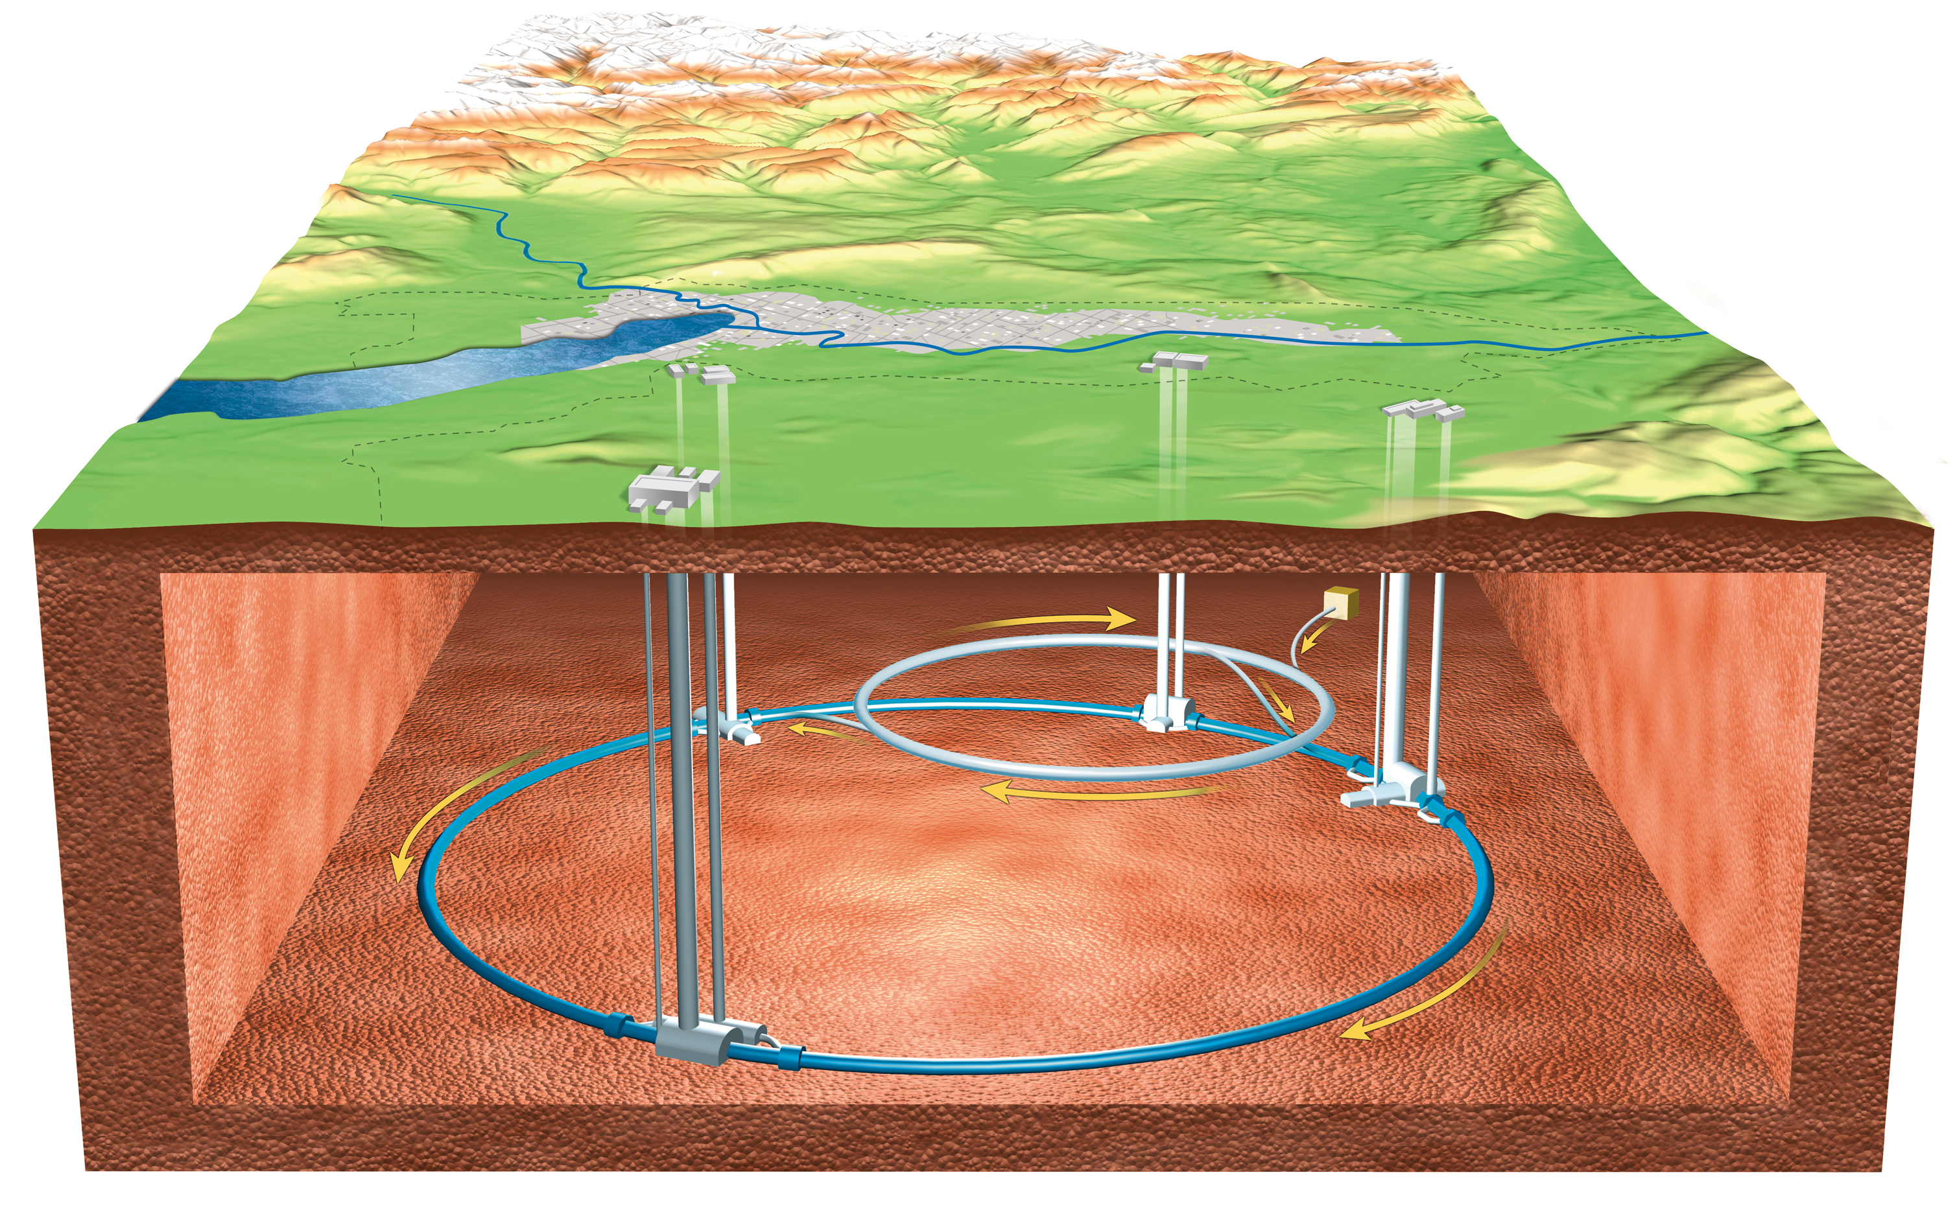
From where the ions start?
A black box somewhere …

Slide 5
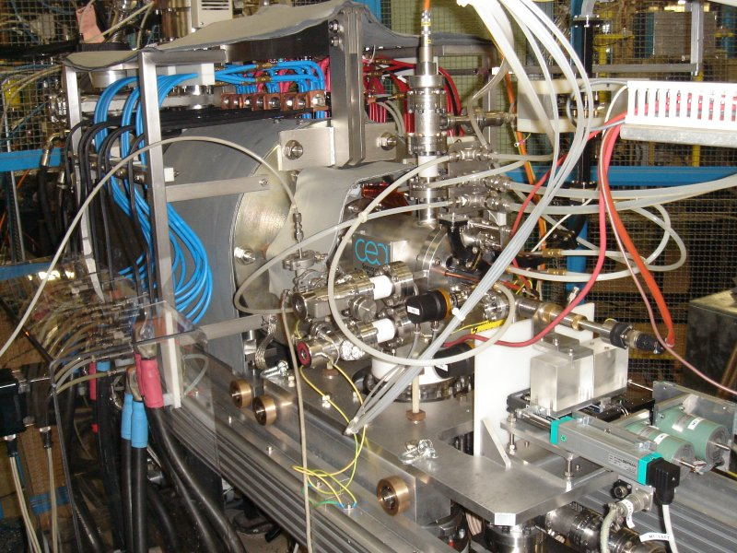
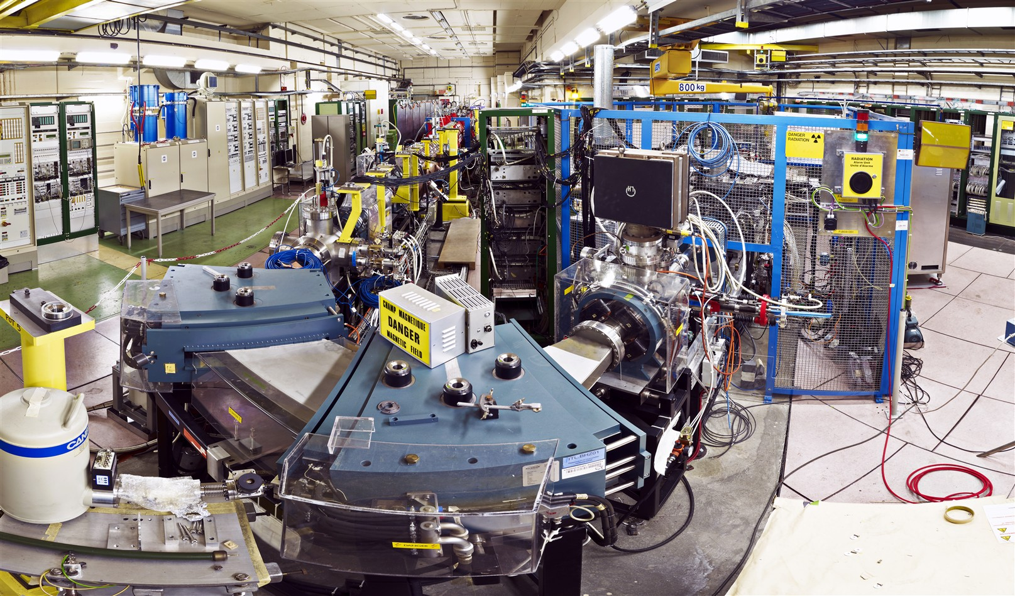
From where the ions start?
The lead ions are delivered by the GTS-LHC ion source connected to Linac3.

Slide 6
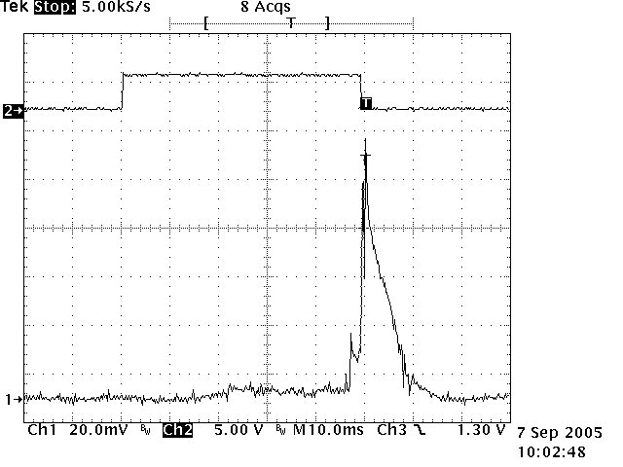
Present operation conditions
isotope: ²⁰⁸Pb (isotopically enriched material)
charge states: Pb²⁹⁺ in the linac, Pb⁵⁴⁺ after stripping
source type: electron cyclotron resonance ion source (ECRIS)
source runs in afterglow mode (10 Hz, 50% duty cycle)
pulse length in the linac 200 µs, up to 5 Hz for LEIR filling
RF
ion
current

Slide 7
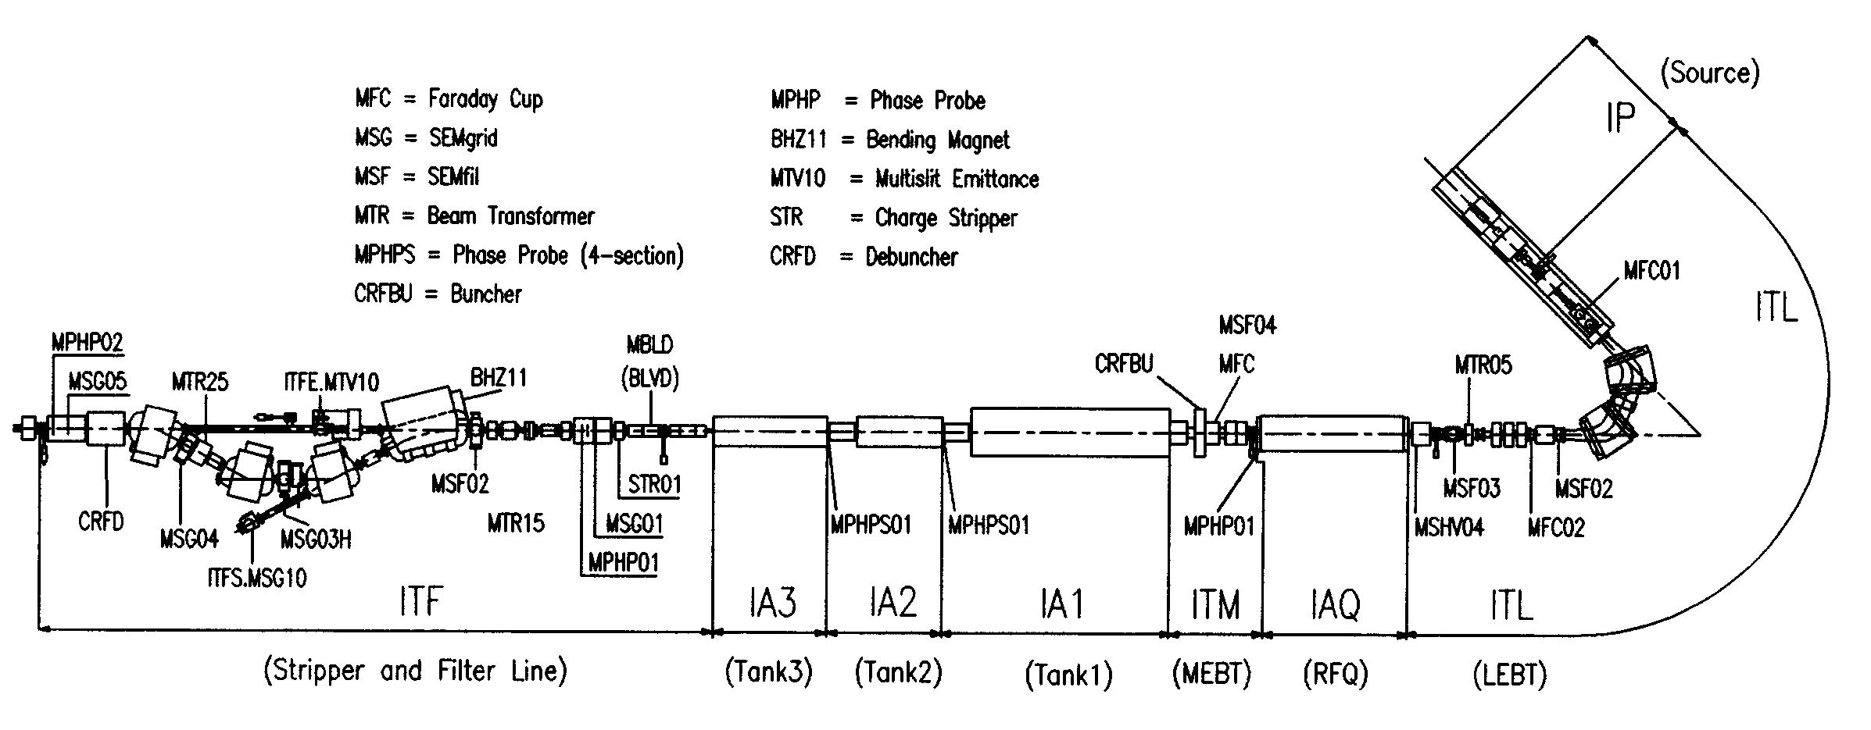
Present performance
records
  215 eµA Pb²⁷⁺ out of the spectrometer
  31 eµA Pb⁵⁴⁺ at the end of the linac
  but not at the same time!
operational
  100-120 eµA Pb²⁹⁺ out of the RFQ
  20-25 eµA Pb⁵⁴⁺ at the end of the linac (TRA25)
  ≈ 50% of the design value

Slide 8
Options to study
improved source extraction system
  new extraction electrodes and/or adding an einzel lens may improve the source emittance
  higher extraction voltage may give more beam and improve the transmission, but would need a new RFQ
improved or new Low Energy Beam Transport (LEBT)
  reducing the space charge before the charge state separation may improve beam quality and reduce losses
  the present LEBT is very long resulting in a low transmission
  a new shorter LEBT adapted to the present source may have a higher transmission

Slide 9
Options to study (cont’d)
10 Hz repetition rate of the linac
  source runs already at 10 Hz, most of the linac elements designed for 10 Hz, only some power converters in the ITF and the transfer line need an upgrade
  all foreseen consolidations of the transfer lines take the 10 Hz operations into account
multi-charge acceleration
  several charge states in the linac (2 or 3) by “weakening” the charge stage separation in the spectrometer
  after stripper only one charge state (Pb⁵⁴⁺)
  need a test with linac and LEIR in an operational (!) state

Slide 10
Would a new source solve all problems?
probably not
present 3rd generation ECRIS
(superconducting magnets, frequencies up to 28 GHz)
  took more than 10 year to reach the peak performance
  big emittance
  unstable beams
present electron beam ion sources (EBIS) do not deliver enough current
  but for HIE-ISOLDE a project is ongoing to develop a source based on the RHIC EBIS which could deliver enough current
  an EBIS has the advantage to switch in principle pulse to pulse the ion species
new developments do not guarantee the success
(e.g. the superconducting magnets for the MS-ECRIS never reached the specifications due to technological issues)

Slide 11
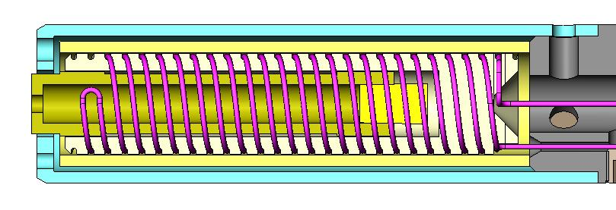
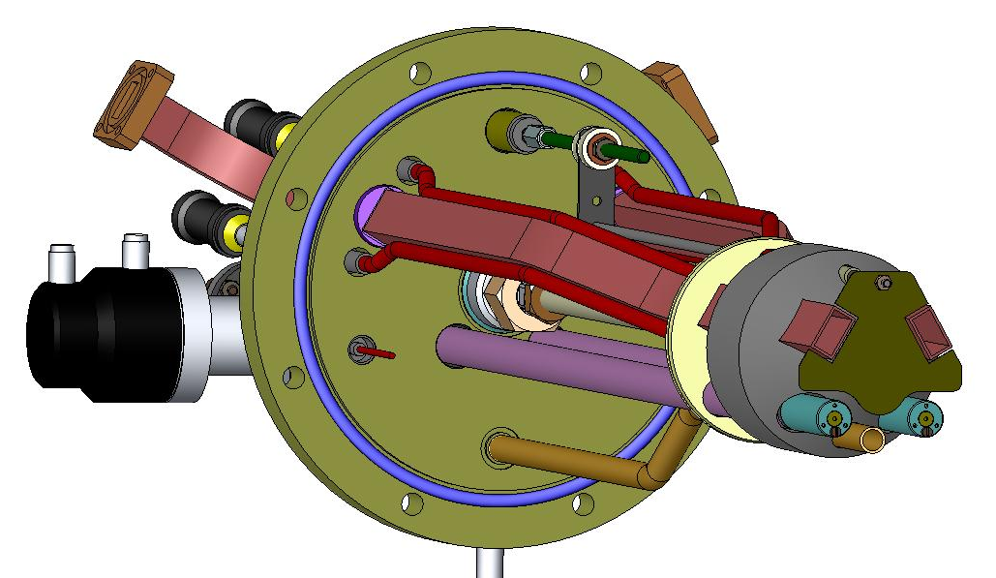
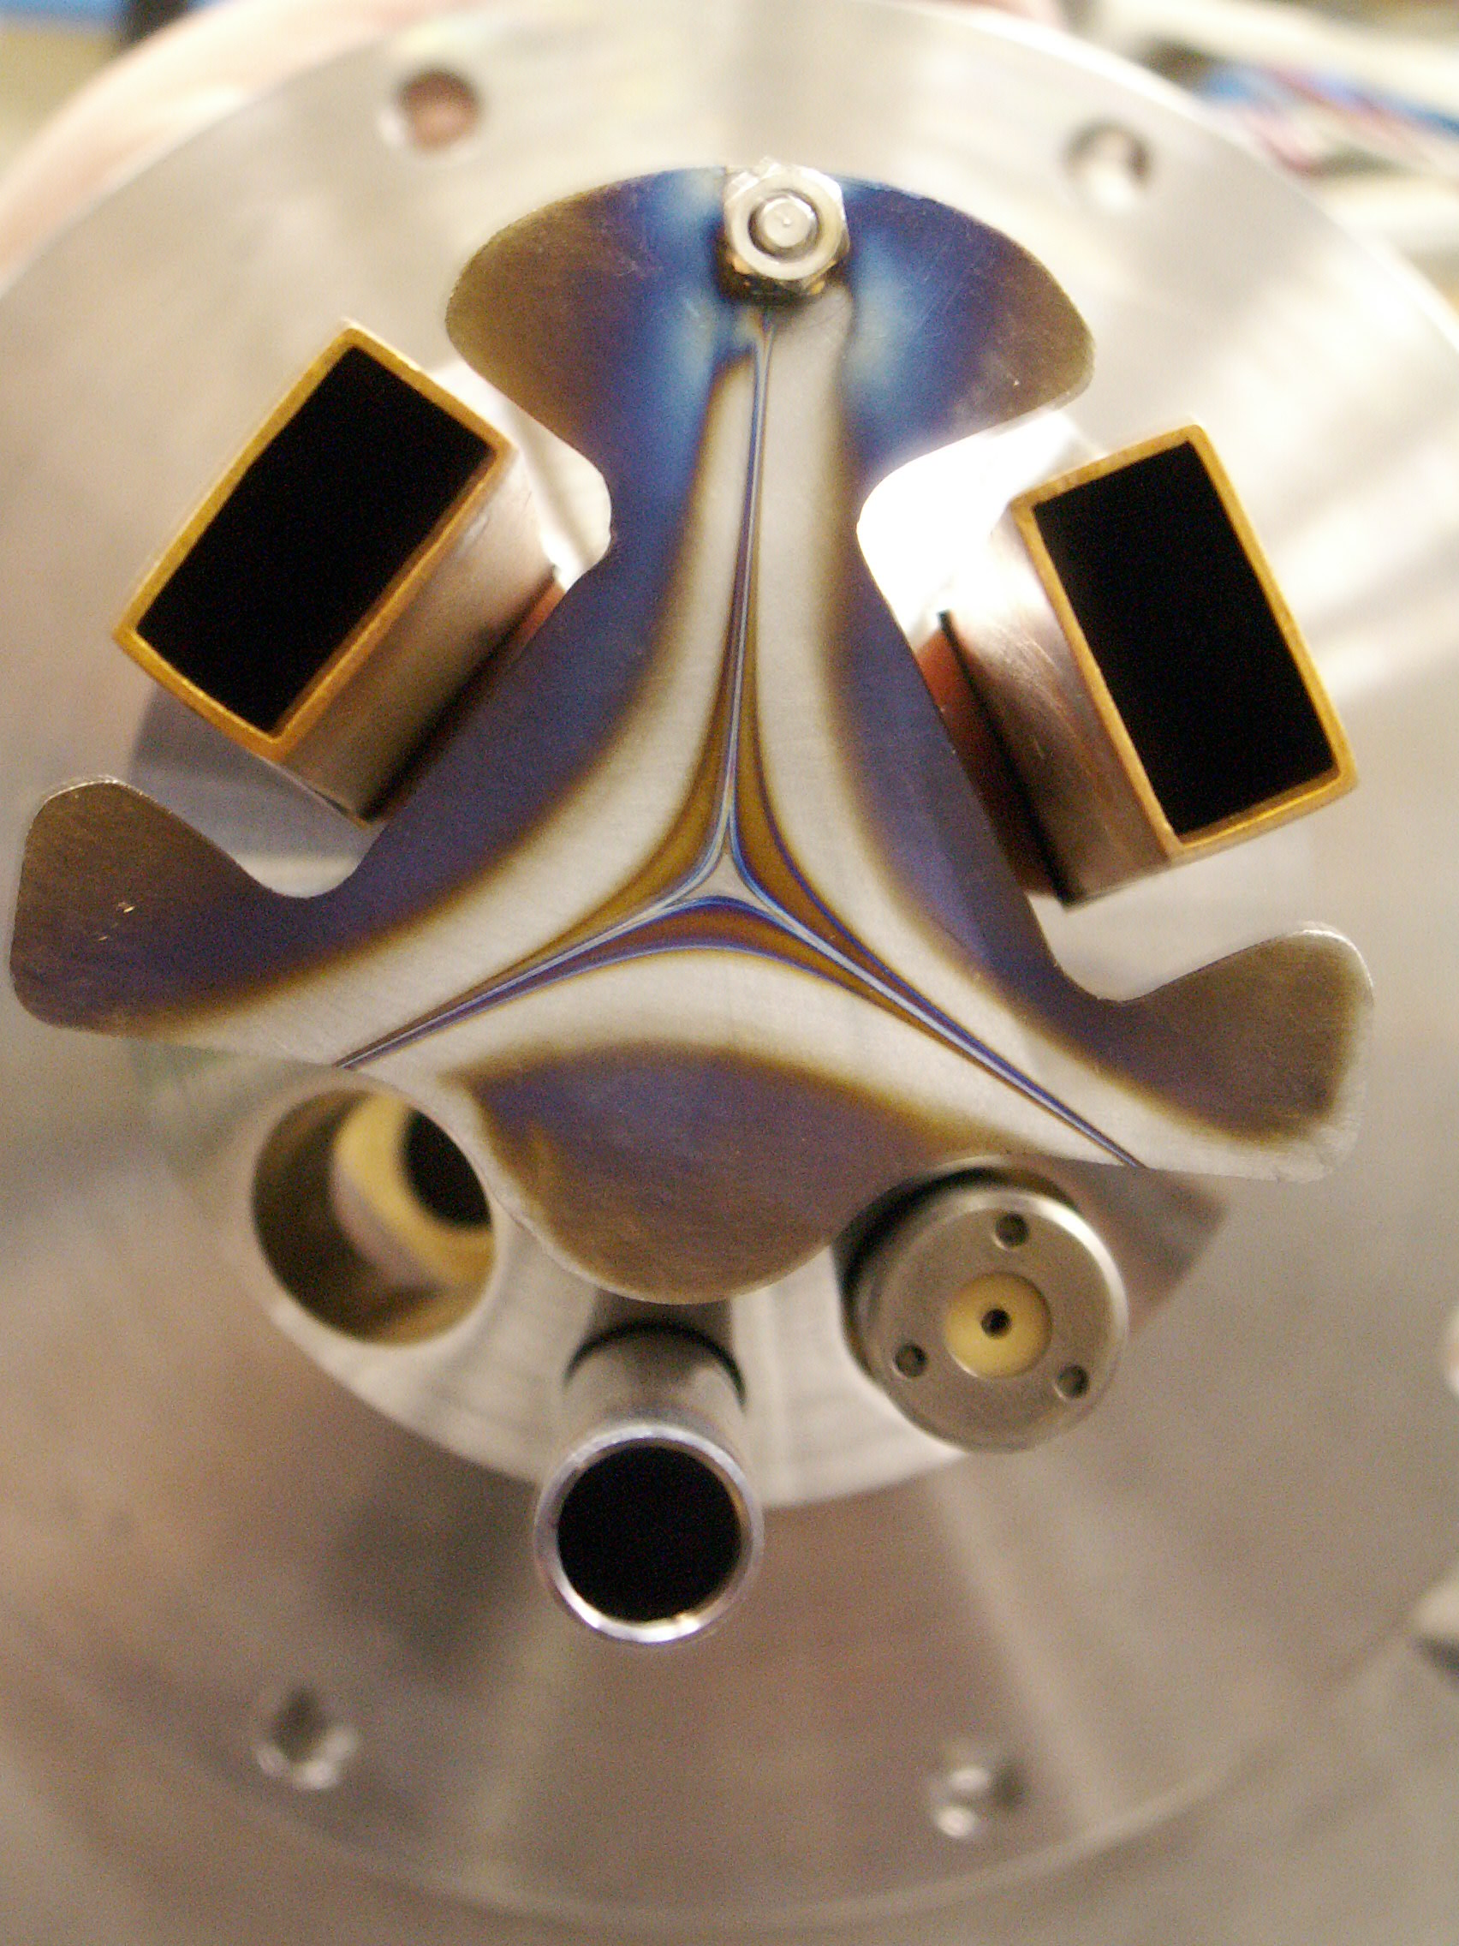
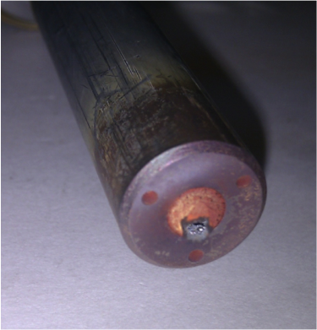
The oven
two ovens are available during operation
there are around 1.5 g of lead in the sample, consumption ~2 mg/h
the 1st oven is good for around two weeks, the 2nd only for an other week (sees some plasma during the first two weeks), flexibility of some days
at the end of the life time usually the tip of the oven is blocked
an oven refill takes around 8 h (down time for all machines)

Slide 12
Improving the oven operation
several filling methods were tested
only the use of a fresh lead sample in an unused crucible gave some improvements concerning the source stability
all other methods (e.g. molten lead) even shortened the life time
an oven test stand is foreseen to study the oven (temperature distribution, relation between oven power and the evaporation of lead)
the result of the studies may help to improve the oven and source tuning to get long term a more stable beam
the oven redesign is not excluded, but may include a redesign of the whole source injection side (due to the present constraints)

Slide 13
The daily operation
3 experts able to tune and operate the Linac3 source, which needs daily tuning
they also serve as Linac supervisors
4 weeks of LHC running are covered through careful planning, but longer times will need more trained staff
(to operate the ion source one needs several years of practical experience!)
higher operation workload as several parameters with tight limits have to be monitored carefully and request follow-up

Slide 14
Final remarks requests
Final remarks
need a dedicated lead operation period in 2015 to make tests and verify simulations
oven test stand in preparation
dedicated source test stand needed
(refused in Chamonix 2006)
  can be used to test source modifications
  can be used to train additional source specialists
  would be roughly 5 MCHF (1.5 MCHF the source itself + test stand infrastructure, LEBT and some partial man power) + 10 man years (for the installation and commissioning)

Slide 15
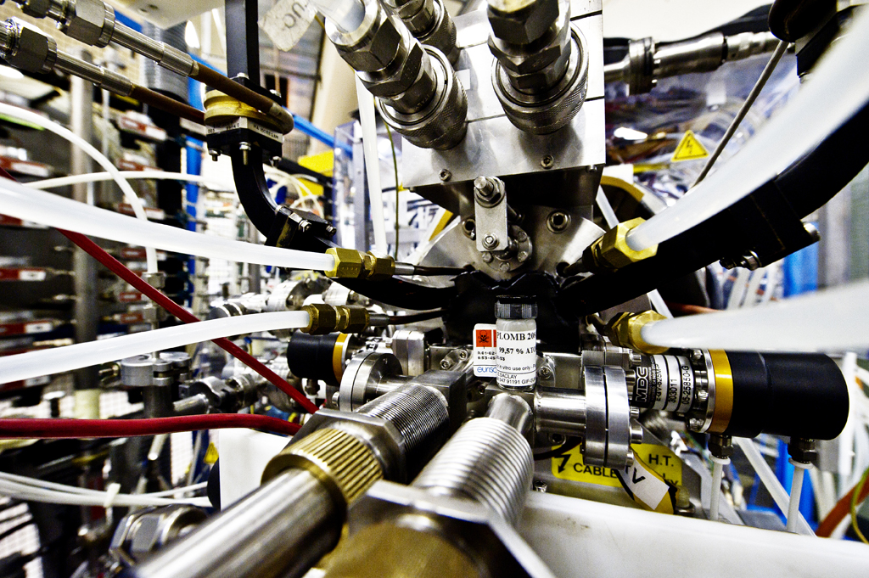
Thank you for your attention!

