Slide 2


LIU:
Exploring alternative ideas
H. Damerau
Review of LHC & Injector Upgrade Plans Workshop (RLIUP)
30 October 2013
Contributions from: H. Bartosik, R. Garoby, S. Hancock, Y. Papaphilippou, E. Shaposhnikova
Acknowledgements: G. Arduini, T. Argyropoulos, M. Benedikt, T. Bohl, C. Carli, S. Gilardoni, B. Goddard, W. Herr, W. Höfle, B. Mikulec, E. Montesinos, G. Rumolo, L. Sermeus, H. Timkó, R. Tomas, R. Wasef and many others

Slide 3
Overview
Introduction
Alternative schemes in the Pre-injectors
  Manipulation schemes in the PS
  Additional improvements
  Special case for limited upgrades
Alternative schemes in the SPS
  RF power considerations
  Transverse improvements
Summary

Slide 4
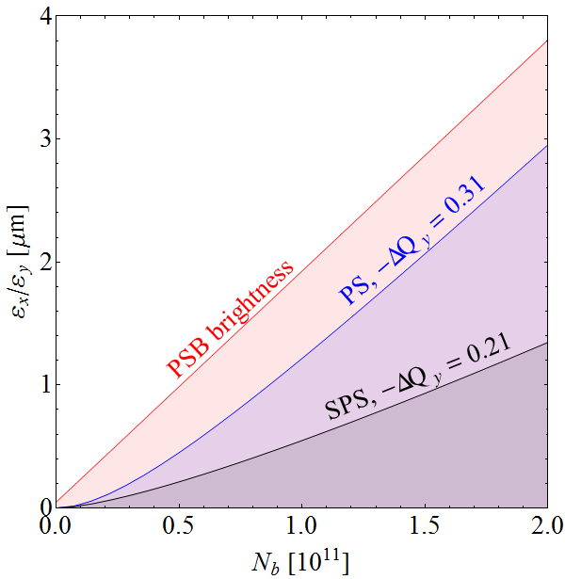
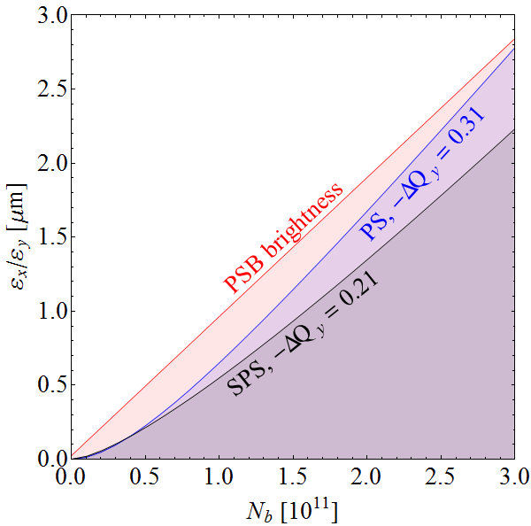
Introduction: baseline upgrade plan
Increase brightness from Linac with PS Booster Linac2 → Linac4
Reduce space charge in the PS PSB/PS transfer energy 1.4 GeV → 2 GeV
Increase intensity per bunch in SPS RF upgrade 4.2 → 7.6 MW, 4 → 6 cav.
Linac2, 1.4 GeV, 3-split
Linac4, 2.0 GeV, 3-split
HL-LHC request
Achieved
LIU: after upgrades
Are there alternatives?
 | 25 ns | 50 ns
Splitting ratio PS ejection/injection | 12 | 6
Batch length from PS | 72 | 36

Slide 5
Overview of upgrade options
Basic choices + alternatives
Basic choices
Additional benefit/margin
Linac4
+? %
Vertical painting Linac4
Faster recombination kickers PSB-PS (with 1.4 GeV)
Long. flat or hollow bunches
PSB
+25 %
2.0 GeV at PSB→PS transfer
Double-batch or h=5 single-batch injection
3-split, BCMS, BCS or PBC (pure batch comp.)
8b+4e together with 3-split or BCMS
+? %
Resonance compensation
Special injection optics
Long. flat or hollow bunches
PS
+? %
+25 %
SPS RF upgrade: 4×3+2×4
+15 %
28 GeV at PS→SPS transfer
SPS
More RF power plants: 4×2+4×3 or 10×2
Relaxed ε_{l} with 200 MHz in LHC
+5 %
Split tunes optics
Special injection optics
+? %
Baseline Beam studies before LS1 Beam studies possible after LS1 Needs hardware

Slide 6
Assumptions
Basic assumptions for performance evaluation:
 | Parameter
L4+PSB | Transverse emittances halved compared to Linac2 | ~0.6 μm/10¹²
PS | Beam loss | 5%
 | Transverse emittance growth | 5%
 | Tolerable space charge tune shift, ΔQ_{y} | -0.31
 | Maximum bunch length at injection | Recomb. kickers
SPS | Beam loss | 10%
 | Transverse emittance growth | 10%
 | Tolerable space charge tune shift, ΔQ_{y} | -0.21
 | Baseline intensity per bunch after RF upgrade | 2.0·10¹¹ ppb
All parameters only valid for 25 ns bunch spacing
For comparison, performances are given at extraction from SPS
Caution: most considerations over-simplified

Slide 7
Overview
Introduction
Alternative schemes in the Pre-injectors
  Manipulation schemes in the PS
  Additional improvements
  Special case for limited upgrades
Alternative schemes in the SPS
  RF power considerations
  Transverse improvements
Summary

Slide 8
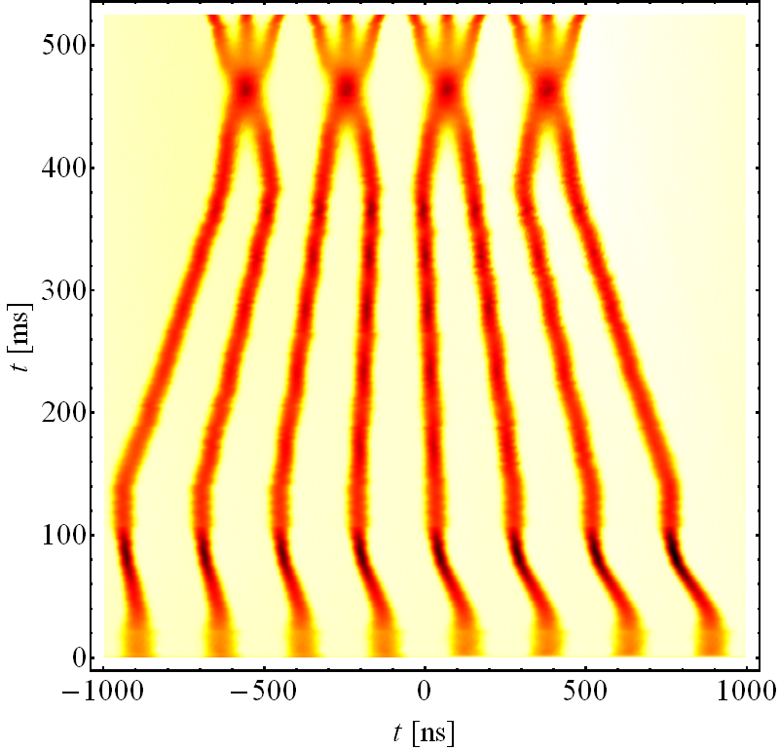
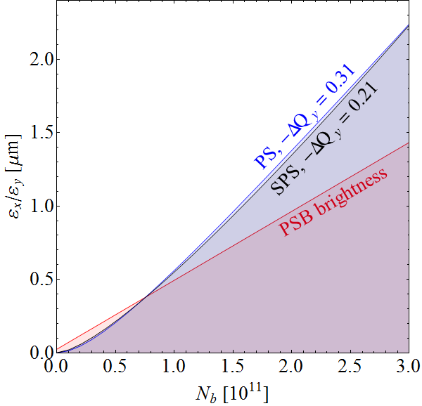
Batch compression, merging, splitting
Effectively reduce PSB brightness by smaller splitting factor in PS
Successfully made operational in 2012, baseline for 25 ns after LS1
HL-LHC request
E_{kin} = 2.5 GeV
  Measurement
Bunches split by 6 in PS: batches of 48 bunches, 6% less bunches in LHC
Perfectly matches PS (2 GeV) and SPS space charge limits
Brightness reach beyond with HL-LHC request for 25 ns beam

Slide 9
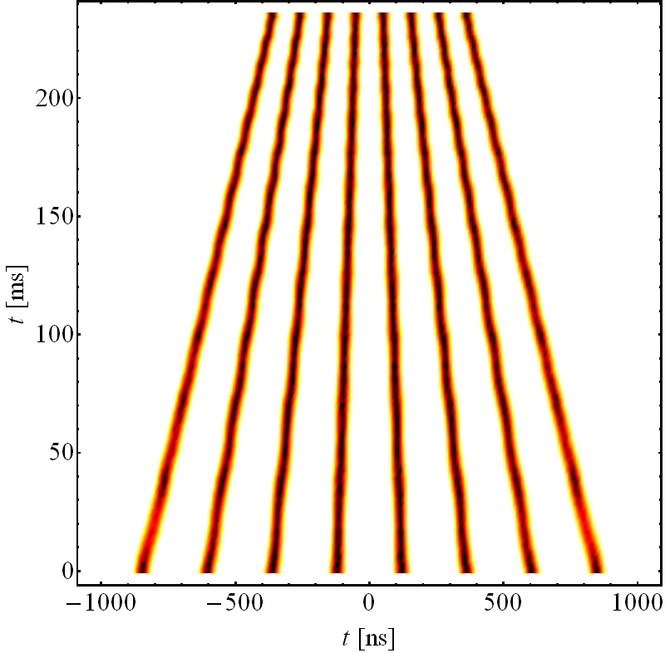
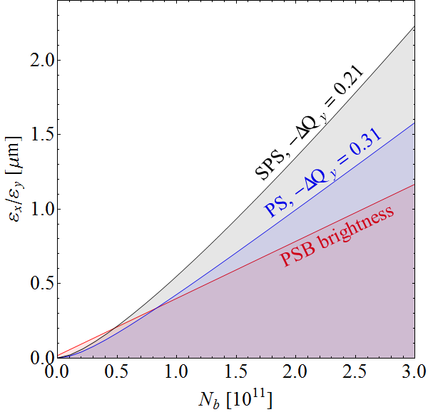
Pure batch compression
Extreme case of no bunch splitting at low energy at all
E_{kin} = 2.5 GeV
  Simulation
Bunches split by 4 in PS: batches of 32 bunches, 13% less bunches in LHC
Can be tested after LS1 controls upgrade of PS LLRF
Pushes SPS to space charge limitation!

Slide 10




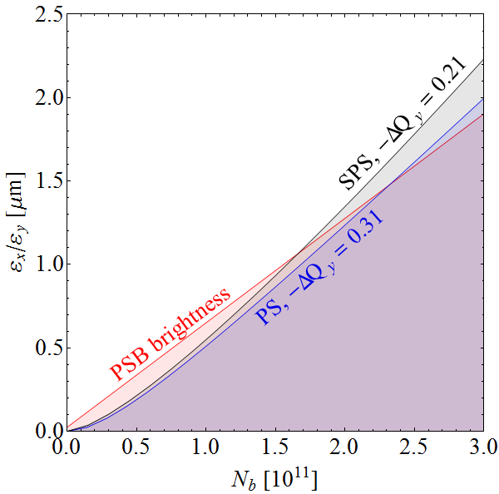
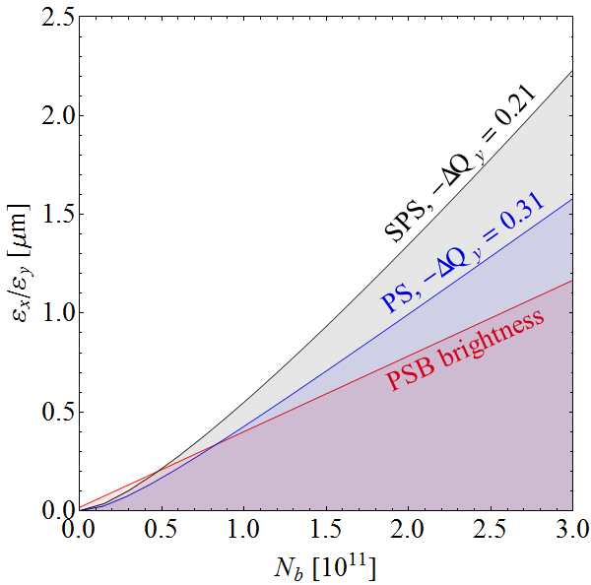
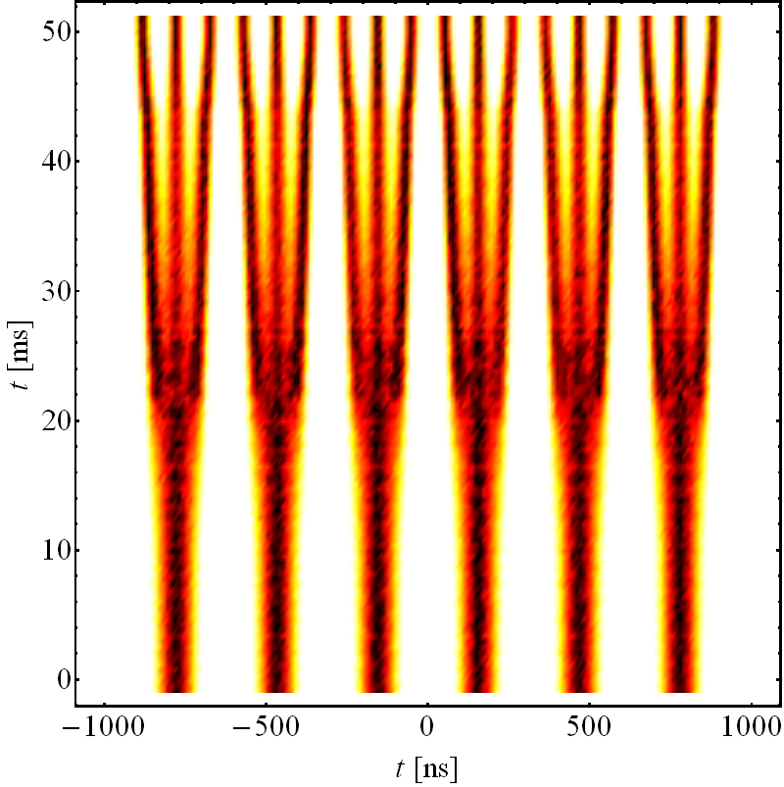
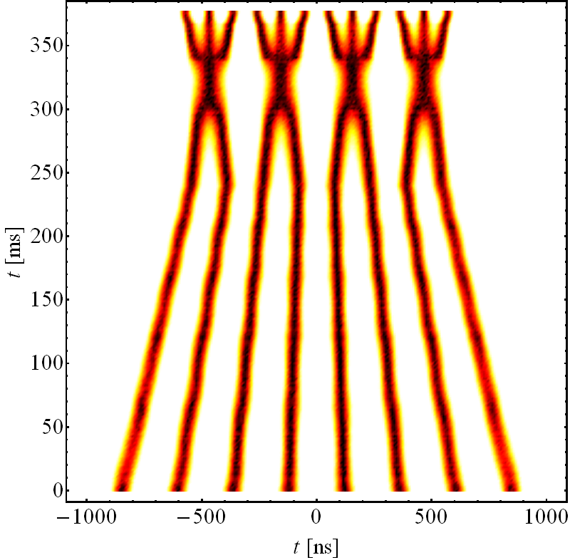
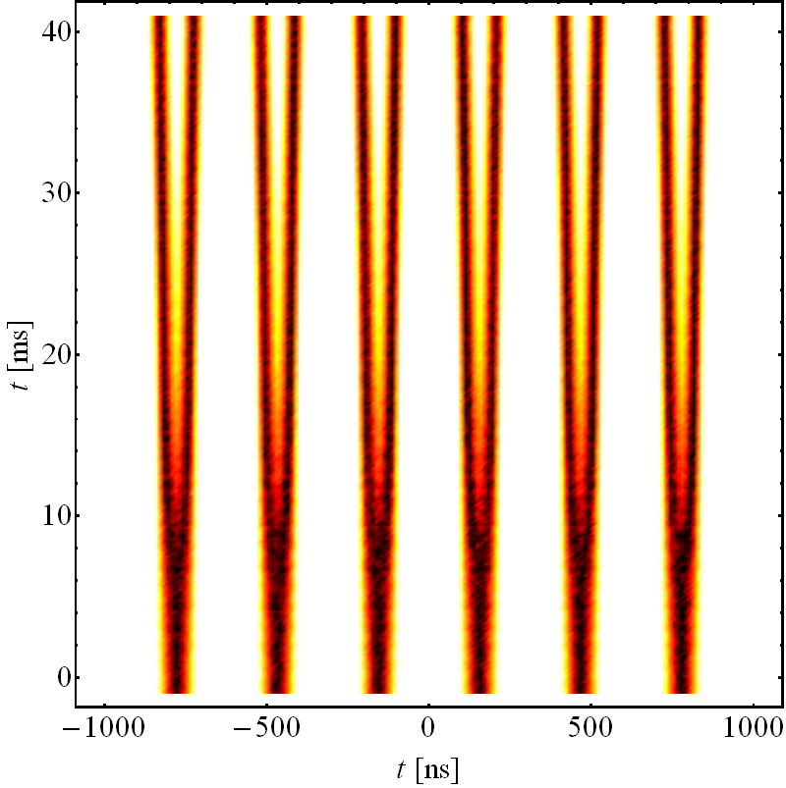
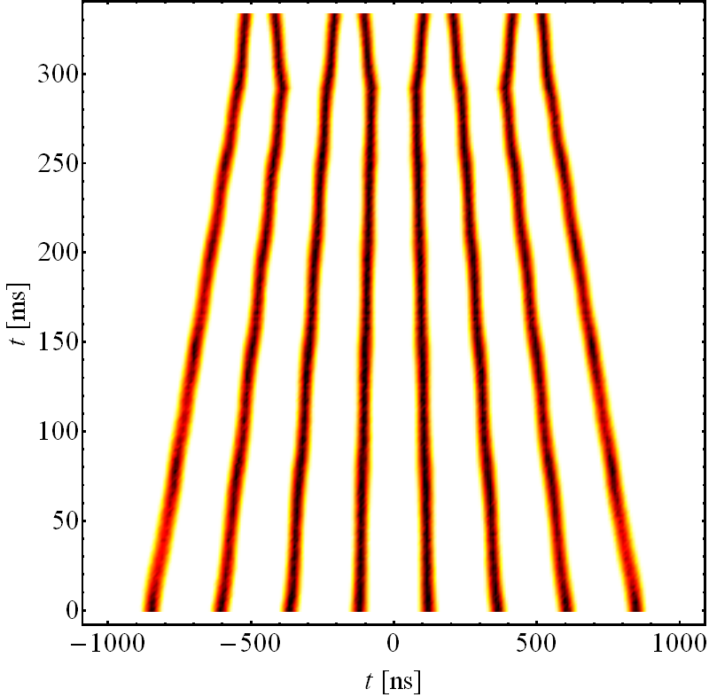
8b+4e bunch pattern schemes
Replace h = 7 → 21 triple split by direct double split, leaving empty bucket
In combination with BCMS beams, merging and triple split suppressed
Bunch pattern 6×(8b+4e) or 4×(8b+4e)
E_{kin} = 2.5 GeV
E_{kin} = 2.5 GeV
  Simulation
  Simulation
4 bunches missing every 8 bunches → improvement for e-cloud
50% less bunches in LHC, but with significantly higher intensity
To be tested with beam after LS1

Slide 11
Overview
Introduction
Alternative schemes in the Pre-injectors
  Manipulation schemes in the PS
  Additional improvements
  Special case for limited upgrades
Alternative schemes in the SPS
  RF power considerations
  Transverse improvements
Summary

Slide 12
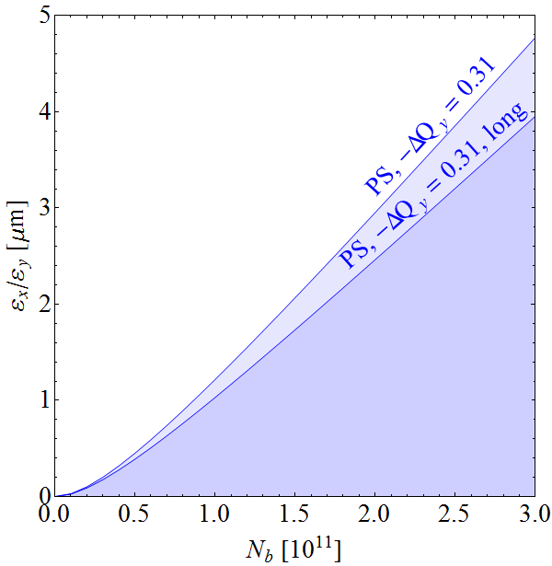
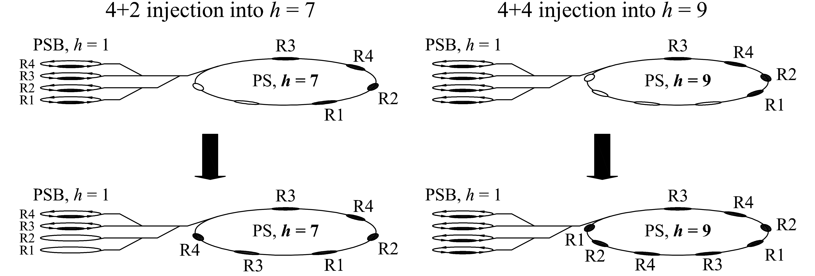
Space charge reduction, longitudinal
Flat-bunches
  Double harmonic RF or hollow bunch distribution
  Space charge reduction by up to 25%
Longer bunches
  Bunch length at PSB-PS transfer limited by switching time between PSB rings
  Reducing switching time: 105 ns → 65 ns (1.4 GeV), 110 ns → 70 ns (2 GeV)
4+2 injection into h = 7
4+4 injection into h = 9
Reduce ΔQ_{sc} at PS flat-bottom, potential brightness about 15%
Technically challenging even for transfer at 1.4 GeV
No interest after upgrade of to 2.0 GeV

Slide 13
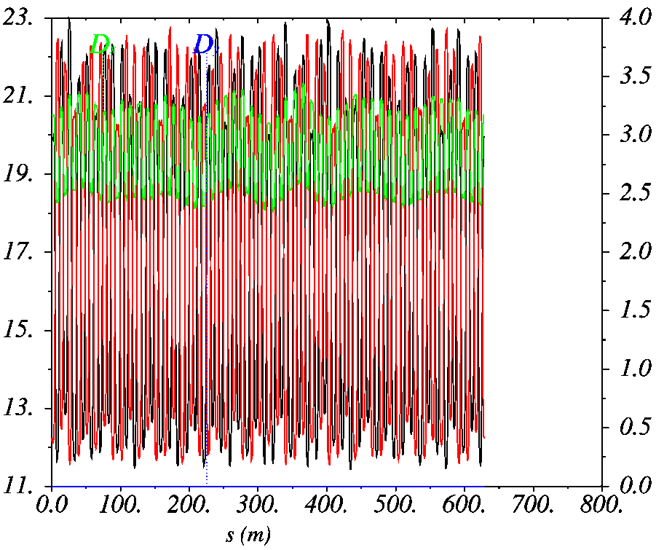
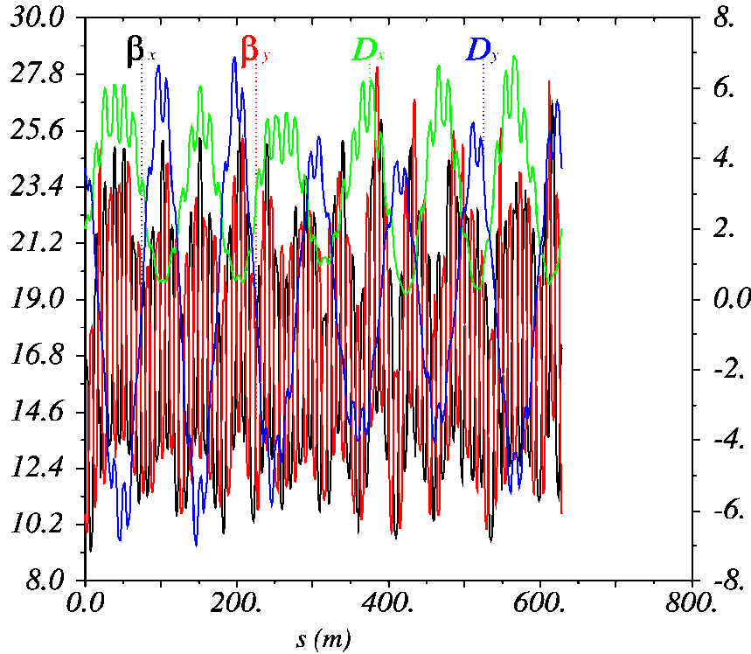
Space charge reduction, transverse
  Compensation of resonances (Q_{x/y}=0.21/0.24)
    Closest resonance 4Q_{y} = 1 difficult as excited by space charge
    Compensation of 2Q_{x} + Q_{y} = 1 and 3Q_{y} = 1 lines during studies in 2013
  Special optics with vertical dispersion
    Introduce vertical dispersion to maximize beam size and reduce ΔQ_{sc}
    Optics becomes very irregular, needs simulations and beam studies
    Evaluate potential benefit with first beam studies after LS1
Regular optics, zero D_{y}
Irregular optics, non-zero D_{y}
Present configuration
Requires hardware upgrades

Slide 14
Overview
Introduction
Alternative schemes in the Pre-injectors
  Manipulation schemes in the PS
  Additional improvements
  Special case for limited upgrades
Alternative schemes in the SPS
  RF power considerations
  Transverse improvements
Summary

Slide 15
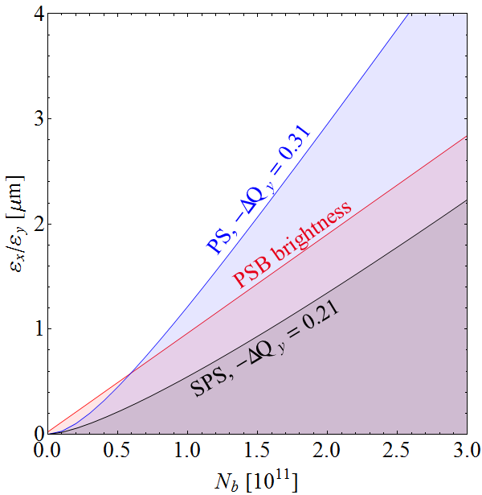
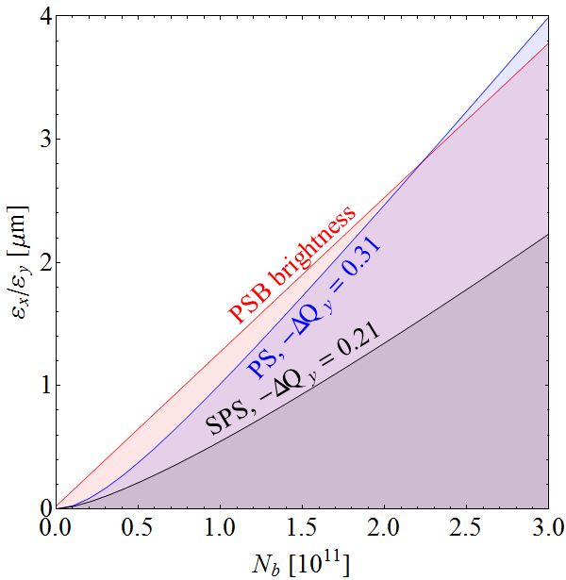
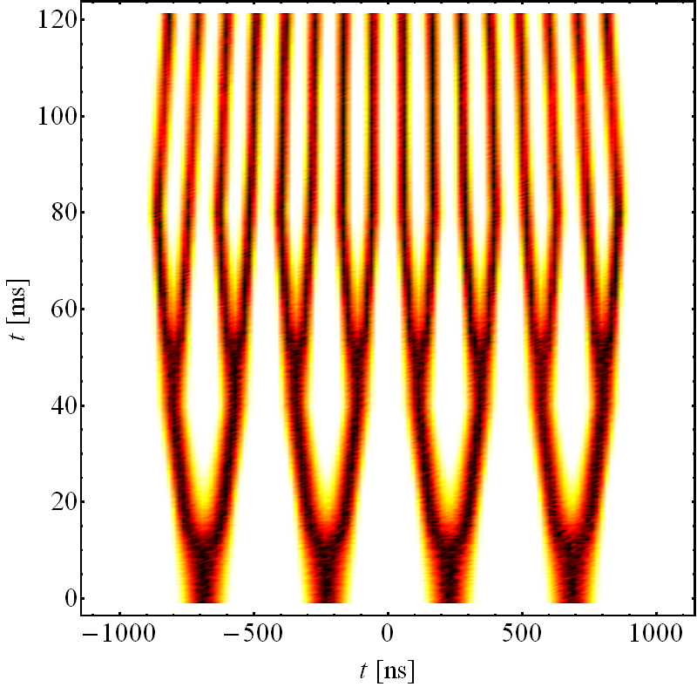
Single-batch injection with Linac4
Combination of Linac4 with 1.4 GeV PSB→PS transfer energy unfavorable
  Linac4 + PSB can deliver brightness far beyond PS space charge limit
Transfer 4 long bunches from PSB to h = 5 in PS, then h = 5 → 10 → 20 → 21
Linac4, 1.4 GeV, 3-split
Linac4, 1.4 GeV, h = 5 inj.
Double-batch transfer
Single-batch transfer
Rematches Linac4 + PSB and PS in terms of space charge
Bunches split by 16 in PS: batches of 64 bunches, 3% less bunches in LHC
Needs additional RF cavity at h = 5 or renovated cavities in PS

Slide 16
Overview
Introduction
Alternative schemes in the Pre-injectors
  Manipulation schemes in the PS
  Additional improvements
  Special case for limited upgrades
Alternative schemes in the SPS
  RF power considerations
  Transverse improvements
Summary

Slide 17
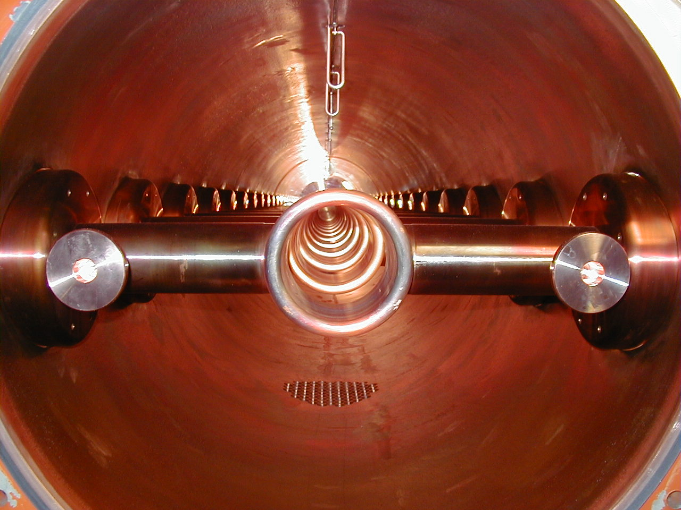
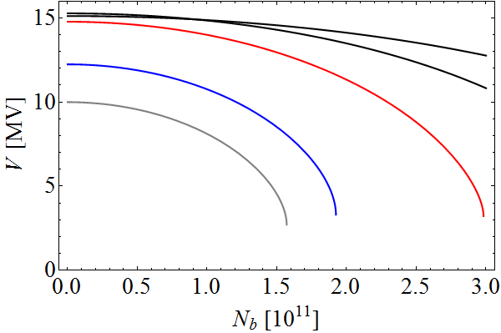
Maximum intensity from SPS
Fixed bunch length required at SPS → LHC transfer
Available RF voltage decreases with beam intensity
RF voltage at transfer to LHC (25ns)
4×3+2×4
10×2
2×4+2×5
4×3+4×2
P_{now} = 0.7 MW
P_{old} = 1.05 MW
P_{new} = 1.6 MW
Q20 optics
Pulse amplifiers at f_{rev} for more power during beam passage (new LLRF)
Effective RF power 0.7 MW → ~1.05 MW

Slide 18
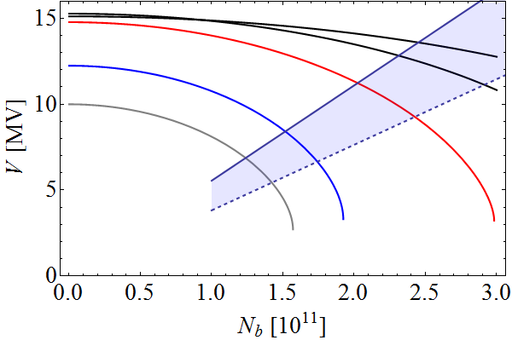
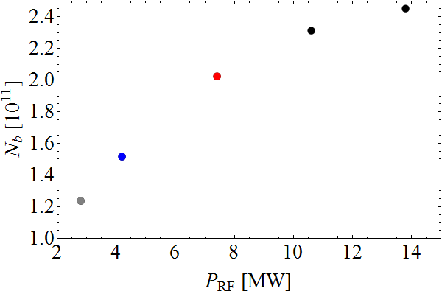
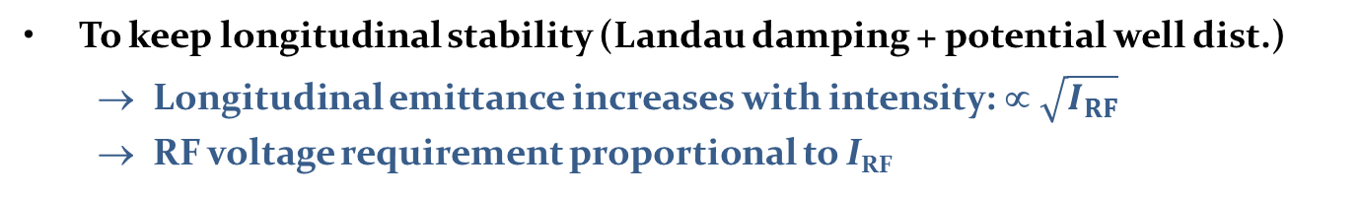
Larger bunch intensity from SPS?
To keep longitudinal stability (Landau damping + potential well dist.)
  Longitudinal emittance increases with intensity: ∝ $\sqrt{I_{RF}}$
  RF voltage requirement proportional to I_{RF}
RF voltage at transfer to LHC
RF voltage at transfer to LHC
4×3+2×4
10×2
+0.18 · 10¹¹
2×4+2×5
4×3+4×2
+0.29 · 10¹¹
P_{old} = 1.05 MW
P_{new} = 1.6 MW
+0.51 · 10¹¹
Z/n today
Q20 optics
τ = const, LD+PWD
LD: Loss of Landau damp.
PWD: Potential well dist.
Baseline upgrade: shorter cavities and 2×1.6 MW RF power
N_{b} ≈ 2 · 10¹¹ ppb without degradation, 2.5 · 10¹¹ ppb for 10% longer bunches
Even shorter cavities and more RF power?

Slide 19
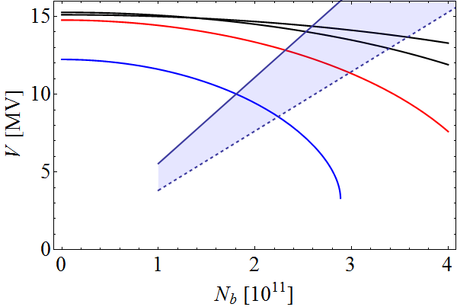
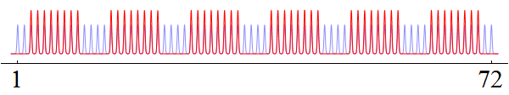
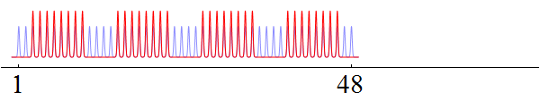
8b+4e scheme in the SPS
Line density averaged over 0.3 μs (≈τ_{fill}/2) reduced by 2/3 at constant N_{b}
  50% more intensity per bunch for the same beam loading
No benefit for single-bunch instability effects
Bunch pattern from PS
4×3+2×4
10×2
Triple splitting: 6×(8b+4e)
2×4+2×5
4×3+4×2
BCMS –like manipulation: 4×(8b+4e)
τ = const, LD+PWD
LD: Loss of Landau damp.
PWD: Potential well dist.
N_{b} ≈ 3 · 10¹¹ ppb reachable assuming SPS impedance reduction by 50%
First beam tests after LS1 possible

Slide 20
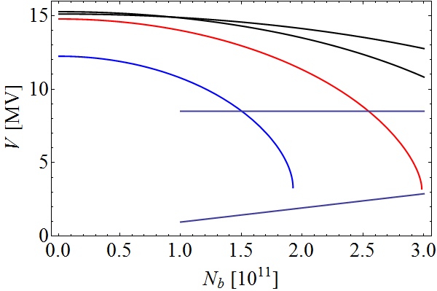
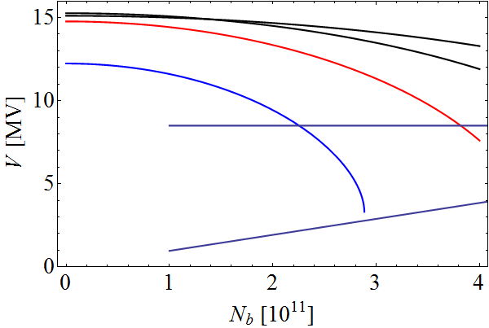
200 MHz in LHC
Injecting with 200 MHz RF in LHC relaxes emittance constraint:
  ε_{l} = 1.0…1.5 eVs, depending on whether transfer to 400 MHz RF
  No single-bunch stability issues at SPS flat-bottom
ε_{l} ~ 1 eVs at SPS → LHC transfer
Combined with 8b+4e scheme
4×3+2×4
10×2
10×2
4×3+2×4
2×4+2×5
4×3+4×2
4×3+4×2
2×4+2×5
V_{RF} for 3 MV at 200 MHz in LHC
V_{RF} for 3 MV at 200 MHz in LHC
τ = const, LD+PWD
τ = const, LD+PWD
Larger ε_{l} in SPS associated with 200 MHz LHC helps on SPS flat-top
Power limitations for longitudinal emittance during acceleration?

Slide 21
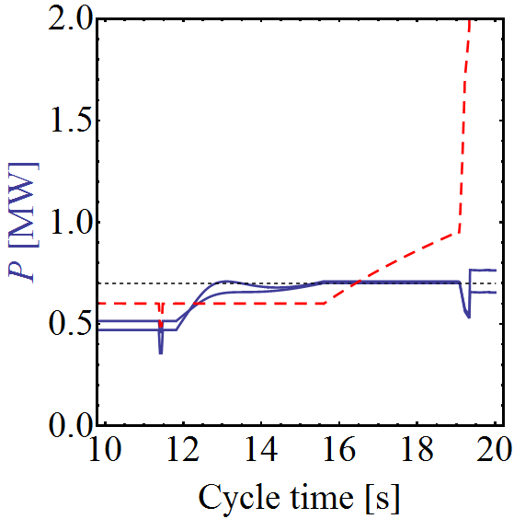
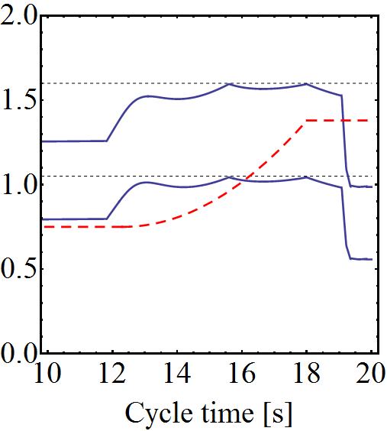

Power Requirements during Acceleration
Small ε_{l} imposed during first part of acceleration (present magnetic cycle)
Present configuration
4×3+2×4 cavities (baseline upgrade)
4×3+4×2 cavities (extended upgrade)
N_{b} = 1.2 · 10¹¹ ppb
N_{b} = 2.3 · 10¹¹ ppb
N_{b} = 3.2 · 10¹¹ ppb
A_{B} [eVs]
A_{B} [eVs]
A_{B} [eVs]
P [MW]
P [MW]
A_{B} required could be even higher
P [MW]
25 ns acceleration limit with 4×3+2×4 cavities 2.3 · 10¹¹ ppb
Limit with 8b+4e scheme (density in PS) 3.0 · 10¹¹ ppb
estimated
200 MHz in LHC or 8b+4e scheme only beneficial with SPS RF upgrade

Slide 22
Overview
Introduction
Alternative schemes in the Pre-injectors
  Manipulation schemes in the PS
  Additional improvements
  Special cases for limited upgrades
Alternative schemes in the SPS
  RF power considerations
  Transverse improvements
Summary

Slide 23
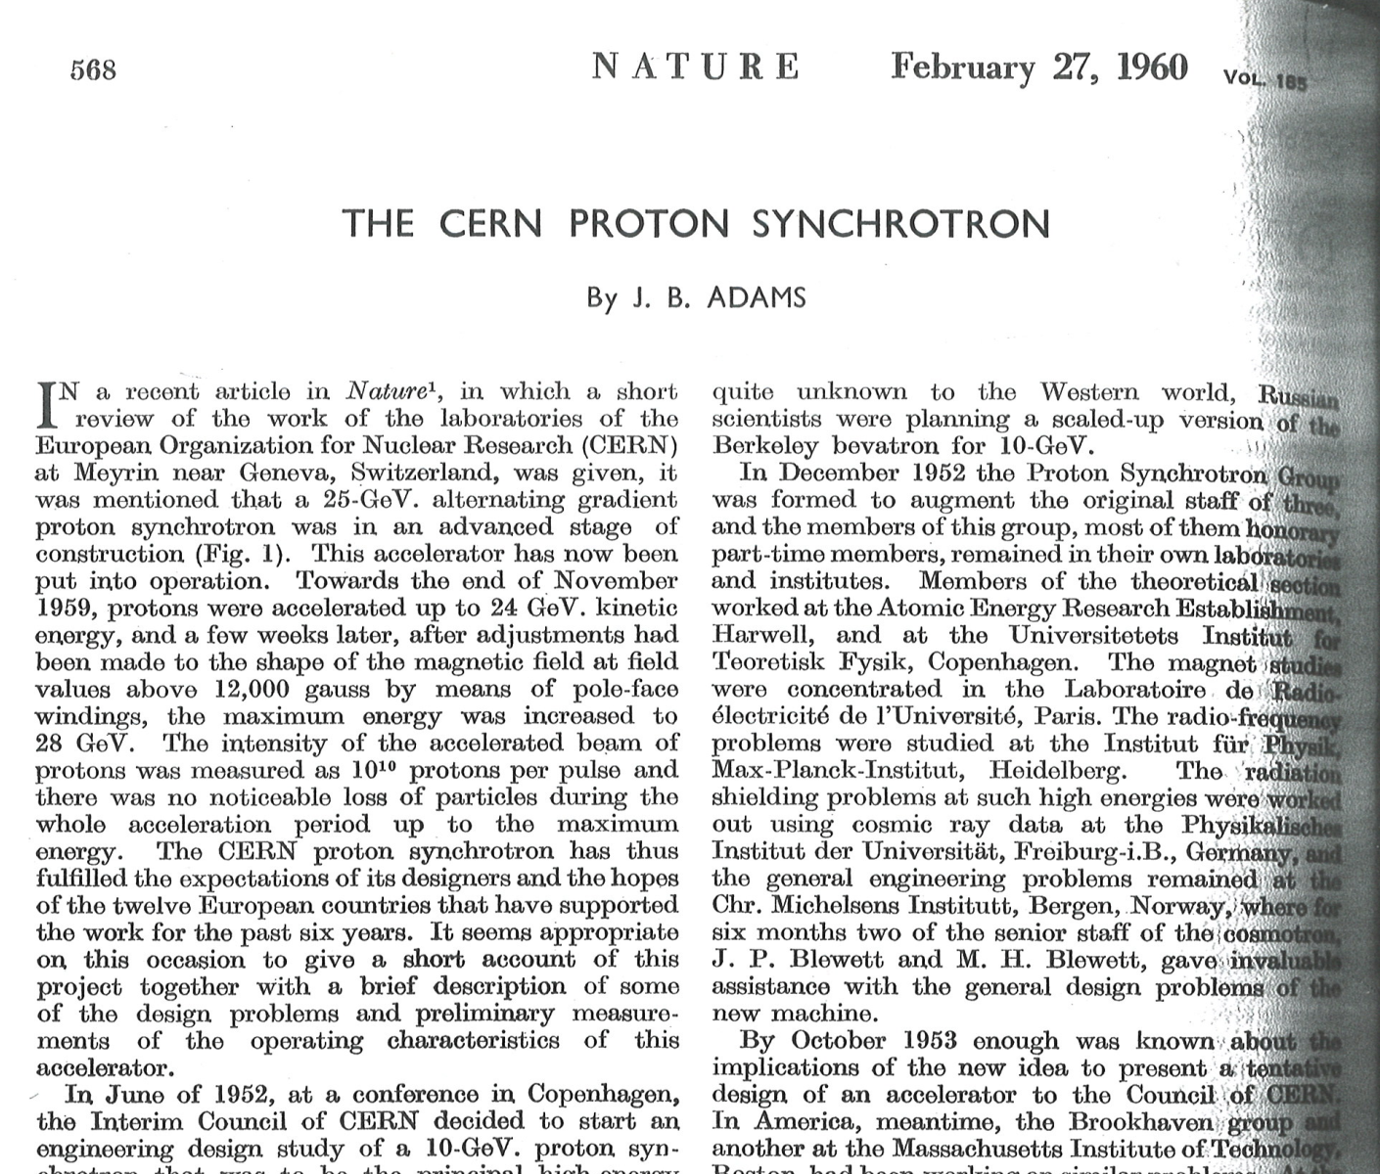
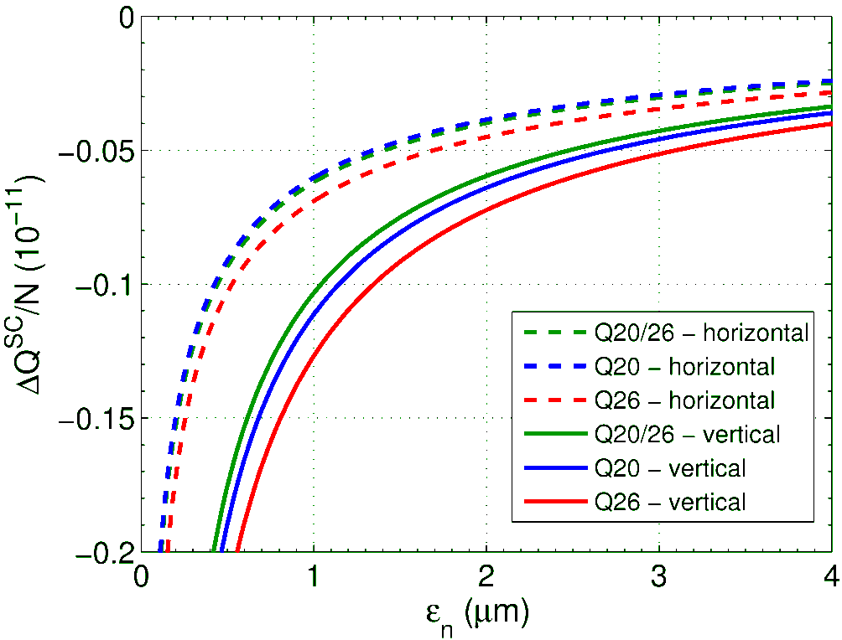
Reducing space charge in the SPS
  Increase extraction energy from PS
    Transfer LHC-type beams at 28 GeV instead of 26 GeV
    Immediate space charge tune shift reduction by 15%
    Combinable with any scheme at SPS space charge limit
Less possibilities and margin than in PS
  Split tunes optics, Q_{h} = 20 and Q_{v} = 26
    Gain from simulations 5% with respect to Q_{h,v} = 20
    Beneficial for injection of 28 GeV beam
  Irregular optics with non-zero vertical dispersion
    Important changes to cabling and supply of skew quadrupoles
[…] the maximum energy was increased to 28 GeV.
ΔQ_{sc}/N_{b} [10¹¹ ppb]
ε_{x/y} [μm]

Slide 24
Overview
Introduction
Alternative schemes in the Pre-injectors
  Manipulation schemes in the PS
  Additional improvements
  Special cases for limited upgrades
Alternative schemes in the SPS
  RF power considerations
  Transverse improvements
Summary

Slide 25

Preliminary summary and remarks
No magic alternative to Linac4 + 2.0 GeV + SPS RF upgrade
Large number of schemes to increase intensity and brightness from injectors
  Linac4+PSB+PS may push SPS to space charge limit
Longitudinally larger bunches in SPS possible together with RF upgrade
Limited reach of brute-force approach for even more RF power
Interesting alternatives can be studied in injectors after LS1
  PSB: Hollow bunches
  PS: Flat or hollow bunches, special flat-bottom optics, pure batch compression, 8b+4e schemes, higher PS-SPS transfer energy
  SPS: split tunes optics, higher intensity with slightly longer bunches
Combinations of alternatives keep flexibility of injector complex to react to requests from LHC: short-, micro-, 8b+4e-batches

Slide 26

THANK YOU FOR YOUR ATTENTION!

Slide 27
PSB
Small upgrades beyond baseline:
Vertical painting at PSB injection from Linac4
  More flexibility in controlling transverse distribution
Reduction of horizontal tune by one unit to increase dispersion
Optimization of resonance compensation
  Potentially higher brightness (study will be pursued anyway)
Discarded options:
Replacement of PSB magnets for energy above 2 GeV
  Present main magnets potentially useable up to ~2.2 GeV (M. Giovannozzi) (http://indico.cern.ch/getFile.py/access?contribId=34&sessionId=7&resId=1&materialId=paper&confId=67839)
  New magnets expensive and require excessive shutdown for installation
Significantly fast cycling → Rapid cycling synchrotron (K. Hanke et al., 2011) (https://edms.cern.ch/file/1154705/1.2/PBU-1154705-10-20.pdf)
  Decision not to pursue PSB replacement by RCS

Slide 28
PS
Discarded options:
Direct H⁻-injection from SPL-like like prolongation of Linac4 into PS
  Requires down-graded SPL, transfer line and new injection system 40 MHz PS2-like acceleration system for LHC-type beams, but incompatible with other physics users (C. Carli, Chamonix 2010)
  (http://indico.cern.ch/getFile.py/access?contribId=36&sessionId=7&resId=2&materialId=paper&confId=67839)
20 ns bunch spacing from the PS (and possibly 10 ns)
  Interesting as RF frequencies in all machines become integer multiples
  Requires 50/100 MHz (h = 105/210) cavities for bunch rotation in PS
  Possible production scheme 8b/h9 → 16b/h18 → 32b/h36 → 32b/h35 → 96b/h105 requires even more RF system
  40 ns bunch spacing practically impossible

Slide 29
SPS
Discarded options:
Slip-stacking in the SPS (T. Argyropoulos, E. Shaposhnikova, LIU brainstorming) (http://indico.cern.ch/getFile.py/access?contribId=16&sessionId=1&resId=1&materialId=slides&confId=138437)
  Many issues: beam loading, too large longitudinal emittance, etc.
Low frequency cavities (e.g. 80 MHz, 120 MHz) in the SPS to capture longer bunches: less space charge, better stability in PS due to larger ε_{l}
  Introduces important beam stability issues in the SPS (E. Shaposhnikova) (http://paf-spsu.web.cern.ch/paf-spsu/meetings/2011/m14-04/Low_frequency_RF_Heiko.pptx)
400 MHz cavities for bunch compression and Landau damping in the SPS
  Originally foreseen for bunch compression (D. Boussard, Th. Bohl) (Part. Acc. 58, 1997, pp. 237-240 and SL/Note 93-47, http://cds.cern.ch/record/703346/files/CM-P00064463.pdf)
  Issues with beam loading would require non-integer harmonic number acceleration
Bunch splitting on flat-top against e-cloud on flat-bottom; merging for higher intensity
  Empty buckets between bunches would require re-bucketing to lower harmonic RF system, which is excluded for stability reasons

Slide 30
New PS Injector: SPL
Geometry (just to fix ideas) for
2.5 GeV:
  Length of SPL ~300m
  (in addition to Linac4, extrap. from sLHC Proj. Rep. 0015)
  ~500 m transfer line
PS Injection
  New H⁻ charge exchange injection to be constructed
  Flexibility to generate suitable PS bunch structures (SPL chopper, painting?)
  Close to East Hall ejection
Simplified PS RF system with ~40MHz possible for LHC protons only (see PS2 scheme)
75 m

Slide 31
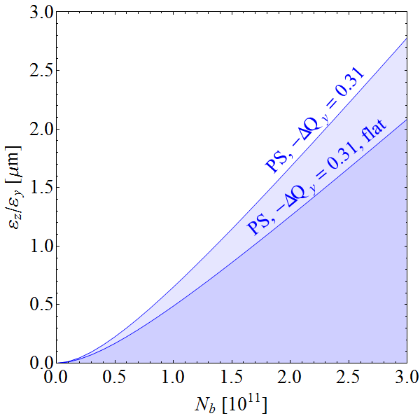
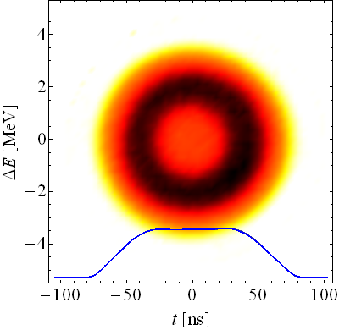
Space charge reduction, longitudinal
  Flat-bunches in double-harmonic RF system
    Requires two RF systems
    Transfer between accelerators difficult
  Bunch distributions with depleted core, flat profile
    Only single harmonic RF system needed
    Little complexity in downstream chain
    Even survives distribution conserving RF manipulations, e.g. pair splitting
  Measurement, 2001
  PSB, E_{kin} = 1.4 GeV
Reduce ΔQ_{sc} at PS flat-bottom, potential brightness gain up to 25%
Last studies in 2001; simulations preparing new beam studies ongoing

Slide 32
Compensation of the 2Q_{x}+Q_{y} = 19 in the PS
Scan direction
  A. Huschauer, R. Wasef
Scan direction

Slide 33
Compensation of 3Q_{y} = 19 in the PS
Scan direction
A. Huschauer
Scan direction

