Slide 1
Integrated performance of the LHC at 25 ns
without and with LINAC4
J. Wenninger
G. Arduini, G. Rumolo, V. Kain, A. Apollonio, A. Gorzawski

Slide 2
25 ns @ SPS
Beam type | Scenario | N_{bunch} [10¹¹] | ε* [μm] | Limit
BCMS | Achieved | 1.15 | 1.39 | --
BCMS | No upgrade | 1.3 | 1.28 | PS/SPS
BCMS+L4 | Linac 4 | 1.3 | 1.28 | PS/SPS
Standard | Achieved | 1.2 | 2.6 | --
Standard | No upgrade | 1.3 | 2.44 | SPS
Standard+L4 | Linac 4 | 1.3 | 1.65 | SPS
Only standard beam gains with Linac4.
Limits after LS1:
  Brightness in the PS (BCMS),
  RF in the SPS (all).
See presentation by G. Rumolo

Slide 3
25 ns @ LHC collisions
Beam type | N_{bunch} [10¹¹] | ε* [μm] | k | β* [cm] | ½ Xing angle [μrad]
BCMS (+L4) | 1.25 | 1.65 | 2590 | 40 / 50 | 150 / 140
Standard | 1.25 | 2.9 | 2740 | 50 | 190
Standard+L4 | 1.25 | 2.0 | 2740 | 40 / 50 | 150 / 140
N_{bunch} and ε* : values for LHC collisions.
From SPS extraction to LHC collision:
  Assumed emittance blow up of 15% on top of IBS - optimistic wrt 2012 (~ 30% observed),
    E-cloud-driven and additional 2012-like blow up under control,
  Transmission of 96% (~ 2012 values).
Crossing angles: deduced from an analysis by R. Bruce.
Filling scheme variations may affect k at the level of ~5%.

Slide 4
Pile-up & luminosity limits
A maximum average pile-up of 45 events per crossing is used as upper limit (given as rough guideline for 2015).
  Based on a visible cross-section of 85 mb @ 6.5 TeV.
  For simplicity it is assumed that we can also level at a pile-up of 45.
The cooling of the triplet sets a limit to the maximum achievable luminosity of ~1.75 ×10³⁴ cm⁻²s⁻¹ ±10-20%.
  We will have to explore the limit in 2015+.
  Further reduction of limit due to e-could heat load?
  A study will be launched to analyze all possible limitations in the triplet (starting with the limiting heat-exchanger).
L. Tavian
@ Evian 2012

Slide 5
Intensity & brightness limitations
The intensity/brightness may be limited by instabilities.
  25 ns up to 1.3E11 ppb just at the edge?
  Stabilized by head-on beam-beam if needed, but implies more complicated operation.
Other possible limitations to intensity:
  heating,
  e-cloud,
  UFOs.
  - more experience must be collected in 2015+.

Slide 6
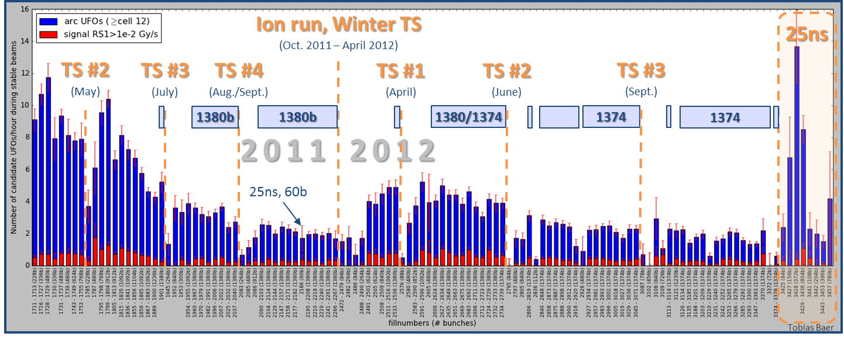
UFOs
Extrapolation from 2012 to 7 TeV: ~100 beam dumps from UFOs
UFO rate depends on bunch spacing, stronger with 25 ns.
  But: fast conditioning observed over a few fills in 2012 – there is hope !
We have to expect serious deconditioning after LS1.
Current status of quench test analysis (LBOC meeting 22.10): we may have extra margin (x 2) at 4 TeV for UFO timescales. To be confirmed.
Clear picture only after 2015.
T. Baer

Slide 7
E-cloud in 2012
Scrubbing
  Demonstrated to be efficient at 450 GeV
  It lowers e-cloud in dipoles, less evident in quadrupoles (due to a significantly lower threshold SEY)
Despite 2-beam-50 ns operation in triplet for ~ 2 years (high electron dose), e-cloud still present in triplets.
  SEY ~1.2-1.3 – deduced from heat-load & simulations.
Significant increase of heat load (~ factor 4) in arcs during ramp.
  From e-cloud in the dipoles. No change in quadrupoles.
  Does not decrease over time at flattop (no scrubbing at flattop ?)
  Underlying mechanism to be understood
G. Rumolo at al

Slide 8
E-cloud for 2015
Available cooling power in the arcs (~ 250 W / ½ cell) will possibly limit (initial) operation at 6.5 TeV.
  Limitations in SAMs will be lifted during LS1.
Projection of CURRENT situation to 2015: limitation to ≈ ½ number of bunches at 25 ns (~1400).
Idea to enhance scrubbing at 450 GeV to remove e-cloud in the dipoles “completely” with dedicated scrubbing beam.
  Use doublet beam : 5 – 20 ns or 2.5 – 22.5 ns spacing
  Implications and issues (BI, RF, ADT) under investigation. Report at the next LHC Beam Operation Committee (5th November).
5 or 2.5 ns
25ns
25ns
25ns

Slide 9
Run length & overheads
A run length of 160 days (high int pp) per year is assumed.
Periods of reduced luminosity are embedded in our runs. Such periods include:
  Initial intensity ramp up – few weeks. Likely to improve every year up to an incompressible minimum.
  Ramp up after technical stops: ~ 2 days.
β* leveling setup may be required (and learning curves).
  Important to train asap – LHCb !
And one should not forget all the special runs like high-beta, LHCf etc that eat up additional few % of the proton runs.
>> this reduces the integrated luminosity by 5-10%

Slide 10
Availability in 2012
The 2012 run can be split into 3 blocks.
    On a per-physics-fill basis we had:
Stable beams
Faults
Turn-around =
the ‘rest’
6.1 hours
4.8 hours
5.5 hours
⇔ 36% stable beams fraction / physics efficiency
The blue turn-around box also accounts for
    Test cycles (Q/Q’ measurements, FB tests, loss maps, high beta setup…) and lost cycles.
    ‘Short’ tests that were inserted in a standard cycles.
    A certain number of pre-cycles.
    Etc…
    Minimal / best turn-around time ~ 2.2 hours.
This will always be required !

Slide 11
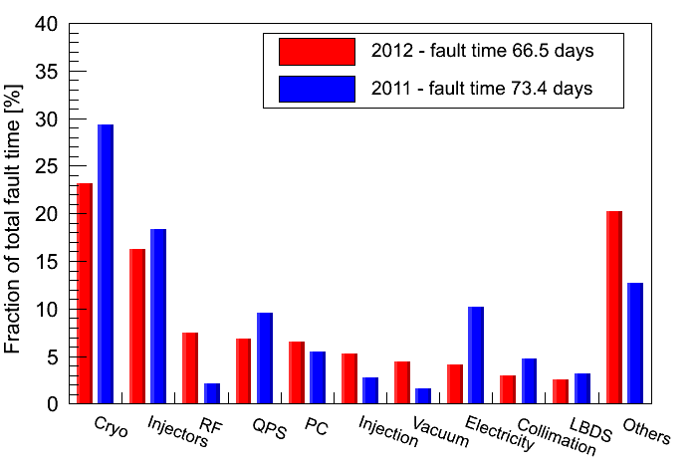
Failure breakdown
Cryo + injectors account for ~1/3 of fault time in 2012.
  Typical SPS efficiency:85 ± 5%.
A. Macpherson
Ordered by 2012 top-10

Slide 12
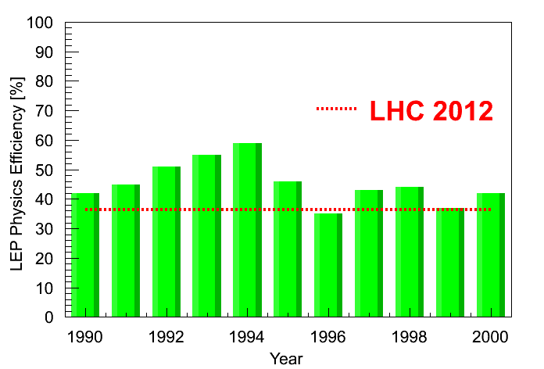
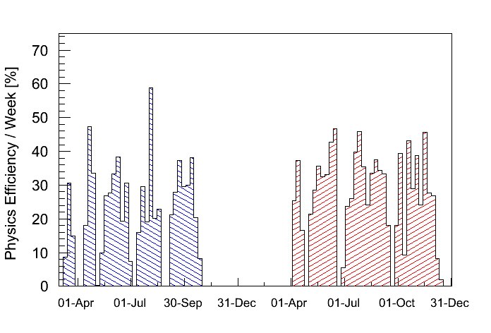
Physics Efficiency of LHC & LEP
LEP1
LEP2
LEP1 reached physics efficiencies > 50% (1992-1994).
  Simpler machine, long fills.
  LEP2 had short(er) fills – similar to LHC.
2011
2012
With one exception, best LHC weeks achieved ~45% physics efficiency. Do it more often...

Slide 13
Availability Modeling - future
Our current accounting of faults & ‘turn-around’ is rather coarse.
There is an ongoing effort between AWG (Availability WG) and OP to improve the modeling and information on the different phases.
Aim to build a tool that combines
    Cycle information (beam modes, intensity, energy),
    Post-mortem information
    Fault information,
    Etc
    … to provide a better model for faults and for ‘the rest’.
Work in progress

Slide 14
Availability assumption
What we know:
    The cycle length increases by ~20 minutes.
Baseline assumption for performance:
    Everything remains the same except for cycle length,
    Assume that in ‘Turn-around’ there are ~2 cycles → 40 minutes,
Stable beams
Faults
Turn-around =
the ‘rest’
6.1 hours
4.8 hours
6.2 hours
⇔ 35% stable beams fraction
Many uncertainties ⇔ assumptions optimistic for 2015? No point in speculating too much.
Baseline for analysis: stable beams efficiency of 35%.

Slide 15
Luminosity model
A simple luminosity model is used for 6.5 TeV, based on 2012 observations during collisions.
Ingredients:
  Burn-off (σ = 105 mb),
  Single beam lifetimes,
  Emittance growth.
Cross-checked with:
  Simple analytic approach (simple closed formula) for exponential fill length distribution and constant averaged luminosity lifetime (CERN-ATS-Note-2013-033 PERF).
  Monte-Carlo approach (A. Apollonio).
Model dependence of predictions can be > 10%

Slide 16
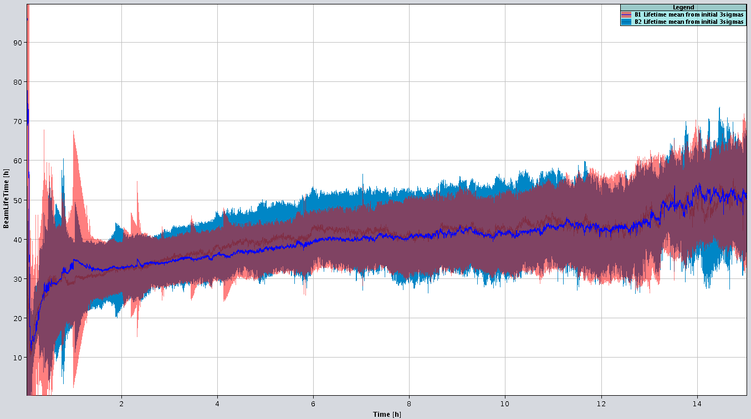
Intensity lifetime
2012 beam intensity lifetimes:
  τ ≈ 25-40 hours in collision (includes burn-off)
  Before collision tricky to obtain due to large influence of tails in the squeeze.
  → assume 60 hours average intensity lifetime without burn-off.
Lifetime [h]
2012 average
A. Gorzawski
Time in stable beams [h]

Slide 17
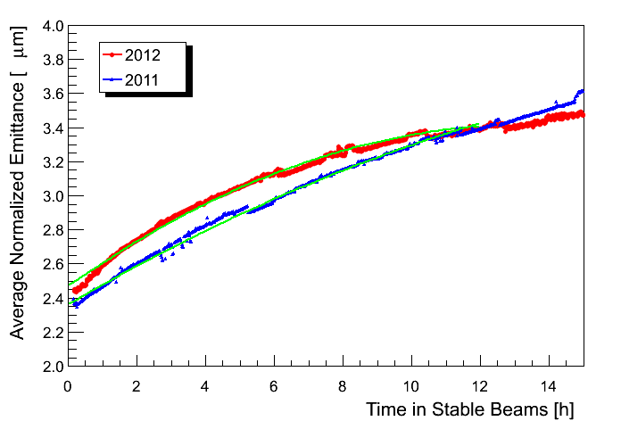
Emittance growth
Significant ‘effective’ emittance growth is observed in collision (from luminosity evolution) at 3.5/4 TeV.
  Origin of growth not understood. IBS is not sufficient, need an extra 20 h emittance growth time (→ G. Arduini).
  Growth was steeper in 2011.
  2012 evolution is used to model the luminosity at 6.5 TeV, corrected for radiation damping.
2011: β* 1 m
2012 : after MO polarity switch
2011: ε² ≅ ε₀² + 0.59 t
A. Gorzawski

Slide 18
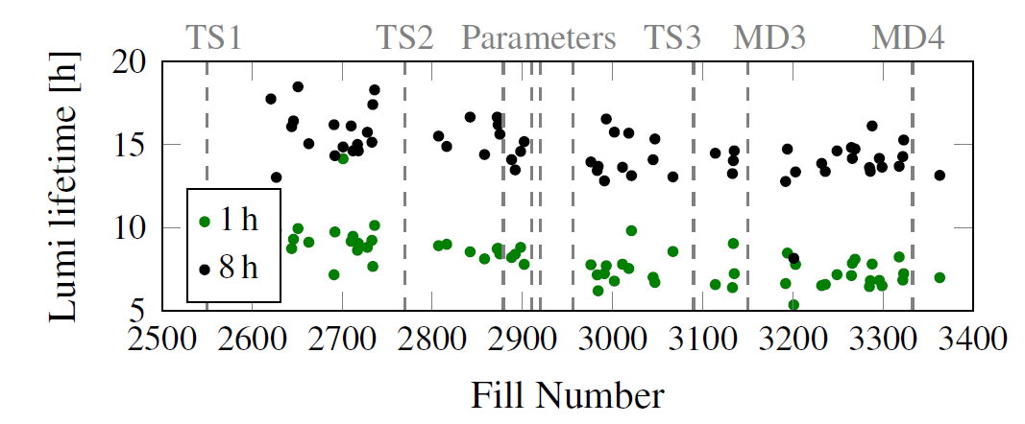
Luminosity lifetimes 2012
2012 run experience @ 4 TeV:
  τ ≈ 6-8 hours – first hour,
  τ ≈ 12-15 hours – after 8 hours.
Reproduced by the model
M. Hostettler, G. Papotti
Luminosity lifetime from burn-off @ 2×10³⁴ cm⁻²s⁻¹ + 6.5 TeV :
  τ ≈ 12 hours.

Slide 19
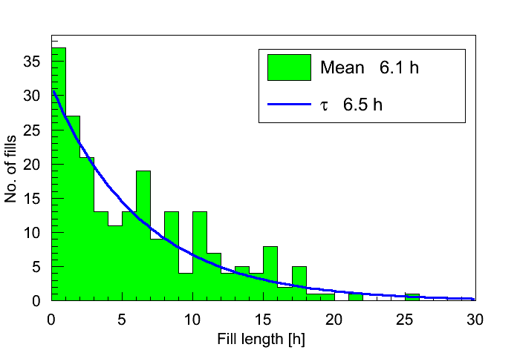
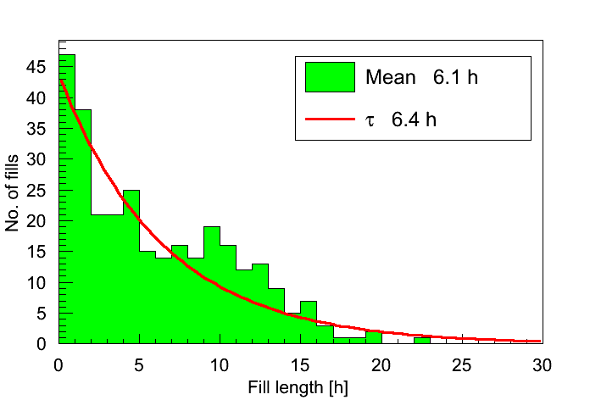
Fill length
Fill lengths in 2011 and 2012 ≈ exponentials.
  ~30% of the fills are dumped by OP.
2011
2012
An exponential fill length distribution is used for the performance figures quoted in the next slides.

Slide 20
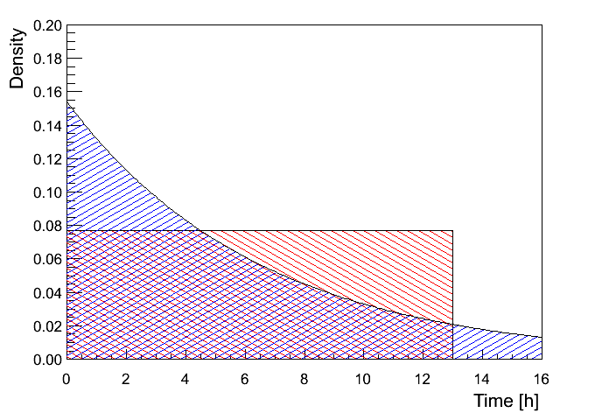
Distributions
Effect of the fill length distribution:
  Exponential (truncated @ 20 hours), flat, delta – mean length 6.5 h in all cases.
Distribution | Rel. Int. L
Exponential | 1
Flat | ~1.1
Delta | ~1.2
Depends on lifetime assumptions
Distribution for 2012 is a mixture of:
  Exponential – faults (~2/3),
  Flat + smeared delta from OP dumps (1/3).
+5-10% wrt exponential

Slide 21
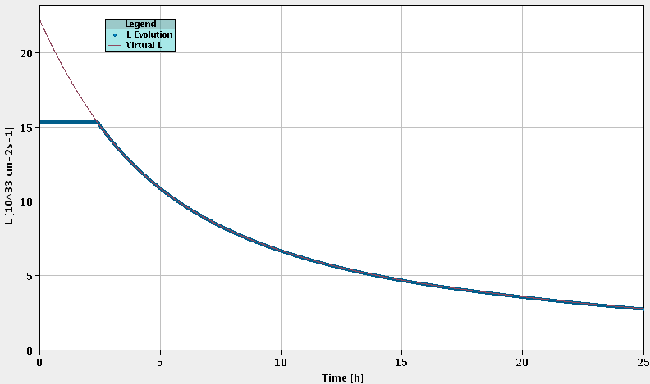
BCMS example
 | N_{bunch} [10¹¹] | ε*_{l} [μm] | k | β* [cm] | ½ Xing [μrad]
BCMS (w/wo L4) | 1.25 | 1.65 | 2590 | 40 | 150
Model | Int L/fill (pb⁻¹)
Exp (6.5 h) | 259
Flat (6.5 h) | 283
Dump (6.5 h) | 306
Leveling ~2.5 hours

Slide 22
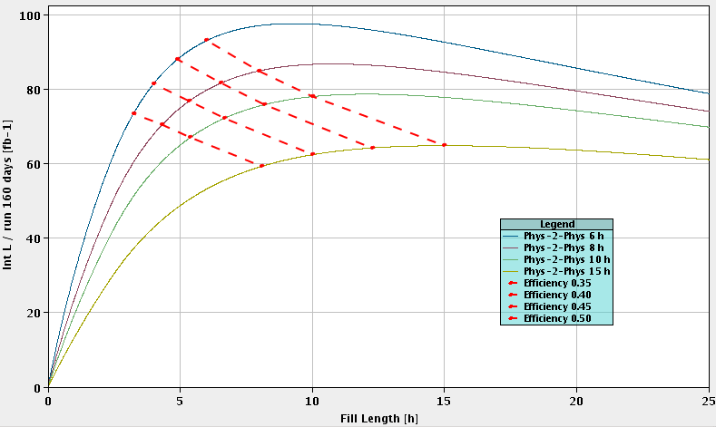
Optimum fill length – BCMS example
The 6.5 hours dump time is not too far from the optimum ~ 8-10 h.
40%
45%
50%
35%
-- Turnaround = 6h
-- Turnaround = 8h
-- Turnaround = 10h
-- Turnaround = 15h

Slide 23
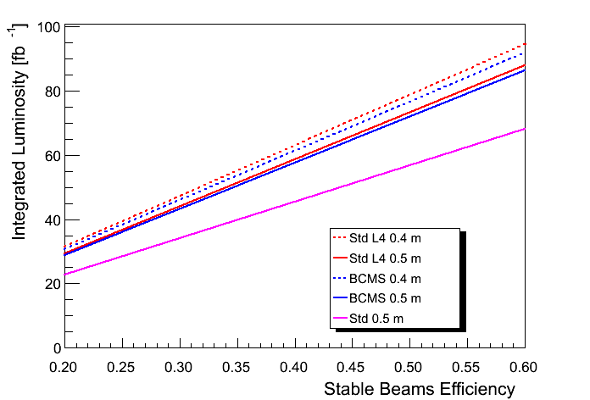
Comparison – exponential model
Beam | β* (m) | Leveled L (10³⁴ cm⁻²s⁻¹) | Peak L (10³⁴ cm⁻²s⁻¹) | Leveling time (h)
Standard L4 | 0.4 | 1.65 | 2.1 | ~1.6
BCMS | 0.4 | 1.54 | 2.2 | ~2.5
Standard L4 | 0.5 | 1.65 | 1.9 | ~0.7
BCMS | 0.5 | 1.54 | 2.0 | ~1.6
Standard | 0.5 | 1.65 | 1.2 | --
BCMS & standard are very close in performance.
Leveled L ~at the triplet limit, peak lumi BCMS / L4 above limit.
With 2011 emittance model, values increase ~2%.
48-53 fb⁻¹/year
Add 5-10% to account for mixed fill length distribution

Slide 24
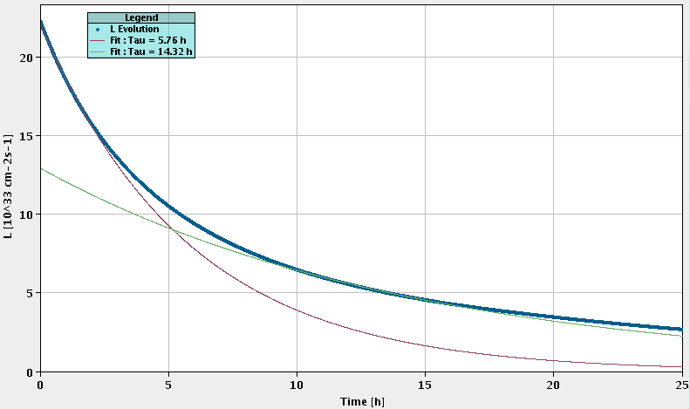
BCMS example – no leveling
 | N_{bunch} [10¹¹] | ε*_{l} [μm] | k | β* [cm] | ½ Xing [μrad]
BCMS (w/wo L4) | 1.25 | 1.65 | 2590 | 40 | 150
Initial L lifetime ~5 h
10-15 h L lifetime ~14 h

Slide 25
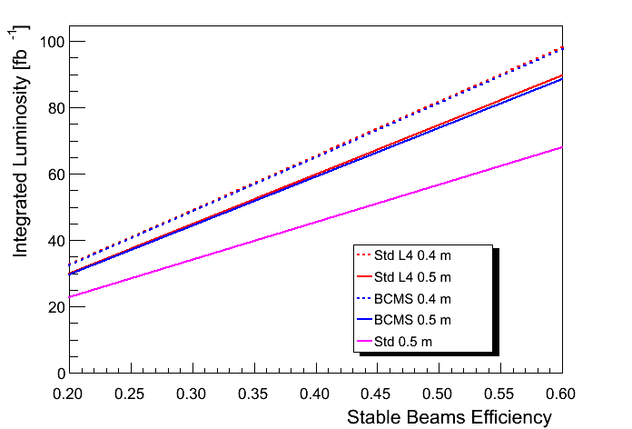
Performance – no leveling
  Modest gain of a few fb⁻¹ due to short leveling time & low(er) initial lifetime.
  BCMS and Standard+L4 have again similar performance, but higher pile-up with BCMS.
  Peak pile-up ~66 for BCMS and β* = 0.4 m.
50-55 fb⁻¹/year

Slide 26
Monte-Carlo Model
  Monte-Carlo model by A. Apollonio, developed for HL-LHC, to model luminosity (simplified), failures and turn-around. Applied to 25 ns operation post-LS1:
    30% fills dumped by operation,
    6.2 hours of turn-around,
    Fault time modeled by 4 LogNormal distributions.
  Results are consistent in the range of ~45 fb⁻¹.
  The increased impact of UFOs (~100 dumps/year) can lower the integrated luminosity by 15% for the current BLM thresholds.

Slide 27
Summary (1)
The expected integrated luminosity per year for 25 ns is in the range of 45-55 fb⁻¹ for a 2012-like efficiency.
    For 5 ½ years of operation until LS3 → 250-300 fb⁻¹.
    Before L4 : use BCMS – with L4: use standard beam.
    Unknowns on limitations, emittance, efficiency – 10% level effects – situation will be clearer end 2015.
    Peak luminosity close to / above expected triplet limitation !!!!
With L4 the standard 25 ns beams and the BCMS beams have very similar performance.
  Bonus for standard 25 ns: lower pile-up (~10%).
  The emittances that are eventually achieved may make the difference – easier for standard (larger ε) ?

Slide 28
Summary (2)
To be sure to reach/exceed 300 fb⁻¹ by LS3 we should aim to improve the average physics efficiency of the LHC from ~35% to at least 40%.
    Concerted long term effort !
    Could reduce peak L / pile-up and compensate with efficiency if we get too close to detector damage.
To reach luminosities of 2.5 10³⁴ cm⁻²s⁻¹ as quoted in reference figures β* needs to be pushed further, emittances lowered etc.

Slide 30
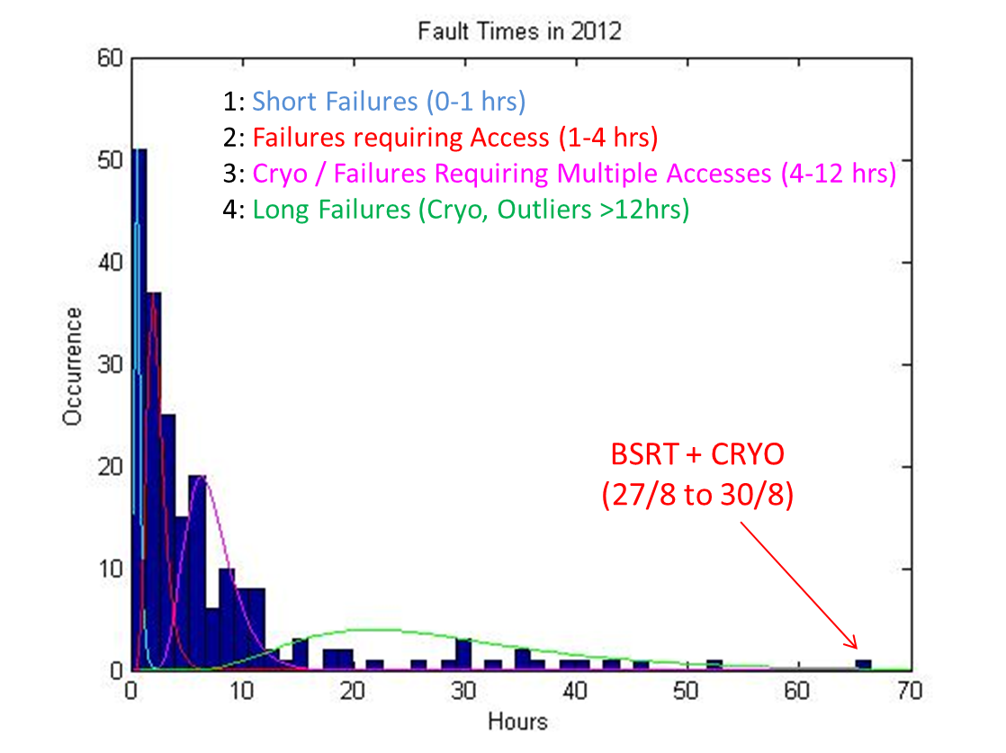
High-Luminosity LHC and Availability
Fault time distributions in 2012 (4 logn):
A. Apollonio

Slide 31
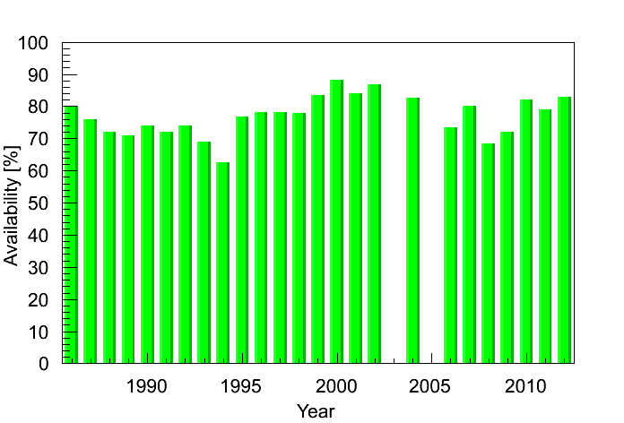
SPS efficiency (fixed target)
SPS
Shutdown
?

Slide 32
Summary: β*-reach
50 ns, 2.5 um | beta* crossing (cm) | beta* separation (cm) | Half crossing angle (urad) | BB sep (sigma)
mm scaled, no BPM | 47 | 49 | 129 | 9.3
mm scaled, BPM | 39 | 39 | 141 | 9.3
2 sig retraction, no BPM | 42 | 43 | 136 | 9.3
2 sig retraction, BPM | 35 | 33 | 150 | 9.3
50 ns, 1.6 um | beta* crossing (cm) | beta* separation (cm) | Half crossing angle (urad) | BB sep (sigma)
mm scaled, no BPM | 43 | 49 | 108 | 9.3
mm scaled, BPM | 35 | 39 | 119 | 9.3
2 sig retraction, no BPM | 38 | 43 | 115 | 9.3
2 sig retraction, BPM | 31 | 33 | 127 | 9.3
25 ns, 3.75 um | beta* crossing (cm) | beta* separation (cm) | Half crossing angle (urad) | BB sep (sigma)
mm scaled, no BPM | 60 | 49 | 180 | 12
mm scaled, BPM | 52 | 39 | 194 | 12
2 sig retraction, no BPM | 55 | 43 | 189 | 12
2 sig retraction, BPM | 46 | 33 | 205 | 12
25 ns, 1.9 um | beta* crossing (cm) | beta* separation (cm) | Half crossing angle (urad) | BB sep (sigma)
mm scaled, no BPM | 49 | 49 | 141 | 12
mm scaled, BPM | 42 | 39 | 154 | 12
2 sig retraction, no BPM | 45 | 43 | 149 | 12
2 sig retraction, BPM | 37 | 33 | 163 | 12
Updates after MD?

Slide 33
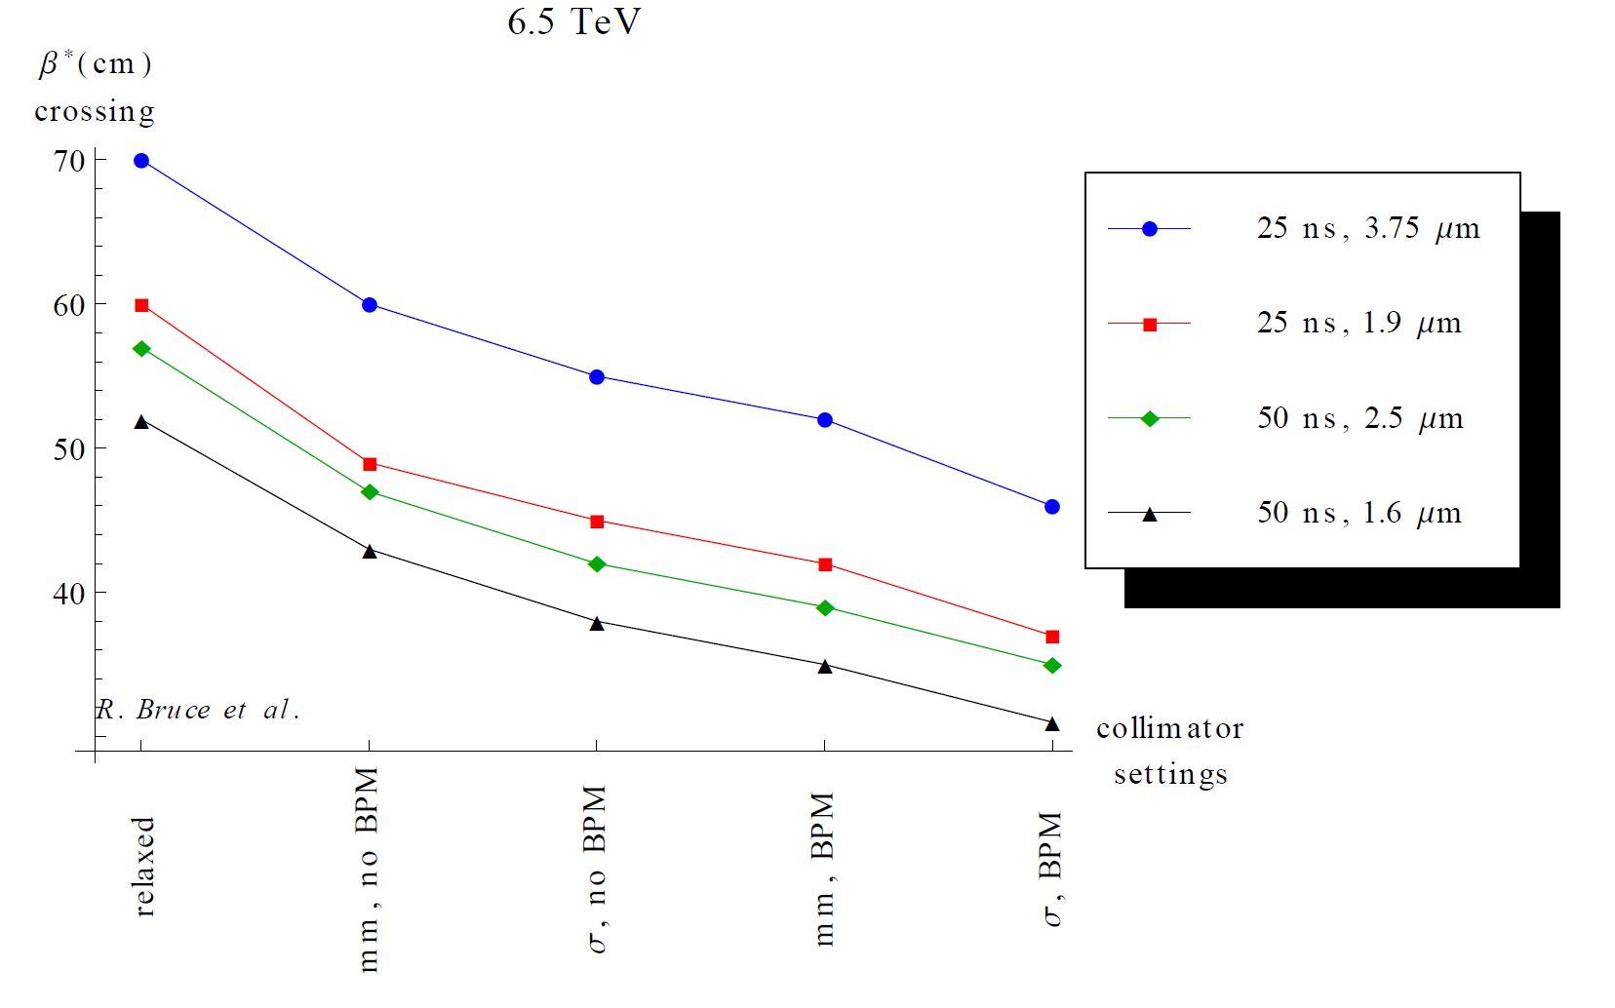
Summary: β*-reach in crossing plane

