Slide 2
Expected performance in the injectors at 25 ns without and with LINAC4
Giovanni Rumolo, Hannes Bartosik and Adrian Oeftiger
Acknowledgements: G. Arduini, E. Benedetto, C. Bracco, C. Carli, H. Damerau, A. Findlay, R. Garoby, S. Gilardoni, B. Goddard, S. Hancock, K. Hanke, G. Iadarola, K. Li, M. Meddahi, B. Mikulec, Y. Papaphilippou, V. Raginel, E. Shaposhnikova, R. Wasef
Notes:
Abstract
The quality of the 25 ns beams that can be delivered at the LHC injection is determined by the injection process into the PSB, as well as by space charge, collective interactions, electron cloud and RF power limitations in the PS and SPS. Using the information available from our present experience, the main goal of this presentation is twofold: (1) to assess the intensity and brightness reach of the 25 ns beams produced by the LHC injector chain with the traditional scheme, before and after the connection of the PSB to Linac4; and (2) to identify which bottlenecks will be likely to limit the performance with Linac4. A few options to maximize the potential of the increased brightness provided by Linac4, based on flattened bunch profiles at the PS injection or the use of alternative production schemes, will be included in the analysis.

Slide 3
Outline
The 25 ns beam parameters throughout the LHC Injector Chain
  Achieved performance in 2012-2013
  What can be expected after LS1
Parameter reach after Linac4 connection
  Performance with Linac4: assumptions and limitations
  Possible strategies to mitigate space charge
  Single batch PSB-PS transfer
Conclusions

Slide 4
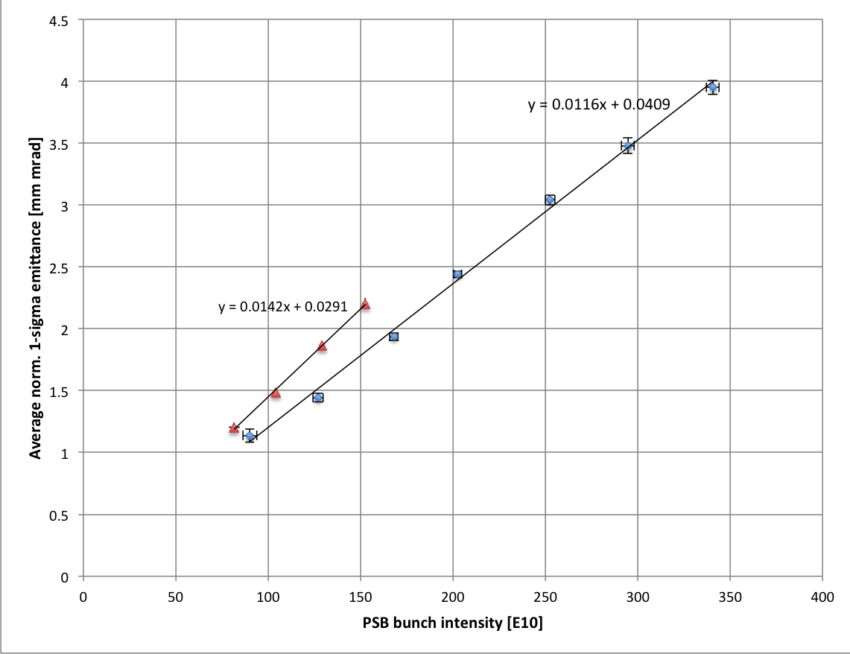
2012 performance (@PSB extraction)
BCMS production scheme
(ε_{z} = 0.9 eVs)
Nominal 25ns
Multi-turn injection (efficiency of the process, space charge)
Constant longitudinal emittance at extraction
25ns
Operational 50ns
LHC traditional production scheme
(ε_{z} = 1.2 eVs)
50ns

Slide 5
2012 performance (@SPS extraction)
25 ns
Trains of 72 bunches to SPS
Used for the LHC scrubbing run in 2012
Trains of 48 bunches to SPS
Used for the LHC pilot physics run in 2012
Measurement points
Emittances deduced from combined wire-scans at end of SPS flat bottom (values cross-checked with LHC)
Error bars include spread from several measurements as well as systematic uncertainty (10%)
Intensity measured at SPS flat top after scraping

Slide 6
2012 performance (@SPS extraction)
25 ns
25 ns
 | Δε_{x,y}/ε_{x0,y0} | ΔN/N₀
PS | 5% | 5%
SPS | 10% | 10%
Projected lines derived from the measured brightness curve of the PSB translated into SPS flat top applying budgets (see table)
The traditional 25 ns beam suffers about 15% extra losses and/or emittance growth (slow losses at the SPS FB, PS space charge, electron cloud)

Slide 7
2012 performance throughout the injector chain: Space Charge
Space charge tune spread
DEPENDENCIES

Slide 8
2012 performance with standard production scheme: summary table

Slide 9
A simple overview:
Evolution of space charge ΔQ_{y} across the injector chain
1.2 sec long flat bottom (FB) to allow for double batch injection
Limit set to 0.31
PSB cycle
(0.5 s)
PS cycle
(3.6 s)
PS FB
(1.2 s)
SPS FB
(10.8 s)
Large tune spreads
Determine brightness
Handled thanks to efficient resonance compensation, dynamic working point and rapid cycling
10.8 sec long flat bottom (FB) to allow for 4 injections
Limit set to 0.21

Slide 10
2012 performance with BCMS scheme: summary table

Slide 11
Expected performance after LS1
25 ns beam (both standard production and BCMS) already very close to the limits in injectors
  Intensity per bunch → 10% from the limit due to the SPS constraints
  Brightness → At the limit for space charge in the PS
Higher intensity
  In 2012 SPS MD in which 1.35 x 10¹¹ ppb were accelerated, but with degraded beam quality at 450 GeV/c (longitudinal instabilities, e-cloud ?)
  In any case, max 1.3 x 10¹¹ ppb can be presently extracted from the SPS compatibly with RF power and longitudinal instabilities limitations
  → H. Bartosik’s talk tomorrow
Higher brightness
  RF manipulations in the PS @2.5 GeV (instead of 1.4 GeV)
    Larger longitudinal emittance from the PSB
    Space charge alleviated by both longer bunches and larger momentum spread
  PSB control of longitudinal parameters along the cycle
    Controlled longitudinal emittance blow up to produce the required longitudinal emittances
    Use of h1+2 in phase at the PSB extraction to keep these larger longitudinal emittance bunches within a certain length (recombination kicker rise time constraint)

Slide 12


PSB – PS transfer
Recombination kicker rise time:
 | h=7 (Standard) |  | h=9 (BCMS)
E_{kin} | T_{RF} | B_{l} | T_{RF} | B_{l}
1.4 GeV | 327 ns | 220 ns | 255 ns | 150 ns
Values pre-LS1 |  | 180 ns |  | 150 ns
Longitudinal emittance per bunch at PS injection should not exceed
[Total Split Factor x 0.35 eVs]/1.1 (includes 10% margin for blow-up)
About 3 eVs (h=7) and 2 eVs (h=9) for RF manipulations at E_{kin}=2.5 GeV
[FB Split Factor x 1 eVs] for transition crossing in h=21
Matched value in the PSB (h1+2) to obtain the above bunch lengths

Slide 13
PSB – PS transfer
Recombination kicker rise time:
 | h=7 (Standard) |  | h=9 (BCMS)
E_{kin} | T_{RF} | B_{l} | T_{RF} | B_{l}
1.4 GeV | 327 ns | 220 ns | 255 ns | 150 ns
Values pre-LS1 |  | 180 ns |  | 150 ns
Longitudinal emittance per bunch at PS injection should not exceed
[Total Split Factor x 0.35 eVs]/1.1 (includes 10% margin for blow-up)
About 3 eVs (h=7) and 2 eVs (h=9) for RF manipulations at E_{kin}=2.5 GeV
[FB Split Factor x 1 eVs] for transition crossing in h=21
Matched value in the PSB (h1+2) to obtain the above bunch lengths
RF Manip. | @1.4 GeV | @2.5 GeV
Standard | 1.2 eVs | 2.8 eVs
BCMS | 0.9 eVs | 1.5 eVs

Slide 14
Potential improvement
(standard scheme)
Present situation
With new longitudinal parameters
Achieved performance

Slide 15
Potential improvement
(BCMS)
Present situation
With new longitudinal parameters
Achieved performance

Slide 16
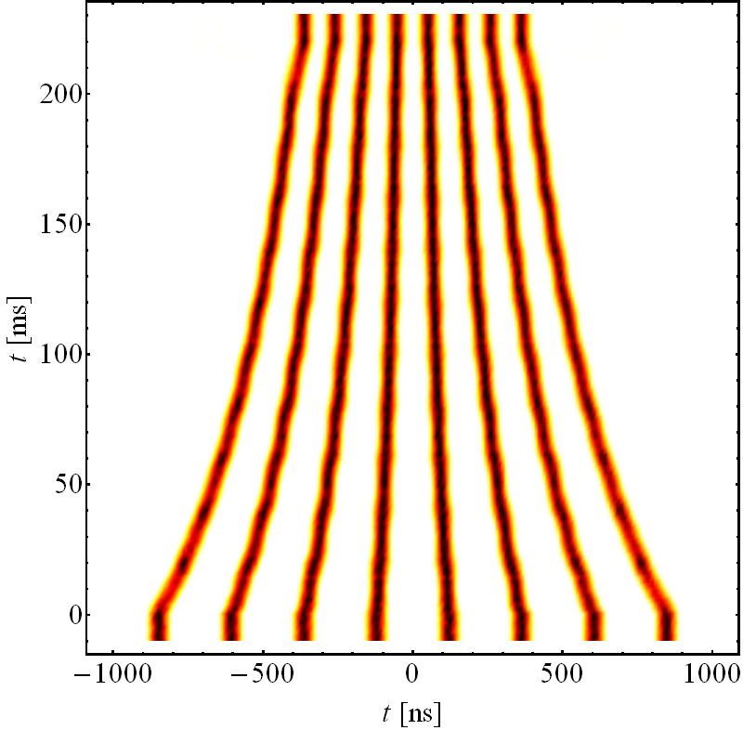
Pure batch compression (BC) scheme
Alternative production scheme for 25 ns beams
Pure batch compression at 2.5 GeV (from h=9 to h=21)
Twice double splitting at FT
Trains of 32 bunches to the SPS
Pure
h = 21
2.5 GeV
Pure h = 9

Slide 17
Pure batch compression (BC) scheme
Alternative production scheme for 25 ns beams
Pure batch compression at 2.5 GeV (from h=9 to h=21)
Twice double splitting at FT
Trains of 32 bunches to the SPS
Extra-bright 25 ns beam
Trains of 32 bunches can relax the electron cloud issues in the LHC
About 13% lower # of bunches in the LHC
Production and transport of beams with sub-μm transverse emittance not yet demonstrated

Slide 18
Post-LS1 scenarios: summary

Slide 19
Post-LS1 scenarios: summary
N.B. The BC emittance values below 1 μm are in principle attainable in the PSB with transverse shaving

Slide 20
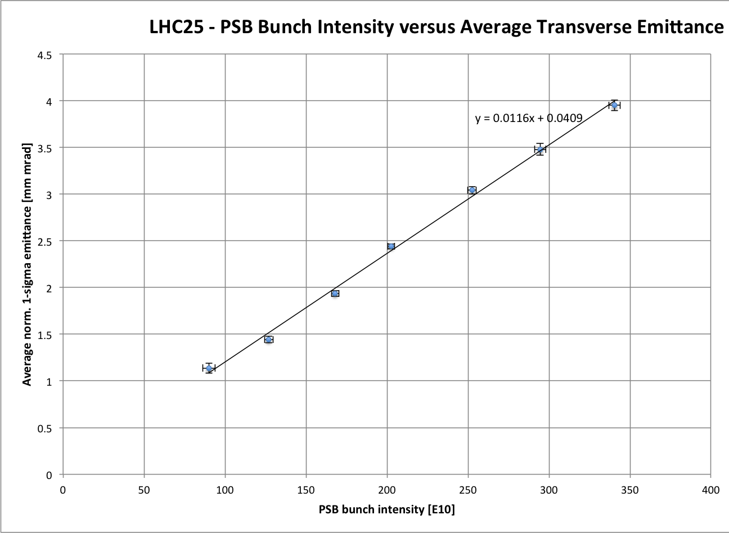
Connection to Linac4: assumptions
Injection at 160 MeV (relaxed space charge)
H⁻ injection (more efficient phase space painting)
Sub-μm emittance region accessible ?
y = 0.0058 x

Slide 21
Standard scheme with Linac4
Starting point assumes all benefits from the larger longitudinal parameters in the PSB – PS transfer
1.3 x 10¹¹ ppb
1.65 μm
Starting point assumes all benefits from the larger longitudinal parameters in the PSB – PS transfer
Staying at 1.4 GeV, potential knobs to reduce ΔQ_{PS} by as much as 24%
  Flattening the bunches (i.e. lowering λ_{max})
  Changing the injection optics (D_{x,y})
1.3 x 10¹¹ ppb
1.25 μm

Slide 22
BCMS with Linac4
Starting point assumes all benefits from the larger longitudinal parameters in the PSB – PS transfer
Starting point assumes all benefits from the larger longitudinal parameters in the PSB – PS transfer
Staying at 1.4 GeV, potential knobs to reduce ΔQ_{PS} by as much as 22-38%
  Flattening the bunches (i.e. lowering λ_{max})
  Changing the injection optics (D_{x,y})
1.3 x 10¹¹ ppb
1.28 μm
1.3 x 10¹¹ ppb
≈ 1 μm
(0.8 μm at the SPS SC limit)

Slide 23
Flat bunches at PSB-PS transfer
Transfer of flat bunches (with second harmonic in counter-phase in both PSB and PS)
  However, little gain available and synchronisation problems
Hollow bunches
  Production
    Use of a double harmonic RF for phase space redistribution*
    RF phase modulation close to ω_{s} with much higher harmonic excitation**
    Paint the hollow distribution at the PSB injection with Linac 4 and accelerate & extract the hollow bunch (assuming it is stable)
  MDs in the past (1993, 1997, 2001) already proved feasibility, though never used operationally
  Positive side effect to also have larger momentum spread
  Triple splitting of hollow bunches can be an issue
  Different tune footprint, dynamics with possible resonance crossing to be assessed through tracking
* C. Carli, Creation of Hollow Bunches using a double harmonic RF system, CERN/PS 2001-073
** S. Hancock, Improved longitudinal blowup & shaving in the Booster, and references therein

Slide 24
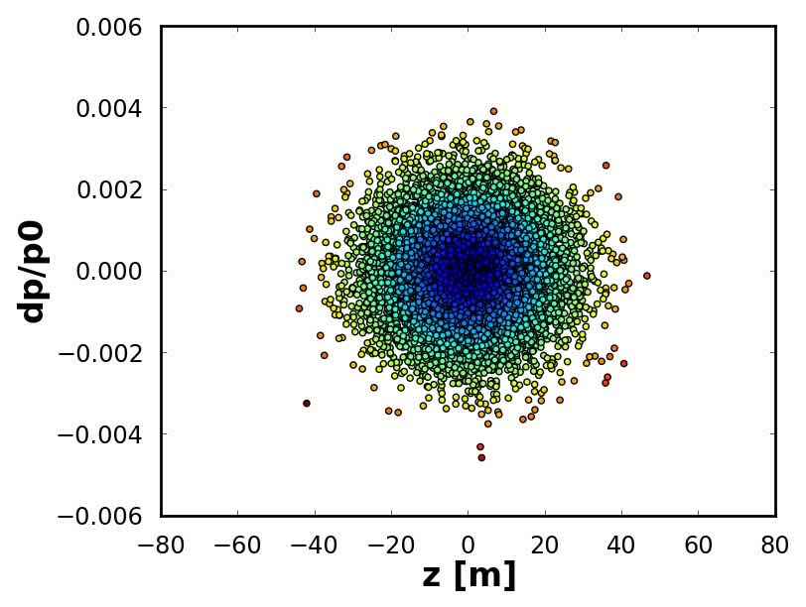
Example: Hollow bunches before PSB extraction by including h2
Longitudinal phase space evolution (example of hollow bunch production at 1.4 GeV in the PSB)

Slide 25
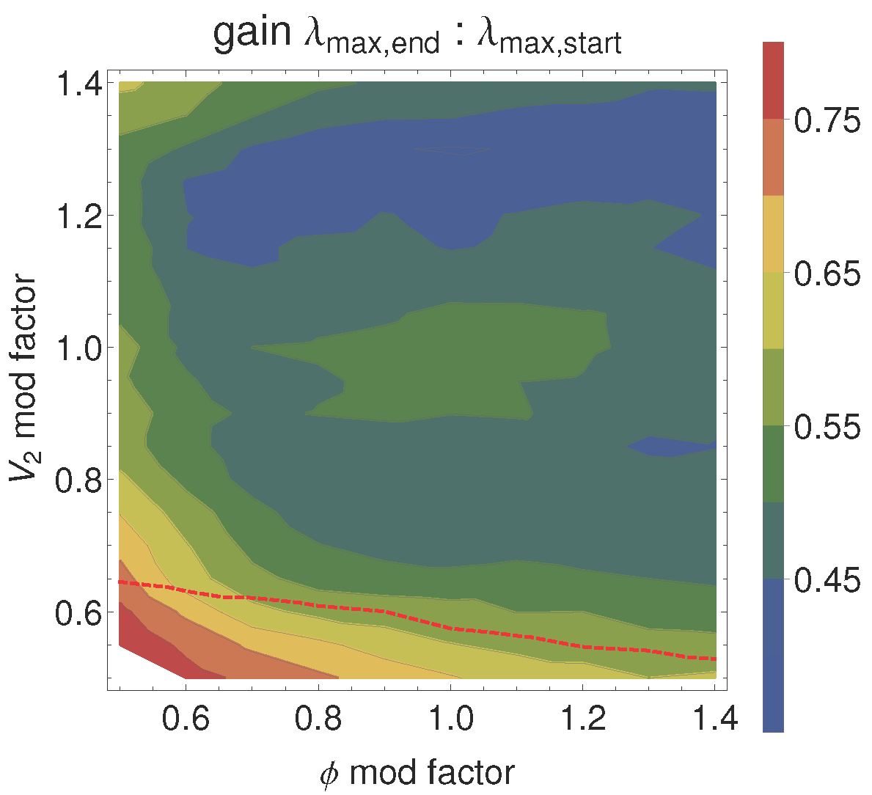
Example: Hollow bunches before PSB extraction by including h2
Parameter scan
We can obtain a final hollow bunch with bunch length below 220 ns
In the best case, this results in a suppression factor of 0.6
A bunch with this distribution has to be tracked with space charge in the PS to assess the effect of the tune distribution
220 ns

Slide 26
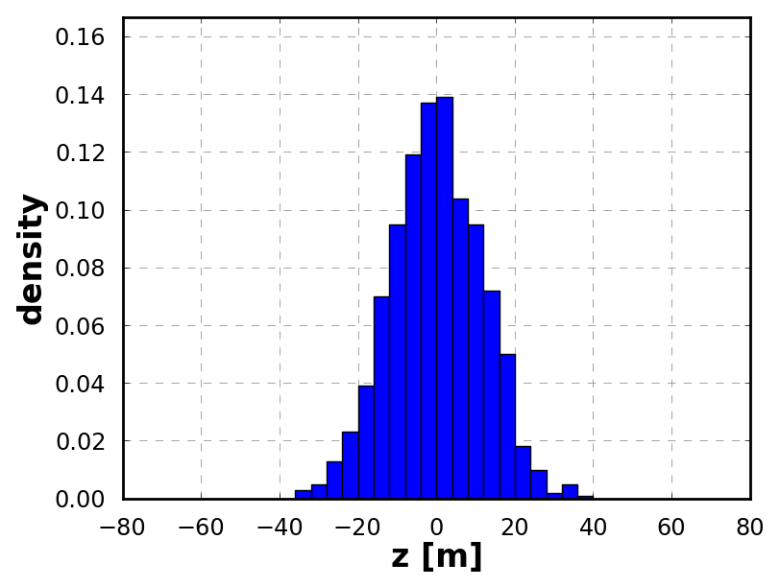
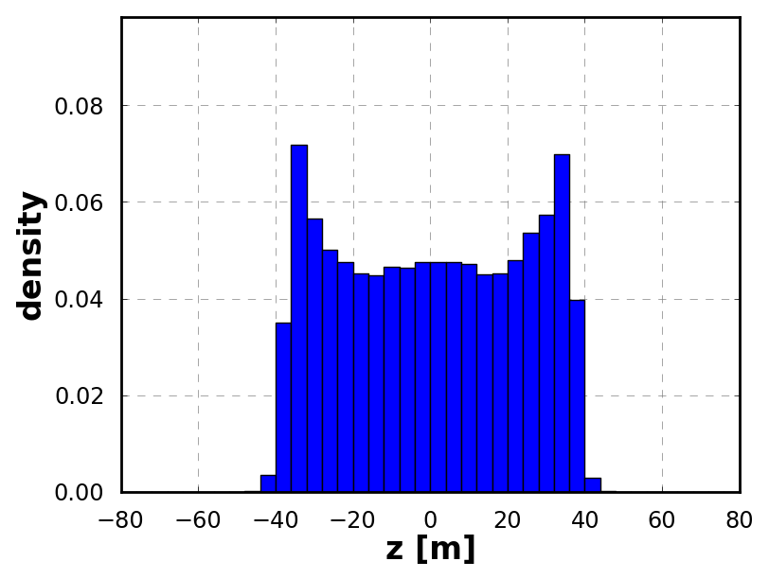
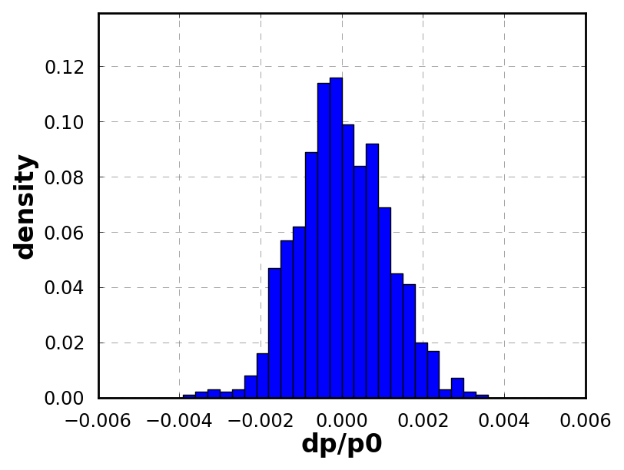
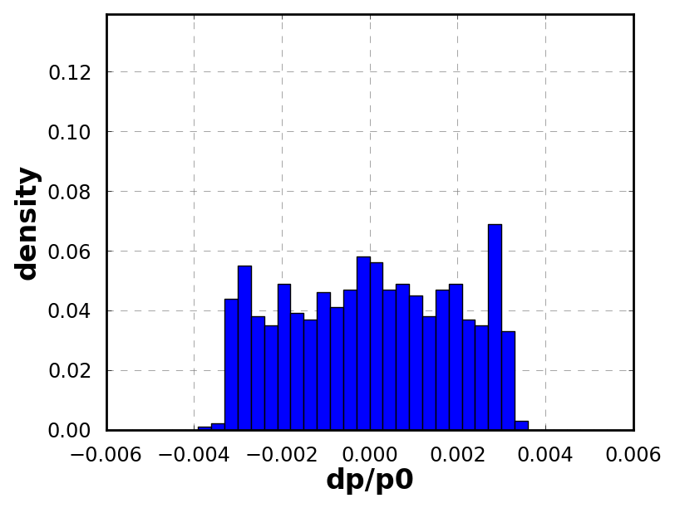
Example: Hollow bunches before PSB extraction by including h2
Initial and final distributions

Slide 27
Optics modifications
High dispersion optics at injection
  Based on enhancing horizontal dispersion to weaken space charge
  Compatible with machine acceptance because the LHC beams have low horizontal emittances
  Tracking and resonance study needed due to change of machine symmetry
  2012-2013 MDs not yet conclusive, but potential gain around 15%

Slide 28
Optics modifications
High dispersion optics at injection
  Based on enhancing horizontal dispersion to weaken space charge
  Compatible with machine acceptance because the LHC beams have low horizontal emittances
  Tracking and resonance study needed due to change of machine symmetry
  2012-2013 MDs not yet conclusive, but potential gain around 15%
Coupled optics at injection (more in “Exotic Schemes” by H. Damerau)
  Based on creating vertical dispersion to weaken space charge by powering existing PS skew quadrupoles
  Compatible with machine acceptance because the LHC beams have low vertical emittances
  Potential gain up to 30% with existing magnets, higher depending on HW
  MDs to be organized after machine start-up in 2014

Slide 29
Single batch PSB-PS transfer
Providing LHC beams with double brightness compared to the present, Linac4 in principle enables the production of the present LHC beams by using the single batch transfer (simplified view, as h2 bunches in PSB are actually shorter)
No 1.4 GeV flat bottom in the PS ➔ the space charge ΔQ limit of 0.31 could become potentially higher
The length of the SPS flat bottom would be reduced by 33% (7.2 sec instead of 10.8 sec), which results in an overall reduction of the SPS filling cycle by 17%
  In the best case (i.e. dedicated LHC filling), this could reduce the minimum waiting time of the LHC beam at 450 GeV by 17%
  This could have a beneficial effect on the emittance growth in SPS/LHC, especially in the case of important electron cloud degradation in the LHC at 450 GeV.

Slide 30
Single batch PSB-PS transfer

Slide 31
Summary
Present performance and post-LS1
  25 ns beams from both standard and BCMS production schemes
    Perform about within budgets throughout the LHC injector chain
    Were used in 2012 for the LHC scrubbing and pilot physics runs
  After LS1, expected improvement from relaxed longitudinal constraints at the PSB-PS transfer → needs MD time to become fully operational
  The pure BC scheme holds great promise to produce ultra-bright 25 ns beams for the post-LS1 era with short trains (favorable against electron cloud), at the price of 13% lower number of bunches in LHC
Only Linac4
  Standard 25 ns beams: 50% higher brightness is in reach (limited by PS space charge)
  BCMS beams: no improvement with Linac4 alone because limited by space charge in PS both now and with post-LS1 parameters
  Possible additional gains by creating hollow bunches or using alternative optics in the PS at injection → need lots of MD time and full experimental validation!
  Use of single batch transfer potentially leading to reduction of minimum LHC filling time by 17% for the same brightness as with Linac2

Slide 33
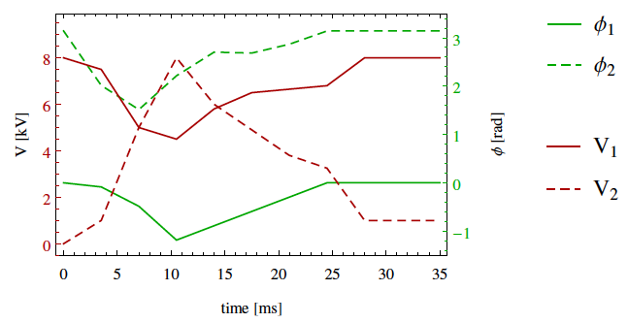
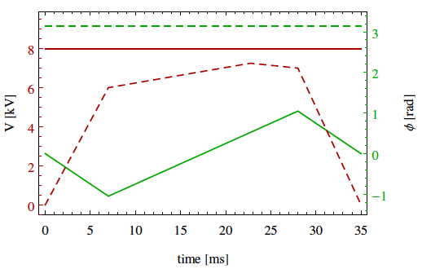
Example: Hollow bunches before PSB extraction by using h2
RF parameters are tailored at 1.4 GeV, two possible schemes proposed (CERN/PS 2001-073)
Turn on h2 and trim the phases
Needs about 70000 turns (35 ms) for adiabatic phase space re-distribution

Slide 34
Optics modifications (II)
Coupled optics at injection
  Based on creating vertical dispersion to weaken space charge by powering existing PS skew quadrupoles in 4 families, while keeping tunes constant @ (6.31,6.28)
  Compatible with machine acceptance because the LHC beams have low vertical emittances
  Reduction of SC tune-shift by a factor of 1.2 in the horizontal and 1.8 in the vertical plane in this extreme case (high skew quadrupole settings)
  Already a 30% reduction can be achieved with existing magnets
  MDs to be organized after machine start-up in 2014

