Slide 1
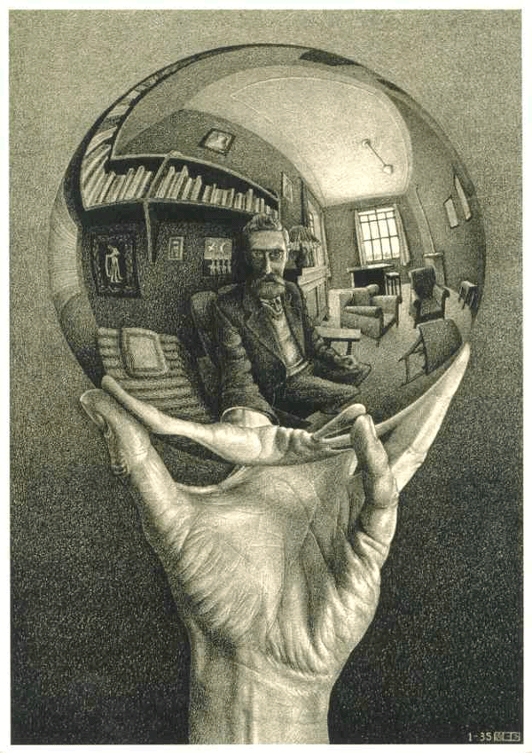
What could stop us,when and how long?
As far as magnets are concerned
L. Bottura
Review of LHC & Injector Upgrade Plans Workshop (RLIUP)
Archamps, October 2013
M.C. Escher, “Hand with a Reflecting Sphere”, 1935

Slide 2
Outline
Magnet failure modes
Electrical/mechanical failures
Effect of radiation
  Magnets in the triplet region
  Magnets in the collimators region
Personal dose
A summary and required actions
I will not cover the injectors (see talk from Katy)
I will not cover the arcs (but advocate diagnostic)
I will not cover cooling limits in the present triplet

Slide 3
Outline
Magnet failure modes
Electrical/mechanical failures
Effect of radiation
  Magnets in the triplet region
  Magnets in the collimators region
Personal dose
A summary and required actions

Slide 4
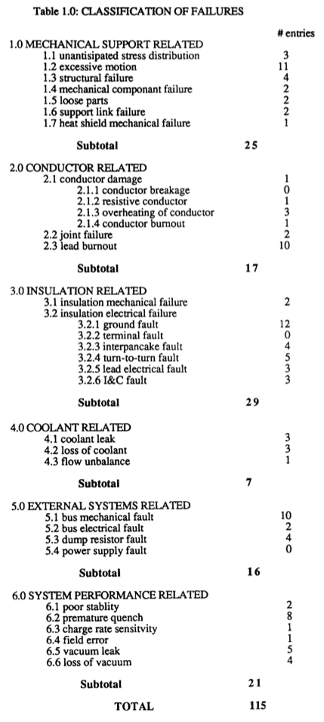
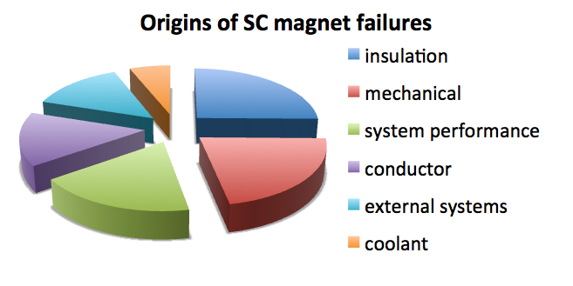
Sc magnets failure modes
Operational
Ice blocks causing overpressure
Manufacturing QA
Joint installation without solder
Shorts (chips, slivers, debris)
Mechanical abrasion of insulation
Reliability
Power supplies/switch control failure
Structural
J.H. Schultz, in Engineering Superconductivity, J. Wiley & Sons, 2001
≈ 50 %
Y. Iwasa, Case Studies in Superconducting Magnets, Plenum Press, 1994.
D.B. Montgomery, Review of Fusion Magnets System Problems, Proc. 13th IEEE Symp. Fus. Eng., 27, 1989

Slide 5
Potential causes of failures in the LHC
Mechanical fatigue on coil, structure, busses:
  Powering cycles: 10⁴ per magnet
  Thermal cycles: a few for the LHC
Singular events and associated thermal and electrical stress:
  Quenches: order of 10 per magnet
  Heater discharges (triggers): order of 10 per magnet
Radiation and associated degradation of mechanical and electrical strength:
  Magnet in the triplet region (Point 1 and Point 5)
  Magnets in the collimators region (Point 7)

Slide 6
Outline
Magnet failure modes
Electrical/mechanical failures
Effect of radiation
  Magnets in the triplet region
  Magnets in the collimators region
Personal dose
A summary and required actions

Slide 7
Electrical NC’s in the LHC SC magnets
To date (M. Bednarek, LSC 31.05.2013) we have 35 NC’s pending
Limiting to the cold part, 12 were known before LS1, 7 were identified during the LS1 ELQA
Magnet exchanged so far
  2007: 1 dipole (suspected developing interturn short)
  2008: 2 dipoles for high internal resistance
  2013: 15 dipoles and 3 quadrupoles, of which
    13 dipoles for electrical issues (high internal resistance, 4+1 QH issues, 1 dielectric strength),
    1 quadrupole for failure of the orbit corrector
  2018 (?): at least 8 dipoles and 3 quadrupoles, of which
    all dipoles and 1 quadrupole for high internal resistance
    a number “TBD” for other issues “TBD” (e.g. re-training ?)
Warning: we have not pushed the LHC yet

Slide 8
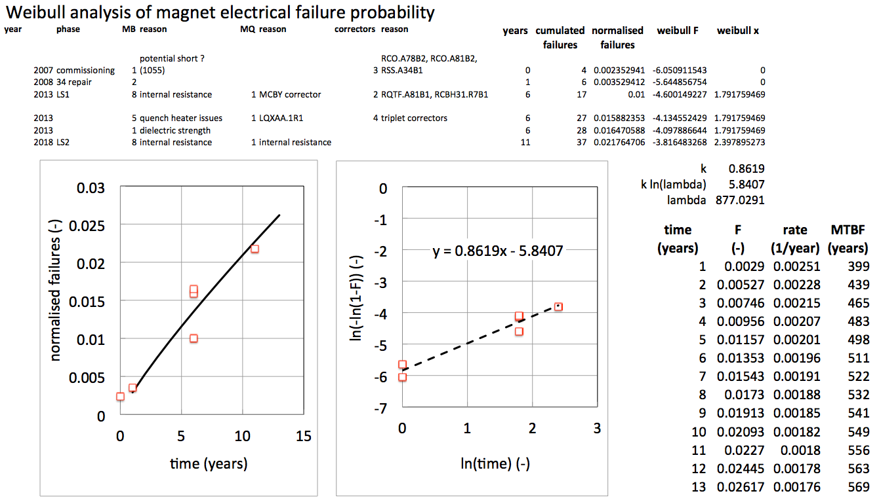
Expected MTBF of SC magnets
Expected MTBF of 400 to 500 years, translates in a range of 3…4 magnets electrical NC’s per year

Slide 9
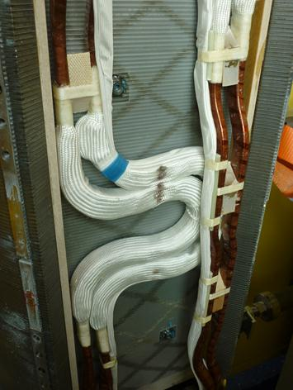
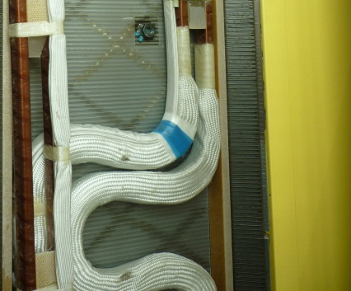
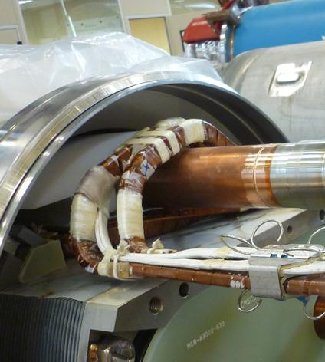
Delicate details – 1/2
SSS bus bar routing with marks due to the contact between lyre and heat exchanger tube

Slide 10
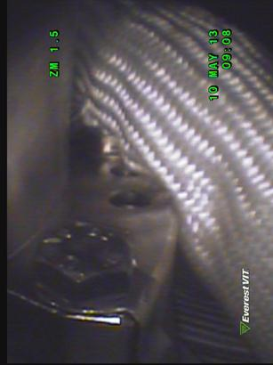
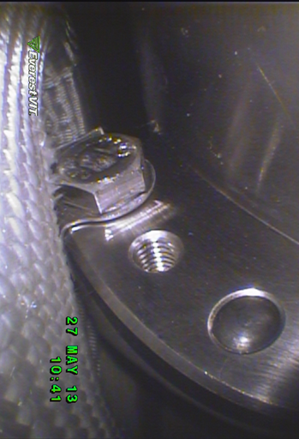
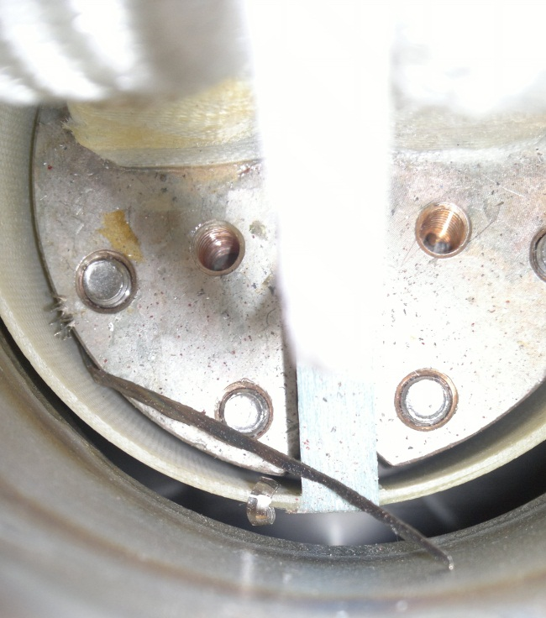
Delicate details – 2/2
Contact between MB circuit bus bars and MCS corrector
Chip causing a short between the half moon and the diode
The LHC, as all electrical machines, will most likely experience electrical faults. This is true for the whole CERN accelerator complex, and is normal

Slide 11
Summary – SC electromechanics
An MTBF of 400…500 years has been estimated⁽¹⁾ for the LHC superconducting magnets
This translates in approximately 3…4 magnet electrical NC’s per year of operation, and at least 10…15 magnets exchanges every long shutdown⁽²⁾
A proposal was made to adapt the main ring spare policy at the ACC Consolidation Day: procure NbTi wire, magnetic steel, build MQ’s (https://indico.cern.ch/conferenceDisplay.py?confId=266926)
Given the estimated MTBF, the probability of electrical failure of one of the triplet magnets within the next 10 years of operation is 3 %, i.e. 1 magnet

Slide 12
Outline
Magnet failure modes
Electrical/mechanical failures
Effect of radiation
  Magnets in the triplet region
  Magnets in the collimators region
Personal dose
A summary and required actions

Slide 13
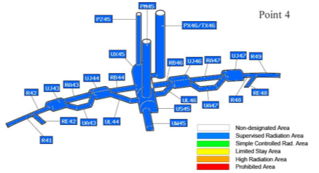
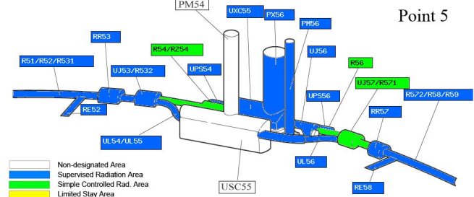
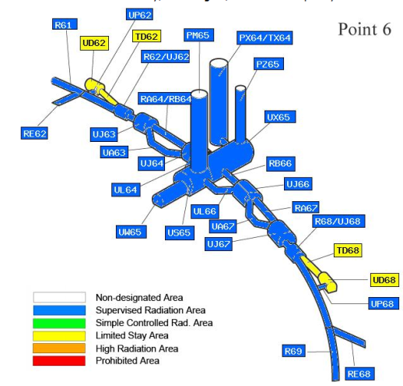
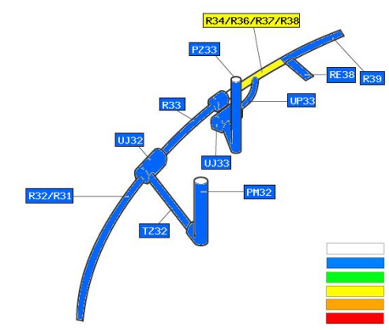
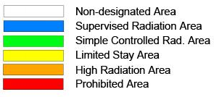
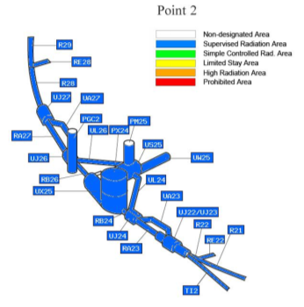
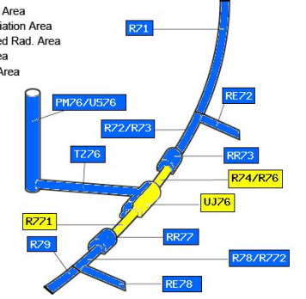
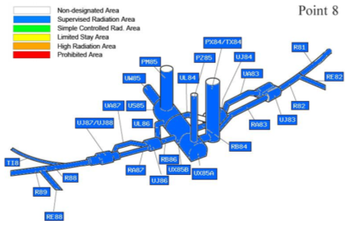
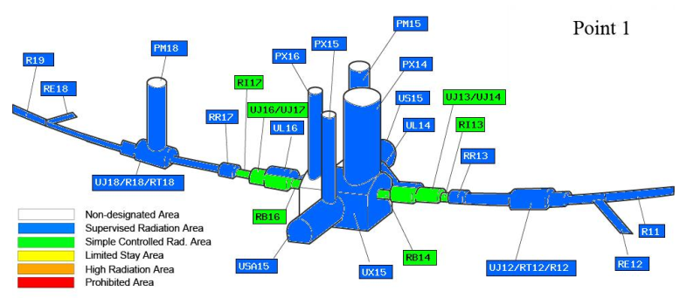
Radiation – where ? Today
Point 3
Point 5
permanent
low-occupancy
< 0.5 µSv/h | < 2.5 µSv/h
< 3 µSv/h | < 15 µSv/h
< 10 µSv/h | < 50 µSv/h
n/a | < 2 mSv/h
n/a | < 100 mSv/h
n/a | > 100 mSv/h
Point 1
Point 7

Slide 14
Outline
Magnet failure modes
Electrical/mechanical failures
Effect of radiation
  Magnets in the triplet region
  Magnets in the collimators region
Personal dose
A summary and required actions

Slide 15
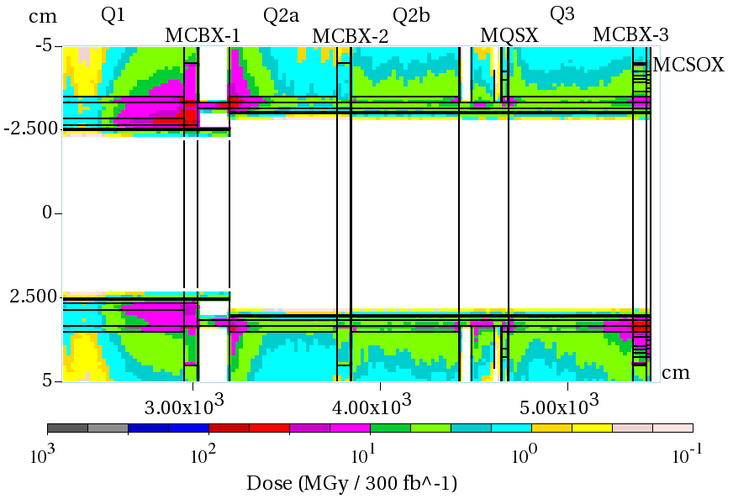
Radiation dose in the present triplet (300 fb⁻¹)
Two “hot-spots”

Slide 16
Radiation dose in the present triplet (300 fb⁻¹)
Cold bore insulation
≈ 35 MGy
Q2
27 MGy
MCBX3 20 MGy

Slide 17
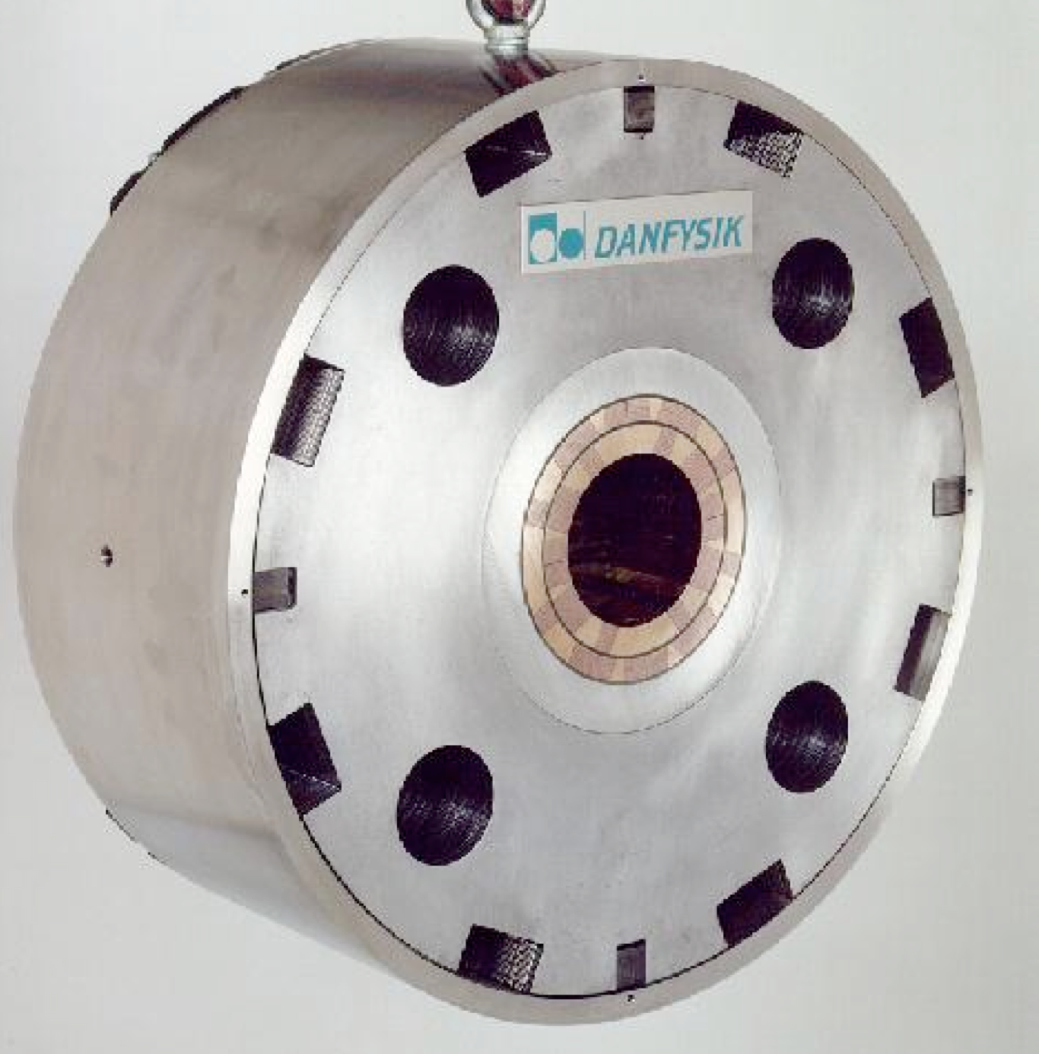
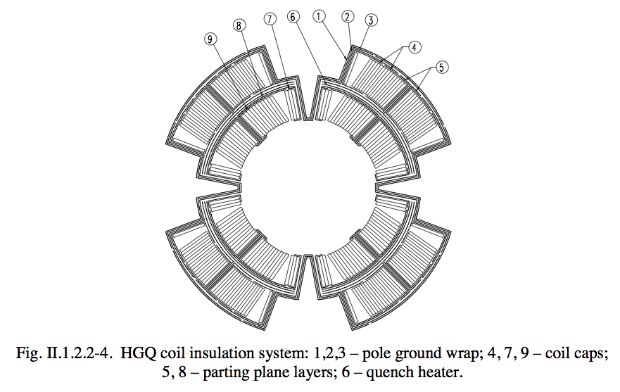
In the gizzards of the triplet
Q2 (MQXB)
  Conductor insulation: 50 (150) μm Kapton
  Coil insulation: 400 μm Kapton
  Ground insulation: 450 μm Kapton
  G11R end spacers
MCBX
  Multi-wire cable, each layer potted with epoxy resin
  Two layers potted (glued) in the final coil with epoxy resin

Slide 18
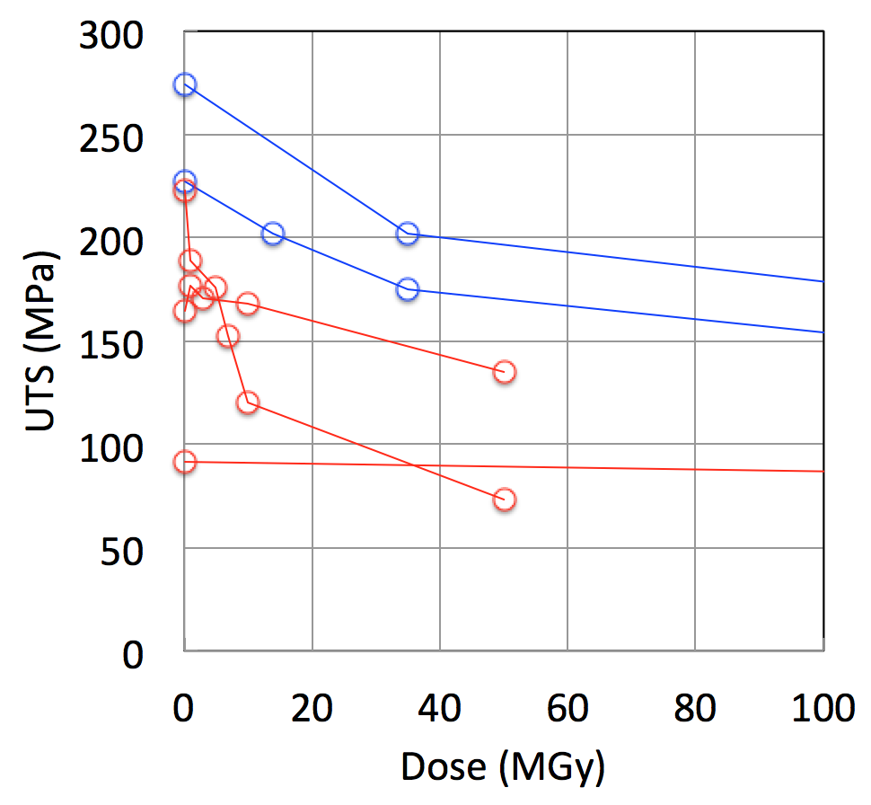
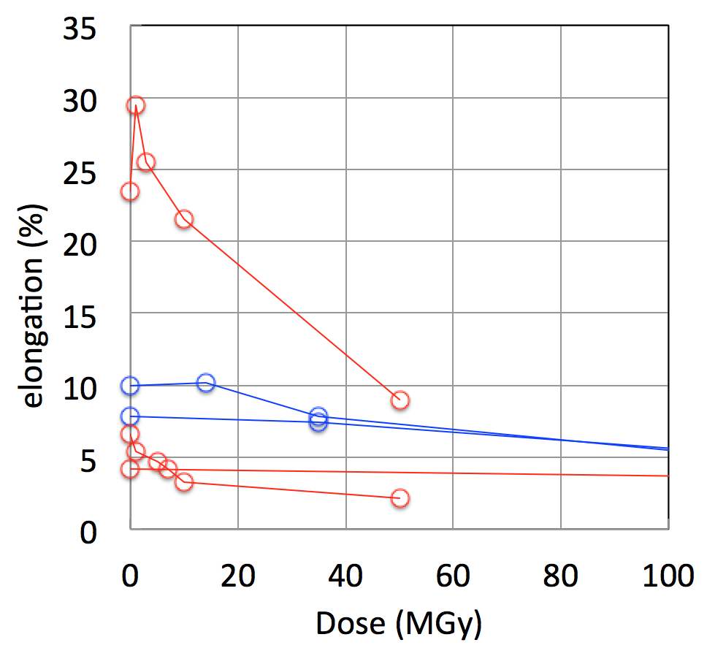
Material limits – Polyimide
Tensile
Tensile
KAPTON H
KAPTON H
KAPTON AH
KAPTON H
KAPTON AH
Sintimid
Vespel
KAPTON H
Sintimid
Vespel
Significant degradation at ≈ 50 MGy
E.R.Long, S.A.T. Long, NASA Technical Paper 2429, 1985
D.J.T. Hill, Radiat. Phys. Chem., 48 (5), 533-537, 1996
M. Tavlet, et al., Compilation of Radiation Damage Data, CERN 98-01, 1998

Slide 19
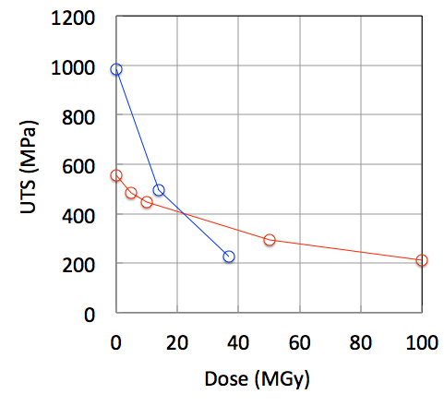
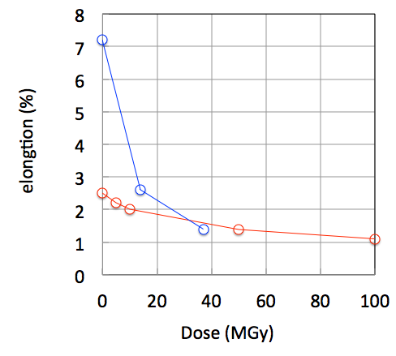
Material limits – G11
Tensile
Tensile
77 K
77 K
300 K
300 K
Significant loss of strength and elongation at dose above 30 MGy
M. Tavlet, et al., Compilation of Radiation Damage Data, CERN 98-01, 1998

Slide 20
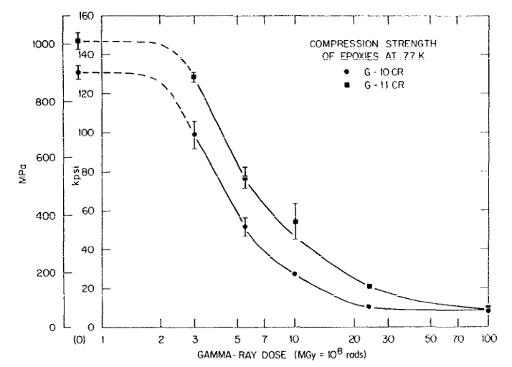
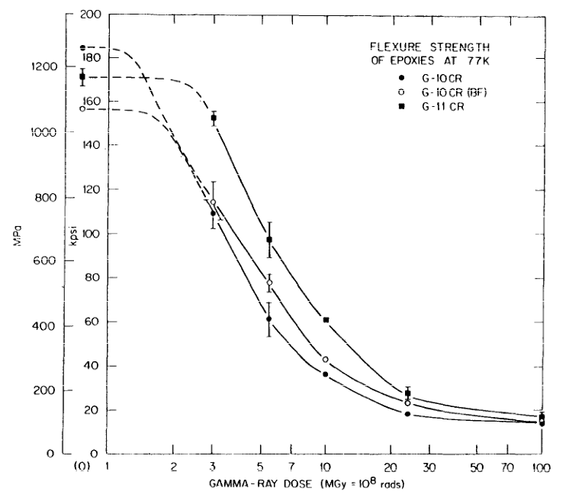
Material limits – G11
10
20
30
50
MGy
10
20
30
50
MGy
Irradiation at 4.9 K
Irradiation at 4.9 K
Compression 77 K
Flexural 77 K
The degradation is caused by loss of bonding in the epoxy component at 10…20 MGy
R.R. Colman, C.E. Klabunde, The Strength of G-10CR and G-11CR epoxies after Irradiation at 5 K by Gamma Rays, J. Nucl. Mat., 113, 268-272, 1983

Slide 21
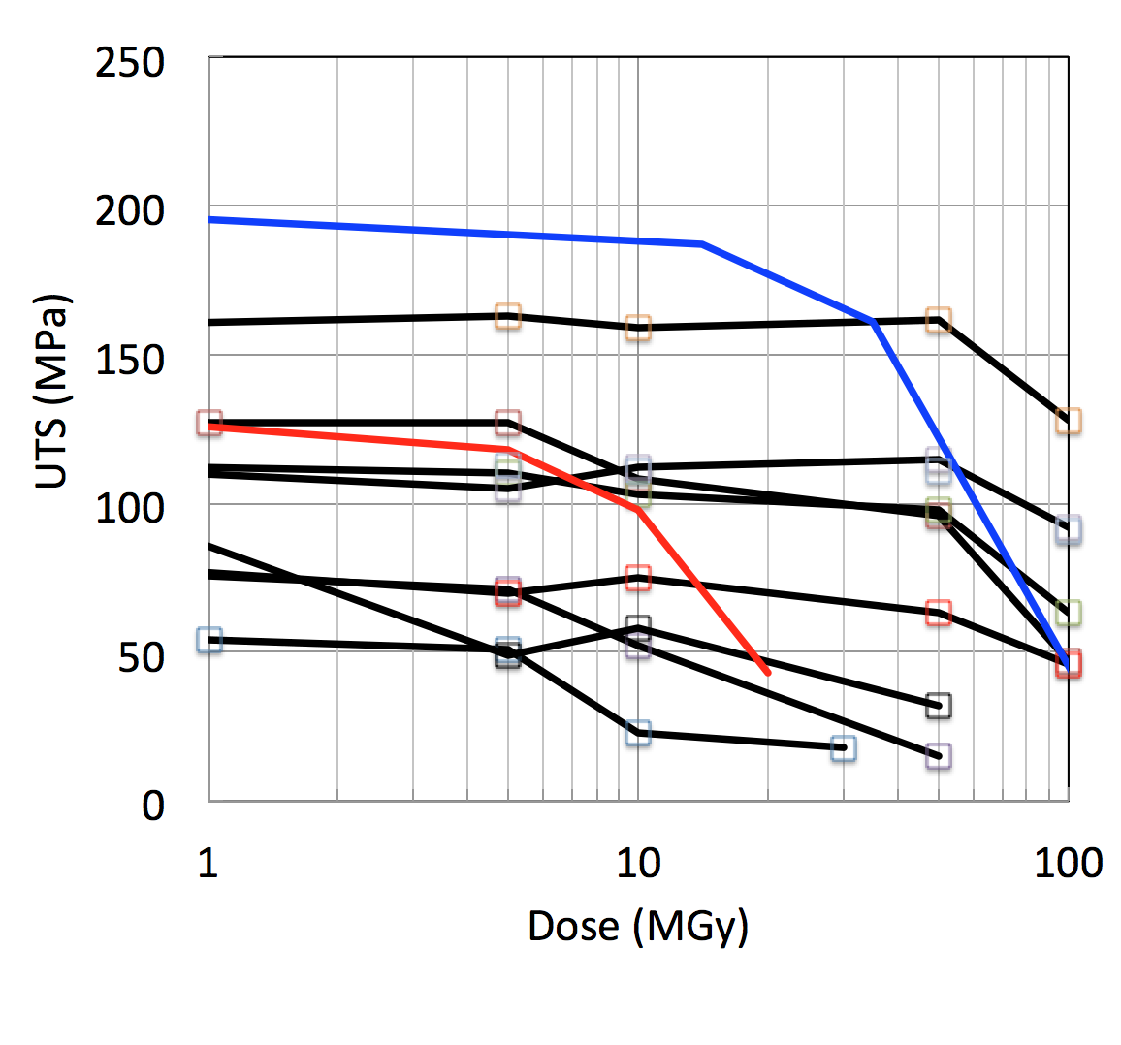
Material limits – Thermosetting resins
Tensile
MY745
77 K
MY745
300 K
Complex situation, significant loss of strength (50% at cold) at dose above 50 MGy
M. Tavlet, et al., Compilation of Radiation Damage Data, CERN 98-01, 1998

Slide 22
Summary on triplet magnets
Expected dose by LS3 (300 fb⁻¹) with 50 % uncertainty⁽³⁾
  Range of 27 [18…40] MGy in the Q2
  Range of 20 [13…30] MGy in the MCBX
Bonding strength (shear) of epoxies is strongly degraded (80 %) above 20 MGy
Fracture strength of insulating materials degrades by about 50 % in the range of 20 MGy (G11) to 50 MGy (epoxies, kapton)
Insulations (polyimide) become brittle above 50 MGy
Triplet magnets may experience mechanically-induced insulation failure in the range of 300 fb⁻¹ (LS3 ± 1 year)
  Premature quenches (cracks in end spacers)
  Insulation degradation (monitor on line⁽⁴⁾)
  Mechanical failure (nested coils in MCBX)

Slide 23

Is this a surprise ?
J. Kerby, M. Lamm, “INNER TRIPLET QUADRUPOLE MQXB”, LHC-LQX-ES-0002 rev 1.1, EDMS 256806, 2001:
  Projected maximum acceptable dose of the triplet magnets of 20 MGy (based on G11 spacers)
  Expected lifetime of 7 years at 10³⁴ 1/cm² s (200 days operation, 50 % lumi time, dose calculation by N. Mokhov)
  Compensatory measures included, as described in N.V. Mokhov, I.L. Rakhno, J.S. Kerby, J.B. Strait, “Protecting LHC IP1/IP5 Components Against Radiation Resulting from Colliding Beam Interactions”, LHC Project Report 633, 2003
  Note: additional limits from the functional specification
  Note: the functional specification proposed magnet swaps among points…
R. Ostojic, 2009: […] on the lifetime of the LHC triplet […] That is the reason I quoted the radiation hardness of the present triplet as “about 400 fb⁻¹”
A limit in the range of 300 fb⁻¹ (with the present evaluation) is hence consistent with previous analyses

Slide 24
Outline
Magnet failure modes
Electrical/mechanical failures
Effect of radiation
  Magnets in the triplet region
  Magnets in the collimators region
Personal dose
A summary and required actions

Slide 25
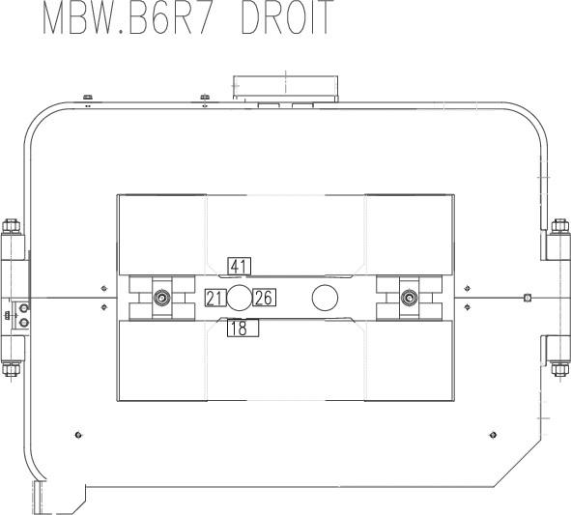
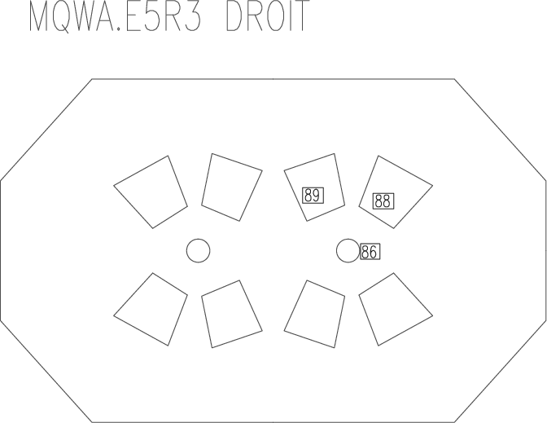
Dose in the MBW and MQW
RP survey LS1
487.3 kGy
43.7 kGy
19.1 kGy
469.1 kGy
297.4 kGy
> 500 kGy
329.4 kGy
Dose esimates at 300 fb⁻¹ (MGy)
 | IR7 right | IR7 left | IR3 right | IR3 left
MQW | 86 | 29 | 9 | 18
MBW | 87 | 43 | 3.8 | 7.6
P. Fessia, MBW-MQW in the LHC, Considerations on expected life and available options, 2013

Slide 26
Summary on warm magnets
Expected dose by LS3 (300 fb⁻¹)
  Range of 80….90 MGy in the MBW and MQW
Limits for the epoxies used are in the range of 50 MGy for MQW and 70 MGy for MBW
Actions have been proposed and approved (TETM67 8/10/2013, LSC24 11/10/2013) to avoid insulation failure in the period LS2 to LS3
Mitigation and preparation work is planned (and mandatory) during LS1

Slide 27
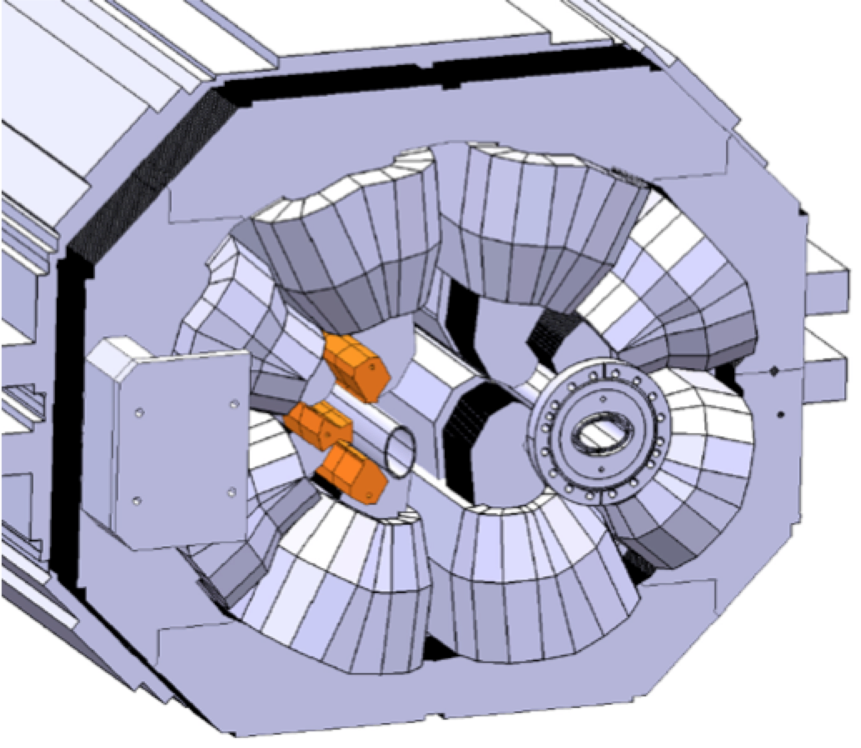
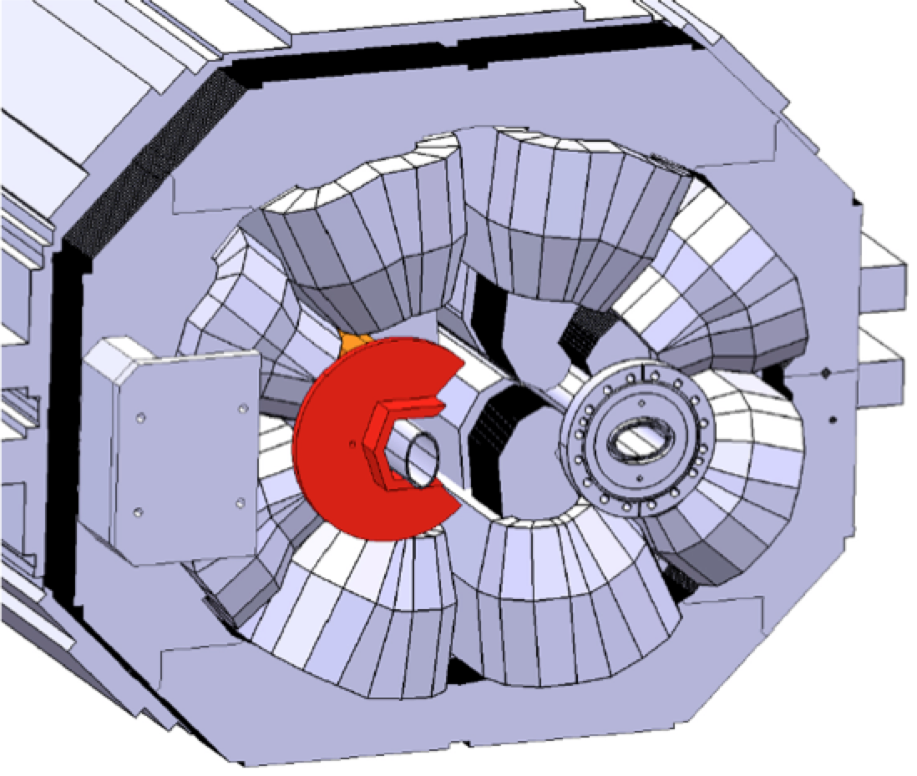
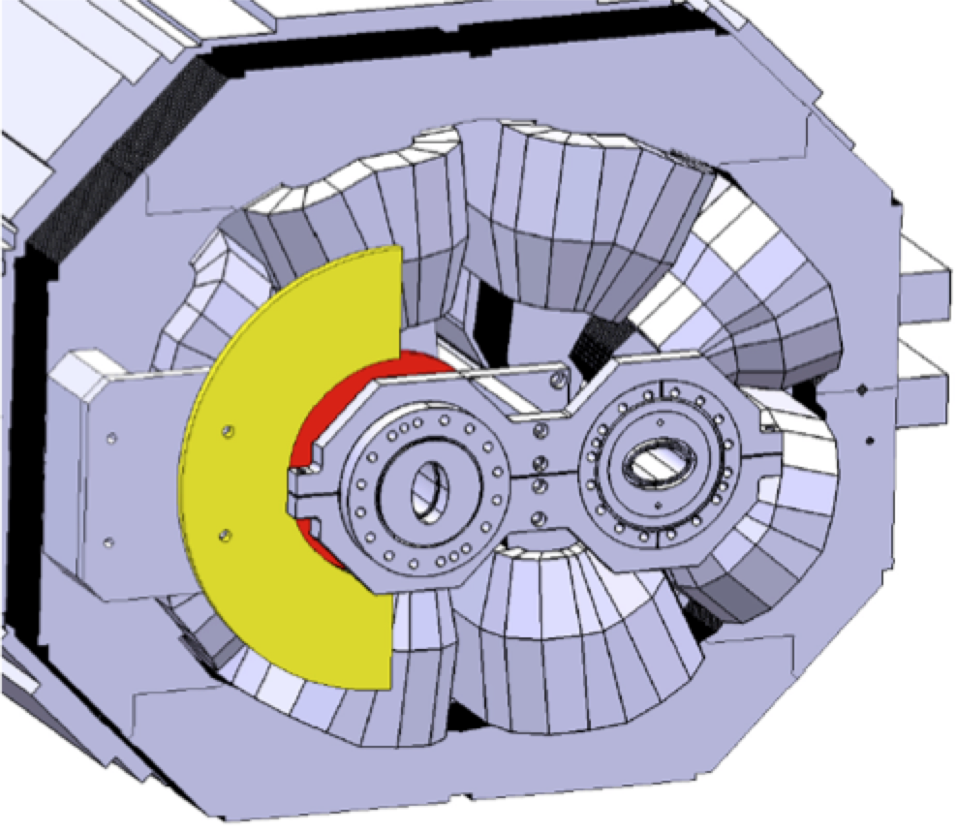
Compensatory measures
Shield (W inserts and masks)
Remove magnets (change optics, insert absorber, simplify powering, add redundancy)
Build rad-hard replacements for the longer term
Shield inserts and masks for MQW, by courtesy of P. Fessia

Slide 28
Outline
Magnet failure modes
Electrical/mechanical failures
Effect of radiation
  Magnets in the triplet region
  Magnets in the collimators region
Personal dose
A summary and required actions

Slide 29
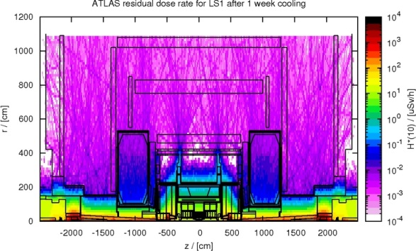
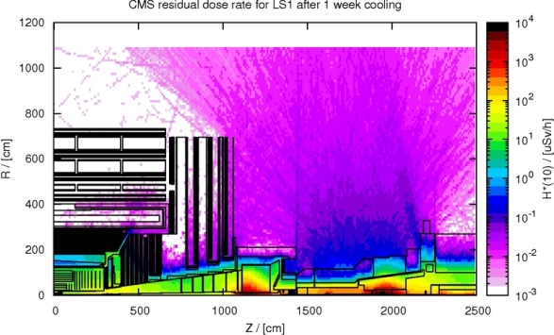
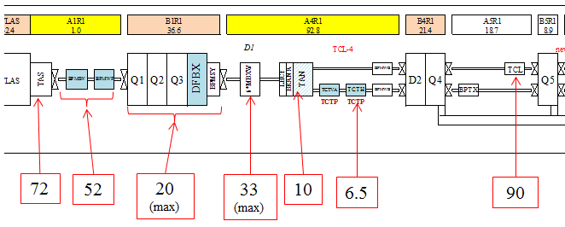
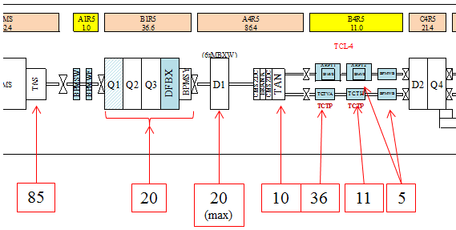
Radiation map – LS1 after 1 week
Point 1
Point 5
Ambient dose equivalent rates in µSv/h at 40cm measured on Dec 17, 2012 (last “good” fill on Dec 5)

Slide 30
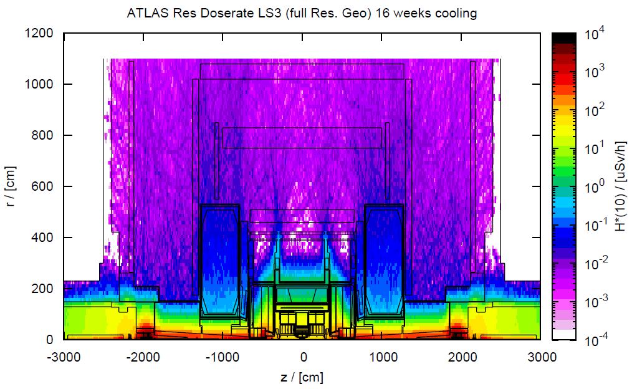
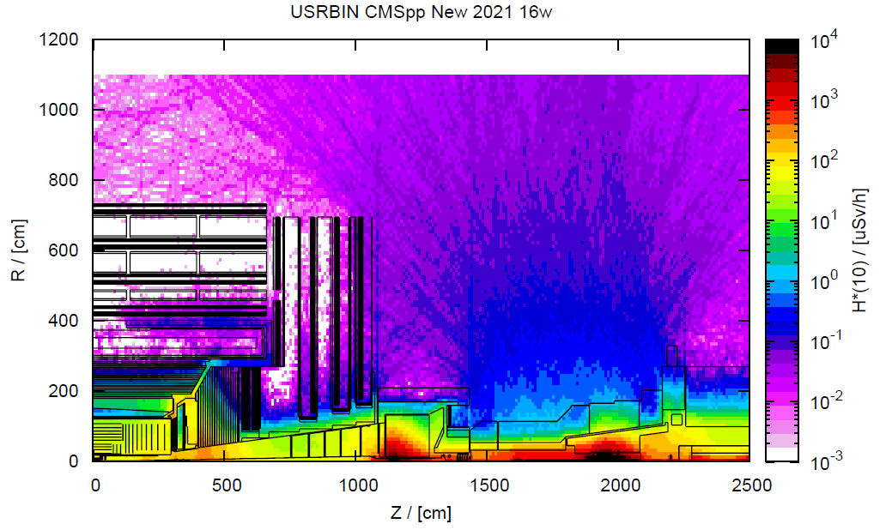
Radiation map – LS3 after 4 months
Point 1
Point 5
The triplet will be a limited stay area
Ambient dose equivalent rates in µSv/h at 40cm extrpolated from measurements after LS1
346
250
96
(max)
158
(max)
50
31
432
408
96
96
(max)
48
173
53
24

Slide 31
7L extrapolation of dose to LS2 and LS3
Between 3 and 30 hours of work
  Personal dose < 2mSv for Winter Shutdowns and operational period
  Personal dose < 3mSv for Long shutdowns
P. Fessia, MBW-MQW in the LHC, Considerations on expected life and available options, 2013

Slide 32
Issues of personal dose – actions
Access and work in the triplet and collimator area will be subject to ALARA-level III rules
Measures must be taken to reduce intervention time by:
  Adopting rad-hard designs for magnet replacements, with robustness improved by factors (3…5)
  Adding redundancy when and where possible (tolerate failures of single elements)
  Reducing/facilitating/accelerating manual operations for disconnection, removal, installation, reconnection, and introducing “remote handling” concepts
This work needs to be prepared in LS2, and executed in LS3 (at the latest) to make further exploitation of the LHC a success

Slide 33
Outline
Magnet failure modes
Electrical/mechanical failures
Effect of radiation
  Magnets in the triplet region
  Magnets in the collimators region
Personal dose
A summary and required actions

Slide 34
Summary
On the time scale of LS3, and provided the present operation scenario scales as discussed, we should expect aging-related and/or radiation induced failures in
  The triplet magnets (Q2, MCBX) at Points 1 and 5
  Warm magnets in the collimation region of Point 7
By that time, a magnet exchange in the triplet may require ≈1 year (4…6 months cooling time, 6…8 months of work, scenario TBD)
The situation for the warm magnets is less dramatic (few units concerned), provided the area is prepared

Slide 35
A must-do plan
During LS1
  Protect most exposed warm magnets in the collimator area (4 MBW + 4 MQW)
  Survey the triplet to prepare for repair in the following period (LS1-LS2)
Between LS1 and LS2
  Design modifications to collimator area for long term operation after LS3
  Work out a baseline for triplet replacement after LS2, and design triplet modification for long term operation after LS3
During LS2
  Shield warm magnets in the collimator area (6 MBW + 29 MQW)
  Prepare triplet area and tools for works in LS3
During LS3
  Preventive triplet exchange (?)
  Modify hardware layout and (possibly) machine operation parameter of critical radiation exposed areas

Slide 36





Slide 37
Notes and caveats
The estimation is based on the infancy of hardware and operation, and before reaching full electro-mechanical stress conditions
This is obviously consistent with the present work (LS1, 18 cryo-magnets) and plans (LS2, in excess of 10 cryo-magnets)
According to benchmarking and expectations by F. Cerutti, (CERN EN-STI)
I strongly advocate for the development of hardware and procedures for the on-line monitoring of the dielectric strength of the LHC
A number of effects, such as ion irradiation (see next slides) may cause localised degradation, which is difficult to quantify today

Slide 38
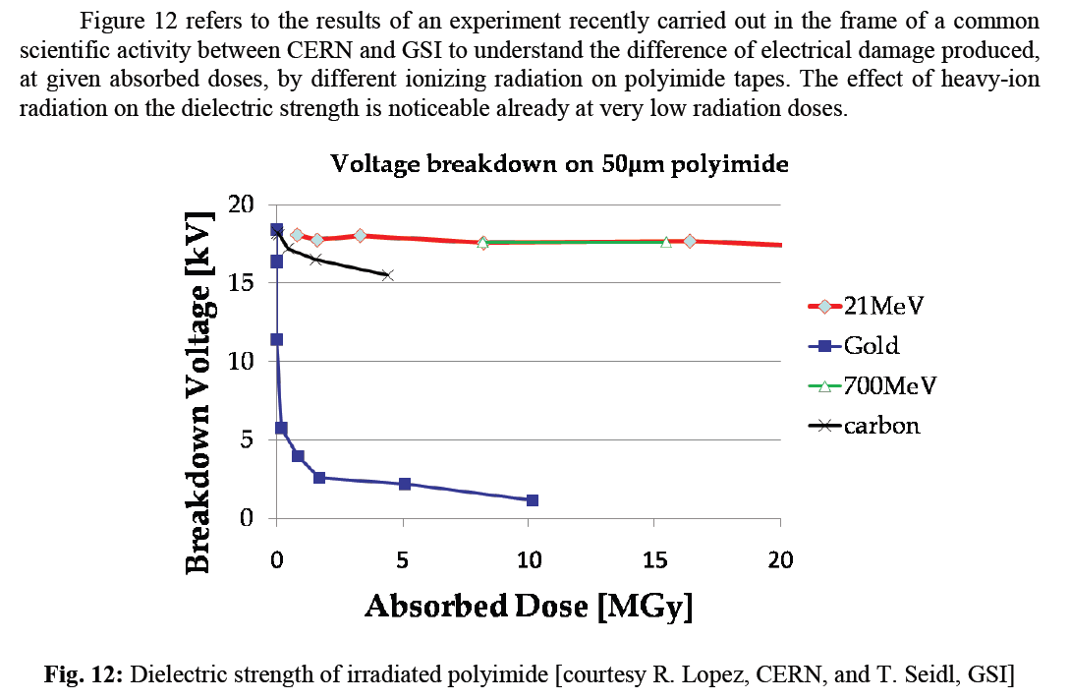
The ion case
By courtesy of P. Fessia, CERN TE-MSC

Slide 39
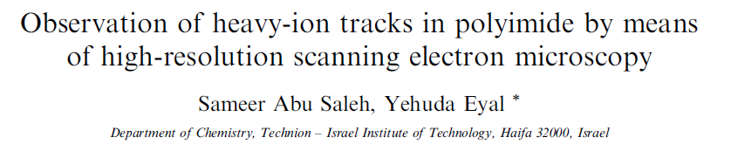
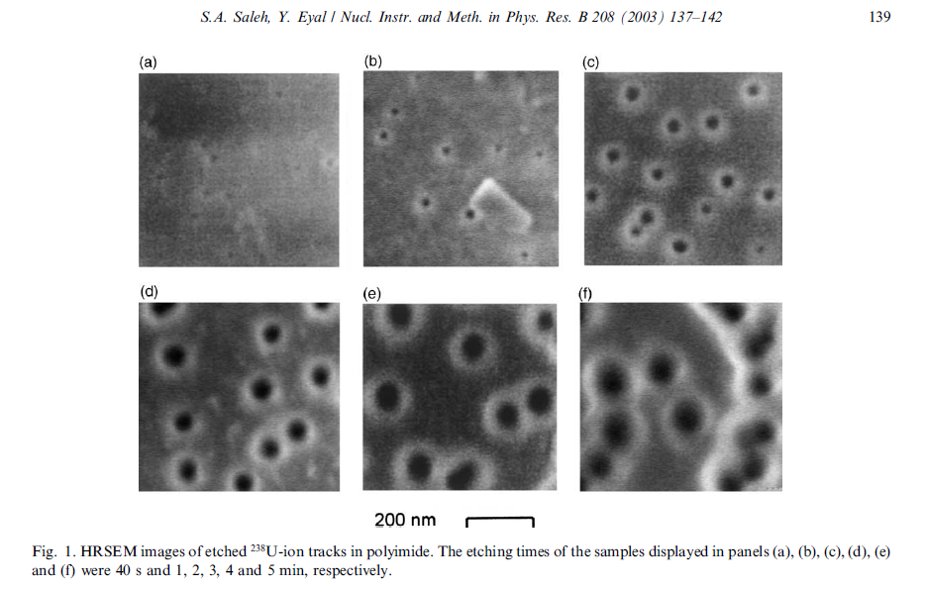
By courtesy of P. Fessia, CERN TE-MSC

