Slide 1
Shutdown schedule until 2035 to ensure reliable operation of the LHC & Injectors
Prepared by S. Baird & K. Foraz
Presented by K. Foraz

Slide 2
What we will present
Outline and background assumptions
Information included
Overall plan
  Technical stops
  End of year Technical Stops
  Long Shutdowns
LINAC4 connection to PSB?
Conclusions

Slide 3
Outline
Aim
  Establish a base-line scenario for shutdowns until 2035
  Taking into account the optimum periodicity and length of Technical Stops, End of Year Technical Stops, Long Shutdowns
With the following assumptions
  LINAC4 is connected to PSB during first suitable stop* after LS1
  PSB is not upgraded to 2GeV operation
  There is no upgrade of SPS RF system
  There is no HL-LHC program
  Only maintenance and consolidation needed to maintain 2012 performance and reliability levels are performed
  * Two possible scenarios studied
No LIU and no HL-LHC

Slide 4
Information included
Standard maintenance and essential consolidation (including replacement of equipment) needed to maintain reliable LHC & Injector operation until 2035
  What do you need to do?
  When do you need to do it?
  How long will it take?
  How frequently should it be done?
  Are the resources available to do multiple works in parallel?
  Do you need a significant cool-down period (ALARA)?

Slide 5
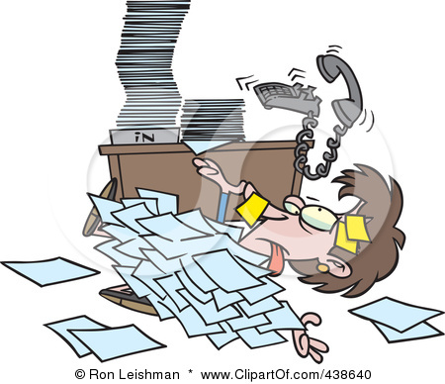


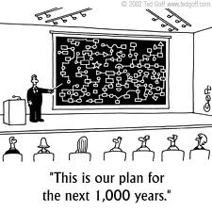
Followed by a careful analysis of the data…….
Leading to….

Slide 6
Technical stops
In order to perform preventive and corrective maintenance
Strong request
  EL, RF, CV*, CRG, ABT, BI * initial request 4 TS
  CV & CRG maintenance determines the
  length = 5 days, and frequency – every 10 weeks
Useful but not essential: MSC, VSC, GS
Not needed: EPC, SU, STI
Technical Stops
Operation

Slide 7
End of year Technical Stops
Assuming ion operation in LHC with no protons in the Injectors at the end of each year to optimize the cool-down time before access
  Longest possible cool-down period is essential for ABT
Requests from all groups ranging from 4 to 10 weeks (incl. Xmas holidays)
  Essential works
    CV & Cryo maintenance (determines the length = 10 weeks)
    (CV maintenance in the injectors: 8weeks)
    Alarm tests during Xmas holidays;
    EL 400kV maintenance(4wks) ; ABT (4 wks CD +4wks)
    Access (6-8wks) RF (6 wks), VSC (6 wks), & BI
  Useful but not essential
    SU, EPC, MSC
EyTS

Slide 8
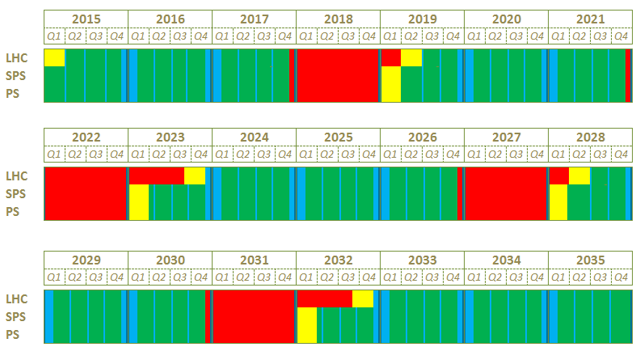
Long Shutdowns
Scenario 1 – Connection of L4 during LS2
Beam commissioning
LS2
LS3
LS4
LS5

Slide 9
LS2 from 2018 (according to scenario 1)
LHC 16 months, Injectors 12 months
LS2

Slide 10
LS2 - LHC
Maintenance
  Cooling – Ventilation & Cryogenics equipment
  are defining the length : 16 months
  Cryogenics equipment could be maintained
  in 1 year but including CV gives 16 months
  ABT septa & kickers 6 months CD+ 3 months
  RF maintenance 6 months
  Electrical equipment, collimation,
  beam instrumentation, detection… in the shadow
Potential main consolidation
  MSC exchange 20 s/c magnets 6 months
  MBW-MQW (shields, absorbers)

Slide 11
LS2 – Injectors (1/3)
Maintenance & “recurrent” consolidation
  Cooling and ventilation equipment 12 months
  Kickers and Septa 6 months CD + 3 months
  SPS irradiated cables campaign 6 months CD + 5 months
  Cable clean up campaign up to 12 months
  6 months/zone with 2 zones in //
  Renovation of SPS surface buildings 9 months
  Renovation of 8 PS main magnets * 6 months CD + 4 months
  Exchange of 20 SPS magnets * 4 months
* See next slide

Slide 12
LS2 – Injectors (2/3)
Roadmap for preventive maintenance of injectors magnets
  by end 2014-2015 every magnet should have spare units (coils or entire magnet)
  complete the PFW procurement and perform consolidation during LS2
  procure additional spare coils for the SPS bending magnets
  spare PS machine bus-bars manufactured, postpone decision for replacement
  spare PS machine-to-power generator bus bars do not exist: decision to take

Slide 13
LS2 – Injectors (2/3)
In addition
  Connection of LINAC 4 to PSB (scenario 1) 9 months
  Replacement of TT2 power converters 9 months
  Replacement of SPS access system 12 months
  SPS evacuation alarms, BIW and
  replacem^{t} of PVC fire detection cables 12 months

Slide 14
LS3 from 2022 (according to scenario 1)
LHC 20 months, Injectors 12 months
LS3

Slide 15
LS3 - LHC
Maintenance
  Cooling – Ventilation & cryogenics equipm^{t} 16 months
  ABT septa & kickers 6 months CD+ 3 months
  RF maintenance 6 months
  Electrical equipment, collimation,
  beam instrumentation, detection… in the shadow
In addition
  Inner triplet magnets exchange 20 months
  Arc pumping group replacement 6 months
  Collimator replacement campaign 6 months CD + 3 months
  Cryo compressor consolidation 12 months
  (can be done in parallel with maintenance)
  MSC exchange 20 s/c magnets 6 months

Slide 16
LS3 - Injectors
Maintenance & “recurrent” consolidation
  Cooling and ventilation equipment 12 months
  Kickers and Septa 6 months CD + 3 months
  SPS irradiated cables campaign 6 months CD + 5 months
  Cable clean up campaign up to 12 months
  6 months/zone with 2 zones in //
  Renovation of 8 PS main magnets 6 months CD + 4 months
  Exchange of 20 SPS magnets 4 months
  Renovation of SPS surface buildings 9 months
In addition
  SU full SPS survey 10 months

Slide 17
LS4 from 2027 (according to scenario 1)
LHC 16 months, Injectors 12 months
LS4

Slide 18
LS4 - LHC
Maintenance
  Cooling – Ventilation & cryogenics equipm^{t} 16 months
  ABT septa & kickers 6 months CD+ 3 months
  RF maintenance 6 months
  Electrical equipment, collimation,
  beam instrumentation, detection… in the shadow
Consolidation
  Septa replacement 6 months CD + 3 months
  Collimator replacement campaign 6 months CD + 3 months
  MSC exchange 20 s/c magnets 6 months
  VSC replace arc pumping 6 months

Slide 19
LS4 - Injectors = 12 months
Maintenance & “recurrent” consolidation
  Cooling and ventilation equipment 12 months
  Kickers and Septa 6 months CD + 3 months
  SPS irradiated cables campaign 6 months CD + 5 months
  Cable clean up campaign up to 12 months
  6 months/zone with 2 zones in //
  Renovation of 8 PS main magnets 6 months CD + 4 months
  Exchange of 20 SPS magnets 4 months
  Renovation of SPS surface buildings 9 months

Slide 20
LS5 from 2031 (according to scenario 1)
LHC 20 months, Injectors 12 months
LS5

Slide 21
LS5 - LHC
Maintenance
  Cooling – Ventilation & cryogenics equip. 16 months
  ABT septa & kickers 6 months CD+ 3 months
  RF maintenance 6 months
  Electrical equipment, collimation,
  beam instrumentation, detection… in the shadow
In addition
  Change Inner triplet magnets??? 20 months
  Collimator replacement campaign 6 months CD + 3 months
  MSC exchange 20 s/c magnets 6 months

Slide 22
LS5 - Injectors
Maintenance & “recurrent” consolidation
  Cooling and ventilation equipment 12 months
  Kickers and Septa 6 months CD + 3 months
  SPS irradiated cables campaign 6 months CD + 5 months
  Cable clean up campaign ? up to 12 months
  6 months/zone with 2 zones in //
  Renovation of 8 PS main magnets 6 months CD + 4 months
  Exchange of 20 SPS magnets 4 months
  Renovation of SPS surface buildings 9 months

Slide 23
Can we wait until 2018 to connect Linac4 to PSB?
Scenario 1
from 2015 to 2035: beam = 57%
% of time
LS2
LS3
LS4
LS5

Slide 24
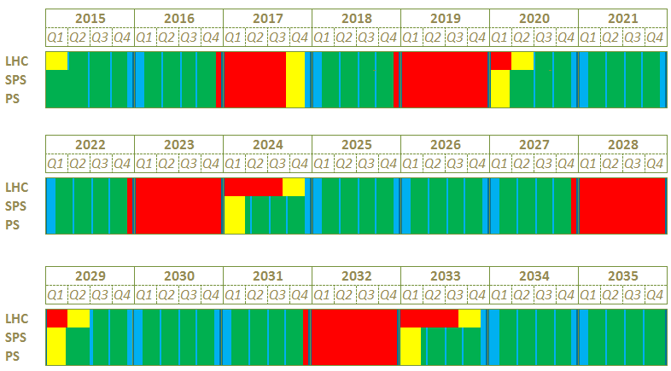
L4 connection to PSB in 2017
Scenario 2
from 2015 to 2035: beam = 54 % of time
LS1.5
LS2
LS3
LS4
LS5

Slide 25
To LS1.5 or not to LS1.5?
Advantages
Disadvantages
  Mitigate risk of Linac2 failure
  Linac4 is not left idle
  Reduce LS2 workload (mainly in Injectors) EL, GS, CV….
  9 months is too short to complete LHC CRG maintenance
  Need LS2 in 2019 at the latest
  Reduces potential physics output by 1 year
    = 12% 2015 to 2020
    = 4% 2015 to 2035

Slide 26
Conclusions
Two base-lines established
  With and without LS1.5
Minimum shutdown lengths have been given
  Leading to beam operation ~3/5th of the time from 2015 to 2035
Preference for scenario 2 with LS1.5
  Mitigate risk of Linac2 failure
  Linac4 is not left idle
  Reduce LS2 workload (mainly in Injectors) EL, GS, CV….
  Reduced physics potential ( ~ 4 %) can be recuperated with one year of additional running in 2036

