Slide 1
Post LS1 Schedule
Mike Lamont
29th October 2013
Thanks to Serge Claudet, Simon Baird, Austin Ball, Fabiola Gianotti, Beniamino di Girolamo, Didier Contardo, Richard Jacobsson

Slide 2
Considerations
Bit of a matrix here: demands on run 2, LS2, run 3, LS3 from: injectors, LHC machine, LHC experiments…
LHC machine
  How long can we run for? (Cryogenics, maintenance…)
  How long can the operations group run for?
  Ion program – North area, LHC
Injectors
  Risks of running with Linac2 until 2018/2019
  Linac4 connection, LIU upgrades
Experiments
  Upgrades I & II, YETS
Longer-term strategy
  Accelerator technology development time
  Detector technology development time, funding profiles for the phase II upgrades…

Slide 3
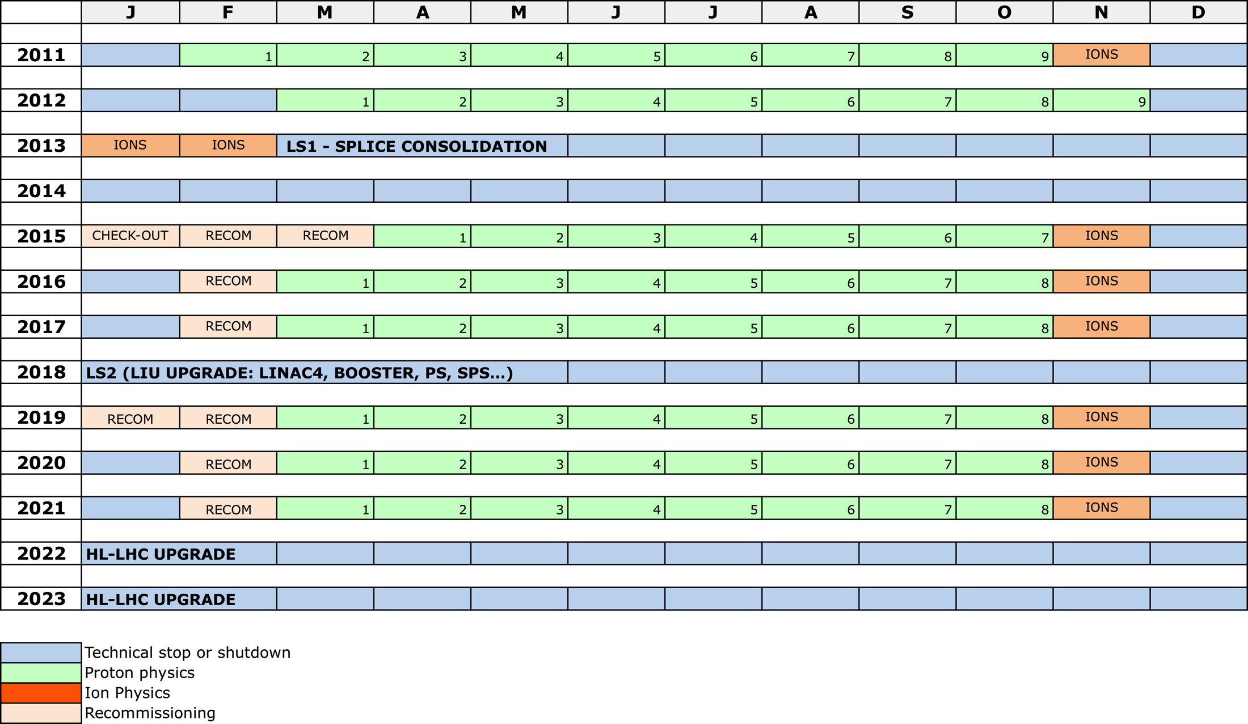
Baseline
LS1
RUN 2
LS2
RUN 3
LS3

Slide 5
Standard long year
Phase | Days
Christmas technical stop including HWC – beam to beam | 91 (13 weeks)
Commissioning with beam (double coming out of a LS) | 21
Machine development | 22
Scrubbing | 7 (to 14)
Technical stops | 15 (3 x 1 week)
Technical stop recovery | 6
Proton physics including intensity ramp-up | 160
Ion run set-up | 4
Ion physics run | 24
Contingency | 7 (or 0)
Total | 365

Slide 6
Winter technical stops (including hardware commissioning): 13 weeks beam to beam
3 technical stops through the year:
1 week – 10 week – 1 week
Xmas: ~10 days required before CERN closure to secure the helium inventory (worth ≈ 7 MCHF) and be protected again serious failure with only minimal "on-call” support

Slide 7
Recall 2009 - 2013
2009
  23rd November – 16th December
2010
  22nd February – 6th December
  AMS 4th – 9th February
2011
  21st February – 7th December
2012
  14th March – 17th December
2013
  14th January – 16th February
At the limit!
Injectors start ~2 weeks before these dates to have beam ready for the LHC

Slide 8
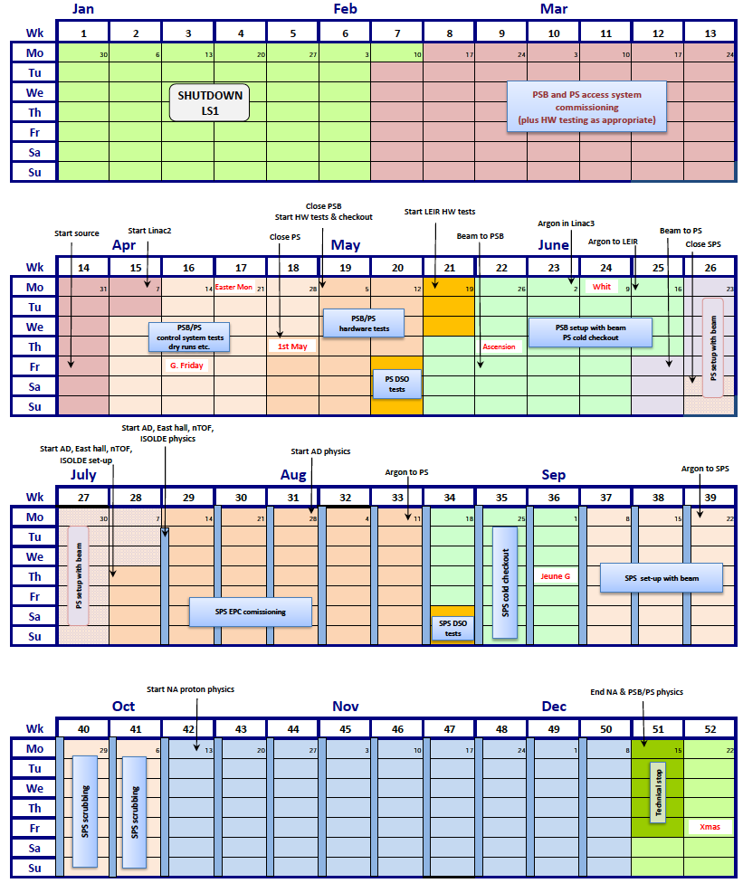
Injectors
2014

Slide 9
LHC Run 2
Maximum Length?
Extended year end technical stop? Linac4 connection?

Slide 10
Extended Year End Technical Stop (EYETS)
CMS:
  4 layer pixel ready to install at end of 2016
  4.5 months beam to beam (plus some contingency)
Other experiments
  ATLAS don’t need it
  Not of any significant benefit to ALICE and LHCb but…
Cryogenics
  magnets would be kept cold below 80K during this "physics break” must ensure we don’t lose conditioning
  could imagine some sectors in nominal conditions for some training quenches in order to push towards 7 TeV.
  some opportunity for selective maintenance
Even sandwiching the extended stop with ion runs would appear to be too short for Linac4 connection (~9.5 months – see Bettina Mikulec)
LIU preparation
  Could use time in Booster/PS – e.g. cable cleanup

Slide 11
Extended run 2?
Four year run without an extended stop
  Unacceptable to CMS – rule out
With extended stop:
  Operation of LHC for 3.5 to 4 years with ~5 months out in the middle
  Operation of injector complex for 4 to 4.5 years with ~5 months out in the middle
Also buys at least two LHC experiments important contingency in preparation for major upgrades in LS2
Risk of running with Linac2 until 2018/2019

Slide 12
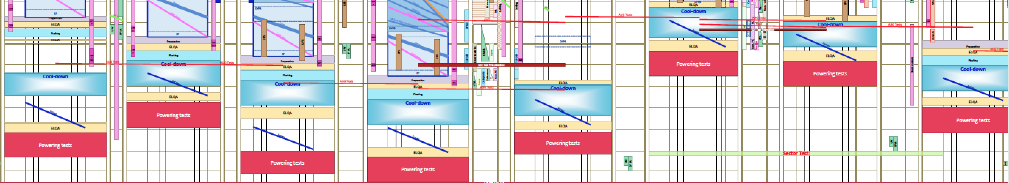
Cryogenics
Serge Claudet
APRIL 2014
DECEMBER 2014
Machinery and global cryo maintenance plan have periodicity of maximum 40,000 hrs (5 yrs at 8'000hrs (or 11 months)) including cool-down, HWC before beams and warm-up before next LS, this would give 1 yr of technical setup and 4 yrs of physics
Experience so far shows that some equipment reliability falls before these accumulated hours, we work on that, some could accept a bit more, but not yet 50% more…
One work-around it could be an intermediate 6 months physics break, to give us time to treat most sensitive machines and allow for 1 to 2 more yrs, t.b.c

Slide 13
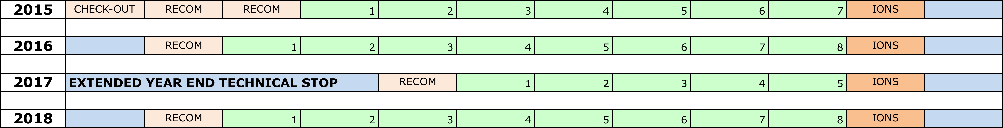
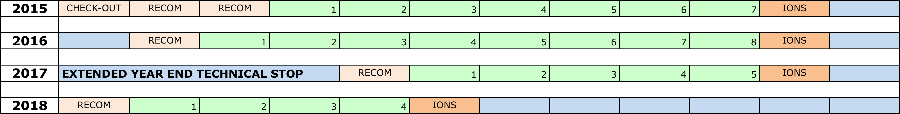
Run 2 - options
Baseline
Slipped baseline + 12
Slipped baseline + 6
Options not shown: 4 year run straight through; extending EYETS to 9 months.

Slide 14
LS2
Experiments?
Injectors?
LHC?
Re-commissioning?

Slide 15
LS2 - experiments
ALICE
  Major upgrade of ALICE detector, for installation in 2018/19
  “we assume LS2 is 18 months”
  “would not violently object if LS2 shifts to 2019” – would provide important contingency
LHCb
  Requires 18 months
  A later start of LS2 at end 2018 would be advantageous for LHCb
  Further delay of the start of LS2 beyond 2018 would be disfavoured
ATLAS
  Assumes baseline (LS2 14 months in 2018)
CMS
  LS2: 14 to 18 months
  Prefers LS starting end 2018
  “to collect sufficient data… LS2 must not start before summer 2018”
Worry about radiation levels forcing potential constraints/cool-down time etc.

Slide 16
LS2 - Injectors
Updated this morning
 |  | Approx. months
Linac4 | Linac4 connection to the PSB takes place during LS2
PSB | Total of 16 months for PSB works including 1.5 months of cool-down and 4 months of beam commissioning Cabling! Might be able to claw some time back in EYETS | 20.5 to pilot
PS | PS upgrade is determined mainly by magnet program (replacement of the PFWs) – about 1 year – plus 1 month cool-down | 13
SPS | 12 months for the 200 MHz upgrade 7 months for aC coating of main bending magnets (tbc) Injection upgrade | 17.5
Total duration of LS2 works of the injectors 20.5 months
Some co-commissioning injectors/LHC might be necessary
See Bettina for full details

Slide 17
LS2 - LHC
16 months for Cryogenics and cooling/ventilation (also LS4)
DS collimators
Vacuum – point 2
RF cryogenics
Possible HL-LHC prep. (crabs…)
Prep. for TAS aperture change?
Clear conclusion – LS2: ~18 months

Slide 18
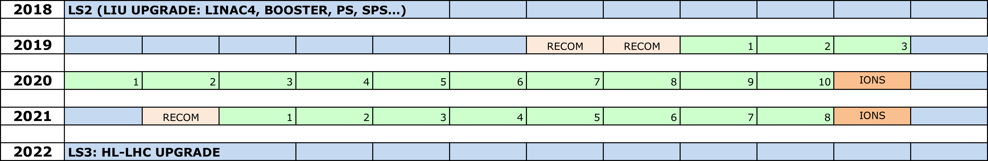
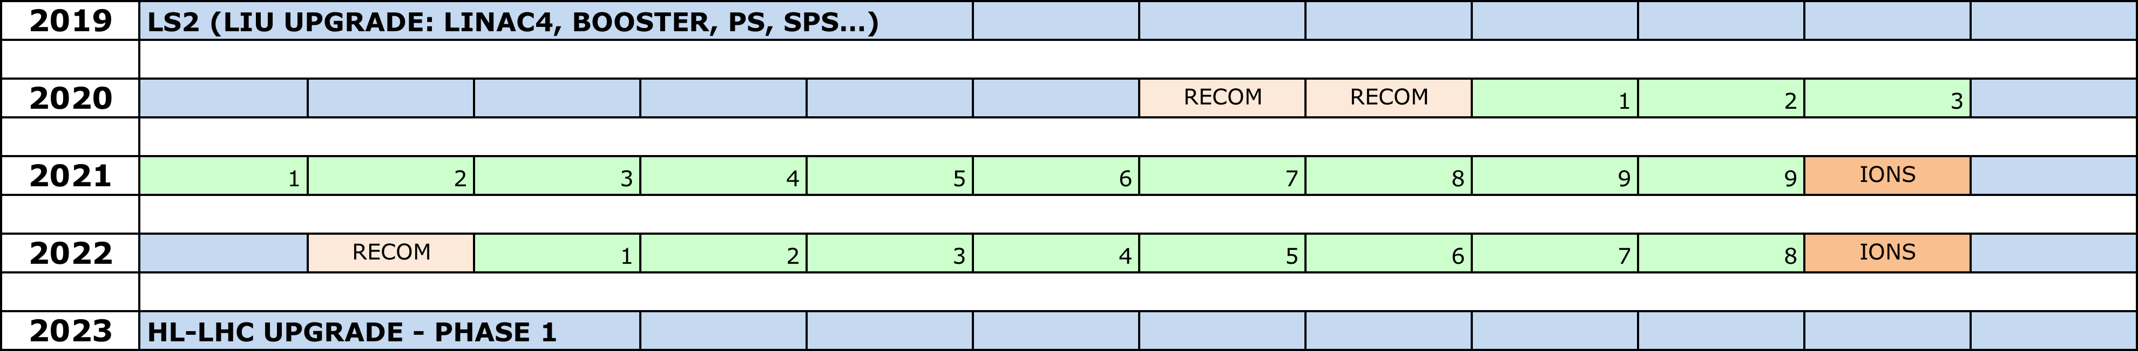
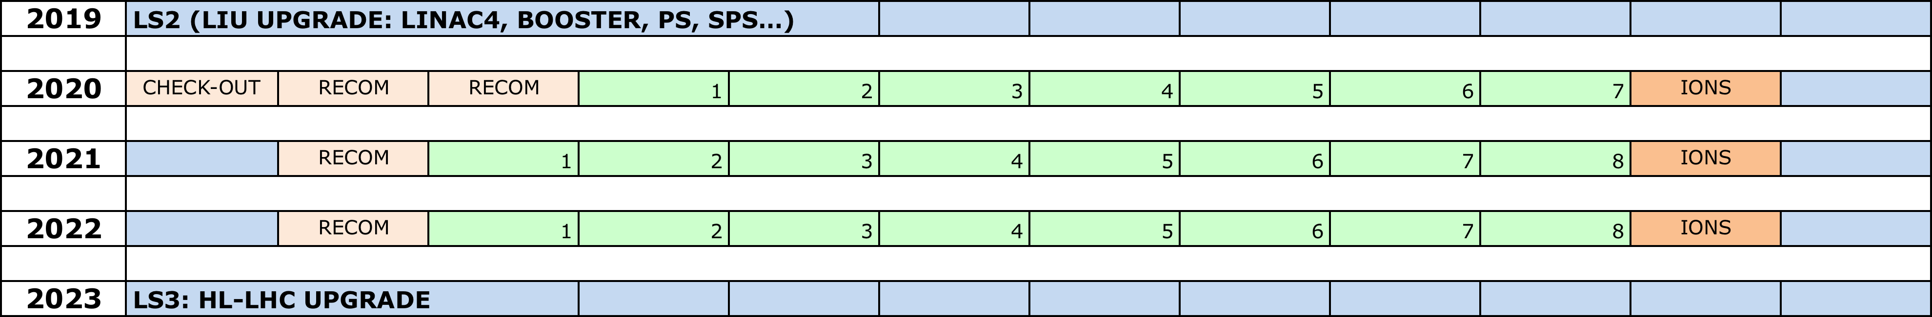
Run 3 - options
Baseline + 18 month LS2
Slipped baseline + 12
Slipped baseline + 6

Slide 19
LS3 – length
Experiments
  CMS: 30 months seems feasible
  ATLAS: 27 months (outside possibility for 35 months)
LS3 could become longer due to activation aspects, infrastructure increase and maintenance, longevity issues still to discover and… our usual packing in of whatever we can
LHC:
  20 months for cryogenics and cooling/ventilation (also LS4)
  Major upgrade of insertion regions etc. triplets, 11 T dipoles, collimators, cryogenics, crab-cavities, cold powering…
  Possible civil engineering in the tunnel (crab-cavities)
  Possible civil engineering on surface
  Major infrastructure implications
2.5 years seems a reasonable working hypothesis

Slide 20
Pushing start LS3 to 2023
Possible considerations:
  Additional time to cover R&D to production phase for detector upgrades
  Associated funding profiles
  Accelerator technology development times
Slipped baseline + 12

Slide 21
Ions
Ions are part of the HL-LHC program.
Extended periods of running are not an option.
Scheduling: longer ion run before LS3 (~2 months) plus any other low luminosity stuff such as pp reference data, high beta*, MD etc. is clearly a possibility but a second order concern at the moment.

Slide 22
Conclusions
Baseline
  No EYETS
  2018 LS2 has to go to 18 months
  LS3 starts in 2022
Slipped baseline+6
  EYETS plus run to mid-2018
  3 year run 3 – LS3 starts in 2023
Slipped baseline+12
  EYETS plus run to end 2018
  Slightly shortened run 3– LS3 starts in 2023

Slide 23
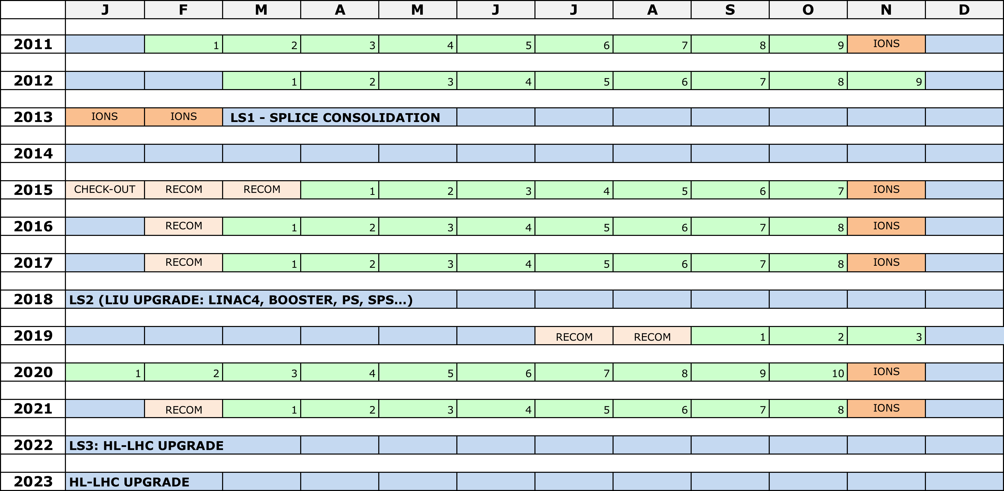
Adjusted baseline

Slide 24
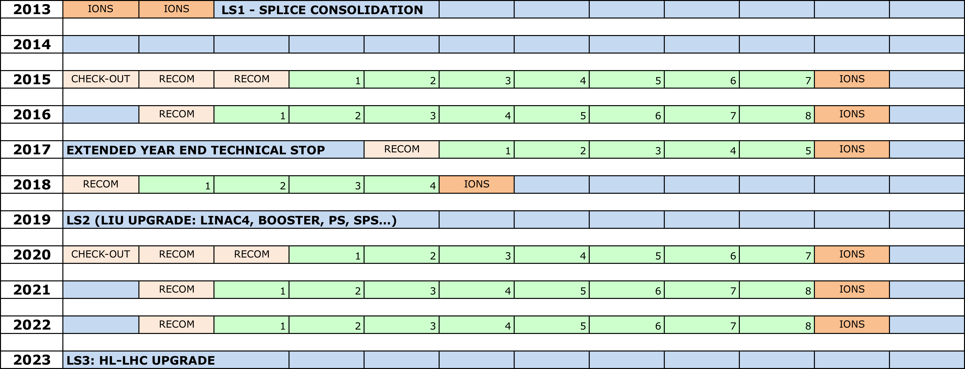
Slipped baseline+6

Slide 25
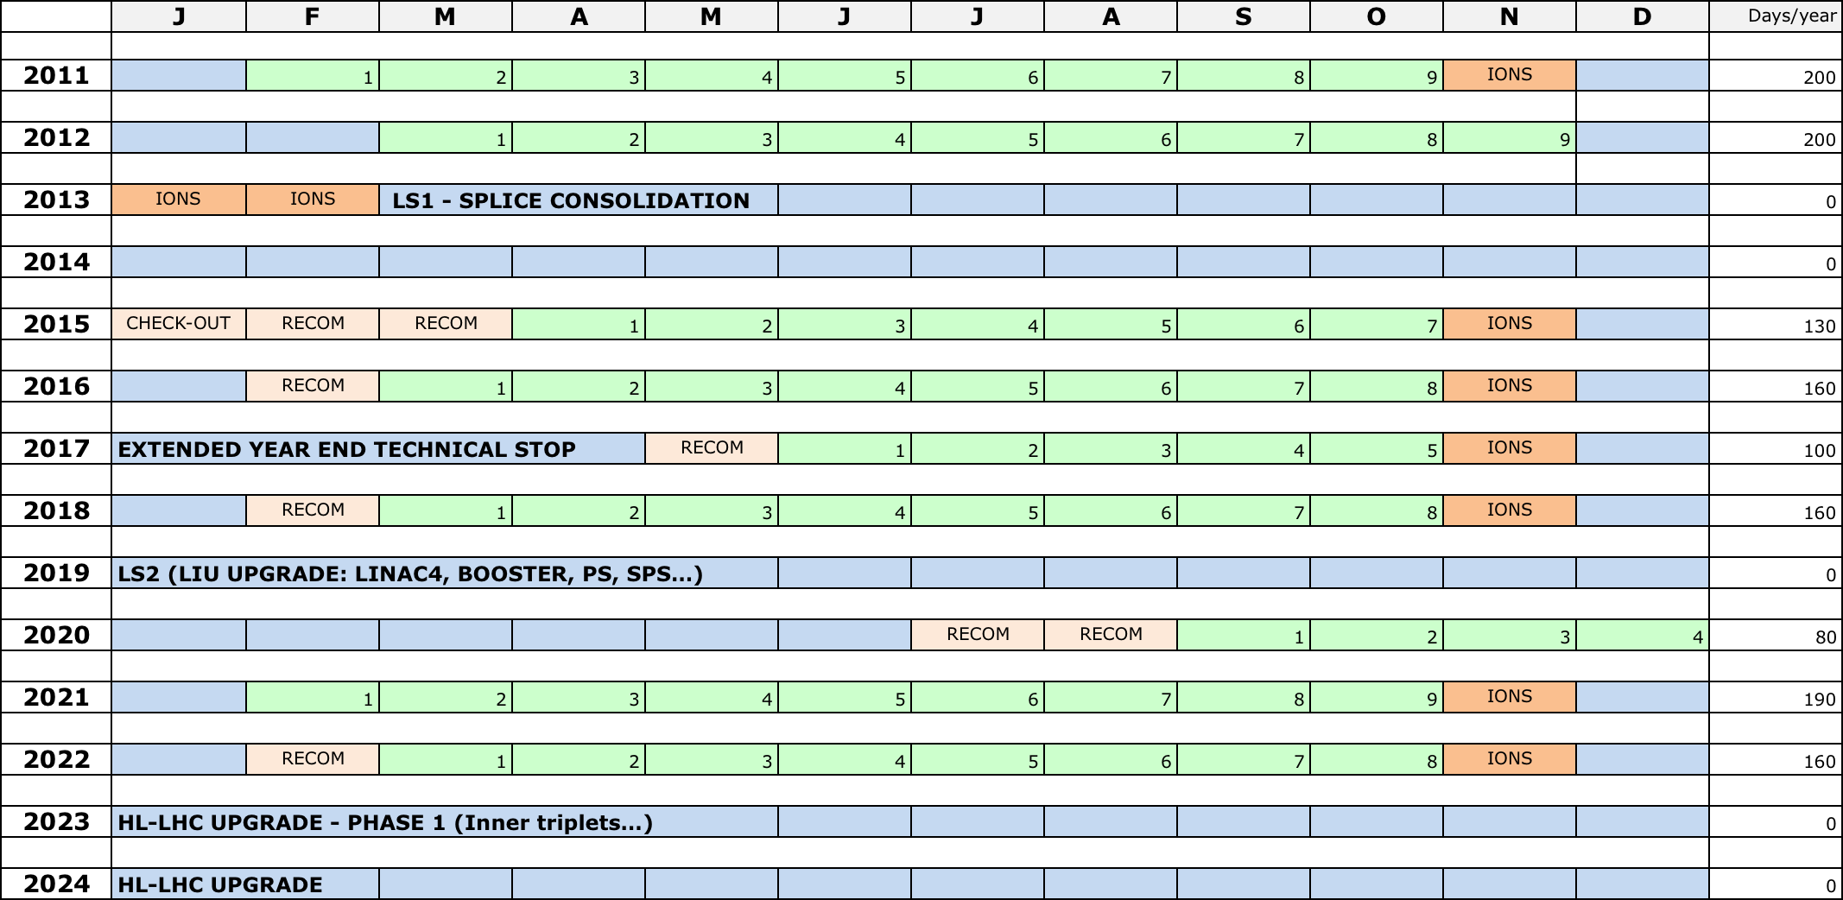
Slipped baseline+12

