Slide 1
Work Effort in the LHC Injector Complex, Including Linac4 Connection, for the Upgrade Scenarios
J-B. Lallement, B. Mikulec
Thanks for the invaluable input from the LIU project leaders and LIU work-package holders and many other colleagues
+ precious planning help from D. Hay, S. Mataguez and D. Mcfarlane
B. Mikulec

Slide 2
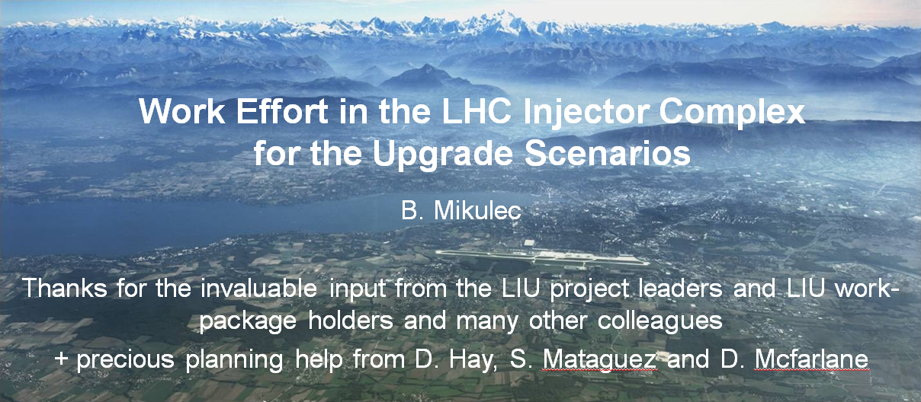
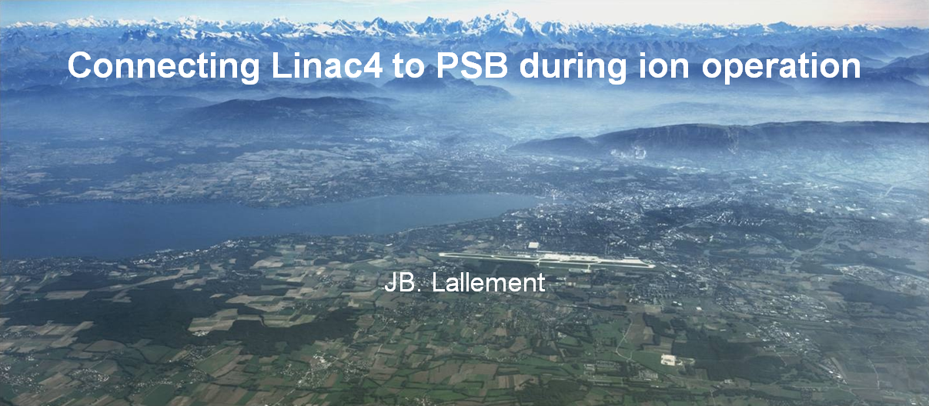
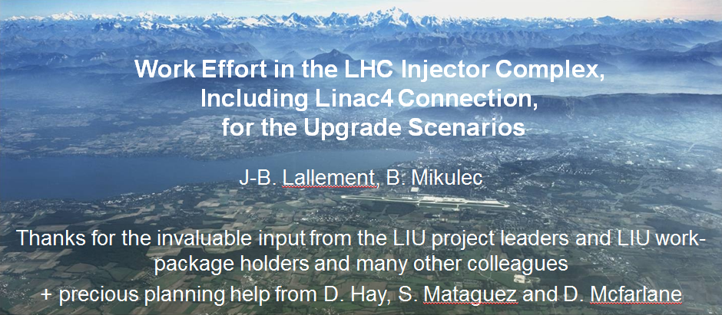
2 talks in 1
For coherency and clarity:

Slide 3
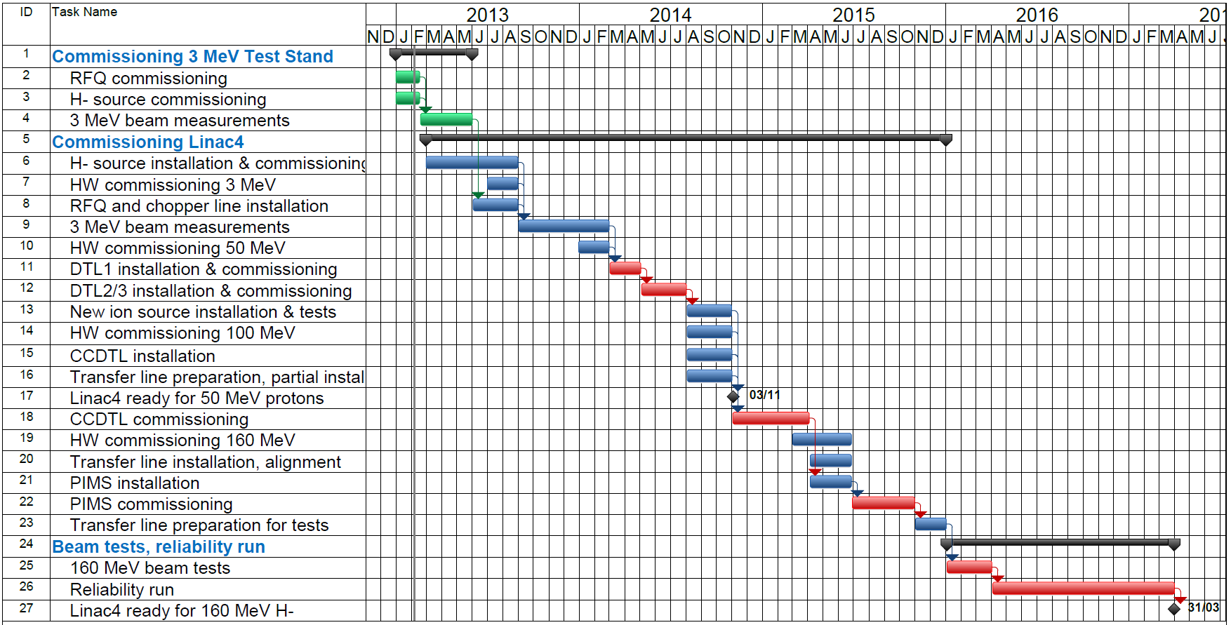
Linac4 ready for connection by end 2016
Flexibility to adapt to any connection schedule
If connection in LS2:
Risk of Linac2 breakdown – Emergency connection at 50 MeV with reduced performance.
Linac4 in standby 2-3 years after the reliability run (1 week of beam every 2 months).
Key experts will leave the project before LS2 (retirements, LDs, Fellows) .
Keep the motivation to follow a planning.
JB. Lallement – RLIUP Workshop – 31/10/2013

Slide 4
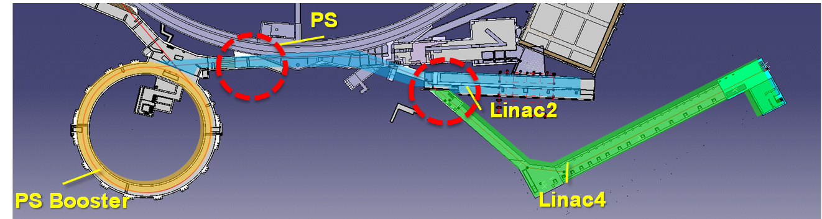



Linac4 : Working on two fronts
1. Linac2-Linac4 interface :
  Where the connection takes place
2. Measurement line(s) at PSB injection :
Upgrade needed from 50 to 160 MeV
50 MeV
160 MeV
JB. Lallement – RLIUP Workshop – 31/10/2013

Slide 5
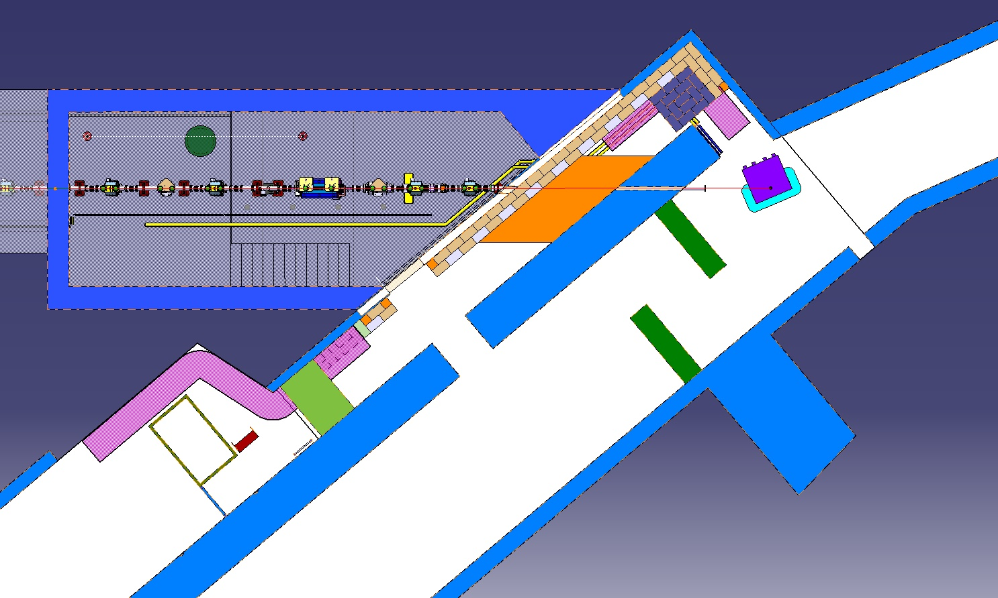
L2/L4 interface : 12 weeks
New path for DC cables.
Shielding wall.
Emergency exit.
“Chateau”.
Chicane.
12 weeks (4 weeks cool down)
Linac4
Linac2 TL
Linac2
Week | 1 | 2 | 3 | 4 | 5 | 6 | 7 | 8 | 9 | 10 | 11 | 12 | 13 | 14
Linac2/Linac4 interface
Cool down
Line removal up to BHZ.20
DC cable path
Emergency exit door
Château
Chicane
Shielding wall
Line installation
L2 tunnel access door
JB. Lallement – RLIUP Workshop – 31/10/2013

Slide 6
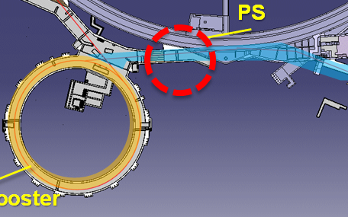
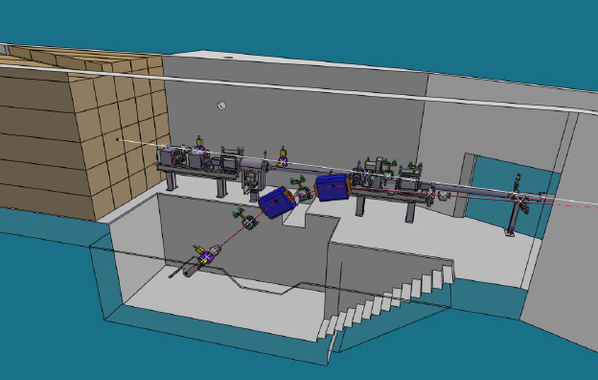
Measurement line(s) : 12 weeks
2 measurement lines : LBE and LBS.
LBE upgraded for 160 MeV.
LBS replaced by a diagnostic in the L4 TL.
Connection time and work considerably reduced:
4-5 months less, 1 M CHF saved, better resolution.
Decoupling L4 planning from PSB and PS.
Can be kept for ions (or similar solution in L3).
12 weeks (6 weeks cool down)
Week | 1 | 2 | 3 | 4 | 5 | 6 | 7 | 8 | 9 | 10 | 11 | 12 | 13 | 14
LBE line
Cool down
Removal of L2 LBE
Installation of L4 LBE
Cabling
JB. Lallement – RLIUP Workshop – 31/10/2013

Slide 7
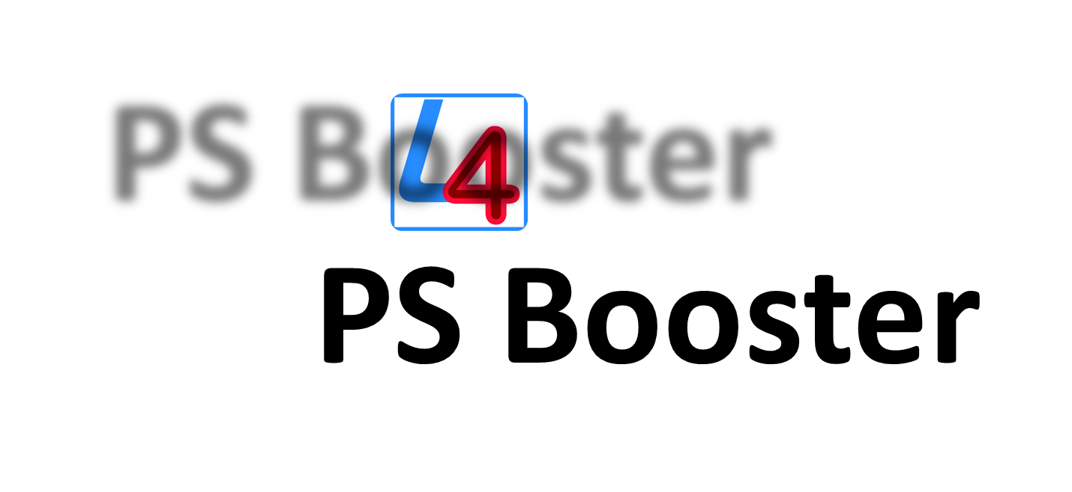
Linac4 : 15 weeks to deliver a beam to the PSB
Week | 1 | 2 | 3 | 4 | 5 | 6 | 7 | 8 | 9 | 10 | 11 | 12 | 13 | 14 | 15 | 16 | 17 | 18 | 19 | 20
Linac2/Linac4 interface
Cool down
Line removal up to BHZ.20
DC cable path
Emergency exit door
Château
Chicane
Shielding wall
Line installation
L2 tunnel access door
LBE line
Cool down
Removal of L2 LBE
Installation of L4 LBE
Cabling
Beam commissioning
3 weeks of beam commissioning : Produce different types of beam and full characterization (transverse and longitudinal parameters).
Commissioning will be extended until validation from PSB.
Linac4 is in the shadow of PSB.
JB. Lallement – RLIUP Workshop – 31/10/2013

Slide 8
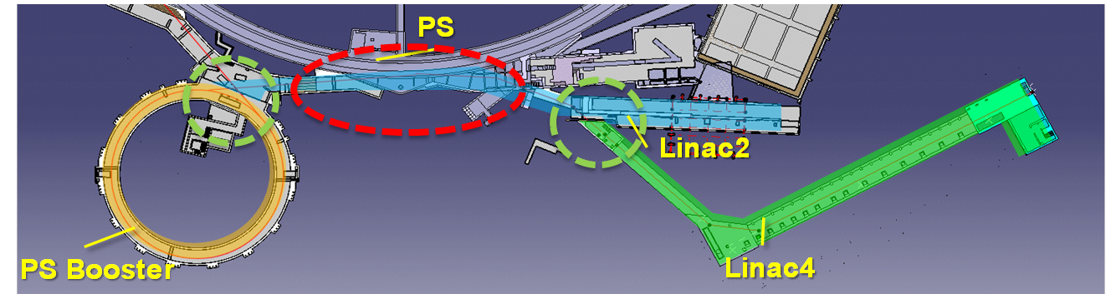
No ions in the PS during cabling and LBE work
While ions in the PS, possible work at L4/L2 interface and PSB.
Beam stopper in the BI line for ions in PS.
Magnet consignation (LT.BHZ30).
Time required for Linac4 with no beam in the PS : 6 weeks (after 6 weeks of cool down).
JB. Lallement – RLIUP Workshop – 31/10/2013

Slide 9
Outline
Linac4 connection to the PSB – an option in case of an intermediate shutdown?
PSB LS2 planning estimate
PS LS2 planning estimate
SPS LS2 planning estimate
Summary

Slide 10
Linac4 Connection to the PSB in an Intermediate Shutdown
Linac4 reliability run will be concluded end 2016
PSB equipment for Linac4 connection ready end 2016
Current baseline: Linac4 to be connected during LS2 (2018?), but:
  Risk of Linac2 breakdown increases → emergency connection of Linac4 (50 MeV protons), but risk stop of ~2 months and reduced performance for many physics beams and spoil Linac4 commissioning
  Linac4 would be in standby during 2-3 years
    Difficult to maintain motivation for current commissioning progress
    Maintenance cost
    Several experts will leave project; problem with recommissioning?
  Linac4 connection to PSB, 2 GeV PSB upgrade and upgrades of all other machines would be in parallel
    Considerable risk in terms of post-LS2 beam quality/reliability
    LS2 duration determined by work in the PSB (see next slides)

Slide 11
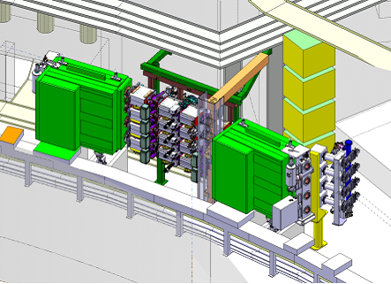
Injection line

Slide 12
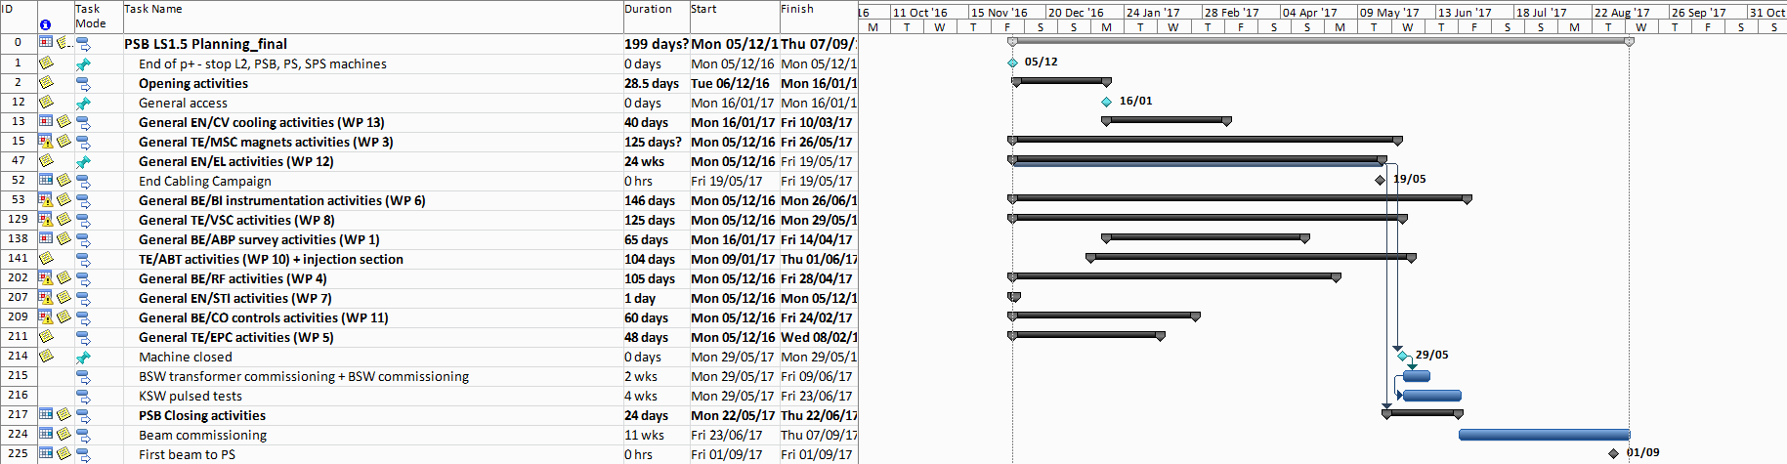
PSB Planning Overview for L4 connection to PSB
Consider purely Linac4 connection to PSB; >200 activities
Main activities:
Cabling campaign (5 months), magnet exchange (BI line), vertical beam distribution, injection kickers (horizontal painting), injection section (injection chicane + charge-exchange foil), beam instrumentation etc.
KSW HV conditioning (1 month) after machine closure in parallel with HW testing and cold checkout.
Complex beam commissioning (~2 months)
Detailed planning worked out for installation of injection section to be confident on time estimate (4 months).
Cabling
(3 shifts/day)
Hardware installation

Slide 13
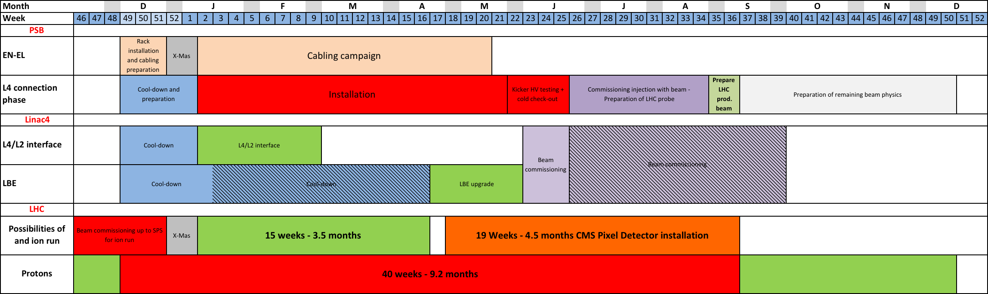
Summary L4 Connection to PSB
LHCPROBE
injected into PS
LHC production beam
injected into PS
LHC production beam
injected into LHC
LHCPILOT
injected into LHC
Duration for the Linac4 connection to the PSB: 9.2 months
  Deliverable: LHC production beam injected into PS; coincides with injection of LHCPILOT beam into the LHC
  Other physics beams to follow at an estimated rate of ~2/week
First beam to the PS after 9 months
Ion run and CMS pixel detector installation in parallel?
  Ion beam commissioning in LHC ion injector chain end of 2016 in parallel to p run
  LHC ion run of up to 3.5 month after X-mas
  CMS pixel detector installation: 4.5 months
  Could other activities profit? (NA61/SHINE etc.)
Notes:
Maybe move LHCPILOT injection into LHC 1 week later (+shift LHC production beam into LHC) → tbc by Karel!

Slide 14
LS2

Slide 15
Boundary Conditions for LS2 Planning
Studied: PSB, PS and SPS
Considered:
  All tunnel activities
  Mainly LIU activities, but also include
    Usual machine opening/closing activities
    Estimated radiation cool-down times
    Estimated cabling campaign durations and
    Consolidation items that could affect the overall LS duration.
  Surface activities only included if they affect LS duration
  Estimates for beam commissioning times

Slide 16
Main PSB LS2 Activities
Modification for H⁻ injection at 160 MeV (if not done during an intermediate shutdown):
  Renovation of PSB injection line, new vertical beam distribution system at injection, complex new injection section with charge-exchange stripping foil, related beam instrumentation, injection and painting chicanes, internal dumps, new vacuum sectorisation etc. (see Linac4 connection to PSB)
New MPS
Renovation of cooling and ventilation systems
RF upgrade
New or improved beam instrumentation
Modifications to main magnet cooling circuits + shimming; replacement of several additional magnets
New extraction kicker, new recombination kicker and septa
Impressive cabling campaign!

Slide 17
PSB LS2 Planning
Close PSB
1m
8.5m
2m
MPS testing
MPS testing
2w +
MPS Testing (new MPS building)
7m
5m
3m
Renovation of PSB cooling system
Run in new RF system
Beam commissioning
3m waiting
for cabling
…
5m
5.5m
Dismantling and installation in parallel
Equipment tests and HV DC conditioning BE.KFA14L1
9m
Start connecting and
testing equipment
Cabling campaign
After 2.5m LHCPROBE
beam to PS
12m
Ventilation consolidation
(work in tunnel possible, but partly no redundancy)
First 1.5 months: radiation cool-down (2w for standard works at end of run + 1m MPS testing)
Cooling system renovation: start dismantling transfer line cooling stations; 7 months very tight for complete renovation → study underway to construct new station in parallel to existing one in new MPS building
Min. cabling campaign duration: 9 months! (3 shifts/day)
First beam to PS after 17.5 months
→ Delivery of LHC production beam to PS: after 18 months

Slide 18
PS LS2 Planning

Slide 19
PS LS2 Planning Summary
Radiation cool-down: 1 month
General access: after 2 months
Assumed duration of cabling campaign: 8 months (detailed cabling study still to be done)
Many LIU-related activities already carried out during LS1
Magnets: new vertical correctors and normal/skew quadrupoles (2 GeV) – 5 months; replace PFW – 1 year (consolidation)
New injection kicker, bumper, septum – 4 months
RF: 10 MHz upgrade etc.; duration defined by general maintenance
BI: not time-critical (BWS, BLMs, injection SEM grid, IPM?)
Vacuum, electrical services, …
Close PS: after 13 months
4 weeks of hardware test and 2 weeks of cold check-out
Ready for beam from PSB: after 14.5 months
Notes:
Magnets: Storage place in lab is limiting factor (max 4. magnets/month)
RF: 10 MHz system renovation; upgrade of feedback amplifiers; fully digital beam control
Do we have to change a large fraction of vacuum flanges (insulation problem)?

Slide 20
SPS LS2 Planning
Start of shutdown works: <2 months
Restart: ~3 months
BI activities (BGI, BSRT, IMM,
head-/tail m., BLM, MOPOS,
wire scanners)
200 MHz RF: ~12.5 months
EN-STI (new external dump etc.)
TE-ABT (fast rise-time kicker for
ions etc.)
TE-EPC (MSE-septa power supply)
Replacement of faulty magnets
aC-coating of 6 sectors:
12 months
Cabling campaigns: estimated
10 months
CV maintenance

Slide 21
SPS: RF 200 MHz Upgrade - Schedule
Work cannot be split and has to be done in one go…

Slide 22
SPS: RF 200 MHz – LS2 Details
New building to be finished with all services by end 2015
New amplifiers installation to start in new building beginning 2016
First six months of LS2 for cavity rearrangement in LSS3
    Cabling
    Cooling system
    Removal of all 18 existing cavity sections
    Displacement/install new cavity supports
    Displacement/installation new pickups
    Re-install 18 existing cavity sections
    Installation 2 new cavity sections
    Installation 6 new coupler covers
    Installation 6 new main power couplers
    Vacuum connections and tests
    Alignment
  Details of LSS3 interventions and schedule to be worked out
  Availability of key services (cabling, CV, VSC) to be verified
Second six months of LS2 for system commissioning and tests
Notes:
2E11/bunch for 25 ns

Slide 23
SPS: aC Coating
Technology now developed for treating chambers in magnets
Needs to be done in special workshop of 700 m² surface (not feasible in tunnel; preferably to be done in BHA5)
Tested for MBB and MBA chambers, and pumping ports
4 SPS half-cells now equipped
Estimated flow: 6 magnets in / 6 magnets out per day
Scope of deployment: carbon thin film coating of min. 90% of the SPS
  MBB+MBA (~5 km; >700 dipoles), QF+QD, LSS and maybe SSS (10%)
  Including pumping port shields
Notes:
BHA5: belongs to ATLAS
Need 700 m^2 workshop on surface; only option for magnet removal would be BA6 due to crane + good lift (+road transport), but no workshop available

Slide 24
SPS LS2 Planning Summary
Remark: US1 + US2 involve identical hardware modifications! (e⁻-cloud mitigation already included in US1 changes)
General access: after 2 months
Critical interventions:
  200 MHz upgrade: 12.5 months; cannot be split
  aC coating: 12 months
  Cabling campaigns? – need study
End of LS2 installations: after 14.5 months
Patrols, DSO tests (1.5 weeks)
6 weeks for magnet + EPC tests
4 weeks cold checkout → ready to receive beam from the PS after 16.5 months
1.5 months for beam commissioning (new SPS RF beam control!)

Slide 25
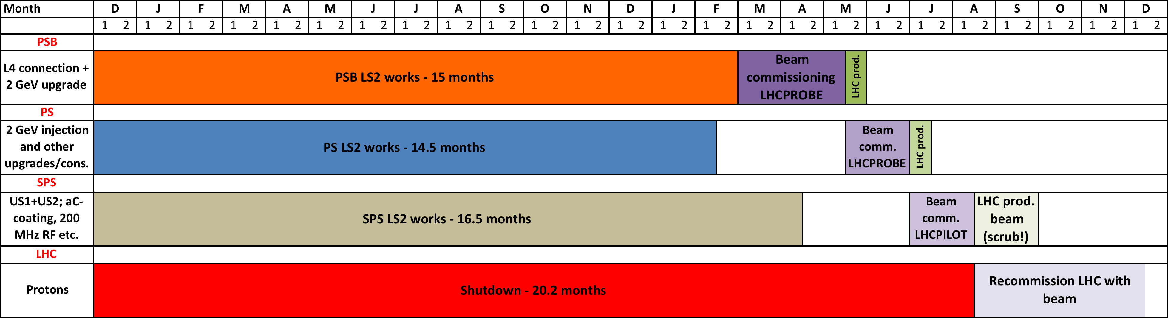
Summary Overall LS2 Planning
LS2 (upgrade scenarios 1 and 2 equivalent for injectors):
Limited by PSB activities (cabling)
PSB first beam (LHCPROBE) to the PS: after 17.5 months
PS ready for beam from PSB already after 14.5 months
  Beam commissioning to be added: 5 weeks*
SPS ready for beam from PS: after 16.5 months
  Beam commissioning to be added: 1.5 months
First injection of LHCPILOT into the LHC: after ~20.5 months
Depending on e⁻-cloud situation in SPS, min. time for injection of LHC production beam into the LHC: after ~22 months (scrubbing!)
* Assume restarting with old beam control and have a switch-over possibility old/new beam control.
Notes:
PS beam commissioning: assuming restarting with old beam control and switch-over possibility old/new beam control implemented; 2w (OP) + 3w (RF)
PS beam commissioning: add 2 weeks (LS1.5 or LS2) for setup of LHC production beam
SPS beam commissioning: add min 6 weeks for LHC production beam (scrubbing? e-cloud situation?)
LHC from 1st injection to 1st collision (Verena; in case of no major changes!): 4-6 weeks

Slide 26
A Few Words on Risk Management
Minimise upgrade risks (mainly in terms of duration) through
  Advance certain interventions if possible during short stops (not a lot to gain…)
  Mechanical mock-ups
  Test stands/beam tests where applicable (half-sector test in L4T)
  Integration studies (include CV and EL equipment!)
  Detailed planning of each modification including co-activity and personnel resources
  Early preparation of new applications/controls
  Detailed beam commissioning planning for restart.

Slide 27
Concluding Remarks
Gaining 3 months in the PSB works would be necessary to align the LS2 injector schedules.
  Detailed study of cabling and rack situation in all machines required.
Investing an additional 3.5 months proton physics to connect Linac4 to the PSB during an intermediate shutdown (together with CMS pixel detector exchange and other potential consolidation/upgrade activities) would save 3 months in LS2, reduce the risk of coactivity during LS2 and of a very difficult beam recommissioning.
  Would finally result in 0.5 additional months overall – useful time for ion community?

Slide 28
THANKS FOR YOUR ATTENTION!

Slide 29
Backup Slides

Slide 30
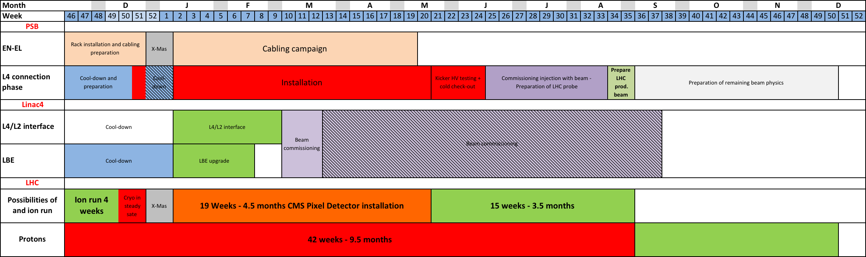
Alternative Option for L4 Connection to PSB
Remark: This option is not preferred (great difficulties in commissioning of ion injector chain with ions after shutdown)!

Slide 31
Cabling implementation and resources for LIU project during LS1.5 and LS2
D. Ricci, JC. Guillaume on behalf of EN-EL-CF

Slide 32
Working scenarios
Scenario I
LS1 | LS1.5 | LS2
LIU Top priorities (PSB, PS, SPS) Identification cables PSB | Transfert line PSB-LINAC4/LINAC2 clean-up PSB Installation PSB & LINACs | PSB upgrade PS upgrade SPS upgrade + clean-up campaigns
 | Identification cables PS, SPS,LINAC2
Scenario II
LS1 | LS1.5 | LS2
LIU Top priorities (PSB, PS, SPS) Identification cables PSB |  | Transfert line PSB-LINAC4/LINAC2 PSB upgrade PS upgrade SPS upgrade + clean-up campaigns
 | Identification cables PS, SPS,LINAC2 (T. Stops)

Slide 33
Machine layout
Equipments in PSB injection tunnel are powered/controlled from LINAC2, LINAC4 and Booster locations.

Slide 34
Scenario I: LINAC4/LINAC2
LINAC4/LINAC2 cabling requests | LS1.5 (Transfert line PSB-LIN4/LIN2) | LS2
Installation de 100 câbles | 23 câbles | 77 câbles
Enlèvement de env. 300 câbles | 0 câbles | Env. 300 câbles
LS1.5: Les convertisseurs existants sont laissés en place (BHZ20, 30 et 40). Seuls un tirage de nouveaux câbles est nécessaire pour les équipements de la ligne LBE: Quad, Steerers, SEM grids, BCT, Beam dump et Wire scanner.
LS2: Les convertisseurs (BHZ20, 30 et 40)seront remis en place définitive au bat 363; remise à jour du câblage des lignes BI, LBE, LT et LTE.
En LS2, l’installation des nouveaux convertisseurs va nécessiter le nettoyage d’anciens câbles situés dans les faux-plancher du bat. 363.

Slide 35
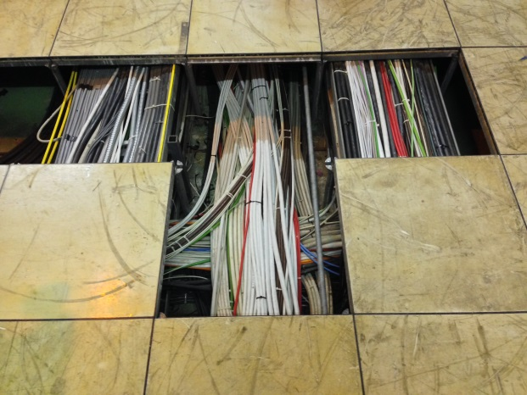
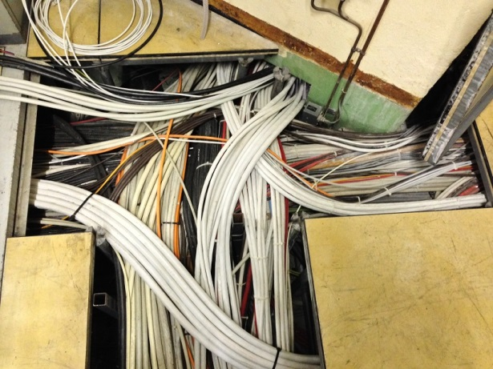
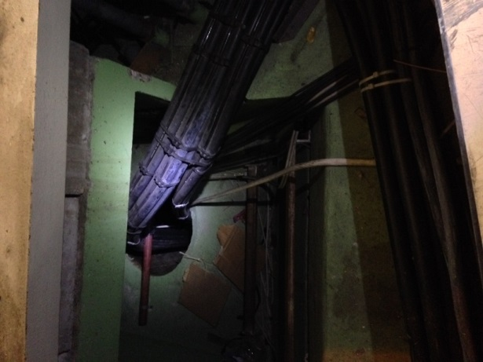
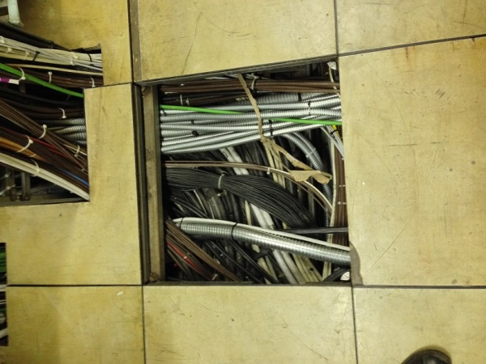
Scenario I: LIU Booster
LIU-PSB cabling requests | LS1.5 (Transfert line PSB-LIN4/LIN2) | LS2 (PSB upgrade)
Installation de 1785 câbles | 954 câbles | 831câbles
Enlèvement de 1210 câbles | 510 câbles | 700 câbles
Ce qui représente une section supplémentaire de:
  2 echelles CTRL et 1.5 échelles Power (LS1.5)
  0.5 échelles CTRL et 1 échelle Power (LS2)
BCER vers galerie surface
Cheminée BCER vers machine
Entrée puits Booster depuis BCER
Le retrait prévu par LIU des câbles obsolètes ne suffit pas pour LS1.5, il faut prévoir une campagne de retrait plus conséquente.
Sortie BOR vers BCER

Slide 36
LIU Booster project flow
User A
User B
User C
- - -
User A
User B
User C
- - -
Situation actuelle
Etudes des systèmes,
demandes de câbles
et de racks
Demandes peu précises (tenants, aboutissants, type de câbles)
Passages actuels bouchés pas pris en compte dans les demandes.
Repérage des
câbles obsolètes
EN-CV
Coordination projet
Design
Intégration
Nouvelles installations à
prendre en compte.
GS-SE
EN-EL
- - -
Etudes câblage EN-EL-CF
Need actions from:
  Machine project technical coordination
  Planning coordination
Enlèvement des câbles obsolètes
Coordination planning
Installation infrastructures
(racks et échelles à câbles)
Installation des câbles LIU
(par campagnes géographiques)

Slide 37
Scenario I : PSB Cabling campaigns
Zones géographiques | Câbles enlevés | Câbles ajoutés | Temps estimé | Câbles enlevés | Câbles ajoutés | Temps estimé
 | LS1.5 (km) | LS1.5 (km) | LS1.5 (3shifts) | LS2 (km) | LS2 (km) | LS2 (3shifts)
Travaux mécaniques dans le PSB et S. de Ctrl |  |  | 2 semaines |  |  | 2 semaines
(inst. racks, cheminements)
Zone 1: S. de Ctrl vers Booster Ring | 22 | 28 | 8 semaines | 45 | 50 | 15 semaines
Zone 2 : S. de Ctrl vers ligne BI et Cellules 1 et 16 | 40 | 30 | 11 semaines | 2 | 2 | 1 semaines
Zone 3: S. de Ctrl vers Lignes BT, BTP, BTM | 2.5 | 3 | 1 semaines | 2.5 | 3.5 | 1 semaines
Total Zones 1, 2, et 3 | 67.5 | 62 | 22 semaines | 49.5 | 55.5 | 19 semaines
 |  |  | (12.3 semaines dépose) |  |  | (9 semaines dépose)
Travaux mécaniques dans le LI2. |  |  | 2 semaines
(inst. racks, cheminements)
Zone 4: Linac4 vers LT Linac 2 | 1 | 3 | 1 semaine | 10 | 10 | 3 semaines
(Travaux zone 4: Dans l'ombre des zones 1, 2 et 3.)
Moyenne: 2.2 km/sem/shift. Hyposthèse: 1 min / m (pose et dépose)
Cette hypothèse doit être vérifiée avec des informations plus précises
Budget: Env 4 MCHF LS1.5 & LS2
Team work in // in the three zones not possible due to limited area and access constraints

Slide 38
Scenario II (LS2)
Combination of Scenario I (LS1.5) and Scenario I (LS2)
  Transfer line PSB-LINAC4/LINAC2
  PSB, PS, SPS upgrade
  + all related clean-up campaigns
Previsional machine planning:
LS2 for injectors: DEC 2017 – JUN 2019 (???)

Slide 39
Resources pour LIU
LIU doit mettre en place une personne qui s’occupe de la coordination technique du projet pour prendre en charge:
1) Mise à jour de l’intégration de tous les services existants et futurs,
2) Identification des câbles obsolètes par les utilisateurs,
3) Prise en compte des contraintes techniques de la zone,
4) Interface avec les utilisateurs.
EN-EL-CF: resources to be foreseen for projet LIU (PSB, PS, SPS).
1 à 2 Chargés de projet (ingénieur électricité) dès le mois de novembre 2013 à fin LS2 selon graphique.
1 à 2 Techniciens pour le suivi du repérage des câbles obsolètes et préparation campagne de décâblage
  à partir de Janvier 2014 selon graphique.
Au moment de l’installation: 1 surveillant de chantier par shift (FSU)
Given the project complexity, it is advisable to keep the
already trained resources in CF (engineers and technicians)
which are otherwise foreseen to leave by the end of LS1
+ contractor resources: 48 people for PSB only during LS1.5
(8 people/shift + 2x turnover due to reached dose limit)
Corresponding to 50% of the total deployed for LS1 (all machines)
EN-EL-CD: Intégration 3D pour mise à jour:
1) Des échelles à câbles – existantes et nouvelles,
2) Racks – existants et nouveaux,
3) Plans d’exécution.
EN-EL: Mise ne place d’un ou plusieurs contrats d’exécution pour être opérationnel pour le LS1.5 et LS2
et être capable de travailler en 3 shifts sur une très ongue période.
LS 1.5
LS 2
Nbre personnes
(PSB, PS et SPS)

Slide 40
Option: Recâblage complet du Booster
Nombre de câbles signaux installés (selon câblo EN-EL) : 13800
Longueur totale estimée: 600 km
Durée estimée pour le retrait total des câbles signaux: 14 semaines en 3 shifts
(2 campagnes en //)
Travaux mécaniques (réfection des échelles à câbles) 4 semaines en 3 shifts
En admettant que 75% des câbles soient ré-installés, (= 450km),
la durée estimée pour la ré-installation des câbles est de (connectique comprise) 50 semaines en 3 shifts
Total du recâblage: 68 semaines en 3 shifts
(17 mois)
Hypothèse Option: Dépose: 15 s/m
Pose: 30 s/m
Hypothèse Scénario 1 (PSB seulement) Pose & Dépose: 1 min/m soit 21.3 semaines pour la dépose sur un total de 41 (L1.5 + LS2).
Budget préliminaire: 11 MCHF
Cette hypothèse doit être vérifiée avec des informations plus précises - l’identification par les utilisateurs des câbles inutilisés.
40
LIU cabling feasibility LS1.5
15/10/13

