Slide 1


RLIUP – Session 2
Post LS1 scenarios without and with LINAC4
Gianluigi Arduini, Steven Hancock
Acknowledgements: L. Bottura, K. Foraz, G. Rumolo, J. Wenninger

Slide 2
Session 2
Performance of the injectors and LHC peak and integrated luminosity if no major upgrade except the connection of LINAC4 and H- injection (G. Rumolo and J. Wenninger)
Expected shut-down schedule (assuming only “winter stops” for regular maintenance) taking into account the lifetime of major accelerator components (K. Foraz and L. Bottura)

Slide 3
2012 injector performance (@SPS ext.)
G. Rumolo
Up to 3 x Nominal Brightness!!!
At the presently known space charge limit of PSB/PS at 1.4 GeV
25 ns
Trains of 72 bunches to SPS
Used for the LHC scrubbing run in 2012
Trains of 48 bunches to SPS
Used for the LHC pilot physics run in 2012
Measurement points
Emittances deduced from combined wire-scans at end of SPS flat bottom (values cross-checked with LHC)
Error bars include spread from several measurements as well as systematic uncertainty (10%)
Intensity measured at SPS flat top after scraping

Slide 4
Expected Injector performance after LS1
G. Rumolo
25 ns beam (both standard production and BCMS) already very close to the limits in injectors
Higher intensity (SPS RF power limit)
  max 1.3 x 10¹¹ ppb
Higher brightness (PS space charge)
  RF manipulations in the PS @2.5 GeV (instead of 1.4 GeV)
  PSB control of longitudinal parameters along the cycle

Slide 5
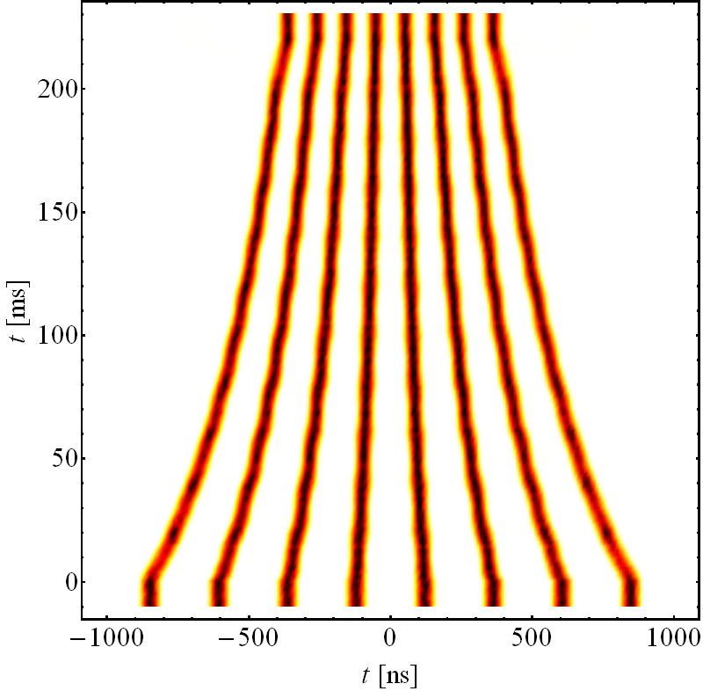
Expected Injector performance after LS1
G. Rumolo
Alternative production scheme for 25 ns beams
Pure batch compression at 2.5 GeV (from h=9 to h=21)
Twice double splitting at FT
Trains of 32 bunches to the SPS
  promise to produce ultra-bright 25 ns beams for the post-LS1 era with short trains (favorable against electron cloud), at the price of 13% lower number of bunches in LHC
Pure
h = 21
2.5 GeV
Pure h = 9

Slide 6
Expected Injector performance after LS1
G. Rumolo
Small emittances are more difficult to handle in the LHC: IBS, additive sources of blow-up, beam stability

Slide 7
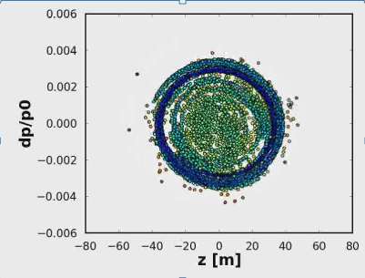
Expected Injector performance after LS1
G. Rumolo
Only Linac4
  Standard 25 ns beams: 50% higher brightness (limited by PS space charge) but intensity limited by the SPS
  BCMS beams: no improvement with Linac4 (space charge in PS)
  Possible additional gains by creating hollow bunches or using alternative optics in the PS at injection → need lots of MD time and full experimental validation!

Slide 8
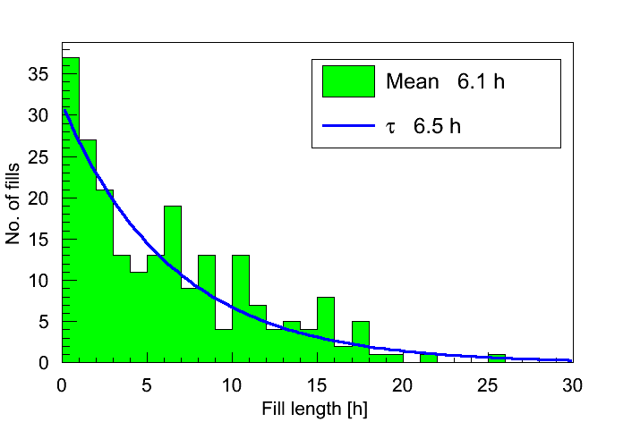
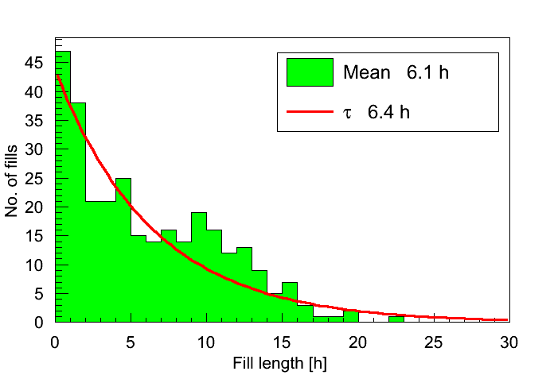
LHC performance estimate post-LS1
J. Wenninger
Fill lengths in 2011 and 2012 ≈ exponentials.
  ~30% of the fills are dumped by OP.
2011
2012
An exponential fill length distribution is used for the performance figures quoted in the next slides.

Slide 9
LHC performance estimate post-LS1
J. Wenninger
The expected integrated luminosity per year for 25 ns is in the range of 45-55 fb⁻¹ for a 2012-like efficiency.
    For 5 ½ years of operation until LS3 → 250-300 fb⁻¹.
    Unknowns on limitations, emittance, efficiency – 10% level effects – situation will be clearer end 2015.
    Peak luminosity close to / above expected triplet limitation (~1.75 ×10³⁴ cm⁻²s⁻¹ ±10-20%) !!!!
    Pile-up limit in the experiments assumed to be ~45 events/crossing
With L4 the standard 25 ns beams and the BCMS beams have very similar performance.
  Bonus for standard 25 ns: lower pile-up (~10%).
  The emittances that are eventually achieved may make the difference – easier for standard (larger ε) ?

Slide 10
LHC performance estimate post-LS1
J. Wenninger
The intensity/brightness may be limited by instabilities.
  E-cloud
  Instabilities
  heating
  UFOs.
Enhance scrubbing at 450 GeV to remove e-cloud in the dipoles “completely” with dedicated scrubbing beam is essential
  Use doublet beam : 5 – 20 ns or 2.5 – 22.5 ns spacing
  Implications and issues (BI, RF, ADT) under investigation.
  Important to test and push bunch population for doublet scheme (20+5 ns) in 2014 to allow faster scrubbing in the SPS and LHC (essential for 25 ns!!!)
5 or 2.5 ns
25ns
25ns
25ns

Slide 11
Shutdown schedule until 2035
K. Foraz
Technical Stops:
  In order to perform preventive and corrective maintenance
  Min. length = 5 days every 10 weeks
  End of Year Technical Stops:
Assuming ion operation in LHC with no protons in the Injectors at the end of each year (cool-down time)
Min. length: 10 weeks (incl. Xmas holidays)
Technical Stops
Operation
EyTS

Slide 12
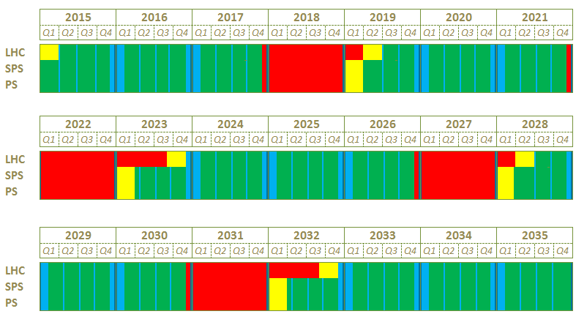
Shutdown schedule until 2035
K. Foraz
Scenario 1
from 2015 to 2035: beam = 57%
% of time
LS2
LS3
LS4
LS5

Slide 13
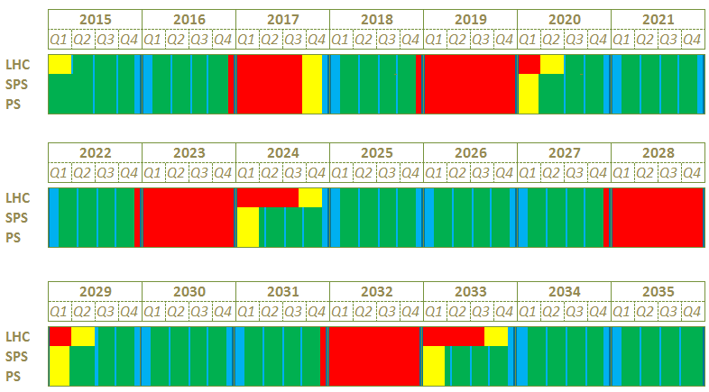
Shutdown schedule until 2035
K. Foraz
Scenario 2
from 2015 to 2035: beam = 54 % of time
LS1.5
LS2
LS3
LS4
LS5

Slide 14
Shutdown schedule until 2035
K. Foraz
Minimum shutdown lengths have been given
  Leading to beam operation ~3/5th of the time from 2015 to 2035
  LS2: LHC 16 months (CV and Cryo), Injectors 12 months (CV and access)
  LS3: LHC 20 months (triplets) , Injectors 12 months (CV)
  LS4: LHC 16 months (CV+Cryo), Injectors 12 months (CV)
  LS5: LHC 20 months (triplets), Injectors 12 months (CV)
  Significantly long stops are required even with no upgrades!
Preference for scenario with LS1.5 (see Session 3 – B. Mikulec)
  Mitigate risk of Linac2 failure
  Linac4 is not left idle
  Reduce LS2 workload (mainly in Injectors) EL, GS, CV….
  Reduced physics potential ( ~ 4 %) can be recuperated with one year of additional running in 2036

Slide 15
What could stop us?
Potential causes of mechanical failures of SC magnets
  Mechanical fatigue on coil, structure, busses:
    Powering cycles: 10⁴ per magnet
    Thermal cycles: a few for the LHC
  Singular events and associated thermal and electrical stress:
    Quenches: order of 10 per magnet
    Heater discharges (triggers): order of 10 per magnet
  Radiation and associated degradation of mechanical and electrical strength:
    Magnet in the triplet region (Point 1 and Point 5)
    Magnets in the collimators region (Point 7)
L. Bottura

Slide 16
What could stop us?
L. Bottura
Electromechanical failures:
  An MTBF of 400…500 years has been estimated for the LHC superconducting magnets
  This translates in approximately 3…4 magnet electrical NC’s per year of operation, and at least 10…15 magnets exchanges every long shutdown ➔ need to have tools to evaluate (on-line) effect of non-conformities
  Given the estimated MTBF, the probability of electrical failure of one of the triplet magnets within the next 10 years of operation is 3 %, i.e. 1 magnet
Questions:
  Ageing?
  Impact of number of cycles?
  Experimental magnets

Slide 17
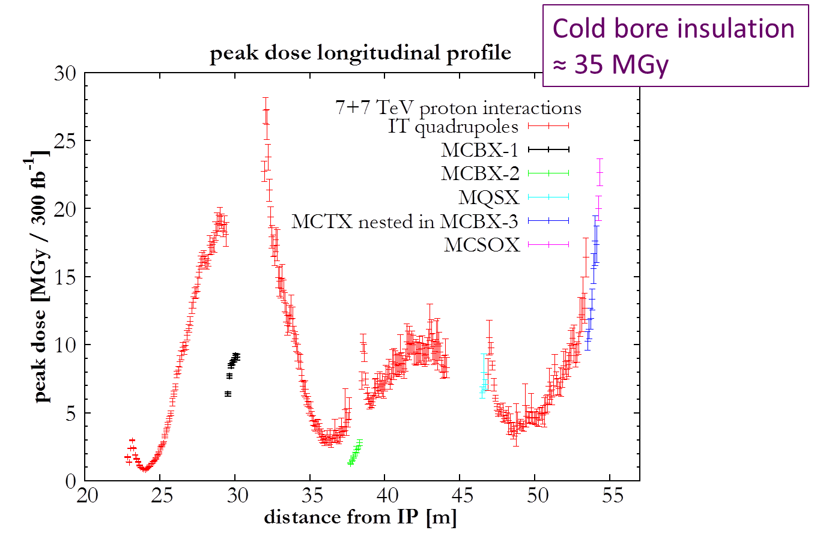
What could stop us?
Radiation and Inner Triplets
L. Bottura
Expected dose by LS3 (300 fb⁻¹)
  Range of 27 [18…40] MGy in the Q2
  Range of 20 [13…30] MGy in the MCBX
IT may experience mechanically-induced insulation failure in the range of 300 fb⁻¹ (LS3 ± 1 year) consistent with previous analyses.
Effects:
  Premature quenches (cracks in end spacers)
  Insulation degradation (monitor on line)
  Mechanical failure (nested coils in MCBX)

Slide 18
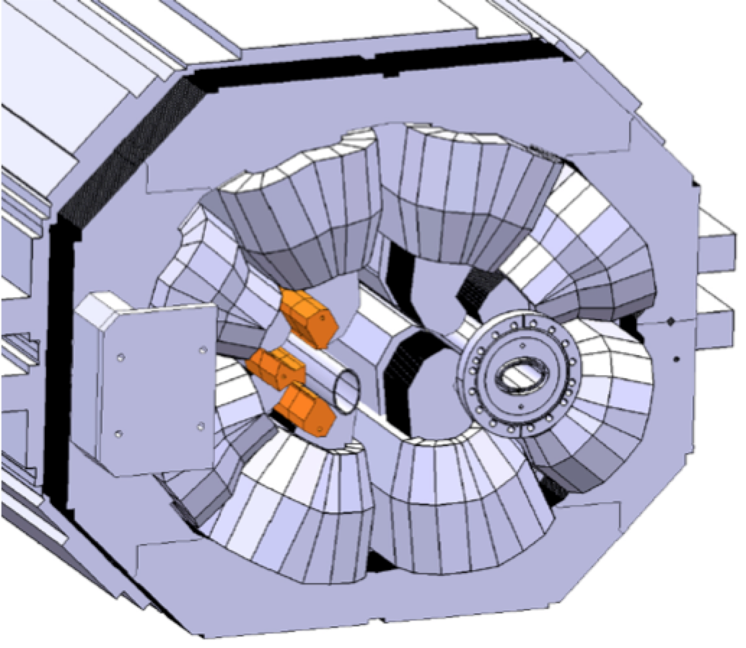
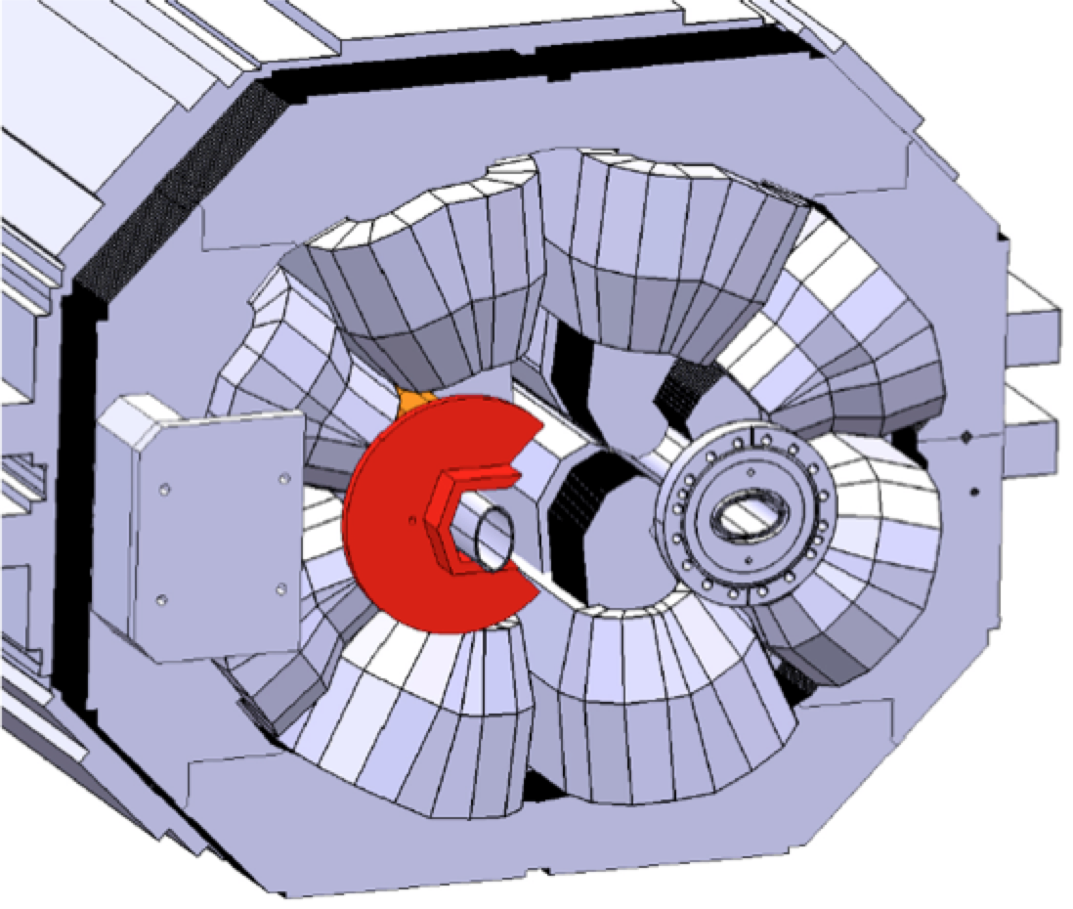
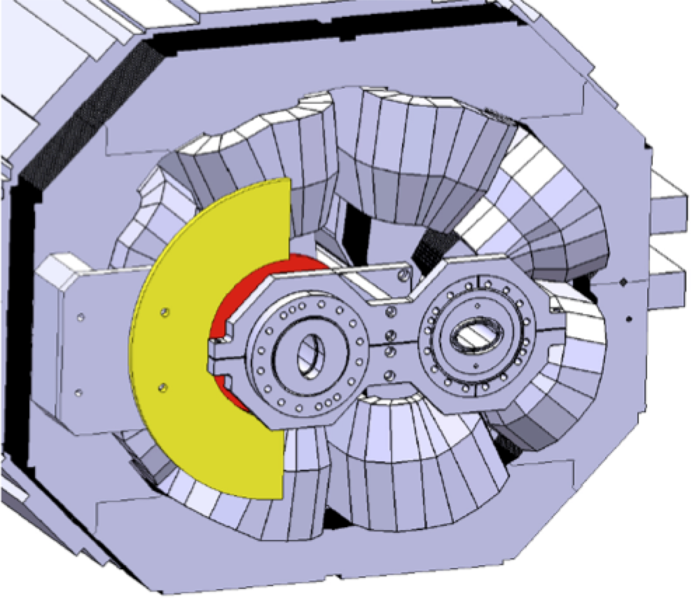
What could stop us?
L. Bottura
Radiation on the warm magnets (collimation area)
Expected dose by LS3 (300 fb⁻¹)
  Range of 80….90 MGy in the MBW and MQW
Actions have been proposed and approved to avoid insulation failure in the period LS2 to LS3
Starting in LS1
Shield inserts and masks for MQW, by courtesy of P. Fessia

Slide 19
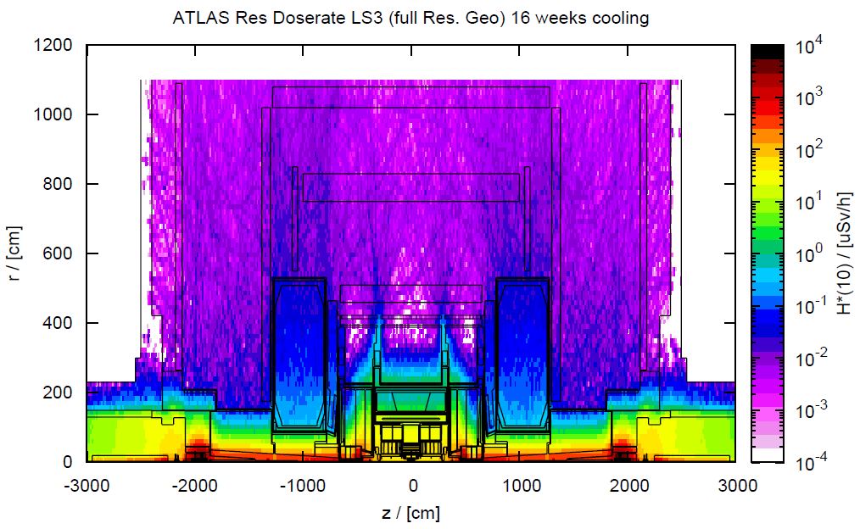
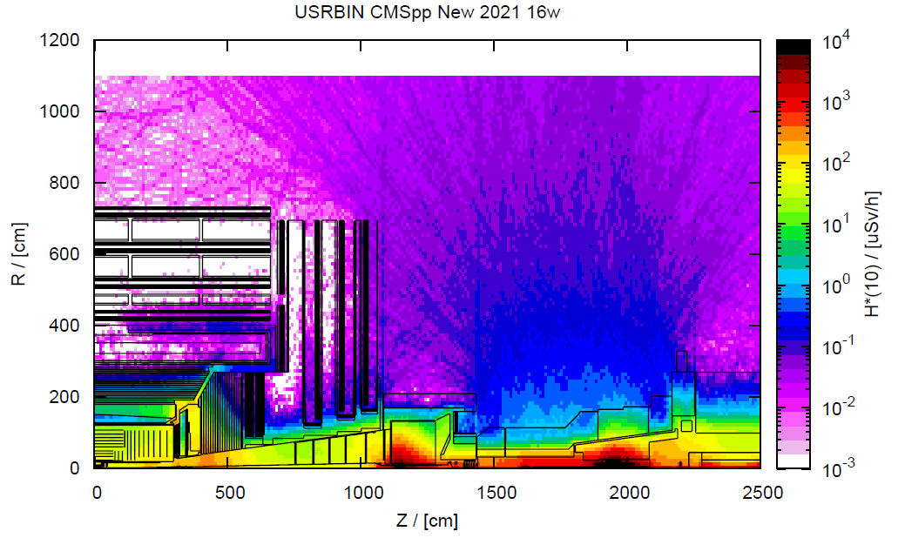
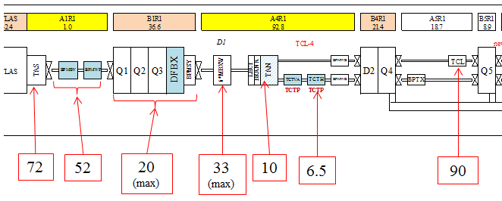
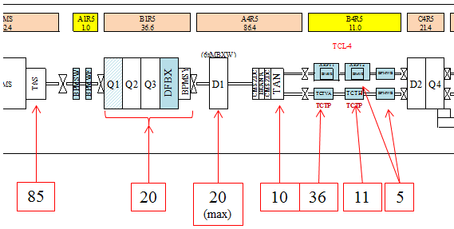
What could stop us?
L. Bottura
Point 1
Point 5
Radiation to the personnel
The triplet will be a limited stay area
Access and work in the triplet and collimator area will be subject to ALARA-level III rules
Measures must be taken to reduce intervention time ➔ in LS3 at the latest
Ambient dose equivalent rates in µSv/h at 40cm extrpolated from measurements after LS1
346
250
96
(max)
158
(max)
50
31
432
408
96
96
(max)
48
173
53
24

