Slide 1
UPGRADE SCENARIO ONE:
WORK EFFORT
CERN, 30th October 2013
Review of LHC and injectors upgrade
E. Todesco
CERN, Geneva Switzerland
Acknowledgements: A. Ballarino, O. Bruning, F. Cerutti, L. Esposito, P. Fessia, R. Jones, L. Rossi, R. Steinhagen, L. Tavian

Slide 2
CONTENTS
Scenario
Heat load and radiation damage
11 T collimators
SC link for matching sections in IR1 and IR5
Beam-beam Long Range compensator wire (LRBB)

Slide 3
SCENARIO: HOW TO REACH THE TARGET
PIC
  Wide aperture magnets from Q1 to D1 to allow lower β∗ → new TAS
  New cryoplant able to withstand heat load of full upgrade
US1
  No change in TAS-D2–Q4, whose aperture will limit β∗, so integrated luminosity is increased through beam intensity
  11 T collimators
  Long Range Beam-Beam compensating wires (LRBB)
    To allow compensate beam-beam effect, and reduce the crossing angle
      R&D needed to prove the efficiency of this hardware
US2
  New matching sections removing the
  aperture bottleneck → β∗ is an
  additional source of performance

Slide 4
MAIN FEATURES OF US1 SCENARIO
Beta* → optics
Peak luminosity → heat load
Integrated luminosity → radiation damage
US1 features
  Same optics of PIC
  Improvement w.r.t. PIC is given by more protons
  Same peak lumi of US2, similar heat loads from lumi debris
    But smaller heat loads due to beam w.r.t. US2

Slide 5
RADIATION DAMAGE
Q: is it possible to intercept the shower of particles by shielding with reasonable thickness (i.e. mm)
A: YES [see works by the Fluka team, F. Cerutti et al.]
Q: Is the magnetic field playing a relevant role?
A: YES
  The screen needs to be
  inside the magnet and
  needs aperture
Energy deposition in the triplet with and without magnetic field
[F. Cerutti, E. Wildner, et al.]

Slide 6
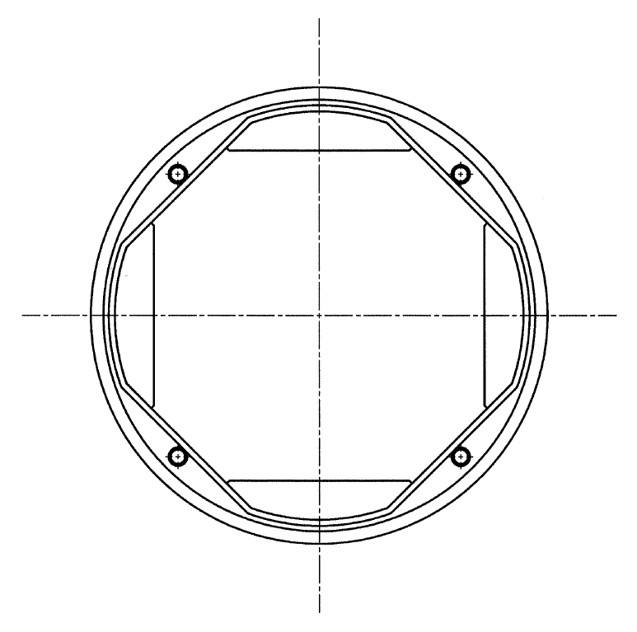
RADIATION DAMAGE
The Q1 – D1 part is designed to have 25 MGy after 3000 fb⁻¹
  This is done thanks to wide aperture and shielding [see P. Fessia talk]
  So we will be below 20 MGy
Tungsten inserts
Cold bore
Beam screen
Peak dose (for 3000 fb⁻¹) and peak power (for peak lumi 5×10³⁴ cm⁻² s⁻¹)
[L. Esposito, F. Cerutti, IPAC 2013]
Beam screeen sketch
[R. Kersevan]

Slide 7
RADIATION DAMAGE
For the rest of the matching section we scale the results of the baseline
  Baseline peak dose is 2 MGy (average), 4 MGy (local) for 500 fb⁻¹
  So one will reach 16 MGy for 2000 fb⁻¹
Peak dose (average over cable, for 500 fb⁻¹) and peak power (for peak lumi 10³⁴ cm⁻² s⁻¹)
[L. Esposito, F. Cerutti]

Slide 8
HEAT LOADS
(i) Total cryogenic power
    Assume as in PIC to withstand 5×10³⁴ cm⁻² s⁻¹ peak lumi (target of full upgrade) – about 700 W on the triplet, 600 W on the beam screen
    US1 has same peak lumi, so same situation
(ii) Local increase in temperature due to the thermal impedances of the components and the distance to the heat sink: two issues
  Δt in the coil, to avoid reducing too much the margin of the superconductor (below 0.2 K)
    With peak 5×10³⁴ cm⁻² s⁻¹ the peak heat load on the coil is 2 mW/cm³ – as in the LHC baseline (see next slide), so this is not an issue
  Δt in the beam screen, to avoid degassing (below 10 K) – this is a delicate issue
    Design work of the beam screen is ongoing

Slide 9
HEAT LOADS
(ii) Local increase in temperature (cont’d)
  Q1-D1 is designed for US2, so we have margin (2 mW/cm³ expected, limit at 4 mW/cm³)
  In the matching section rescaling the baseline results gives about 1.5 mW/cm³ (baseline multiplied by 5) → ok
Peak power in Q1-D1 (for peak lumi 5×10³⁴ cm⁻² s⁻¹)
for HL-LHC [L. Esposito, F. Cerutti, IPAC 2013]
Peak power in D2—Q7 (for peak lumi 10³⁴ cm⁻² s⁻¹)
for LHC [L. Esposito, F. Cerutti]

Slide 10
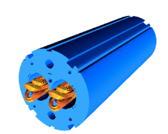
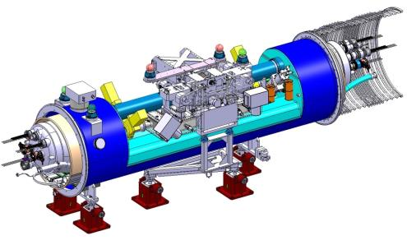
COLLIMATORS
The plan for collimation in the next years is strongly dependent on the first results of operation at 7 TeV
[S. Redaelli]
  So it is difficult to make a guess, but we must have a baseline
With these caveat, for US1 we foresee installation of additional collimators in IR7 – IR1 – IR5
  11 T technology used to make space
  10 units needed: 20 magnets (5.5 m long) plus 10 collimators
  Same hardware used in IP2 for the PIC – cost ~65 MChf
Collimator [A. Bertarelli et al.]
11 T dipole [M. Karppinen, S. Zlobin et al.]

Slide 11
COLLIMATORS
Position in IR7
IR7 layout [R. Bruce, S. Readelli, collimation team]

Slide 12
CRYOGENICS REMINDER
Two critical areas:
  Point 4, need of separating RF from magnets
  Point 1 and 5, need of separating triplet from arcs
  As usual in these systems, margin matters
    Both included in PIC [see P. Fessia talk], so ok for US1
No IT cryoplants
With IT cryoplants
Temperature along the arc for the three scenario [L. Tavian]

Slide 13
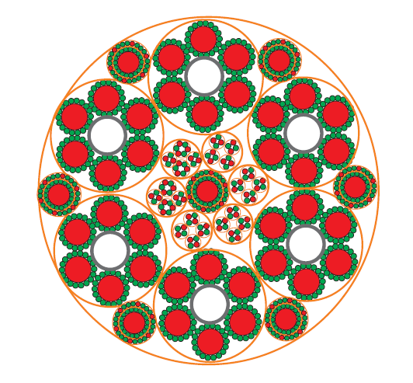
SUPERCONDUCTING LINK
Aim: move power converters of matching sections from tunnel to surface
Synergy with triplet sc link
Technology: possibly MgB₂
Cost: ~20 MChf
Cross-section of link for triplets
[A. Ballarino]

Slide 14
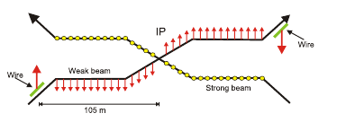
BEAM BEAM LONG RANGE WIRE COMPENSATOR
Idea: use a current to cancel the longe range beam-beam effect and close crossing angle
Initial proposal based on CERN-SL-2001-048-BI [J. P. Koutchouk]
Experimented on RHIC and SPS, but not yet in a collider
  In RHIC: you can spoil a beam with this
  In SPS: a wire can compensate another wire
A proof of principle in the LHC is needed

Slide 15
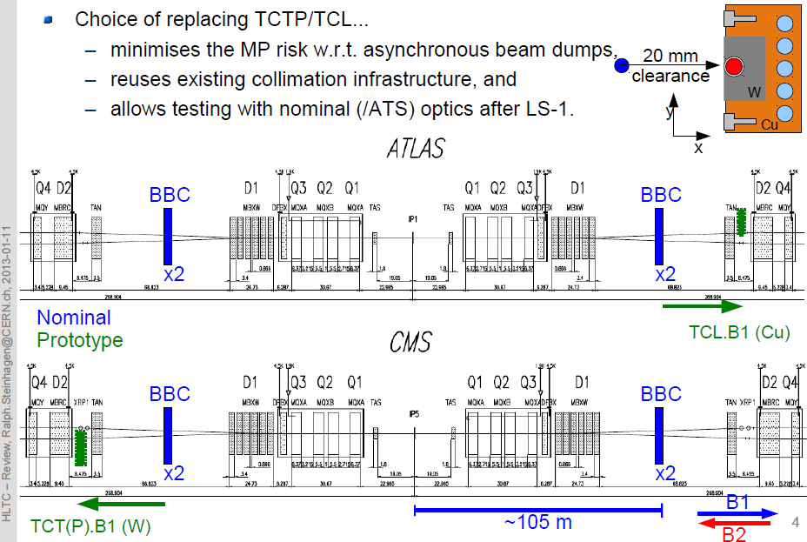
BEAM BEAM LONG RANGE WIRE COMPENSATOR
Proof of principle
  Timing: between LS1 and LS2, 1-2 years of operation needed
  Postion: between D1 and D2
    Proposal to insert it in collimators, but difficult to integrate without breaking collimator hierarcy
Courtesy of R. Steinhagen, talk at HLTC

Slide 16
BEAM BEAM LONG RANGE WIRE COMPENSATOR
Based on the results of the proof of principle in ~2016 run, baseline for HL-LHC can be defined
What we know already
  4 BBLR needed
  Location: as close as possible to D1
  There are some delicate technical points
    Radiation resistance, hot place full of neutrons
    Compatibility with flat beams to be proved
    Integration – as usual, evil is in details
Plan and cost
  Time scale for conceptual design, engineering and construction: ~4 years (fits with HL-LHC schedule)
  Cost order of magnitude ~10 MChf

Slide 17
CONCLUSIONS
We presented the upgrade scenario one work effort
  Same peak lumi as US2 (heat loads), and 2/3 of data (radiation damage) – many unknowns to be seen with 7 TeV operation
  New triplet/D1 as defined for PIC allows to swallow larger heat loads, and radiation damage
  Matching section becomes a bottelneck for β* (not lower than 30 cm), but can swallow heat load and radiation damage
  Scenario relies on ability to increase beam intensity
Work effort
  Collimators in IR7, IR1, IR5
  Superconductive link for matching sections in IR1 and IR5
  Beam-beam long range wire compensator needed
    New piece of hardware, not yet proved for LHC
    Proof of principle for the LHC in ∼2017

