Slide 1
Session 3
Performance Improving Consolidation and Upgrade scenario 1
Malika Meddahi, Lucio Rossi
Thanks to all speakers and contributors

Slide 2
PICs in the injectors: What are we talking about?
- K. Hanke
PERFORMANCE IMPROVING CONSOLIDATION:
Replacement or upgrade of a system justified by consolidation but with the goal of improving performance
Clear definition but some
overlaps and grey zone
with pure consolidation
and US 1 and 2.
grey area 1
grey area 2
pure consolidation
upgrade scenario 1
upgrade scenario 2
performance improving consolidation

Slide 3
In short
Time drivers and minimum single block
LIU-PSB: minimum single block 12 m
LIU-PS: minimum single block 3 m
LIU-SPS: minimum single block 6 m
=> all time estimates depend strongly on available resources (manpower)
=> consequent amount of work to be done in parallel for all machine
=> to be considered with the Cons, maintenance, upgrade preparatory work
Cost of PICs
LIU-PSB: 50 MCHF (essentially LIU-PSB budget¹ without the Linac4 part)
LIU-PS: 16 MCHF (80% of total budget 20 MCHF²)
LIU-SPS: 23 MCHF (30% of total budget 77 MCF)
¹: total budget 60.8 MCHF
²: baseline 20 MCHF, with all options 32 MCHF
PICs are mandatory and must be fully implemented in LS2 in the injectors regardless of which upgrade scenario is chosen

Slide 4
PIC @ 6.5 TeV (Pile-up limit at 140)
PICs: what do we gain in beam performance? – Gianluigi Arduini
 | Lev. time [h] | Opt. Fill length [h] | η_{6h}/η_{opt} [%] | φ_{6h}/φ_{opt} [%] | Int. Lumi for η=50% for 6h /opt. fill length [fb⁻¹ /y] | Max. Mean Pile-up density/Pile-up [ev./mm]/[ev./xing]
BCMS – 40/20 | - | 6.5 | 37/37 | 25/26 | 93/94 | 0.97/84
Standard - 40/20 | - | 7.3 | 40/40 | 27/28 | 87/88 | 0.79/69
BCMS – 50/25 | - | 6.8 | 39/39 | 26/27 | 89/89 | 0.77/78
Standard – 50/25 | - | 7.6 | 43/42 | 28/30 | 82/83 | 0.63/64
2012
6h
Goal
<50%
2012
36%
Goal > 70 fb⁻¹
<1.3/<140
The luminosity target can be reached with 40/20 optics
BCMS: slightly higher performance but more sensitive than standard scheme to additive sources of emittance blow-up
50/25 optics provides margin in aperture and offers a reduction of the pile-up density below 0.7 events/mm
Key questions and studies required in Run 2 have been sketched - Understanding and Control of the additive sources of blow-up; Confirmation of the feasibility of β*-levelling as a possible solution for IP8; Confirmation of the feasibility of scrubbing the dipoles down to SEY=1.3-1.4 possibly with dedicated beams; Full understanding of the stability limits for single and two-beams
Notes:
25 % for a pile-up of 4.5 would give 5.5 fb-1/year for LHCb

Slide 5
Which beams in the injectors fulfil HL-LHC Upgrade Scenario 1 goals? Simone Gilardoni
 | Ib(10¹¹) | ε (μm 1σ norm)
US1 requirements (LHC collision/injection Βaseline) | 1.5/1.58 | 1.5/1.25 | LHC
US1 requirements (LHC collision/injection Alternate) | 1.2/1.26 | 1/0.83
US1 NEW requirements (LHC collision/injection Alternate) | > 1.45e11 | > 1.8
Linac4 + 2 GeV + SPS LLRF upgrade US1 (PS Standard scheme – 72 bchs) | 1.45 | 1.37 | LIU at SPS extraction
Linac4 + 2 GeV + full SPS upgrade (PS Standard scheme – 72 bchs) | 2.0 | 1.88
Linac4 + 2 GeV + SPS LLRF upgrade (PS BCMS scheme – 48 bchs) | 1.45 | 0.91
Linac4 + 2 GeV + full SPS upgrade (PS BCMS scheme – 48 bchs) | 2.0 | 1.37
Large bunch intensity in LHC more important than low emittances
200 MHz RF Upgrade necessary to match the preferred requirements of LHC-US1 with unchanged longitudinal parameters at LHC injection.
LIU US1 ≣ LIU US2

Slide 6
Linac4 : 15 weeks to deliver a beam to the PSB
Work Effort in the LHC Injector Complex, Including Linac4 Connection, for the Upgrade Scenarios – Jean-Baptiste Lallement, Bettina Mikulec
Week | 1 | 2 | 3 | 4 | 5 | 6 | 7 | 8 | 9 | 10 | 11 | 12 | 13 | 14 | 15 | 16 | 17 | 18 | 19 | 20
Linac2/Linac4 interface
Cool down
Line removal up to BHZ.20
DC cable path
Emergency exit door
Château
Chicane
Shielding wall
Line installation
L2 tunnel access door
LBE line
Cool down
Removal of L2 LBE
Installation of L4 LBE
Cabling
Beam commissioning
JB. Lallement – RLIUP Workshop – 31/10/2013

Slide 7
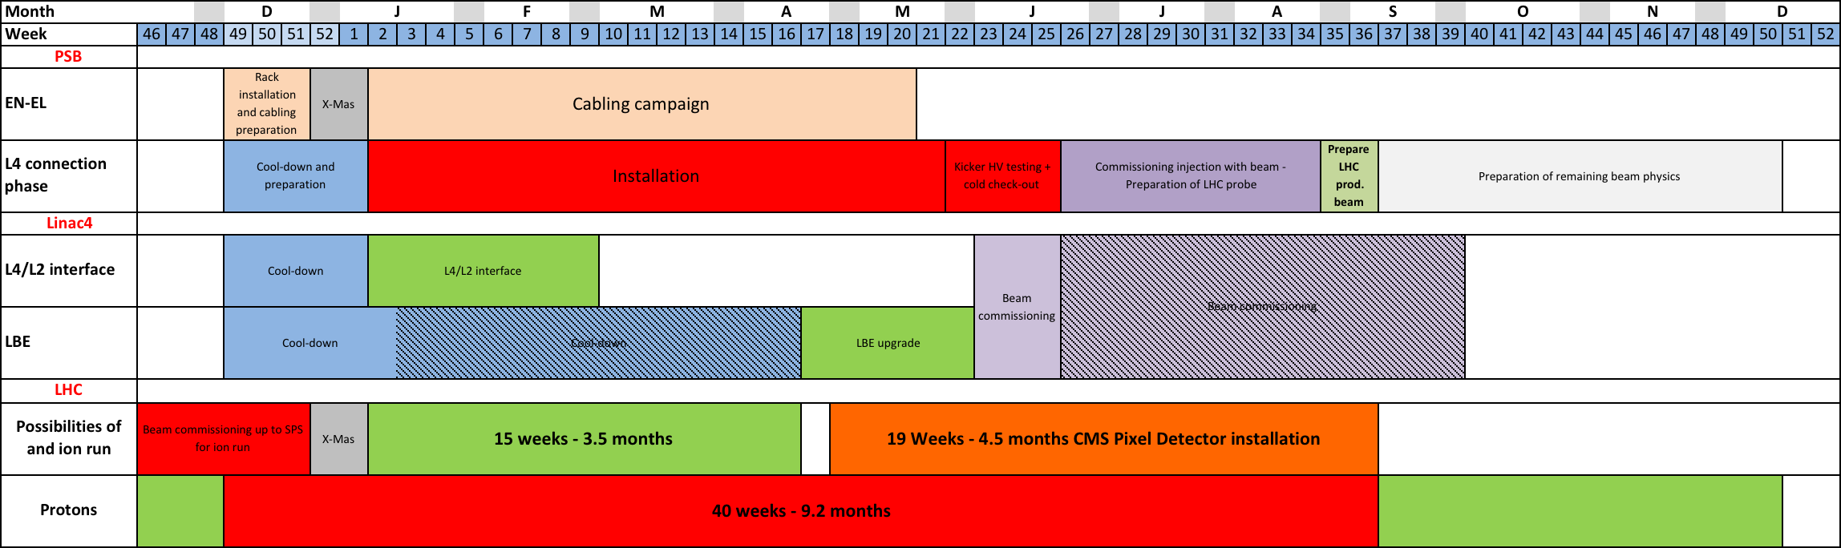
Overall L4 Connection to PSB
LHCPROBE
injected into PS
LHC production beam
injected into PS
LHC production beam
injected into LHC
LHCPILOT
injected into LHC
Duration for the Linac4 connection to the PSB: 9.2 months
  Deliverable: LHC production beam injected into PS; coincides with injection of LHCPILOT beam into the LHC
  Other physics beams to follow at an estimated rate of ~2/week
First beam to the PS after 9 months
Ion run and CMS pixel detector installation in parallel?
  Ion beam commissioning in LHC ion injector chain end of 2016 in parallel to p run
  LHC ion run of up to 3.5 month after X-mas
  CMS pixel detector installation: 4.5 months
  Could other activities profit? (NA61/SHINE etc.)

Slide 8
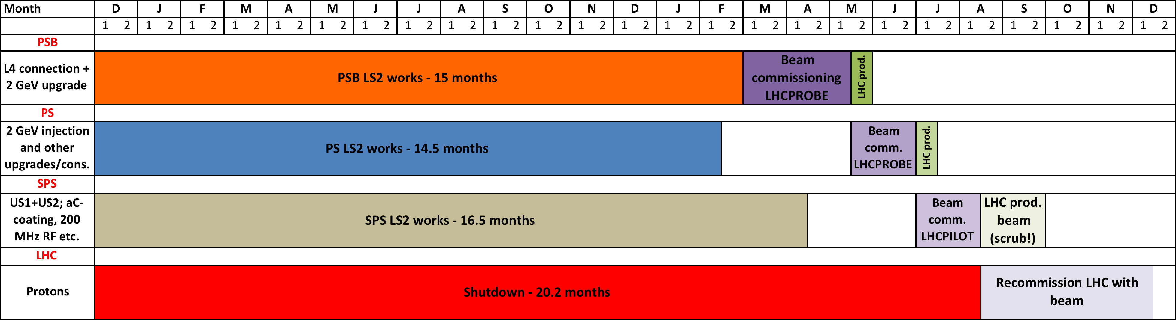
LIU LS2 Planning
LS2:
Time line driven by PSB activities (impressive cabling work to be performed -> coherent scheduling in progress taking into account the overall requests needed for other projects)
  PSB first beam (LHCPROBE) to the PS: after 17.5 months
  PS ready for beam from PSB already after 14.5 months -> need to gain 3 m in PSB
  SPS ready for beam from PS: after 16.5 months
First injection of LHCPILOT into the LHC: after ~20.5 months
Minimum time for injection of LHC production beam into the LHC: after ~22 months (scrubbing!)

Slide 9
Layouts
From P. Fessia
Aperture ∼twice the LHC baseline (70 mm to 150 mm),
but more compact triplet layout thanks to Nb₃Sn and superconductive D1
LHC
[E. Todesco]
HL LHC
[E. Todesco]

Slide 10
Implications & Assumptions (e-cloud)
From . G. Arduini
Control of the blow-up due to e-cloud via scrubbing at 450 GeV
  Emittance blow-up occurs when electron cloud activity in the dipoles
  SEY reduction in the dipoles at 450 GeV with 25 ns scrubbing run. Need margin for small emittance/shorter bunch ➔ doublet beams being considered and LS1 interventions to increase cryo-margin at injection (SAM and Sector 34)
G. Iadarola, G. Rumolo
25 ns scrubbing (2011/12)
Expect heat load in the quadrupoles due to the lower threshold SEY ➔ cryo upgrade (c/o P. Fessia)
HL-LHC triplets/D1 will have e-cloud countermeasures implemented (aC coatings and possibly clearing electrodes)

Slide 11
Total load per sector 4.6-20K range
 | 4.6-20 K e-cloud Dipole off | 4.6-20 K e-cloud Dipole on
T O D A Y
+ IP4 + IP1 + IP5
Present installed capacity of LHC cryoplants
S45 no separate cryo for RF
Load on 4.5 K sector cryoplant [kW]
Load on 4.5 K sector cryoplant [kW]
Present installed capacity of LHC cryoplants
Load on 4.5 K sector cryoplant [kW]
Load on 4.5 K sector cryoplant [kW]
From P. Fessia
[L. Tavian]

Slide 12
Conclusions
From P. Fessia
PIC actions
  Concern practically all the sectors of the machine
  The are spread between the 1st long technical stop after LS1 and LS3
Interaction region interventions in IP 1 and 5 provide safe operation for
2025->2035 years and the required luminosity capacity (See G. Arduini talk)
Collimation interventions push down the whole machine impedance providing more robust collimators and ensure safe ion run in IP2. Remark: the collimator lifetime is being analysed in this moment. Possible intervention on secondaries could be necessary to provide reliable exploitation after LS2
Beam diagnostic interventions provide the necessary diagnostic capacity, with hardware compatible with the higher radiation dose
Sc links provide a solution to radiation electronic issues for the Power converters, but also contribute in reducing collective dose, interventions time and reduce risk of SEE
Cryoplant at point 4 provides flexibility in the management of the RF interventions and eliminate the 1st machine bottleneck in term of cooling capacity. All cryo installation have to be performed with a long term view from the installation/integration perspective (foresee for future needs)
High radiation dose point call for radiation management and possible reconfiguration to provide the best as possible reliability and access conditions. Radiation tolerant electronic development (including R&D and testing) will affect several equipment groups (costs, resources)

Slide 13
HL-LHC Assumptions for US1:
-New triplet magnets (PIC) -> smaller than nominal β* reach
-No new magnets or movements in the matching section
-No Crab Cavities
-Long Range Beam-Beam wire compensators at a position of ca. 10 sigma resulting in a required beam separation of 10 sigma (question was raised why we assume LRBB wires for US1 but not for US2 and if compatible with CS).
-160 days of operation for physics production; -Beam energy = 6.5 TeV
-25ns scheme using BCMS -> 2593 bunches
-5% intensity loss from SPS extraction to LHC collisions
-Cases 1: 20% emittance blow-up from SPS extraction to LHC collisions (the question was raised if this is a realistic assumption for small emittance beams)
-Other Cases: emittances between 1.8 and 2 micrometer (between 50% and 75% blow up from SPS extraction to LHC collisions wrt LIU expectations)
From. O. Bruning
29-31. October; Review of the LHC and Injector Upgrade Plans; Archamps
13

Slide 14
Summary of LIU Performance:
[Simone Gilardoni]
 | LHC collision |  | SPS extraction
Classical Scheme | Int/b | Emitt* (μrad) | Int/b | Emitt* (μrad)
US1 Baseline | 1.50E+11 | 1.5 | 1.58E+11 | 1.25
US1 low emit. | 1.20E+11 | 1 | 1.26E+11 | 0.83
US1 LIU SPS LLRF 200 MHz upgrade | 1.38E+11 | 1.64 | 1.45E+11 | 1.37
US1 LIU SPS 200 MHz full upgrade | 1.90E+11 | 2.26 | 2.00E+11 | 1.88
BCMS
US1 Baseline with BCMS | 1.50E+11 | 1.5 | 1.58E+11 | 1.25
US1 low emittance with BCMS | 1.20E+11 | 1 | 1.26E+11 | 0.83
US1 LIU SPS LLRF 200 MHz upgrade | 1.38E+11 | 1.09 | 1.45E+11 | 0.91
US1 LIU SPS 200 MHz full upgrade | 1.90E+11 | 1.64 | 2.00E+11 | 1.37
BCBMS ➔ 2592 bunches for trains of 48 bunches
following presentation by John Jowett @ LIU Technical meeting
and Christian Carli’s Chamonix 2011 presentations
Last lines refer to SPS upgrade with RF Power upgrade [ca. 25MCHF]
Following analysis based on evaluation of non-crossed out cases
and with variations of the beam emittance
From. O. Bruning
29-31. October; Review of the LHC and Injector Upgrade Plans; Archamps
14

Slide 15
Large β & SPS RF Power Upgrade: Case 3b
-US1 flat beams; SPS with new LLRF system and withthe RF power upgrade
-N at collisions = 1.9 10¹¹ppb
-n = 2508 colliding pairs in IR1 and IR5 (revised BCMS filling scheme)
-normalized emittance = 2.80 micrometer ( > 70% blow-up wrt SPS extraction)
-flat beams with beta* = 0.5m / 0.25m
-beam separation of 10sigma -> crossing angle of 310 microrad
-IBS growth rates of ca. 22h horizontally and 25h longitudinally (scaled)
-Peak Luminosity = 5 10^34 cm^-2s^-1
-No Leveling time; Lumi decay time = 6 h; Turnaround time = 3 hours
-Total fill length (leveling + decay + turnaround) = 9h
-Integrated Lumi per fill =0.71 fb⁻¹; Lumi per year for perfect operation = 304fb⁻¹
-Required efficiency for achieving 170fb^-1 per year = 56%
==> Case 3b could reach the US1 goals but is challenging in terms of efficiency.
From. O. Bruning
29-31. October; Review of the LHC and Injector Upgrade Plans; Archamps
15

Slide 16
+MS Upgrade for US1: Case 4
-US1 flat beams; SPS with new LLRF system and with the RF power upgrade
-N at collisions = 1.9 10¹¹ppb
-n = 2508 colliding pairs in IR1 and IR5 (revised BCMS filling scheme)
-normalized emittance = 2.65 micrometer ( > 70% blow-up wrt SPS extraction)
-flat beams with beta* = 0.4m / 0.1m
-beam separation of 10sigma -> crossing angle of 310 microrad
-IBS growth rates of ca. 22h horizontally and 25h longitudinally (scaled)
-Peak Luminosity = 8 10³⁴ cm⁻² s⁻¹
-Leveling time = 2.9 h; Lumi decay time = 4 h; Turnaround time = 3 hours
-Total fill length (leveling + decay + turnaround) = 9.9h
-Integrated Lumi per fill =1.06 fb⁻¹; Lumi per year for perfect operation = 413fb⁻¹
-Required efficiency for achieving 170fb^-1 per year = 41%
==> Case 4 could easily reach the US1 goals and is OK from the IBS point of view.
20% L-int increase wrt Case 3b (requiring essentially TAS and TAN upgrades)
From. O. Bruning
29-31. October; Review of the LHC and Injector Upgrade Plans; Archamps
16

Slide 17
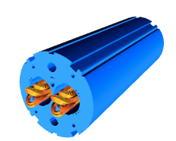
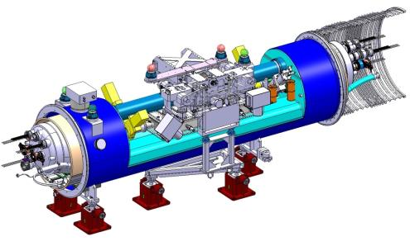
COLLIMATORS
From E. Todesco
The plan for collimation in the next years is strongly dependent on the first results of operation at 7 TeV
[S. Redaelli]
  So it is difficult to make a guess, but we must have a baseline
With these caveat, for US1 we foresee installation of additional collimators in IR7 – IR1 – IR5
  11 T technology used to make space
  10 units needed: 20 magnets (5.5 m long) plus 10 collimators
  Same hardware used in IP2 for the PIC – cost ~65 MChf
Collimator [A. Bertarelli et al.]
11 T dipole [M. Karppinen, S. Zlobin et al.]

Slide 18
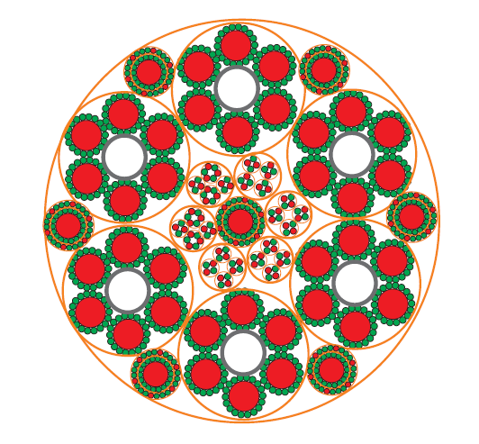
SUPERCONDUCTING LINK
From E. Todesco
Aim: move power converters of matching sections from tunnel to surface
Synergy with triplet sc link
Technology: possibly MgB₂
Cost: ~20 MChf
Cross-section of link for triplets
[A. Ballarino]

Slide 19
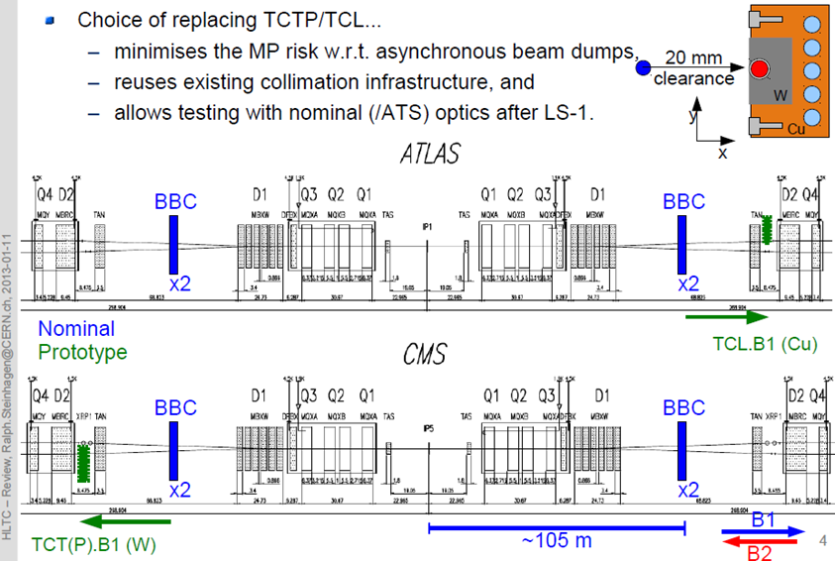
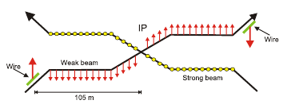
BEAM BEAM LONG RANGE WIRE COMPENSATOR
From E. Todesco
Idea: use a current to cancel the longe range beam-beam effect and close crossing angle
Initial proposal based on CERN-SL-2001-048-BI [J. P. Koutchouk]
Experimented on RHIC and SPS, but not yet in a collider
  In RHIC: you can spoil a beam with this
  In SPS: a wire can compensate another wire
A proof of principle in the LHC is needed

