Slide 2

LHC PICs: what are we talking about?
A 2x mn overview

Slide 3
Preparation work by
Alignment: H.M. Durand
Beam Instrumentation: R. Jones
Beam-Screen: R. Kersevan
Collimation: A. Bertarelli, J. Jowett, S. Redaelli
Cryogenics: L.Tavian
Cryostat: D. Duarte Ramos, V. Parma
Heat and radiation loads: F. Cerutti, L. Esposito
Magnets : E. Todesco with contribution from P. Ferracin, G. Ambrosio and the whole LARP collaboration
QPS: R. Denz, D. Wollmann,
R2E: M. Brugger
RP related matters: C. Adorisio, S. Roesler
SC Link: A. Ballarino
All costs in CERN accounting, evaluation 2011.
No installation and infrastructures costs.

Slide 4
  Performance Improvement Consolidation
  Integrate luminosity 1000 fb⁻¹ by 2035
  Assumptions 10 years operations starting from 300 fb⁻¹
  160 days of physics per year
  Performance goals: PIC 70 fb⁻¹ / year
PIC Scenarios 6.5 TeV
PIC Scenarios 7 TeV
Momentum [TeV/c] | 6.5
Bunch population in collision [10¹¹ p] | 1.38
Total RF Voltage | 16
e_{L}*[eV.s] at start of fill | 3.6
Bunch length (4 s)[ns]/ (r.m.s.) [cm] | 1.33/10
Beam-beam separation [s] | 14
Momentum [TeV/c] | 7
Bunch population in collision [10¹¹ p] | 1.38
Total RF Voltage | 16
e_{L}*[eV.s] at start of fill | 3.8
Bunch length (4 s)[ns]/ (r.m.s.) [cm] | 1.33/10
Beam-beam separation [s] | 14
 | e*_{n} _{coll} [mm] | # Coll. Bunches IP1,5 | Xing angle [mrad] | L_{peak} [10³⁴ cm⁻²s⁻¹]
BCMS – 40/20 | 1.85 | 2592 | 364 | 2.9
Standard - 40/20 | 2.25 | 2736 | 400 | 2.5
BCMS – 50/25 | 1.85 | 2592 | 326 | 2.7
Standard – 50/25 | 2.25 | 2736 | 360 | 2.3
 | e*_{n} _{coll} [mm] | # Coll. Bunches IP1,5 | Xing angle [mrad] | L_{peak} [10³⁴ cm⁻²s⁻¹]
BCMS – 40/20 | 1.85 | 2592 | 351 | 3.1
Standard - 40/20 | 2.25 | 2736 | 387 | 2.7
BCMS – 50/25 | 1.85 | 2592 | 315 | 2.9
Standard – 50/25 | 2.25 | 2736 | 347 | 2.5
See Talk of G. Arduini
All hardware shall be compatible with the 7 TeV operation

Slide 5
Equipment on the Beam | Underground equipment | Vert. lines | Surface equipment
R+P
Interaction Region
IP 1,5
Cryo line
IP 1,5
Magnet system
IP 1,5
Alignment
IP 1,5
Beam vacuum
IP 1,5
QPS
IP 1,5
TAS
IP 1,5
SC Link + DFB
IP 1,5
Power converters
IP 1,5
Collimation
IP 1,5
Beam diagnostic
IP 1,5
R+P
Collimation PIC
Collimators with jaws in new material
IP 2,3,7,8 (1,5)
Protection during dump
IP 6
R+P
Collimation for ion
IP 2
Legend
Cryo-bypass
IP 2
System
Equipment
Location
H.F. dipoles
IP 2
R eliability
P erformance
R+P
Beam diagnostic
IP 1,4,5
R
SC link/powering
IP 7
Hor. SC Link + DFB
IP 7
Power converters
IP 7
Cryo line
IP 4
R+P
Cryoplant
IP 4
Cryo-plant U
IP 4
Cryo-plant S
IP 4
Cryo line
IP 1,5
R+P
Cryoplant
IP 1,5
Cryo-plant U
IP 1,5
Cryo-plant S
IP 1,5
R
H.R. area reconf.
IP 7 (3)

Slide 6
Interaction region modification and related changes

Slide 7
Layouts
Aperture ∼twice the LHC baseline (70 mm to 150 mm),
but more compact triplet layout thanks to Nb₃Sn and superconductive D1
LHC
[E. Todesco]
HL LHC
[E. Todesco]

Slide 8
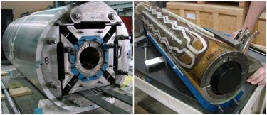
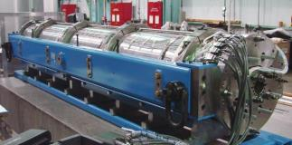
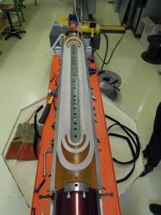
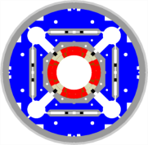
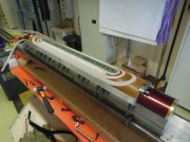
Quadrupoles
Triplet made with Nb₃Sn technology
  Long history of development in US, since 2002 (LARP)
    120 mm aperture 1 m long model HQ reaching most of the specifications (FQ, performance,…)
    90 mm 3.4-m-long model LQ (first long Nb₃Sn coils) succesful
  HQ performance similar to MQXC (Nb-Ti twin of HQ)
[LARP]
HQ magnet, 120 mm aperture with final structure
LQ magnet, first 3.4 m long Nb₃Sn magnet
Production shared between US and CERN
Heat exchanger
Coil
[P. Ferracin]
Al cylinder
Iron
QXF cross-section

Slide 9
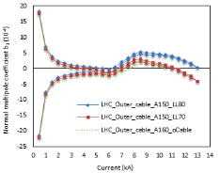
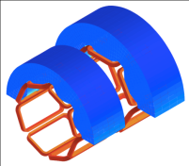
Other magnets of the interaction region
 | D1 Increase kick from 26 to 35 T m Nb-Ti technology, ∼5 T operational field, ∼7 m long Challenging field quality, large saturation Collaboration with KEK (Japan) 1st deliverable: one short model by 2015
 | Correctors Orbit correctors: 2.5 T m at Q1 and Q2, and 4.5 T m at Q3, both H and V Nb-Ti technology, nested option to save space (4 m) 2.1 T field, giving 1.2 and 2.2 m long magnets Collaboration with CIEMAT (ES) 1st Deliverable: one 1.2-long-magnet in 2016 Nonlinear correctors: Superferric option, not nested Easier operation, short heads, low current Typical lenght 15 cm, skew quad 80 cm Collaboration with INFN (Italy) 1st Deliverable: B₂, B₃, B₄, B₅, B₆ correctors by 2016
D1 cross-section, with cryostat
(Q. Xu, T. Nakamoto)
D1 b3 versus current
(Q. Xu, T. Nakamoto)
Proposal for nested MCBX
(M. Karppinen, D. Smekens)
[E. Todesco]
Proposal for nonlinear correctors (F. Toral)

Slide 10
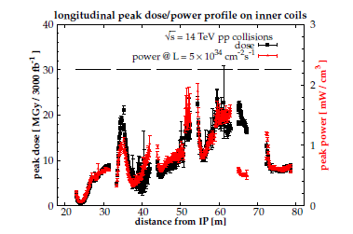
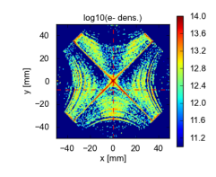
Shielding and beam screen
Key element is a shielding to bring radiation dose and heat load down to LHC baseline
For 1000 fb⁻¹ it limits the radiation to the coil to 10 MGy (safe, limit at 30-50 MGy)
For 3×10³⁴ cm⁻² s⁻¹ peak lumi one has 1.5 mW/cm³ (safe, quench limit at 4 mW/cm³ in LHC)
Apart from structural elements we have 6 mm W inserts
That’s a challenging piece – model should be realized in 2014
The large aperture provides the space to insert adequate shielding and to think to mitigation action for e-cloud (in addition to the other e-cloud elimination action already part of the HL-LHC) (see G. Arduini ).
Optimization of cooling design to be completed
[G. Iadarola]
Radiation dose and heat load [Cerutti, Esposito]
Beam screen in the triplet and in the correctors[Kersevan]

Slide 11
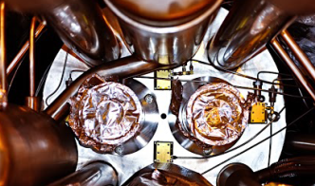
Beam Instrumentation
Cryogenic BLMs
  Current LSS configuration not suitable for HL-LHC
    Cannot distinguishing dangerous losses from collision debris
  Detectors for cryogenic environments studied
    To be placed inside cryostat of the new triplet magnets
    Dose measured more accurately represents correspond dose deposited in the coils
  This builds on the
    Radiation hard electronics (see later)
    BLM electronics consolidation (see later)
New BPMs Q1 to Q5
  New design required for new triplet layout
    Need to minimise transverse impedance
    Need for tungsten alloy shielding

Slide 12
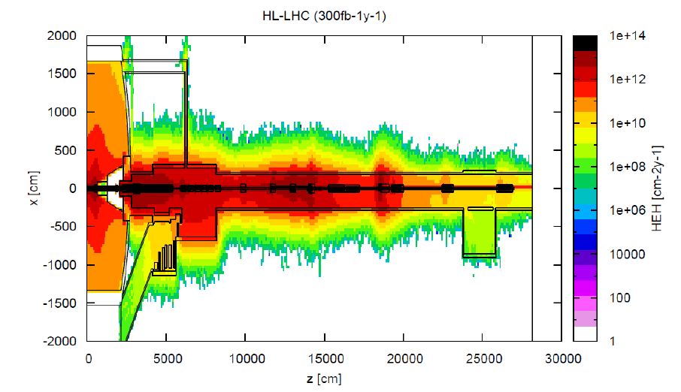
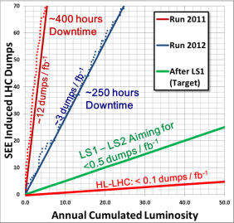
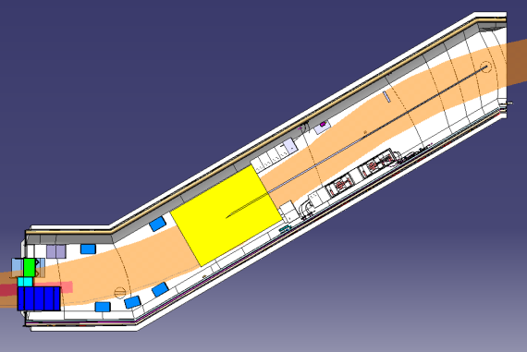
IR Powering
PIC 3×10⁸ HEH
US2 10⁹ HEH
[M. Brugger]
UL16 – 2014/03 – Relocalisation Racks & Convertisseurs
Zone transport
PIC 6×10⁷ HEH
US2 2×10⁸ HEH
RYSC01
Convertisseurs
RYMCB 01-04
CYCIP01 + DYPG02
During last year of operation
we had a number of radiation induced failures
at 10⁸ -10⁹ HEH
Below 10⁷ HEH failures unlikely
HEH: High Energy Hadron fluence
DYPG01
Convertisseurs
RYLB01
RYLC01
Convertisseurs
RQX.R1
RTQX2.R1
RYMCC01
RYCA01
RYCA02
QYC01
QYC02
[EN-MEF-INT]
TYCFL01

Slide 13
Superconducting Links at P1 and P5 interaction region magnets
Two Superconducting Links per point – from surface to underground areas
New DFBs installed in at the surface (added value to reduce personal exposure to radiation )
Integration studies started
Need for civil engineering to be verified – integration studies in 2014.
R&D in progress
Test of full system (DFB and SC Link) at CERN in 2015
Installation in LHC during LS3
Procurement of series to be started by end 2016

Slide 14
Few key data for cost and planning
2013
2014
2015
2016
2017
2018
2019
2020
2021
2022
Quadrupole
D1
Correctors
Beam screen
Cryostat
SC link
Item | Estimated Cost
Magnet system+TAS | 210 MCHF
QPS | 3 MCHF
Instrumentation | See later instrumentation chapter
Collimation | See later collimation chapter
SC links | 31 MCHF+3 MCHF infrastructures+ 6 MCHF Power Converters

Slide 15
Collimation decisions related impedance issues and IR7 cleaning are linked to the operational evidences at 6.5 TeV, in particular IP 7 requirements, see US1.
“…Extrapolation of the collimation performance from 4TeV to 7TeV based on collimation quench tests and accompanying simulations has a number of uncertainties, …” from the recommendation of the May 2013 collimation review

Slide 16
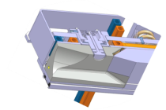
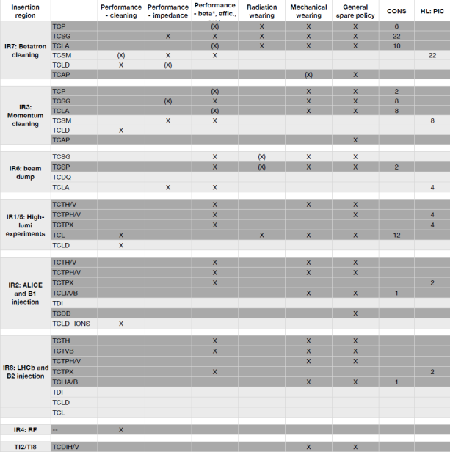
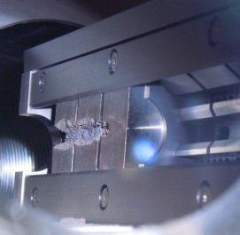
PIC Collimation
Up to 30 units with jaws in Mo-Gr, Mo coated to provide collimation with reduced impedance. Installation staged from 2016 (1 proto).
Collimator equipped with BPM therefore fully functional from LS2
Q4 and Q5 protection during dump
Interaction region
Displace the 12 TCL
Add 2+2 horizontal collimator in more robust material
Add 2+2 vertical collimators to protect Q4 and Q5
2 TCT horizontal built with more robust material
[A. Bertarelli]
    Inermet 180, 72 bunches
2
2 TCLD to protect magnet in the DS during the ion run
2 TCT horizontal built with more robust material

Slide 17
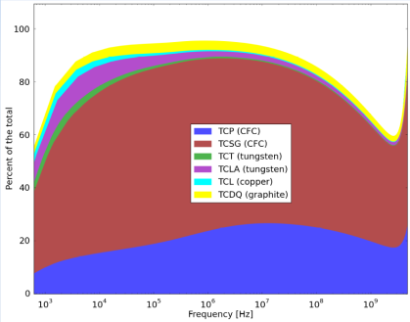
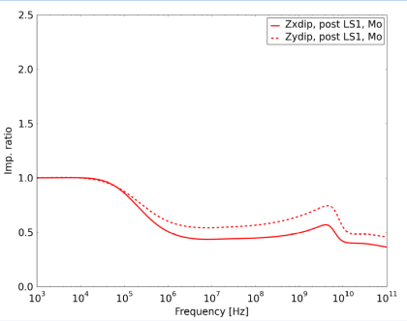
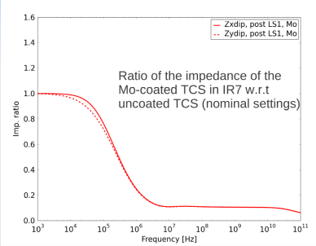
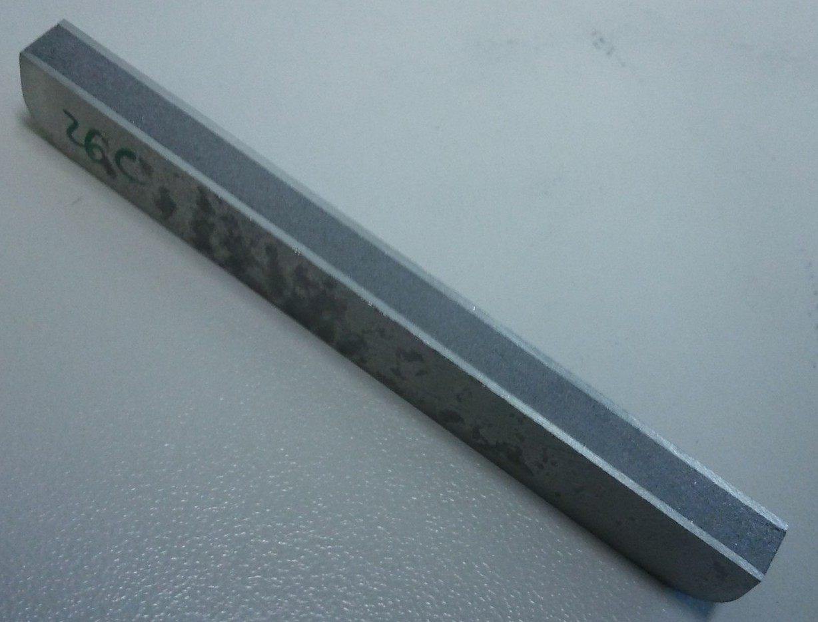

Program for impedance reduction
[N. Mounet]
Core:
1 MS/m
Carbide layer: 1.5 MS/m
Mo Sheet:
18 MS/m
[A. Bertarelli]

Slide 18
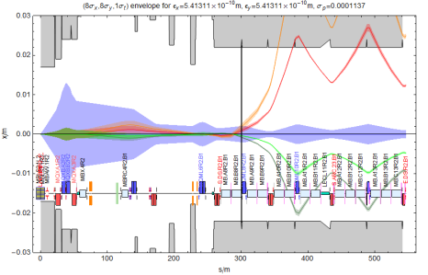
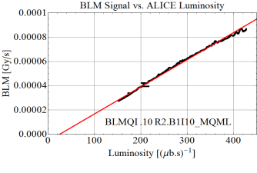
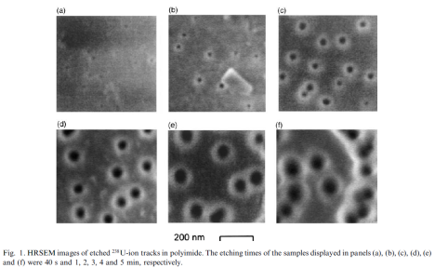
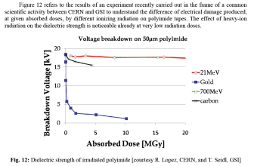
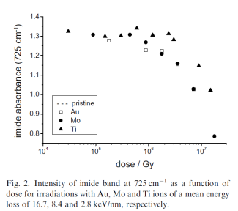
Ions at point 2 (see J. Jowett talk tomorrow)
(same physics and problem in IP1 and IP5, needs linked to the chosen operating scenarios)
Peak luminosity
Integrated luminosity
[J. Jowett, M. Schaumann]
ALICE upgrade luminosity goal for post LS2 is 10 nb⁻¹, 10 times the 1st phase, 10 nb⁻¹/y
Estimated dose of the most exposed dipole coil of 2.2 MGy/nb⁻¹ for a total of 22 MGy
[J. Jowett, M. Schaumann]
Cannot separate BFPP and main beam in warm area (TCLs not useful) .BFPP beam is smaller than main beam (source is luminous region).
ALICE upgrade luminosity goal for post LS2 is 6×10²⁷ cm⁻² s⁻¹ nb⁻¹, 6 times the design value.
P_{BFPP1} =155W. Maximum power density in coil at 7 Z TeV P=15.5 mw/cm³ (design luminosity)
For upgrade luminosity P=93.3 mw/cm³ expected respected to the estimated dipole quench limit of 25-50 mW/cm³ [MB-MQ]
[J. Jowett, M. Schaumann]
[Lopez, Tommasini]

Slide 19
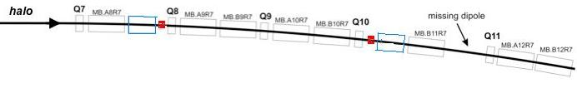
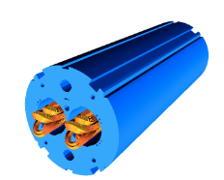
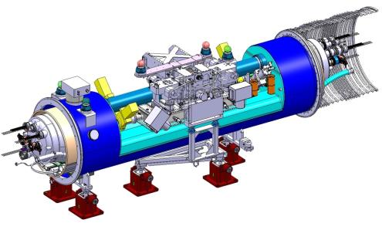
Integrated technological solution for point 2
(same solution deployable in IP 7 in case of need)
MB.A8R2
MB.A9R2
MB.B9R2
MB.A10R2
MB.B10R2
MB.B11R2
MB.A12R2
MB.B12R2
LTC Main Features (as presented in 2011 Review)
4.5 m between Interconnection Planes
[M. Karppinen]
Cryogenic By-pass
(QTC)
Sector Gate Valves (separate vacuum for QTC and TCLD)
[A. Bertarelli]
Collimator External Support
(fully independent from QTC)
Collimator Module (TCLD)

Slide 20
Few key data for cost and planning
Costs
  Collimation in warm section
    Collimators about 0.5 MCHF/unit-> 23 MCHF for the 46 foreseen units (upper bound). Strongly affected by the final choices by the scale up cost reduction of material for jaws and by the embarked rad hard electronics
  Collimation in cold sections
    Collimator TCLD: 0.5MCHF/unit-> 1 MCHF for 2 units in point 2
    Cryo-bypasses for the TCLD: 0.8MCHF/unit-> 1.6 MCHF for 2 units in point 2
    D11 T: 2×8.5 MCHF/unit-> 17 MCHF
    Total ion collimation IP2: 20 MCHF
Main planning milestones
  Collimation in warm section
    Parameter to be fixed 5 years before installation
    From decision of launching series production 3 years to get all the units at CERN (remarked possible staged installation, 1st unit at CERN after 2 years )
  Collimation in cold section
    TCLD including cryo-bypasses
      4.5 years before installation start proto phase
      3.5 years before installation place long lead component orders
      2.5 years before installation start assembly to be completed 6 month before installation
    End 2014 define if other strategies for IP2 are necessary (i.e. study magnet displacement)
    Beginning 2015: launch final Nb₃Sn conductor production
    Final D11 T model validation July 2015
    Cold mass assembly mid 2016->August 2018 (including tests)

Slide 21
Beam diagnostic

Slide 22
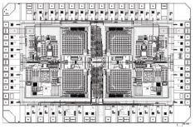
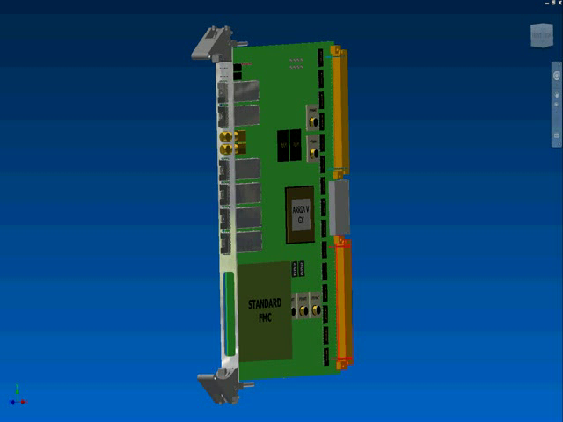
Beam Instrumentation
Radiation Hard Electronics
  7TeV quench levels close to noise level of the acquisition system (IR3/IR7/LSS)
    Due to long cables from detectors to front-end electronics
  Development started on radiation hard Application Specific Integrated Circuit (ASIC) to remove need for such cables
Consolidation of BLM Electronics
  Replacement of surface electronics with new digital acquisition system
  Allows additional BLM functionality not possible with today’s system
  Proposed for 2014-2018 using CONS budget
Upgrade to Synchrotron Light Monitor
  Interlocked abort gap monitor
  Prototype for LS2 full installation LS3
New Wideband Pick-ups for Instability Monitoring
  Prototyping phase for crab cavity diagnostics
[R. Jones]

Slide 23
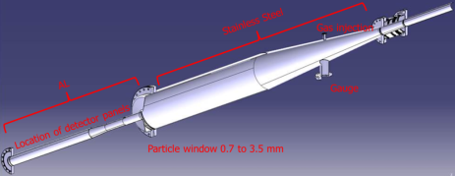
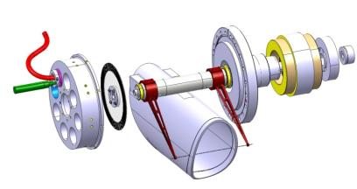
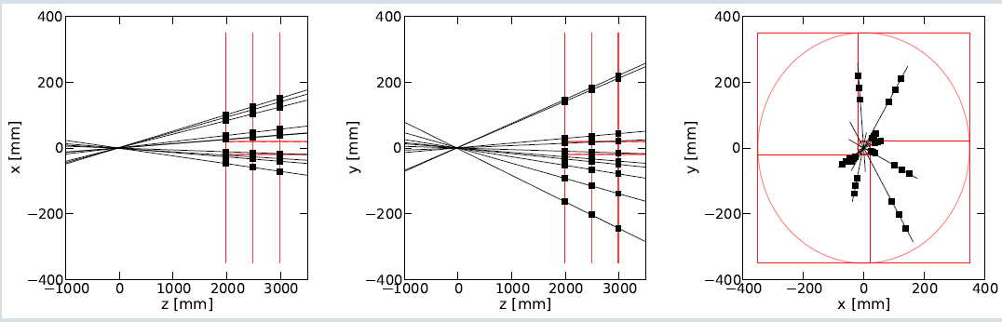

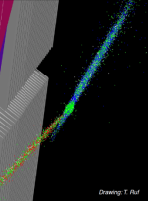
Emittance Measurement (IP4)
Fast Wire Scanners
  Would allow average emittance measurement of every batch at injection
    Currently limited to first 2 batches injected
  Principle to be tested in SPS in 2014
  LHC prototype for LS2 & full installation for LS3
Beam Gas Vertex Detector – BGV
  Prototype underway for installation during/after LS1
  Full system would significantly enhance emittance measurement capabilities
  Transparent for the beam, no shower on magnets
Optical fibre
X Axis: Optical position sensor
Motor
Resolver
Y Axis: Diamond Detector
[R. Jones]
All components in vacuum
Eliminates moving bellows
Designed to be faster and to stand higher beam load
[R. Jones]

Slide 24
Few key data for cost and planning
PIC beam diagnostic
  Parameters fixed 4 years before installation
  Main order placed 2-3 years before installation
  Completion of delivery at CERN 1 year before installation
Interaction region instrumentation:
  Parameters fixed/development start 3 years before the installation in the magnet cold masses (probably 2016)
  1st order placed 2 years before installation in cold masses
  Assembly of equipment 1 year before
Equipment | Approx. cost [MCHF]
Radiation hard electronics | 0.6
BLM electronics | 1
Synchrotron light monitor upgrade | 0.4
Instability monitor | 0.2
Fast wire scanner | 0.6
Beam Gas Vertex detector | 1.1
Cryogenic BLM | 1.7
BPM Q1 to Q5 | 1.2

Slide 25
SC link caveat: The use of radiation-hard power converter (not discussed here and in any case needed for 120 A ) can partially solve the radiation problem, but probably not the exposure to radiation of the maintenance team

Slide 26
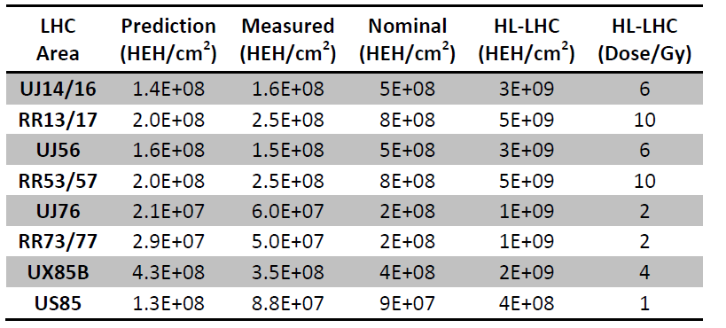
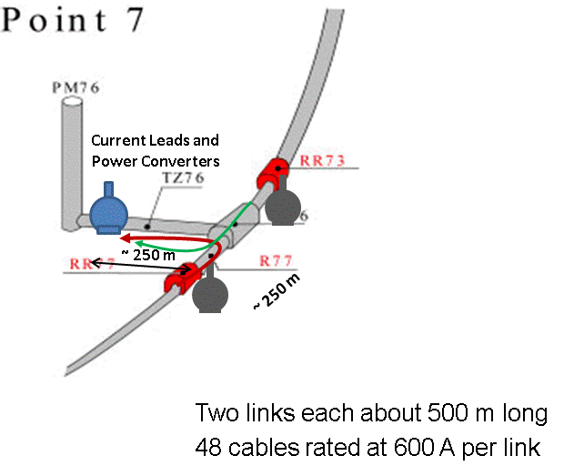
Estimated dose for electronics
PIC (HEH/cm²)
7E+8
1 E+9
7E+8
1E+9
3E+8
3E+8
6E+8
1.8E+8
During last year of operation
we had a number of radiation induced failures
at 10⁸ -10⁹ cm⁻² y⁻¹
Below 10⁷ HEH failures unlikely
TID also an issue
[M. Brugger]
Superconducting Link in point 7
Two Superconducting Links installed in underground areas
Powering of 600 A circuits
New DFBs installed in TZ76
None or very limited civil engineering required
R&D well advanced: prototype link tested
Test of full system (DFB and SC Link) in SM-18 by end 2014
Installation in LHC during LS2
Procurement of series to be launched in 2015
Cost SC link IP 7 5 MCHF
[A. Ballarino]

Slide 27
Cryogenics

Slide 28
Total load per sector 1.9 K and 20-300 K ranges
 | 1.8 K | 20-300K
T O D A Y
+ IP4 + IP1 + IP5
Present installed capacity of LHC cryoplants
Present installed capacity of LHC cryoplants
Load on Sector 1.8 K unit [W]
Load on Sector 1.8 K unit [W]
[L. Tavian]

Slide 29
Total load per sector 4.6-20K range
 | 4.6-20 K e-cloud Dipole off | 4.6-20 K e-cloud Dipole on
T O D A Y
+ IP4 + IP1 + IP5
Present installed capacity of LHC cryoplants
S45 no separate cryo for RF
Load on 4.5 K sector cryoplant [kW]
Load on 4.5 K sector cryoplant [kW]
Present installed capacity of LHC cryoplants
Load on 4.5 K sector cryoplant [kW]
Load on 4.5 K sector cryoplant [kW]
[L. Tavian]

Slide 30
Remaining cooling budget for beam scrubbing: the bottlenecks
RF Plant IP4 gets rid of bottleneck in sector 3-4 and 4-5
Remaining cooling budget [W/m aperture]
Larger margins for beam scrubbing obtained with additional cryoplants at P4 (RF cooling) and at P1 & P5 (IT/MS cooling)
[L. Tavian]

Slide 31
New cryo-hardware requirement
Hardware | PIC | US1 | US2
New QRL line and Service Modules for IT | Y | Y | Y
New QRL line and Service Modules for MS | N | Y | Y
New QRL Service Modules for DS P1 & P5 | N | Y | Y
New Cryoplant for RF at P4 | Y/N ⁽¹⁾ | Y | Y
New Cryoplants for IT at P1 & P5 | Y/N ⁽²⁾ | Y | Y
Keep in mind to dimension for future steps and needs i.e. vertical distribution lines…
Loss of about 2 points, i.e. 4 days per operation year (200 d/y)
⁽¹⁾: Y, depending on the required margins for e-clouds and on the required HWC/sectorization flexibility.
⁽²⁾: Y, depending on required temperature margins and on the required HWC/sectorization flexibility.
2012 availability
… but reduced-load plants could be more tolerant (lower risk of stops)
… but thank to a new sectorization, possible significant gain of time if specific interventions or HWC are required on RF modules and/or high luminosity insertions (IT + MS)
[L. Tavian]

Slide 32
Few key data for cost and planning
System | Cost
Cryo plant IP4 | 15 MCHF
Cryo plant IP1 | 37 MCHF
Cryo plant IP5 | 37 MCHF
: Freeze of heat load requirement

Slide 33
High Radiation point reconfiguration

Slide 34
POINT 7 integrated dose to material
POINT 7 residual dose at 40 cm after 6 months of cooling
Dose LS3 [MGy]
350 fb⁻¹
Dose PIC
[MGy]
1000 fb⁻¹
Dose US2
[MGy]
3000 fb⁻¹
Dose with shielding
Installed LS1-LS2
Reduction factor 0.35
[S. Roesler, C. Adorisio]

Slide 35
Conclusions
PIC actions
  Concern practically all the sectors of the machine
  The are spread between the 1st long technical stop after LS1 and LS3
Interaction region interventions in IP 1 and 5 provide safe operation for
2025->2035 years and the required luminosity capacity (See G. Arduini talk)
Collimation interventions push down the whole machine impedance providing more robust collimators and ensure safe ion run in IP2. Remark: the collimator lifetime is being analysed in this moment. Possible intervention on secondaries could be necessary to provide reliable exploitation after LS2
Beam diagnostic interventions provide the necessary diagnostic capacity, with hardware compatible with the higher radiation dose
Sc links provide a solution to radiation electronic issues for the Power converters, but also contribute in reducing collective dose, interventions time and reduce risk of SEE
Cryoplant at point 4 provides flexibility in the management of the RF interventions and eliminate the 1st machine bottleneck in term of cooling capacity. All cryo installation have to be performed with a long term view from the installation/integration perspective (foresee for future needs)
High radiation dose point call for radiation management and possible reconfiguration to provide the best as possible reliability and access conditions. Radiation tolerant electronic development (including R&D and testing) will affect several equipment groups (costs, resources)

Slide 36



For new and
unexpected
discoveries
with PIC, LHC will leave
new adventures and,
who knows,
one could be…
[Angela and Luca]

Slide 37
Back up slides

Slide 38
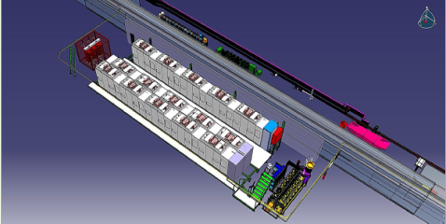
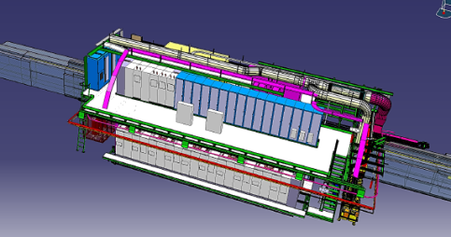
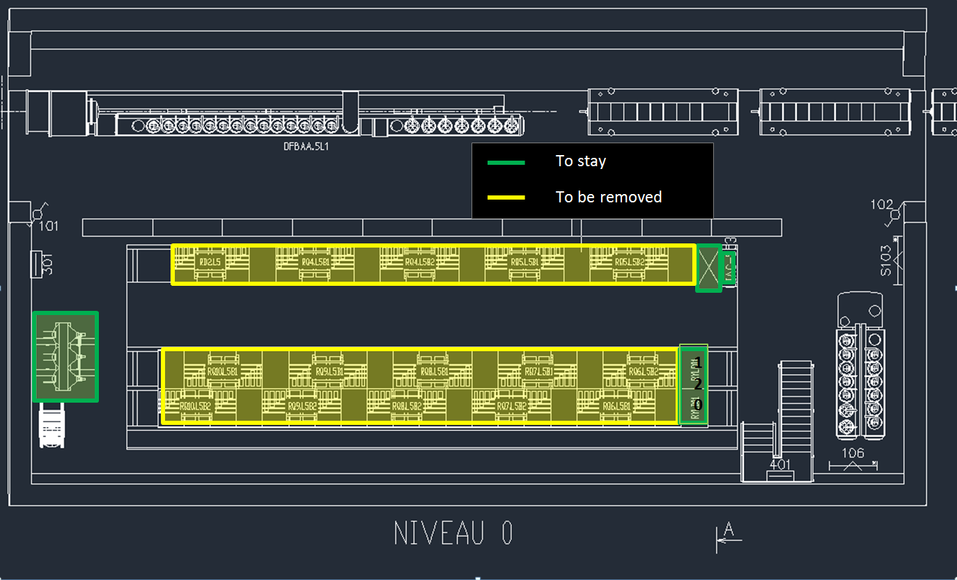
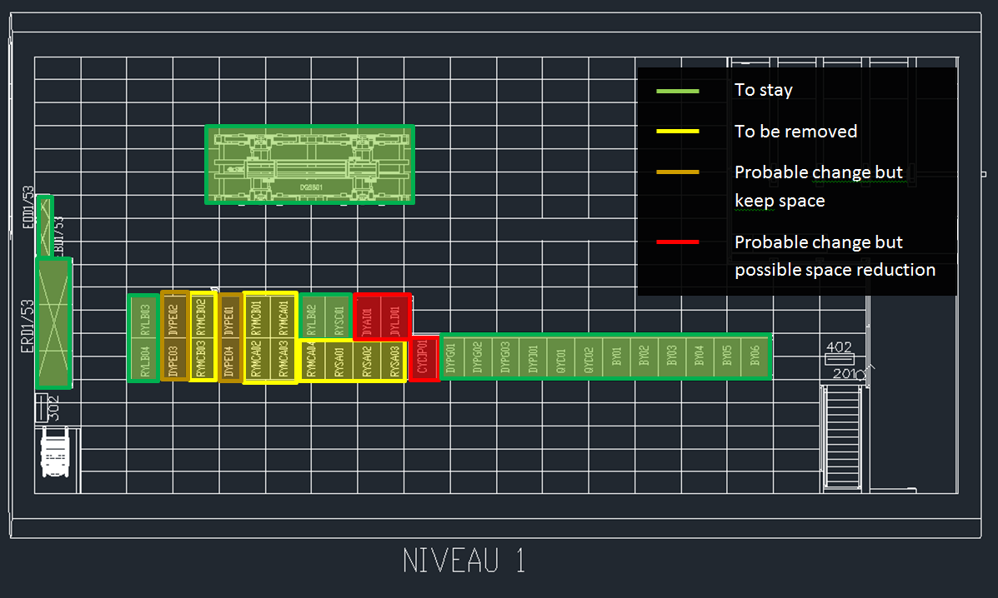
SC link Point 1 and 5 for power converters in the RRs

Slide 39
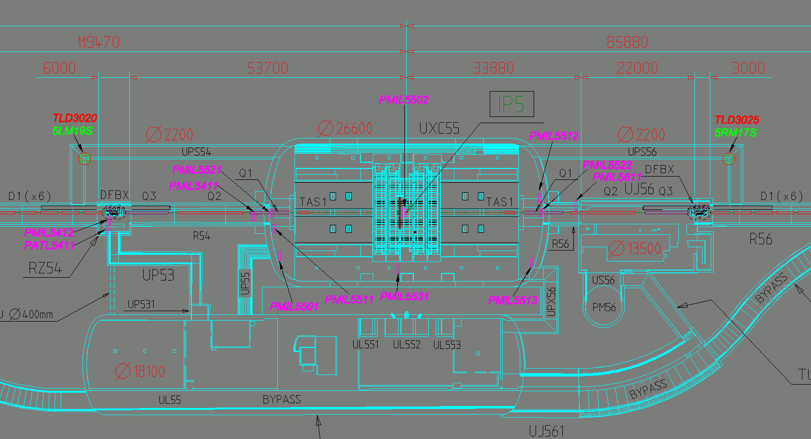
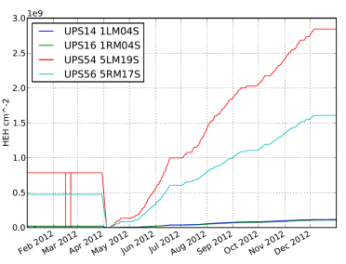
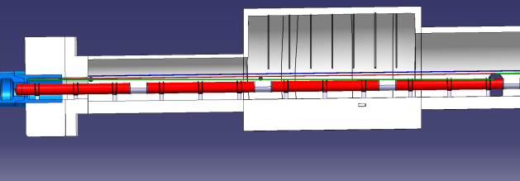
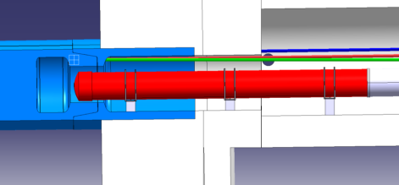
Alignment
 | Scaling factor approx. with luminosity
PIC | 3
US1 | 7
US2 | 12

Slide 40
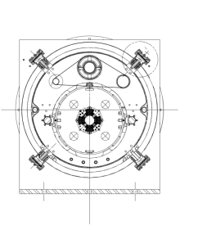
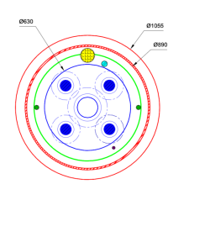
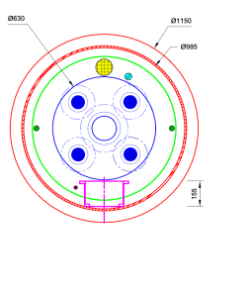
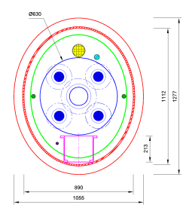
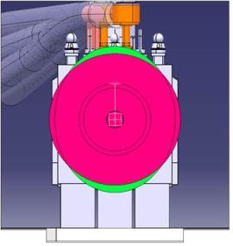
Cryostat system
Heat exchanger
Quench line
Pumping line
OD 1055
Thermal shield cooling
“Spider” support
Cold mass
Standard cryostat diameter no solution to accommodate all manifolds
Larger diameter cryostat, but compatible with transport space, feasible but issues (heat loads)
Elliptical cryostat. Very good accommodation but technological challenges
The 2 solutions in the
IP 5 shielding

Slide 41
Cryogenics
PIC-US1-US2
(updated version2)
16 October 2013
RLIUP Preparation
L. Tavian, TE-CRG

Slide 42
Content
Beam parameters for IC, US1 and US2
Heat loads for PIC, US1 and US2
Margin for beam scrubbing
Temperature profile (line B pressure drop)
Cryoplant sizing
Availability
New cryo-hardware requirement

Slide 43
Beam parameters (impacting cryo) for PIC and upgrade scenarios
Parameters |  | PIC | US1 | US2
E | [TeV] | 7 | 7 | 7
Nb | [# p / bunch] | 1.38E+11 | 1.9E+11 | 2.2E+11
nb | [-] | 2760 | 2592 | 2760
L | [Hz/cm-2] | 2.96E+34 | 5E+34 | 5E+34
σ | [ns] | 1 | 1 | 1

Slide 44
Heat loads
To be validated by the Heat Load Working Group!

Slide 45
Total loads per sectors
Present installed capacity of LHC cryoplants
4.6 – 20 K (Dipole off)
4.6 – 20 K (Dipole on)
A strong show-stopper!!
1.9 K
20 – 300 K

Slide 46
Remaining cooling budget for beam scrubbing
Larger margins for beam scrubbing obtained with additional cryoplants at P4 (RF cooling) and at P1 & P5 (IT/MS cooling)

Slide 47
Magnet temperature profile
(Line B pressure drop)
Still acceptable? For new magnets? For existing magnets (arc and DS)?
Without IT cryoplants
With IT cryoplants
New IT cryoplants required for US1 & US2.

Slide 48
Size of new IT cryoplants (provisional)
Uncertainty coefficient, fu: 1.5
Overcapacity coefficient, fo: 1.5
(Qsta*fu + Qdyn)*fo
To be validated by the Heat Load Working Group!

Slide 49
Size of new RF cryoplant (provisional)
Uncertainty coefficient, fu: 1.25 for existing component (400 MHz RF module)
1.5 for new equipement
Overcapacity coefficient, fo: 1.5
(Qsta*fu + Qdyn)*fo
To be validated by the Heat Load Working Group!

Slide 50
Total loads on sector cryoplants
(with additional cryoplants at P4, P1 and P5)
Present installed capacity of LHC cryoplants
4.6 – 20 K (Dipole off)
4.6 – 20 K (Dipole on)
1.9 K
20 – 300 K

Slide 51
Availability
Loss of about 2 points, i.e. 4 days per operation year (200 d/y)
2012 availability
… but reduced-load plants could be more tolerant (lower risk of stops)
… but thank to a new sectorization, possible significant gain of time if specific interventions or HWC are required on RF modules and/or high luminosity insertions (IT + MS)

Slide 52
New cryo-hardware requirement
Hardware | PIC | US1 | US2
New QRL line and Service Modules for IT | Y | Y | Y
New QRL line and Service Modules for MS | N | Y | Y
New QRL Service Modules for DS P1 & P5 | N | Y | Y
New Cryoplant for RF at P4 | Y/N ⁽¹⁾ | Y | Y
New Cryoplants for IT at P1 & P5 | Y/N ⁽²⁾ | Y | Y
⁽¹⁾: Y, depending on the required margins for e-clouds and on the required HWC/sectorization flexibility.
⁽²⁾: Y, depending on required temperature margins and on the required HWC/sectorization flexibility.

Slide 53





layouts
Aperture ∼twice the LHC baseline (70 mm to 150 mm),
but more compact triplet layout thanks to Nb₃Sn and superconductive D1
LHC
HL LHC

Slide 54
SHIELDING
One key element is a shielding to bring radiation dose and heat load down to LHC baseline
    For 1000 fb⁻¹ this gives 10 MGy (safe, limit at 30-50 MGy)
    For 3×10³⁴ cm⁻² s⁻¹ peak lumi one has 1.5 mW/cm³ (safe, quench limit at 4 mW/cm³ in LHC)
    Apart from structural elements we have 6 mm W inserts
      That’s a challenging piece – model should be realized in 2014
Radiation dose and heat load [Cerutti, Esposito]
Beam screen in the triplet and in the correctors[Kersevan]

Slide 55


QUADRUPOLES
Triplet made with Nb₃Sn technology
  Long history of development in US, since 2002 (LARP)
    120 mm aperture 1 m long model HQ reaching most of the specifications (FQ, performance,…)
    90 mm 3.4-m-long model LQ (first long Nb₃Sn coils) succesful
  HQ performance similar to MQXC (Nb-Ti twin of HQ)
HQ magnet, 120 mm aperture with final structure
LQ magnet, first 3.4 m long Nb₃Sn magnet

Slide 56
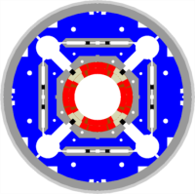
QUADRUPOLES
Production shared between US and CERN
  Timeline:
    First short model 2015, First prototype end 2016
    2017-2020: production
Risks
Heat exchanger
Coil
Al cylinder
Iron
QXF cross-section
Winding of the first practice coil at CERN

Slide 57

CORRECTORS
Orbit correctors:
  2.5 T m at Q1 and Q2, and 4.5 T m at Q3, both H and V
  Nb-Ti technology, nested option to save space (4 m)
    2.1 T field, giving 1.2 and 2.2 m long magnets
  Collaboration with CIEMAT (ES)
    Deliverable: one 1.2-long-magnet in 2016
Nonlinear correctors:
  Superferric option, not nested
    Easier operation, short heads, low current
    Typical lenght 15 cm, skew quad 80 cm
  Collaboration with INFN (Italy)
    Deliverable: B₂, B₃, B₄, B₅, B₆ correctors by 2016
Proposal for nested MCBX
(M. Karppinen, D. Smekens)
Proposal for nonlinear correctors
(F. Toral)

Slide 58

SEPARATION DIPOLE D1
Increase kick from 26 to 35 T m
  Nb-Ti technology, ∼5 T operational field, ∼7 m long
  Challenging field quality, large saturation
Collaboration with KEK (Japan)
  Deliverable: one short model by 2015
D1 cross-section, with cryostat
(Q. Xu, T. Nakamoto)
D1 b3 versus current
(Q. Xu, T. Nakamoto)

Slide 59
Beam Diagnostics
PIC
Rhodri Jones (BE/BI)

Slide 60

BI-PIC BLM
Cryogenic BLMs (1.7 MCHF)
  Current LSS configuration not suitable for HL-LHC
    Cannot distinguishing dangerous losses from collision debris
  Detectors for cryogenic environments studied
    To be placed inside cryostat of the new triplet magnets
    Dose measured more accurately represents correspond dose deposited in the coils
Radiation Hard Electronics (0.6 MCHF)
  7TeV quench levels close to noise level of the acquisition system (IR3/IR7/LSS)
    Due to long cables from detectors to front-end electronics
  Development started on radiation hard Application Specific Integrated Circuit (ASIC) to remove need for such cables
Consolidation of BLM Electronics (1 MCHF)
  Replacement of surface electronics with new digital acquisition system
  Allows additional BLM functionality not possible with today’s system
  Proposed for 2014-2018 using CONS budget

Slide 61


BI-PIC Emittance Measurement #1
Fast Wire Scanners (0.6 MCHF)
  Would allow average emittance measurement of every batch at injection
    Currently limited to first 2 batches injected
  Principle to tested in SPS in 2014
  LHC prototype for LS2 & full installation for LS3
Optical fibre
X Axis: Optical position sensor
Motor
Resolver
Y Axis: Diamond Detector
All components in vacuum
Eliminates moving bellows

Slide 62


BI-PIC Emittance Measurement #2
Beam Gas Vertex Detector – BGV
  200kCHF for prototype in 2013-2015 & 850kCHF for final installation (LS2)
  Prototype underway for installation during/after LS1
  Full system would significantly enhance emittance measurement capabilities

Slide 63
Other BI-PIC
New BPMs Q1 to Q5 (1.2 MCHF)
  New design required for new triplet layout
    Need to minimise transverse impedance
    Need for tungsten shielding
Upgrade to Synchrotron Light Monitor (0.4 MCHF)
  Interlocked abort gap monitor
  Prototype for LS2 full installation LS3
New Wideband Pick-ups for Instability Monitoring (0.2 MCHF)
  Prototyping phase for crab cavity diagnostics
Long Range Beam-Beam Compensator Prototype (1 MCHF)
  On-going with installation foreseen between LS1 and LS2

Slide 64
Superconducting Links at P7, PIC
Two Superconducting Links installed in underground areas
Powering of 600 A circuits
New DFBs installed in TZ76
None or very limited civil engineering required
R&D well advanced: prototype link tested
Test of full system (DFB and SC Link) in SM-18 by end 2014
Installation in LHC during LS2 (2018)
Procurement of series to be launched in 2015
A. Ballarino, October 2012

Slide 65
Superconducting Links at P1 and P5, PIC
Hi-Luminosity Insertions
Two Superconducting Links per point – from surface to
underground areas
New DFBs installed in at the surface
Integration studies started
Need for civil engineering to be verified – integration
studies in 2014. If needed, LS2 or earlier
R&D in progress
Test of full system (DFB and SC Link) at CERN in 2015
Installation in LHC during LS3 (2022)
Procurement of series to be started by end 2016
A. Ballarino, October 2012

Slide 66
Superconducting Links at P1 and P5
Matching Sections and Arc
Two Superconducting Links per point – from surface to
underground areas – for powering of MSs
Two Superconducting Links per point – from surface to
underground areas – for powering of arcs
Need for civil engineering to be verified
R&D Combined with development of system for Triplets
→ Test of full system (DFB and SC Link) in 2015
Installation in LHC during LS3 (2022) or LS2 (2018)
Procurement of series to be started by end 2015 for
  integration during LS2
A. Ballarino, October 2012

Slide 67
IP 6 new TCLAs

Slide 68

Q4
0.6
0.1
Gain : a factor of
6
Profile over Z of the maximum energy deposition on the Q4 coils.
Values are in mW cm⁻³
Normalisation [2.2 · 10¹¹ p/bunch – 2808 bunches lost in 1 hour * (1854/6.4 · 10⁶ ) ]

Slide 69

Q5
1.3
0.4
Gain : a factor of 3.3
Profile over Z of the maximum energy deposition on the Q5 coils.
Values are in mW cm⁻³
Normalisation [2.2 · 10¹¹ p/bunch – 2808 bunches lost in 1 hour * (1854/6.4 · 10⁶ ) ]

Slide 70


Q4
Total Energy deposition
Without TCLA : 2.76 W With TCLA : 0.40 W
X,Y cross section at the Z of the maximum energy deposition on the Q4
Values are in mW cm⁻³
Normalisation [2.2 · 10¹¹ p/bunch – 2808 bunches lost in 1 hour * (1854/6.4 · 10⁶ ) ]

Slide 71


Q5
Total Energy deposition
Without TCLA : 2.15 W With TCLA : 0.66 W
X,Y cross section at the Z of the maximum energy deposition on the Q5
Values are in mW cm⁻³
Normalisation [2.2 · 10¹¹ p/bunch – 2808 bunches lost in 1 hour * (1854/6.4 · 10⁶ ) ]

Slide 72

Q4 Asynchronous Beam Dump
10.5
1.8
Gain : a factor of 5.8
Profile over Z of the maximum energy deposition on the Q4 coils
Values are in J cm⁻³
Normalisation [2.2 · 10¹¹ p/bunch – 40 bunches]

Slide 73

Q5 Asynchronous Beam Dump
32.9
8.6
Gain : a factor of 3.8
Profile over Z of the maximum energy deposition on the Q5 coils
Values are in J cm⁻³
Normalisation [2.2 · 10¹¹ p/bunch – 40 bunches]

Slide 74


Q4
Total Energy deposition
Without TCLA : 49.34 kJ With TCLA : 14.22 kJ
X,Y cross section at the Z of the maximum energy deposition on the Q4
Values are in J cm⁻³
Normalisation [2.2 · 10¹¹ p/bunch – 40 bunches]

Slide 75


Q5
Total Energy deposition
Without TCLA : 32.08 kJ With TCLA : 8.157 kJ
X,Y cross section at the Z of the maximum energy deposition on the Q5
Values are in J cm⁻³
Normalisation [2.2 · 10¹¹ p/bunch – 40 bunches]

