Slide 1
PICs: what do we gain in beam performance?
G. Arduini
with input from: D. Banfi, J. Barranco, O. Brüning, R. De Maria, O. Dominguez, S. Fartoukh, P. Fessia, S. Gilardoni, B. Gorini, G. Iadarola, V. Kain, M. Kuhn, E. Métral, N. Mounet, T. Pieloni, S. Redaelli, L. Rossi, G. Rumolo, R. Tomàs, A. Valishev, J. Wenninger and in general LIU and HL-LHC teams

Slide 2
Outline
Beam parameters:
  Injectors
  LHC
Beam Parameter Evolution during the fill
Yearly performance
Key questions and studies
Conclusions

Slide 3
Beam Parameters
5% intensity loss assumed during the cycle
  ➔ Average lifetime along the cycle before collision of ~22 hours
  But minimum lifetime > 0.2 hours (assuming tight collimator settings) limited by power deposited on the collimators
Emittance blow-up of 20% from SPS extraction to LHC collision when compatible with inevitable sources of blow-up ➔ IBS
  Margin of ~10-15 % on the average emittance blow-up on top of IBS
  IBS calculations including injection/ramp and squeeze assuming controlled-longitudinal blow-up to keep bunch length at 10 cm up to flat-top
 | SPS Extraction |  | LHC collision (min. value – IBS) | LHC collision
 | Bunch population [10¹¹] | ε_{n} (H/V) [μm] | ε_{n} (H/V) [μm] | Bunch population [10¹¹] | ε_{n} _{coll} (H/V) [μm] | Blow-up [%]
BCMS | 1.45 | 1.45/1.45 | 1.74/1.45 | 1.38 | 1.85/1.85 | 27
Standard | 1.45 | 1.85/1.85 | 2.09/1.85 | 1.38 | 2.25/2.25 | 21
AGREED - LIU
R. Tomàs, O. Dominguez
Notes:
28% blow-up for BCMS case
21 % blow-up for standard case

Slide 4
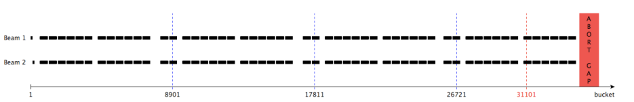
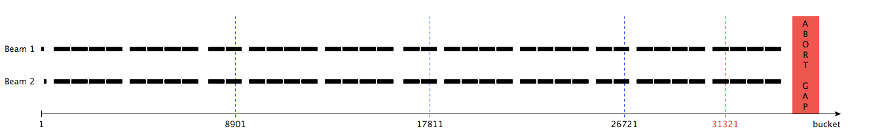
Beam parameters (Filling schemes - 25 ns)
Filling scheme | Total | IP1-5 | IP2 | IP8
BCMS: 48b 6 PS inj, 12 SPS inj | 2604 | 2592 | 2288 | 2396
Standard: 72b 4 PS inj, 12 SPS inj | 2748 | 2736 | 2452 | 2524
B. Gorini

Slide 5
Implications & Assumptions (e-cloud)
Control of the blow-up due to e-cloud via scrubbing at 450 GeV
  Emittance blow-up occurs when electron cloud activity in the dipoles
  SEY reduction in the dipoles at 450 GeV with 25 ns scrubbing run. Need margin for small emittance/shorter bunch ➔ doublet beams being considered and LS1 interventions to increase cryo-margin at injection (SAM and Sector 34)
G. Iadarola, G. Rumolo
25 ns scrubbing (2011/12)
Expect heat load in the quadrupoles due to the lower threshold SEY ➔ cryo upgrade (c/o P. Fessia)
HL-LHC triplets/D1 will have e-cloud countermeasures implemented (aC coatings and possibly clearing electrodes)

Slide 6
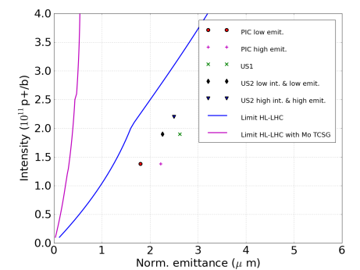
Implications & Assumptions (impedance)
Collimators are the largest source of impedance in the LHC.
Possible limitation in minimum opening and β* reach
Interplay between impedance and beam-beam possible origin of the instabilities observed in 2012 (not fully understood yet)
Limited margin for all the scenarios based on extrapolations from 2012 (with positive octupole polarity)
Impedance reduction with metallic collimators (Mo-C) to provide safe margin
EFFECT OF CHROMATICITY, DAMPER, OCTUPOLES INCLUDED
E. Métral, N. Mounet

Slide 7
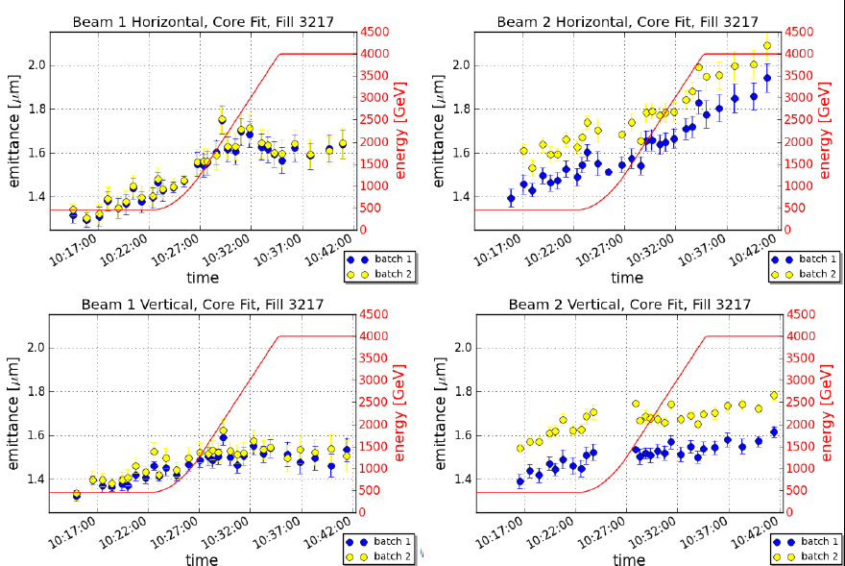
Implications & Assumptions
Control of the additive sources of blow-up (injection errors, noise, etc.)
  Contributions at injection and first part of the ramp in H-plane consistent with IBS
V. Kain, M. Kuhn
  Asymmetry between the two beams and planes
  Not yet managed in reducing observed blow-up
  Assume progress in the understanding and solutions. Had a similar process in the injectors.

Slide 8
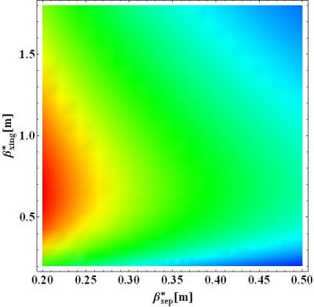
Optics
Minimum β* in IR1 and 5 limited by aperture in the matching section
  TAN,Q5,Q4,D2 become aperture bottlenecks ➔ need to install new TCTs in IR1-5 for D2-Q5 for protection
Two flat optics considered with maximum β* ratio = 2 (S. Fartoukh):
  β*_{xing}= 40 cm / β*_{sep} =20 cm
  β*_{xing}= 50 cm / β*_{sep} =25 cm
The latter providing more margin in aperture and possibly better behaved in the absence of MS in Q10
Flat beams likely require larger beam-beam separations as compared to round. Larger β* ratios (>2) might imply larger B-B separations ➔ being further investigated
β*_{xing}/β*_{sep}=4
β*_{xing}/β*_{sep}=3
β*_{xing}/β*_{sep}=2
β*_{xing}/β*_{sep}=1
Peak luminosity (Max=2.6x10³⁴ – Min=1.2x10³⁴) at constant beam-beam separation (14 σ)
Notes:
1.2

Slide 9
Peak Performance at 6.5 TeV
Momentum [TeV/c] | 6.5
Bunch population in collision [10¹¹ p] | 1.38
Total RF Voltage [MV] | 16
ε_{L}*[eV.s] at start of fill | 3.6
Bunch length (4 σ)[ns]/ (r.m.s.) [cm] | 1.33/10
Beam-beam separation [σ] | 14
 | ε*_{n} _{coll} [μm] | # Coll. Bunches IP1,5 | Xing angle [μrad] | BB separation [σ] | L_{peak} [10³⁴ cm⁻²s⁻¹]
BCMS – 40/20 | 1.85 | 2592 | 364 | 14 | 2.9
Standard - 40/20 | 2.25 | 2736 | 400 | 14 | 2.5
BCMS – 50/25 | 1.85 | 2592 | 326 | 14 | 2.7
Standard – 50/25 | 2.25 | 2736 | 360 | 14 | 2.3

Slide 10
Performance estimate during collisions
Evolution of beam parameters based on:
  Burn-off
    Total cross-section: 100-110 mb (assumed worst case 110 mb for E_{cm}=13-14 TeV)
Emittance evolution (no coupling assumed) including:
  IBS
  Radiation damping
Additional (unknown) sources of loss/blow-up from comparison with 2012 fills with similar bunch populations with no sign of instability
  Intensity loss (τ ~ 200 hours)
  Vertical emittance blow-up (τ ~ 40 hours)
Finite difference method (5 mins step)

Slide 11
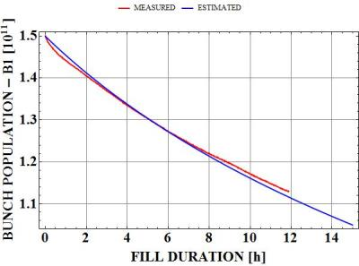
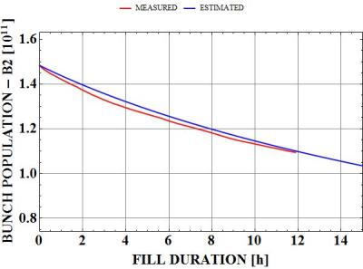
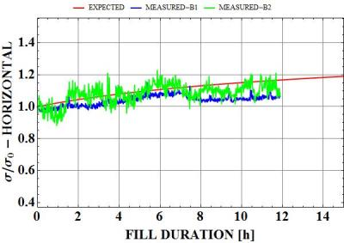
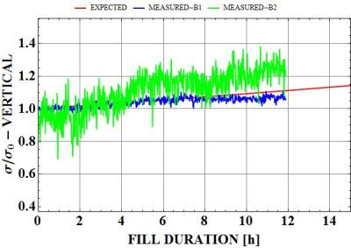
Comparison with 2012 (Fill 2728)
No sign of instability
Bunch population similar to PIC scenario
BSRT-relative
BSRT-relative

Slide 12
Comparison with 2012 (Fill 2728)

Slide 13
Integrated luminosity targets
Assumptions:
  Luminosity in 2015=30 fb⁻¹
  310 fb⁻¹ by the end of 2021. (M. Lamont 6th HL-LHC Coordination Group meeting 26/07/13).
 | PIC | US1 | US2
Integrated luminosity by end 2021/ end 2035 | 310/1000 | 310/2000 | 310/3000
Number of years of operation after 2021 | 10 | 10 | 10
Target luminosity/year | 70 | 170 | 270

Slide 14
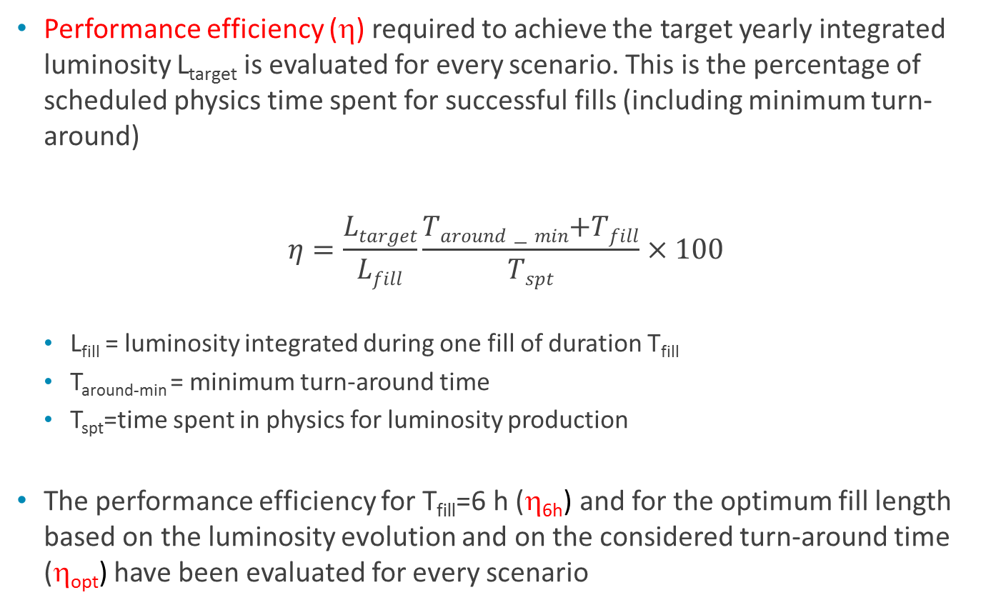
Yearly Performance
Performance efficiency (η) required to achieve the target yearly integrated luminosity L_{target} is evaluated for every scenario. This is the percentage of scheduled physics time spent for successful fills (including minimum turn-around)
$$η=\frac{Ltarget}{Lfill}\frac{Taround−min\text{+}Tfill}{Tspt}×100$$
  L_{fill} = luminosity integrated during one fill of duration T_{fill}
  T_{around-min} = minimum turn-around time
  T_{spt}=time spent in physics for luminosity production
The performance efficiency for T_{fill}=6 h (η_{6h}) and for the optimum fill length based on the luminosity evolution and on the considered turn-around time (η_{opt}) have been evaluated for every scenario
# successful physics fills/year

Slide 15
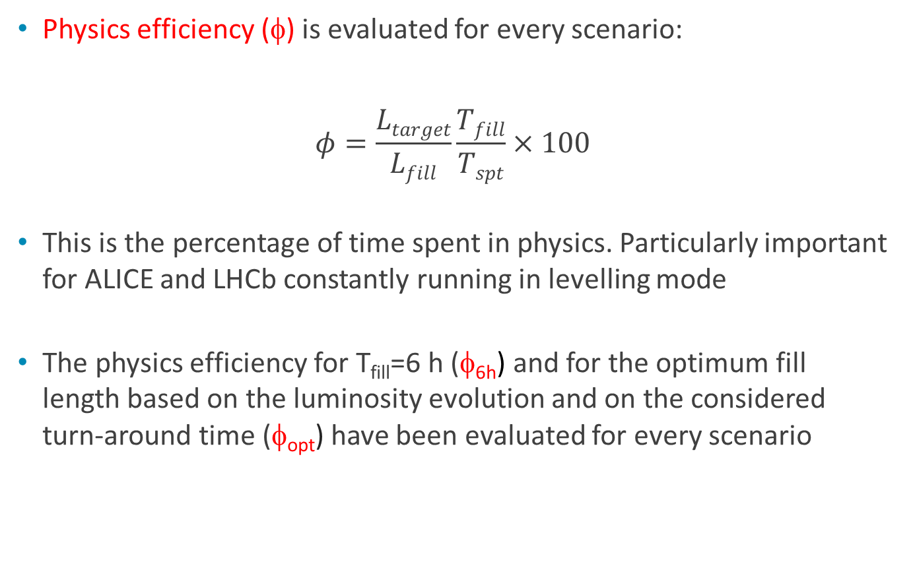
Yearly Performance
Physics efficiency (φ) is evaluated for every scenario:
$$φ=\frac{Ltarget}{Lfill}\frac{Tfill}{Tspt}×100$$
This is the percentage of time spent in physics. Particularly important for ALICE and LHCb constantly running in levelling mode
The physics efficiency for T_{fill}=6 h (φ_{6h}) and for the optimum fill length based on the luminosity evolution and on the considered turn-around time (φ_{opt}) have been evaluated for every scenario

Slide 16
Yearly Performance
2012 data
Scheduled Physics Time for p-p luminosity production/year (T_{spt}) [days] | 190.5
Minimum Turn-Around Time (T_{around-min}) [h] | 2.2
Average Fill length T_{fill}[h] | 6.1
Integrated Luminosity (L_{int}) [fb⁻¹] | 23.3
Physics efficiency φ [%] | 36
Fills that made it to physics (N_{fill}) | 295
Performance efficiency η = N_{fill}*(T_{around-min}+T_{fill})/T_{spt}*100 [%] | 53.5

Slide 17
Yearly Performance
HL-LHC Assumptions
Scheduled Physics Time for p-p luminosity production/year (T_{phys}) [days] | 160
Minimum Turn-Around Time [h] | 3
Average Fill length [h] | 6 or optimum
Performance Efficiency – goal [%] | 50
Pile-up limit [events/crossing] | 140
Pile-up Density limit – baseline (stretched) [events/mm/crossing] | 1.3 (0.7)

Slide 18
PIC @ 6.5 TeV (Pile-up limit at 140)
 | Lev. time [h] | Opt. Fill length [h] | η_{6h}/η_{opt} [%] | φ_{6h}/φ_{opt} [%] | Int. Lumi for η=50% for 6h /opt. fill length [fb⁻¹ /y] | Max. Mean Pile-up density/Pile-up [ev./mm]/[ev./xing]
BCMS – 40/20 | - | 6.5 | 37/37 | 25/26 | 93/94 | 0.97/84
Standard - 40/20 | - | 7.3 | 40/40 | 27/28 | 87/88 | 0.79/69
BCMS – 50/25 | - | 6.8 | 39/39 | 26/27 | 89/89 | 0.77/78
Standard – 50/25 | - | 7.6 | 43/42 | 28/30 | 82/83 | 0.63/64
2012
6h
Goal
<50%
2012
36%
Goal > 70 fb⁻¹
<1.3/<140
All the configurations allow to achieve the target integrated luminosity per year with performance efficiency and physics efficiency compatible with 2012 values
Fill lengths are comparable (although slightly longer) to 2012 average ➔ Importance of consolidation to increase reliability
50/25 optics provides reduced pile-up density for small reduction of the integrated luminosity and it relaxes constraints on aperture/optics
Standard filling scheme provides slightly lower performance but it is more tolerant to additive sources of blow-up
Notes:
25 % for a pile-up of 4.5 would give 5.5 fb-1/year for LHCb

Slide 19
PIC @ 6.5 TeV (Pile-up limit at 45)
 | Lev. time [h] | Opt. Fill length [h] | η_{6h}/η_{opt} [%] | φ_{6h}/φ_{opt} [%] | Int. Lumi for η=50% for 6h /opt. fill length [fb⁻¹ /y] | Max. Avg. Pile-up density/Pile-up [ev./mm]/[ev./xing]
BCMS – 40/20 | 6.8 | 10.2 | 49/45 | 33/34 | 71/79 | 0.53/45
Standard - 40/20 | 5.3 | 9.6 | 47/44 | 31/33 | 75/80 | 0.53/45
BCMS – 50/25 | 6.2 | 9.8 | 49/45 | 33/35 | 71/77 | 0.45/45
Standard – 50/25 | 4.5 | 9.2 | 47/45 | 32/34 | 74/78 | 0.46/45
With a reduced pile-up limit the target luminosity is still achievable but with reduced margin and longer fills (by >50 %)
BCMS and standard filling schemes provide the same performance with a slight advantage for the standard scheme due to larger number of bunches and therefore larger levelling luminosity for the same pile-up limit.

Slide 20
Yearly Performance
Assumed distribution (delta at T_{fill} - see J. Wenninger) is likely optimistic (10-20%) but:
  Improvement in reliability could be expected as a result of PICs and in particular:
    SC links in 1/5/7 ➔ R2E
    Cryogenics upgrade in point 4 and additional IR1-5 cryoplants providing more margin for operation

Slide 21
Key questions and studies required in Run 2
Confirmation of the feasibility of scrubbing the dipoles down to SEY=1.3-1.4 possibly with dedicated beams
Full understanding of the stability limits for single and two-beams
Study of the beam-beam effects with flat beams and large tune spread. Round beams with 30/30 cm and 12 σ separation as a back-up ➔ same pile-up density for smaller integrated luminosity (-12 %).
Understanding and Control of the additive sources of blow-up
Confirmation of the feasibility of β*-levelling as a possible solution for IP8

Slide 22
Conclusions
The luminosity target can be reached with 40/20 optics
  Comfortably, provided pile-up limit is increased above present values
BCMS production scheme gives slightly higher performance as compared to Standard filling scheme although the latter is less sensitive to additive sources of emittance blow-up
50/25 optics provides margin in aperture and offers a reduction of the pile-up density below 0.7 events/mm for a small reduction of the integrated luminosity but still within the target
Key questions and studies required in Run 2 have been sketched

Slide 24
Main Hardware Modifications (c/o P. Fessia)
  PIC
  New TAS, New IT, D1 with 150 mm aperture and correctors
  New collimators with buttons:
    new materials (Mo-C) for robustness and impedance (should be required already at this stage)
    new TCTs in IR1-5 for D2-Q5 for protection
  SC links in IR1-5, QRL
  New powering with SC links at P7 (RR)
  New Cryoplant P4 for SCRF
  Cryoplants in P1, 5

Slide 25
Peak Performance at 7 TeV
Momentum [TeV/c] | 7
Bunch population in collision [10¹¹ p] | 1.38
Total RF Voltage | 16
ε_{L}*[eV.s] at start of fill | 3.8
Bunch length (4 σ)[ns]/ (r.m.s.) [cm] | 1.33/10
Beam-beam separation [σ] | 14
 | ε*_{n} _{coll} [μm] | # Coll. Bunches IP1,5 | Xing angle [μrad] | L_{peak} [10³⁴ cm⁻²s⁻¹]
BCMS – 40/20 | 1.85 | 2592 | 351 | 3.1
Standard - 40/20 | 2.25 | 2736 | 387 | 2.7
BCMS – 50/25 | 1.85 | 2592 | 315 | 2.9
Standard – 50/25 | 2.25 | 2736 | 347 | 2.5

Slide 26
PIC @ 7 TeV (Pile-up limit at 140)
“Visible” cross-section IP1-5 [mb] for pile-up estimation | 85
“Visible” cross-section IP8 [mb] for pile-up estimation | 75
Pile-up limit IP1 | 140
Pile-up limit IP5 | 140
Pile-up limit IP8 | 4.5
Luminosity limit IP2 [10³⁴ cm⁻² s⁻¹] | 0.002
 | Lev. time [h] | Opt. Fill length [h] | η_{6h}/η_{opt} [%] | φ_{6h}/φ_{opt} [%] | Int. Lumi for η=50% for 6h /opt. fill length [fb⁻¹ /y] | Max. Avg. Pile-up density/Pile-up [ev./mm]/[ev./xing]
BCMS – 40/20 | - | 6.6 | 34/34 | 23/24 | 102/102 | 1.0/90
Standard - 40/20 | - | 7.4 | 37/37 | 25/26 | 95/95 | 0.85/74
BCMS – 50/25 | - | 6.8 | 36/36 | 24/25 | 97/97 | 0.83/84
Standard – 50/25 | - | 7.6 | 39/39 | 26/28 | 90/91 | 0.68/69
50/25 optics reduced pile-up density for small reduction of the integrated luminosity)

Slide 27
Break-down of Turn-Around (HL-LHC)
Phase | Duration [min]
Ramp down/pre-cycle | 60
Pre-injection checks and preparation | 15
Checks with set-up beam | 15
Nominal injection sequence | 20 (=2*12 injections*48.8s)
Ramp preparation | 5
Ramp | 25
Squeeze/Adjust | 40
Total | 180
M. Lamont

Slide 28
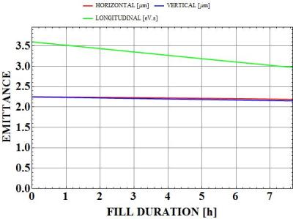
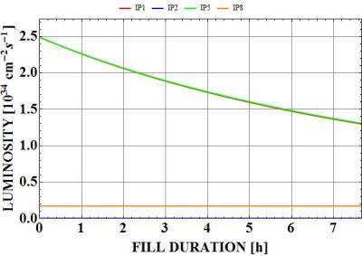
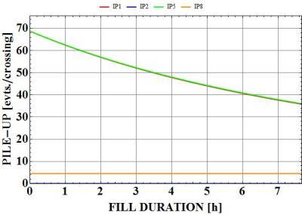
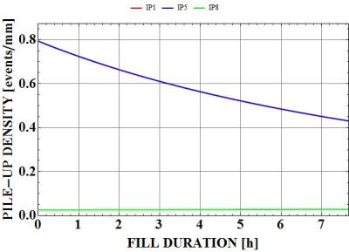
Parameter evolution at 6.5 TeV (model)
Standard filling – 40/20 optics

Slide 29
PIC @ 6.5 TeV (Pile-up limit at 140) – 30/30
 | ε*_{n} _{coll} [μm] | # Coll. Bunches IP1,5 | Xing angle [μrad] | BB separation [σ] | L_{peak} [10³⁴ cm⁻²s⁻¹]
BCMS – 30/30 | 1.85 | 2592 | 360 | 12 | 2.5
Standard - 30/30 | 2.25 | 2736 | 396 | 12 | 2.1
 | Lev. time [h] | Opt. Fill length [h] | η_{6h}/η_{opt} [%] | φ_{6h}/φ_{opt} [%] | Int. Lumi for η=50% for 6h /opt. fill length [fb⁻¹ /y] | Max. Avg. Pile-up density/Pile-up [ev./mm]/[ev./xing]
BCMS – 30/30 | - | 7 | 41.7/41.5 | 27.8/29.1 | 83.8/84.3 | 0.9/72
Standard - 30/30 | - | 7.9 | 45.1/44.4 | 30.1/32.2 | 77.6/78.8 | 0.75/59

Slide 30
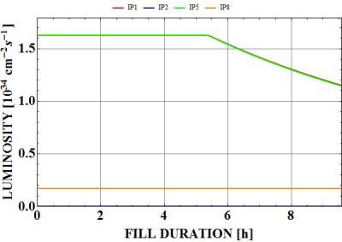
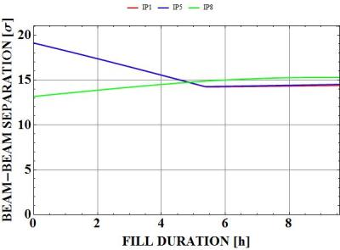
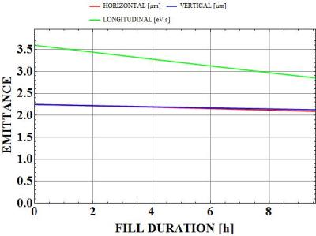
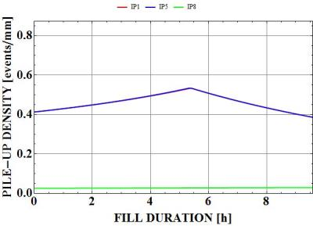
Parameters evolution
Standard beam – 40/20 optics

Slide 31
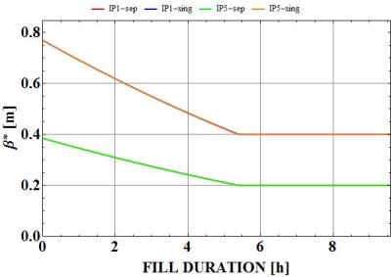
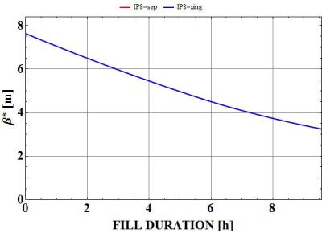
Parameters evolution
Standard beam – 40/20 optics

Slide 32
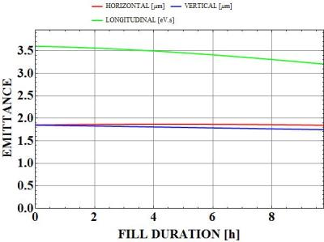
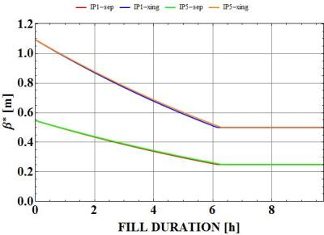
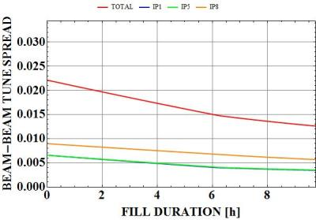
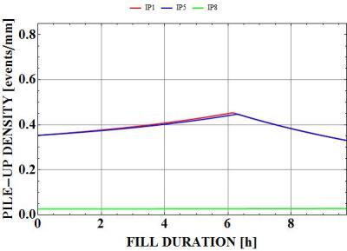
BCMS (50/25)

Slide 33
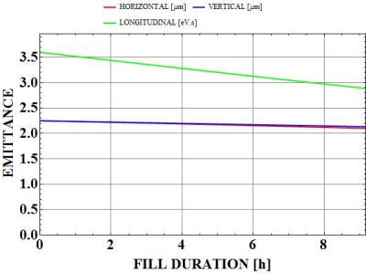
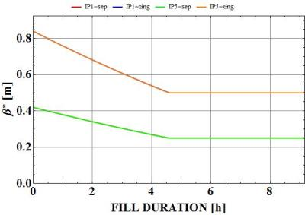
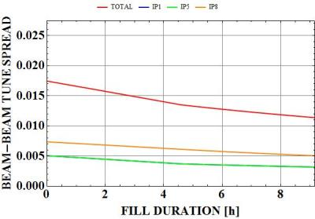
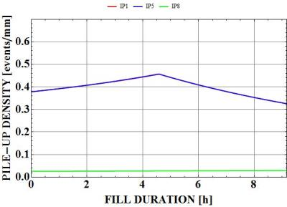
Standard (50/25)

Slide 34
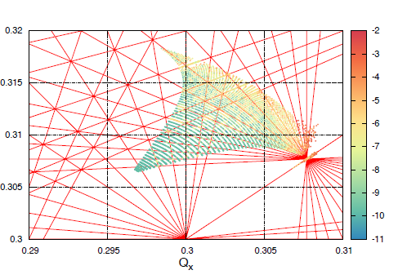
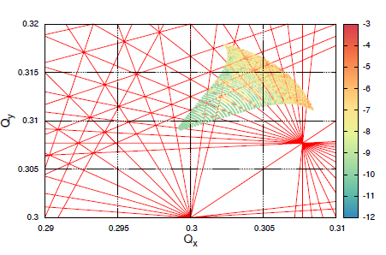
Beam-beam separation
Standard filling – 40/20 optics
Frequency map analysis show the importance of increasing beam beam-separation for flat beams (no optimization of working point done yet) at least in the absence of Beam-Beam Compensator and no levelling (all the fill with minimum β*)
12 σ BB separation
D. Banfi, J. Barranco, T. Pieloni
PRELIMINARY
14.3 σ BB separation

