Slide 1
How to implement all the HL-LHC upgrades
Lucio Rossi for the HL-LHC team
Review of LHC & Injector Upgrade Plans
(RLIUP Workshop)
Archamps 30 October 2013

Slide 2
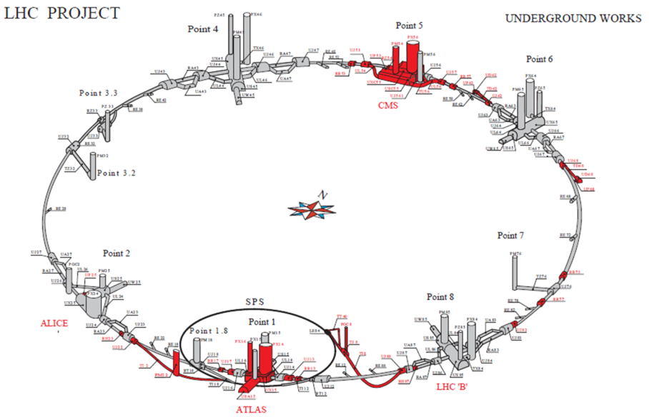
HL-LHC : work around the ring > 1.2 km
3000 fb⁻¹ in 10 years
Limited pile up : 140 ⇒ 5 10³⁵ levelled
Nov 2011 : FP7 HiLumi LHC Design Study
20 (+1) Institutes from EU, Ru, USA and JP

Slide 3
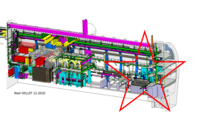
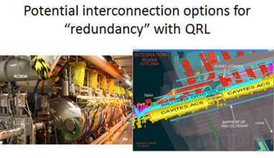
Point 4 : Cryoplant for RF (LS2 2018)
Main aim is to separate SCRF form the arc cooling
But will have capability for a harmonic RF system and for e-lens SC solenoid

Slide 4
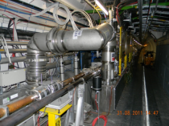
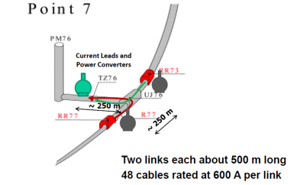
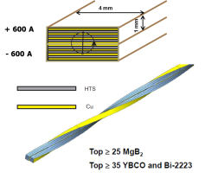
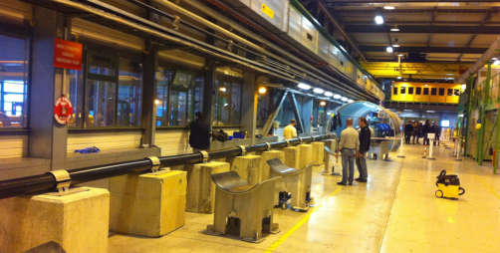
Point 7: horizontal SC links (LS2 2018)

Slide 5
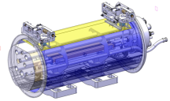
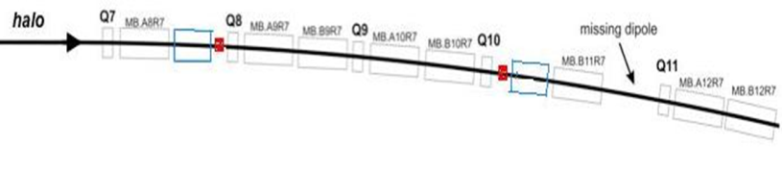
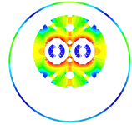

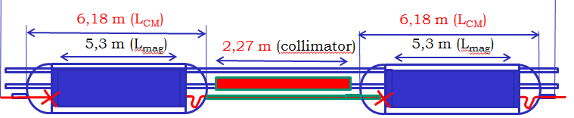
P2 - DS collimators ions – 11 T (LS2 -2018)
Recommended by the Collimation Review
11 T Nb₃Sn

Slide 6

P7 DS collimation – 11 T (LS2 2018)
Colimation review: preparare and then check real need during Run II
11 T Nb₃Sn

Slide 7
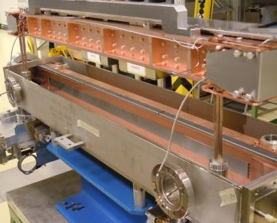
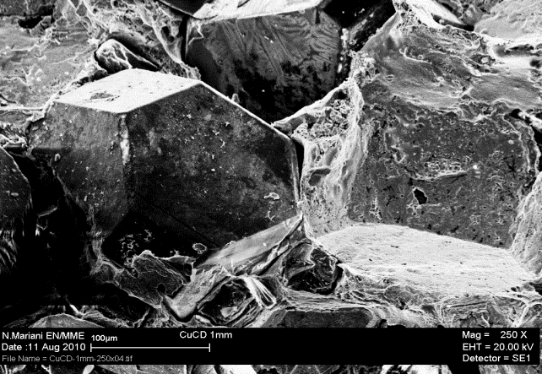
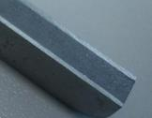
Low impedence collimators(LS2 & LS3)
New material: MoGr

Slide 8
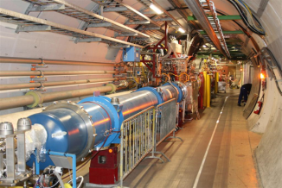
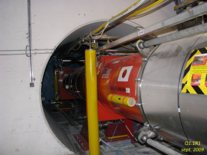
P1-P5 IR Magnets (IT-D1) Powering, TAS
IT : LARP –CERN
D1: KEK

Slide 9
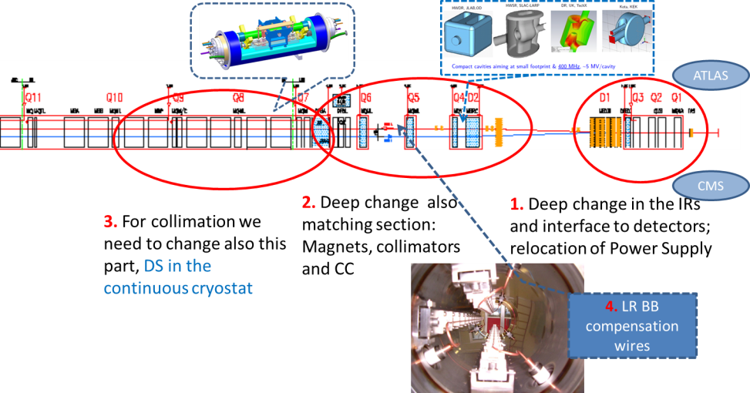
The critical zone around IP1 and IP5
1.2 km of LHC !!

Slide 10
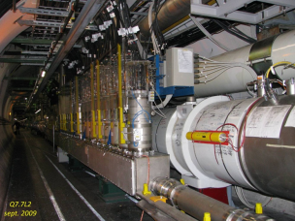
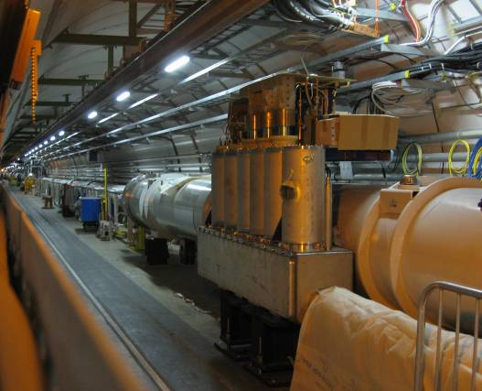
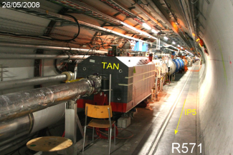
P1-P5 MS Magnets, Powering, TAN
Stronger Q5 IR6
2 magnets
  Q4-Q5-Q6
  MS in Q10 in Sectors 12,45,56,81

Slide 11
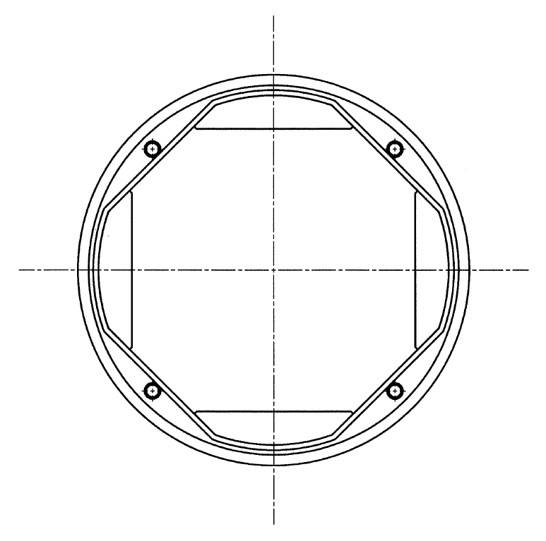
IT robusteness: beam screen is critical
Tungsten inserts
Cold bore
Beam screen
4 LHe channels with inner radius = 1.78 mm
Tungsten density = 19.3 g/cm³ (no packing factor)
Beam screen and e-clouds in the triplet
Nanographite coatingfor SEY 0.95!
Test at cold in SPS end of 2014
Electrodes (tested at LNF in 2012) also studied

Slide 12
IT dose on critical components in HL-LHC
E. Todesco
F. Cerutti
L. Esposito
However design for rad hard is under way (better insulation, metallic spacers, etc.)

Slide 13
Crab Cavities

Slide 14
Situation: from drawings to reality…
LARP-BNL
LARP-ODU-JLAB
UniLancaster-CI-CERN

Slide 15
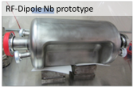
And excelent results: RF dipole > 5 MV
¼ w and 4-rods also tested (1.5 MV) cleaning & vacuum issues: new test under way)
Initial goal was 3.5 MV
> 5 MV would easy integration

Slide 16
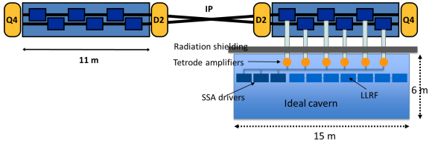
Crab Cavities for fast beam rotation
Present baseline: 3 cavity /cyomodule
4 cavity/cryomod is under study for Crab Kissing scheme

Slide 17
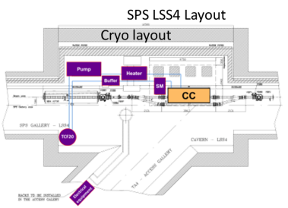
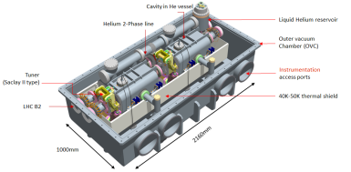
Crab Cavities roadmap: beam test SPS
Test with SPS beam foreseen in 2016/17; 2 cavity/cryomod.

Slide 18
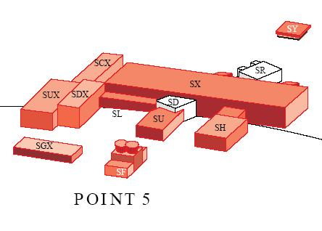
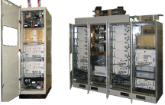
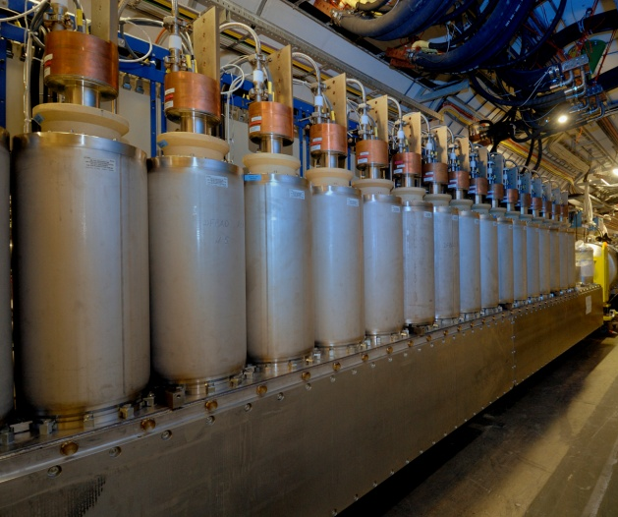
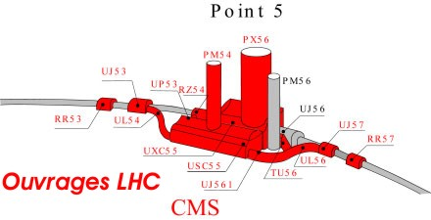
Availability: SC links ⇒EPCs, DFBs on surface)
1 pair 700 m 50 kA – LS2
4 pairs 300 m 150 kA (MS)– LS3
4 pairs 300 m 150 kA (IR) – LS3 tens of 6-18 kA CLs pairs in HTS
2×150 kA
A. Ballarino

Slide 19
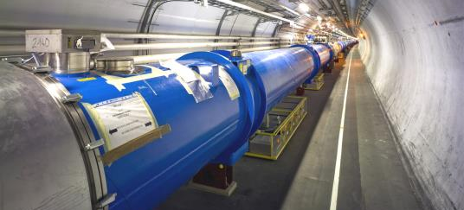
Availability 2: Magnet QPS upgrade
Removal on surface
2oo3 logic
Upgrade of IC system

Slide 20
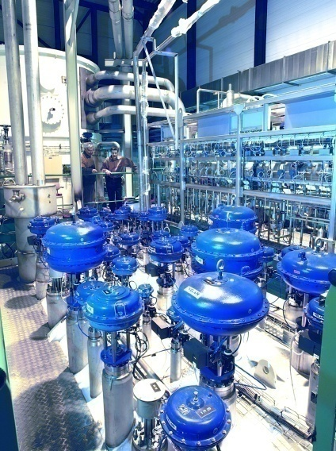
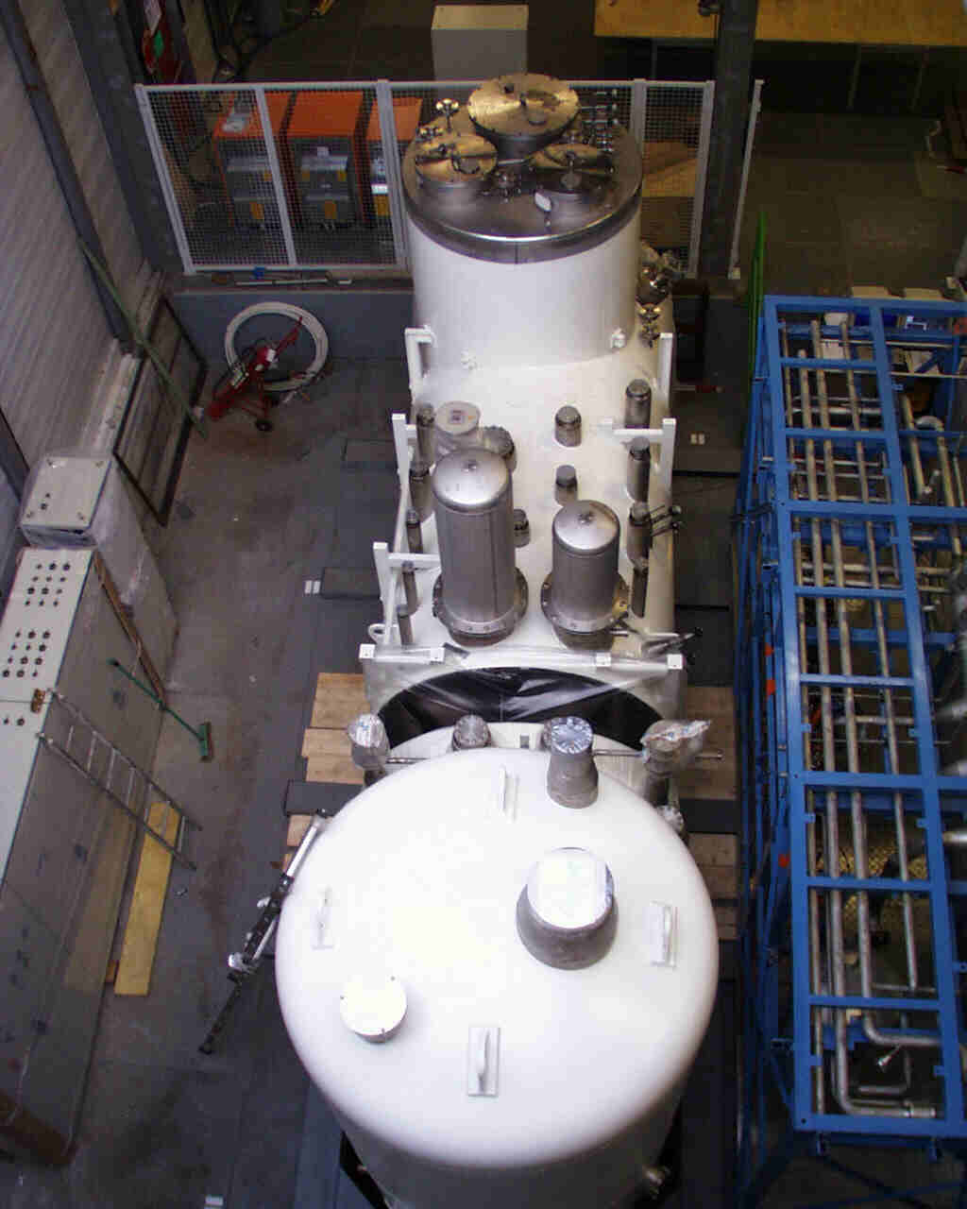
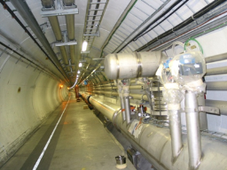
IT cryoplants and new LSS QRL
Avaibility: separation New Inner Triplets (and IPM in MS) from the arc cryogenics.
Keeping redundancy for nearby arc cryoplant
Redundancy with nearby Detector SC Magnets cryoplant

Slide 21
SCRF 800 MHz harmonic: under study
P4
200 MHz system too recent to discuss integration

Slide 22
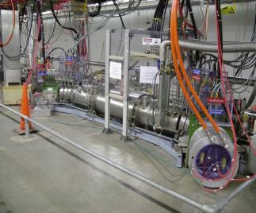
Halo control (hollow e-lens)

Slide 23
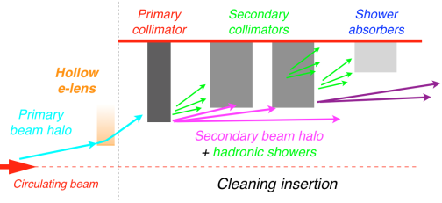
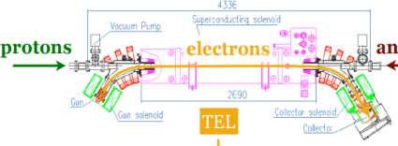
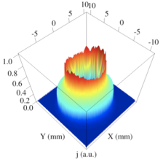
Controlling diffusion rate: hollow e-lens
Promises of hollow e-lens:
1. Control the halo dynamics without affecting the beam core;
2. Control the time-profile of beam losses (avoid loss spikes);
3. Control the steady halo population (crucial in case of CC fast failures).
Remarks:
- very convincing experimental experience in other machines!
- full potential can be exploited if appropriate halo monitoring is available.
S. Redaelli
Developed by Fermilab

Slide 24
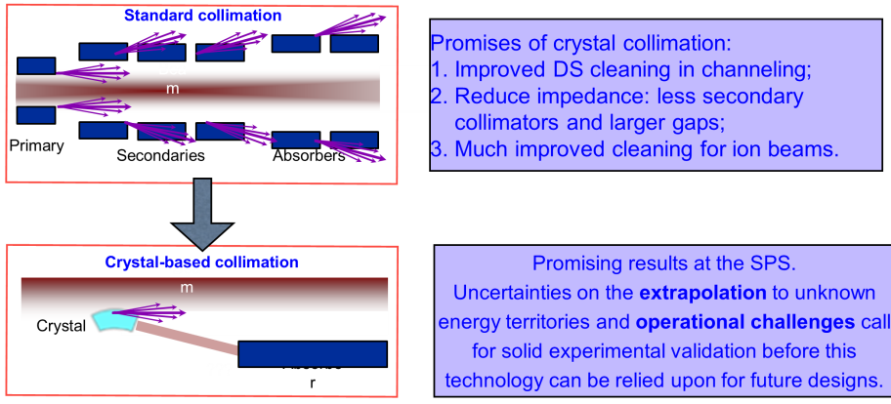
Option for improved collimation: crystal
S. Redaelli
- Can crystal collimation compete with the present very good cleaning system?
- Uncertainty for the scaling to higher energy (e.g.: single diffractive losses).
- Operational challenges for the complex operational cycle (ramp, squeeze, etc...).
- Some outstanding machine protection concerns must be addressed.
- Can we absorb more than 1 MW in one single block?

Slide 25
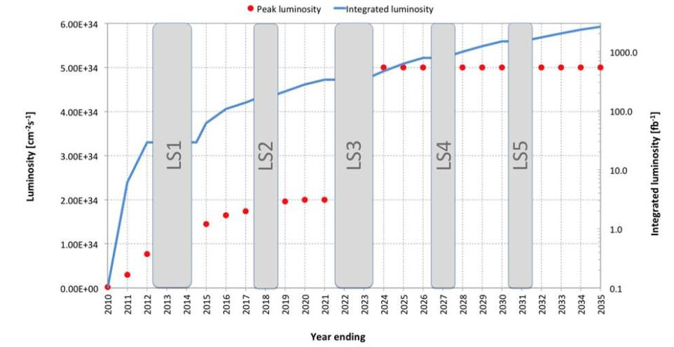
Extended Baseline operation scenario
HL-LHC Coord. Group 27 July 2013
M. Lamont

Slide 26
LHC tunnel will be a hostile environment: robustness, removal to surface (or aside alcove?), remote handling…
 | remaining dose radiation enhancement factor w.r.t. June 2013 (6 months of cooling after RUN I)
LS2 (2019) | 3.4
LS3 (2022) | 4.3
PIC (2035) | 7
US1(2035) | 15
US2(2035) | 22.7
We need to catch up with Integration Studies and Collider-Experiment Interface
1 day workshop on remote handling ⇒ start of a WG CERN-wide

Slide 27
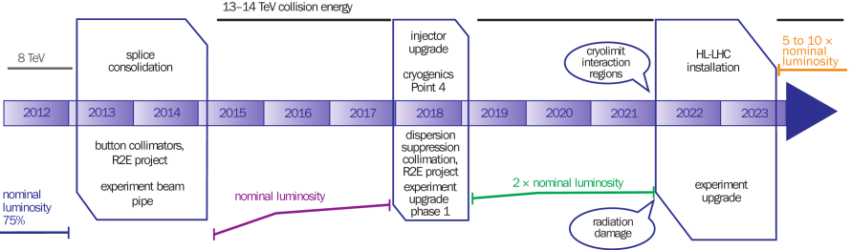

HL-LHC installation fits the present plan
11 T (for DS cryolcoll.) by 2017 for P2 (ions) is difficult: a shift of six months or more would be welcome
Demo of CC in 2016-17 (with SPS beam test); 2022 is challanging; one year more would certainly welcome.
Anticipating infrastructure for LS2: an extended Winter Stop is welcome (but not mandatory)
Summary:
  an extended winter stop end of 2016; 6 months shift of LS2 with LS2 = 1.5 y;
  LS3 covering 2023-24 IS FINE for HL-LHC.
  Longer «delay» or shift would make reconsider the whole schedule (anticipating IR installation in LS2?, Merging LS2-LS3?)

Slide 28
HL-LHC matrix: equipment, time, cost

Slide 29
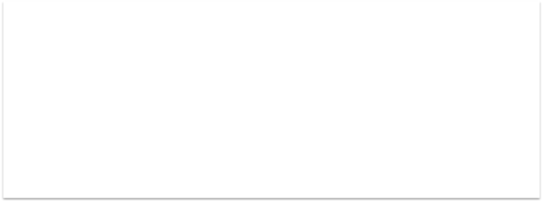
HL-LHC matrix: equipment, time, cost

Slide 30

HL-LHC matrix: equipment, time, cost

Slide 31
HL-LHC matrix: equipment, time, cost

Slide 32
Conclusions
The upgrade is robust for 250 (300 ) fb⁻¹/y
    Means to maintain or increase availability are under study
All hardware is more robust for 3000 fb⁻¹ than it is today for 300 fb⁻¹
Design Study finished by 2015 with the TDR
Margins are there and – once established and proved:
  Possible to decrease pile density and/or increase to 350 fb⁻¹ (7⋅10³⁴ of L_{level}) thanks to crab kiss (CC in II & ⊥ planes) and β* of 10 cm (large aperture IT & ATS)
  Increase data collection to > 4000 fb-1

