Slide 1
Session 1: experiments: summary
Selection of highlights and topics of discussion from the ECFA HL-LHC Experiments
Workshop (1-3 Oct) which seemed (to the speaker) to be relevant to RLIUP Austin.
The “physics landscape” 30fb-1 −−>300fb-1 −−> 3000fb-1 and thus the
physics potential of the HL-LHC. Fabiola.
The need to upgrade certain key detector elements of ATLAS and CMS for
ANY programme beyond 300fb-1. Beniamino
The role of the upgrade changes in mitigating the high rate, high pile-up conditions
of HL-LHC needed to reach the 3000fb-1 target in a reasonable timescale.
Prospects for pile-up mitigation by tuning the luminous region. Didier.
Physics motivation & realisation of the LHCb upgrade, plus
the forward physics and ALICE p-p programmes. Richard
Which left Mike as the victim trying to fit the disparate requirements for operation and
upgrade into a workable schedule, taking into account accelerator consolidation and
upgrade options

Slide 2
EFCA HL-LHC expts workshop: 1-3 Oct
Motivation: ESPP document adopted by Council in May
c) The discovery of the Higgs boson is the start of a major programme of work to measure this particle’s properties with the highest possible precision for testing the validity of the Standard Model and to search for further new physics at the energy frontier. The LHC is in a unique position to pursue this programme. Europe’s top priority should be the exploitation of the full potential of the LHC, including the high-luminosity upgrade of the machine and detectors with a view to collecting ten times more data than in the initial design, by around 2030. This upgrade programme will also provide further exciting opportunities for the study of flavour physics and the quark-gluon plasma.
Strategy explicitly recommends 3 ab-1 target
DG −−> we should consider this tacit approval for the HL-LHC programme and proceed.
Further evaluation of: physics reach
technical feasibility for expts and machine
timeline & cost estimates
needed for formal approval by Research Board, Council, Funding Agencies
“Do not wait to strike until the iron is hot….make it hot by striking!!!” W.B. Yeats

Slide 3
Physics landscape & further exploration
Think like a wise (wo)man but communicate in the language of the people
W.B. Yeats
Fabiola:
Three main results from LHC Run-1
We have consolidated the Standard Model
(wealth of measurements at 7-8 TeV, including the rare, and very sensitive
to New Physics, B_{s} → μμ decay)
→ it works BEAUTIFULLY …
We have completed the Standard Model: Higgs boson discovery
(almost 100 years of theoretical and experimental efforts !)
We have NO evidence of new physics
Note: the last point implies that, if New Physics exists at the TeV scale and is discovered
at √s ~ 14 TeV in 2015++, its spectrum is quite heavy → it will require a lot of luminosity
(→ HL-LHC 3000 fb⁻¹) and energy to study it in detail → implications for future machines
(e.g. most likely not accessible at a 0.5 TeV LC)

Slide 4
Physics landscape & further exploration
However: we also know that the SM is not the ultimate theory of particle physics, because of the many outstanding questions, including:
Why is the Higgs boson so light (“naturalness” problem) ?
What is the the nature of the dark part (96% !) of the universe ?
What is the origin of the matter-antimatter asymmetry ?
Why is gravity so weak ?
There are compelling reasons to believe that answers to some of the above questions lie
at the TeV scale, whose exploration JUST started …
The STRONG physics case for the HL-LHC with 3000 fb⁻¹ comes from the imperative
necessity of exploring this scale as much as we can with the highest-E facility we
have today (note: no other planned machine, except a 100 TeV pp collider, has a similar direct discovery potential). Likely, and perhaps more importantly, the HL-LHC will also tell us what are the right questions to ask and how to continue.

Slide 5
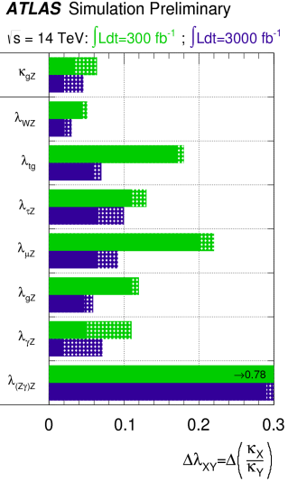
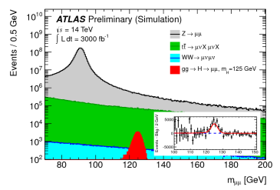
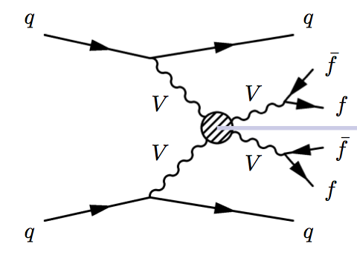
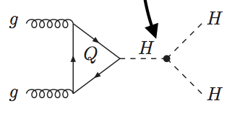
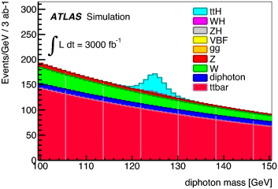
LHC −−> HL-LHC: THE Higgs factory
today : ATLAS+CMS have 1400 Higgs events events HL-LHC (3000fb-1) > 3M/170M useful for precise measurement
Measure as many Higgs couplings to fermions and bosons as precisely as possible
Measure Higgs self-couplings (give access to λ)
Verify that the Higgs boson fixes the SM problems with W and Z scattering at high E
Couplings
Vector boson fusion
Self-coupling
ttH
γγ
g_{HHH}~ λv
H −−> μμ
Check if Higgs does the
(whole) job of
cancelling divergences
Difficult measurement
precision 30% for 3000fb-1?
x 1.5 to 2 for
300 --> 3000fb-1
Access to rare
processes

Slide 6

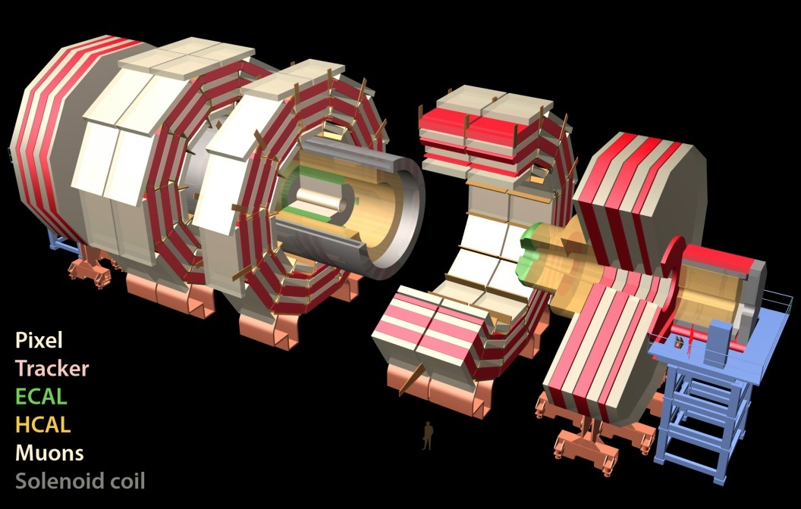
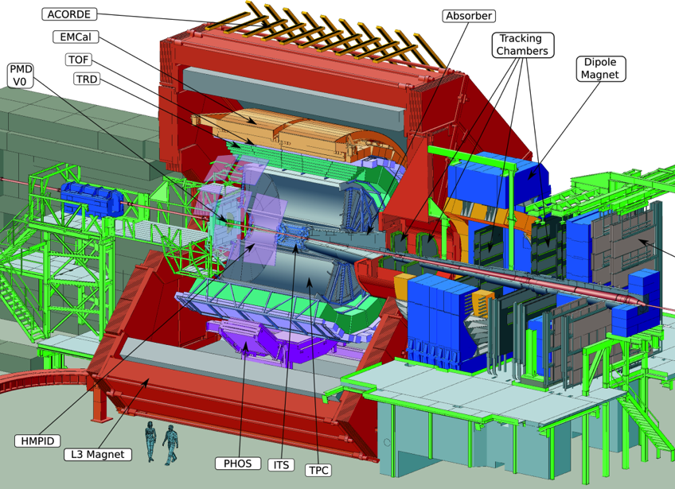
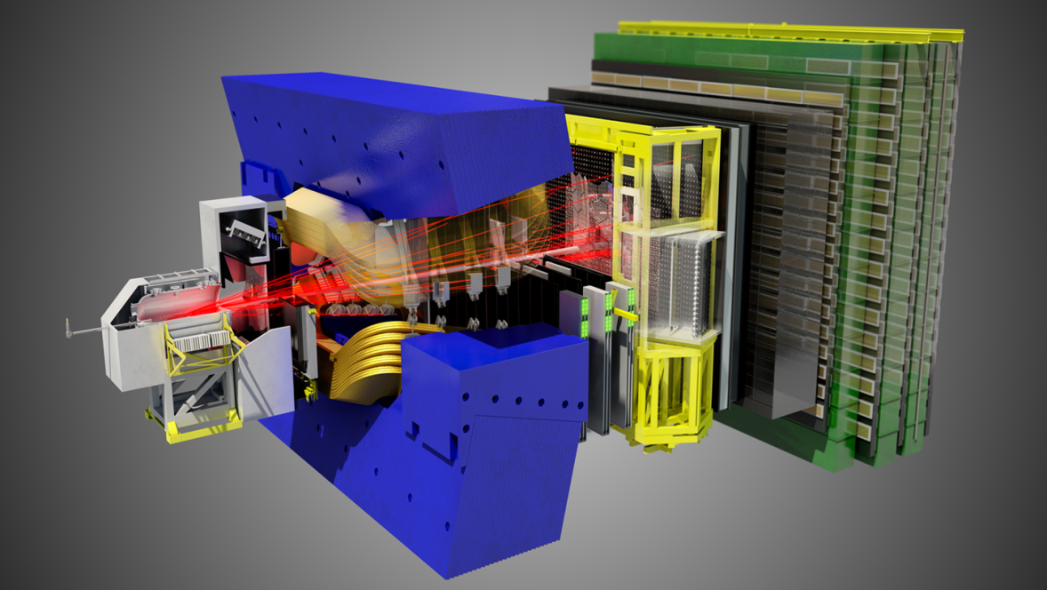
Experiment upgrades
Study Standard Model in detail, including
Higgs couplings and eventually self-coupling
Continue search for Physics beyond the SM.
Requires x10 in statistics beyond design 300fb-1
Phase 0,1 upgrades in LS1, YETS and LS2
to match LHC performance over Run 2,3.
Key components of present detectors will not
survive radiation beyond 500fb-1 −−> Phase2
in LS3, equip for 3000fb-1 p-p over 10 years
LHC −−> HL LHC : <pileup> (23 −−> 140)
High statistics HI
measurements
using rare
probe particles
at low pT.
10nb-1, min bias
Single phase major
upgrade to detector
& readout
in LS2
Record very high stats
to search for effect of
possible new physics
on flavour structure.
(complementary to
ATLAS & CMS progr)
50fb-1 , 40Mz readout
Single phase major
upgrade to detector
& readout
in LS2

Slide 7
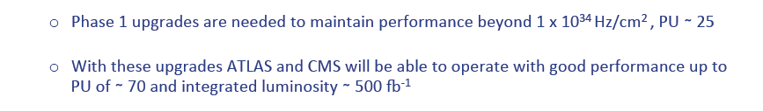
Phase1 upgrades
ATLAS & CMS: some analogy to PIC’s – few radical changes in technology
By run 3: pixel, new muon stations, trigger, calorimeter improvements:
(max) [ PU will be severe limit if @ 50ns]
LHCb and ALICE:
potential of existing detectors becoming exhausted by LS2 (doubling time v. long)
major upgrades to detector & readout in LS2 −−> program extending well into HL-LHC era
operation assumes levelled luminosities for rate tolerance, efficiency and physics stability
LHCb
Replacement of VELO
Major upgrade of RICH optics,
Major upgrade of tracking system (technology decisions by end of this year)
Upgrade all existing detector FE electronics
1 MHz −−> 40MHz
ALICE
All readout :
500Hz −−> 50kHz with min bias trigger
new beampipe,
Inner tracking system
4-GEM endplates for TPC

Slide 8
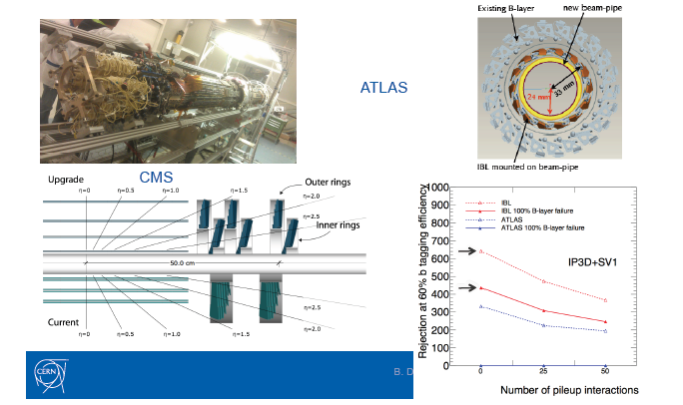
ATLAS & CMS “PICs”
4 layer pixel trackers

Slide 9
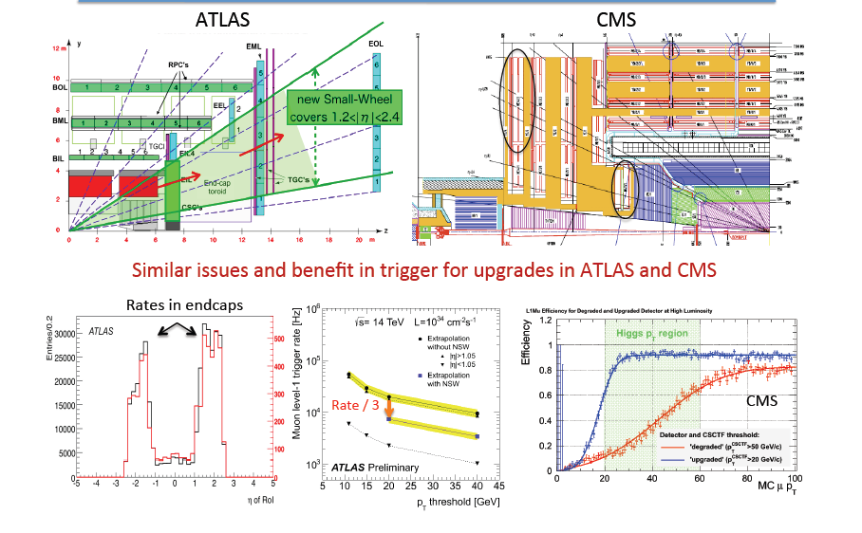
ATLAS & CMS “PIC’s”: muon systems

Slide 10
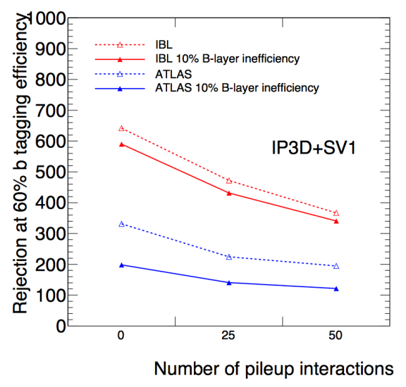
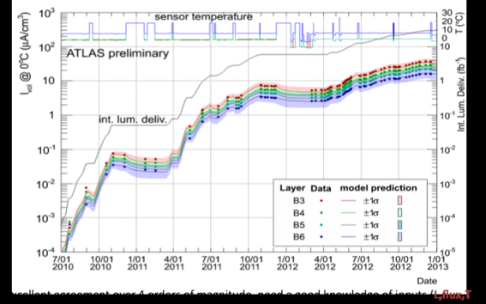
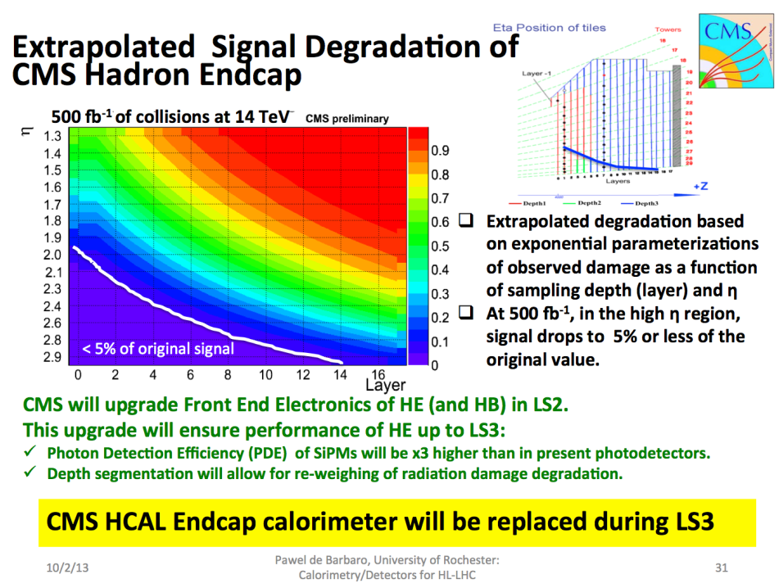
ATLAS & CMS: Phase 2 upgrades mandatory
Beniamino
Silicon sensors: leakage current increase with
radiation dose = ∫L dt.
-very well modelled
- can predict that existing detectors
will be seriously compromised
at ~500fb-1
-key physics quantities degrade much
faster than layer inefficiency
Calorimeters:
Signal (light) output reduced by radiation damage
Can prolong life with smarter readout but
at ~500fb-1, there’s nothing left to work with.

Slide 11
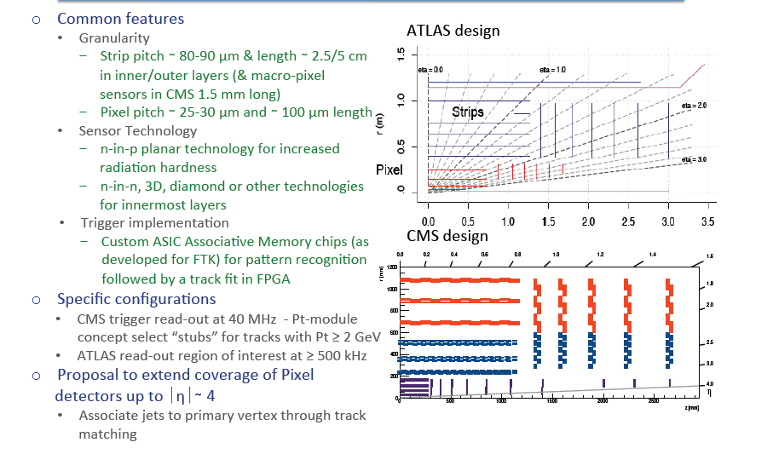
ATLAS & CMS Phase 2 trackers
Didier
Light-weight designs using 2-phase CO2 cooling systems
Pixels will need replacement in LS’s

Slide 12
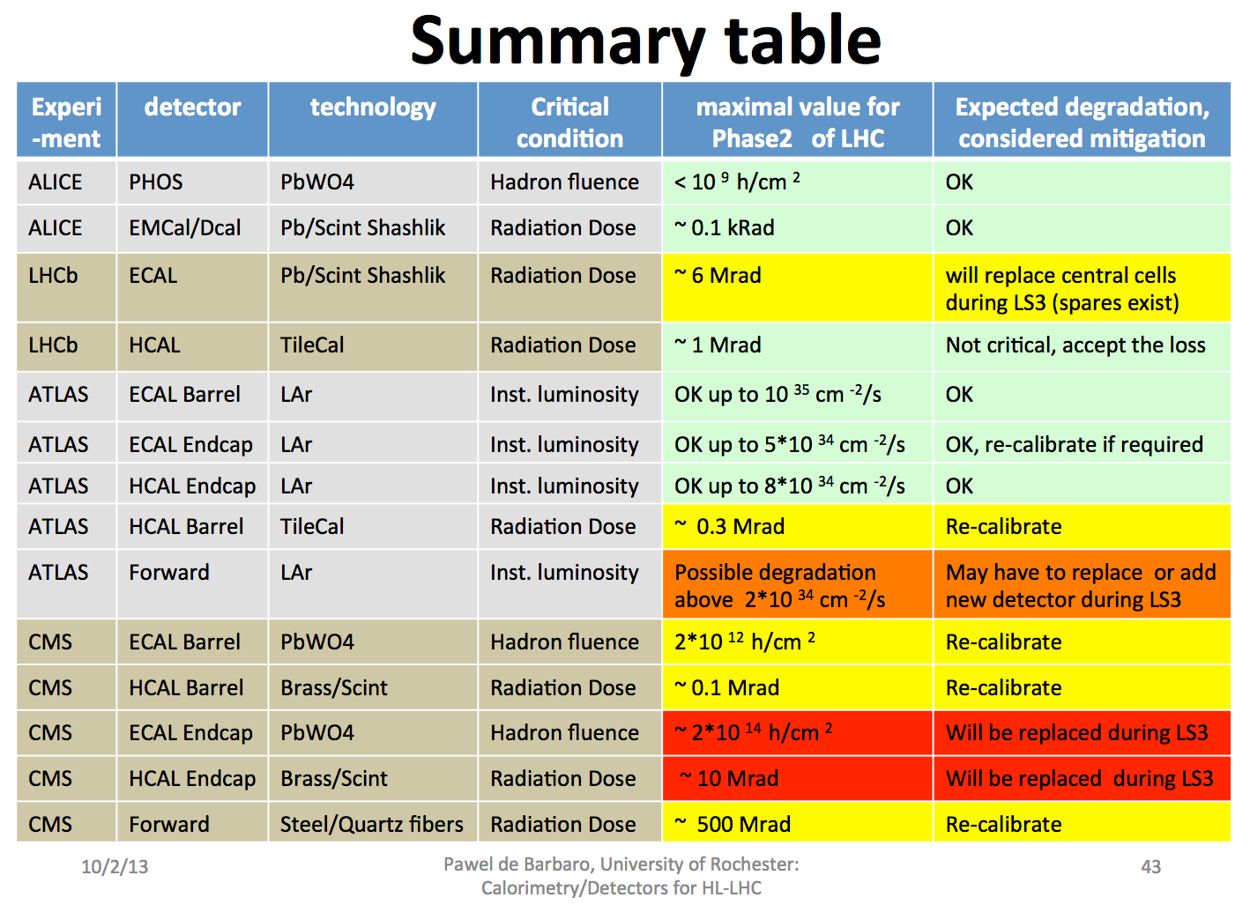
Phase2: Calorimeters
Beniamino

Slide 13
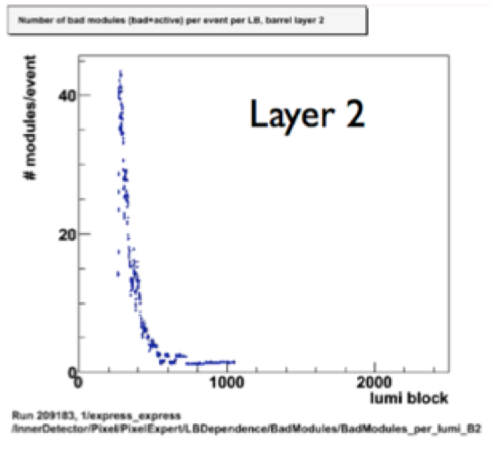
Pileup and luminous region
Pile-up effects visible throughout detector & readout chain
- Occupancy – difficulty separating event information
- Memory buffers on front-end chips
- Selectivity of trigger system working with limited info
- Links between the front-end and the back-end electronics
- Limitations in processing power in back-end electronics
- Links between the back-end & rest of DAQ
- Event reconstruction in high level trigger & offline
Both ATLAS and CMS:
- are designing Run 4 detectors to cope with a mean pile-up of 140 (<140>) (25ns, 5 x 10³⁴)
“tails” up to 200 events per crossing.[Degradation not sudden, but tails have large effect]
-are very interested in methods (eg crab kissing) allowing the extent of the luminous region
in time and space to be tuned, so as to reduce the pileup density in either z or t dimensions
does not open up a door to accepting 2x the inst lumi
(mean pile-up also has bad effects eg neutrals in calorimeters)
The potential to exploit fast timing (σ ~10ps) to mitigate pile-up still requires substantial
R & D, but there is a dedicated community pursuing this.

Slide 14
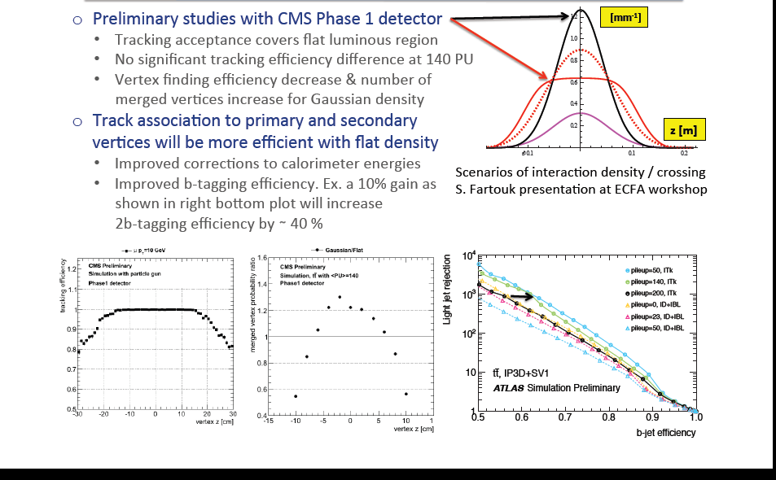

Pileup mitigation
Didier

Slide 15
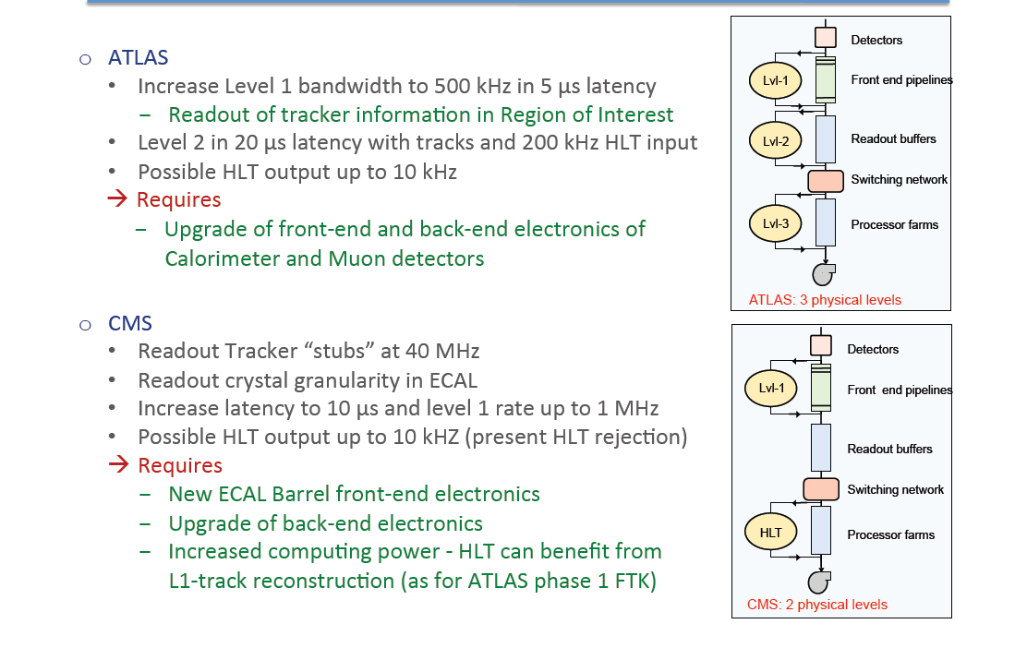
Trigger systems
Didier
Phase 1: L1 trigger upgrades to operate at 50 PU within the limitation of 100kHz output rate:
ongoing from LS1 through LS2. exploit: additional muon layers
better calorimeter granualirty
more complex event info/analysis
Phase 2:
Increase bandwidth
latency
HLT o/p rate
use tracker in trigger
Major changes to detector
electronics required.

Slide 16
The Matrix
Mike
 | Run 2 | EYETS | LS2 | Run 3 | LS3
ALICE |  | Contingency | 18 mo. Shift into 2018
ATLAS | 3 years | No | 14 mo. Start 2018 |  | 27 (35) mo. Start 2022
CMS | EYETS plus N months | 19 weeks | 14 – 18 mo. Not before summer |  | 30 – 35 mo. Start 2023
LHCb |  | Contingency | 18 mo. End 2018
Cryo | 4 years max. | Selective maintenance
Maintenance |  | Selective maintenance | 16 mo. |  | 20 mo.
LIU |  | 9.5 months for L4 connect/or cable prep. | 20.5 mo. beam to pilot
LHC | 3 years max contiguous | Opens way for year 4 | 18 mo. | 3 years | 2 years

Slide 17
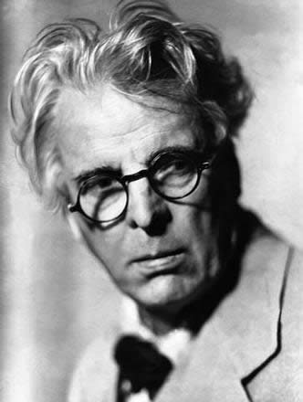
EYETS
Mike
EYETS (YETS + 6 weeks= YEETS? ) required by CMS, buys contingency for ALICE and LHCb.
Extending EYETS to 9.5 months for Linac4 subsequently presented as an option
  motivation recognized
  is problematic for the experiments.
  note the possibility of cable cleanup and preparation for LS2 during this period
Given EYETS:
  continue run 2 into 2018 for at least 6 months
  continue run 2 until end 2018
  possible compromise 9 months into 2018
Any of these options naturally leads to a delay of the start of LS3 from 2022 to 2023
W.B Yeats

Slide 18
Options presented
Mike
Baseline
  No EYETS
  2018 LS2 has to go to 18 months
  LS3 starts in 2022
Slipped baseline+6
  EYETS plus continue run 2 to mid-2018
  3 year run 3 – LS3 starts in 2023
Slipped baseline+12
  EYETS plus continue run 2 to end 2018
  Slightly shortened run 3 – LS3 starts in 2023

Slide 19
Planning : further comments
-Phase 1: consolidations & upgrades underway will help equip expts for cycle of 3-4
operations years including minimal ~ 13 week year end stop, followed by LS of 1-2 years.
-Phase 2 : ATLAS& CMS will need ~30 month LS3: not effective to stage
Activation (+ contamination?) serious issue from LS3 onwards .
ALARA to be built into designs & operating procedures from outset
eg Low intensity runs for cooling + Advance “hot” LS3 activities to end LS2
-Infrastructure end of lifetime replacements not yet accounted for
- in LS3 could seriously disrupt underground work −−> advance to LS2 if at all possible
LS2 timed to allow Phase 2 infra work to be advanced −−> help restrict length of LS3
-1 year shift in LS3 start (to 2023) eases funding profile for Phase 2 upgrades
-Best to minimise # sequential calendar years without any physics (continuity, headlines)
Resources: labs, test beams , RP facilities & equipment , simulations, new TAS/shielding
needed well in advance −−> Joint coord. & executive structures (coord comm + PO)

Slide 20
Operation: special requests
Apart from usual programme of p-p and Pb-Pb at top energy
-p-p reference data: equiv energy: ALICE (6 pb-1: takes about 2 month @ 200kHz)
end of run 3 : dominant ref data requirement
ATLAS/CMS 300pb-1
-p-Pb proven to be very interesting : requested for Run 2 : 50nb-1 @ 5.1 or 8 TeV
after LS2 : ~1pb-1
p-Ar and Ar-Ar possible requests
-Luminosity calibrations needed at every energy
-Forward programmes :
TOTEM High β* & AFP & CMS-TOTEM fwd programme at low β * in Runs 2,3
no high β* running anticipated after LS3
(ATLAS and CMS beampipes bore to be kept at ~45mm despite TAS at ~60mm)
forward physics at nominal lumi may continue thereafter (eg LHCb)
Experiment magnet field reversals as previously :
LHCb will need to switch dipole polarity every ~2 weeks to control systematics
ALICE will need to switch solenoid polarity occasionally

Slide 21
Conclusion
Following the Higgs discovery, the justification for high lumi LHC and a target
p-p luminosity of 3000fb-1 is compelling.
Phase 1 consolidations to ATLAS & CMS and major upgrades to ALICE & LHCb
will allow the present programme to continue effectively for Runs 2,3.
(ie to initial p-p target of 300fb-1).
Thereafter, ATLAS and CMS must make major upgrades due to radiation effects which
critically damage performance once ∫Ldt exceeds 300-500fb-1.
These Phase 2 upgrades are being designed to allow studies of a broad range of physics,
including precision studies of the (low mass) Higgs, at the high pile-up, high radiation
dose conditions expected at Hl-LHC. (3-4 years R & D + 5-6 years to build)
A realistic schedule over the next decade is essential for correct resource request/allocation.
Basic gaol is to cost-effectively maximise useful integrated lumi as a function of time.
These are technically very difficult upgrades – getting the resources (including human)
needs new models of support from Collaborations & much help from CERN.
Support facilities and planning for infrastructure replacement are urgent issues.

