Slide 1

EFCA HL-LHC expts workshop: 1-3 Oct
objectives
From Opening talk:
Help define the upgraded HL-LHC detectors and physics program for many years to come at the LHC.
In particular:
Develop a common approach to the HL-LHC program; identify synergies and possible common efforts.
Provide a consistent presentation of physics goals,
detector requirements and technology R&D needed, also accelerator interfaces, long shutdown constraints, and costing methods.
Identify areas for further joint HL-LHC workshops.
Provide a summary report to ECFA.

Slide 2
EFCA HL-LHC expts workshop: 1-3 Oct
Motivation: ESPP document adopted by Council in May
c) The discovery of the Higgs boson is the start of a major programme of work to measure this particle’s properties with the highest possible precision for testing the validity of the Standard Model and to search for further new physics at the energy frontier. The LHC is in a unique position to pursue this programme. Europe’s top priority should be the exploitation of the full potential of the LHC, including the high-luminosity upgrade of the machine and detectors with a view to collecting ten times more data than in the initial design, by around 2030. This upgrade programme will also provide further exciting opportunities for the study of flavour physics and the quark-gluon plasma.
Strategy explicitly recommends 3 ab-1 target
DG −−> we should consider this tacit approval for the HL-LHC programme and proceed.
Further evaluation of: physics reach
technical feasibility for expts and machine
timeline & cost estimates
needed for formal approval by Research Board, Council, Funding Agencies
.....the workshop in Aix was a step along this road

Slide 3
3 Days, 10 sessions (prep group for each)
https://indico.cern.ch/conferenceOtherViews.py?view=standard&confId=252045
1
Opening*: European strategy, HL-LHC, Expt upgrade programmes, CERN perspective
Physics Goals, Theoretical Developments & Performance Reach:
Theory Overview, Higgs physics, Physics beyond SM,
Input to upgrade spec, Heavy Flavours, Heavy Ions
Accelerator & Experiments Interface *:
Special requests, pile-up, instrumentation, protection systems
LS constraints, radiation & activation including infrastructure changes *:
Electronics & Readout: IC’s, power, modular electronics, high speed links:
Tracking systems: Overview, sensors, electronics, thermal management *, summary
Calorimetry systems: Overview, electronics, detector, summary
Muon systems: Challenges, longevity, detector/trigger upgrades, new gaseous detectors
Trigger/DAQ/offline/Computing: technologies, trigger/DAQ, computing, software
Closing*: Machine interface & LS constraints, Physics goals & detector requirements
Technology and R & D, Conclusion .
2
3

Slide 4
This talk
Not at all a summary talk. These highlights are my selection of topics possibly relevant
to RLIUP & include recollections (possibly flawed) of some of the discussions provoked.
The “physics landscape” 30fb-1 −−>300fb-1 −−> 3000fb-1 and thus the
physics potential of the HL-LHC will be covered by Fabiola.
The need to upgrade certain key detector elements of ATLAS and CMS for
ANY programme beyond 300fb-1 will be addressed by Beniamino
The role of the upgrade changes in mitigating the high rate, high pile-up conditions
of HL-LHC needed to reach the 3000fb-1 target in a reasonable timescale will be
discussed by Didier. Prospects for pile-up mitigation by tuning the luminous region will
also be discussed.
Richard will cover physics motivation & realisation of the LHCb upgrade, plus
the forward physics and ALICE p-p programmes.
Which leaves Mike as the victim trying to fit the disparate requirements for operation and
upgrade into a workable schedule for the LHC and injectors, taking into account accelerator
consolidation and upgrade options

Slide 5
ATLAS & CMS ongoing upgrades
Both ATLAS and CMS have approved and funded pre HL-LHC upgrades (Phase 0 &/or 1)
underway in LS1, continuing in tech stops and in parallel with Run2, concluding in LS2.
Objectives : - reach target 300fb-1 with some margin; coping with pile-up> design
- start making provision for another 20 years operation after that
Complete the detectors as originally conceived for 10³⁴(mostly muon systems)
Correct faults, oversights or vulnerabilities exposed during Run 1 (incl cooling, power, etc)
Improve capability to match LHC conditions in Runs 2 & 3 (bp + 4-lyr pix,calorimeters,trigger)
Start consolidation for an active lifetime 10years −−> 30 years ( eg magnet cryo)
The LS1 programmes of both experiments are proceeding approximately on schedule
After LS1:
ATLAS
CMS
Final Phase I upgrades: 2015-LS2.
4-layer pixel tracker : YETS 2016-17
Forward HCAL PMT readout : YETS 16/17
Improved L1-Trigger – started, complete in Run2
New readout in HCAL barrel & endcap: LS2
Final Phase I upgrades: LS2
New muon small wheels
Revise calorimeter R/O electronics
Improved Trigger

Slide 6

ATLAS Phase 2 upgrade in 1 slide
Study Standard Model in detail, including
Higgs couplings and self-coupling
Continue search for Physics beyond the SM
Requires x10 in statistics beyond design 300fb-1
Key components of present detectors will not
survive radiation load beyond 500fb-1.
Equip for 3000fb-1 p-p in 10 years
LHC −−> HL LHC : <pileup> (23 −−> 140)
Replace Pixel Tracker
New all Silicon Tracker, probably with high η extension
New Trigger architecture
New readout for most components
TAS, Shielding & infrastructure for HL-LHC
Under investigation – Hadron Endcap & Forward Calorimeter longevity?

Slide 7
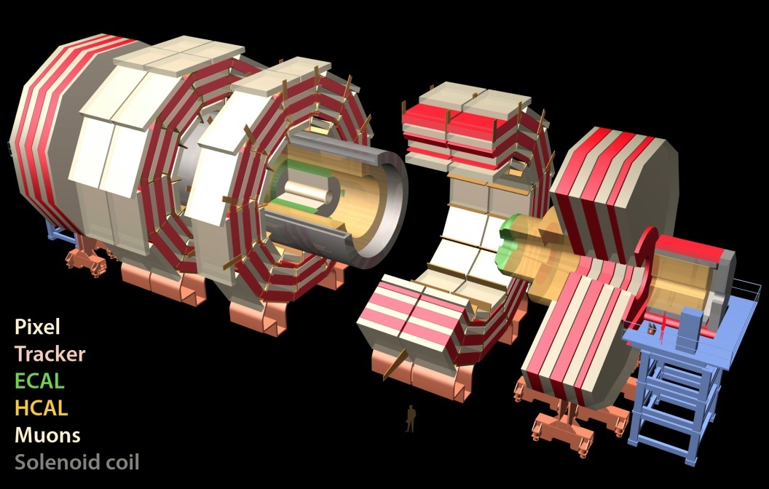
CMS Phase 2 upgrade in 1 slide
Study Standard Model in detail, including
Higgs couplings and self-coupling
Continue search for Physics beyond the SM
Requires x10 in statistics beyond design 300fb-1
Key components of present detectors will not
survive radiation load beyond 500fb-1.
Equip for 3000fb-1 p-p in 10 years
LHC −−> HL LHC : pileup (23 −−> 140)
Replace Pixel tracker
Replace all-Si Tracker, probably with high η extension
New/ revised Endcap Calorimeter system (em & had)
New L1 trigger (longer latency, higher rate)
implies refit of entire Barrel em calorimeter −−> time driver
Install new muon stations at high eta (RPC &GEM) and refit barrel muon readout
TAS, Shielding & infrastructure for HL-LHC, including magnet consolidation

Slide 8
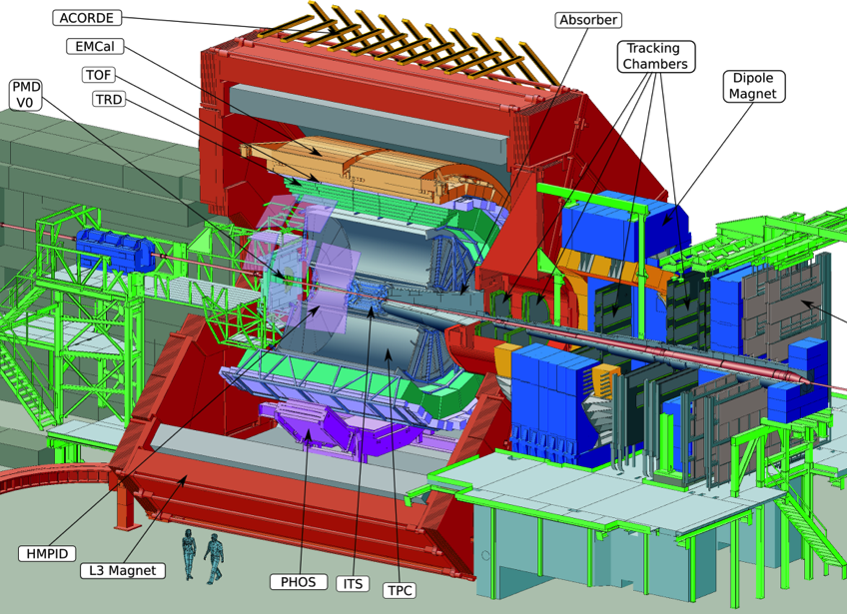
ALICE upgrade in one slide
High statistics measurements using rare
probe particles at low pT.
cannot be selected by trigger
Aim for 10nb-1
(factor of 100 x ongoing programme)
All readout : 500Hz −−> 50kHz with min bias trigger
new beampipe, ITS & 4-GEM endplates for TPC
This is a single phase upgrade targeted for LS2
Physics potential at the existing event rate will by then be ~ exhausted
Requires LHC upgrade to ion source, RFQ, LINAC3, SPS kickers, DS collimators

Slide 9
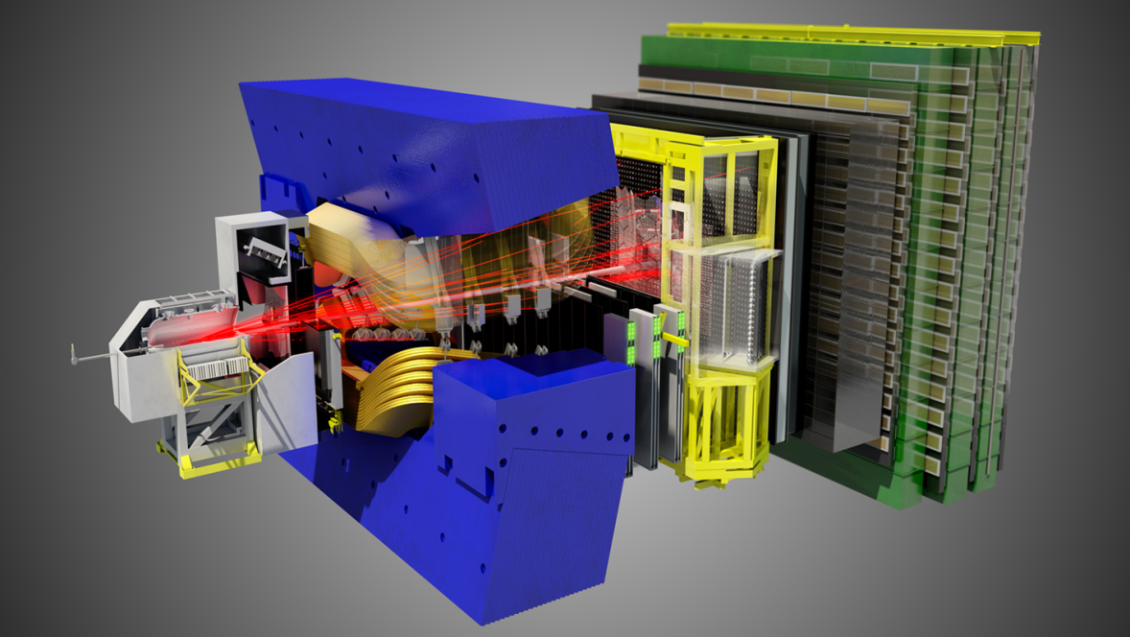
LHCb upgrade in one slide
Record very high statistics to search for
effect of possible new physics on
flavour structure.
Aim for 50fb-1 to match theoretical
uncertainties
(factor of 5 x ongoing programme)
Replacement of VELO
Major upgrade of RICH optics,
Major upgrade of tracking system (technology decisions by end of this year)
Upgrade all existing detector FE electronics 1 MHz −−> 40MHz
This is a single Phase upgrade targeted for LS2
Doubling time with present detector will by then, be ~ 10 years
LHC can deliver 2 x 10³³ to LHC b as soon as the upgrade is ready

Slide 10
Schedule: timing of shutdowns
 | ATLAS |  | ALICE |  | CMS |  | LHCb
YETS 2016-17 duration | Min needed by LHC |  | Min needed by LHC |  | 4.5 mo | Pixel upgrade | Min needed by LHC
Preferred LS2 start | end 2017 | Trigger upgrade | end 2017 | ITS,TPC & readout upgrade | end 2018. | HCAL upgrade, advanced Phase 2 | end 2018 | Readout upgrade
Required LS2 duration | 14 mo | Trigger upgrade μ Small wheels | 18 mo | ITS, TPC 4GEM, MFT | 14 mo | HCAL upgrade & Phase 2 start . | 18 mo | VELO, RICH, Tracking, 40MHz readout.
Preferred LS3 start | end 2021 | Tracker replace-ment ready | 3 y after LS2 end |  | end 2022 < 500fb-1 |  | 3 y after LS2 end
Preferred LS3 duration | 27-35 mo |  | Min needed by LHC |  | 30-35 mo | Tracker, EE and HE repl. | Min needed by LHC

Slide 11
Schedule: timing of shutdowns
LS2 : possible compromise:
Run 2 continues for part (1/2?) of 2018;
Run 3 starts early in 2020
-ATLAS gets trigger upgrade within 6 months of target
-18 months shutdown, but substantial physics in both 2018 and 2020
-LS2 goes on late enough to allow some Phase 2 infrastructure work to be advanced
-1 year shift in LS3 start (to 2023) eases funding profile for Phase 2 upgrades
value (or not) of this may become clear at Resources Review Boards this week
to be discussed once LHC constraints and options are understood.
LS3: best to minimise # sequential calendar years without any physics (continuity, headlines)
BUT highly ineffective to stage the detector upgrades for Phase 2 over >1 shutdown
-hybrid systems: limited by the non-upgraded parts
requiring special operating conditions/ trigger/software
-have to train & retain specialised upgrade teams > 6 years instead of ~4 −−> costs
-activation constraints become x 2-3 more severe in LS4 −−> ALARA, costs.
save time by advancing some activities (machine interface, infrastructure) to LS2 ??

Slide 12
Pileup and luminous region
Both ATLAS and CMS:
- are designing detectors to cope with a mean pile-up of 140 (<140>) (25ns, 5 x 10³⁴)
which means the capability to cope with “tails” up to 200 events per crossing.
[Degradation above this is not sudden, but tends to be dominated by the effect of tails
(eg on event processing times). The effect is detector and physics channel dependent.]
-are very interested in methods (eg crab kissing) allowing the extent of the luminous region
in time and space to be tuned, so as to reduce the pileup density in either z or t dimensions.
Crab kissing: halving of the mean pileup density from 1.2 to 0.6 events/mm ,
= halving high end tail from near 2.0 to near 1.0 events/mm
obviously of great interest considering 2 vertex resolution of tracking systems ≥0.5mm
but :not easy to evaluate gains since depends on accurate simulation of optimised detector.
:does not open up a door to accepting 2x the inst lumi (mean pile-up also has bad effects)
The potential to exploit fast timing (σ ~10ps) to mitigate pile-up still requires substantial
R & D, but there is a dedicated community pursuing this.

Slide 13
Patterns of LHC operation
Run length:
Recall : experiments originally designed around 7- mo run, 4-5 mo shutdown
Consolidations & upgrades underway will help equip them for 3-4 year operations runs
with minimal ~ 3 mo year end stop, followed by LS of 1-2 years.
Single point failures (eg to magnet system, major detector or auxiliary system), requiring
immediate action to restore effectiveness for physics, will always remain a risk.:
Particularly until Phase 2 upgrades in LS3, the underlying designs will still be vulnerable to:
accumulating or debilitating faults requiring several months to fix (extended year end stops)
premature radiation damage or other ageing phenomena, requiring 1+ years shutdown to fix
Annual pattern:
Experiments will still need around 4 short technical stops (each ~ 4 days) every year to
fix minor faults, perform regenerations, minor servicing, calibration etc
HI community is assuming the same pattern of heavy ion running ( 1 mo per year)
+ special p-p runs as seen up to now (see also later)

Slide 14
Operation: special requests
Apart from usual programme of p-p and Pb-Pb at top energy
p-p reference data: 5.5TeV: ALICE 10pb-1 (takes about 1 month @ 200kHz)
ATLAS/CMS 300pb-1
p-Pb proven to be very interesting : requested for Run 2 : 50nb-1 @ 5.1 or 8 TeV
after LS2 : ~1pb-1
p-Ar and Ar-Ar possible requests
TOTEM standalone programme (high β*) to be finished in Run 2
Joint AFP & CMS-TOTEM forward physics programme at low β * in Runs 2,3
- under definition & resource evaluation…new or moved forward detectors at ~ 200m
programme will be complete by LS3: no high β* running anticipated thereafter
(ATLAS and CMS beampipes bore to be kept at ~45mm despite TAS at ~60mm)
As previously :
LHCb will need to switch dipole polarity every ~2 weeks to control systematics
ALICE will need to switch solenoid polarity occasionally

Slide 15
Other factors affecting LS2/LS3
Activation and application of ALARA
LS3 et seq
LS3 activation x 10 wrt LS1, thereafter x 30 (long-lived isotopes increasing)
requires shielding or remote handling or both.
contamination precautions would substantially extend some task lengths
several proposed upgrades (trackers, calorimeters) include replaceable inner sections,
implying replacement in LS4 or 5.
Training (including 1:1 models), monitoring, access control & traceability
have to meet evolving needs.
1-2 months running, other than high lumi p-p, contiguous with year end lab closure
at the start of LS2 and LS3, would give a useful cooling period .
Strong ALARA case for advancing TAS replacement to end of LS2
(proposal to design with replaceable inner bore with special replacement tooling)
Forward beampipes & shielding re-build (if needed) to be considered concurrently
(required outer diameter of TAS is critical parameter)

Slide 16
Other factors affecting LS2 and LS3
resources
LS2
[ALICE & LHCb] single-phase upgrade + end [ATLAS & CMS] Phase 1 + early Phase2
-very substantial lab-wide programme
-resource availability to be included in planning as for LS1.
LS3
[ATLAS + CMS] Phase 2 + infrastructure
I -massive programme (comparable with original construction but trickier)
~30 mo estimated now does not take account of major maintenance
or end-of life replacement of infra equip in LS3
-resource loading of the planning necessary from the outset
substantial surge in resources will be needed from Collaborations & CERN
New models to be developed for:
Best use of collaboration resources for technical support on-site in an epoch where
technical capabilities within institutes are generally reducing inexorably.
CERN specialist technical support for experiments (presently also in steady decline).

Slide 17
Other factors affecting LS2 and LS3
Strong case for advancing some infrastructure end-of-lifetime replacement to LS2
- avoid interference with expt upgrades, (already 2.5 calendar years with no physics)
- mitigate peak resource load at start of LS3
- 20 year service life should suffice to conclude Phase 2 programme.
Possible examples: main elevators
cranes
access system
ventilation system
alarm 3 systems
  all these replacements could stop or severely hinder underground upgrade work on the
  experiments for substantial amounts of time.
even in LS2, mitigation measures will be needed so that work can continue

Slide 18
Support & co-operation
Experiments need office, laboratory, workshop & temp RP infrastructure on their sites
major refitting likely to take place on site (as already seen in LS1)
core M & O teams spend their lives on the remote sites (if they are to be efficient)
Estimates & discussions needed of :
activated material for temporary (during LS’s) and permanent storage on main sites
activities requiring radioactive workshop facilities on- and off- expt sites.
R & D over the next 5-6 years will provide the foundation of the experiment upgrades
assumes: -test beams
-irradiation facilities
-laboratory & office space, including for visitors
Coord/Cooperation between machine and experiments essential to an unprecedented level
-technical group support vital to experiments as well as machine
-many interfaces (planning, access, R2E, activation, ALARA, beam induced effects,
and radiation simulations, infra systems longevity,TAS, beampipes & vac, shielding)
HL-LHC coordination group + existing joint groups (LBS etc) exist.
A project office, reporting to coord group could be helpful to acquire/direct common resources.

Slide 19
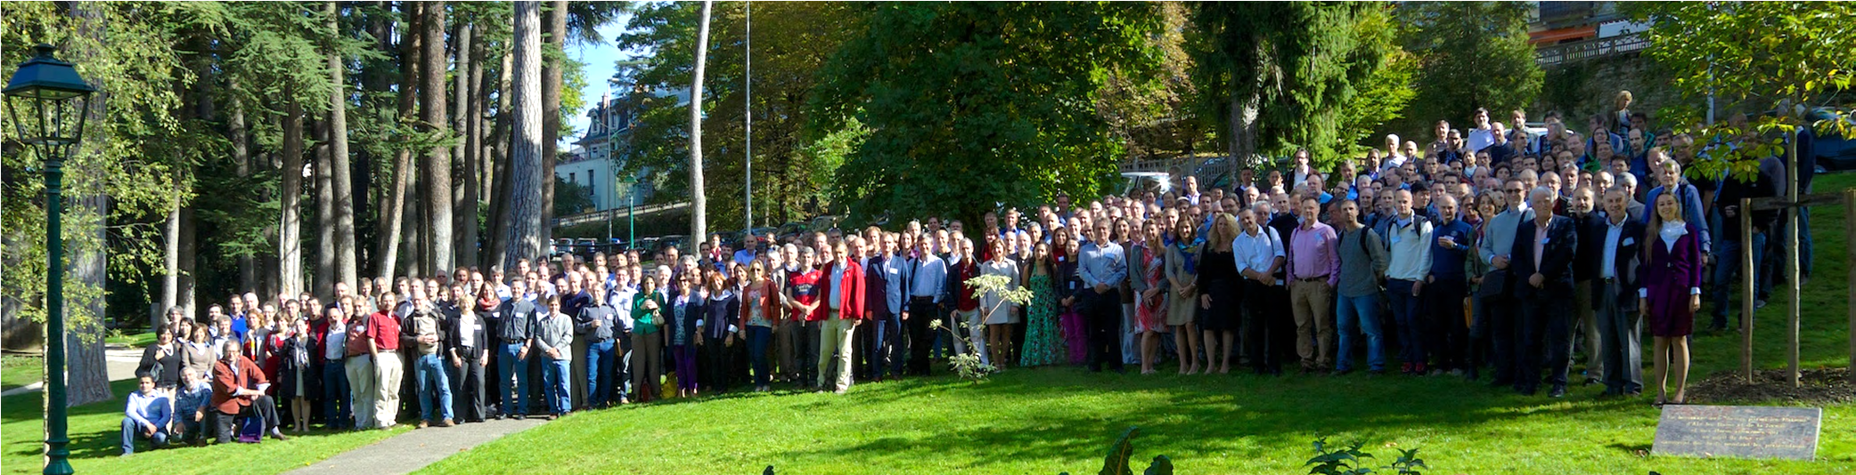
Conclusion
..it won’t be the last such workshop!!
320 people registered ..probably 250 participated: a great success in communication and
cooperation in the common interest : the preparatory groups will likely continue to play a role
Selection of (possibly) RLIUP relevant bullets from the concluding talk: (Phil Allport)
3‐4 years of R&D and prototyping, followed by 5‐6 years of construction, are needed to
complete the largest upgrades. R & D needs proper resources as of now.
Long shutdown durations and schedule need further definition and consensus, especially to
define clear profiles of resource needs vs time.

Slide 20
Conclusion
Experience & expertise from building and operating current experiment systems (including power, cooling, gas, beampipes, survey, magnets & cryo, planning, coordination etc) must be retained and transmitted to those developing new systems.
Modelling of radiation levels and radiation damage is clearly important, and in
some cases more results are needed to identify where upgrades are required.
Many systems would benefit from more common facilities for irradiations and
beam tests as well as greater coordination for use of those already available.
Tools for dealing with the very challenging environments at and after LS3 should
be developed in common with the machine and realistic timescales presented for
interventions that take full account of the overriding ALARA principle.
In some areas common standards & a common CERN interface with industries developing key technologies of importance to several experiments ( & LHC ??) is beneficial to minimize development & procurement costs.
Forums exist for interaction between the machine and the experiments, but always helpful to update a larger forum, to be sure key parameters are widely understood across expts.

