Slide 1
In situ SEM DC experiments in Uppsala – update 01 July 2013
Tomoko Muranaka

Slide 2
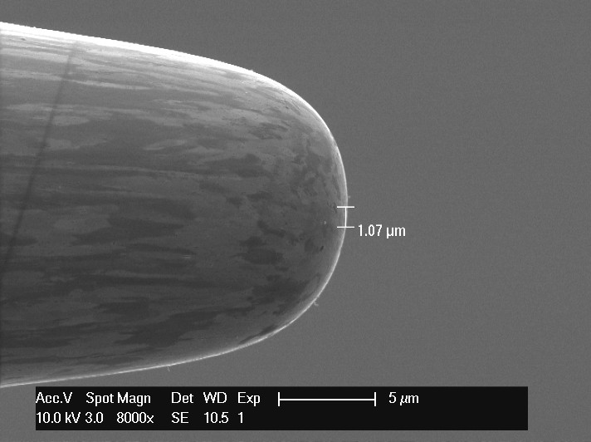
Preparation
Cathode: Copper (SLAC etching + 1040deg H2 heating)
  EBSD analysed
Anode: Tungsten 7um

Slide 3
Experiments
Grain dependent field emission measurement
  5 measurements on (111), (101), (001)
Field emission stability measurement
  1 measurement (for 2000 points, about 30minuites) on (111), (101), (001)
Breakdowns for warm-like feature observation
  1 BD on (111), (101), (001)
  Supply 1kV at 5um gap then make the anode closer step by step until the current constantly over 1uA.

Slide 4
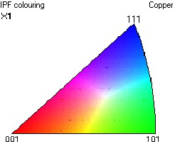
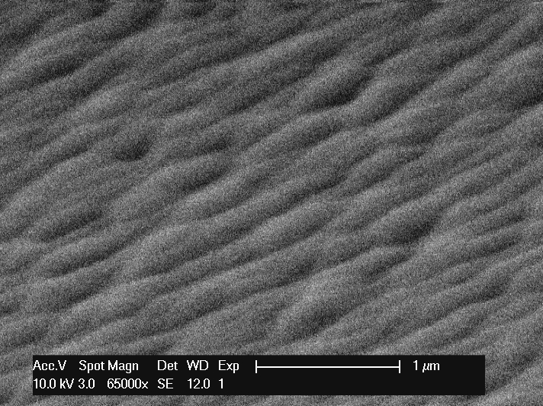
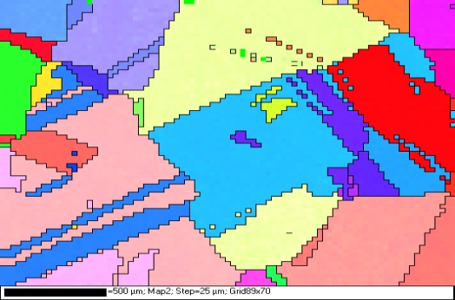
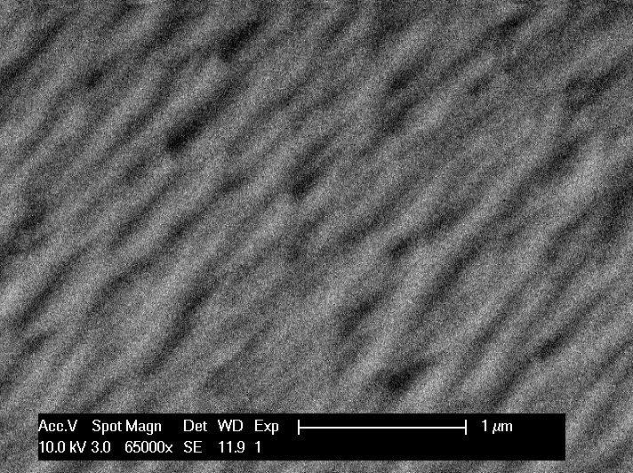
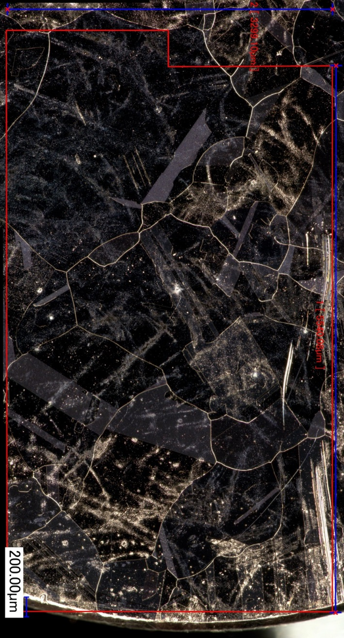
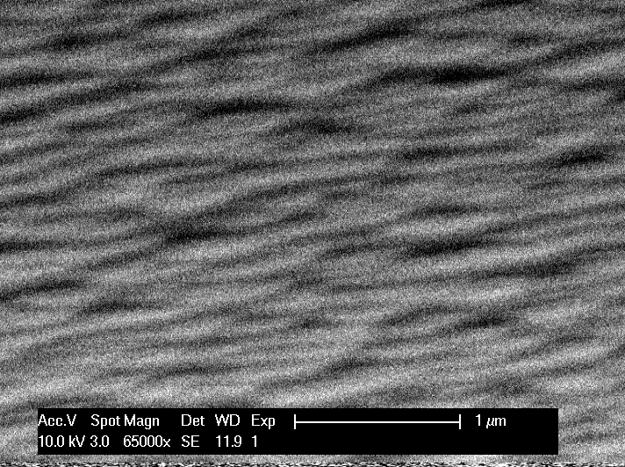
Measurement area
101
001
111

Slide 5
Field emission onset voltage
The onset voltage varies 700-1000V except three spots (two on (101), one on (111)).

Slide 6
Emission stability (001), 800V
Ramping up from 600V, “stay” if the current once exceeded 0.5pA (background was 0.2pA). 2000 meas. points ~ 30minuites

Slide 7
Emission stability (101), 600V

Slide 8
Emission stability (111), 990V

Slide 9
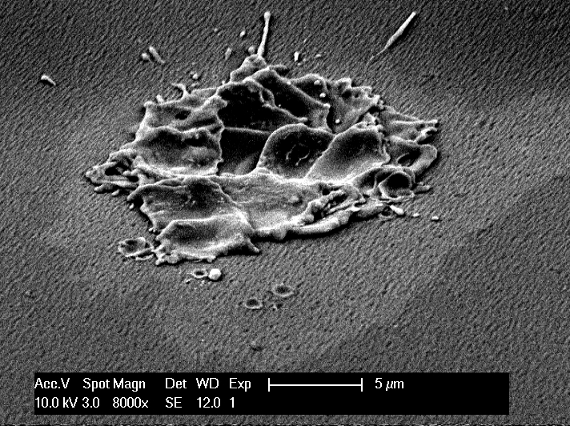
Breakdown site (001)

Slide 10
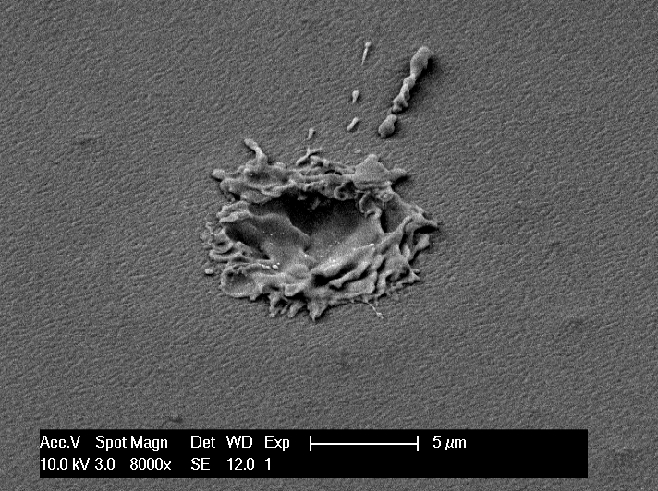
Breakdown site (101)

Slide 11
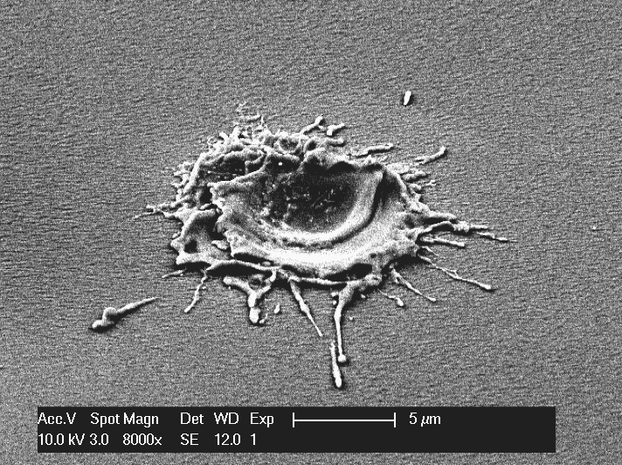
Breakdown site (111)

Slide 12
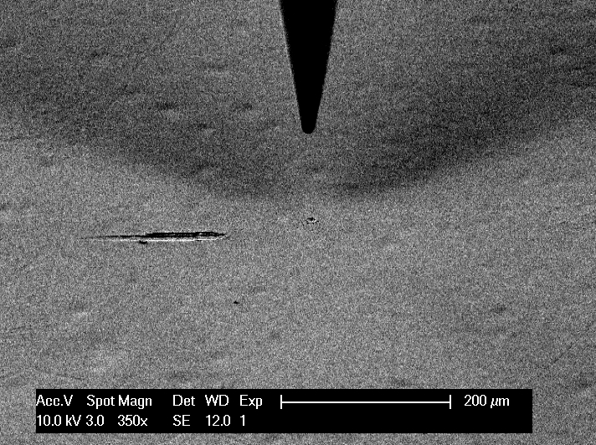
Breakdown site (111)

Slide 13
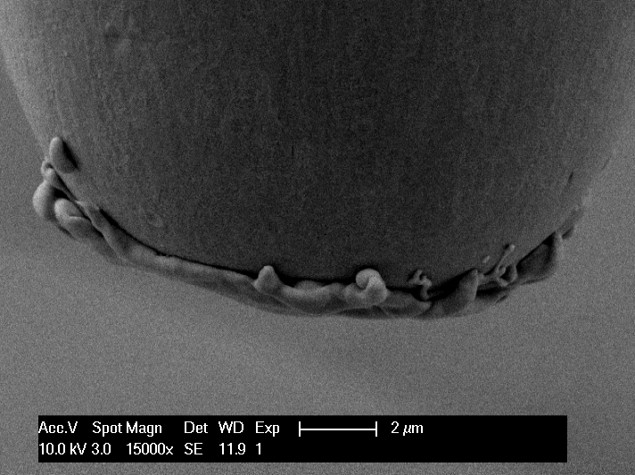
Anode tip after three BD

