Slide 1
TD24R05 BDR results
W. Farabolini – 24th June 2013

Slide 2
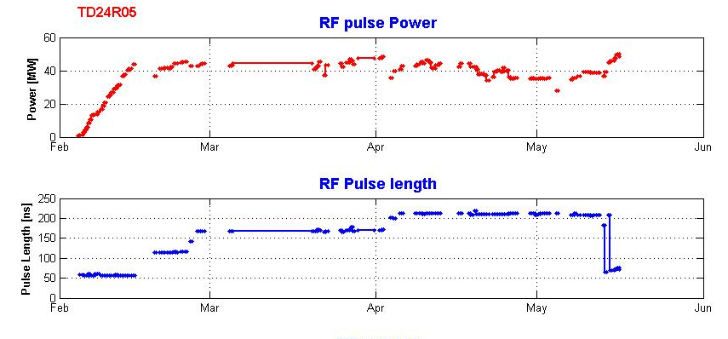
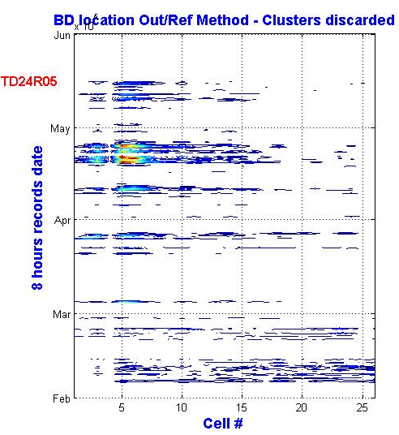
Testing condition evolution
Constant Pulse length period analyzed: from 5 April to 12 May 2013 Total nb. of 8 hours files: 61
The hot spot around cell #5 has already appeared before this period.

Slide 3
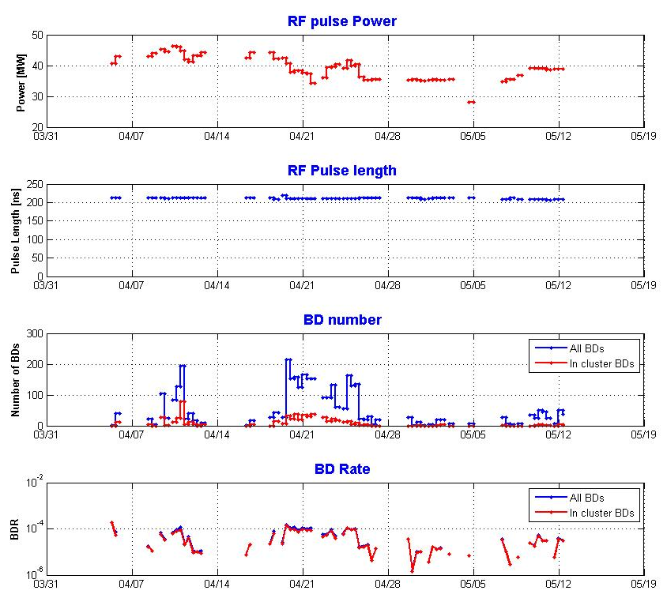
Main parameters of this period
Total nb. of RF pulses : 68.6 x 10⁶
Total nb. of BD : 3281
Mean pulse length: 211 ns [207-218]
Mean power: 39.1 MW [from 28.0 to 46.3] (adapted for BD rate < 10⁻⁴)
  -> Mean accelerating gradient: 96.1 MV/m [81.5-104.7]

Slide 4
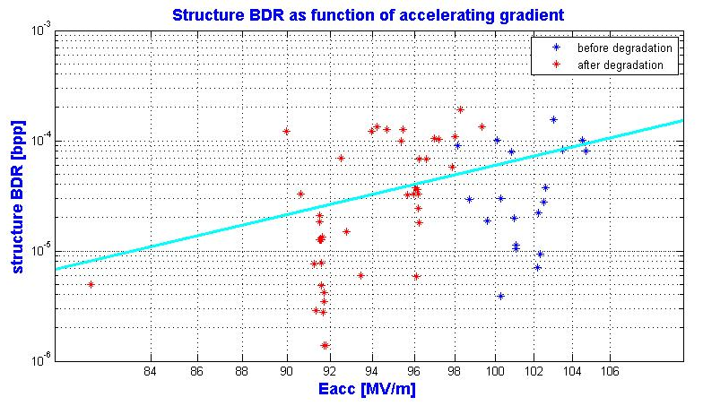
BDR power law
E_{acc}^{9.8}
Quite a great dispersion of BDR for a constant accelerating gradient
-> detailed analyze of each 8 hours period record (61) still to be completed (see below)

Slide 5
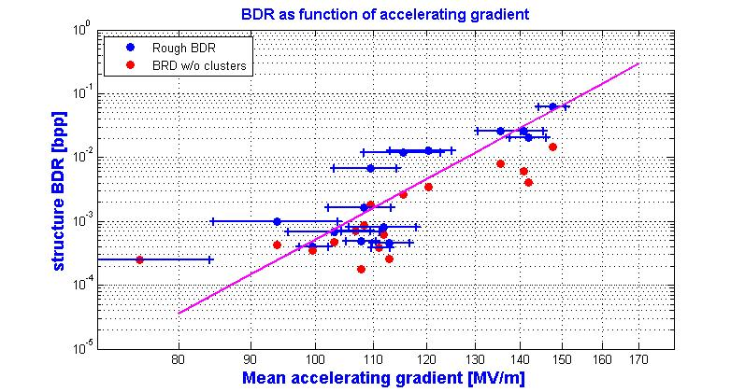
TBTS 2nd period comparison
E_{acc}^{11.5}

Slide 6
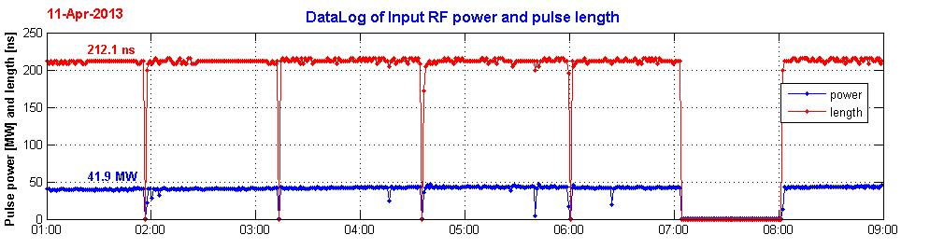
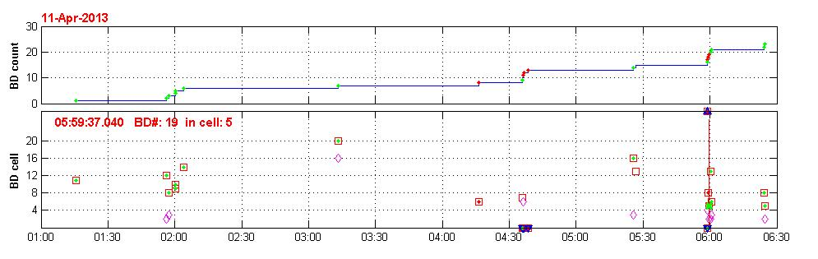
Power, pulse length and BD time evolution 11 Apr (a)
BDR = 2.2 x 10⁻⁵

Slide 7
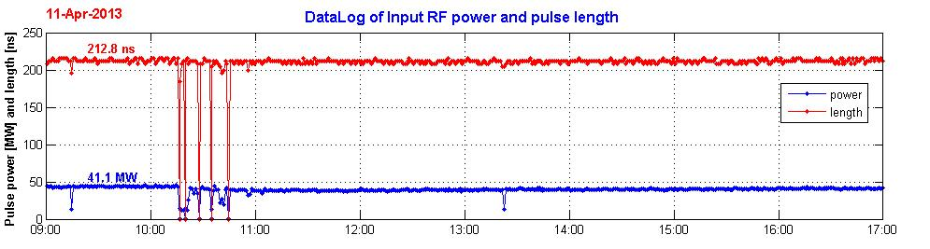
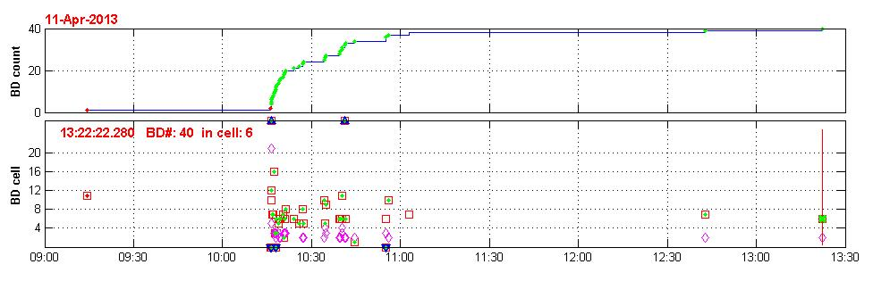
Power, pulse length and BD time evolution 11 Apr (b)
Short period of high BDR
BDR = 4.5 x 10⁻⁵

Slide 8
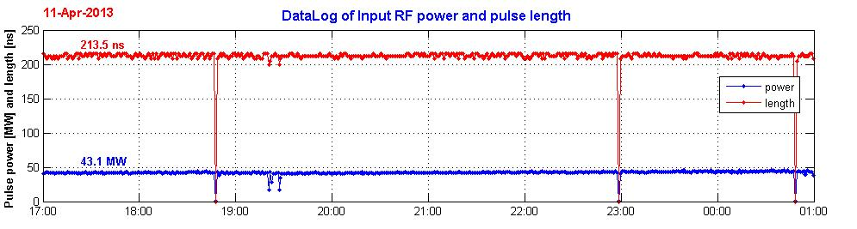
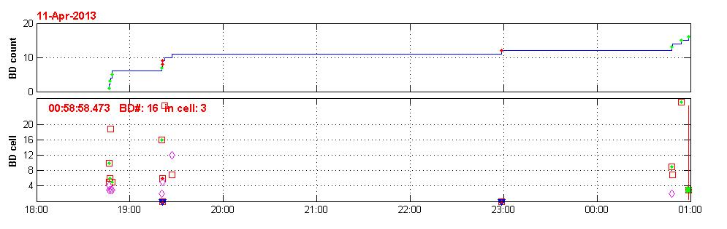
Power, pulse length and BD time evolution 12 Apr (a)
BDR = 1.12 x 10⁻⁵

Slide 9
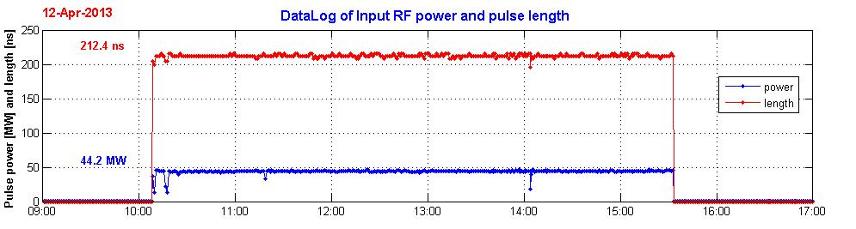
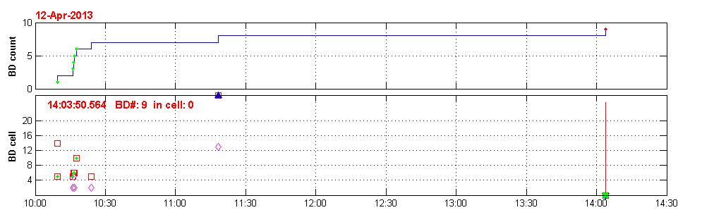
Power, pulse length and BD time evolution 12 Apr (b)
BDR = 1.14 x 10⁻⁵

Slide 10
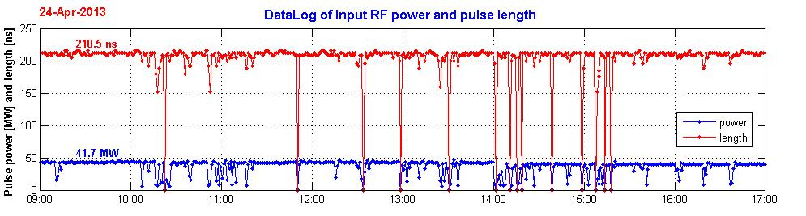
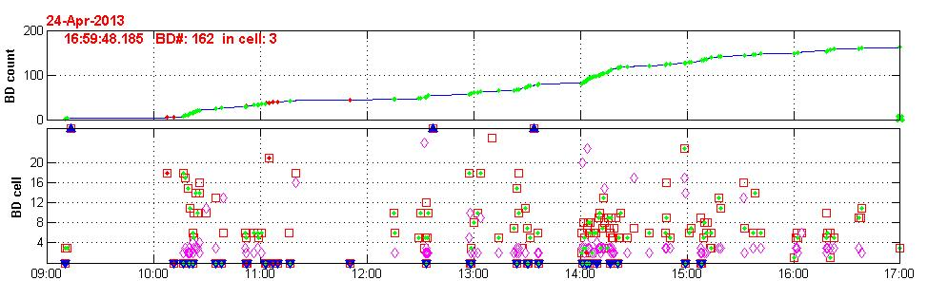
Power, pulse length and BD time evolution 24 Apr (a)
BDR = 1.1 x 10⁻⁴
A strong degradation has appeared !

Slide 11
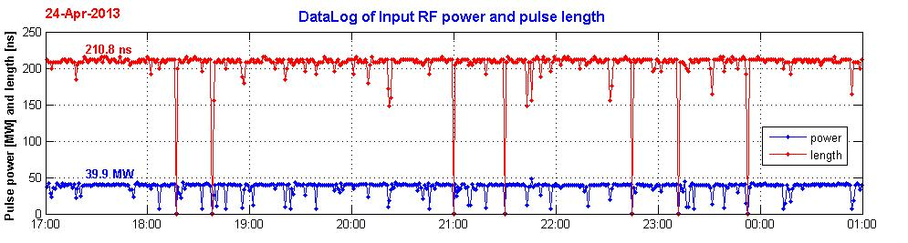
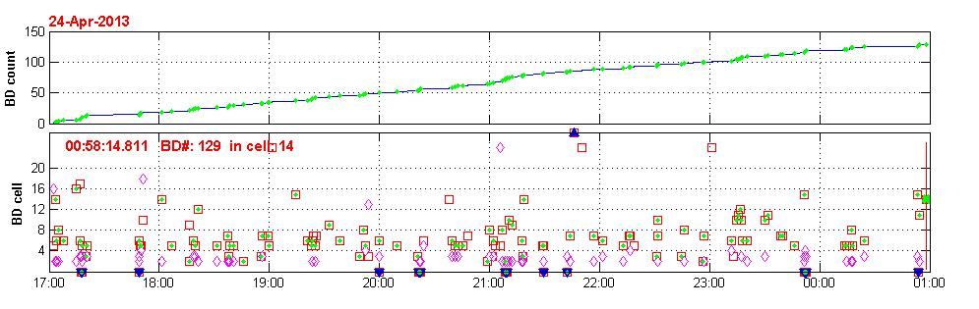
Power, pulse length and BD time evolution 25 Apr (a)
BDR = 9.0 x 10⁻⁵

Slide 12
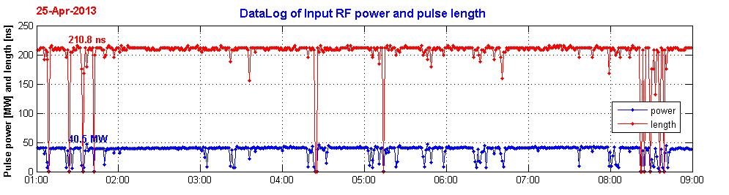
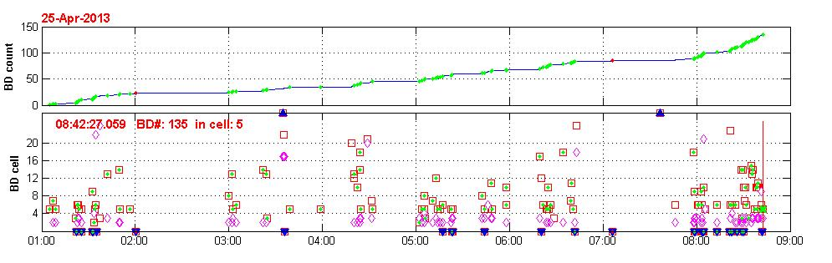
Power, pulse length and BD time evolution 25 Apr (b)
BDR = 9.6 x 10⁻⁵
From 26 April, power has been reduced to 35 – 39 MW
(91 -96 MV/m) to keep BDR around 10⁻⁵ but the ACS did not recover

Slide 13
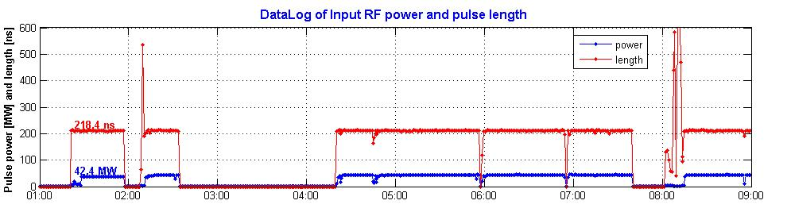
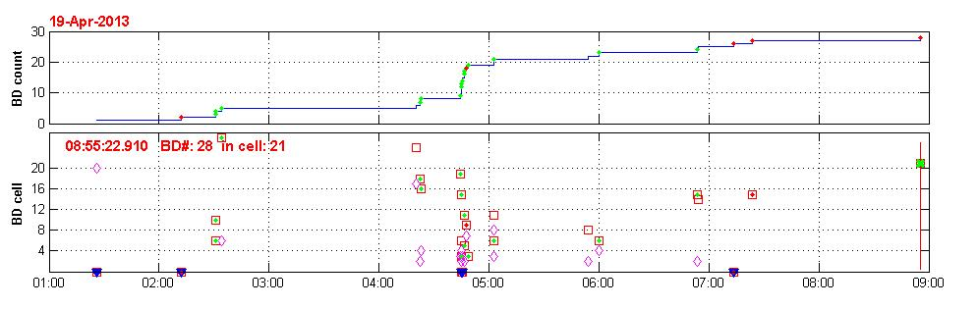
19th April – before degradation
BDR = 2.7 x 10⁻⁵

Slide 14
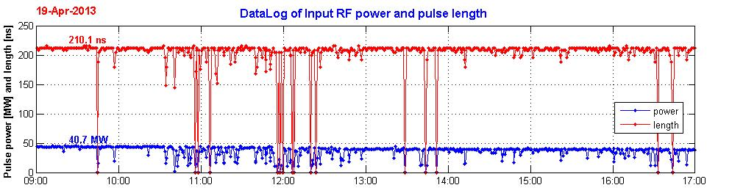
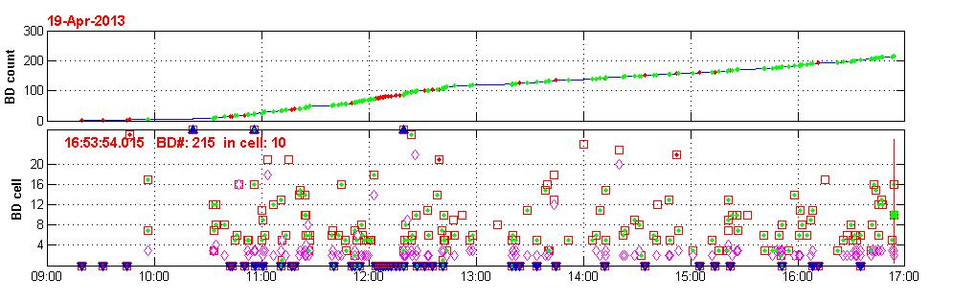
19th April – degradation starts at 10:30
BDR = 1.5 x 10⁻⁴

Slide 15
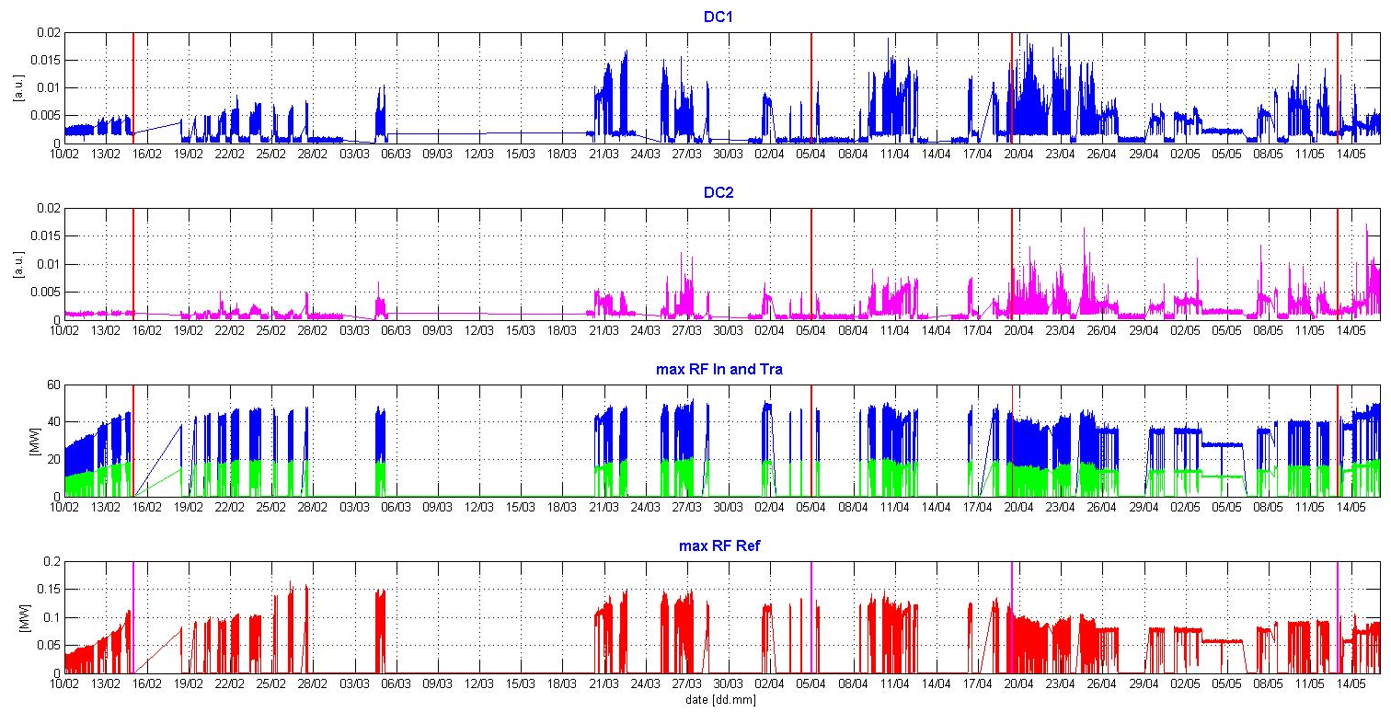
FCU and RF signals
Triangle Pulse shape
Power ramping
Pulse length ramping
Nominal RF pulse
After degradation

Slide 16
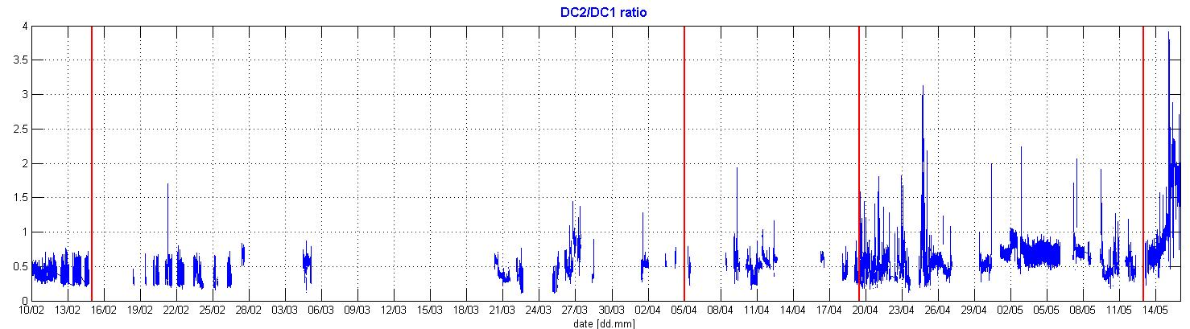
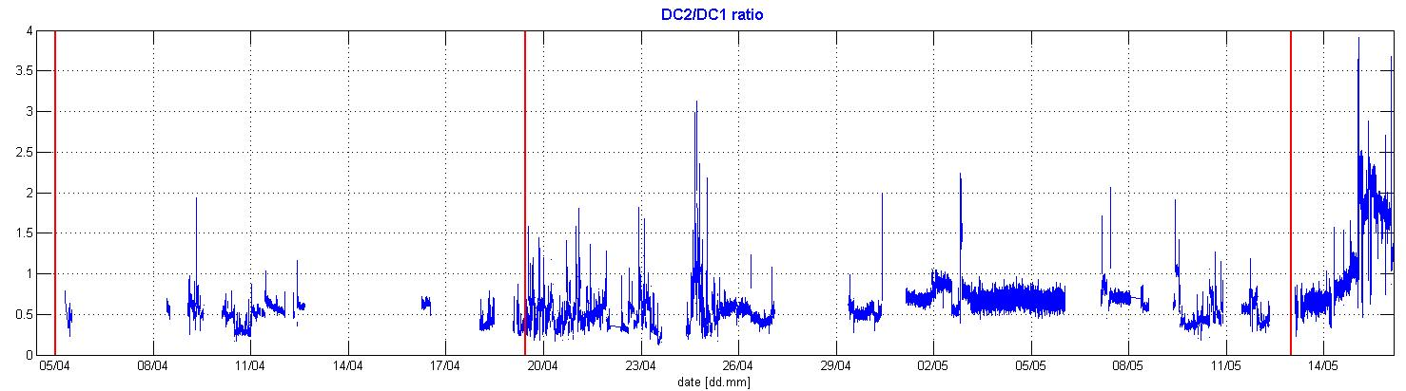
Upstream / downstream Faraday cups ratio
Triangle Pulse shape
Power ramping
Pulse length ramping
Nominal RF pulse
After degradation
Degradation date
DC2/DC1 ratio is more frequently larger than 1 since the degradation occurred

Slide 17
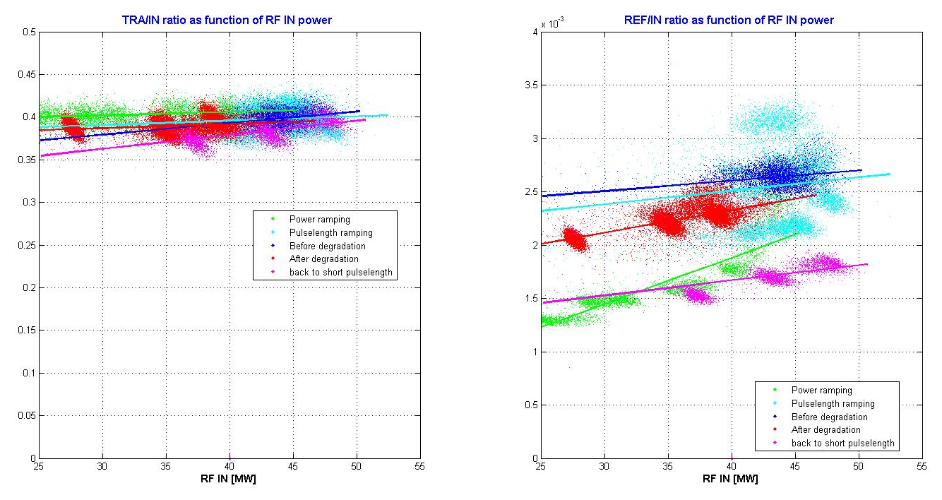
Tra/In and Ref/In ratios
Ref/In ratio increases with the RF input power (but it could be an artifact due to the non linearity of the log detectors)

Slide 18
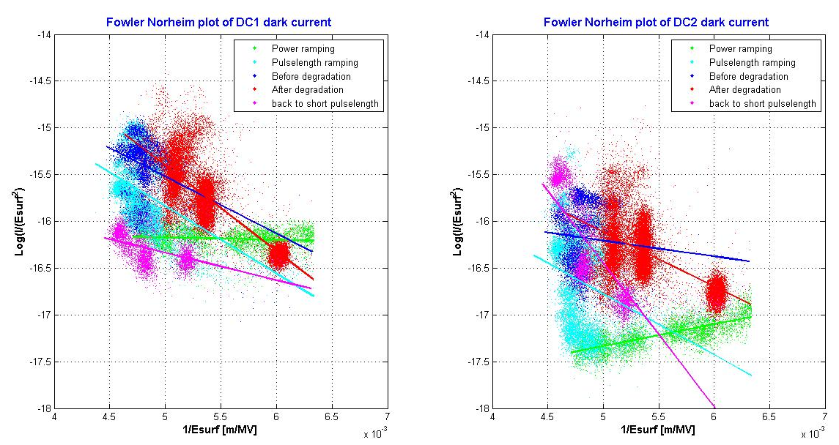
Fowler-Norheim plots on peaks

Slide 19
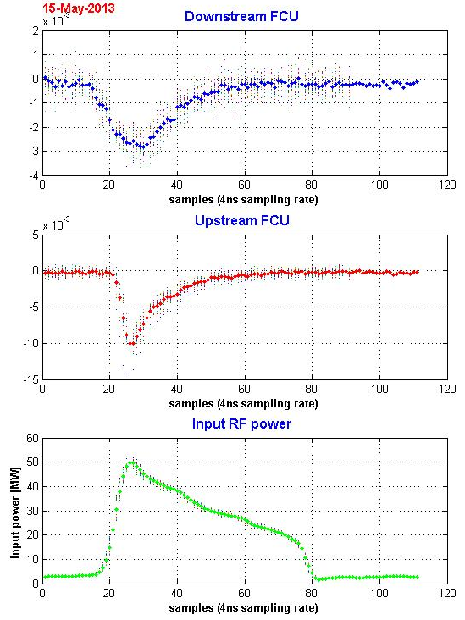
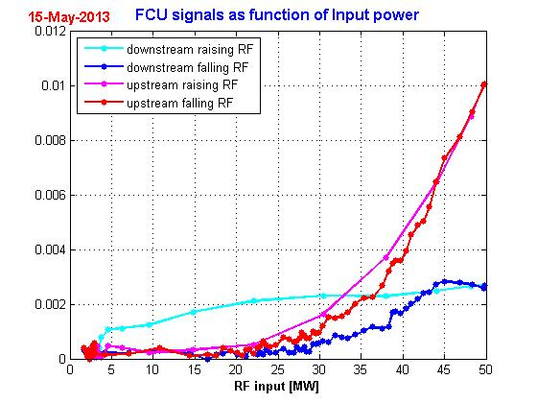
FCU as function of RF power along pulses

Slide 20
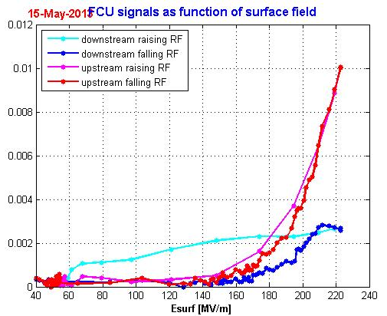
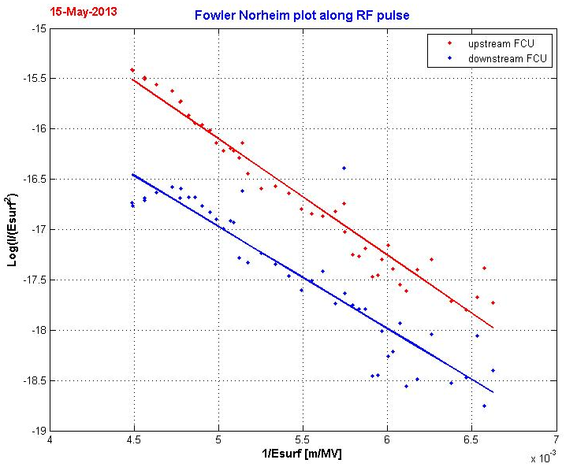
Fowler-Nordheim plot along RF pulses

Slide 21
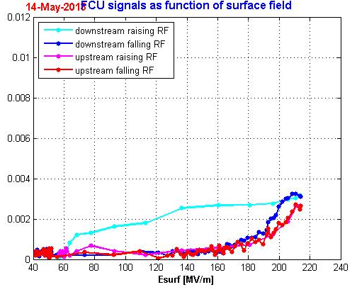
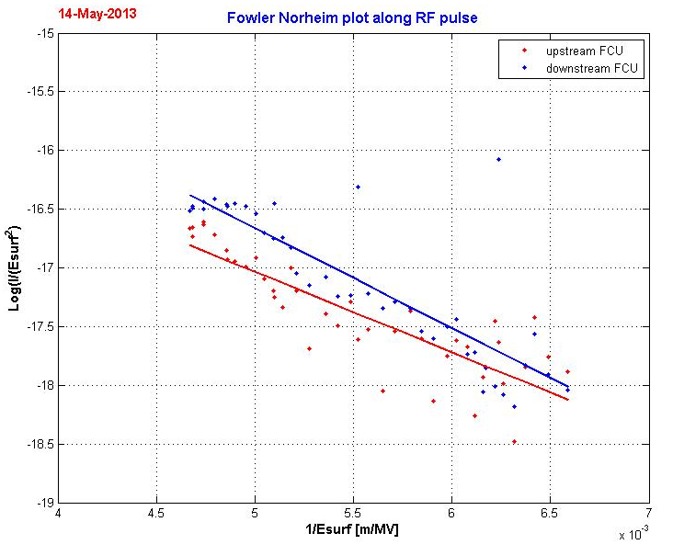
Fowler-Nordheim plot along RF pulses

Slide 22
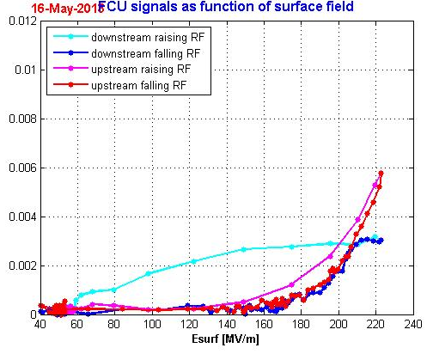
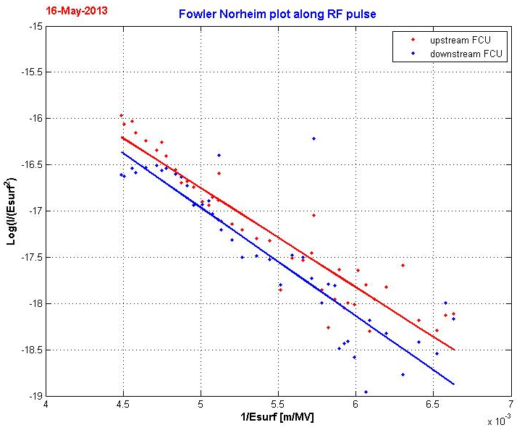
Fowler-Nordheim plot along RF pulses

Slide 23
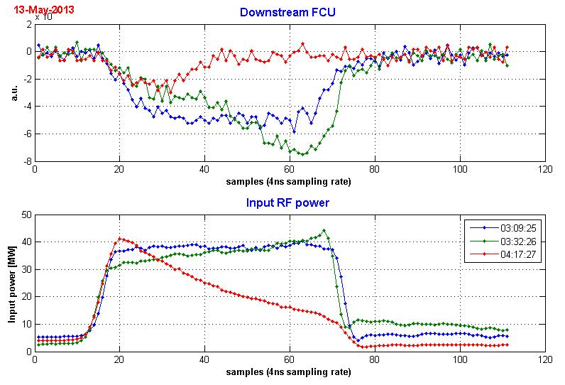
Does pulse length matter in dark current ?
Three different RF pulses (same peak power but different shapes) give different peak dark current. Electronic bandwidth effect or real field emission behavior ?

Slide 24
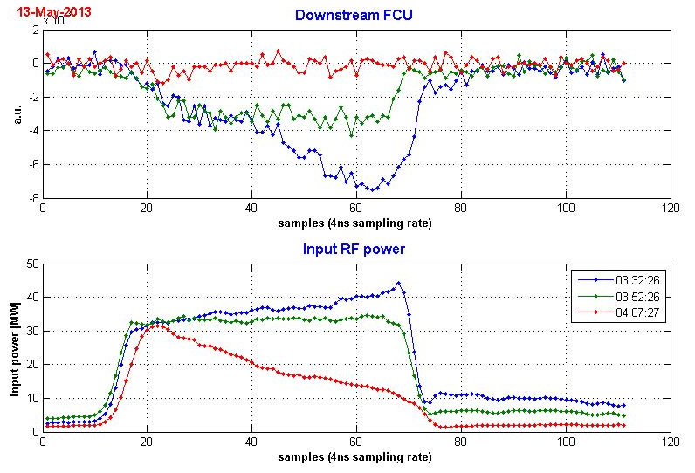
Another example

Slide 25
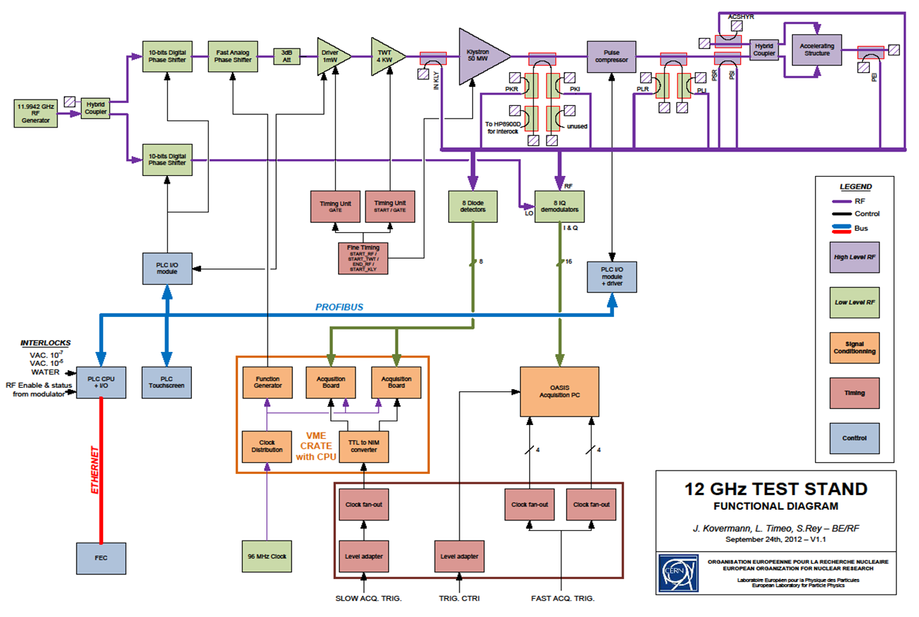
Where are the RF couplers ?

Slide 26
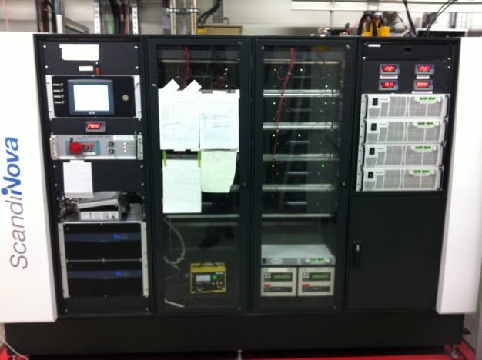
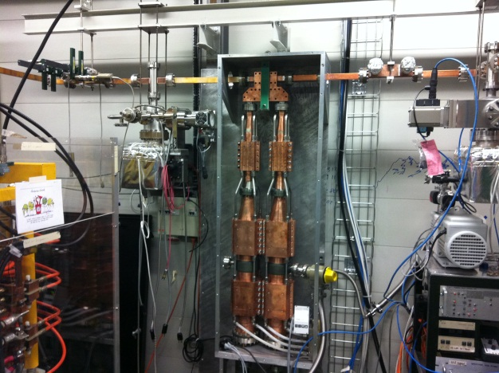
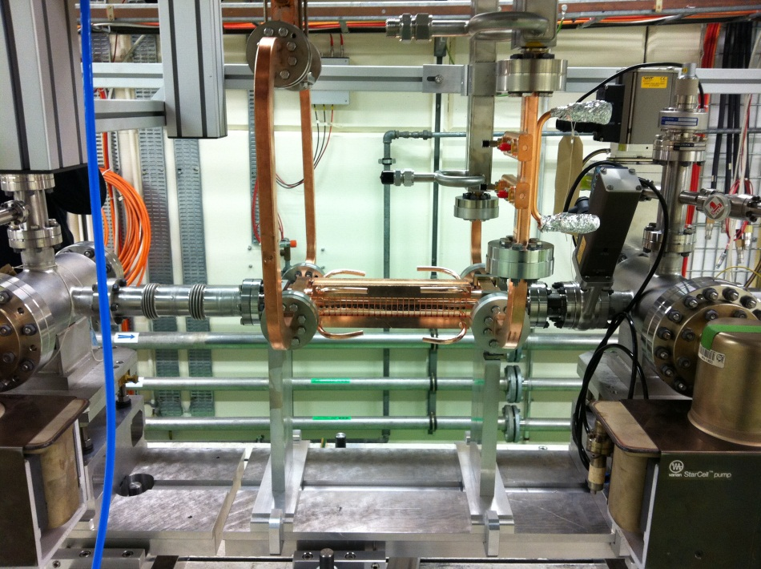
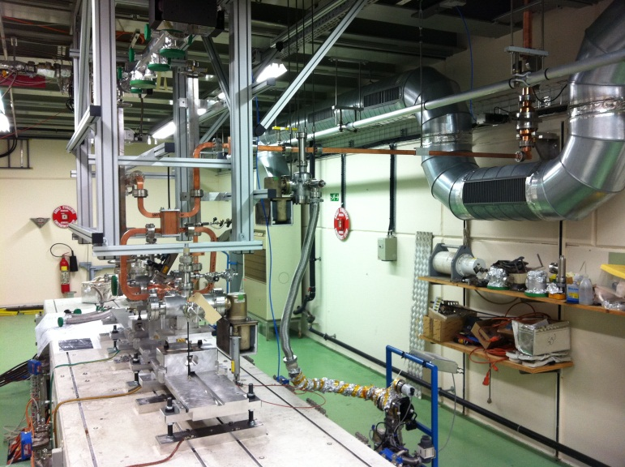
Layout of the CERN x-band test stand
(X-box 1) [I. Kovermann]
Clockwise from top-left:
Modulator
Pulse compressor
DUT + connections
Accelerating structure
Gallery
Bunker

Slide 27
Action for the next X-Box1 run
Decoupled signals used for test stand monitoring (safety interlock) and for test of the accelerating structure.
Accurately calibrate delays between structure diags (RF and FCU)
Use faster sampling rate (1 ns) and adjust the dynamic of the I/Q
Use 2 different dynamics for the FCU (dark current and BD current)
Implement a method for periodic Fowler-Nordheim plots (ramping power up and down RF power during 10 s every 15 min. for example)
Define less stringent rules for stopping the RF on structure BDs signal (use energy loss threshold)
New diagnostics development (optical fibers, higher frequency RF signal probe)

