Slide 1

Jets at RHIC
What have we learned from jet reconstruction and correlation measurements?
Alice Ohlson
Yale University

Slide 2
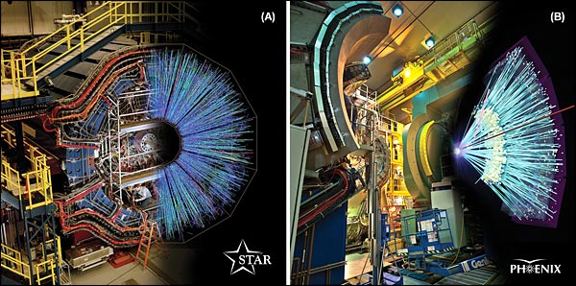
Jets at RHIC
Hard-scattered partons fragment into collimated “jets” of hadrons
By studying jets we can investigate interactions of the high-p_{T} partons with the Quark Gluon Plasma
We look for…
  Suppression of the number of jets (compared to p+p or p+A)
  Modification of the p_{T} or angular distributions of jet fragments
Au+Au collisions at √s_{NN} = 200 GeV

Slide 3
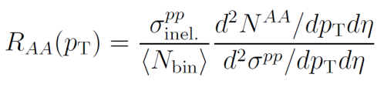

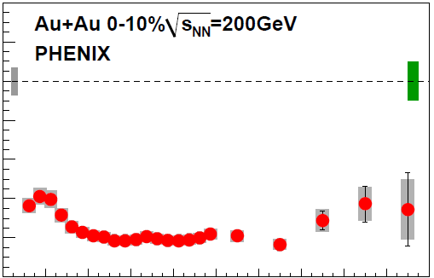

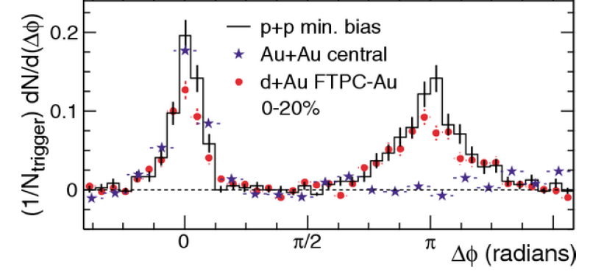

High-p_{T} suppression
Single-particle inclusive measurements
→ suppression of high-p_{T} hadrons in central Au+Au events
Correlations w.r.t. high-p_{T} hadrons
→ suppression of particles associated with jet peak
PRL 101 (2008) 232301
PRL 91 (2003) 072304

Slide 4
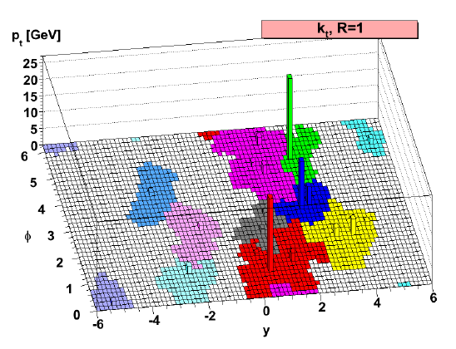
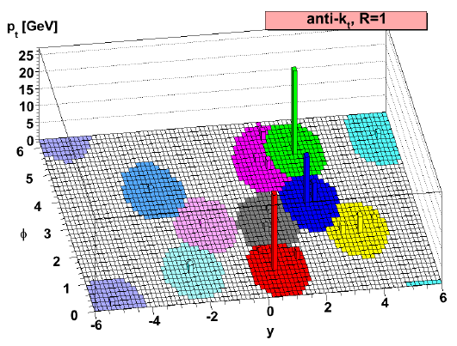
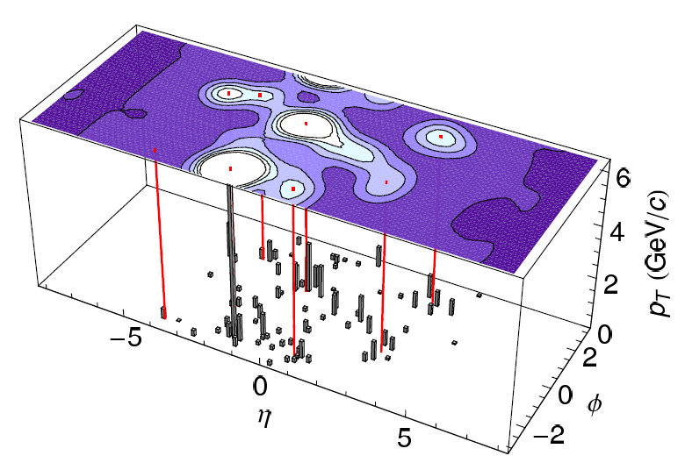
Jet Reconstruction Algorithms
The goal: Find clusters of particles, determine the direction and energy of the original parton
Several options: k_{T}, anti-k_{T}, Gaussian filter, etc.
Main challenge: subtracting the combinatoric heavy ion background, accounting for fluctuations
k_{T} & anti-k_{T}
JHEP04 (2008) 063
Gaussian filter
arXiv:0806.1499 [nucl-ex]

Slide 5
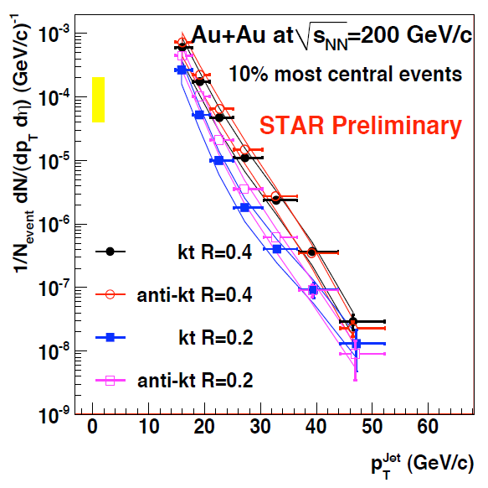
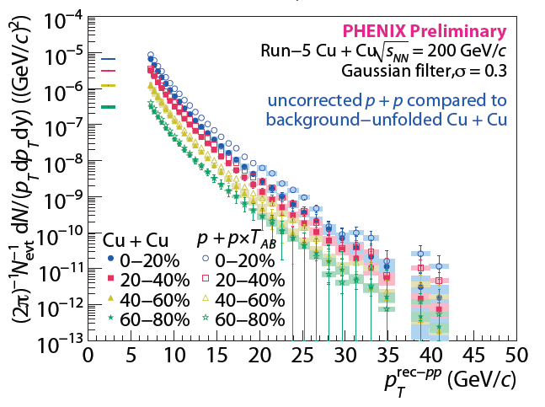
Jet Spectra at RHIC
For the first time → Full jet reconstruction in a heavy ion environment
Different methods of jet reconstruction, background subtraction, fake-jet rejection
QM 2009
QM 2009

Slide 6
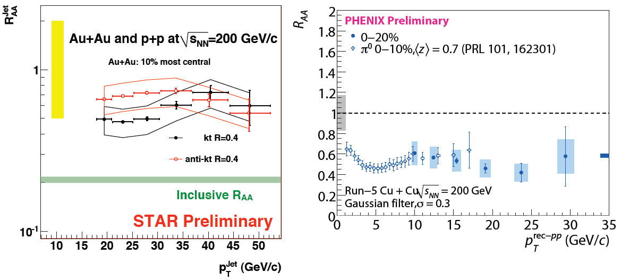
Jet R_{AA} at RHIC
Reconstructed jets demonstrate suppression
Need to use similar techniques for direct comparison, further work is necessary to understand background fluctuations
jets
QM 2009
QM 2009

Slide 7
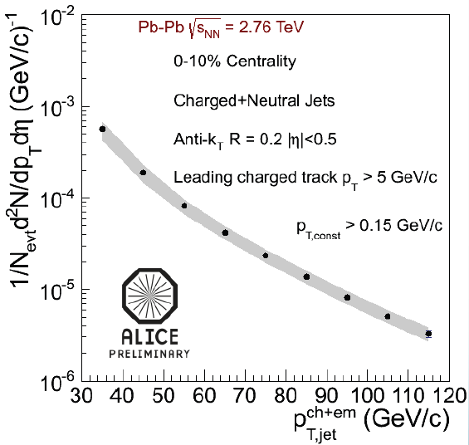
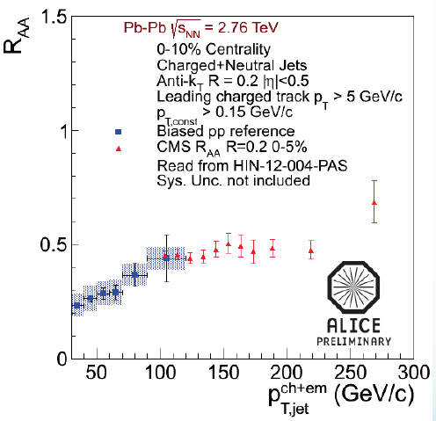
Jet Spectra at the LHC
ALICE, CMS, and ATLAS have produced jet spectra for 30 < p_{T}^{jet} < 300 GeV/c
Jet R_{AA} shows suppression for wide range in jet p_{T}
ALICE, HQ 2012

Slide 8

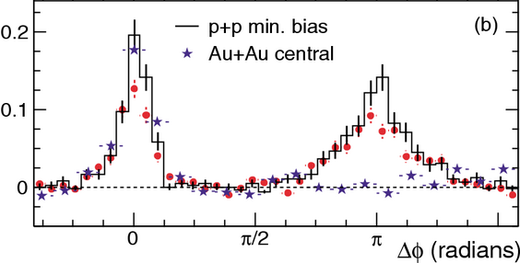
Dihadron Correlations
associates
trigger hadron
PRL 91 (2003) 072304
Investigate correlations of all “associated” particles with a “trigger”

Slide 9
γ-hadron Correlations
associates
trigger photon
γ-jet pairs produced in q+g → q+γ
Photons do not lose energy in the medium, therefore p_{T}^{photon} ≈ p_{T}^{parton}

Slide 10
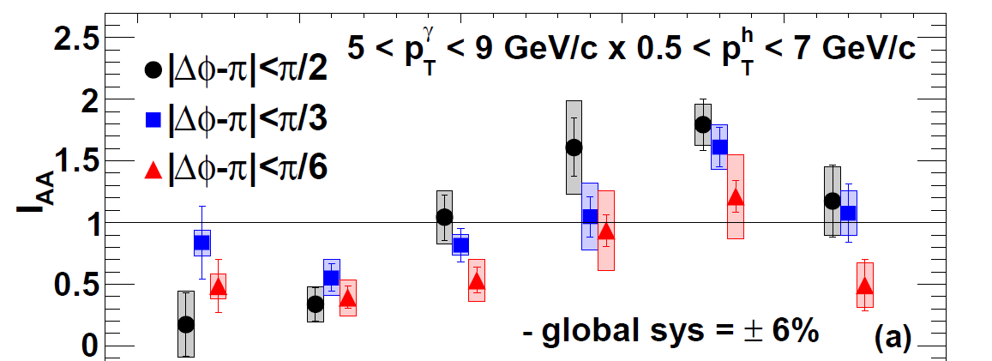
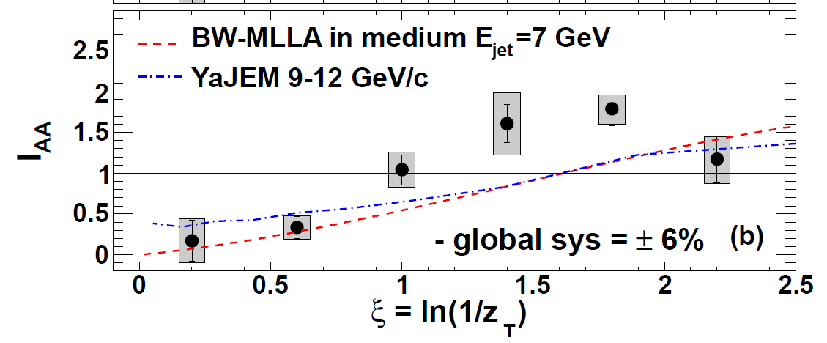

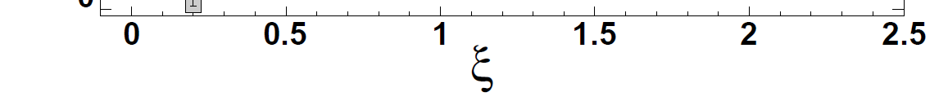
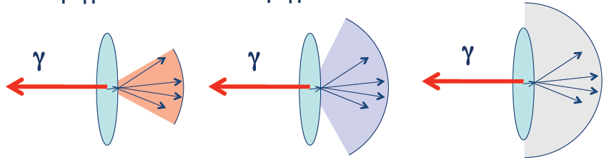
Awayside hadron yields
PHENIX, arXiv:1212.3323 [nucl-ex]
Accepted to PRL
yield in Au+Au
yield in p+p
I_{AA} =
ξ = ln(1/z_{T})
z_{T} = p_{T}^{hadron}/p_{T}^{photon}
Modified fragmentation function in Au+Au compared to p+p
In narrow cone (|Δφ-π| < π/6): suppression (I_{AA} < 1) of high-z_{T} hadrons, no corresponding enhancement at low z_{T}
When integration region is expanded (|Δφ-π| < π/2), low-z_{T} enhancement is observed
|Δφ-π| < π/6 |Δφ-π| < π/3 |Δφ-π| < π/2
high z_{T}
low z_{T}

Slide 11
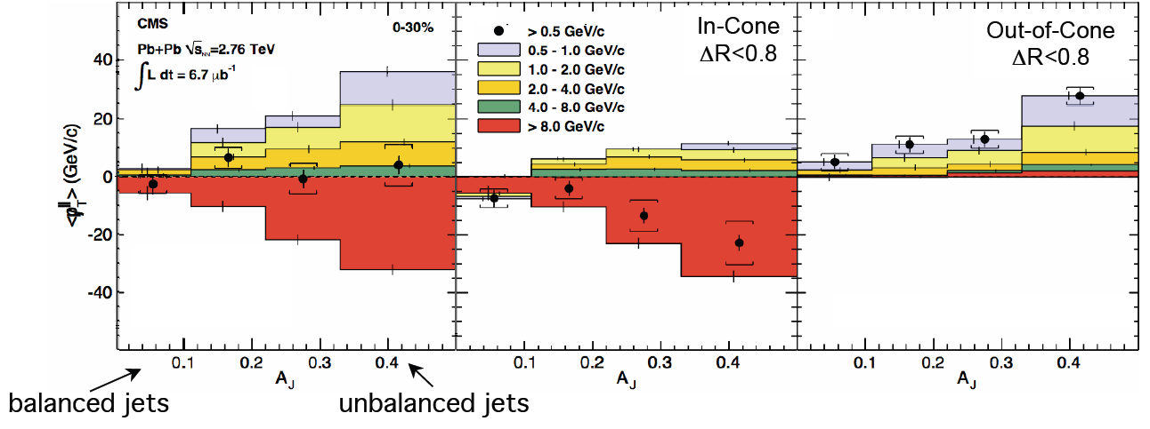
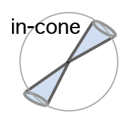
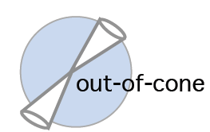

Jets at the LHC
CMS result → Energy is distributed to very wide angles (ΔR > 0.8 ~ π/4)
Similar conclusions for CMS A_{J} and PHENIX γ-jet measurements
Where does the “missing” energy go?
ΔR>0.8

Slide 12
Jet-hadron Correlations
associates
reconstructed
trigger jet
Jet-hadron correlations have increased kinematic reach compared to dihadron correlations, allow for more precise determination of parent parton energy

Slide 13
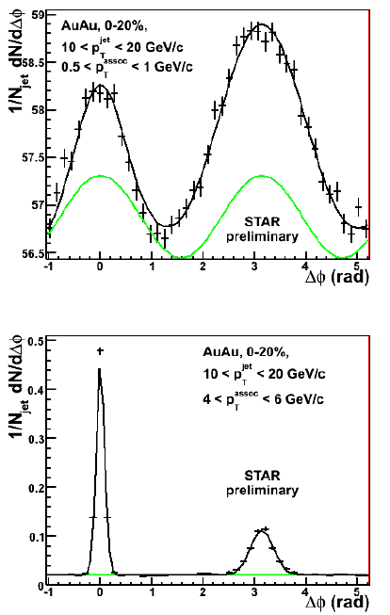
Jet-hadron Correlations
Intentionally impose a bias towards unmodified trigger jets! (surface bias?)
  E_{T} > 6 GeV in a single BEMC tower (Δφ x Δη = 0.05 x 0.05)
  Anti-k_{T} (R = 0.4) using tracks/towers with p_{T} > 2 GeV/c
HT trigger requirement and constituent p_{T} cut
  Reduce effects of background fluctuations
  Comparison to p+p is more straightforward
Trigger (nearside) jet population is highly-biased
  Used to assign uncertainties to shape of background (v₂ and v₃) and trigger jet energy scale
Recoil (awayside) jet fragmentation is unbiased

Slide 14
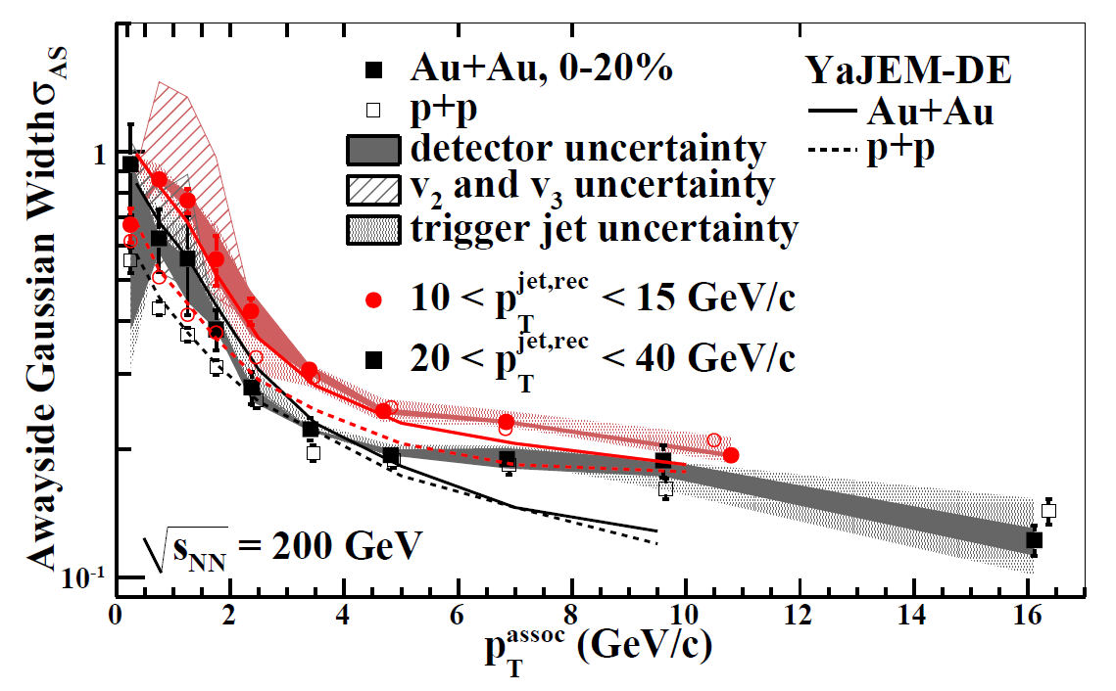
Awayside Gaussian Widths
STAR, arXiv:1302.6184 [nucl-ex] Submitted to PRL
Awayside widths suggest jet broadening to large angles at low-p_{T} (but highly-dependent on assumed v₃ modulation)
Further information is needed about v₂^{jet}, v₃^{jet} (possible correlation of jets with reaction plane / participant planes)…

Slide 15


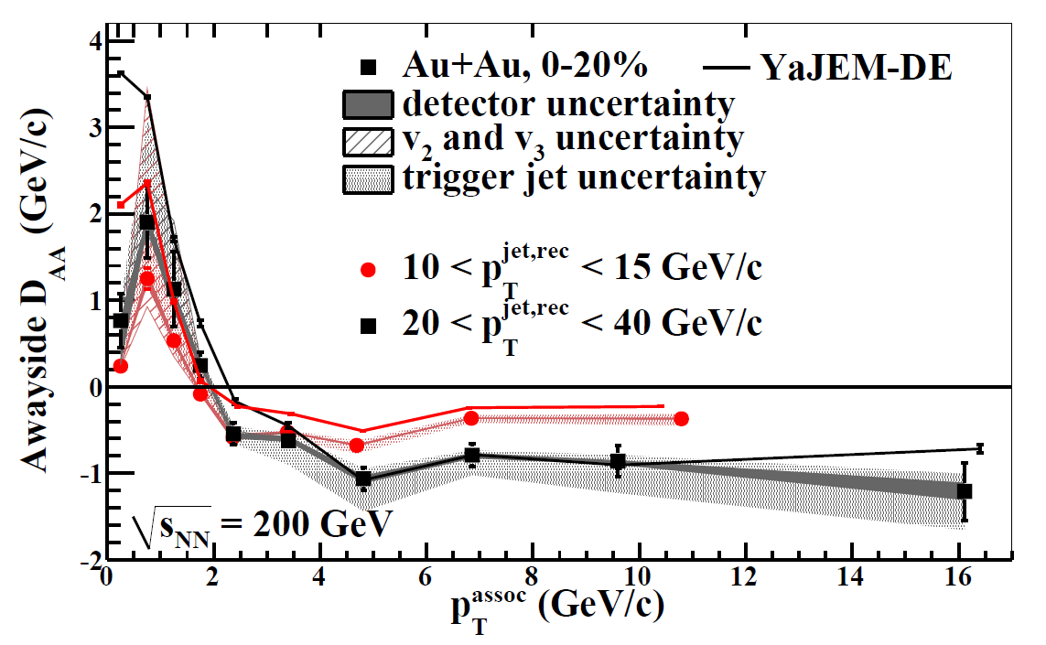
Awayside Energy Balance
STAR, arXiv:1302.6184 [nucl-ex] Submitted to PRL
p_{T}^{jet,rec} (GeV/c) | ΔB (GeV/c)
10-15
15-20
20-40
Uncertainties due to:
detector effects
v₂ and v₃
jet energy scale
Suppression of high-p_{T} associated hadron yield is in large part balanced by low-p_{T} enhancement.

Slide 16
From Qualitative Consistency to Quantitative Conclusions
Need to assess biases in measurements at RHIC and the LHC…
  Dihadron correlations: high-p_{T} hadron → hard fragmentation
  γ-hadron correlations: no geometrical bias?
  Jet-hadron correlations: HT trigger and high-p_{T} constituent cut → hard fragmentation
  CMS A_{J}: Two reconstructed jets with high energy
Need to do the same measurements at each experiment
  A_{J} at RHIC
  Jet-hadron correlations at LHC

Slide 17
2+1 Correlations
Select events containing pairs of back-to-back high-p_{T} hadrons (likely due to dijet production)
Investigate distributions of associated hadrons with respect to both trigger hadrons
associates
primary trigger
(trig1)
dijet trigger
(trig2)

Slide 18
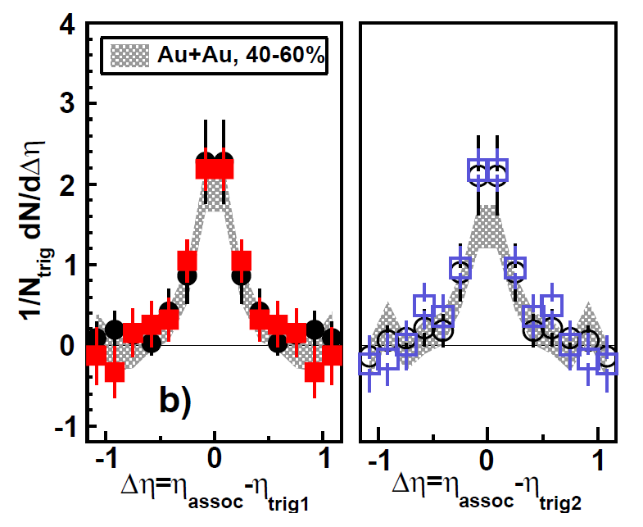
Symmetric Triggers
Near-side
Away-side
PRC 83 (2011)
061901
■ Au+Au
● d+Au
5 < p_{T}^{trig1} < 10 GeV/c
4 < p_{T}^{trig2} < p_{T}^{trig1}
1.5 GeV/c < p_{T}^{assoc} < p_{T}^{trig1}
No significant difference between Au+Au and d+Au
No significant difference between near-side and away-side.
Are we sampling surface-biased/unmodified dijets? Or dijets in which both jets lose similar amounts of energy?

Slide 19
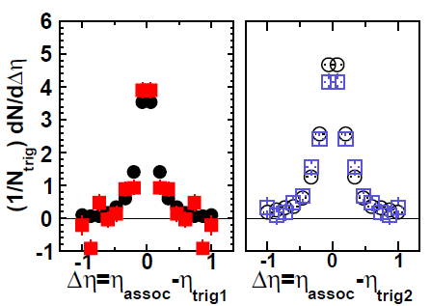
Asymmetric Triggers
Near-side
Away-side
PRC 87 (2013) 44903
■ Au+Au
● d+Au
10 < E_{T}^{trig1} < 15 GeV (in BEMC)
4 < p_{T}^{trig2} < 10 GeV/c (in TPC)
1 < p_{T}^{assoc} < 10 GeV/c
Still no large shape difference between near- and away-sides, or between Au+Au and d+Au.
Energy imbalance indicates slight softening of awayside peak
Compare/contrast to dihadron and jet-hadron results.

Slide 20
Jet-Hadron and 2+1 Correlations
associates
reconstructed
trigger jet
dijet trigger
(trig2)
Require a high-p_{T} hadron ~180º away from reconstructed trigger jet

Slide 21
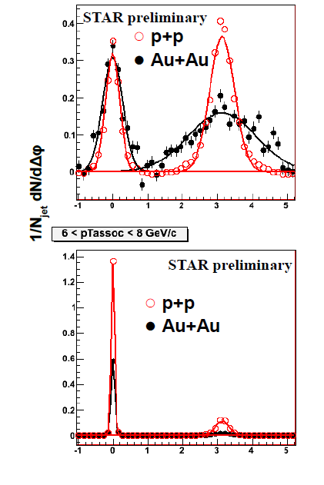
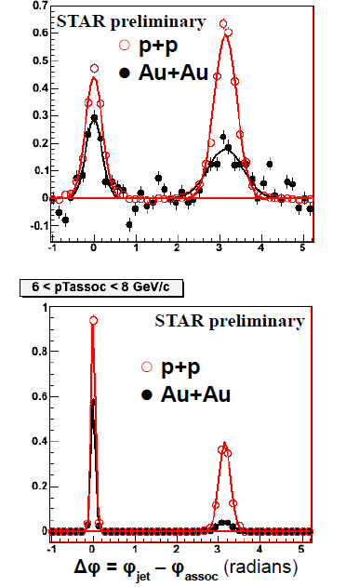
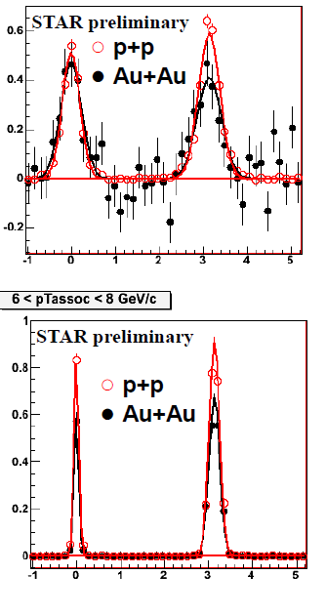
Jet-Hadron and 2+1 Correlations
10 < p_{T}^{jet} < 20 GeV/c
|φ_{jet} – φ_{trig2}| > π – 0.2
STAR, WWND 2011
no trig2 requirement
p_{T}^{trig2} > 2 GeV/c
p_{T}^{trig2} > 4 GeV/c
Low p_{T}^{assoc}
1.5 < p_{T}^{assoc} < 2 GeV/c
High p_{T}^{assoc}
6 < p_{T}^{assoc} < 8 GeV/c
Select unmodified jets with p_{T}^{hadron} > 4 GeV/c requirement.

Slide 22
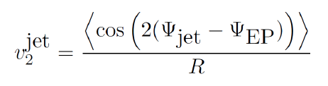
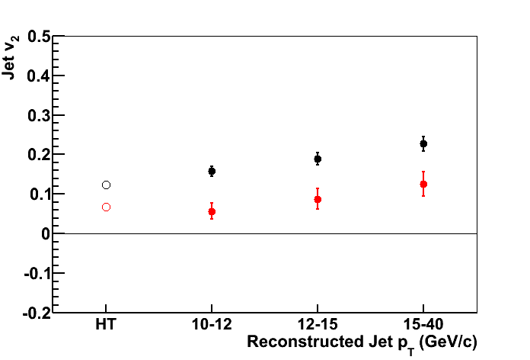
Jet v₂ at STAR
Correlation between jet axis and event plane
Jet v₂{FTPC EP} is non-zero
→ more jets reconstructed in-plane than out-of-plane
→ evidence of pathlength-dependence of parton energy loss
Jet v₂ ≈ HT v₂ → bias towards unmodified jets largely driven by HT requirement
STAR Preliminary
STAR, QM 2012
Jet Definition:
HT trigger E_{T} > 5.5 GeV
constituent p_{T}^{cut} = 2 GeV/c
|η_{jet}| < 0.6
● v₂{TPC EP} (|η| < 1)
● v₂{TPC EP} (2.8 < |η| < 3.7)

Slide 23
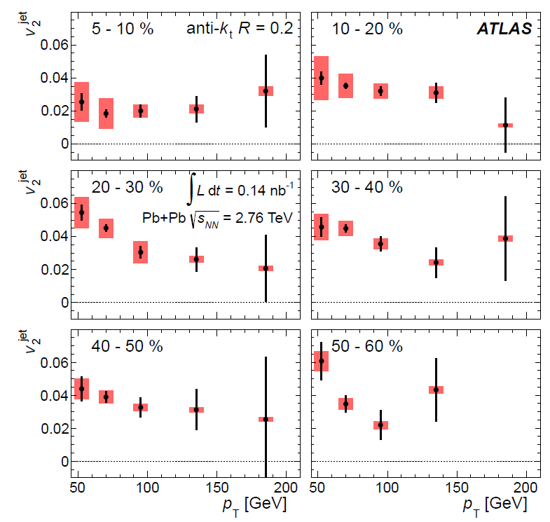
Jet v₂ at ATLAS
ATLAS, arXiv:1306.6469 [hep-ex]
Submitted to PRL
Jet v₂ measured for 45 < p_{T}^{jet} < 210 GeV/c, R = 0.2
Also observed v₂^{jet} > 0
Different kinematic range and biases than STAR measurement
→ different trend with p_{T}^{jet}

Slide 24
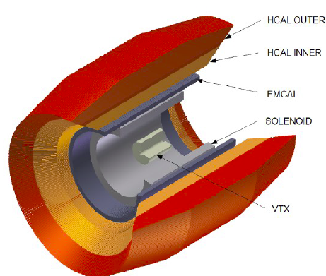
RHIC/LHC Complementarity
RHIC + LHC can cover a huge kinematic range of jets…
  ~5-10 GeV γ-jets in PHENIX
  ~10-40 GeV reconstructed jets in STAR
  ~30-100 GeV jets in ALICE
  ~50-350 GeV jets in CMS/ATLAS
STAR is working to improve their jet p_{T} spectrum measurement
  Recent advancements in understanding the details of jet reconstruction
  Similar methods as ALICE for direct comparison
  A new high-statistics dataset → jets beyond 50 GeV
sPHENIX upgrade will allow additional reach

Slide 25
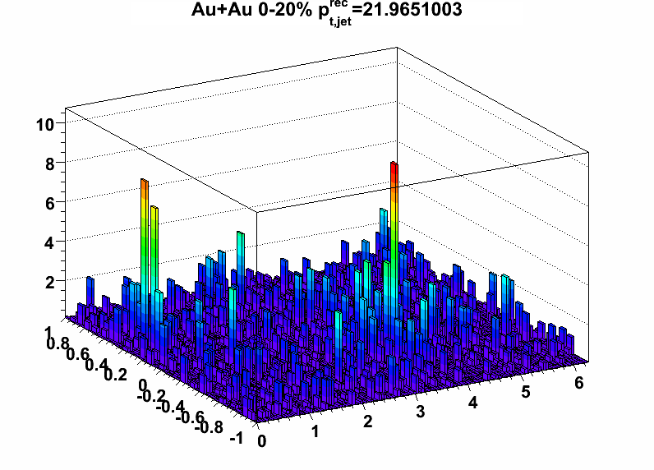
Conclusions & Final Thoughts
Complementary analyses demonstrate jet quenching at RHIC & LHC
  Softening and broadening of jets which traverse the medium in heavy ion collisions compared to p+p collisions
It is necessary to understand biases present in analyses
  At RHIC energies, a p_{T} > 4 GeV/c hadron requirement selects mostly unmodified jets
  What about at LHC energies?
Necessary to do similar measurements with similar techniques among RHIC experiments and at the LHC
Complementarity between RHIC and LHC measurements provide information about parton energy loss over a wide kinematic range
STAR Preliminary
p_{T} per unit grid cell (GeV/c)
η
φ
25

Slide 26
Backup

Slide 27
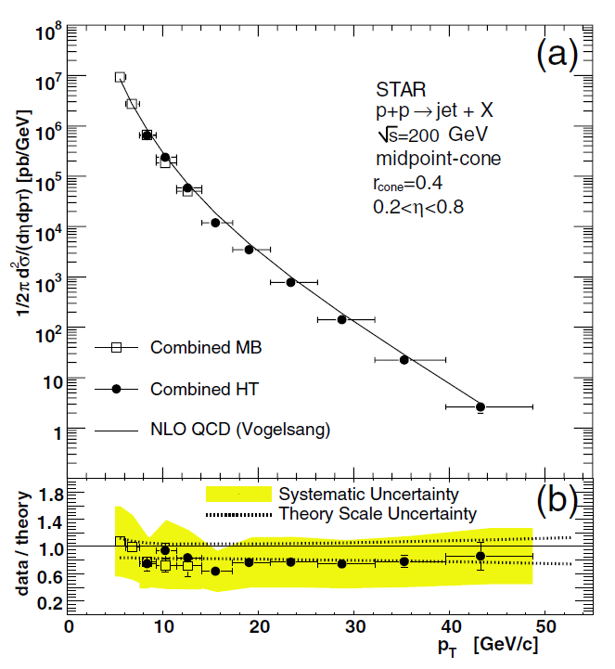
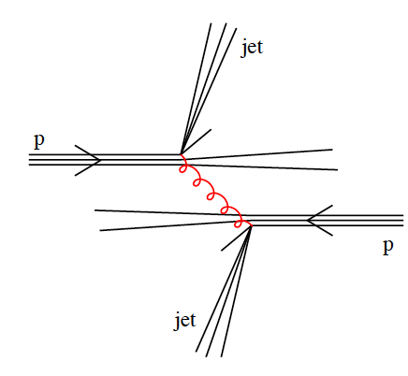
Jets
Hard-scatterings occur in the early stages of the collision
Recoiling partons fragment into clusters of hadrons, known as “jets.”
Use jets as probes of the medium.
Jets in p+p are well-described by pQCD
PRL 97 (2006) 252001

Slide 28
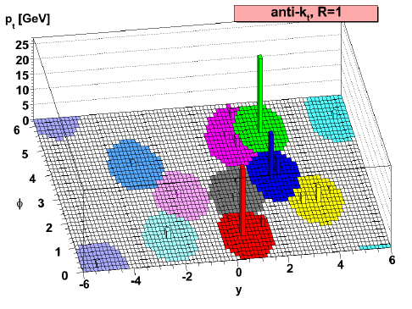
Jet Reconstruction
Anti-k_{T} algorithm – sequential recombination [PLB 641 (2006) 57]
  Start with high-p_{T} particles
  For each pair of particles (i,j), calculate
  d_{ij} = min(1/p_{Ti}², 1/p_{Tj}²)((Δy)_{ij}²+(Δφ)_{ij}²)/R²
  If d_{ij} < 1/p_{Ti}², merge the particles, else call particle i a jet
  Repeat until all particles are clustered
  R is resolution parameter
  → characteristic jet radius
M. Cacciari, G. P. Salam, G.Soyez, JHEP 04 063 (2008)

Slide 29
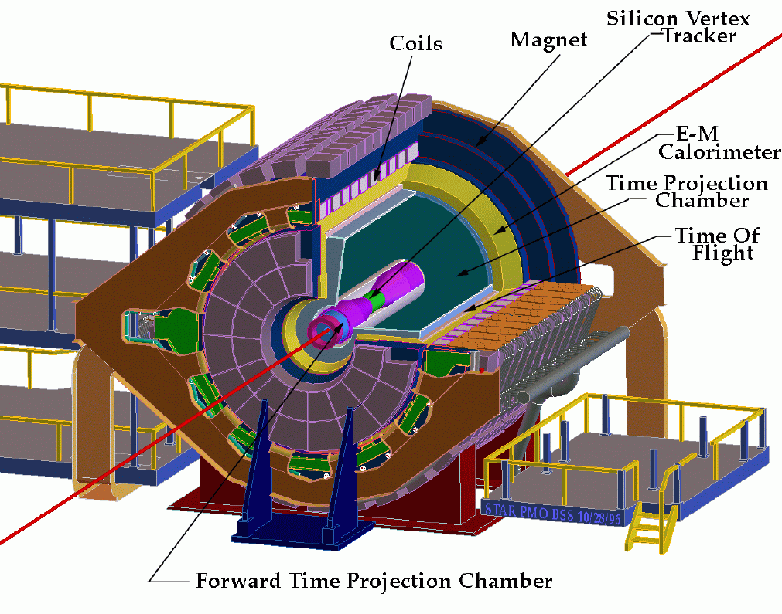
STAR (Solenoidal Tracker at RHIC)
neutral energy detection
Barrel
charged particle tracking & PID
0 < φ < 2π
|η| < 1
Zero Degree Calorimeter

Slide 30
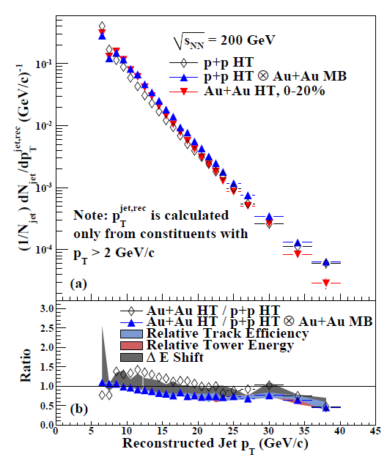
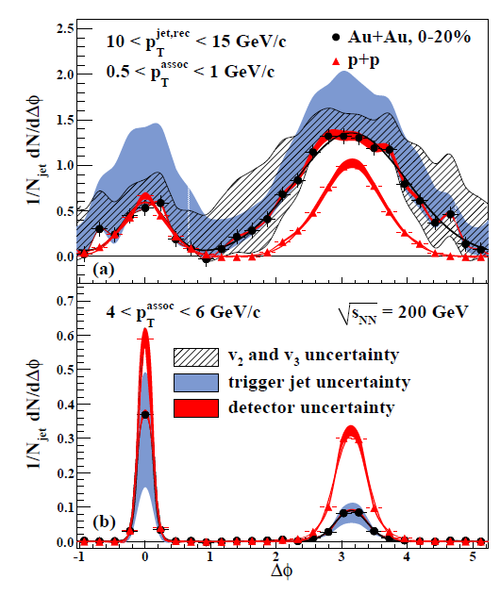
Jet-Hadron correlations

Slide 31
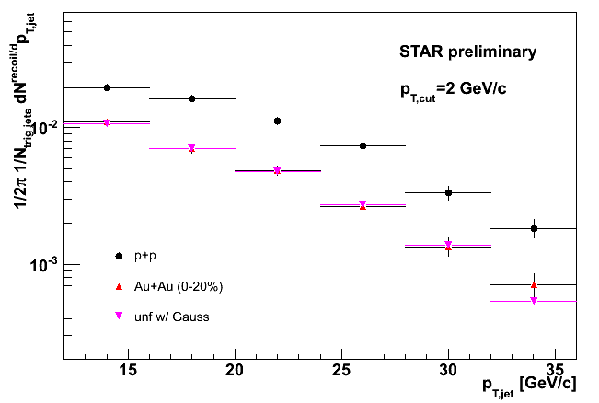
Dijet Coincidence Rate
STAR, QM 2009
Similar trigger jet population in Au+Au and p+p due to p_{T} cut and HT trigger requirements
Compare recoil jet spectrum in Au+Au and p+p
Suppression of recoil jet in Au+Au
Due to softening and/or broadening outside of jet cone
Consistency between correlations and inclusive measurements.
Trigger Jet:
R = 0.4
p_{T,cut} = 2 GeV/c
p_{T}^{jet} > 20 GeV/c
Recoil Jet:
R = 0.4
p_{T,cut} = 2 GeV/c
p+p
Au+Au (0-20%)
Au+Au (0-20%) unfolded

Slide 32
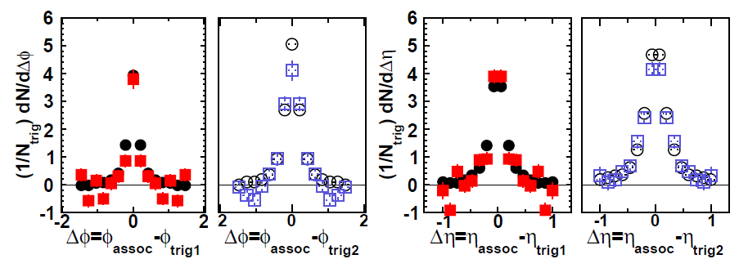
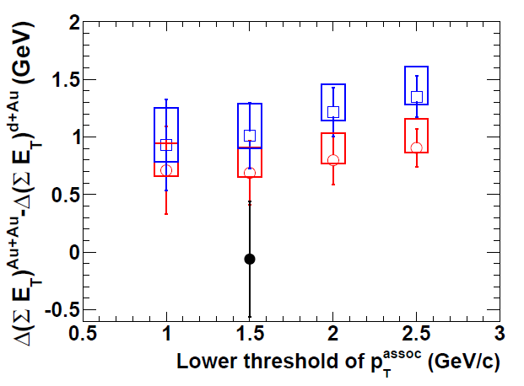
Asymmetric Triggers
PRC 87 (2013) 44903
10 < E_{T}^{trig1} < 15 GeV (in BEMC)
4 < p_{T}^{trig2} < 10 GeV/c (in TPC)
1 < p_{T}^{assoc} < 10 GeV/c
Relative dijet imbalance
Δ(ΣE_{T})^{Au+Au} – Δ(ΣE_{T})^{d+Au}
○ 8 < E_{T}^{trig1} < 10 GeV
□ 10 < E_{T}^{trig1} < 15 GeV
Dijet imbalance indicates slight softening of awayside peak
Still no significant shape difference between near- and away-sides, or between Au+Au and d+Au.
Compare/contrast to dihadron and jet-hadron results.

Slide 33
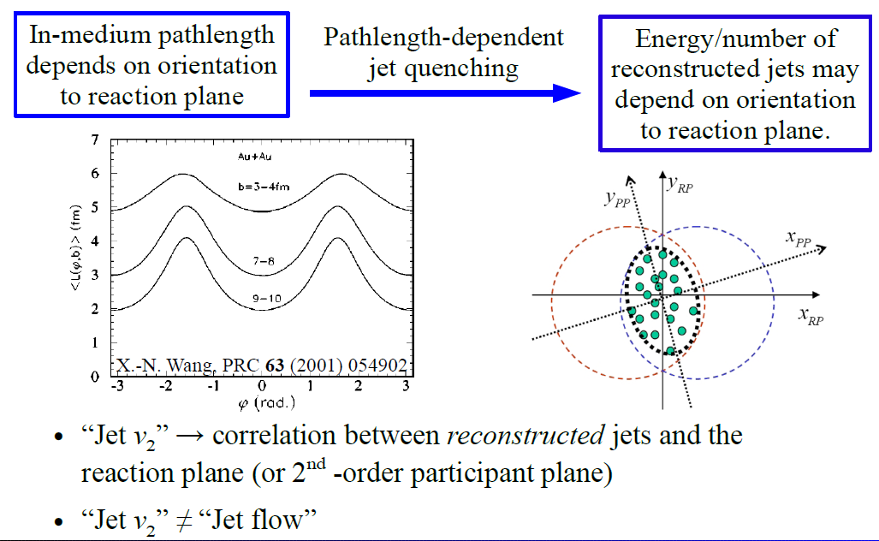
What is jet v₂?

Slide 34
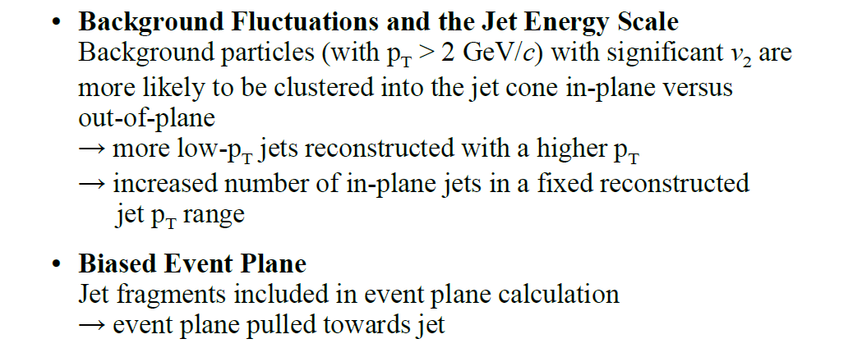
Artificial Sources of Anisotropy

Slide 35
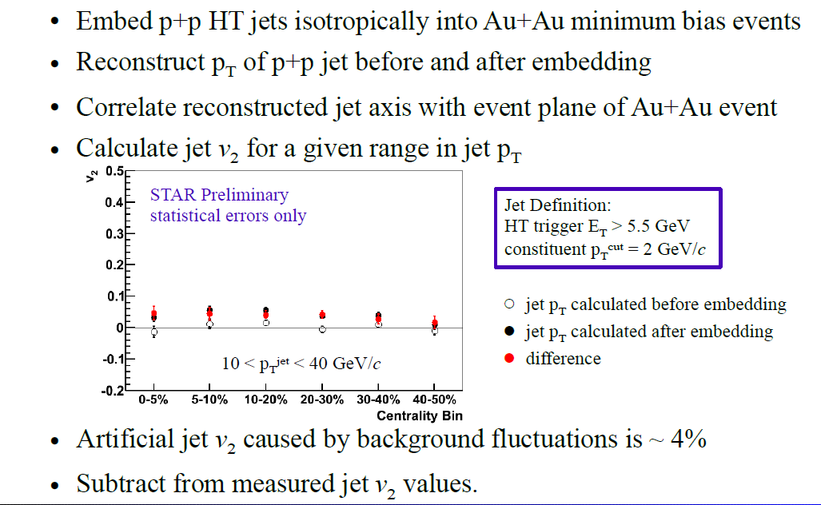
Background Fluctuations

Slide 36
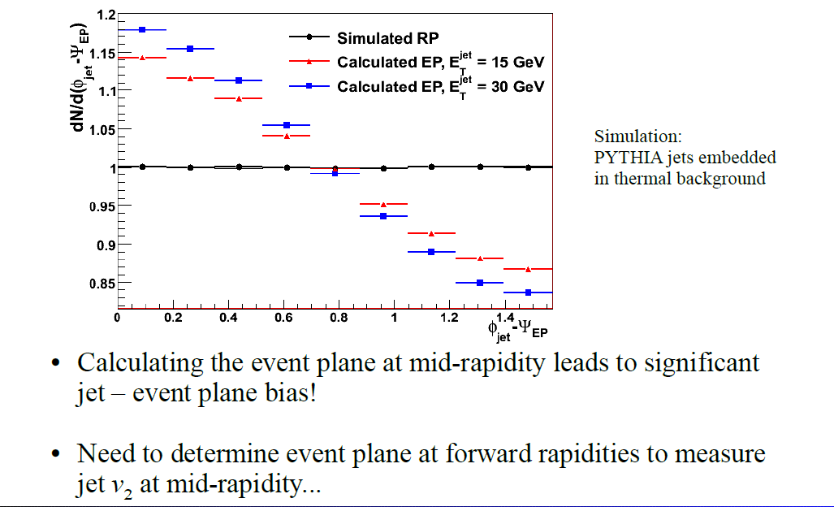
Jet - Event Plane bias

Slide 37
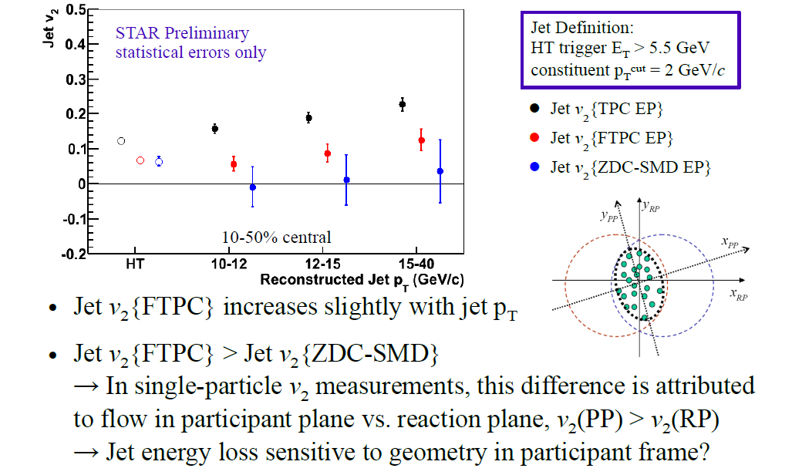
Jet v₂ vs. Reconstructed Jet p_{T}

Slide 38
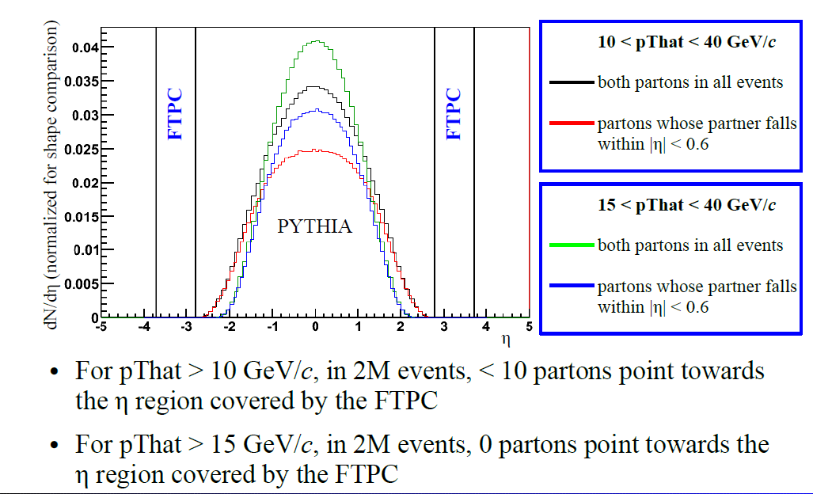
Does the recoil jet hit the FTPC?

