Slide 1


The Qualitative Failure of Holographic Jet Quenching and Success of pQCD Energy Loss in Heavy Ion Collisions.
W. A. Horowitz
University of Cape Town
July 15, 2013
With many thanks to Andriniaina Rasoanaivo,
Razieh Morad, Miklos Gyulassy, and Yuri Kovchegov

Slide 2
AdS/CFT vs. pQCD: Observables
Entropy
Thermalization
η/s
Energy Loss

Slide 3
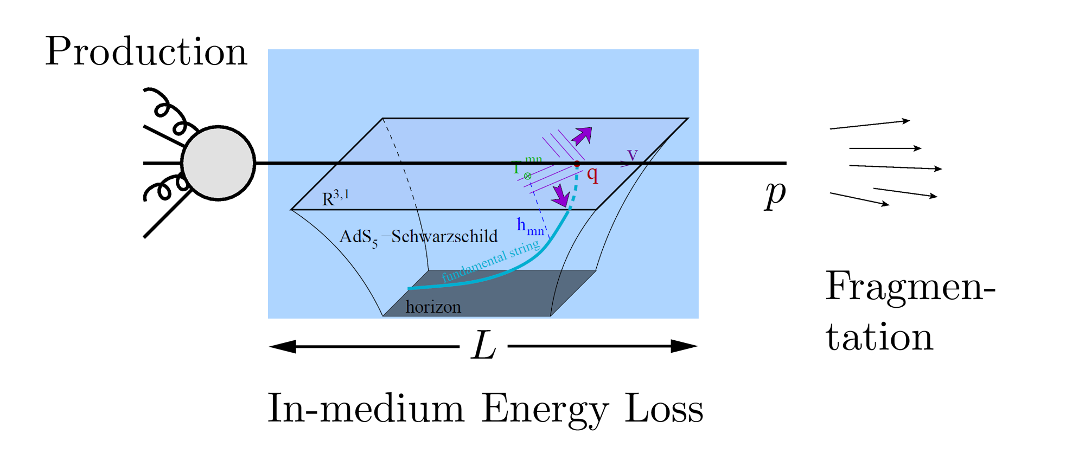
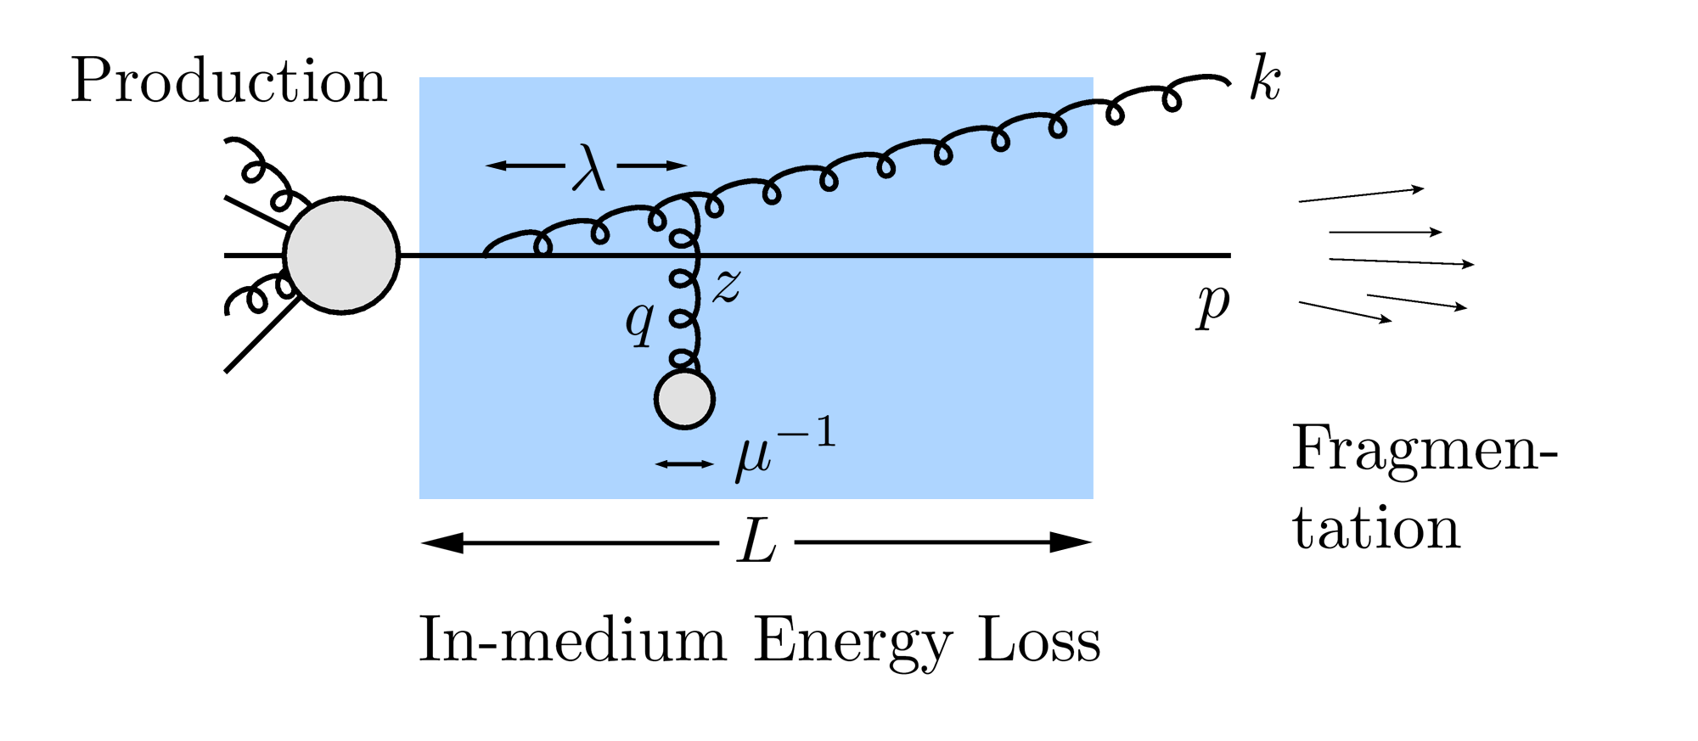
Why Energy Loss?
  Most direct probe of DOF of QGP
pQCD Picture
AdS/CFT Picture

Slide 4
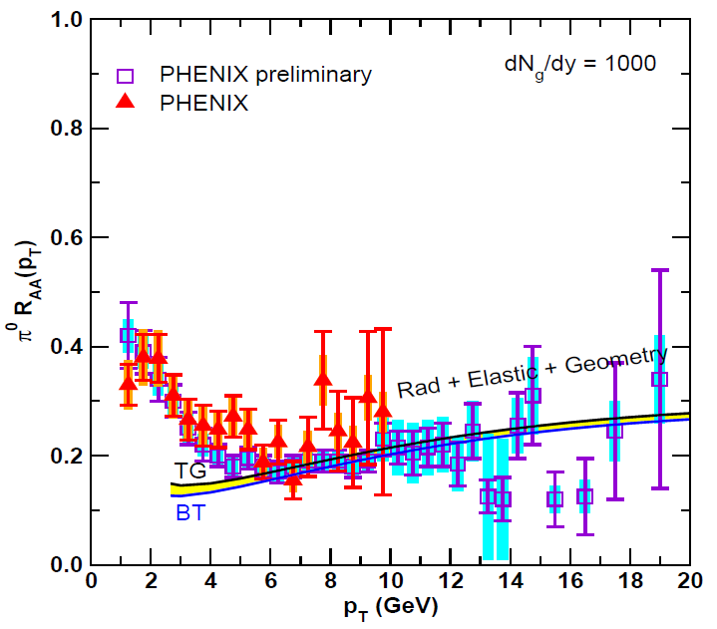
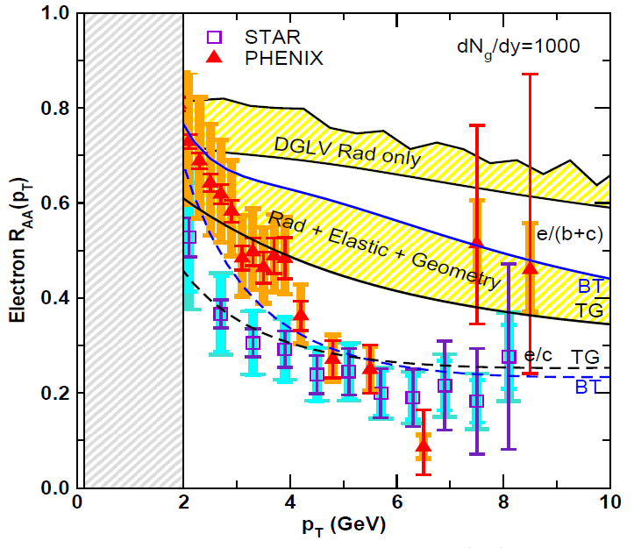
Lesson from RHIC
Extremely difficult to consistently describe all observables
  HF suppression places stringent constraint on possible E-loss mechanism
Wicks, WAH, Djordjevic, Gyulassy, NPA784 (2007)

Slide 5
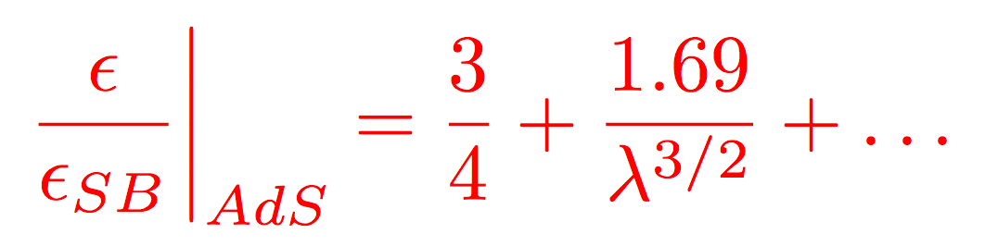
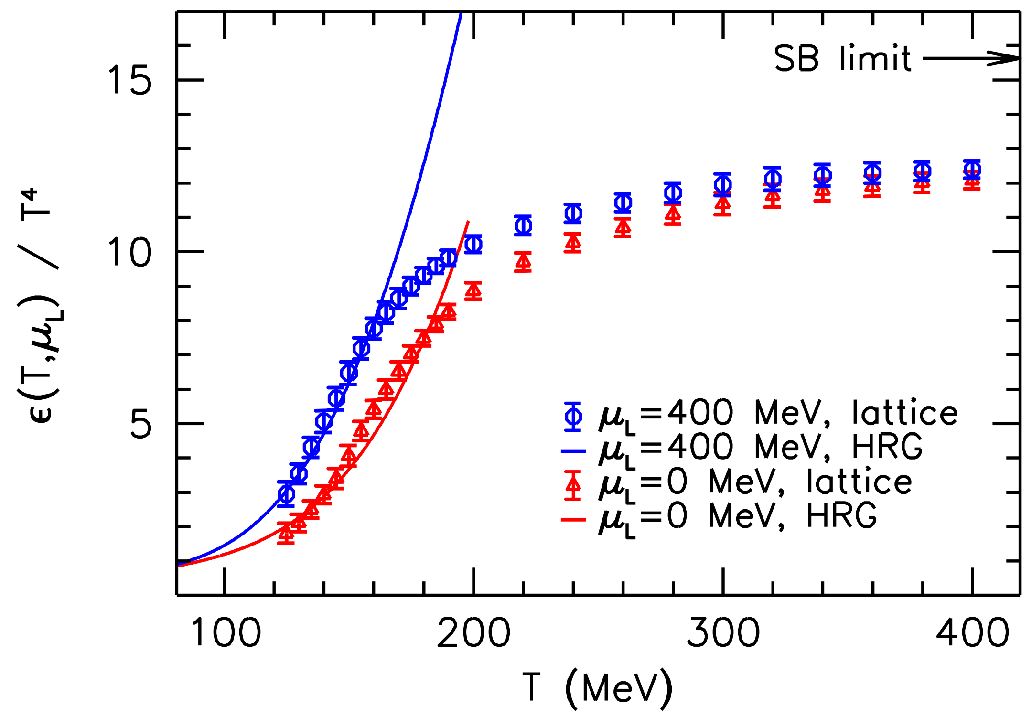
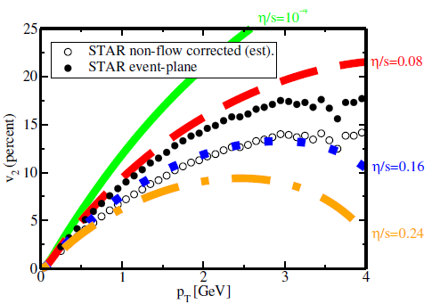
Let’s Assume Strong Coupling
Not crazy
  T ~ 250 MeV, g(2πT) ~ 2, λ = g²N_{c} ~ 12 ≫1
    Always small T scale
  T ≳ T_{c}, lattice deviates from Stefan-Boltzmann
  η/s ~ 1/4π readily explained by AdS/CFT
Luzum and Romatschke, PC78 (2008)
Wuppertal, arXiv:1204.6710

Slide 6
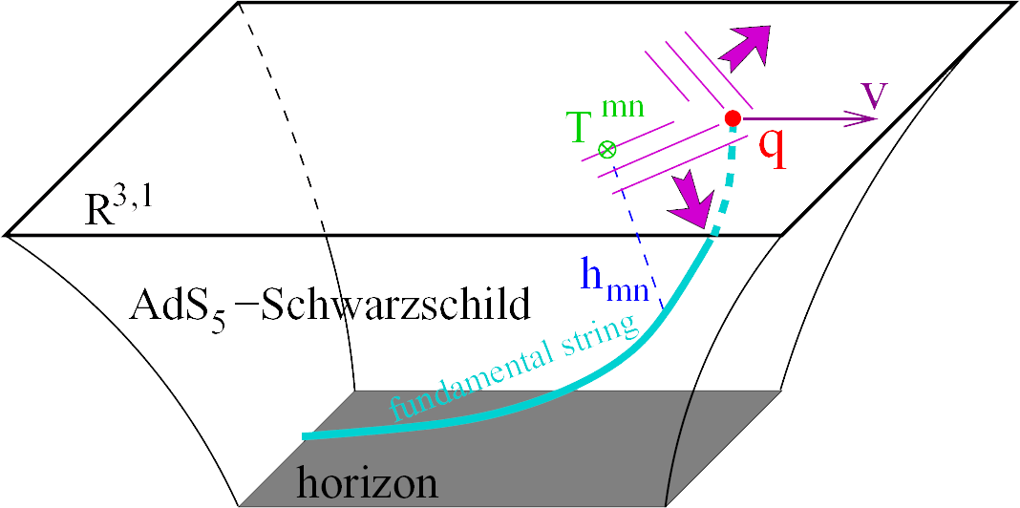
Heavy Quark E-Loss in AdS/CFT
Model heavy quark jet energy loss by embedding string in AdS space
  dp_{T}/dt = - μ p_{T}
  μ = πλ^{1/2} T²/2M_{q}
Herzog et al., JHEP 0607 (2006)
Gubser, PRD74 (2006)
  Similar to Bethe-Heitler
    dp_{T}/dt ~ -(T³/M_{q}²) p_{T}
  Very different from usual pQCD and LPM
    dp_{T}/dt ~ -LT³ log(p_{T}/M_{q})
J Friess, S Gubser, G Michalogiorgakis, S Pufu, Phys Rev D75 (2007)

Slide 7
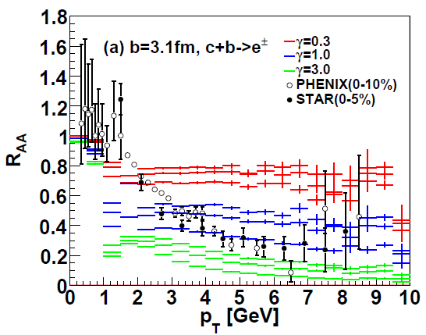
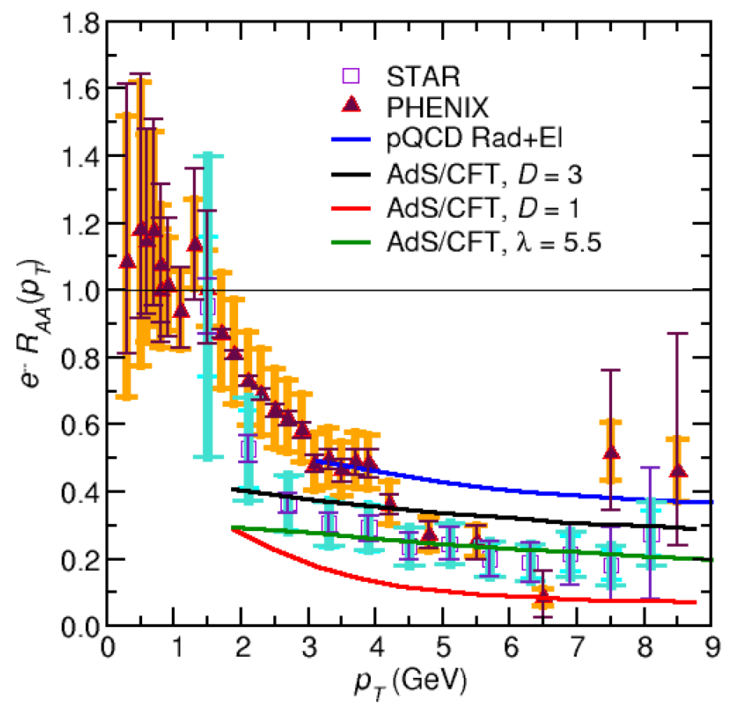
AdS/CFT and HQ
String drag: qualitative agreement at RHIC
WAH, PhD Thesis, arXiv:1011.4316
Akamatsu, Hatsuda, and Hirano, PRC79, 2009

Slide 8
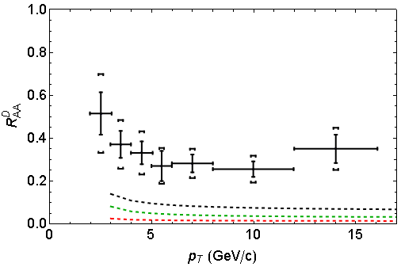
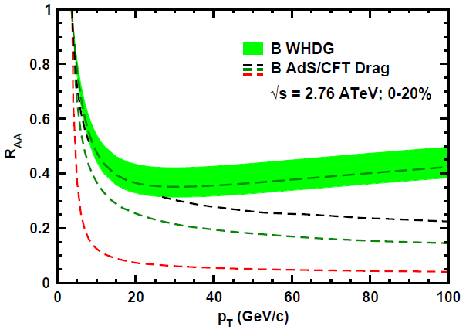
AdS/CFT and HQ at LHC
D Predictions
B Predictions
ALICE 0-20%
D
CMS B→J/ψ
(
(
]
(
(
(
WAH, PANIC11 (arXiv:1108.5876)
ALICE, arXiv:1203.2160
CMS, JHEP 1205 (2012) 063
AdS HQ Drag appears to oversuppress D
  Long. fluctuations likely important, not included
Roughly correct description of B→J/ψ

Slide 9
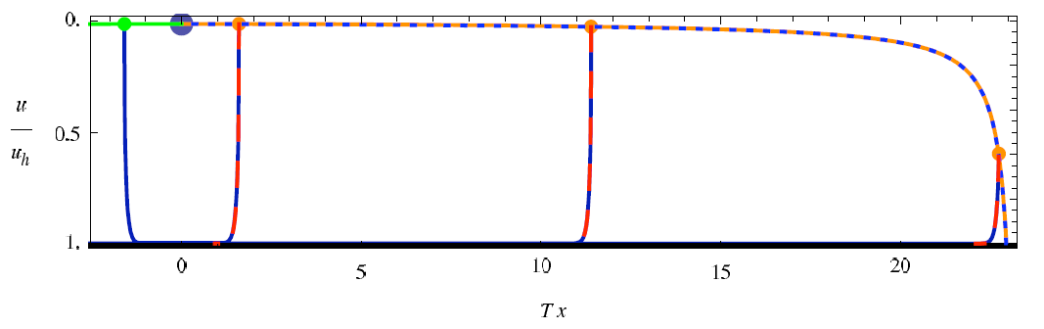
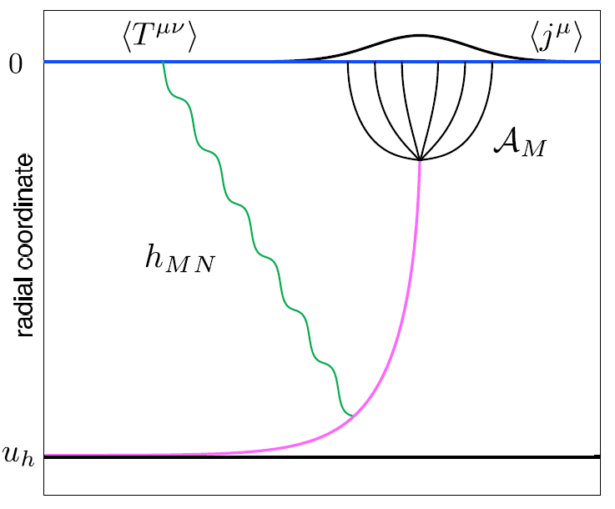
Light Quark E-Loss in AdS
Chesler et al., PRD79 (2009)
Complications:
  string endpoints fall
    => painful numerics
  relation to HI meas.
    less obvious than HQ
In principle, compute T^{μν} from graviton emission
  Extremely hard

Slide 10
Ambiguity in dE/dx Definition
Want dE/dx and/or full jet profile
  Unclear how to do the former
    Light quark E-loss prescription is not clear
Morad and WAH, in prep

Slide 11
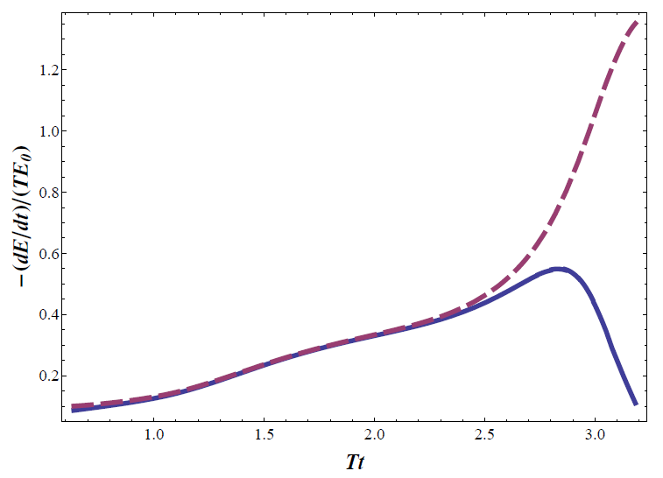
Results?
Prescription chosen has HUGE effect on E-loss
Full jet profile is very hard (determine T^{μν})
  Although potentially related to IC matching

Slide 12
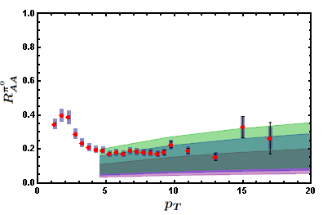
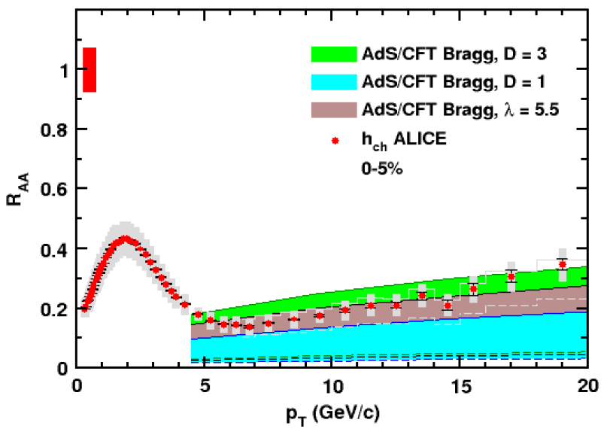

AdS/CFT Light q E-Loss
Static thermal medium => very short therm. time
  x_{th} ~ 1.8 fm
    AdS likely oversuppresses compared to data
Examine T ~ 1/τ^{1/3} geom
  x_{th} ~ 3.1 fm
0.2 TeV
R Morad
2.76 TeV
WAH, JPhysG38 (2011)
Simple Bragg peak model

Slide 13
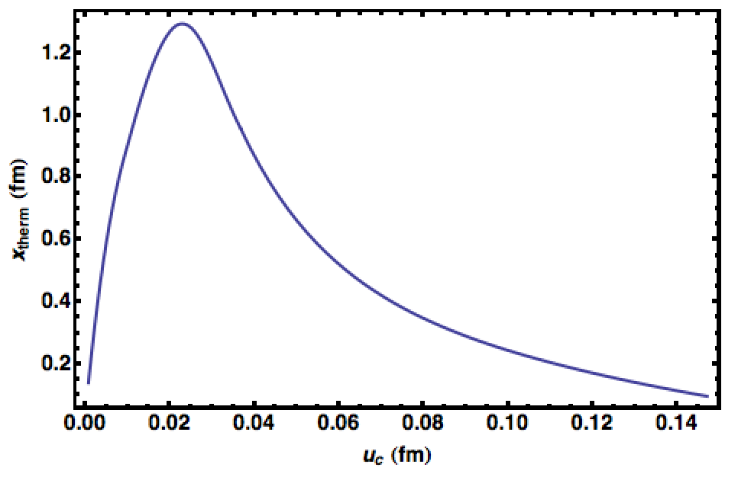
Increasing Theoretical Precision
  Like hydro, AdS/CFT only gives evo. eqns
    Very little of ∞² dim IC phase space explored
    Naïve IC => v. short thermalization times
      => oversuppression
    However, strong dependence on IC
p_{T} = 100 GeV
T = 350 MeV
On-shell
Q² < 0
Q² > 0
Morad and WAH, in prep

Slide 14

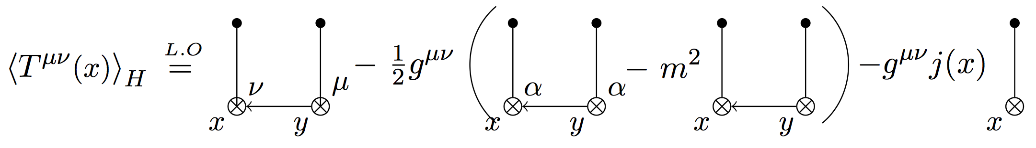
AdS/CFT IC
Seek hybrid weak/strong model
  pQCD vacuum evolution until τ_{therm}
  Match pQCD IC T^{μν} onto AdS/CFT loss
Andri Rasoanaivo
Max distance from geodesic?
  Gubser and Ficnar, arXiv:1306.6648

Slide 15
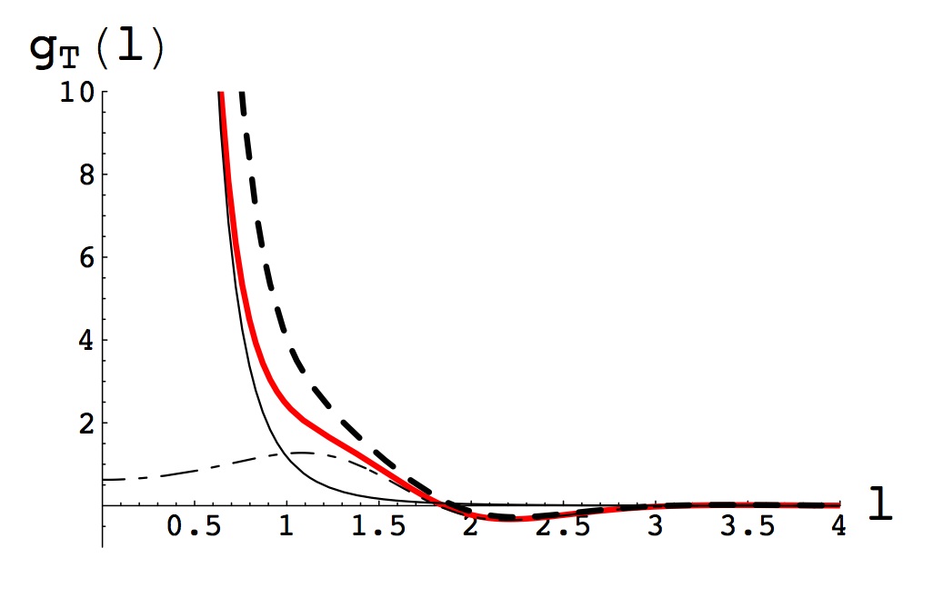
Momentum Fluctuations
String vibrations => HQ mom. fluc.
  Non-Markovian!
    Cannot use Langevin
  Estimate importance:
    Δp_{L}/μ = p_{L} => γ < (M/T)²/4
      Parametrically larger than speed limit (γ_{sl} ~ 1/λ); numerically smaller
Gubser, NPB790 (2008)

Slide 16




Strongly Coupled HF and p+A
Measure open HF in p+A
  Midrapidity: test production
  Forward: test CNM HF E-loss
Embedded String in Shock
Before
After
v_{shock}
z
Q
v_{shock}
z
Q
x
x
WAH and Kovchegov, PLB680 (2009)

Slide 17
Let’s Assume pQCD is the Way to Go
Thermal Field Theory =>
  Debye mass μ ~ gT
  Mean free path λ_{mfp} ~ 1/g²T
Entropy/Hydro => T_{RHIC(LHC)} ~ 350 (450) MeV
  μ ~ gT ~ 0.7 (0.8) GeV => 1/μ ~ 0.3 (0.2) fm
  λ_{mfp} ~ 1/g²T ~ 0.8 (0.7) fm
  R_{Au,Pb} ~ 6 fm
1/μ << λ_{mfp} << L
  Scattering off separated, well-defined quasiparticles
  For HQ, order a few collisions, ~ 4
gluon

Slide 18
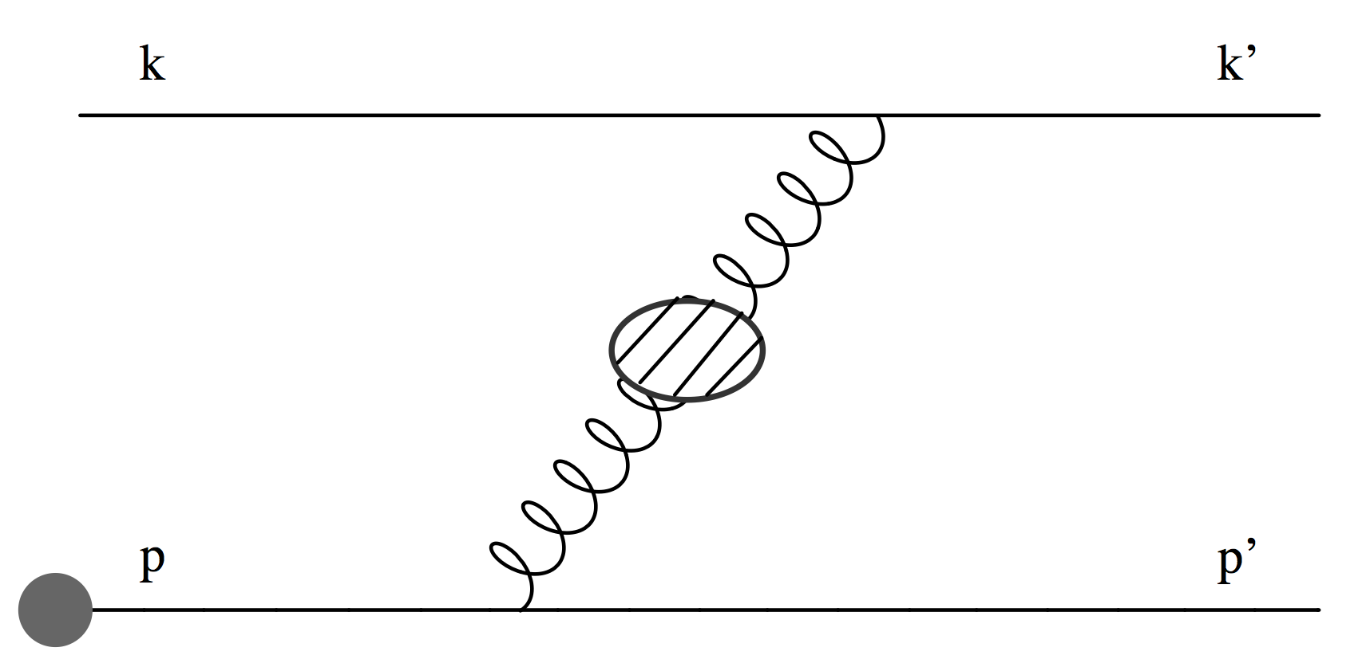
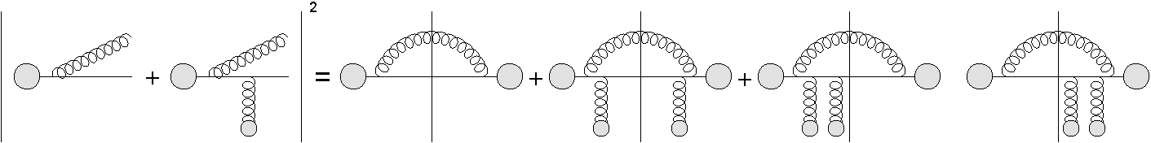
pQCD Continued
Two types of E-loss
  Collisional (elastic) 2➞2
  Radiative (inelastic) 2➞3
    Scales => ~few scatterings, mult. coh. em. => LPM
    Must include interference with production radiation
          Bjorken, FERMILAB-PUB-82-059-THY
          Braaten and Thoma, PRD44:2625–2630, 1991
          Djordjevic, Phys.Rev. C74 (2006) 064907
          Adil et al., Phys.Rev. C75 (2007) 044906
Djordjevic, PRC74 (2006)
          Majumder and van Leeuwen, PPNPA66 (2011), and refs therein

Slide 19
Asymptotic Analytic pQCD
Naively, ΔE_{el} << ΔE_{rad} as E➞∞
Elastic E-loss:
dp_{T}/dt ~ -T² log(p_{T}/M_{Q})
Radiative E-loss, in expected deep LPM regime:
dp_{T}/dt ~ -L T³ log(p_{T}/M_{Q})
  Compare to Bethe-Heitler dp_{T}/dt ~ -(T³/M²)p_{T}

Slide 20
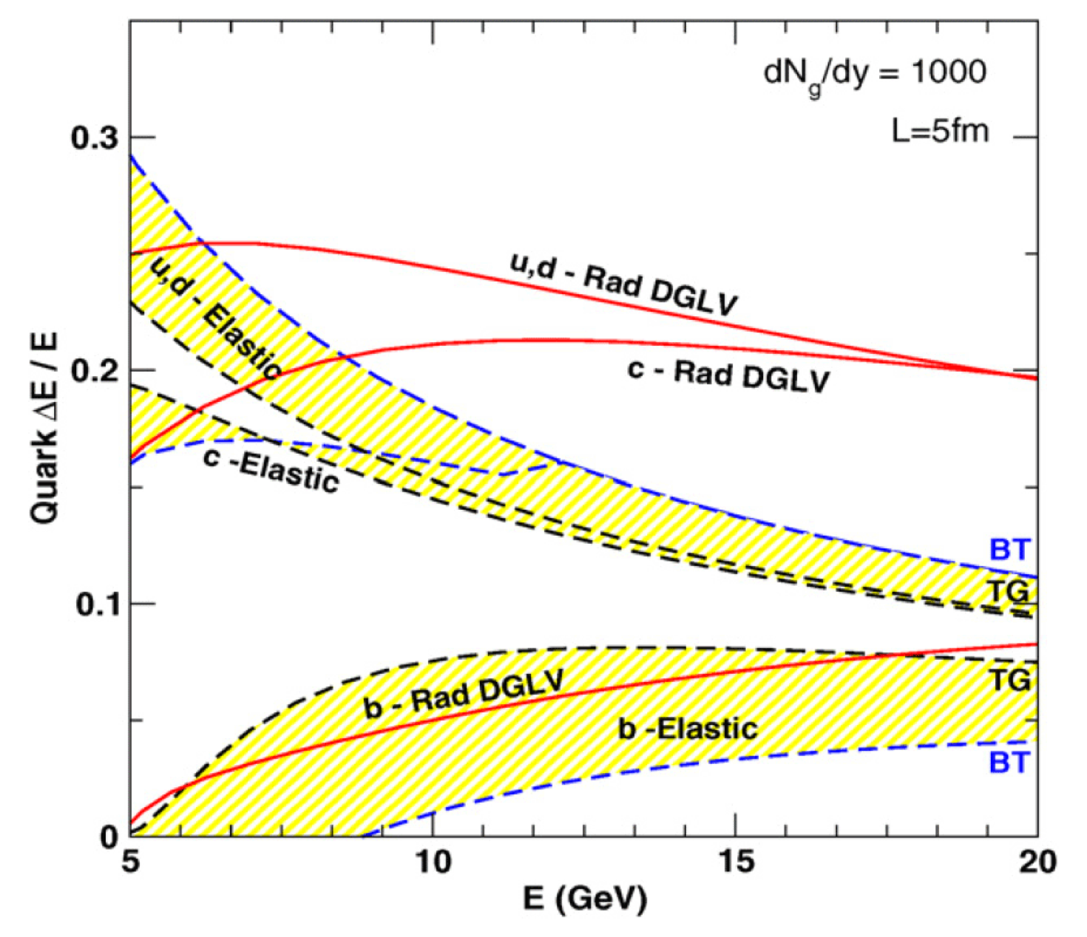
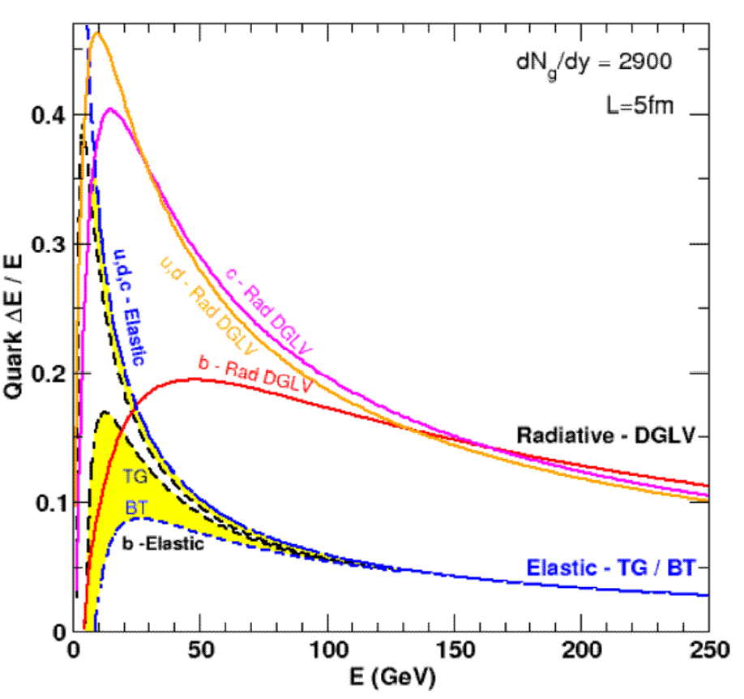
Results
Naively, ΔE_{el} << ΔE_{rad} as E➞∞
RHIC
LHC
WAH, PhD Thesis, arXiv:1011.4316
Finite RHIC/LHC kinematics: both radiative and collisional energy loss processes are important for p_{T} ~ 5 GeV/c and higher

Slide 21
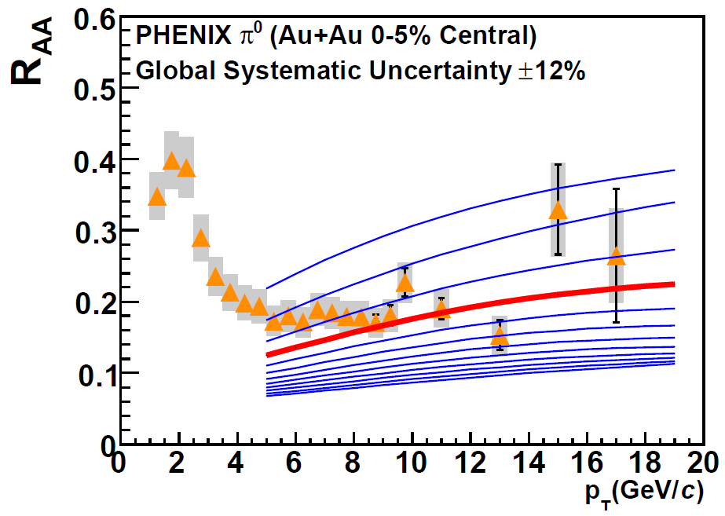
Compare to RHIC & LHC
RHIC R_{AA}: not unreasonable ρ_{med}
  dNg/dy = 1400⁺²⁰⁰
  α_{s} = 0.3, fixed
  1400₋₃₇₅
PHENIX, PRC77 (2008)
For LHC predictions: change only ρ_{med} ∝dN_{ch}/dη

Slide 22
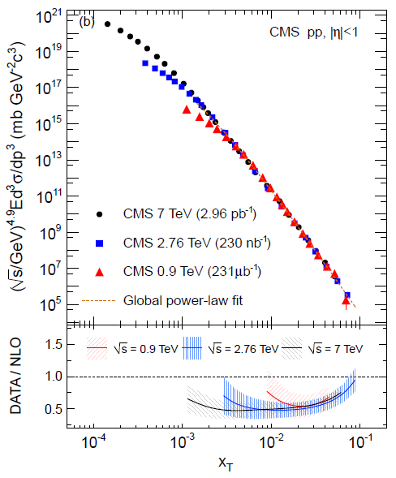
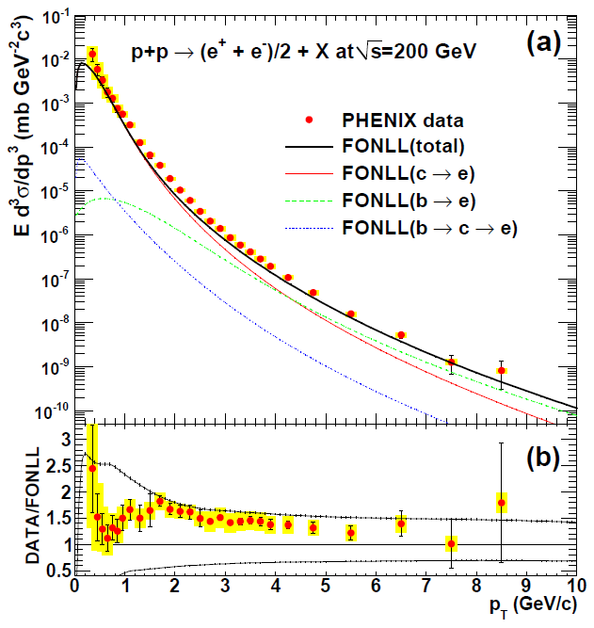
Set Scale for our Expectations
NLO pQCD in pp System ~ factor of 2
CMS, EurPhysJC72 (2012)
PHENIX, PRC84 (2011)

Slide 23
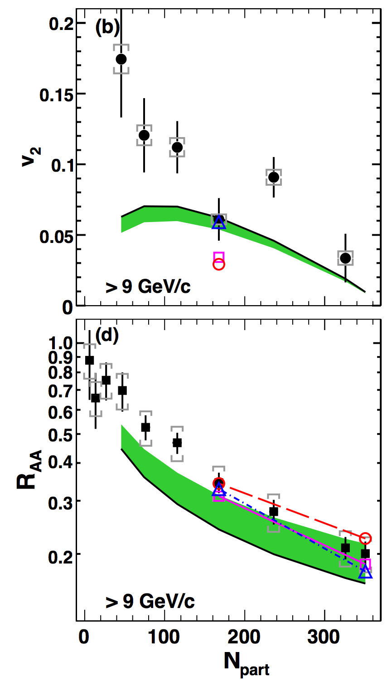
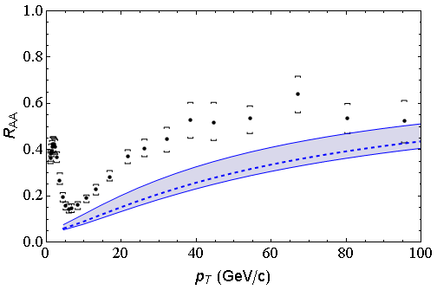
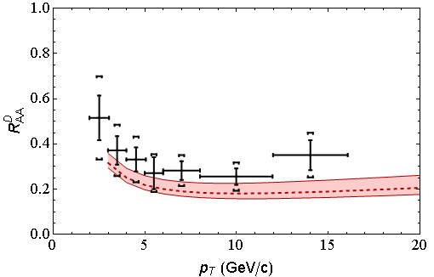
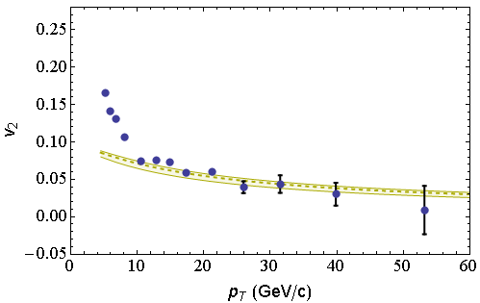
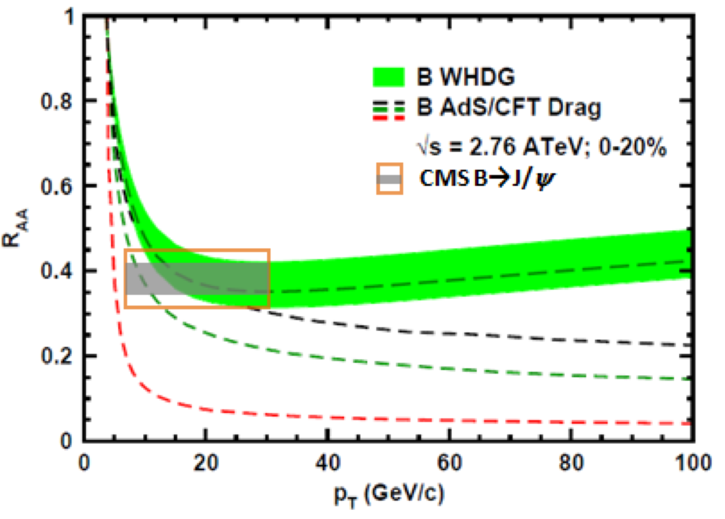
Global Qualitative Agreement
LO pQCD E-loss correct to factor ~2
LHC
CMS h± 0-5%
WHDG π⁰
LHC
ALICE D
WHDG D
RHIC
RHIC
LHC
CMS h± 40-50%
WHDG π⁰
LHC
CMS, Eur.Phys.J. C72 (2012)
CMS, arXiv:1204.1850
ALICE, arXiv:1203.2160
CMS, JHEP 1205 (2012) 063
PHENIX PRL105 (2010)

Slide 24
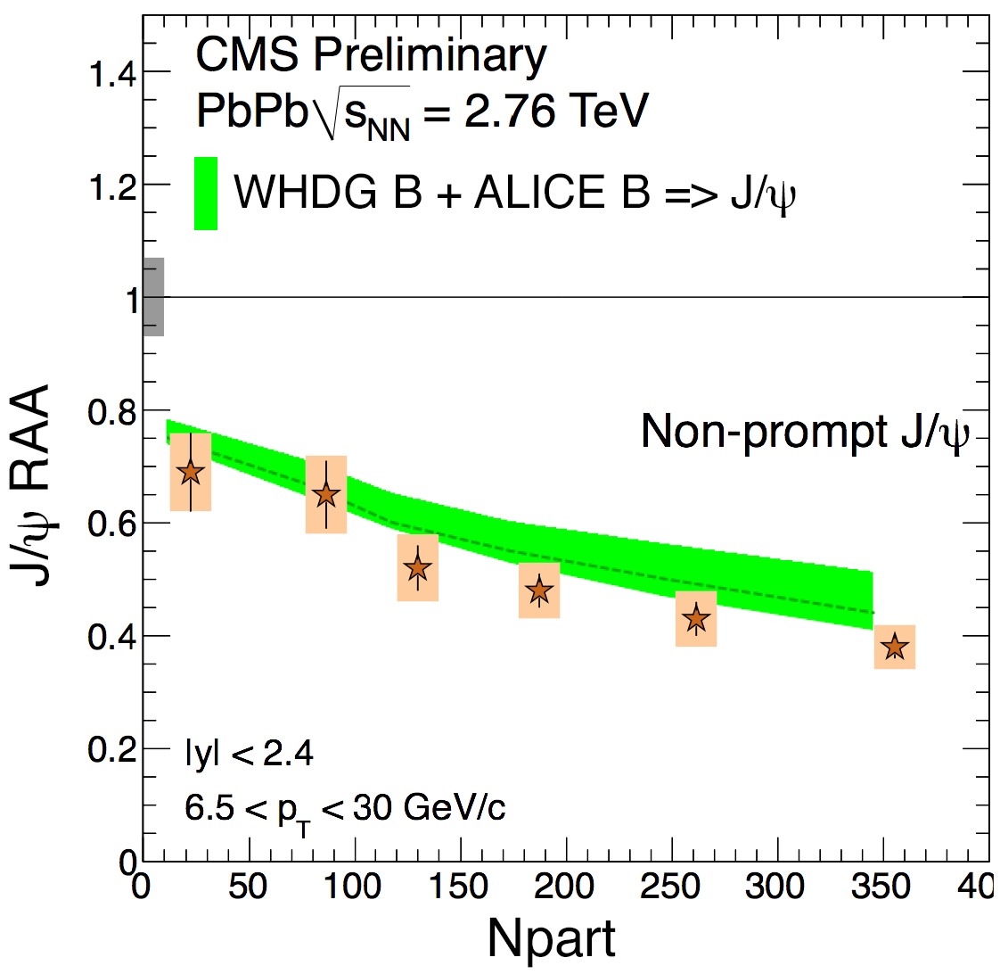
New WHDG J/ψ Comparison to CMS
WHDG B + new ALICE B => J/ψ decay
      Thanks to Andrea Dainese and Zaida Conesa Del Valle
Mironov, QM2012
NPA 904-905 (2013)

Slide 25
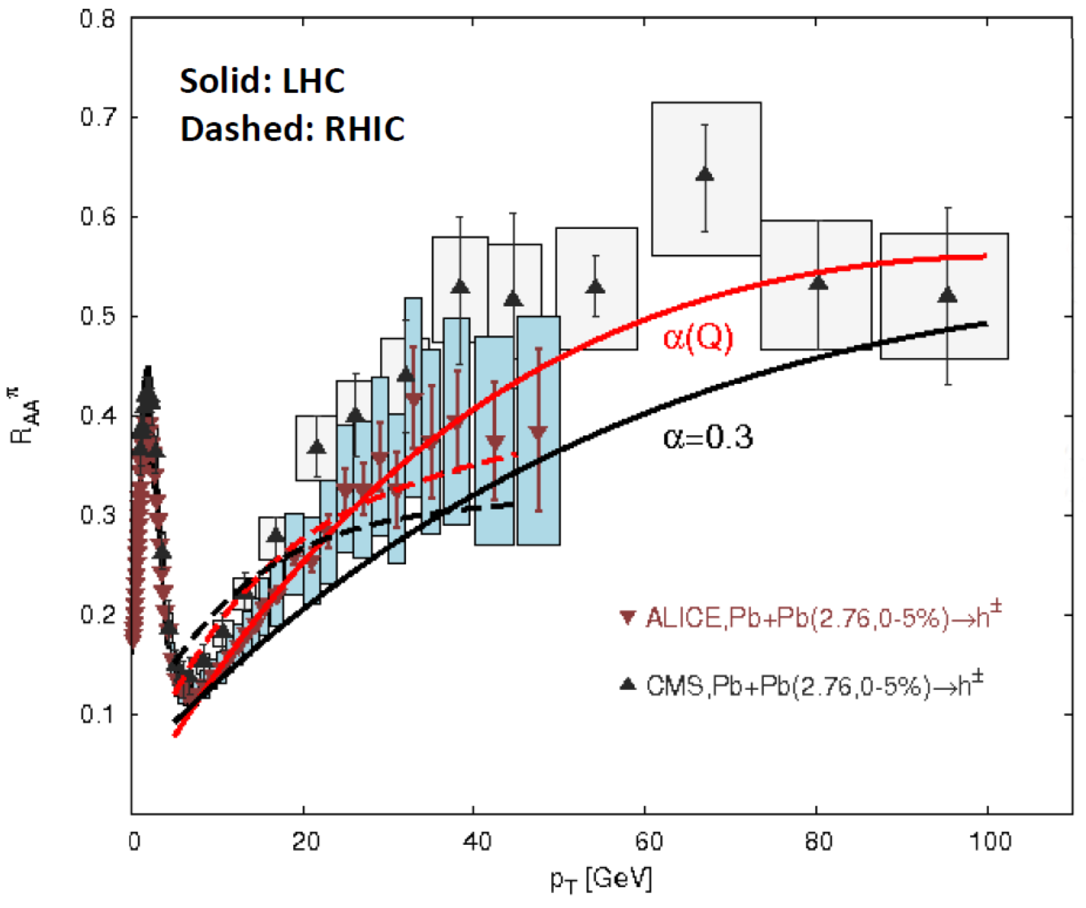
Future pQCD Work
Include neglected effects
Reduce theoretical uncertainty
  Look for new results soon!
Full jet T^{μν}?
Buzzatti and Gyulassy,
NPA 904 (2013)

Slide 26
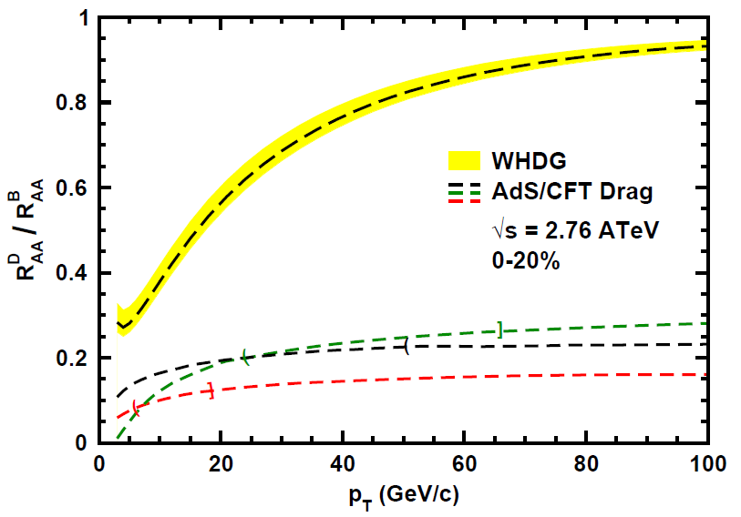
Does pQCD or AdS Yield Correct Mass & Momentum Dependecies at LHC?
WAH, PANIC11 (arXiv:1108.5876)
      T(τ₀): “(”, corrections likely small for smaller momenta
      T_{c}: “]”, corrections likely large for higher momenta
Qualitatively, corrections to AdS/CFT result will drive double ratio to unity
See also:
WAH, M. Gyulassy, PLB666 (2008)

Slide 27
Conclusions
Multiple observables demand simultaneous description: hard
  Difficult to describe E-loss data with holography
  LO pQCD gives reasonable qualitative description
    How do we understand sQGP(hydro) => wQGP(E-loss)
p+A crucial control + physics
Looking forward to new data!

Slide 28


Slide 29


Slide 31
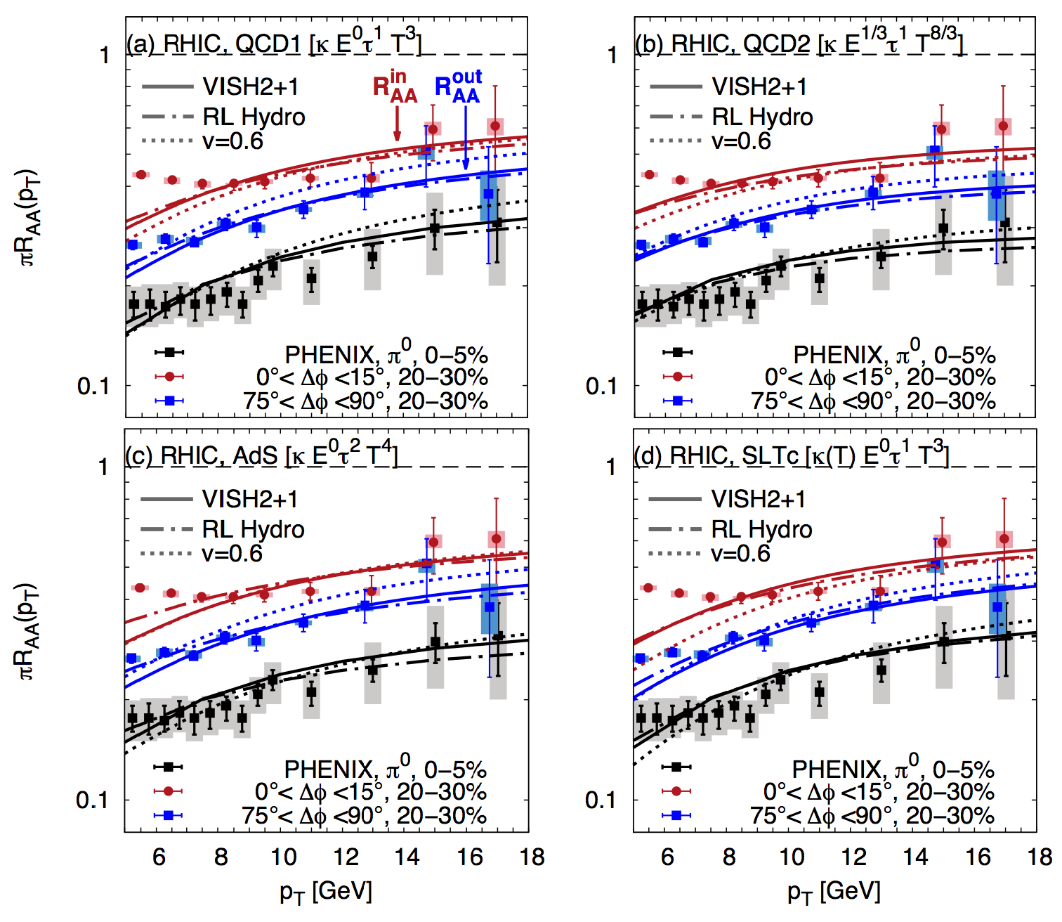
Betz and Gyulassy, arXiv:1305.6458

Slide 32
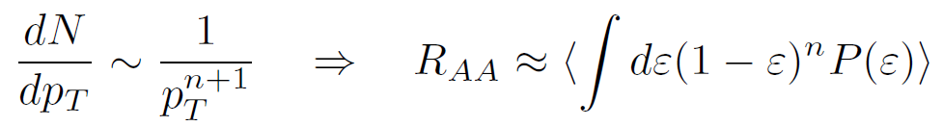
Qualitative Expectations for HF
Energy loss decreases with M_{Q}
  ΔE_{b} < ΔE_{c} < ΔE_{u,d} < ΔE_{g}
    For experts: not always true for pQCD
    (τ_{form} decreases with M_{Q})
DOES NOT IMPLY R_{AA} ORDERING
  For approx. power law production and energy loss probability P(ε), ε = (E_{i} - E_{f})/E_{i}
  Larger n => smaller R_{AA} for same energy loss

Slide 33
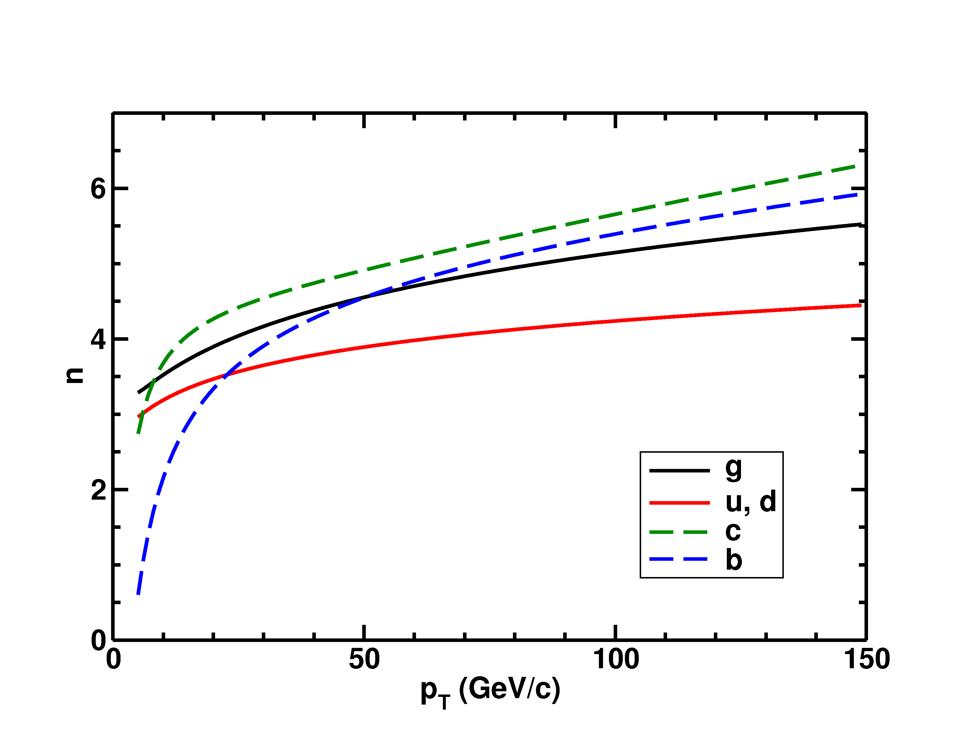
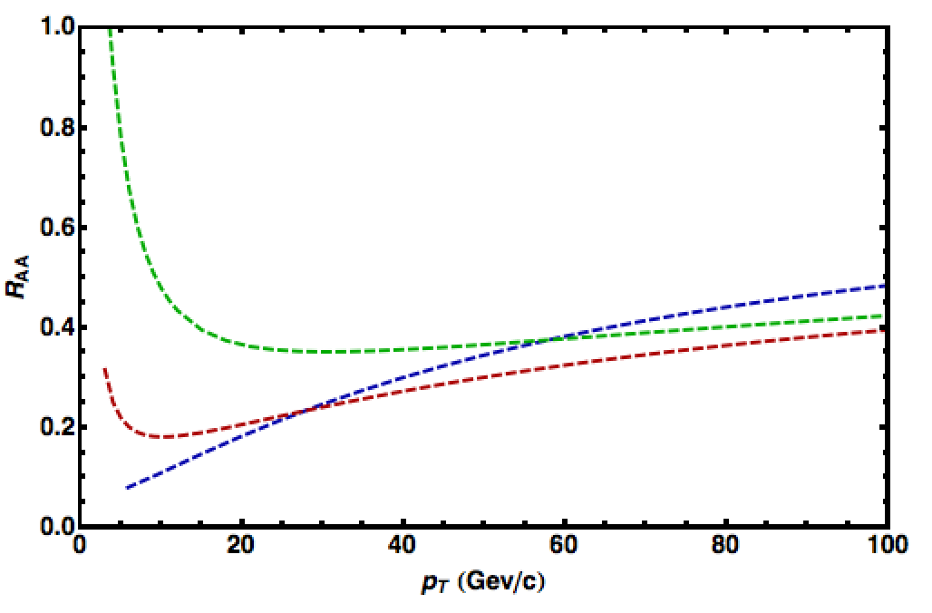
Importance of Production
HQ production spectra softer than lights
  => Nontrivial ordering of R_{AA}(p_{T})
√s = 2.76 TeV
LHC
0-20%
π⁰ WHDG
D WHDG
B WHDG
See also
Buzzatti, 5C (NB: High-p_{T} and Jets)

Slide 34
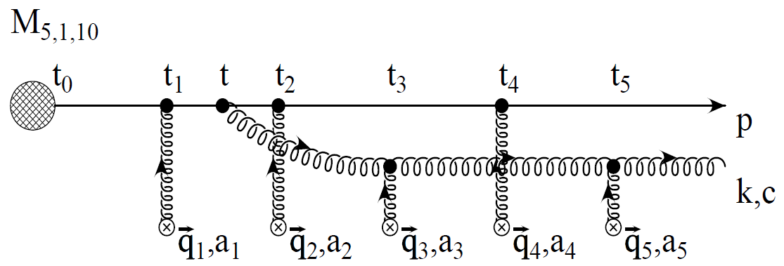
pQCD Rad Picture
Bremsstrahlung Radiation
  Weakly-coupled plasma
    Medium organizes into Debye-screened centers
  T ~ 350 (450) MeV, g ~ 1.9 (1.8)
    μ ~ gT ~ 0.7 (0.8) GeV
    λ_{mfp} ~ 1/g²T ~ 0.8 (0.7) fm
    R_{Au,Pb} ~ 6 fm
  1/μ << λ_{mfp} << L
    multiple coherent emission
Gyulassy, Levai, and Vitev, NPB571 (2000)
  LPM
    dp_{T}/dt ~ -LT³ log(p_{T}/M_{q})
  Bethe-Heitler
    dp_{T}/dt ~ -(T³/M_{q}²) p_{T}

Slide 35
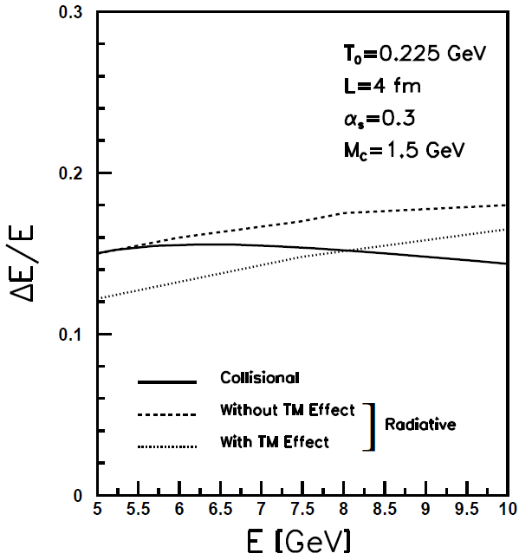
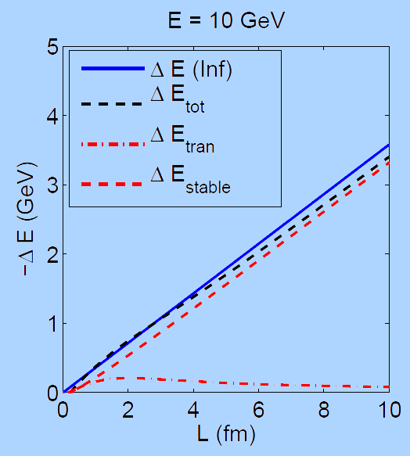
What About Elastic Loss?
Appreciable!
Finite time effects small
Mustafa, PRC72 (2005)
Adil, Gyulassy, WAH,
Wicks, PRC75 (2007)
  For pQCD comparisons with data, use WHDG Rad+El+Geom model; formalism valid for g/lq & hq

Slide 36
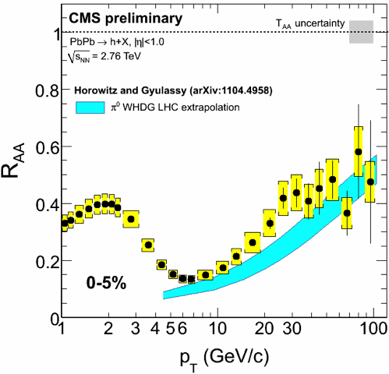
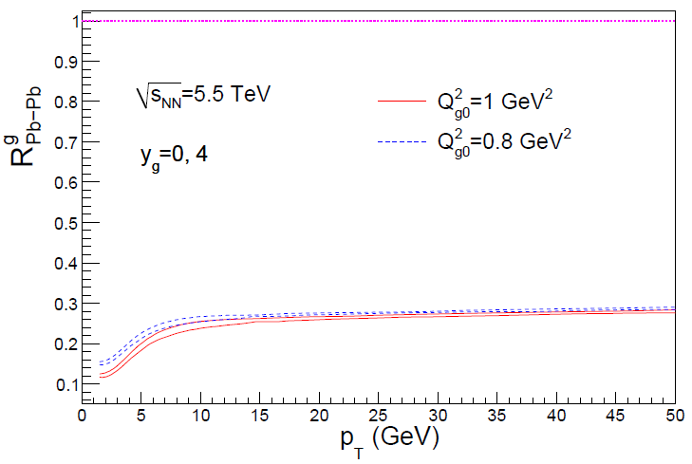
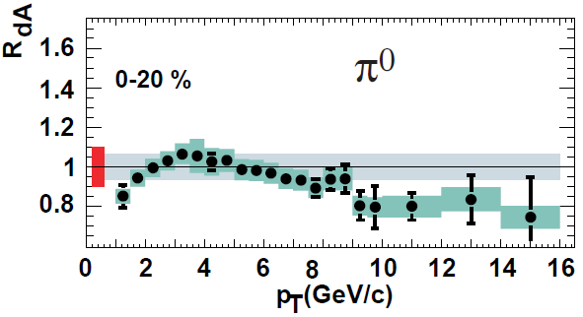
Rise in R_{AA} a Final State Effect?
  Is rise really due to pQCD?
  Or other quench (flat?)
+ initial state CNM effects a la CGC?
Y-J Lee, QM11
Albacete and Marquet, PLB687 (2010)
Require p + A and/or direct γ
PHENIX PRL98, 2007

Slide 37
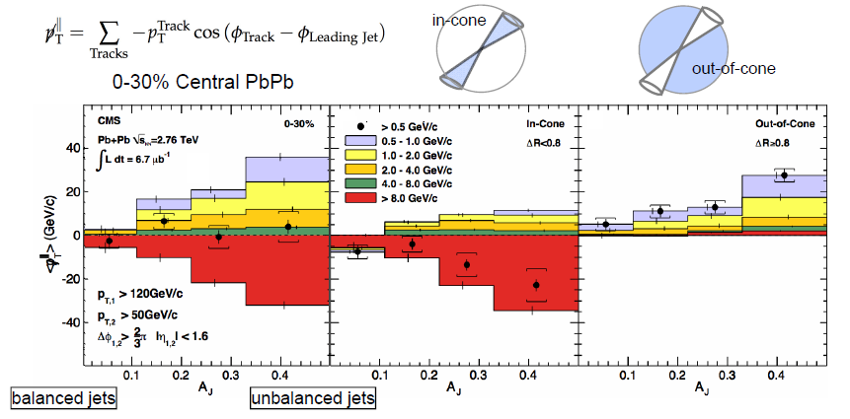
pQCD and Jet Measurements
  CMS sees redistribution of lost energy at large angles
    Naive pQCD expectation: collinear radiation
Wyslouch, CMS, QM11

Slide 38
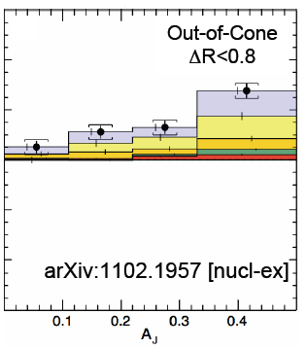
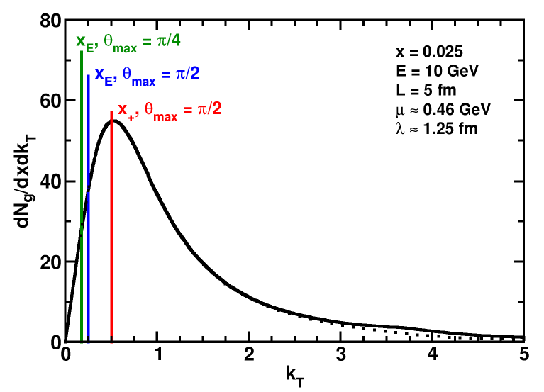
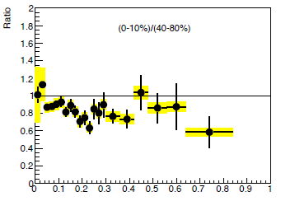
pQCD and Wide Angle Radiation
  Naively, pQCD =>
  x_{typical}, θ_{typical} ~ μ/E; μ ~ 0.5 GeV
  All current Eloss calculations assume small angle emission
  (k_{T} << xE)
  Collinear approximation is (maximally) violated; x_{typ} ~ μ/E
  pQCD is not inconsistent with data
C Roland, CMS, QM11
z
WAH and B Cole, PRC81, 2010
B Cole, ATLAS, QM11

Slide 39

Comparing AdS and pQCD
But what about the interplay between mass and momentum?
  Take ratio of c to b R_{AA}(p_{T})
    pQCD: Mass effects die out with increasing p_{T}
      Ratio starts below 1, asymptotically approaches 1. Approach is slower for higher quenching
    ST: drag independent of p_{T}, inversely proportional to mass. Simple analytic approx. of uniform medium gives
    R^{cb}_{pQCD}(p_{T}) ~ n_{b}M_{c}/n_{c}M_{b} ~ M_{c}/M_{b} ~ .27
      Ratio starts below 1; independent of p_{T}
R^{cb}_{pQCD}(p_{T}) ∼ 1 - α_{s} n(p_{T}) L² log(M_{b}/M_{c}) ( /p_{T})

Slide 40
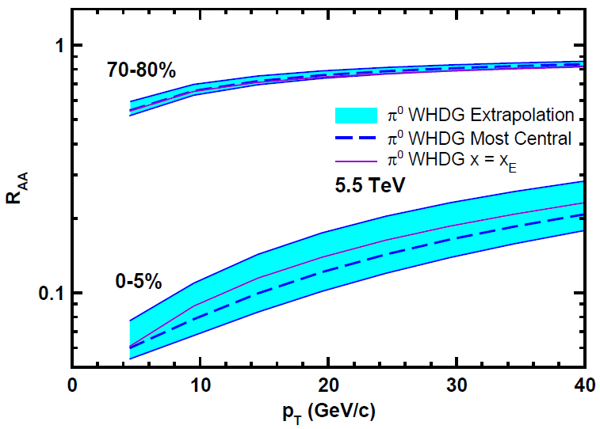
Top Energy Predictions
For posterity:
WAH and M Gyulassy, in preparation

Slide 41

RHIC R^{cb} Ratio
pQCD
pQCD
AdS/CFT
AdS/CFT
WAH, M. Gyulassy, JPhysG35 (2008)
    Wider distribution of AdS/CFT curves due to large n: increased sensitivity to input parameters
    Advantage of RHIC: lower T => higher AdS speed limits

Slide 42


Motivating High Momentum Probes
Probe
Medium
Medium

Slide 43

Not So Fast!
  Speed limit estimate for applicability of AdS drag
    γ < γ_{crit} = (1 + 2M_{q}/λ^{1/2} T)²
    ~ 4M_{q}²/(λ T²)
      Limited by M_{charm} ~ 1.2 GeV
    Similar to BH LPM
      γ_{crit} ~ M_{q}/(λT)
  No Single T for QGP
    smallest γ_{crit} for largest T
    T = T(τ₀, x=y=0): “(”
    largest γ_{crit} for smallest T
    T = T_{c}: “]”
D7 Probe Brane
Q
Worldsheet boundary Spacelike if γ > γ_{crit}
x₅
Trailing
String
“Brachistochrone”
“z”
D3 Black Brane

