Slide 1


Deduction of steady-state cable quench limits for various electrical insulation schemes with application to LHC and HL-LHC magnets
International Conference on Magnet Technology
July 14 – 19, 2013
The Westin Copley Place
Boston, MA USA
Pier Paolo Granieri, Rob van Weelderen
CERN, Cryogenics group

Slide 2
Introduction
Preventing beam induced quenches requires an accurate knowledge of the quench limits
  Especially important for future LHC exploitation at 6.5 – 7 TeV
Comprehension of quench limits is also important for design of future SC magnets, as those for High Luminosity and High Energy LHC
The mechanisms determining magtnets stability strongly depend on the beam loss time scale
We describe how to deduce quench limits from heat transfer measurements of stack of cables
  can be used to set thresholds for the Beam Loss Monitors
Outline
  Experimental technique
  Heat transfer through cable electrical insulation
  Deduction of quench limits: method
  Quench limits of LHC main dipole and HL-LHC interaction regions quadrupole

Slide 3
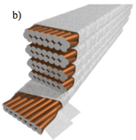
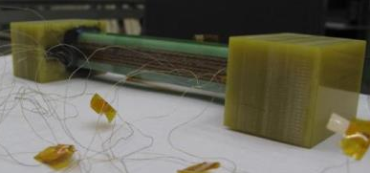
Experimental technique
P
The most widespread method to thermally characterize SC coils is the so-called stack method
It allows to measure the heat transfer through the cable’s electrical insulation
  most severe barrier for heat extraction from the magnet
Measure heat extracted as a function of the cable temperature
  Under a controlled pressure
Cable center
Cable edge

Slide 4
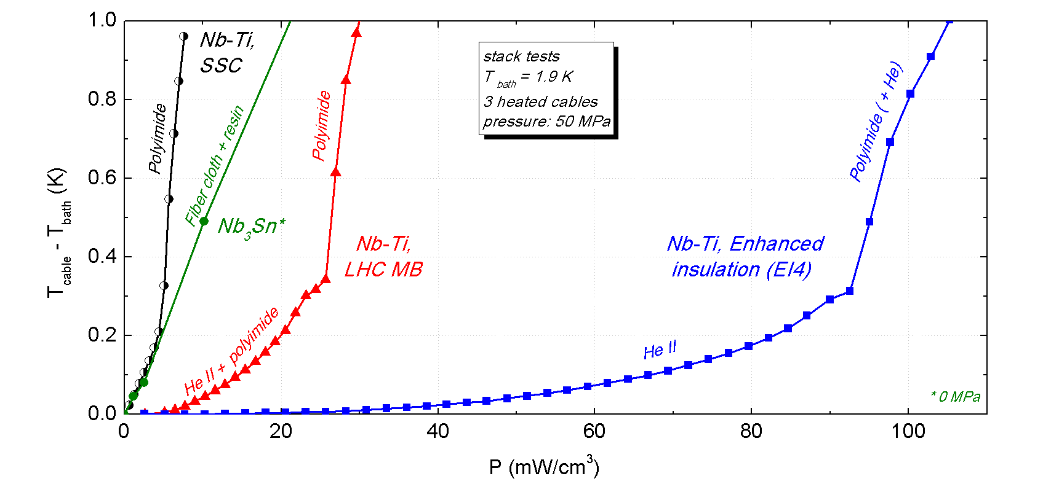
Heat transfer through cable electrical insulation
SSC: C. Meuris, B. Baudouy et al.
LHC MB and EI4: D. Richter, P.P. Granieri et al.
NB3Sn: P.P. Granieri et al.

Slide 5
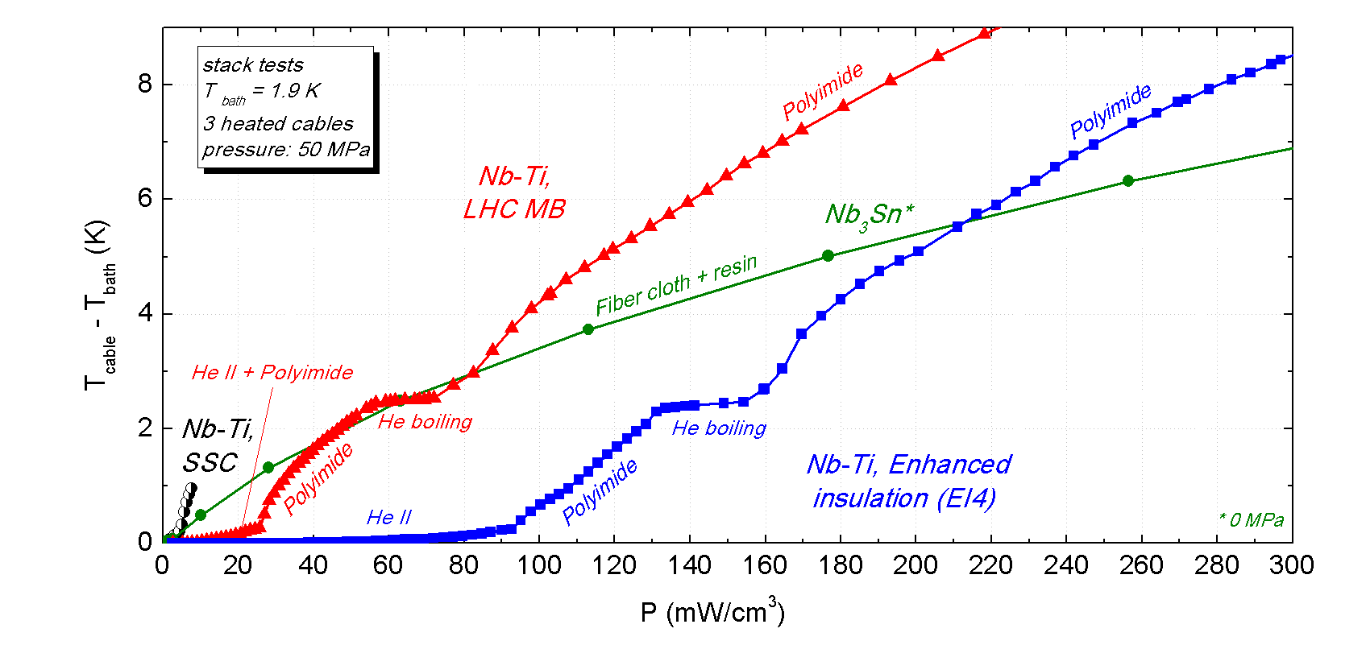
Heat transfer through cable electrical insulation
SSC: C. Meuris, B. Baudouy et al.
LHC MB and EI4: D. Richter, P.P. Granieri et al.
NB3Sn: P.P. Granieri et al.

Slide 6
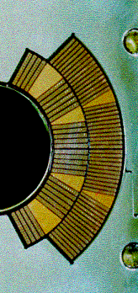
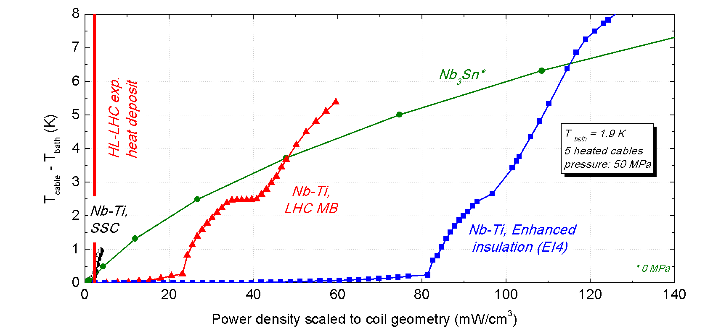
Deduction of cable steady-state quench limits
For steady-state beam losses, a quench occurs if Tcable exceeds Tcs (~ 4 K for Nb-Ti, ~ 7 K for Nb3Sn in a 1.9 K bath)
  not Tλ, which is a design limit for Nb-Ti coils
The cable quench limits depend on :
  Heat extraction:
    Cable cooling within the magnet
    Mechanical pressure, if Nb-Ti coil
    Stack heating configuration
  Operating conditions:
    Transport current
    Magnetic field, thus cable and
    strand considered
mid-plane
11.8 kA, 5.4 T
ΔTcs
ΔTλ

Slide 7
Deduction of cable steady-state quench limits: the method
1) experimentally correlate heat extraction and strands temperature
  Heating configuration of the cables: typically heating all the cables
  As a function of the mechanical pressure (for He II porous Nb-Ti coils)
  In different positions of the cable (center vs. edge)
2) scale the heat extraction to the coil geometry
  Only the innermost cables’ small face is in direct contact with the He II bath
  The outermost small face can be, depending on the magnet design, in contact with He
3) compute Tcs (Iop, B)
  Cable location within the coil cross-section
  Strand location within the cable cross-section
4) compute the heat extracted at Tcs (Iop, B)
  At the pressure corresponding to the cable location within the coil cross-section
    LHC dipole (MB): pressure varying btw 50 MPa (mid-plane) to 5 MPa (pole)
    HL-LHC IR quad (MQXC): pressure varying btw 120 MPa (mid-plane) to 25 MPa (pole)
    HL-LHC IR quad (MQXF): no pressure

Slide 8
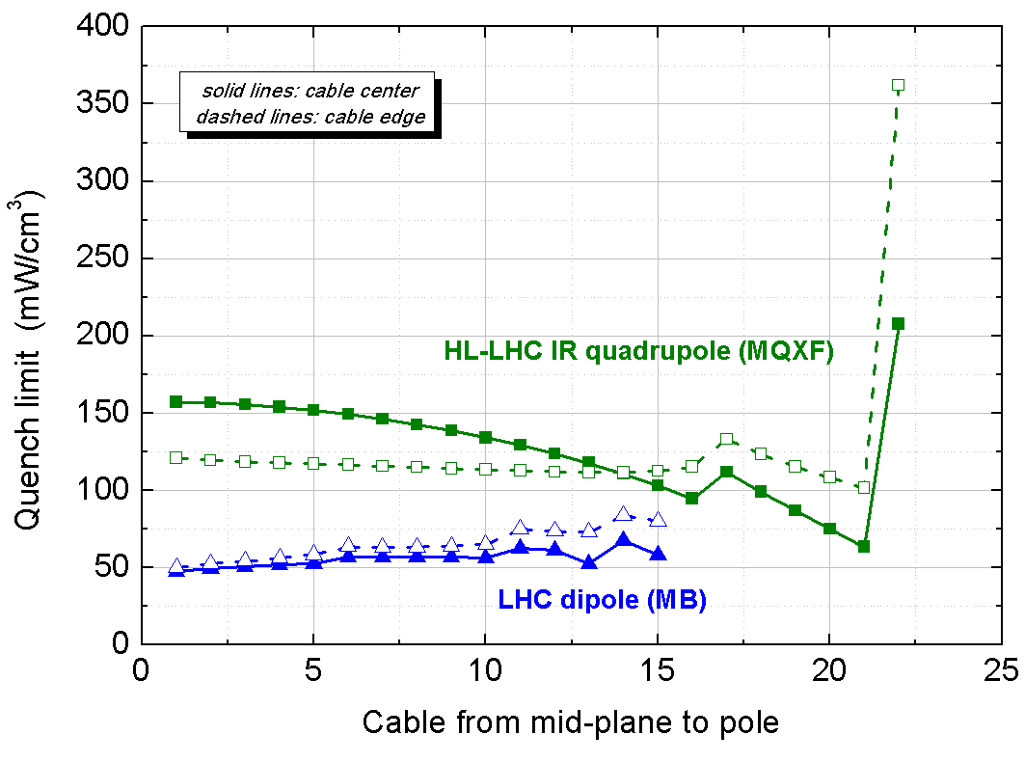
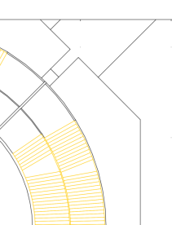
Results
Tbath = 1.9 K, held constant during heat removal
The deduced quench limits refer to an average heat deposit over the cable
Quench limit along the azimuthal direction:
MQXF

Slide 9
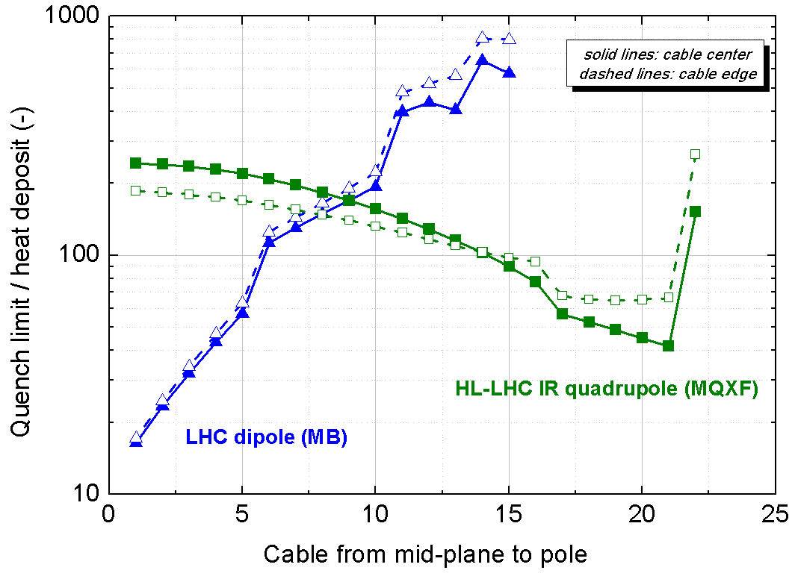
Results
Quench limit / heat deposit along the azimuthal direction
  to determine the most critical cables
  for both magnets the most heated cables have unluckily the smallest quench limit
MQXF
Heat deposit data provided by
L.S. Esposito, L. Skordis, F. Cerutti

Slide 10
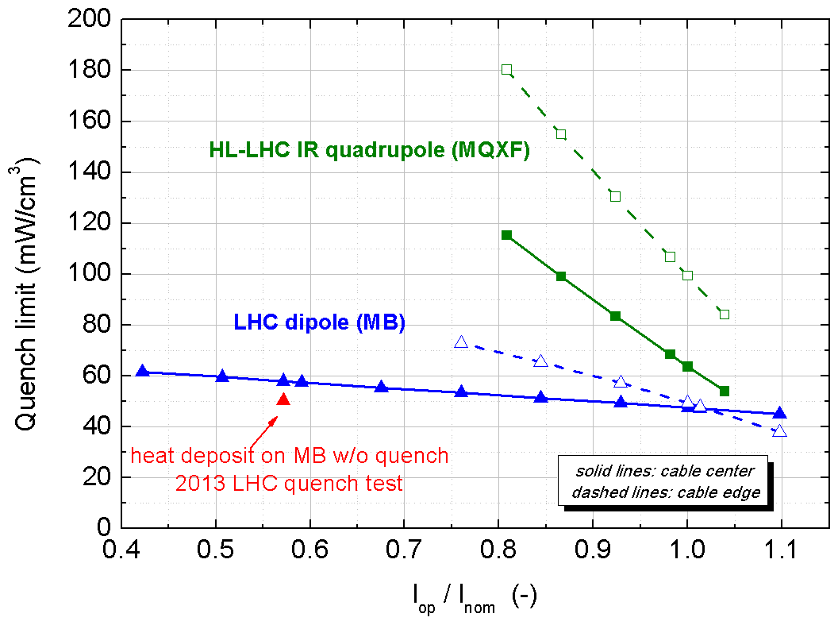
Results
Quench limit as a function of the transport current
  in the most critical regions, i.e. mid-plane for MB and close to the pole for MQXF
LHC quench test data provided by
S. Redaelli, L. Skordis et al.
LHC collimation Review 2013: http://indico.cern.ch/conferenceOtherViews.py?view=standard&confId=251588

Slide 11
Conclusion
By measuring heat transfer on cable stacks, while taking into account the cable cooling within the magnet, one can determine the quench limits
We presented a general method to determine steady-state cable quench limits, based upon the cooling geometry, the coil mechanical and operating conditions
The method has been successfully applied to LHC magnets and to magnets foreseen for the High Luminosity upgrade

