Slide 1
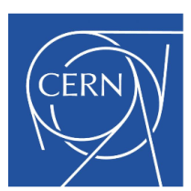
Talk Over View
- LHC Insertion history
- MQXC magnet special features
- Test over view
- Training MQXC0 & MQXC2
- Heat extraction.
- Quench heater Delays
- New superconducting magnet protection system!
LHC IR Upgrade Nb-Ti, 120mm Aperture Model Quadrupole Test Results at 1.8K
G.A. Kirby
B. Auchmann, M. Bajko, V.I. Datskov, M.Durante P. Fessia, J. Feuvrier, M.Guinchard, C. Giloux, P.P. Granieri, P. Manil, J.C. Perez, E. Ravaioli, J.M.Rifflet, S. Russenschuck,
T. Sahner, M. Segreti, E.Todesco, G. Willering.

Slide 2

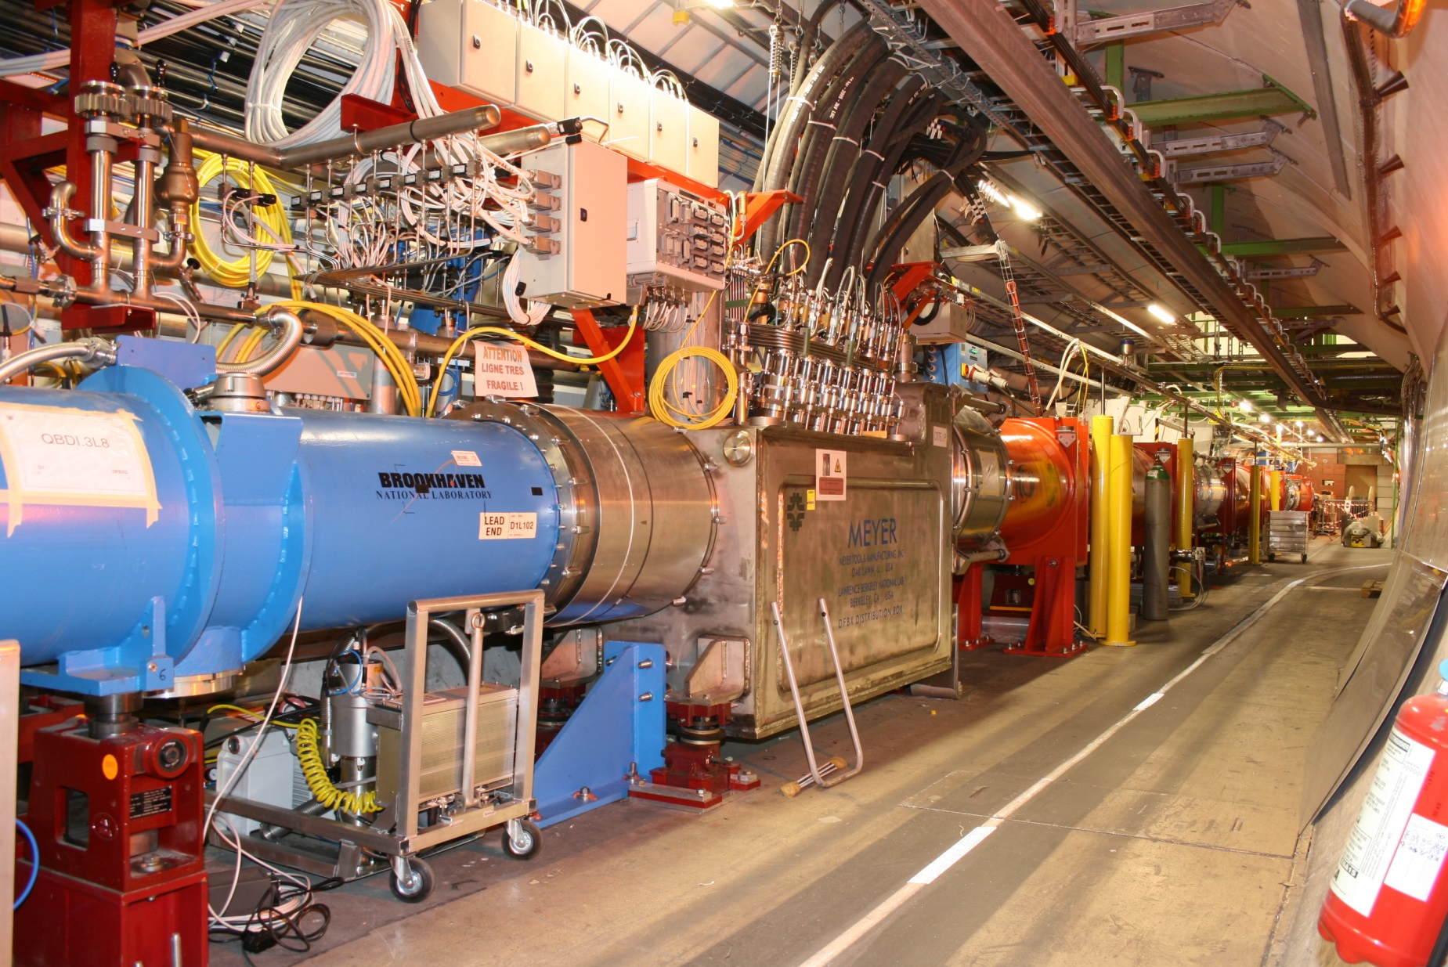
Triplet Upgrade

Slide 3
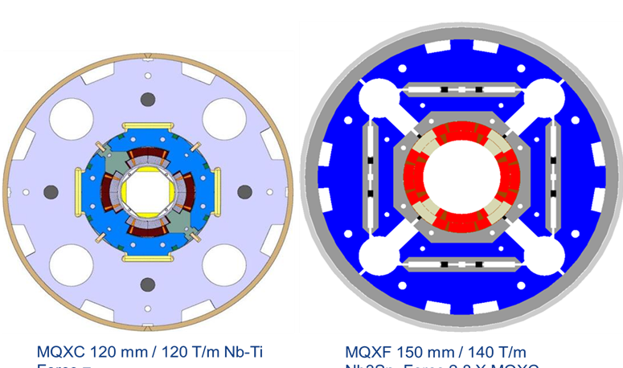
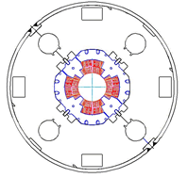
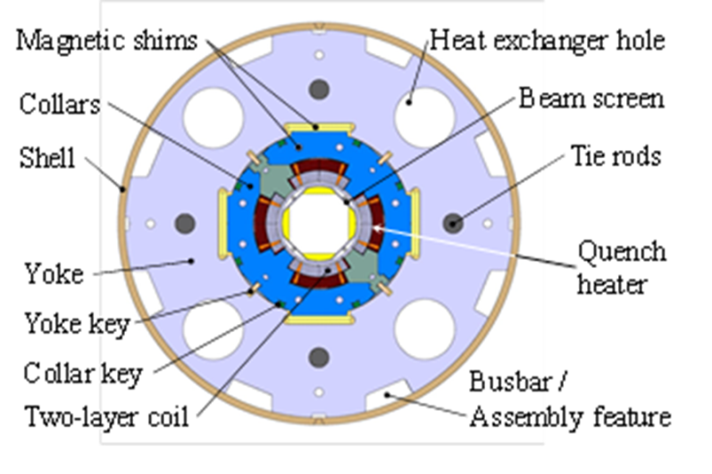
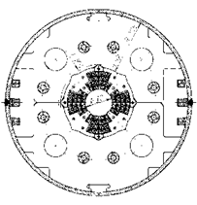
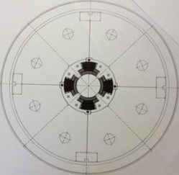
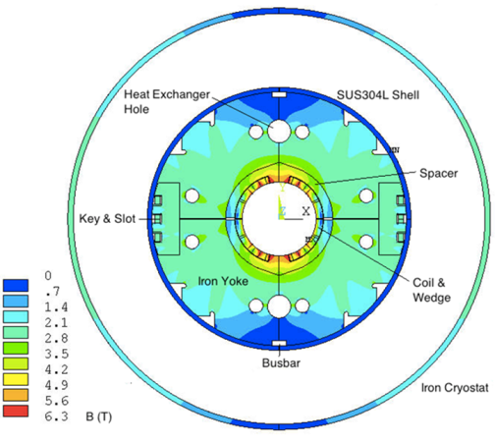
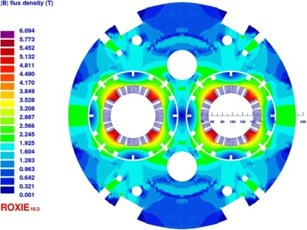

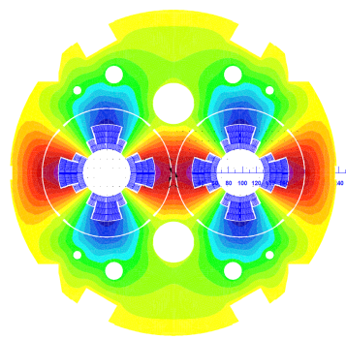
MQXC phase 1 Upgrade,
fallback solution, & technology transfer MQXD
Today's LHC insertion magnets 70mm
KEK’s - MQXA and FERMI- Lab’s-MQXB
1996
2012
2009
MQXF Nb³Sn 150mm, 140T/m
Previous talk!
Phase 1 upgrade MQXC cross section 120mm
120 T/m Nb-Ti high cooling capability
CERN-OXFORD Ins. LHC
1989
MQY / LHC Q4
1998
Q4 Nb-Ti Quad
Nb-Ti out line
proposal at CEA Saclay
D1 Nb-Ti separation dipole
Nb-Ti out line proposal at KEK
All the data for most of the magnets are in www.cern.ch/hilumi/wp3

Slide 4
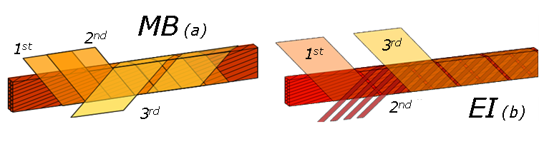
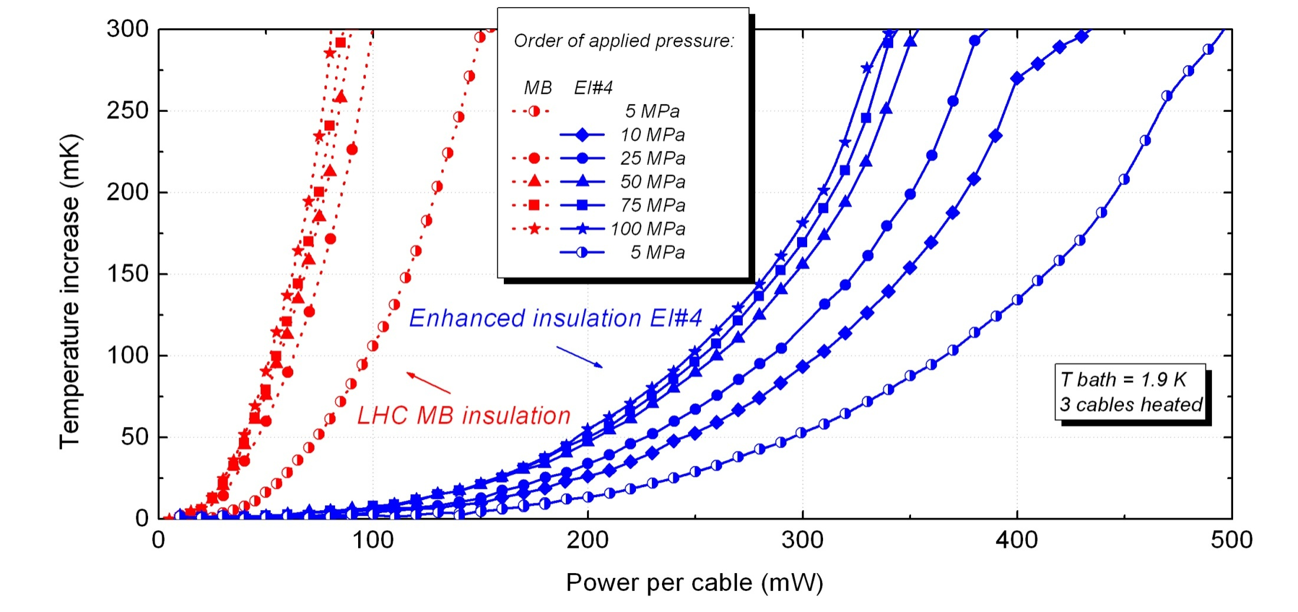
The Enhanced Cable Insulation
Enhanced insulation system from Davide TOMMASINI
Heat extraction plot from Pier Paolo Granieri PhD theses

Slide 5
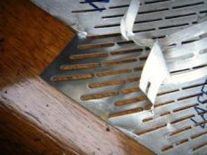
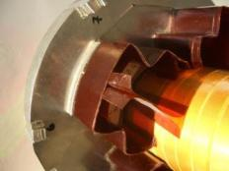
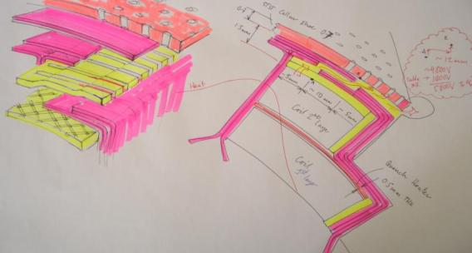
Open Ground Insulation
Thermal plots thanks to : E. Bielert
Closed ground insulation
Open collaring shoe
Closed ground insulation
Open Ground Insulation
Open ground insulation

Slide 6
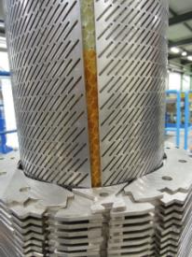
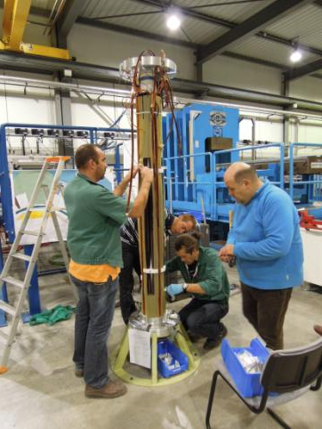
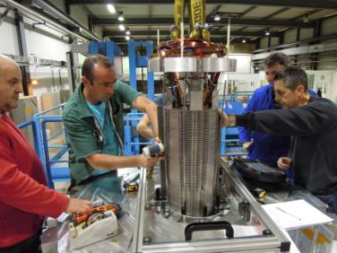
MQXC High Heat Extraction Design
Open cable insulation, open ground insulation

Slide 7
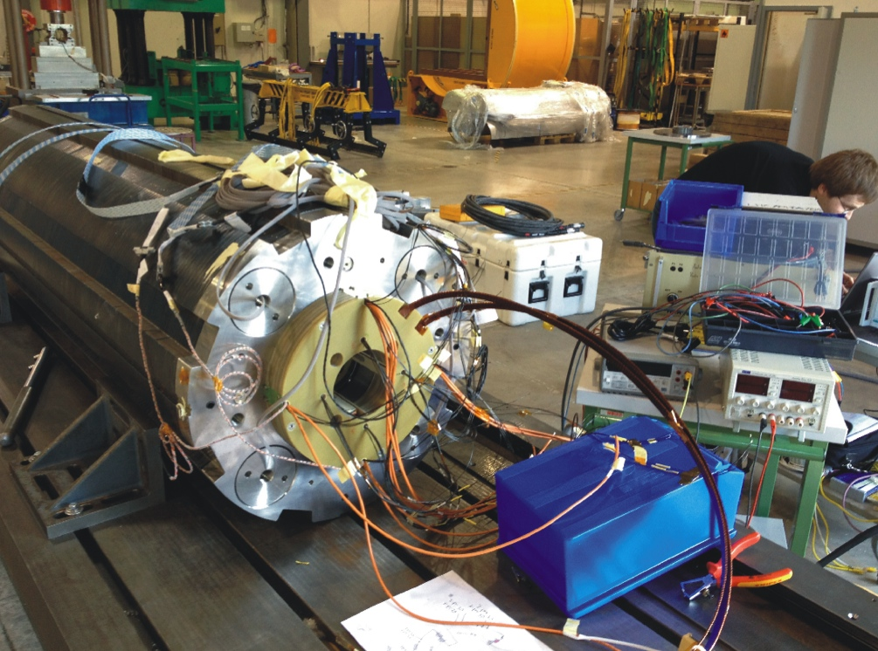
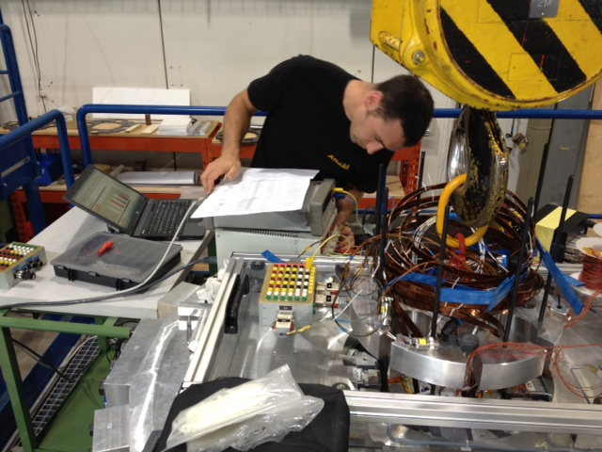
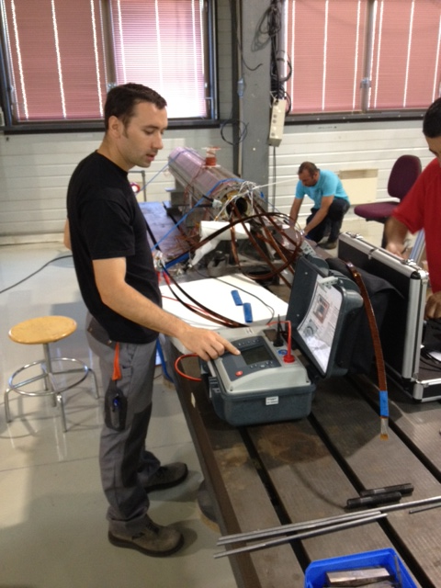
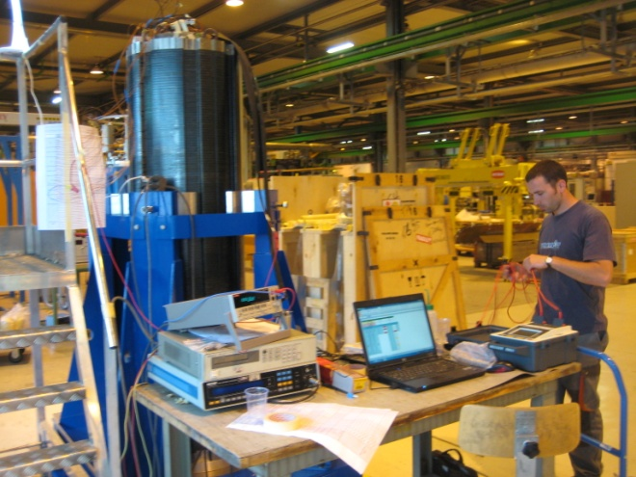
Electrical checks
We performed electrical checks at each stage of production.
1KV pulse test looking for shorts in the coils.
5KV ground insulation tests.
Resistance and inductance of coils
Insulation between all circuits.
Quench heater firing at full 850V, 80A

Slide 8
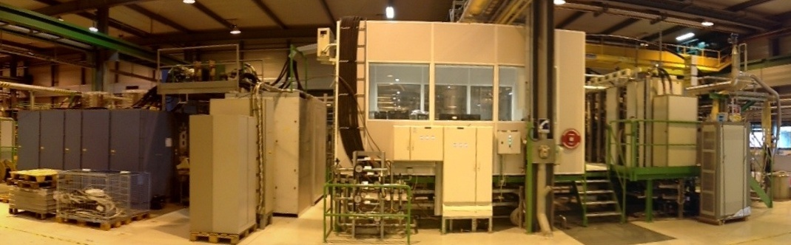
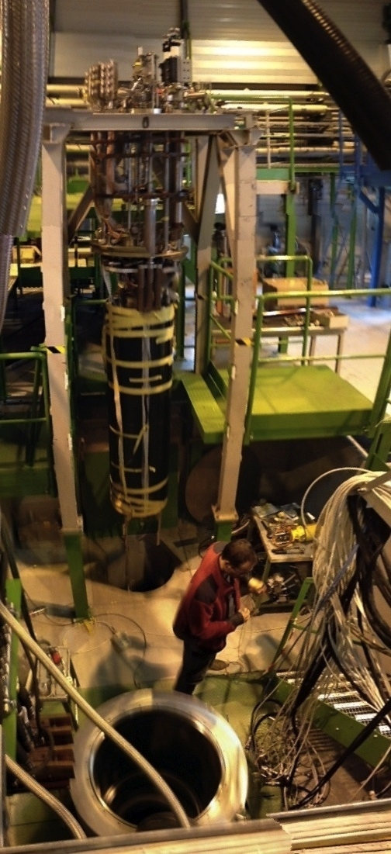
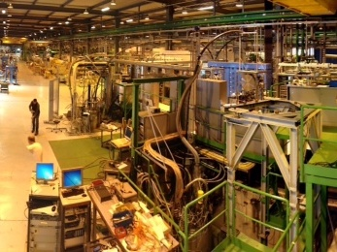
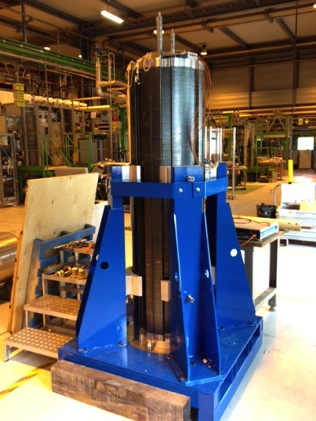
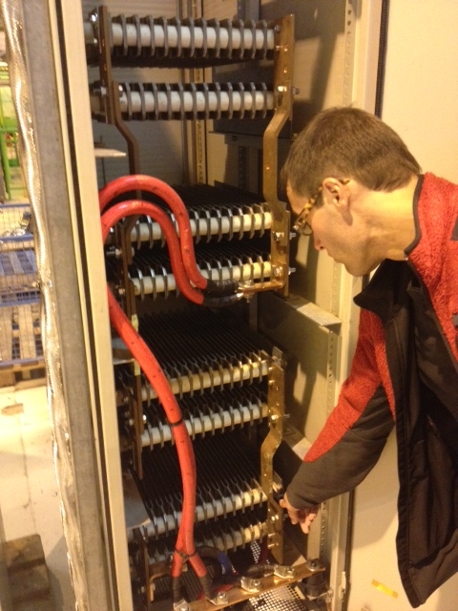
Test lab. For Model magnets at CERN
20KA Power Supply Current Transducer Control Room data racks Test Cryostat
Dump resistor Switch
Magnet in
transport frame
8

Slide 9
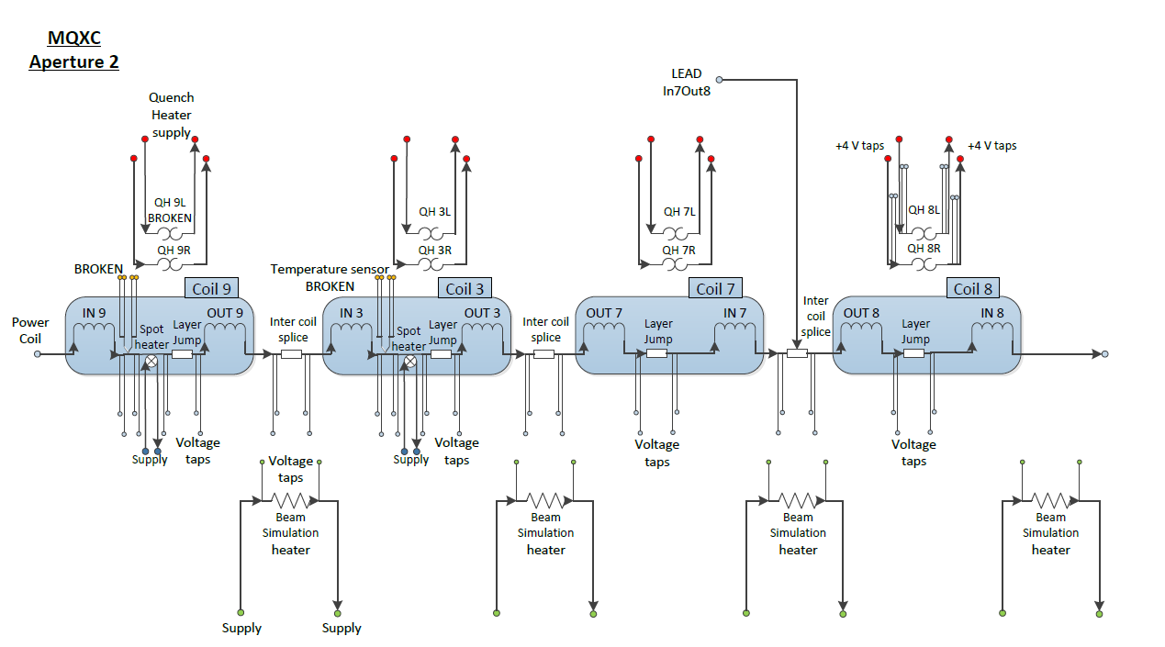
Magnet Circuit

Slide 10
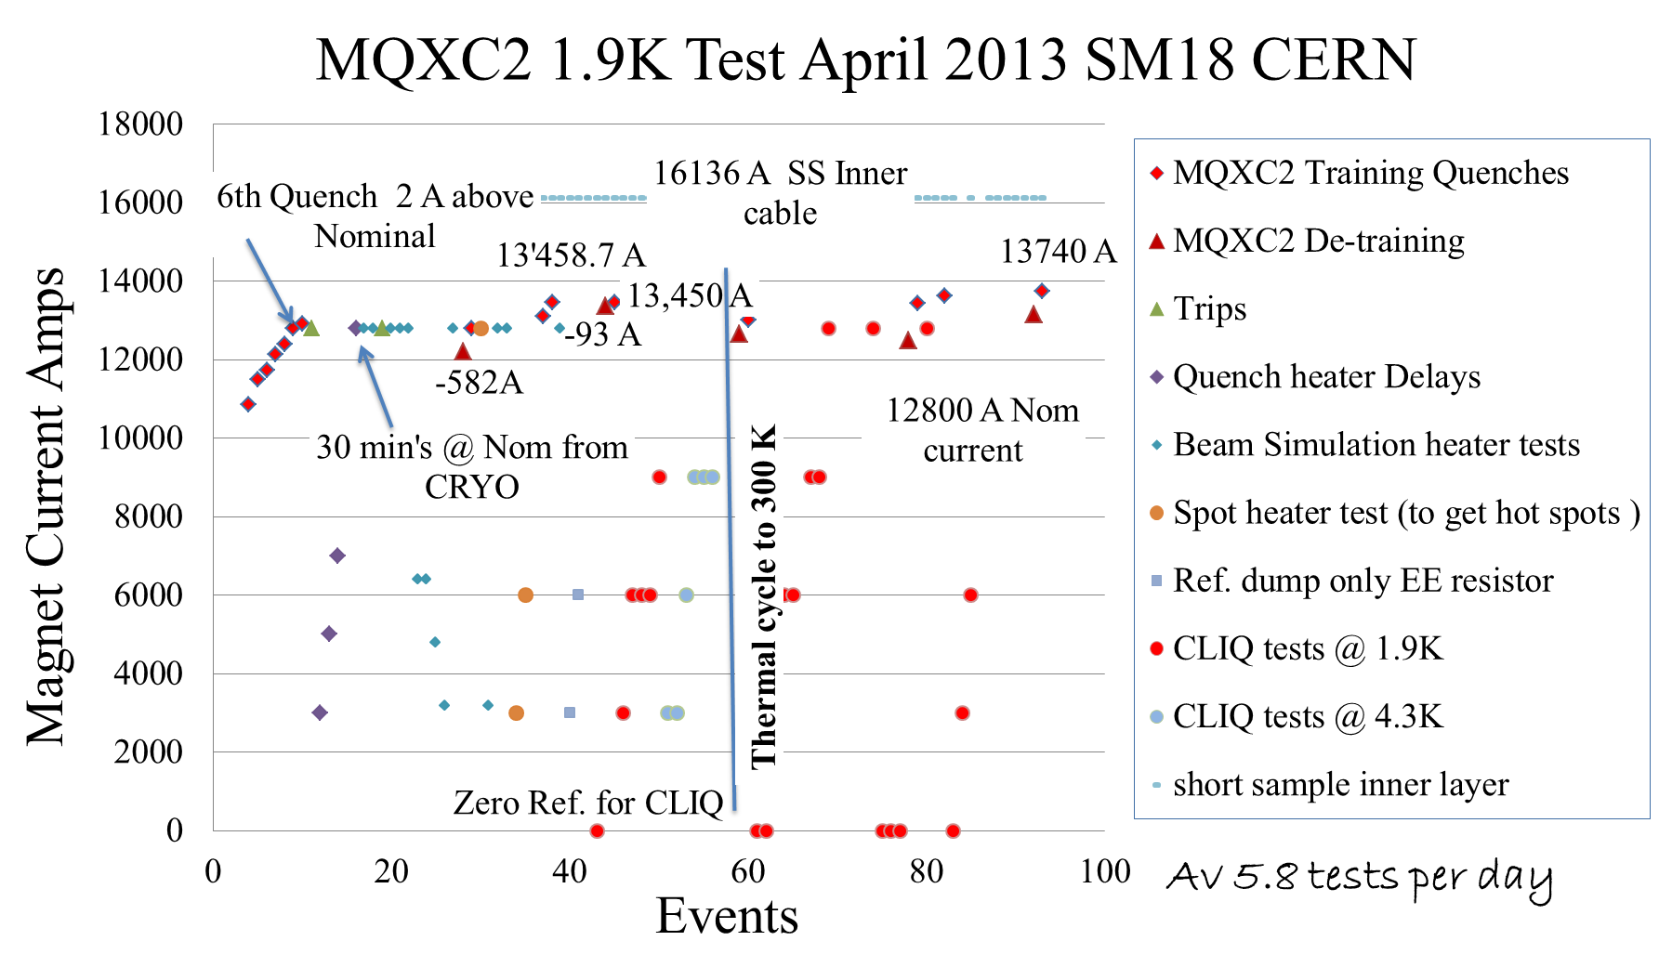
Test Over View

Slide 11
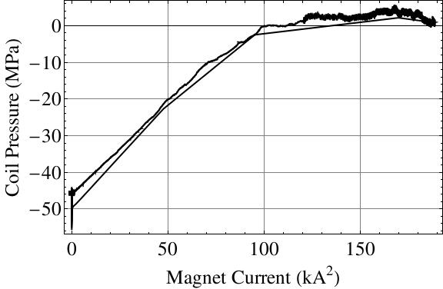
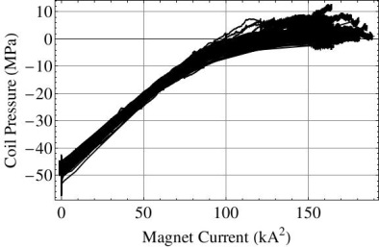
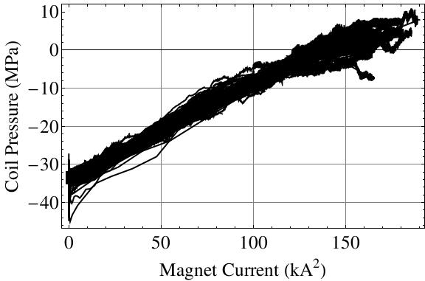
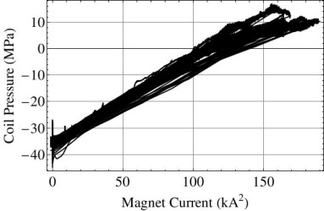
MQXC2 training comparison with MQXC0

Slide 12
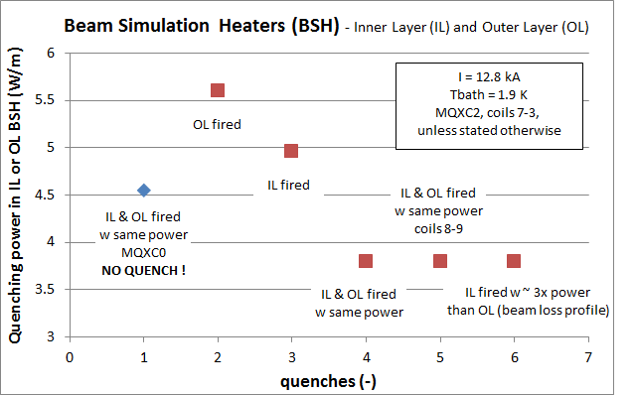
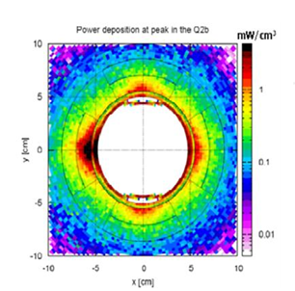
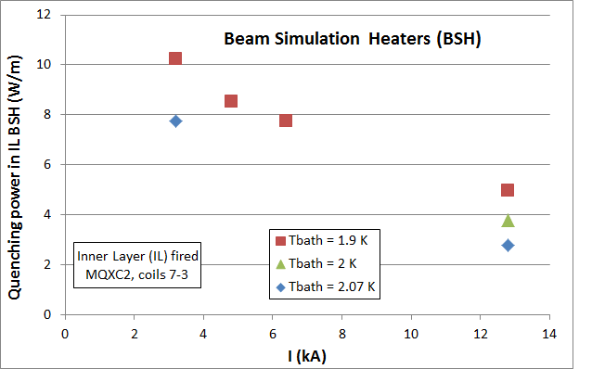
Heat Extraction
Beam Simulation Heaters
Initial observations
MQXC2 ~ 5W/m
MQXC0 ~ 10W/m

Slide 13
Quench heater performance

Slide 14
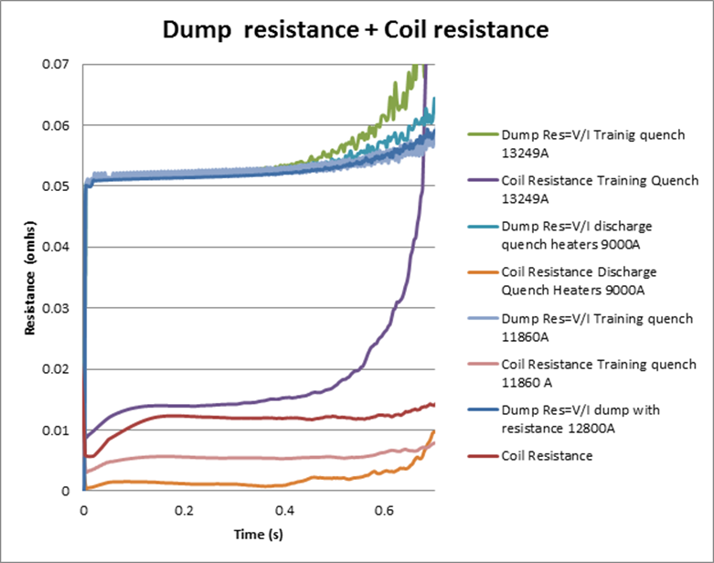
Coil Resistance during Quench.
Hotter hot spots
100K max hot spot
300K max hot spot
Without Dump adiabatic calculated Hot Spot 1200K
Two curves are plotted, giving the circuit resistance needed to limit the hot spot temp. One limiting the cable hot spot to 300K and the second limiting, HS. to 100K. With a 0.012 s detection delay.
We see from the tests that the internal coil resistance is insufficient at all currents to protect the magnet.
With 60% quenched cable we could protect the magnet!

Slide 15
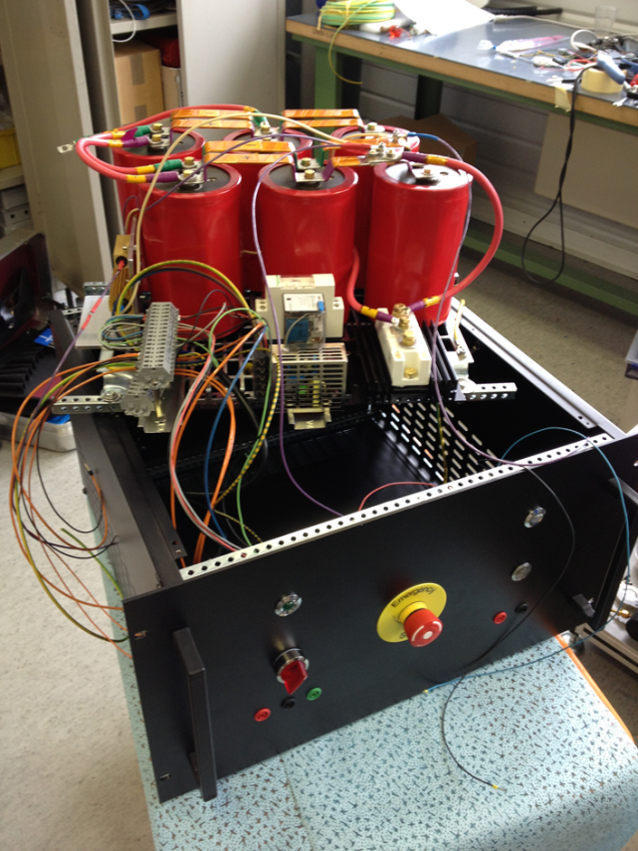
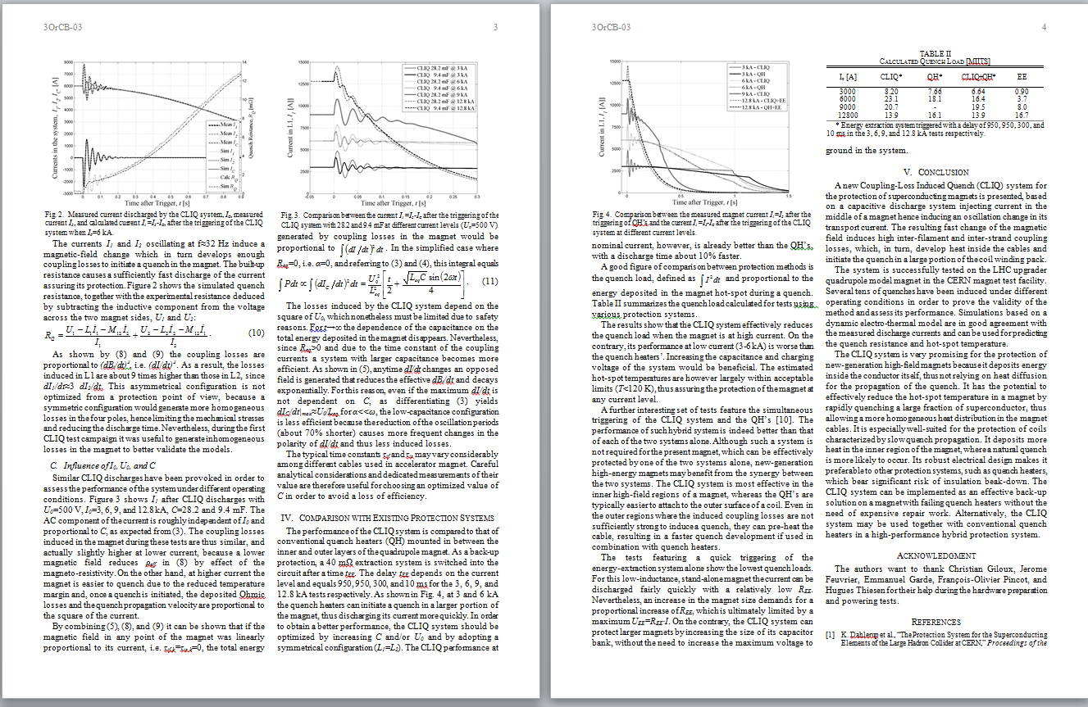
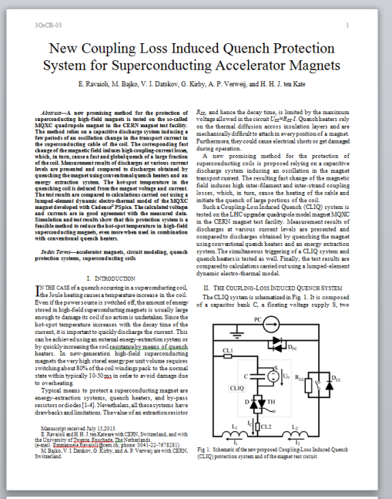
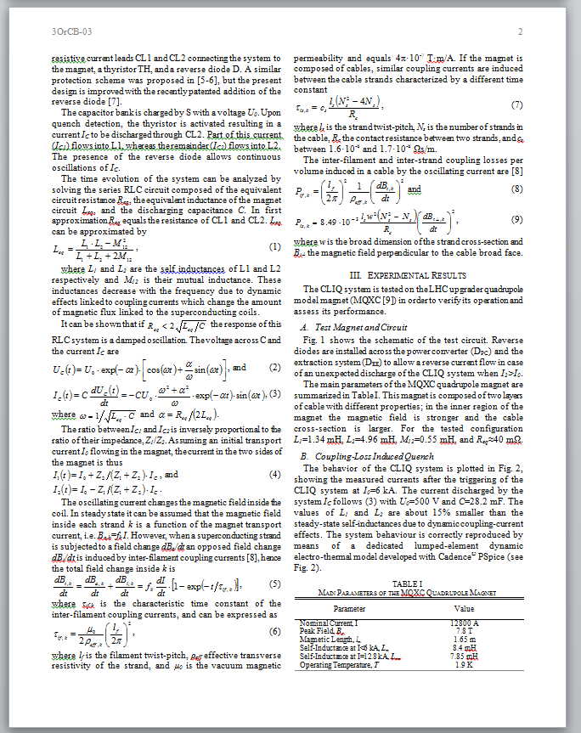
New Coupling Loss Induced Quench Protection System for Superconducting Accelerator Magnets
“CLIQ”
3OrCB-03
“AC-Current Induced Quench Protection system”, application has been filed with the European Patent Office on June 28, 2013 under the application number EP13174323.

Slide 16
Magnet Circuit
1/4
3/4
CLIQ lead

Slide 17
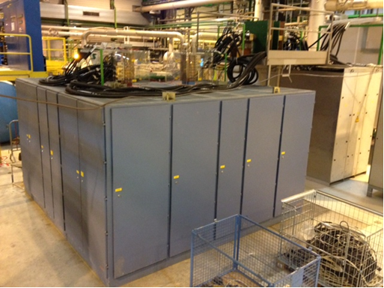
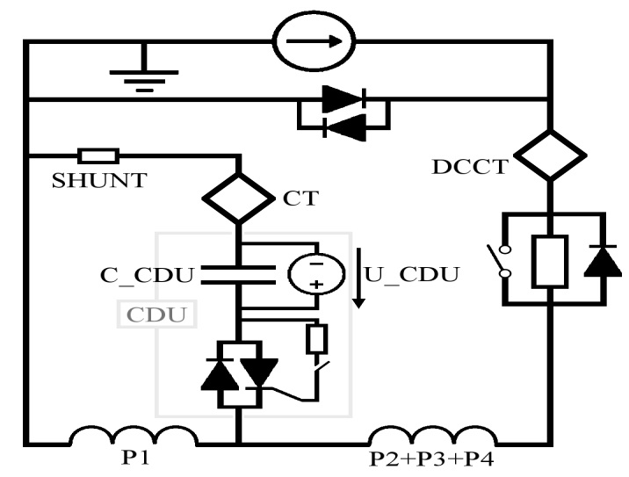
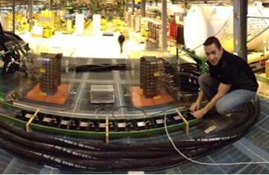
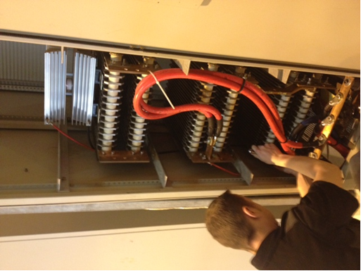
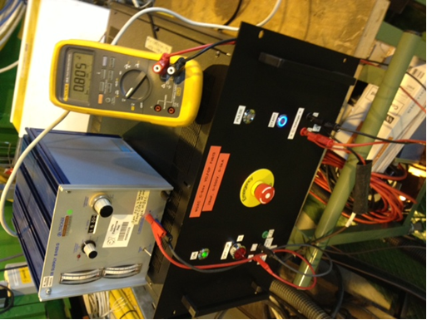
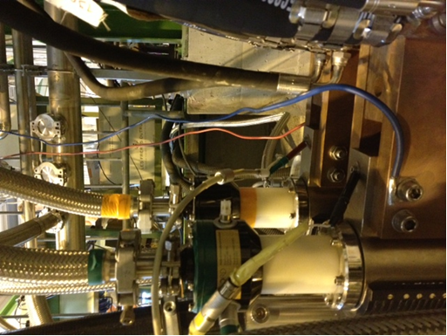
CLIQ set up & PSU modification

Slide 18
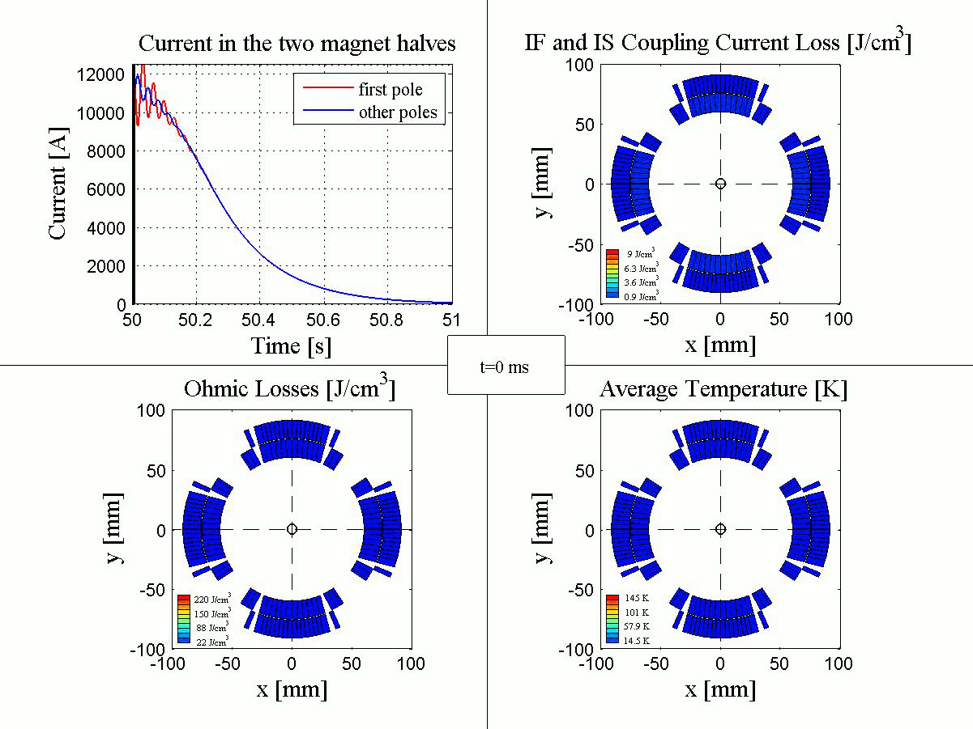
Simulation of a Quench induce by a Capacitive Discharge

Slide 19
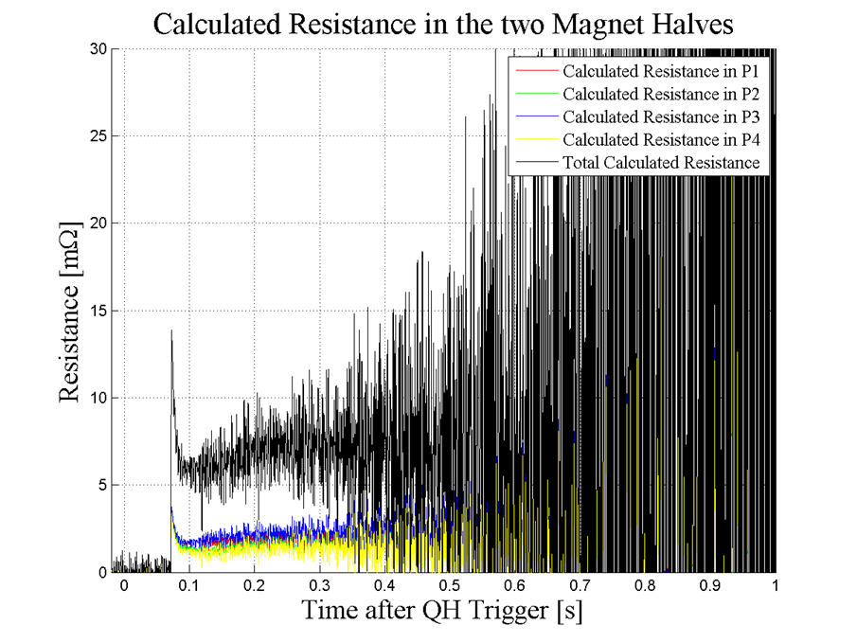
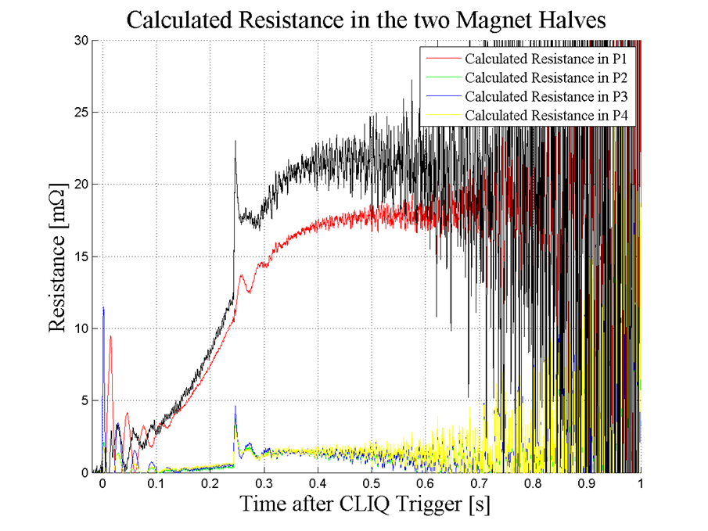

9KA comparison Quench heaters and CLIQ
9KA, QH @40A +EE
9KA, CLIQ + EE @150ms
(capacitor voltage at 400V)

Slide 20

Simulation v Measurements
CLIQ possibilities :
- Fast repair to existing systems
- Nb-Ti, Nb³Sn and HTS protection
- Fast protection
- Uses no real-estate in magnet
- Good prediction of effects.
Best performance: (symmetric, 500 V, 12.8 kA)
In 20 ms 50% coil quenched
In 50 ms 80% coil quenched

Slide 21







Special thanks to the rest of CLIQ team
Vladimir Datskov
Emmanuele Ravaioli
Francois-Olivier Pincot
Mk1
Mk2
1st Signals
Marta Bajko, Jerome Feuvrier

Slide 22






















Thanks to the teams.
The many people that have worked on the Nb-Ti MQXC over last 5 years.

Slide 23

Any Questions

