Slide 1
Latest tracking results from CEA
A. Chancé, B. Dalena, J. Payet
Thanks to R. De Maria & M. Giovannozzi

Slide 2
Field Quality Study
LHC v3.1b @ collision (round beam with β* = 15cm)
Beam normalized emittances 3.75 10⁻⁶ m.rad
Momentum : 2.7 10⁻⁴, (max allowed 2 10⁻³)
Search for the error set which gives the largest average of the DA
Standard errors and corrections for the arcs
IT errors : slhc/errors/IT_errortable_v2
Corrections b3, b4, b5, b6, a2, a3, a4, a5, a6 turned on for the IT and D1 (corr_tripD1_v1 S. Fartoukh; M. Giovannozzi, S. Fartoukh, R. De Maria, WEPEA048, IPAC'13)
The error amplitudes can be divided by 2, at most
DA for 11 angles (0,π/2), 13 amplitudes (10σ, 22σ, step 1σ), 60 particles, 100000 turns, 60 error seeds

Slide 3
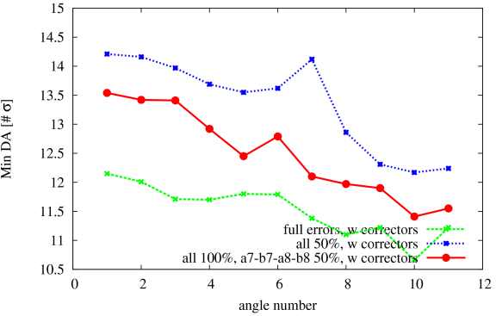
Reduction of the b7, b8, a7, a8 harmonics only
The reduction of b7, b8, a7, a8 only is not sufficient to reach the blue curve (we gain ~1-1.5σ).
Task.2.3 meeting 07/06/2013

Slide 4
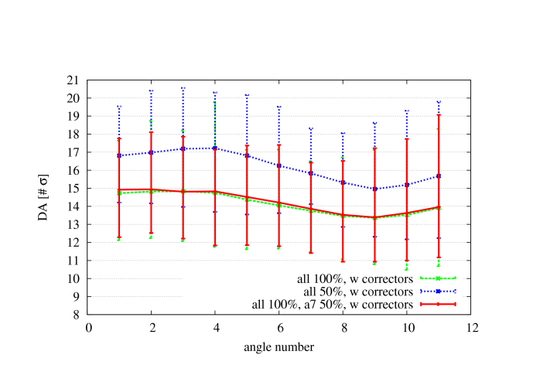
Reduction of the a7 harmonic
The contribution to the DA of a7 at 50% alone is very small.

Slide 5
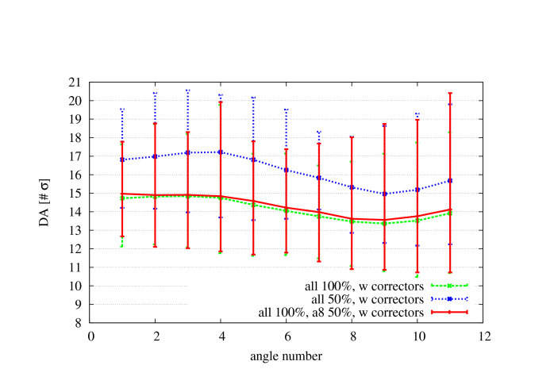
Reduction of the a8 harmonic
The contribution to the DA of a8 at 50% alone is visible at large angles.

Slide 6

Reduction of the b8 harmonic
The contribution to the DA of b8 at 50% alone is small.

Slide 7
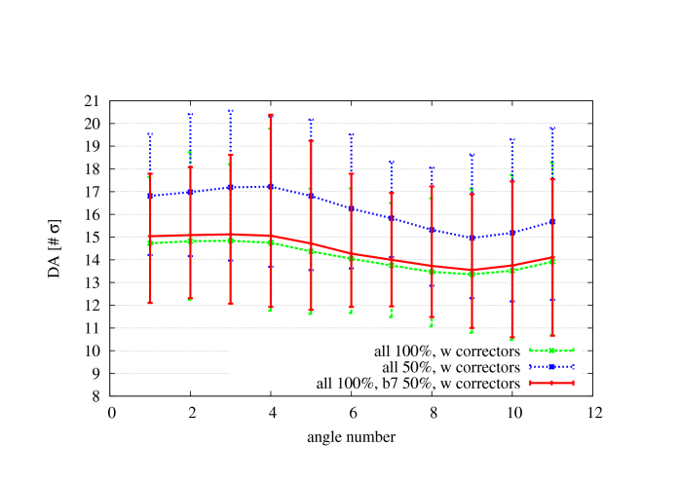
Reduction of the b7 harmonic
The gain on the average DA given by b7 at 50% alone is the most important.

Slide 8
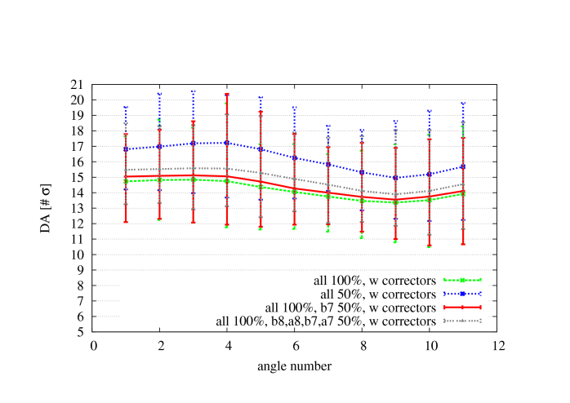
Reduction of the b7, b8, a7, a8 harmonics
The gain on the average DA is about 1σ with b8, a8, b7, a7 at 50%.
b7 alone at 50% gives the most visible effect on the average DA with respect to the other ones.

Slide 9
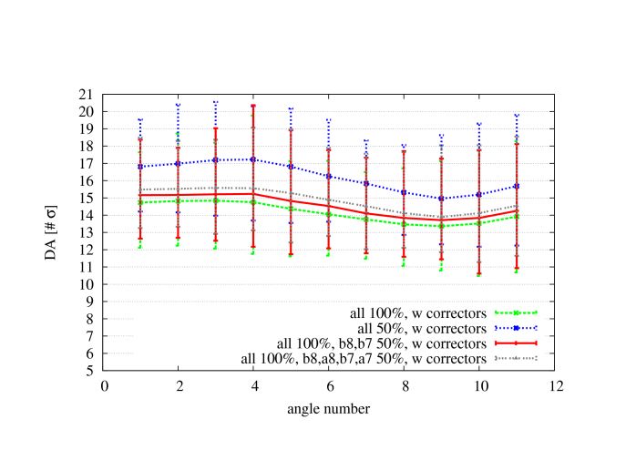
Reduction of the b7, b8 harmonics
The combination of b7 and b8 at 50% gives about half of the gain obtained with b7, b8, a7, a8.

Slide 10
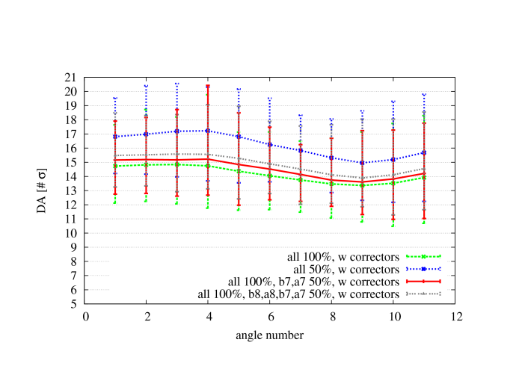
Reduction of the b7, a7 harmonics
The combination of b7 and a7 at 50% gives about the same gain as b7 and b8 together.
The combination of the harmonics adds not linearly.

Slide 11
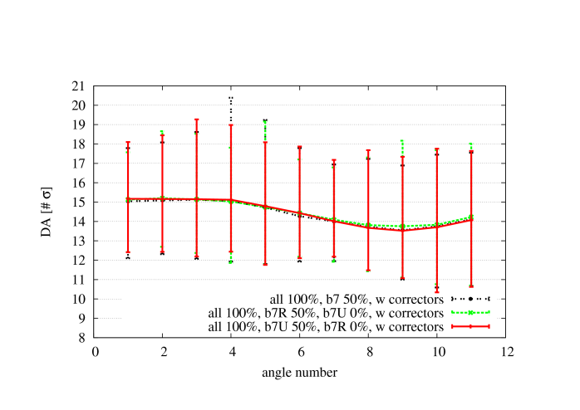
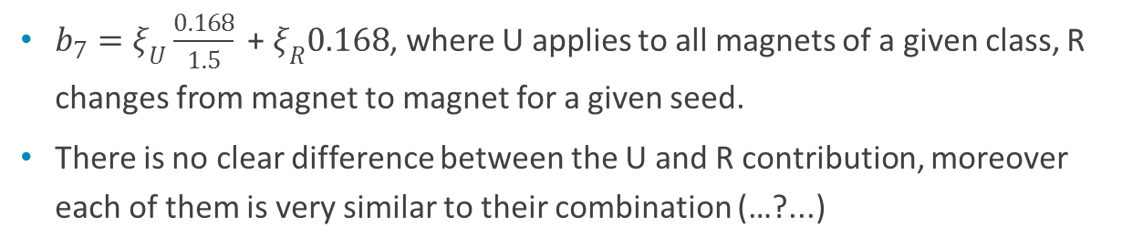
Error components of the b7 harmonics
$b_{7}=ξ_{U}\frac{0.168}{1.5}\text{ + }ξ_{R}0.168$, where U applies to all magnets of a given class, R changes from magnet to magnet for a given seed.
There is no clear difference between the U and R contribution, moreover each of them is very similar to their combination (…?...)

Slide 12
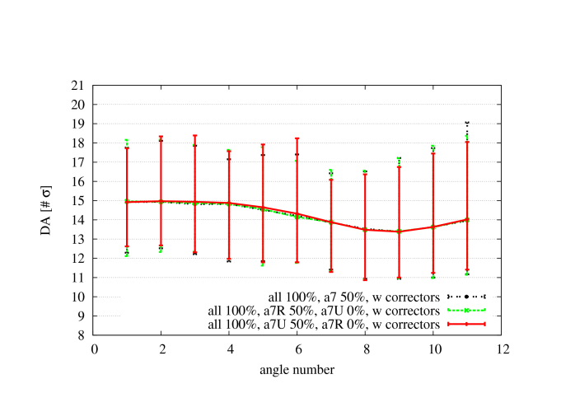
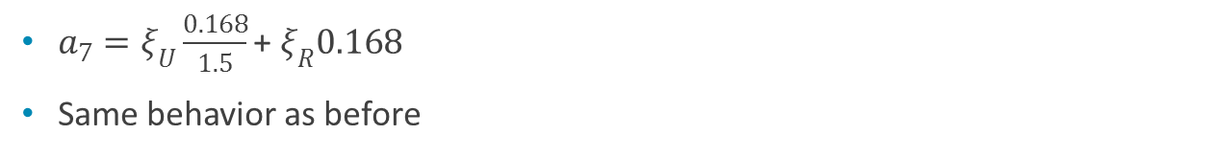
Error components of the a7 harmonics
$a_{7}=ξ_{U}\frac{0.168}{1.5}\text{+} ξ_{R}0.168$
Same behavior as before

Slide 13
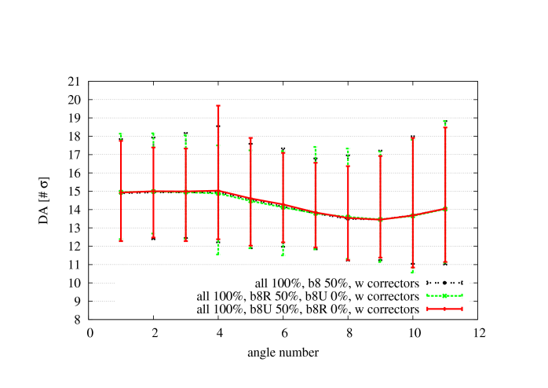

Error components of the b8 harmonics
$b_{8}=ξ_{U}\frac{0.128}{1.5}\text{+} ξ_{R}0.128$
Same behavior as before

Slide 14
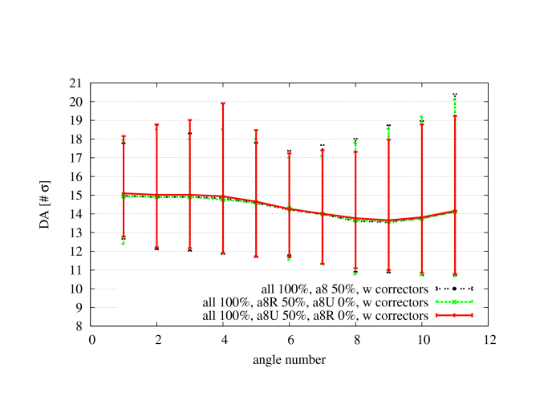
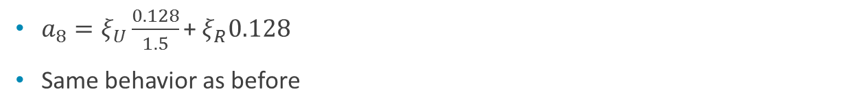
Error components of the a8 harmonics
$a_{8}=ξ_{U}\frac{0.128}{1.5}\text{+}{ ξ}_{R}0.128$
Same behavior as before

Slide 15
Summary
The reduction of the harmonics b7,a7,b8,a8 up to 50% together gives a gain of ~1 σ on the average DA.
b7 alone seems to give the most important contribution to the DA gain but the addition of the harmonics enhances their singular behavior .
The contribution of the U and the R components alone (b8,a8,b7,a7) on the DA is the same and is the same of their total as well.
To do
Determination of the minimum reduction to these multipole leading to a sensible increase of the DA (0.25σ, 0.5σ,… ?)
Check the IT_errortable_v3
Switch to HLLHCV1.0 lattice

