Slide 1
LAGUNA – extraction from LSS6
B.Goddard 5/7/13

Slide 2
Features
Fast extraction installed in LSS6 with MKE kickers
  Needs adapting to CNGS configuration with double batch extraction, no technical issue
Switch needed from TT60 somewhere, or TI2
  TT60 better in that TL apertures compatible with FT beams
Interlocking concept to update
  HiRadMat, LHC and LAGUNA in one extraction...
Transfer line bends above 2 T
  Imposes SC dipoles
  Exploit synergies with HP-PS ring, energy consumption, ...

Slide 3
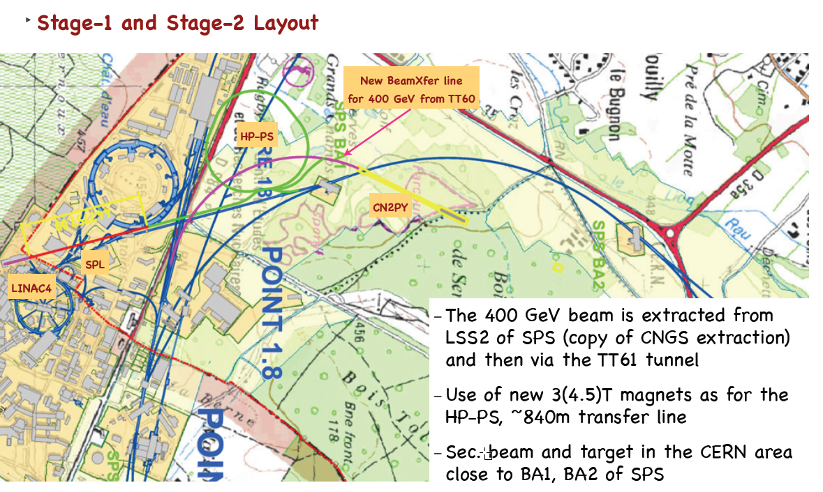
Location of LAGUNA target?
Near SPS BA1, under the golf course (3rd hole, tricky par 3)

Slide 4
Beamlines needed
450 GeV beamline from SPS LSS6 (in fact the TT60/HiRadMat area) to the HP-PS target
4 GeV H- beamline from SPL to HP-PS injection;
50-75 GeV beamline from HP-PS extraction to LAGUNA target (or to join the line 1/ above).

Slide 5
Information available
HP-PS geometry and sequence
TT60/TI2 sequences and geometries
PS2 injection straight
SPL-PS2 transfer line
Angles required for neutrino target
Drawings of TT60/HiRadMat

Slide 6
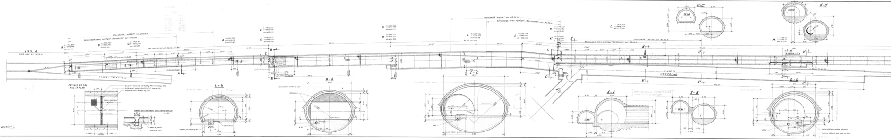
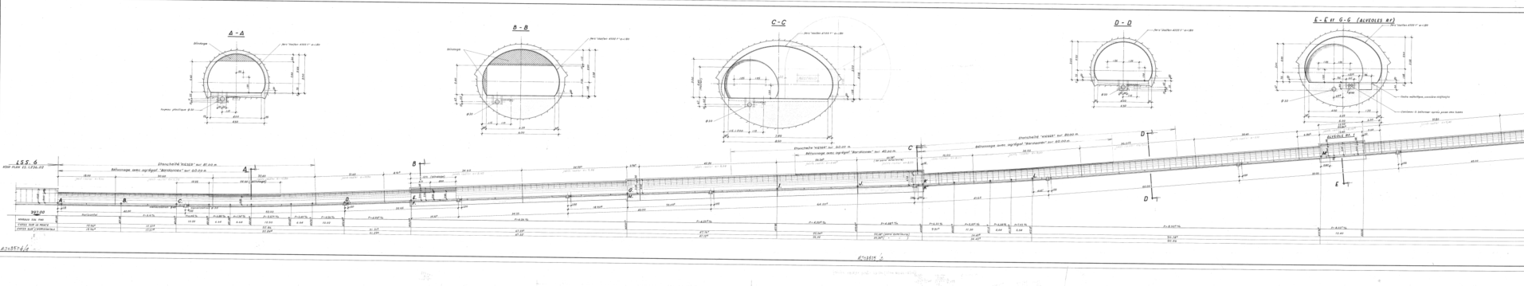
TT60/61 tunnels

Slide 7
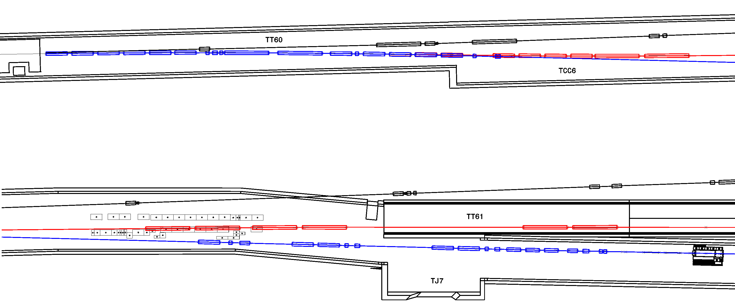
Compatibility with TT66 Beam Line – to TT61
Beam from SPS
8 new switching magnets
Modification of TT66
New PWA beam line
T1 target shielding
HiRadMat primary beam line (TT66)

Slide 8
Switching point to decide
Earlier is better for lower dipole field in TL
Later is better in terms of clearance from SPS
Branch from either TT60, TT66, TT61 (new line to build) or TI2?
To the right hand side would be much easier in terms of angles and total bend, but a lot of potential interferences to avoid...(TJ7...)

