Slide 1
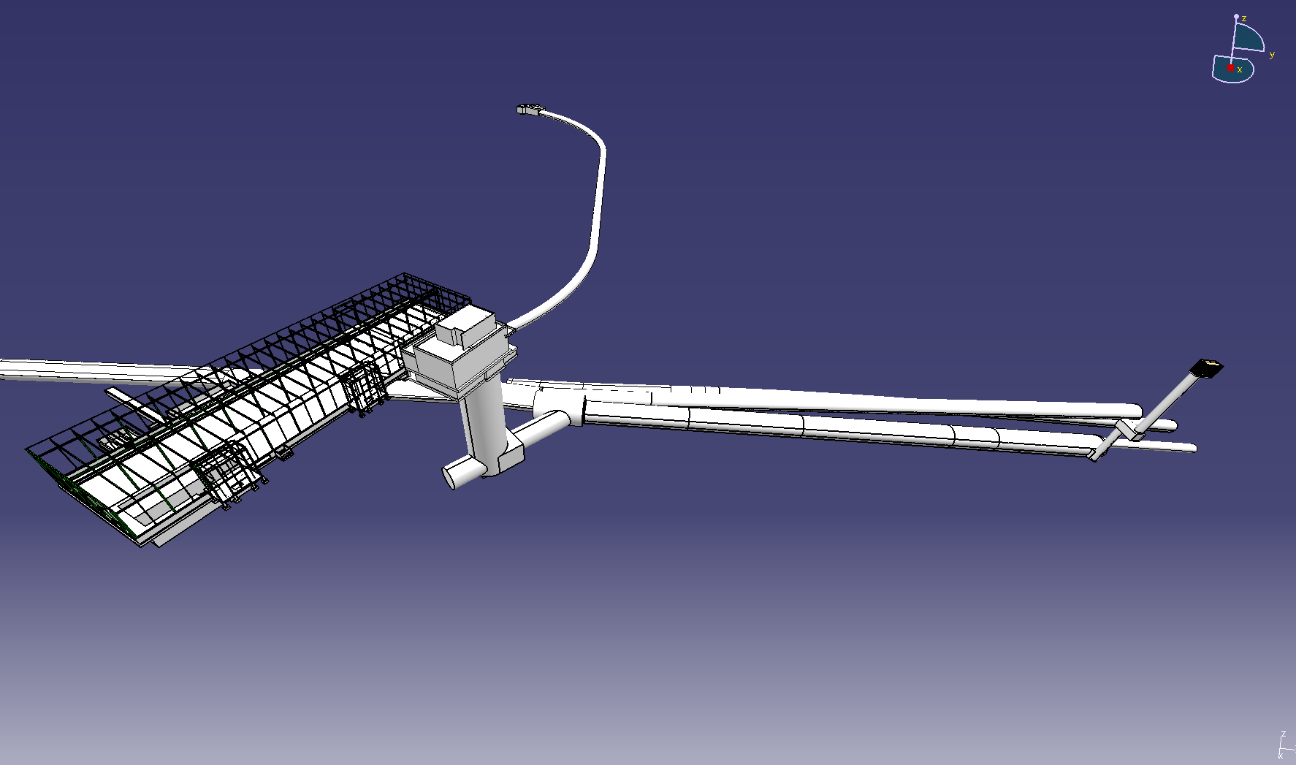
LAGUNA
TT61
TJ7
TT66
BLD 876
CIVIL ENGINEERING FOR DISCUSSION

Slide 2
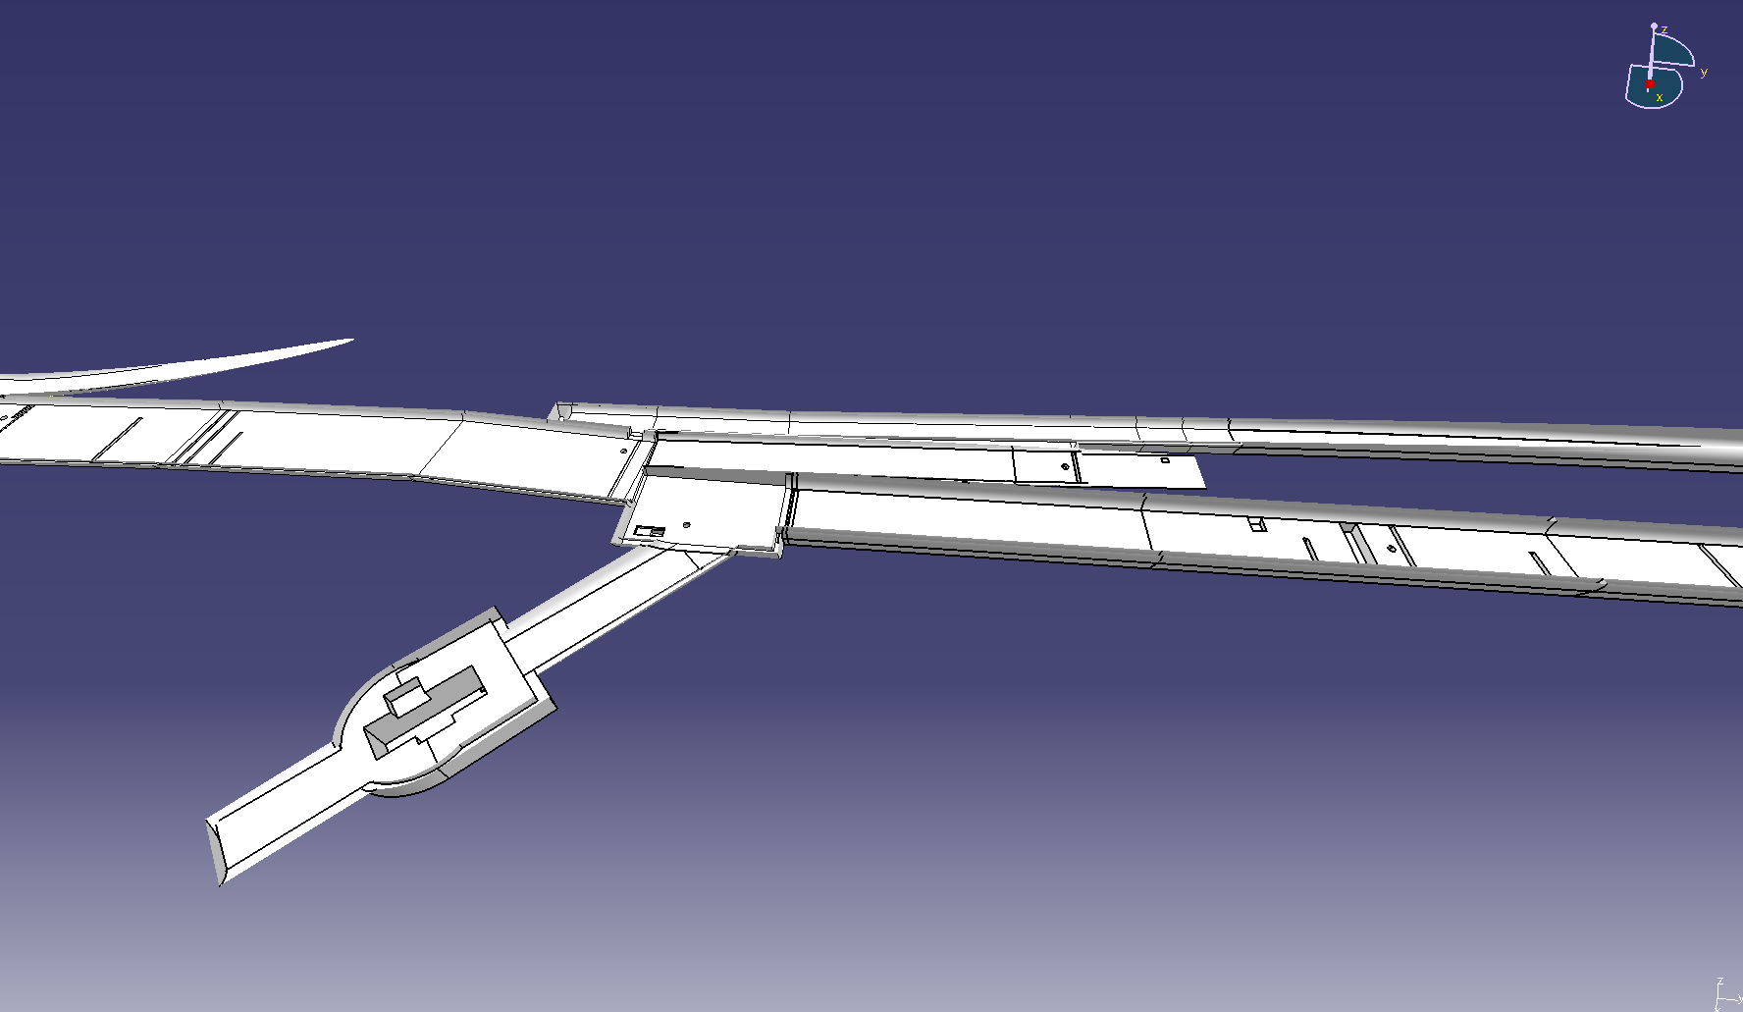

Slide 3
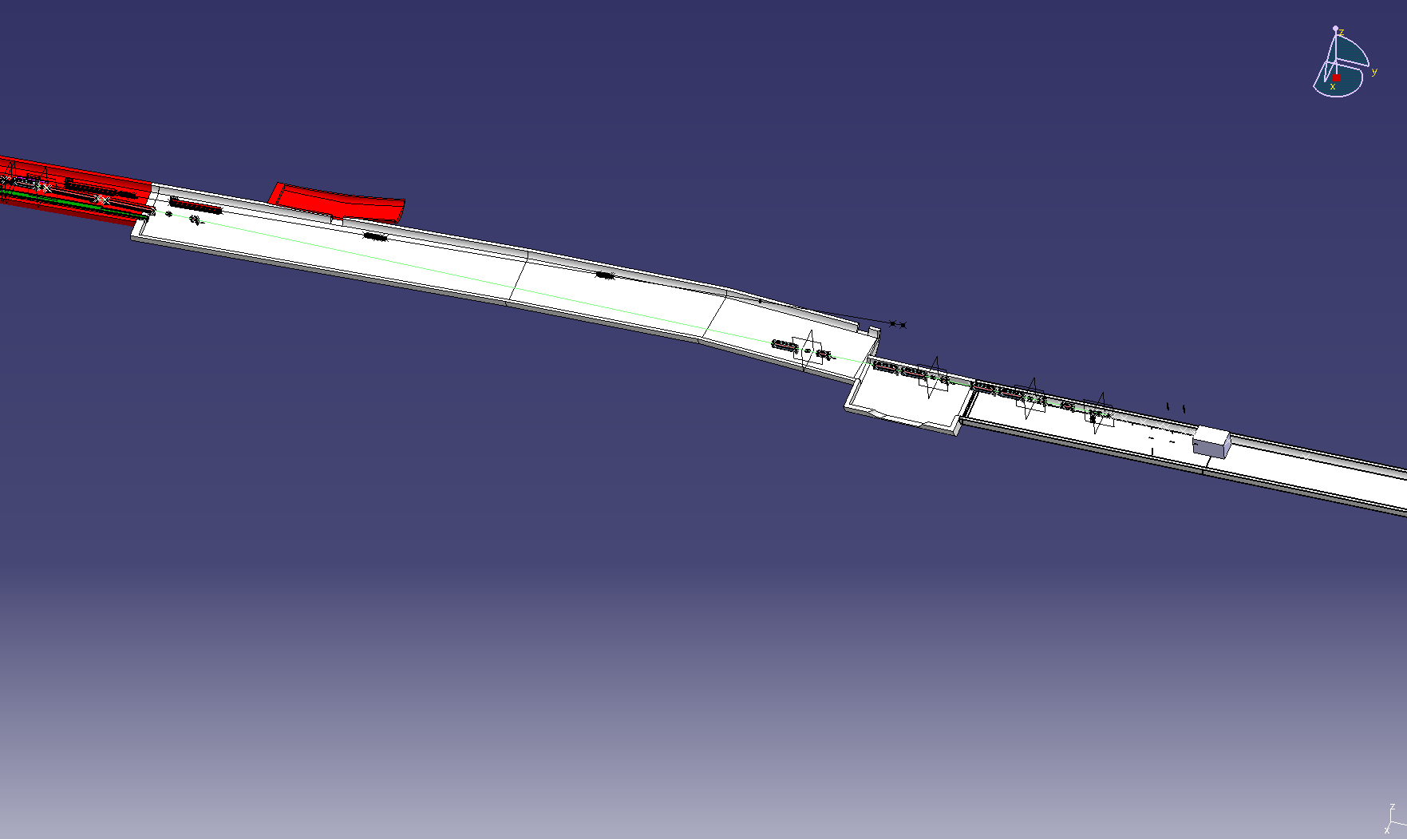

Slide 4
