Slide 1
Elsevier's program to support research data
Presented by: Dr. Eleonora Presani, Publisher High Energy Physics

Slide 2
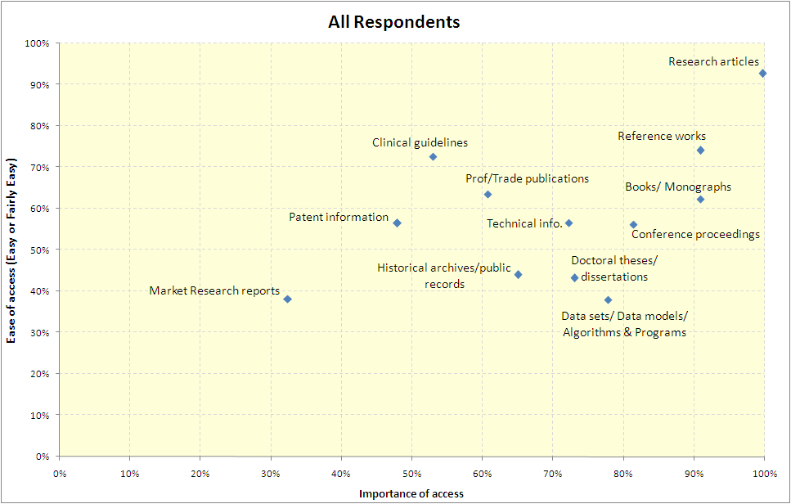
What do researcher’s themselves say?
Very high importance , very high satisfaction
High value & easy access
High value & difficult to access
Source:
4,109 researcher respondents (almost 7% of apx 60.000) , global study commissioned by Elsevier
on researchers’ list of ‘barriers to productivity’;
insufficient funding is #1, insufficient time is #3, too much bureaucracy is #5…
Notes:
Extra factoid : 93% of university researchers globally are now satisfied with access to journal research articles, the most important form of content for them to access
and ‘access to journals’ is last at 12th

Slide 3

Principles of Research Data Services
  A new department to explore collaborations on research data mgmn’t with data repositories, libraries/IT departments and researchers.
  Main goal: make research data optimally available, discoverable and reusable.
  Collaboration is tailored to partner’s unique needs:
    Working with a few domain-specific and institutional repositories and institutions
    Aspects where collaboration is needed are discussed
    Collaboration plan is drawn up using SLA: agree on time, conditions, etc.
  2013: series of pilots, studies and reports to enable feasibility study:
    What are key needs?
    Can Elsevier play a role: skillsets, partnerships?
    Is there a (transparent) business model for this?
Notes:
Elsevier’s Research Data Services is a new group within Elsevier that is exploring collaborations on data management with various parties in this space, including data repositories, libraries and institutes, and research labs.
The underlying goal is always to make research data optimally available, discoverable and reusable, and that’s done in close collaboration with partners so that we learn about their needs and think about services that would really benefit them.
In 2013 a number of pilot project were set up and executed.

Slide 4
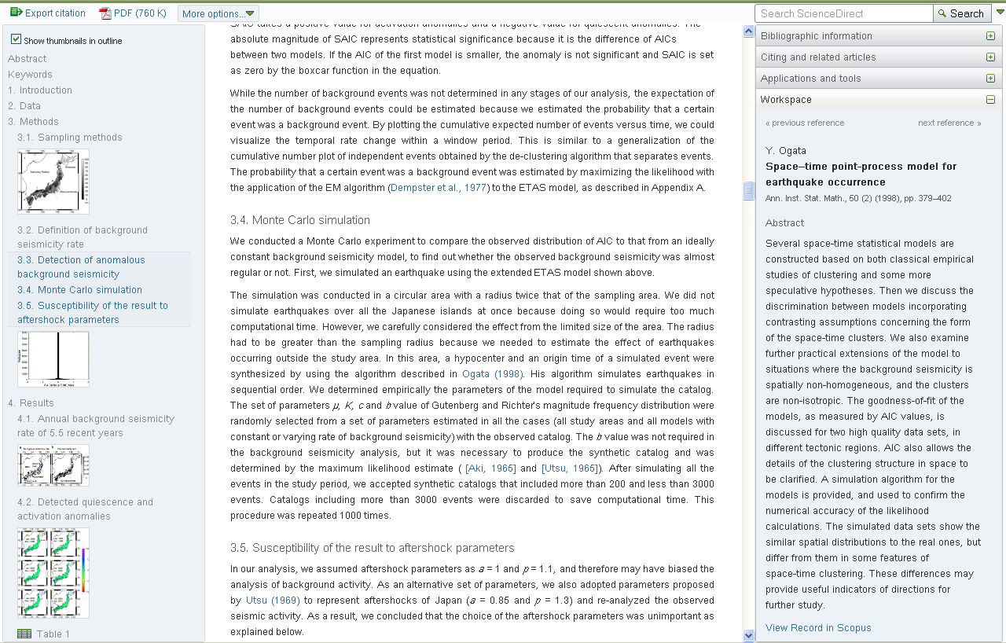
Elsevier’s Article of the Future
Left pane: efficient navigation & browsing
Center pane: “Traditional” full-text view, designed for optimal online reading experience
Right pane: Additional content & tools. Shown here: reference browser
Notes:
At Elsevier we’ve been developing a new format for scientific articles – called the Article of the Future – over the last couple of years. With the Article of the Future, we want to:
- Break away from the ink-on-paper legacy
- Enable researchers to publish their work in all its dimensions, including digital content like data, code, multimedia, etc.
Take advantage of what modern web technology has to offer to create an optimal, rich reading experience.

Slide 5
Interlinking Articles and Data adds value both ways
Increase visibility, discoverability, and usage
Provide context, avoid misinterpretation and incorrect usage
Ensure long-term availability of useful content and context
Coordinate submission process / deposit mechanism
85% of researchers believe it is useful to link underlying digital research data to the formal literature (PARSE.Insight)
Notes:
So starting with the Context part, we have an active program of setting up links between articles on ScienceDirect and data repositories. We see that there is a lot of great work that is done by subject-specific data repositories, who add a lot of value in terms of subject-specific expertise and coordination that really make a corpus of data more useful than the sum of the parts.
At the same time it’s important to keep the connection between article and data, which really is a win/win situation: it makes it easier to find data and articles, and for data it adds context that is often essential for proper interpretation and re-use. So we’re actively involved with an increasing number of data repositories to set up these kind of bidirectional links, and this number has been growing considerably since I last spoke at DataCite 2 years ago.

Slide 6

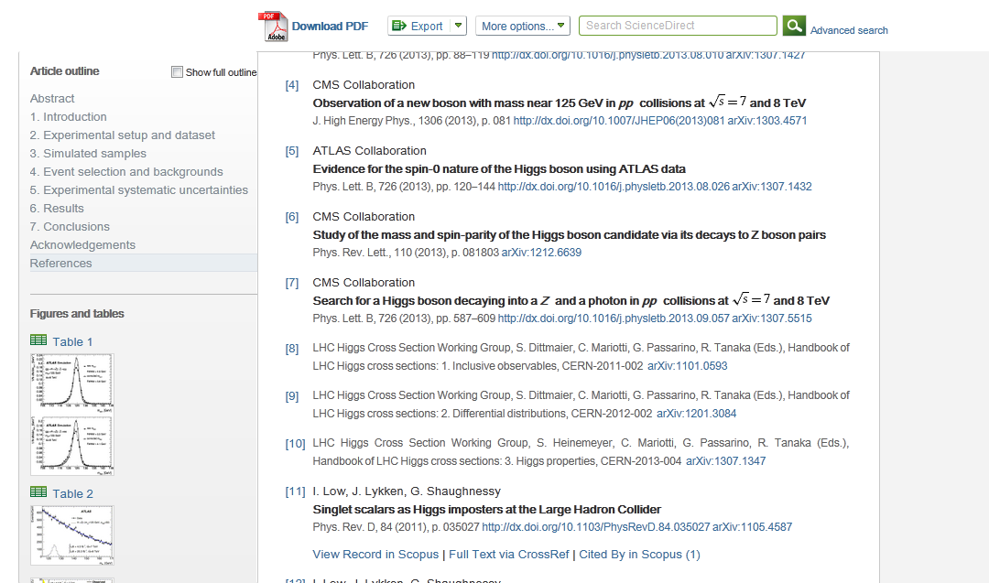
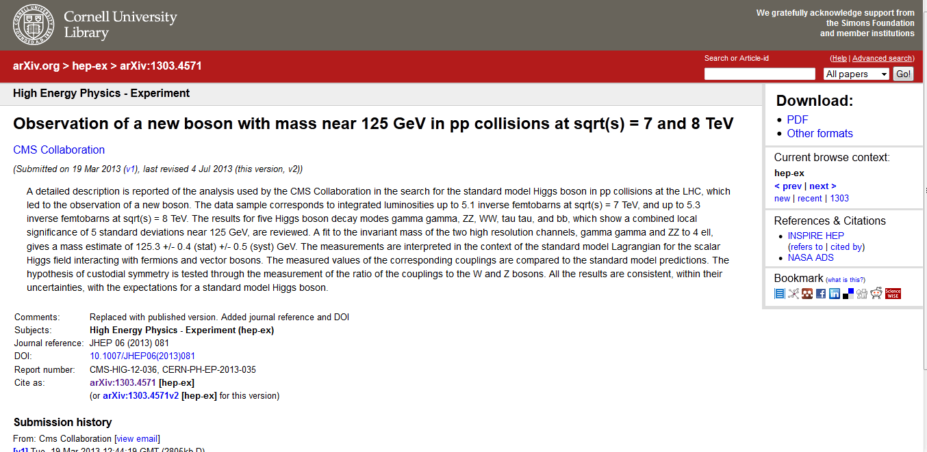

arXiv linking

Slide 7
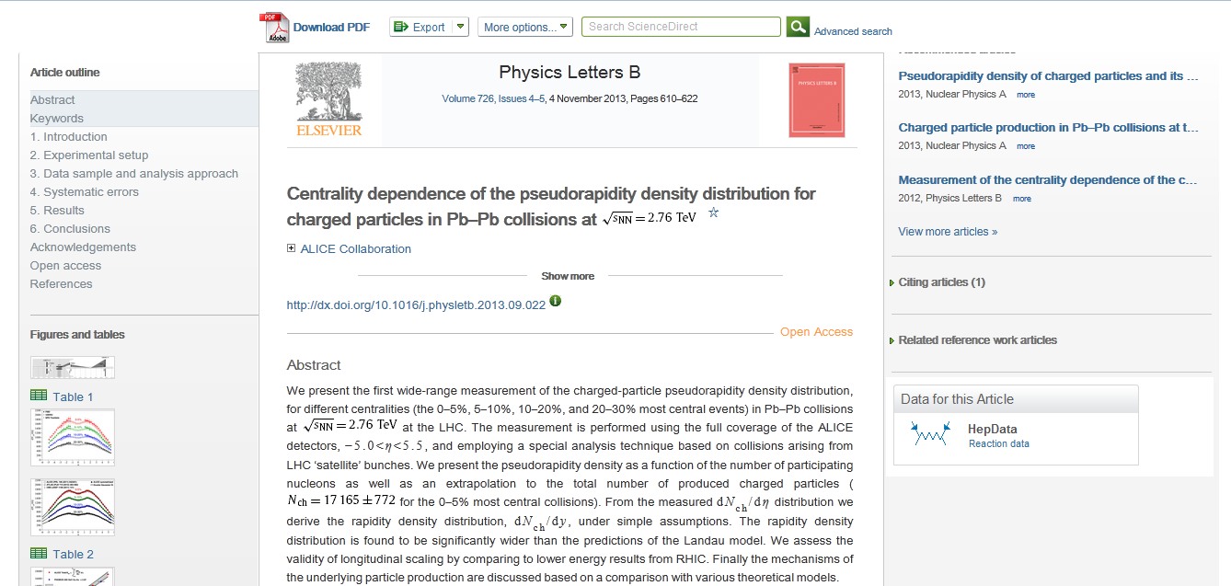
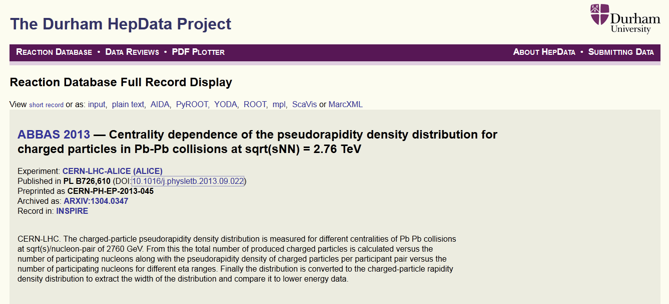
Interlinking Articles and Data through banners
www.sciencedirect.com/science/article/pii/S0370269313007399
Notes:
Note the HepData banner. If you click on it, that’ll take you to the actual data from the article at HepData

Slide 8
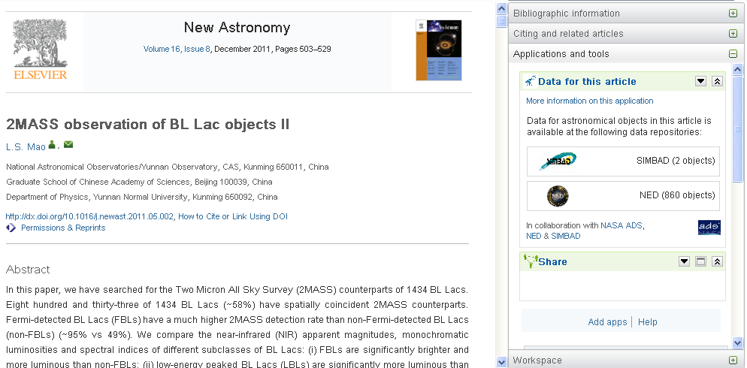
Data-linking in Astronomy – but now pulling data into context
One-click access to relevant primary data
Links to all data available at data repository for this specific article
Developed in collaboration with NASA ADS, SIMBAD & NED

Slide 9
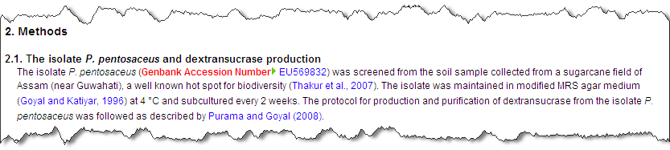
Interlinking Articles and Data through accession numbers
Enabling one-click access to relevant primary data
Author-tagged
Captured in article XML
Linked to data repository from the online article on ScienceDirect
See http://www.elsevier.com/databaselinking
Notes:
Another way in which we link out to data repositories is through accession numbers that the author puts in the manuscript, as in the GenBank Accession Number that is shown here.
These accession numbers are tagged when the article is typeset, and are presented as outgoing links to readers on ScienceDirect. They are also captured and tagged as accession numbers in the article XML for machine consumption.

Slide 10
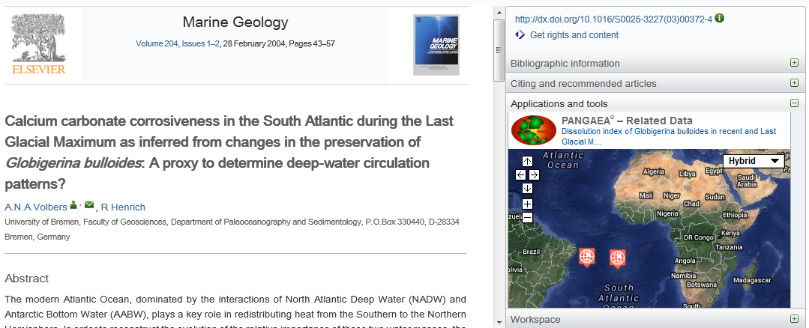
Data-integration brings Articles and Data even closer
Integrating (meta)data into the article page view
See http://www.elsevier.com/databaselinking
Notes:
Taking data linking one step further, we also have the capabilities to build visualization tools on top of data links.
Here’s an example of this kind of tools, namely the PANGAEA viewer that was developed by Uwe Schindler who is also in the room today. This viewer connects to the PANGAEA data repository to get information about data sets that are relevant for this article, and places that on a Google Map. That way readers will very easily get a sense of the data and determine whether or not it’s relevant for them – and if so click on the link to get to the full data record at PANGAEA.

Slide 11
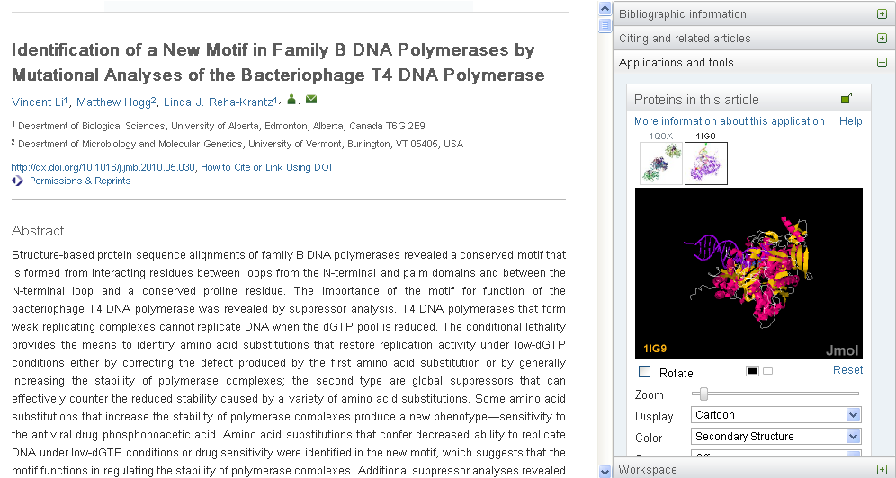
Data-integration brings Articles and Data even closer
Explore protein structures relevant to the article – zoom, rotate, etc.
Structure and other protein data integrated from Protein Data Bank
Author-tagged accession numbers
See http://www.elsevier.com/databaselinking
Notes:
Another example of this kind of data-integration tool is the protein viewer that we’ve built together with the Protein Data Bank. It recognizes protein identifiers that the authors has tagged in the manuscript, and fetches the three-dimensional structural data from the protein data bank web server. These structures are then visualized in the right-hand pane, and made interactive so that the reader can explore the 3-d structure of all the key proteins in the paper by zooming in, rotating, etc.
As with PANGAEA, the full data set is available under a link.

Slide 12
Content Innovations for Supplementary Data
Data viewers built into ScienceDirect
Support for new kinds of data
Inline Supplementary
Material
Interactive Plots
The Executable Paper
Notes:
While in many cases it makes a lot of sense to deposit data at a data repository and link to the article, sometimes authors also submit data with an article – for example if there is no adequate subject-specific data repository or think of a case where the data is just a table that the author wants to include with the paper.
This then speaks to the “Content” side of the Article of the Future, and I’d like to highlight a few ways in which we are improving our support for this kind of material.

Slide 13
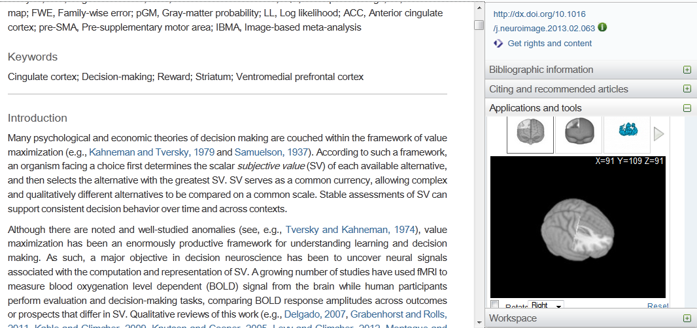
Supplementary Data: 3D Neuroimaging viewer
Exploring 3D data that belongs with the article
Explore figures interactively – zoom, rotate, cut through
Change opacity and color mapping, toggle 2D/3D
Download underlying data to enable validation & re-use
Works with author-provided NIFTI files
See http://www.elsevier.com/about/content-innovation/3d-neuroimaging-data
Notes:
Here you see a 3D viewer for neuroimaging which was recently developed, and that is now available on ScienceDirect. The model is that the author uploads neuroimagery data in the form of NIFTI files, and these are then shown next to the article. The viewer is interactive, so that you can zoom, rotate, even cut through the image to really explore the data that belongs with this article.

Slide 14
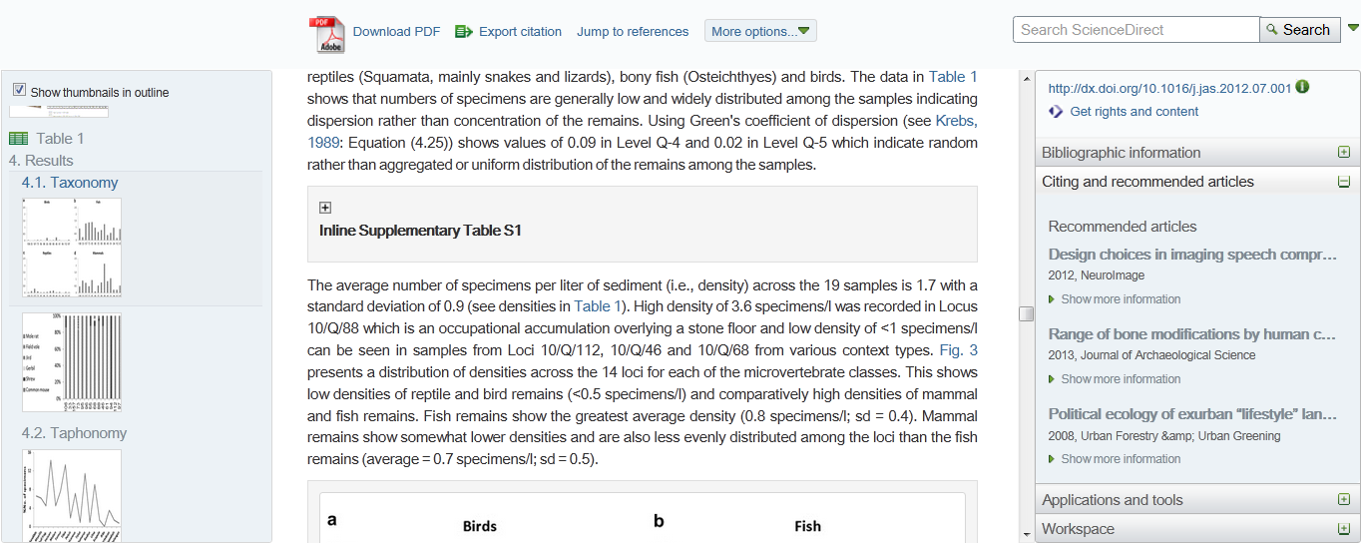
Inline Supplementary Data
Presenting Supplementary Material at the relevant location
Notes:
In another project, we’ve been piloting to place supplementary material inline into the main article so that it’s presented to the reader at the most appropriate location. Initially the reader will see a closed text box,

Slide 15
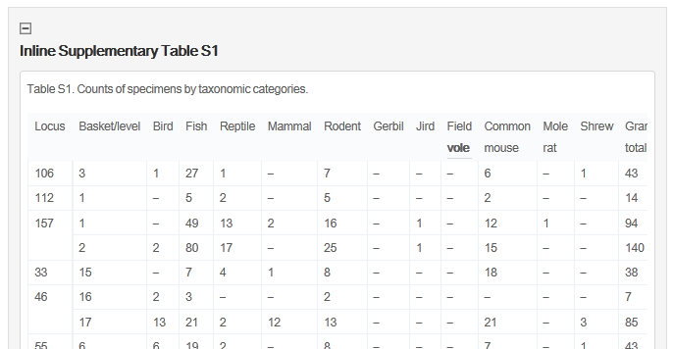
Inline Supplementary Data
Presenting Supplementary Material at the relevant location
Supplementary material inserted at the place of reference/citation
Put material into the right context
Make it easier for readers to find
Initially in closed text-box, action to open
Notes:
Which you can open up to see the data table. So far feedback from readers has been really positive, as it helps them to better find this type of material and place it in the right context.

Slide 16
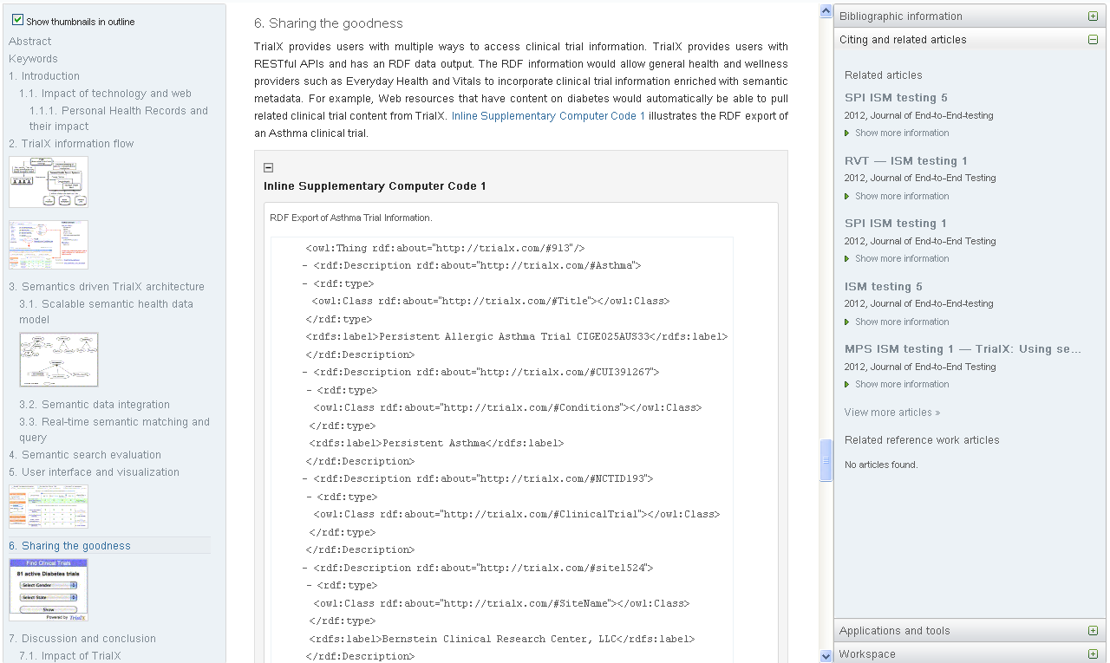
Inline supplementary computer code
In pilot
Present computer code in context in the main article
In expandable box, user can open or close
Code can be copied to the clipboard for validation & re-use
http://www.elsevier.com/ism

Slide 17
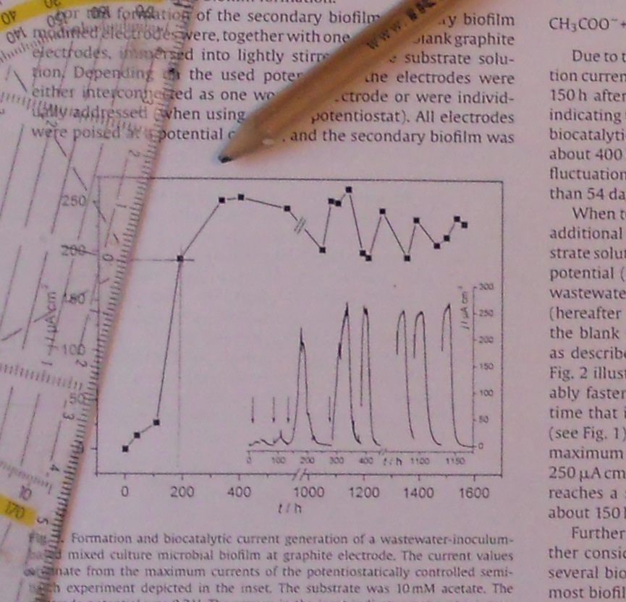
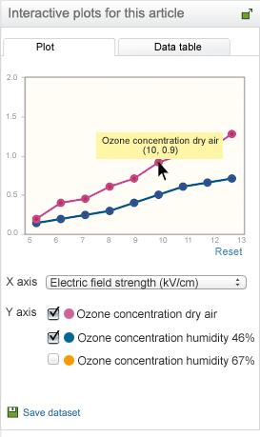
Interactive plots
Allow readers to access data that used to be “buried” in plots
Interactive visualization capabilities
  Data cursor
  Switch between plot and table view
Download data
Works with .CSV files, easily
exported from any scientific software
No more printing
out figures to
reconstruct data
points by hand!
See http://www.elsevier.com/iplots

Slide 18

Executable Papers marry Articles, Data, and Code
Improving the reproducibility of research
See http://www.elsevier.com/physical-sciences/computer-science/executable-papers
Notes:
I’ll almost stop talking now, but there is one more thing I wanted to show: a short video on the Executable Papers that we’ve recently published on ScienceDirect. This moves beyond data, and is a way to really capture data, code, and the full methodology by which researchers arrive at conclusions from their data. I hope that it may inspire you as perhaps a future challenge that’s on the horizon.

Slide 19
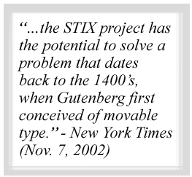
STIX fonts & MathJax: Math typography in print and on the web
Mission: to create a comprehensive set of math fonts
that serve the scientific and engineering community
Unicode based
Applicable to both print + online
Collaboration between AIP, ACS, AMS, IEEE, APS,
and Elsevier
Status:
  STIX fonts 1.1.0 released as OpenType OTF fonts
  ~300 downloads/week
  LaTeX version released in 2012
http://www.stixfonts.org/

Slide 20
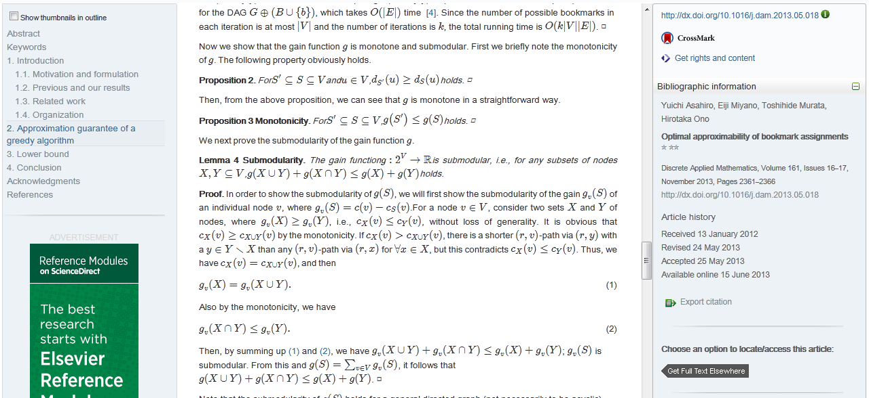
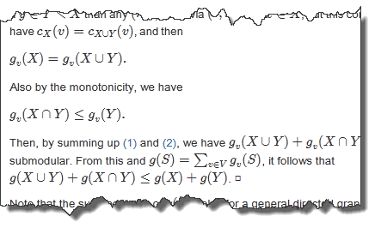

MathJax
High-quality online display of mathematical symbols & equations

Slide 21
The 2007 “Brussels Declaration”
Raw research data should be made freely available to all researchers. Publishers encourage the public posting of the raw data outputs of research. Sets or sub-sets of data that are submitted with a paper to a journal should wherever possible be made freely accessible to other scholars
http://www.stm-assoc.org/brussels-declaration/

