Slide 1

Astronomy Image Explorer
Kerry Kroffe
April 3, 2014

Slide 2

IOP Update
eBooks
  Full text HTML
  DRM free book/chapter download, multiple formats
Article Evolution for AAS Backfile (2008/9 -> 2012)
Hybrid OA
SCOAP3
Transition to ScholarOne
Free access to content in UK libraries
Astronomy Image Explorer

Slide 3
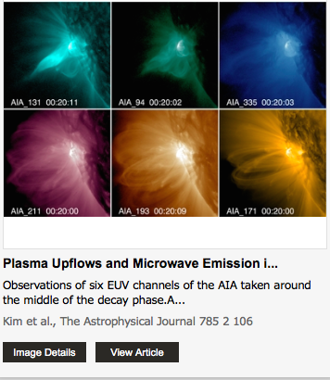
Overview
AIE
Background
Architecture
Development
Usage
Future plans

Slide 4
Background
AAS conceived the application after seeing a similar OSA product in 2012
Focus on service to the community, not revenue
Opportunity to experiment with cloud approach and new technologies
Create a product that was publisher independent and useful for the entire community
An application that was lightweight/easy to maintain
Could be extended to other journals in the field

Slide 5
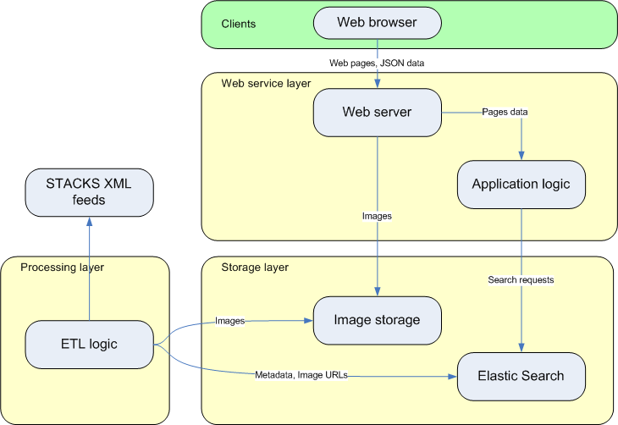
Architecture
Data driven by STACKS
Amazon EC2
Amazon S3
Elastic Search
Cloud Front CDN
Google Analytics

Slide 6
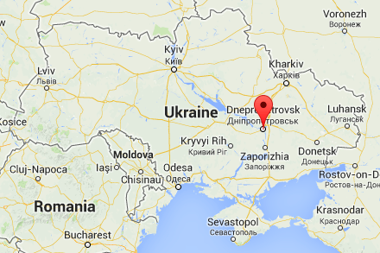
Development
Developed requirements with AAS
Created RFP/ITT
Awarded contract to Luxoft, based in Dnepropetrovsk, Ukraine
Phase 1 required 2 months of development
Rolled out Q4 2013

Slide 7
Usage
Resource for scholars to quickly discover and reuse images:
  figure captions
  paragraphs with reference calls
  abstract
  title
  author
Or to navigate specifically by J/V/P or DOI
Link back to full text or download products (PPT files, hi-res)

Slide 8
Future Plans
Improved search
Incorporation of UAT and semantic relatedness
Addition of Figure Set and DbF discovery services
Legacy content
MathJax
Image widget
Personal library
Improved video handling

Slide 9
Demo
Live (http://astroexplorer.org)
Test server (link)

Slide 10
Thanks!
Kerry Kroffe
kerry.kroffe@iop.org
@kerrykroffe

