Slide 1
APS Taxonomy Project
Arthur Smith, American Physical Society
April 2014

Slide 2
History (APS subjects perspective)
1965 – “Analytic Subject Index”, PRL reorder
1970 – Phys Rev split into A-D
1975 – PACS (from ICSU, AIP, IEE + others)
1977 – revised PACS, internal database
1997+ – journals go online, indexes obsolete?
2010 – last PACS update from AIP
2011 – PRX topical browsing, not PACS

Slide 3
Project Timeline
Initiated in early 2013
  Discussions with APS stakeholders
  No consensus on data structure, organization
  Significant software development needed
November 2013: consultant engaged
  Taxonomy Strategies (Washington DC)
By March 2014: some decisions on structure, software:
  Facets rather than single hierarchy
  SKOS/RDF
  Acquired PoolParty server to create and manage

Slide 4
Taxonomy project goals
  new capability for topical browsing of online journals, expanding the limited interface used now for some APS journals.
  Easy to use for authors to index their submitted journal articles.
  PACS mappable.
  Assists editorial workflow, e.g., assigning articles to journal sections or particular editors, finding referees with the right expertise, etc.
  Applicable to all APS content, e.g., meeting sessions and legacy content.

Slide 5
SKOS/RDF
Several standard approaches to taxonomy/thesaurus creation:
  ISO Thesaurus standard (see ISO 25964, 2012/2013)
  SKOS (“Simple Knowledge Organization System”)
    http://www.w3.org/2004/02/skos/
SKOS based on W3C “Resource Description Framework” (RDF) standard, compatible with “Linked Data”
Basic components of SKOS:
  “concept” = “unit of thought”, identified by a URL, given preferred and alternate “labels”
  “label” = string representing concept in a given language (term)
  “relationships” = links between “concepts”. Hierarchy (broader/narrower), simple associations, or across concept schemes (“match” relationships)
  “concept scheme” = grouping of concepts into a vocabulary/taxonomy (labels should be unique within a given concept scheme)
SKOS is extensible through RDF to add custom properties and relationships
Notes:
SKOS – “simple” but powerful – for example the same concept (identified by URI) can have multiple broader (parent) concepts or be in multiple concept schemes, meaning the same thing. Many major organizations using SKOS or extensions based on SKOS to publish their classification or thesaurus data: Library of Congress, DBPedia categories, UN Food and Agriculture Org, Getty Library (Art and Architecture Thesaurus).

Slide 6
Indexing articles with SKOS
Example:
<http://dx.doi.org/10.1103/PhysRevD.89.072001> dcterms:subject <http://link.aps.org/cs/APSTaxonomy/top_quark> .
We may allow more detailed indexing using existing vocabularies (HEP ontology?):
<http://dx.doi.org/10.1103/PhysRevD.89.072001> dcterms:subject <http://cern.ch/thesauri/HEPontology.rdf#Fermilab> .

Slide 7
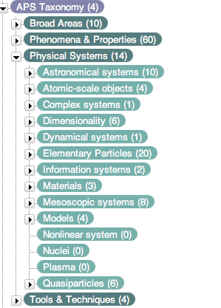
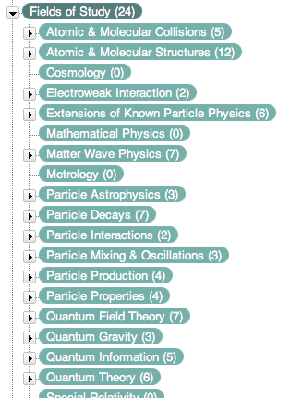
What does it look like (early draft)?

Slide 8
What’s next?
Finalize organization and rules for completion
Work with physicists (mostly editors) to fill out and reconcile the facets
User interfaces for browsing, adding terms, editorial assignment
Publish taxonomy as linked data and use it – expected later this year.

Slide 9
Questions
  Arthur Smith, Lead Data Analyst, APS Journal Information Systems, apsmith@aps.org
  Joseph A Busch, Principal, Taxonomy Strategies, jbusch@taxonomystrategies.com

