Slide 1
Update on LHC observations in LSS and simulation studies
C. Octavio Domínguez
Thanks to
G. Iadarola, G. Rumolo and F. Zimmermann
22 July 2013 - e⁻ cloud meeting

Slide 2

Outline
Pressure rise observations with 25 and 50 ns beams
Bunch intensity thresholds for 50 ns
Behavior during pre-ramp and energy ramp
Interpretation using PyECLOUD simulations
Conclusions
22 July 2013 - e⁻ cloud meeting

Slide 3
Outline
Pressure rise observations with 25 and 50 ns beams
Bunch intensity thresholds for 50 ns
Behavior during pre-ramp and energy ramp
Interpretation using PyECLOUD simulations
Conclusions
22 July 2013 - e⁻ cloud meeting

Slide 4
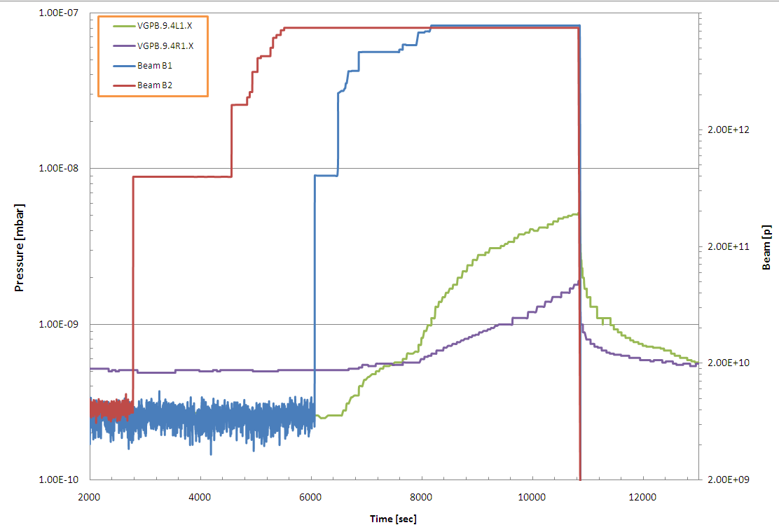
ΔP with 25 and 50 ns
Pressure rises were the first ECE observed in the LHC with 150 and 75 ns
150 ns - 450 GeV
Beam 2
Beam 1
No pressure increase
Pressure increase
G. Bregliozzi
22 July 2013 - e⁻ cloud meeting

Slide 5
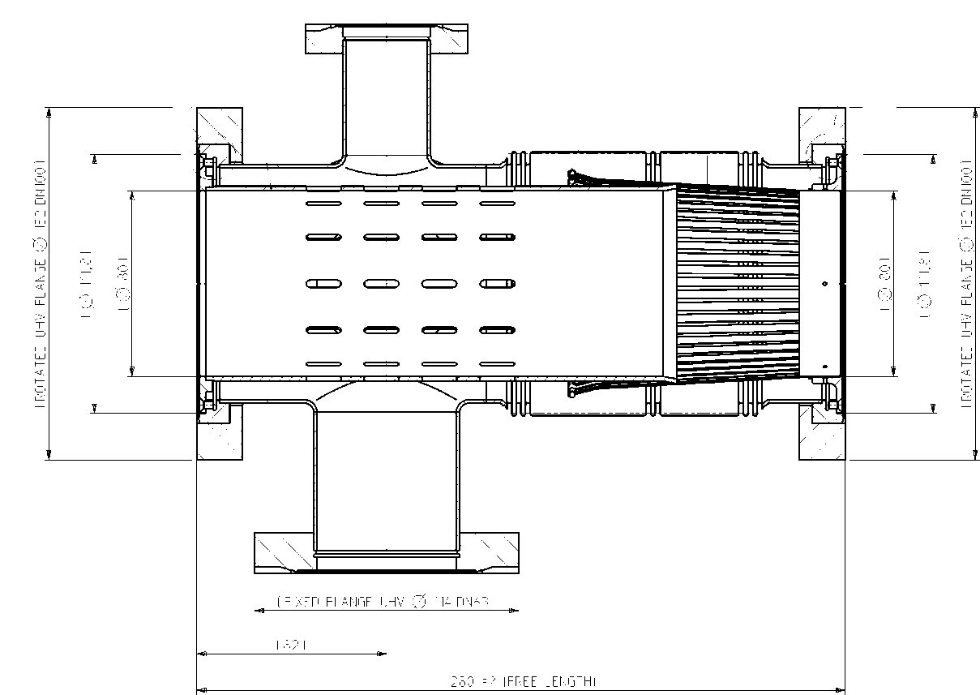
ΔP with 25 and 50 ns
Pressure rises were the first ECE observed in the LHC with 150 and 75 ns
I focused on pressure gauges located in warm-warm transitions (VGI type):
They are more accurate than other types of gauge in the machine
They are all located in the same type of module (with simple geometry)
Ø 80 mm
StSt – Cu coated
22 July 2013 - e⁻ cloud meeting

Slide 6
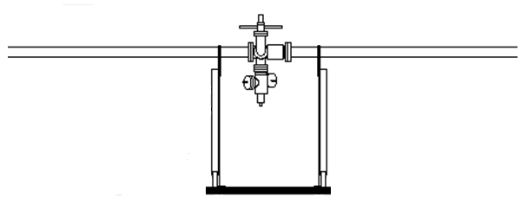
ΔP with 25 and 50 ns
Pressure rises were the first ECE observed in the LHC with 150 and 75 ns
I focused on pressure gauges located in warm-warm transitions (VGI type):
They are more accurate than other types of gauge in the machine
They are all located in the same type of module (with simple geometry)
These modules are located between two 7 m NEG-coated beam pipes
There are few exceptions where one side is shorter
> 7 m NEG coating
> 7 m NEG coating
There are 173 gauges of this type around the ring (easier comparison and extrapolation)
I’ll focus here on beam 1 (68 guages), although conclusions are equivalent for both beams.
SEY estimated by the vacuum colleagues: ~ 1.6 – 1.9 [1]
22 July 2013 - e⁻ cloud meeting

Slide 7
ΔP with 25 and 50 ns
I base my observations on 50 ns on 6 fills:
  2124: 19 September 2011 (before MDs with 25 ns)
  2240: 22 October 2011 (between 14 October MD and 24
  October MD)
  2261: 27 October 2011 (after 25 ns MDs)
  N_{b}≈1.37e11 ppb for all three
  2736: 16 June 2012 (N_{b}≈1.47e11 ppb)
  3000: 24 August 2012 (N_{b}≈1.52e11 ppb)
  3286: 14 November 2012 (N_{b}≈1.65e11 ppb)
  Three random long physics fills during 2012 operation
  I’ll show some observations of 25 ns for the 24/10/11 MD
22 July 2013 - e⁻ cloud meeting

Slide 8
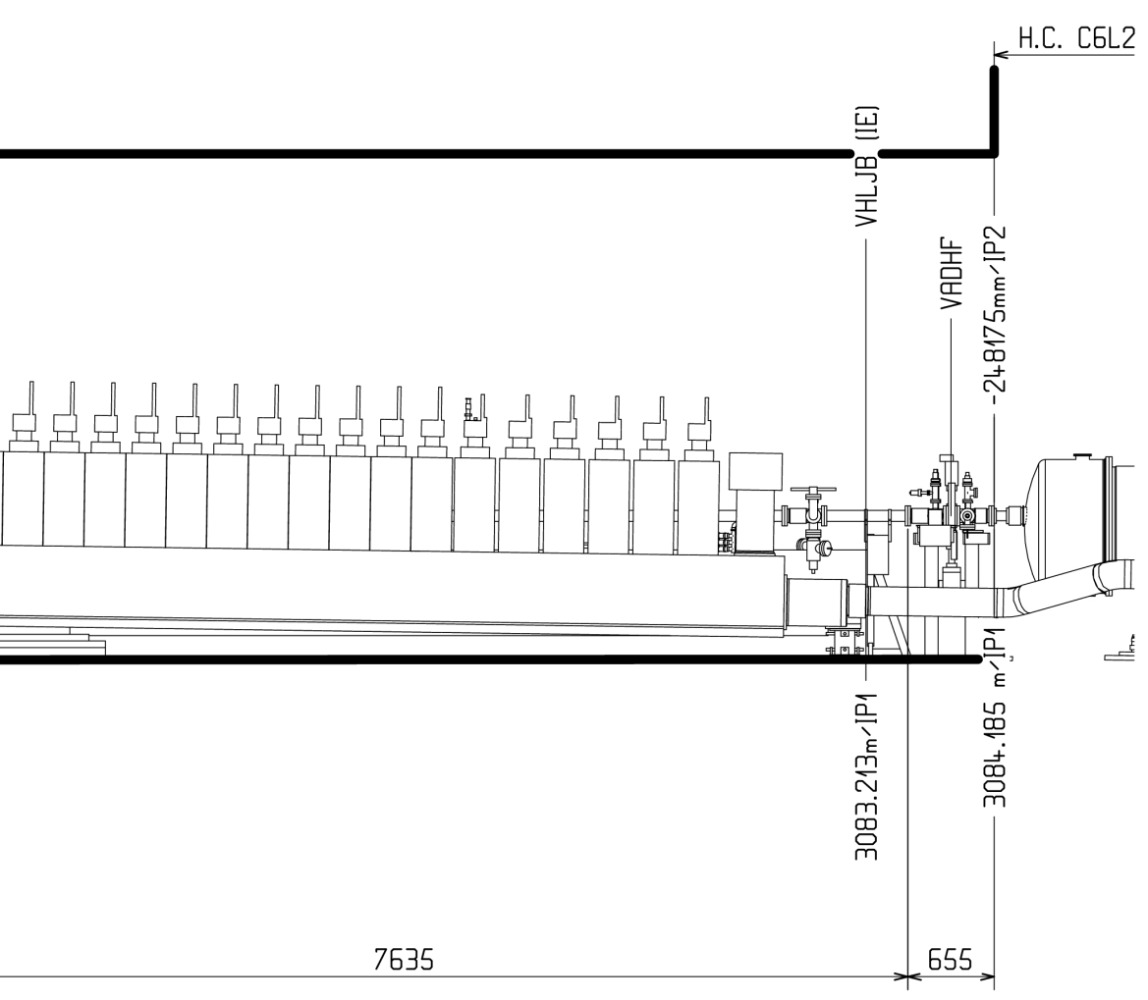
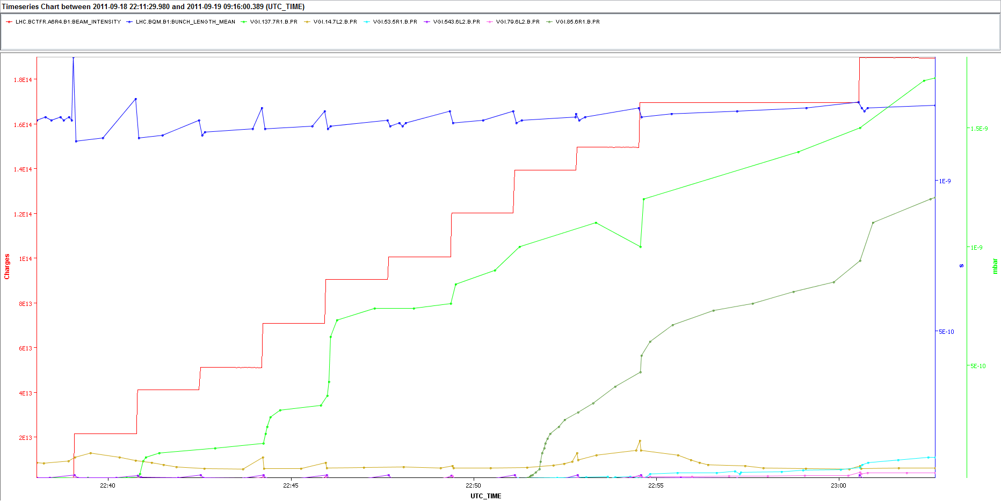
ΔP with 25 and 50 ns - Injection
Sector 1-2
Fill 2124
Quite stable σ_{z}
ΔP after 2nd injection
Too close to the cryocell.
More difficult comparison.
I discarded it.
ΔP after 8th injection
22 July 2013 - e⁻ cloud meeting

Slide 9
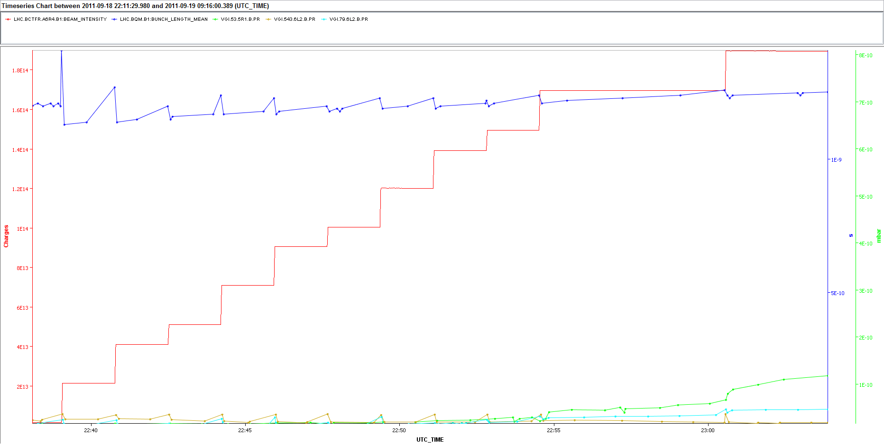
ΔP with 25 and 50 ns - Injection
Sector 1-2
Fill 2124
Small ΔP after 10th injection
No visible ΔP
We observe different behaviors → Different conditioning states?
22 July 2013 - e⁻ cloud meeting

Slide 10
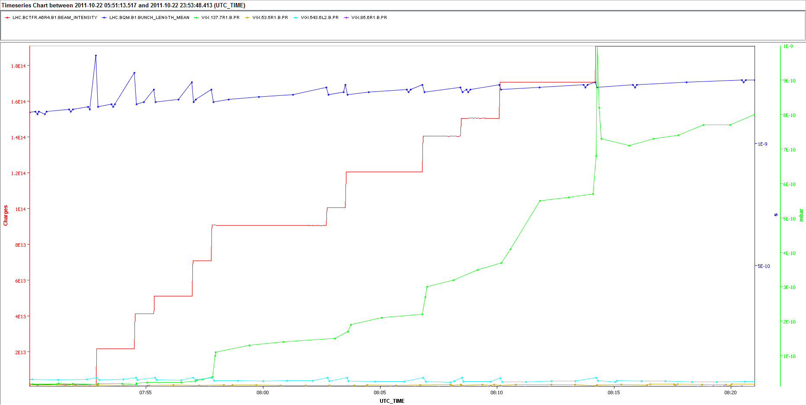
ΔP with 25 and 50 ns - Injection
Sector 1-2
Fill 2240
ΔP after 5th injection
No ΔP for the rest of the gauges
There is a visible conditioning effect after the MD on 14 October with 25 ns
22 July 2013 - e⁻ cloud meeting

Slide 11
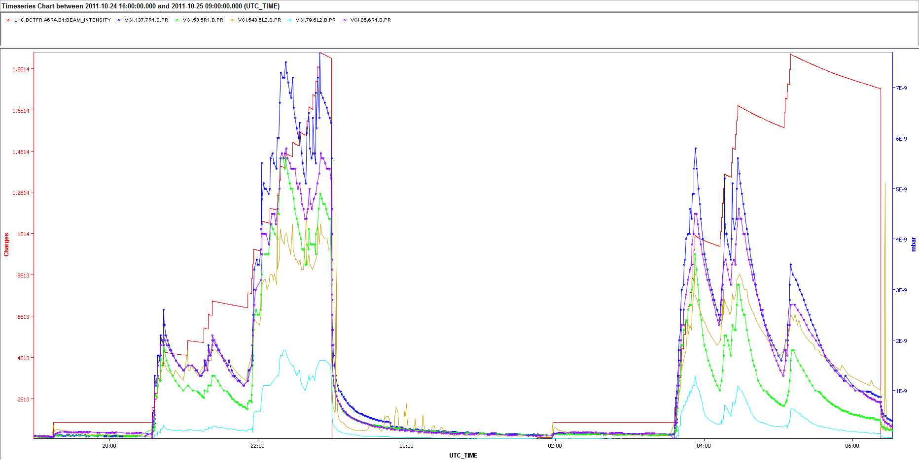
ΔP with 25 and 50 ns - Injection
Sector 1-2
MD 24 October 2011 – 25 ns
With 25 ns we observe ΔP in all the gauges
22 July 2013 - e⁻ cloud meeting

Slide 12
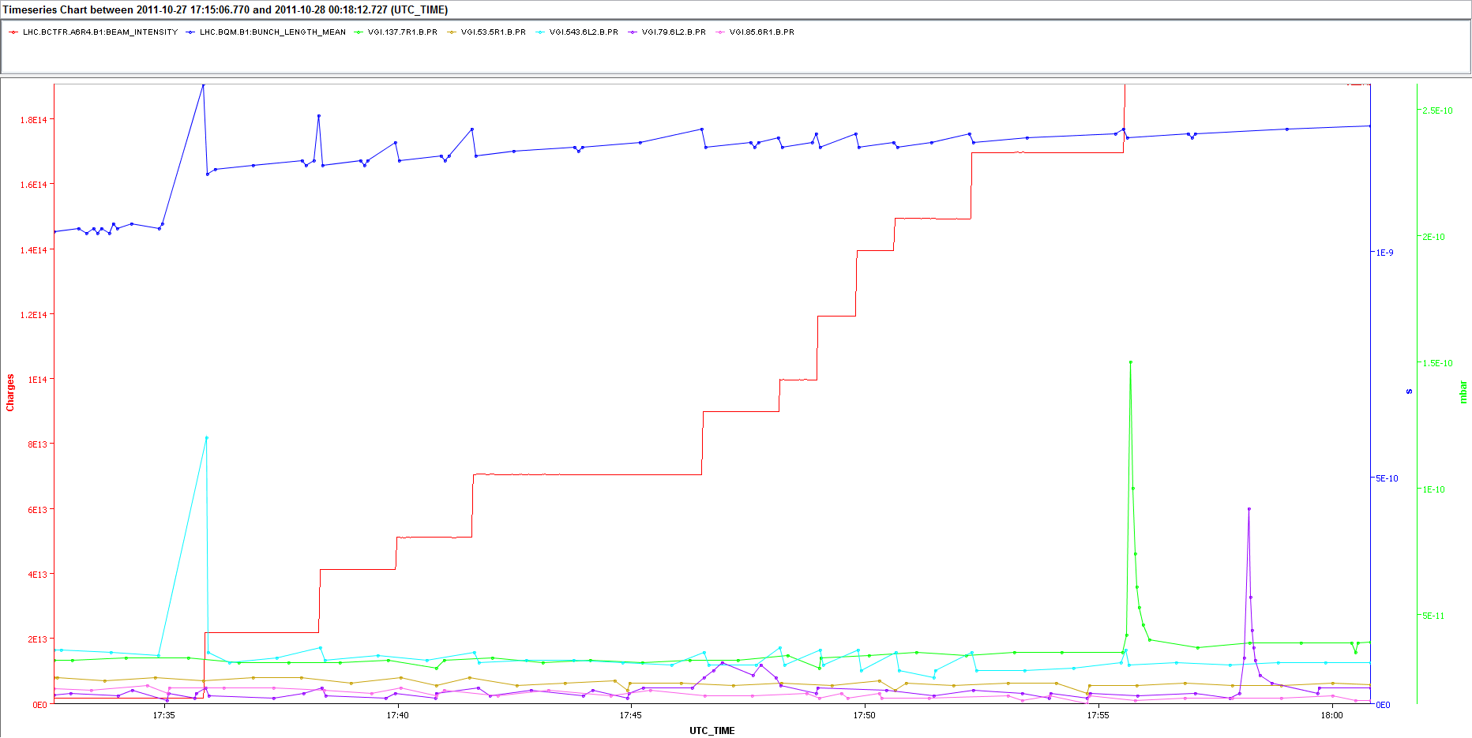
ΔP with 25 and 50 ns - Injection
Sector 1-2
Fill 2261
No e-cloud related ΔP observed in any of the gauges → Clear improvement after conditioning
22 July 2013 - e⁻ cloud meeting

Slide 13
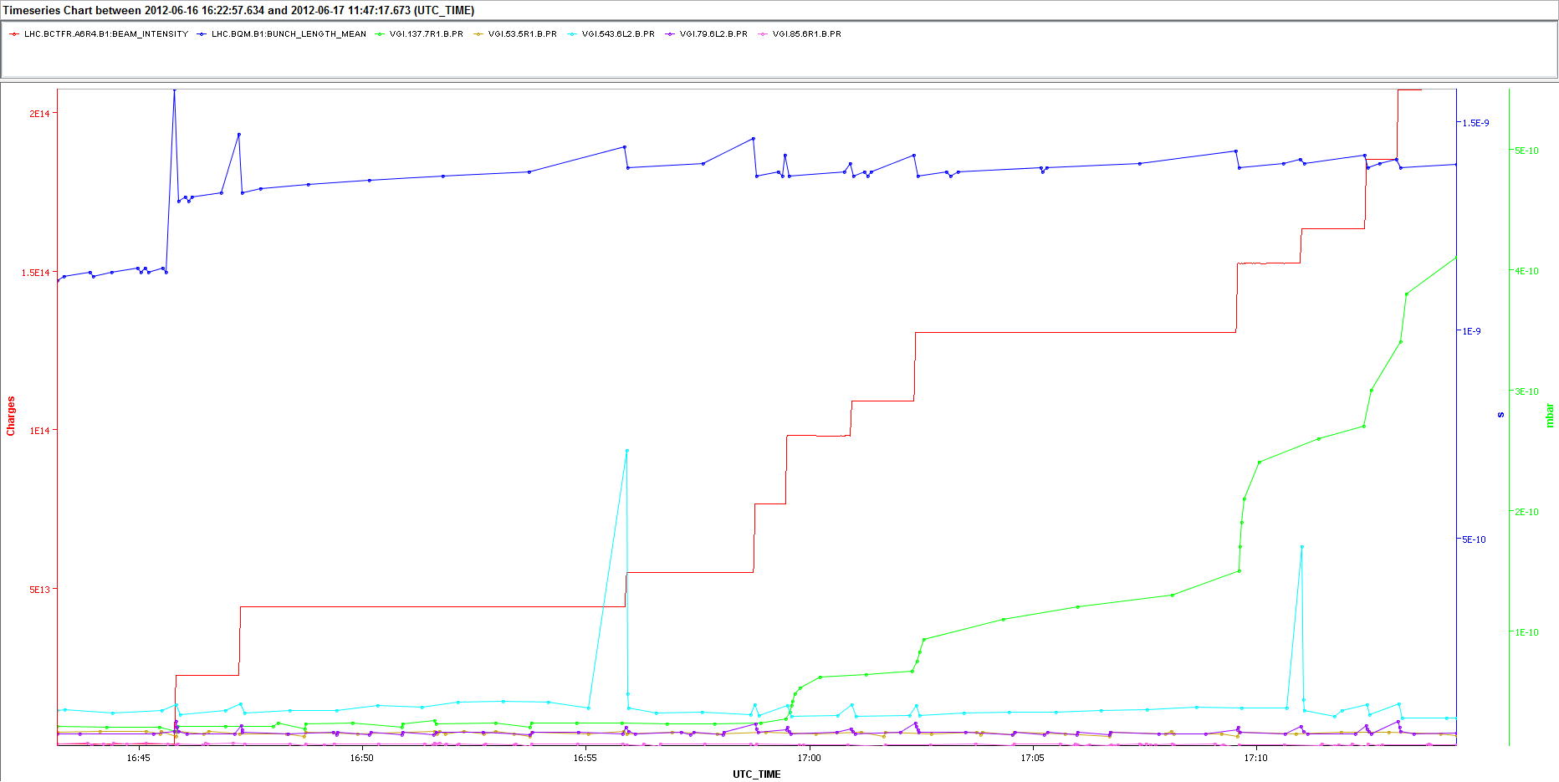
ΔP with 25 and 50 ns - Injection
Sector 1-2
Fill 2736
ΔP after 5th injection
Nb≈1.47∙10¹¹ ppb, but looking at the thresholds it seems that some deconditioning took place in gauge VGI.137.7R1.B
22 July 2013 - e⁻ cloud meeting

Slide 14
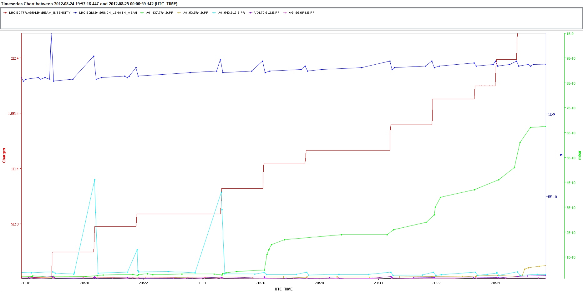
ΔP with 25 and 50 ns - Injection
Sector 1-2
Fill 3000
ΔP after 4th injection
ΔP after last injection
Nb≈1.52∙10¹¹ ppb, ΔP_{Fill3000}> ΔP_{Fill2736} → some deconditioning without 25 ns beams?
22 July 2013 - e⁻ cloud meeting

Slide 15
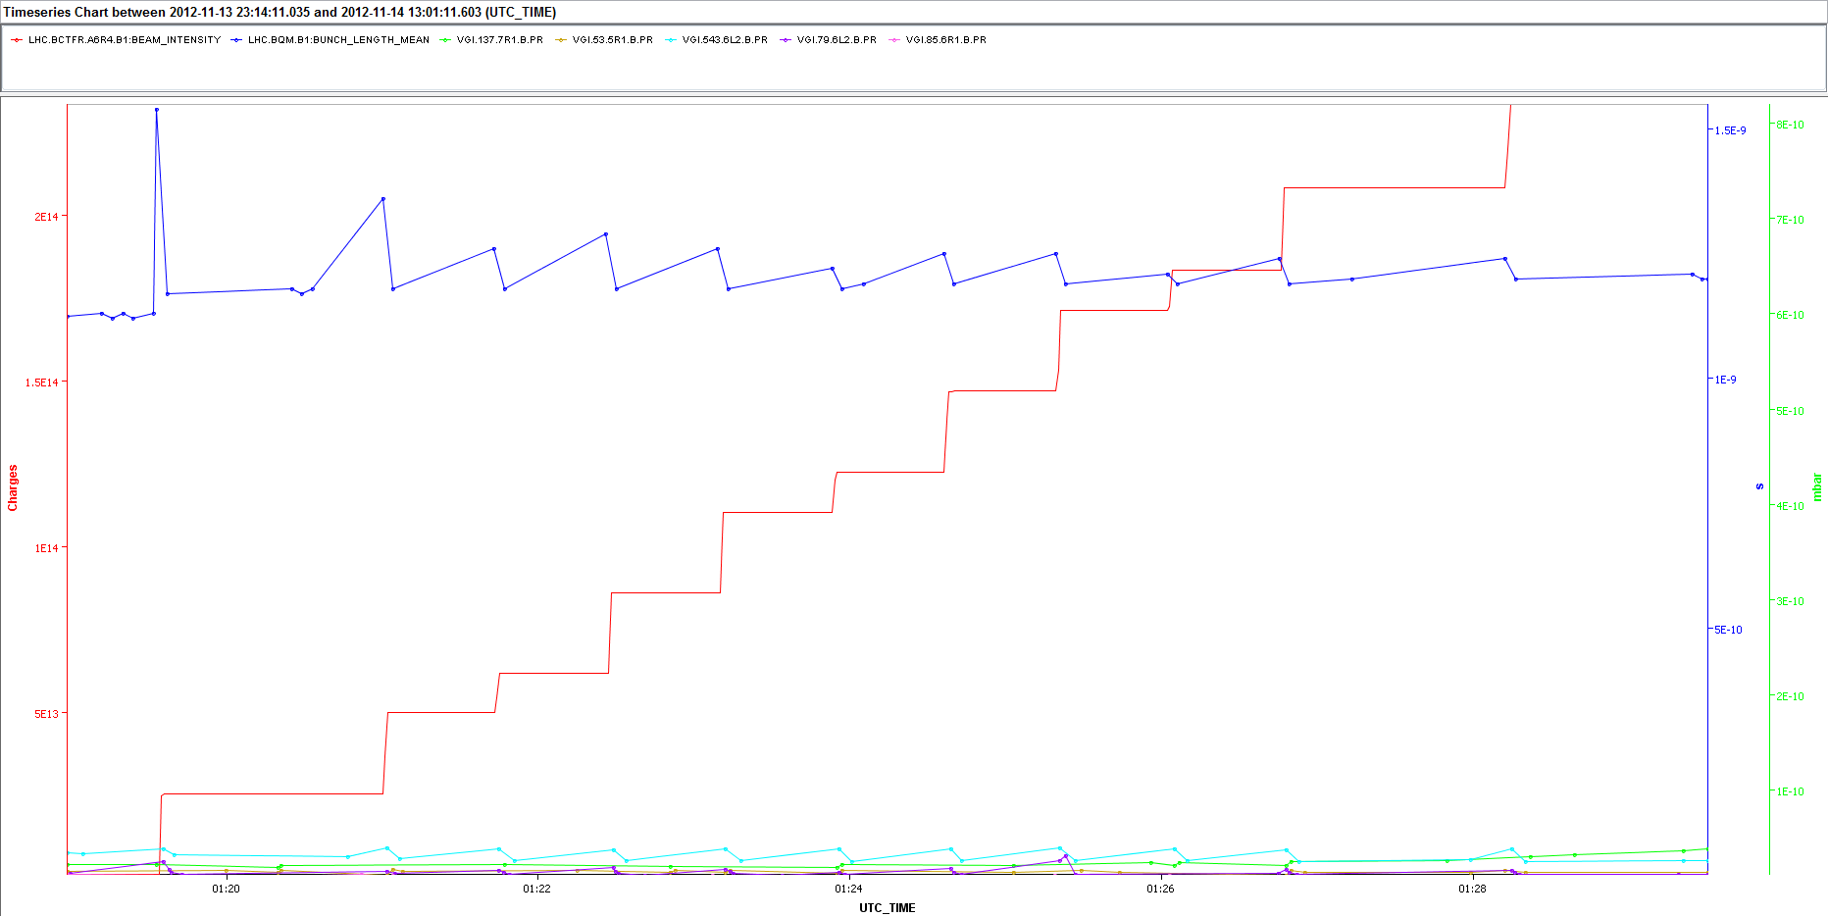
ΔP with 25 and 50 ns - Injection
Sector 1-2
Fill 3286
Nb≈1.65∙10¹¹ ppb. It has a higher threshold. All gauges must be below this threshold
22 July 2013 - e⁻ cloud meeting

Slide 16
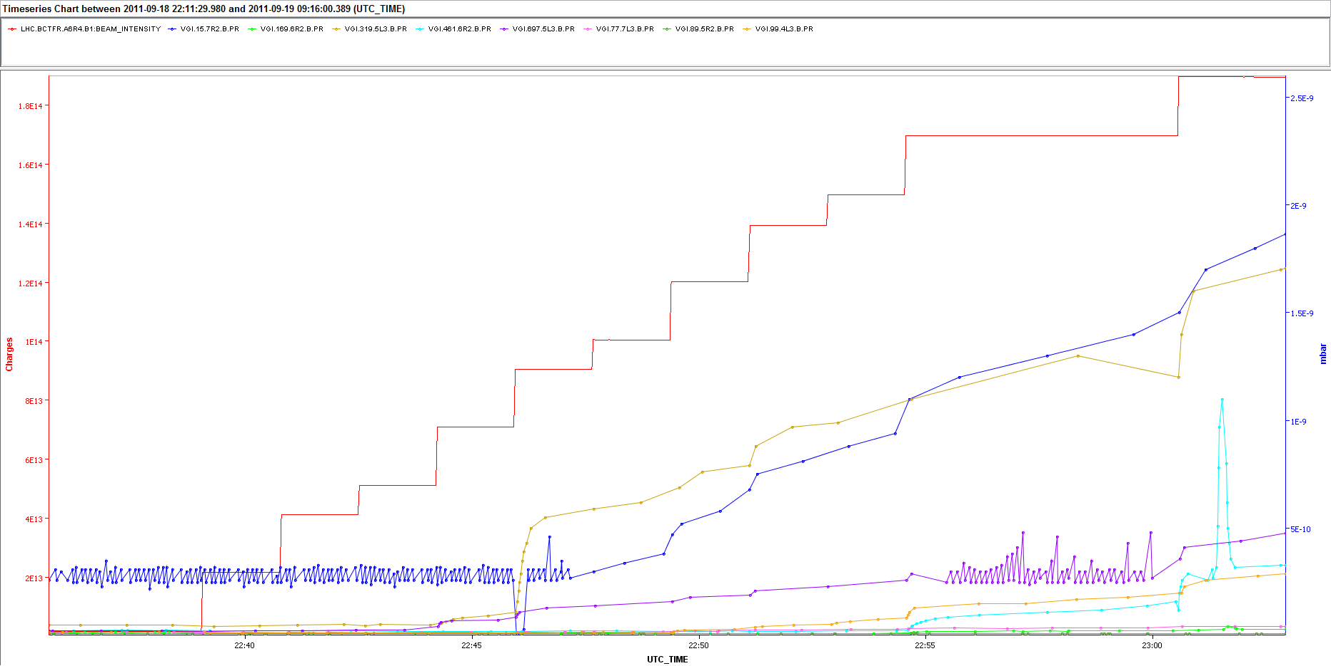
ΔP with 25 and 50 ns - Injection
Sector 2-3
Fill 2124
Similar behavior as in sector 1-2
22 July 2013 - e⁻ cloud meeting

Slide 17
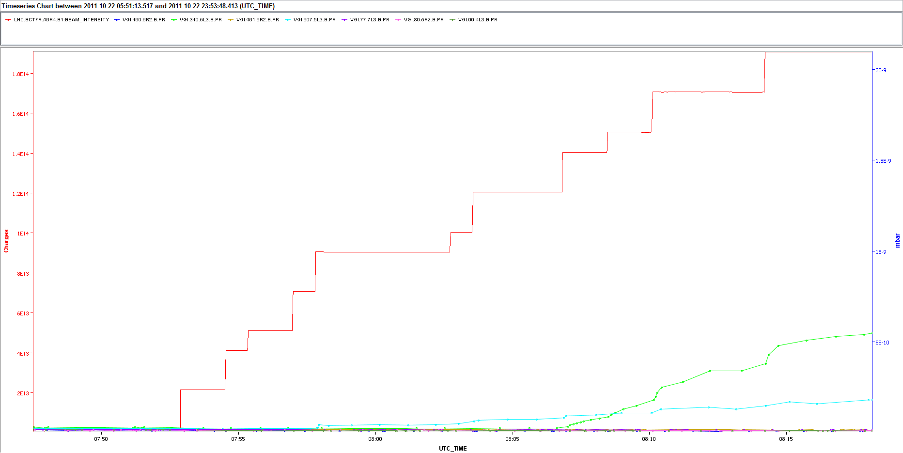
ΔP with 25 and 50 ns - Injection
Sector 2-3
Fill 2240
Similar behavior as in sector 1-2 (some conditioning observed after MD with 25 ns)
22 July 2013 - e⁻ cloud meeting

Slide 18
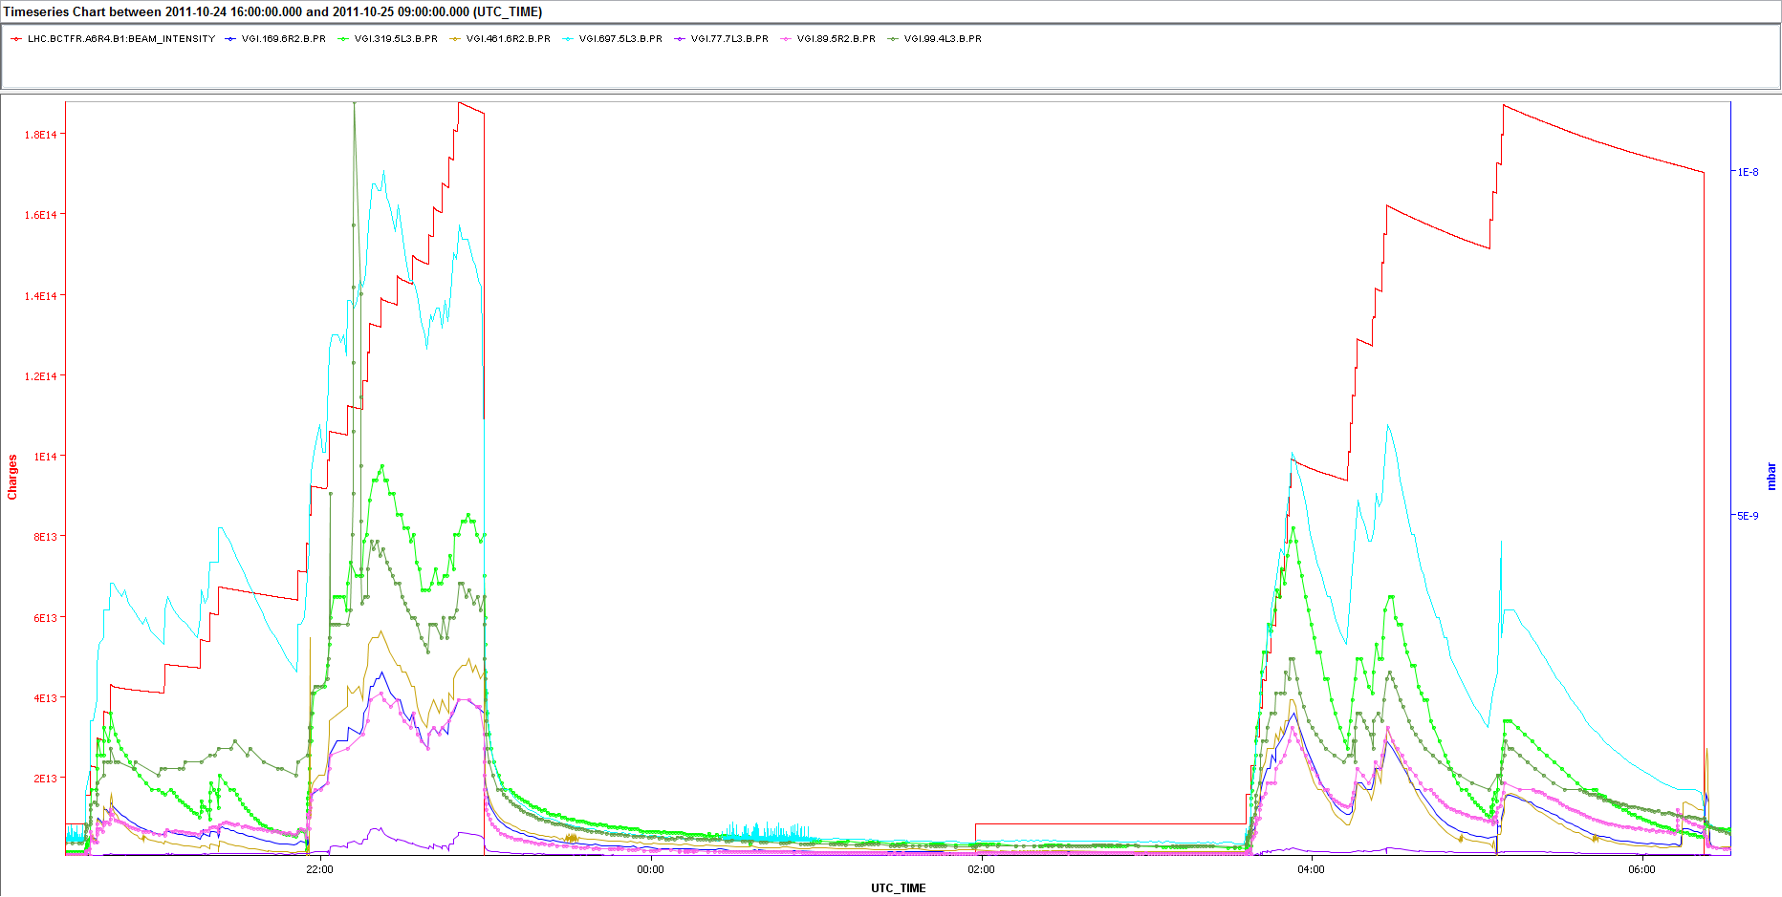
ΔP with 25 and 50 ns - Injection
Sector 2-3
MD 24 October 2011 – 25 ns
Again, with 25 ns we observe ΔP in all the gauges
22 July 2013 - e⁻ cloud meeting

Slide 19
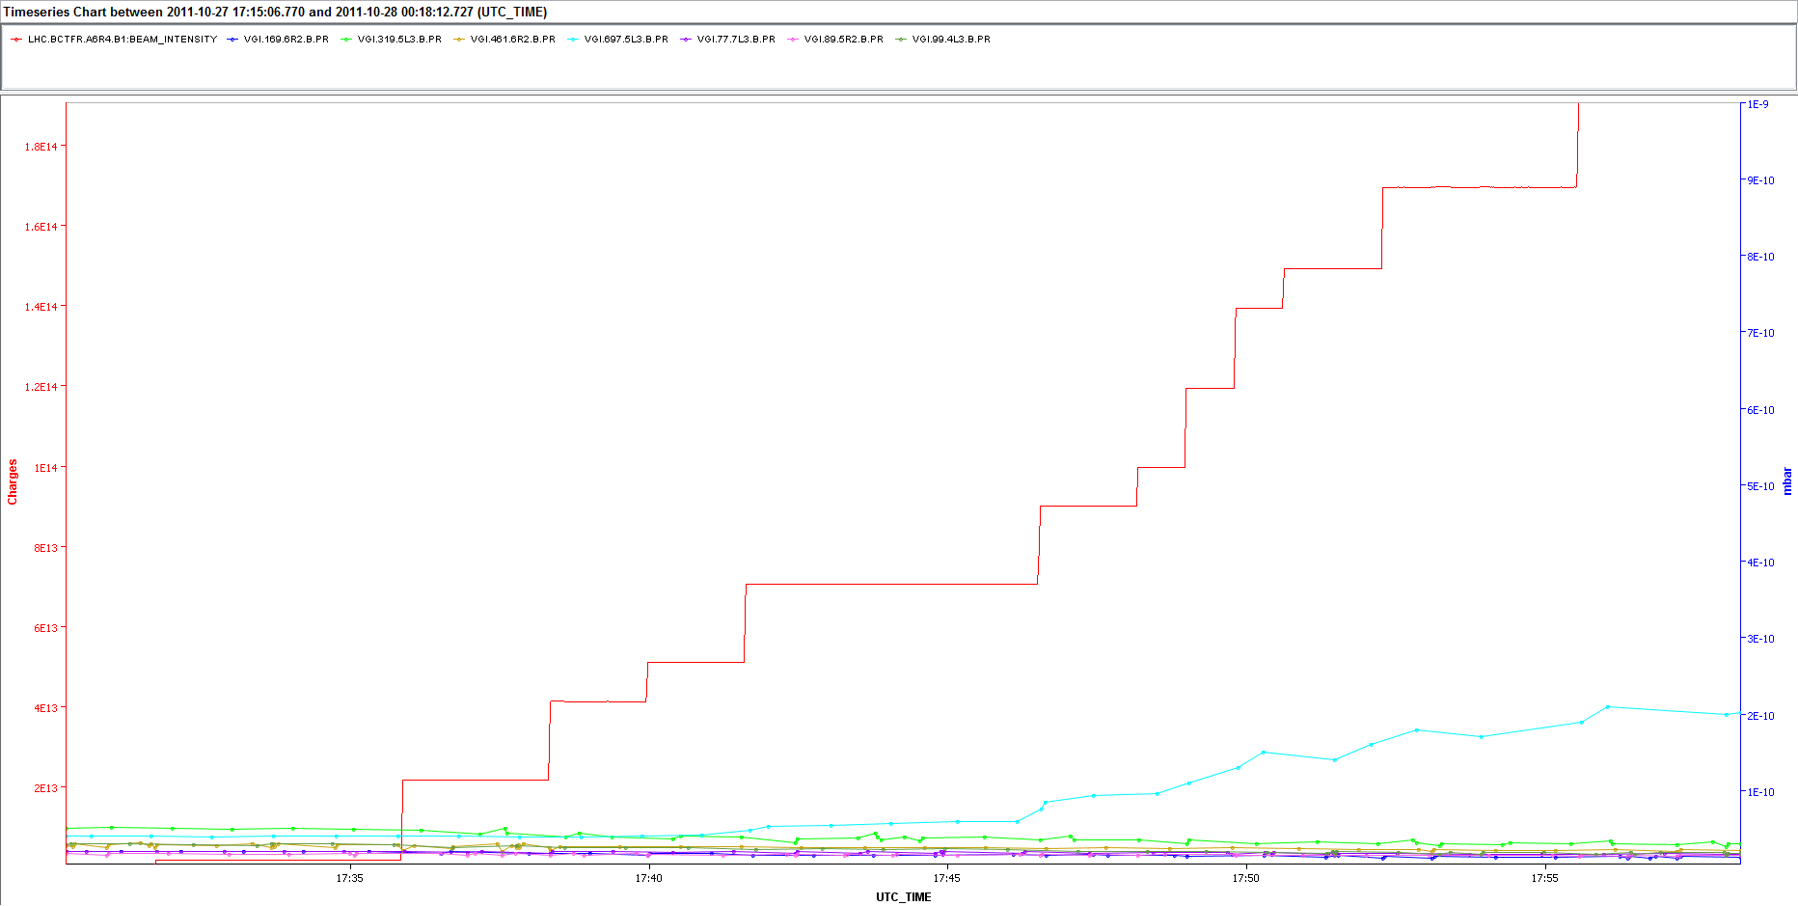
ΔP with 25 and 50 ns - Injection
Sector 2-3
Fill 2261
Again, conditioning observed after MDs with 25 ns.
Not enough to condition gauge VGI.697.5L3.B below the 50 ns threshold
22 July 2013 - e⁻ cloud meeting

Slide 20
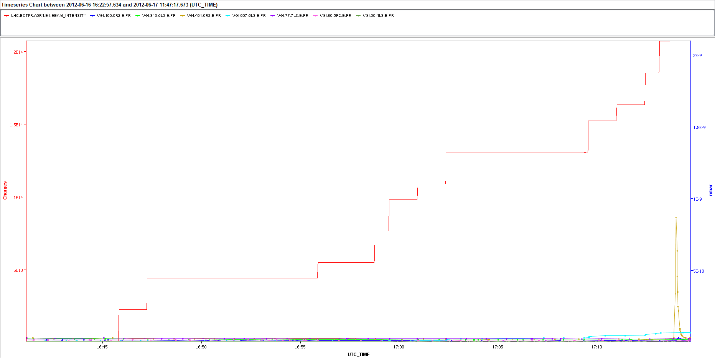
ΔP with 25 and 50 ns - Injection
Sector 2-3
Fill 2736
ΔP after 8th injection
Gauge VGI.697.5L3.B looks better conditioned than before!
22 July 2013 - e⁻ cloud meeting

Slide 21
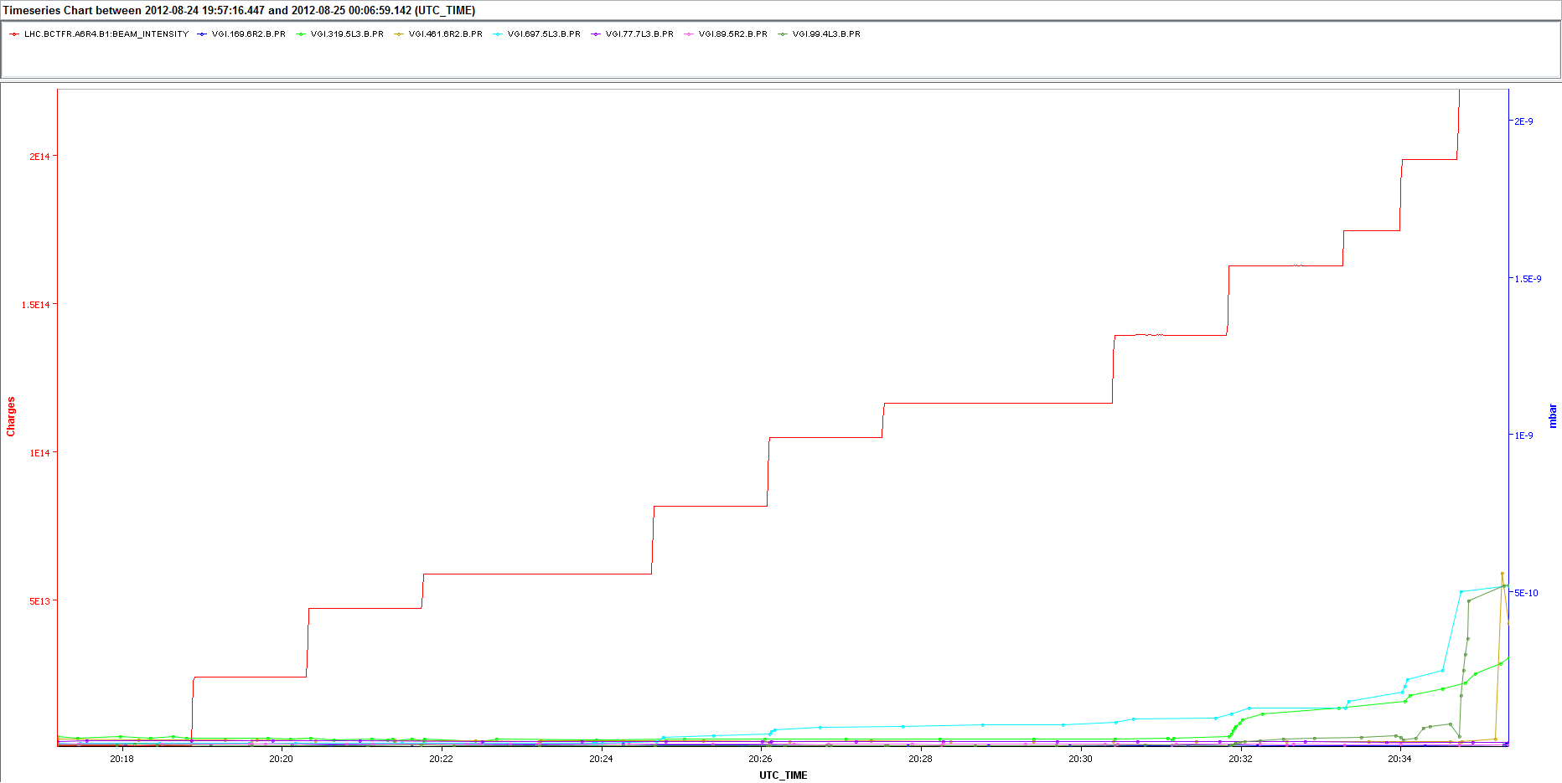
ΔP with 25 and 50 ns - Injection
Sector 2-3
Fill 3000
Nb≈1.52∙10¹¹ ppb, ΔP_{Fill3000}> ΔP_{Fill2736} → some deconditioning without 25 ns beams?
22 July 2013 - e⁻ cloud meeting

Slide 22
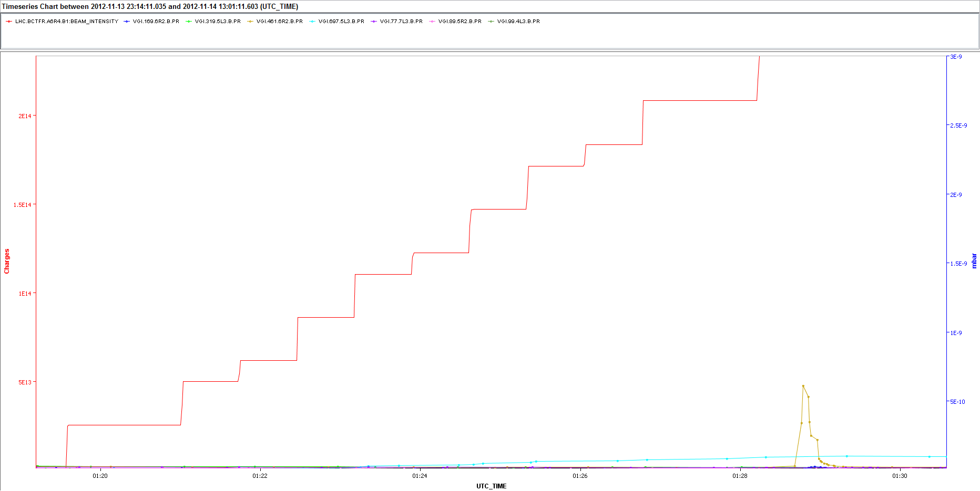
ΔP with 25 and 50 ns - Injection
Sector 2-3
Fill 3286
Nb≈1.65∙10¹¹ ppb. It has a higher threshold. Still some ΔP visible for VGI.697.5L3.B
22 July 2013 - e⁻ cloud meeting

Slide 23
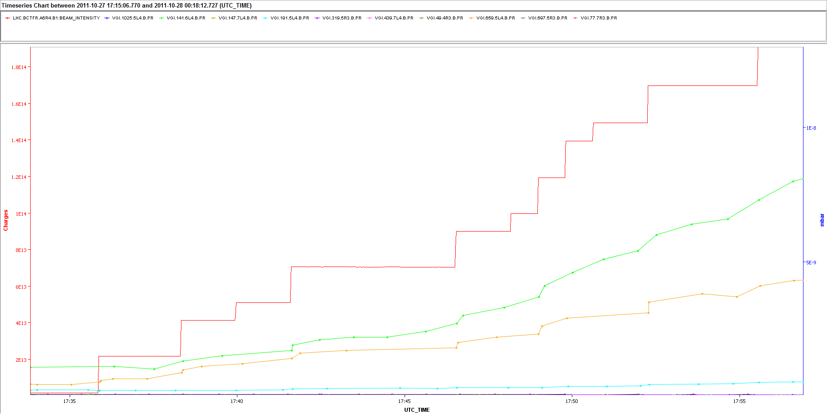
ΔP with 25 and 50 ns - Injection
Sector 3-4
Fill 2261
After the 25ns MDs, there are two gauges still showing large ΔP
22 July 2013 - e⁻ cloud meeting

Slide 24
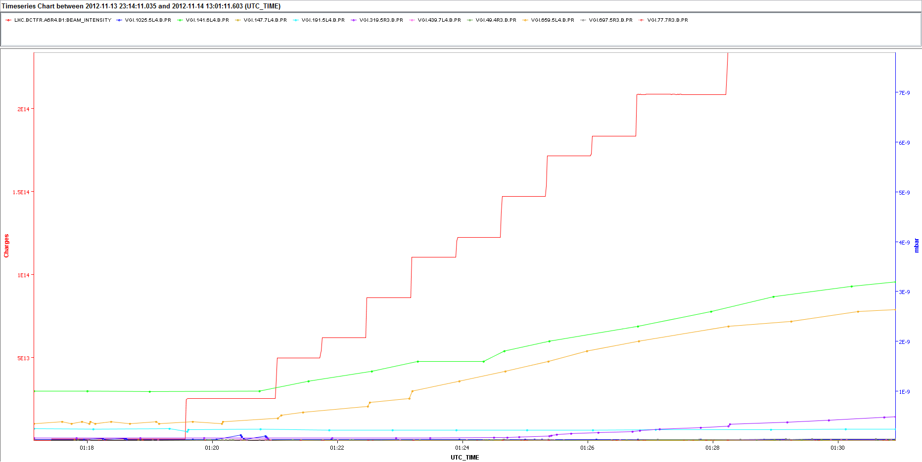
ΔP with 25 and 50 ns - Injection
Sector 3-4
Fill 3286
Nb≈1.65∙10¹¹ ppb. It has a higher threshold, but still some gauges show ΔP
22 July 2013 - e⁻ cloud meeting

Slide 25
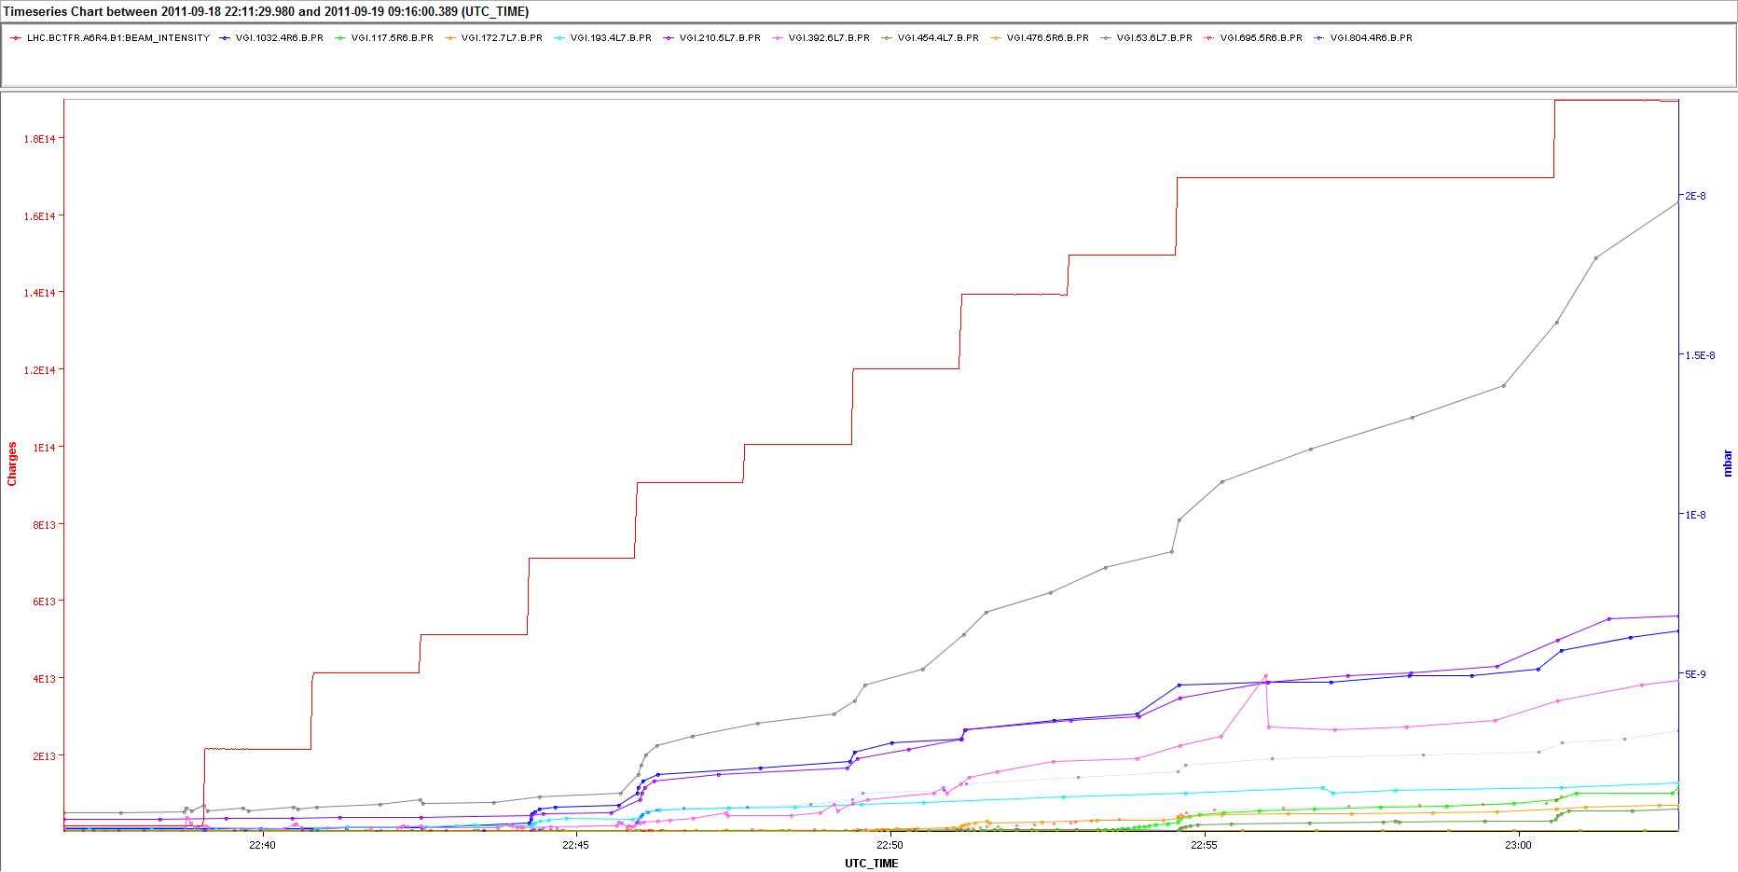
ΔP with 25 and 50 ns - Injection
Sector 6-7
Fill 2124
Almost all gauges show ΔP before the 25 ns MDs
22 July 2013 - e⁻ cloud meeting

Slide 26
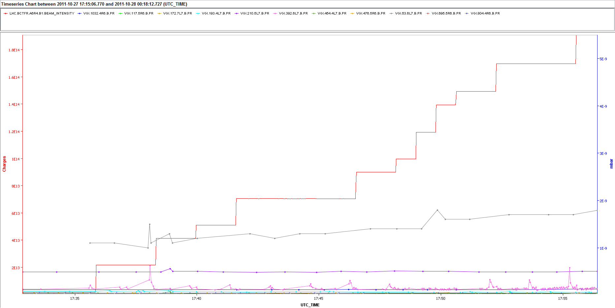
ΔP with 25 and 50 ns - Injection
Sector 6-7
Fill 2261
No visible ΔP after the 25 ns MDs → Enhanced conditioning in
sector 6-7?
22 July 2013 - e⁻ cloud meeting

Slide 27
Outline
Pressure rise observations with 25 and 50 ns beams
Bunch intensity thresholds for 50 ns
Behavior during pre-ramp and energy ramp
Interpretation using PyECLOUD simulations
Conclusions
22 July 2013 - e⁻ cloud meeting

Slide 28
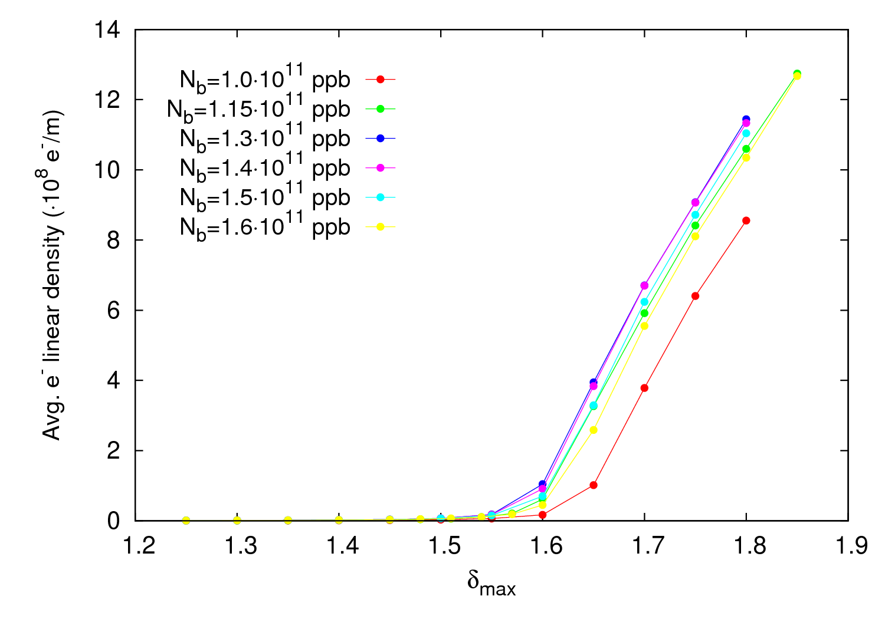
50 ns – N_{b} threshold
450 GeV
Maximum activity for N_{b}=1.3-1.4
Thresholds around δ_{max} ≈ 1.45 – 1.55
22 July 2013 - e⁻ cloud meeting

Slide 29
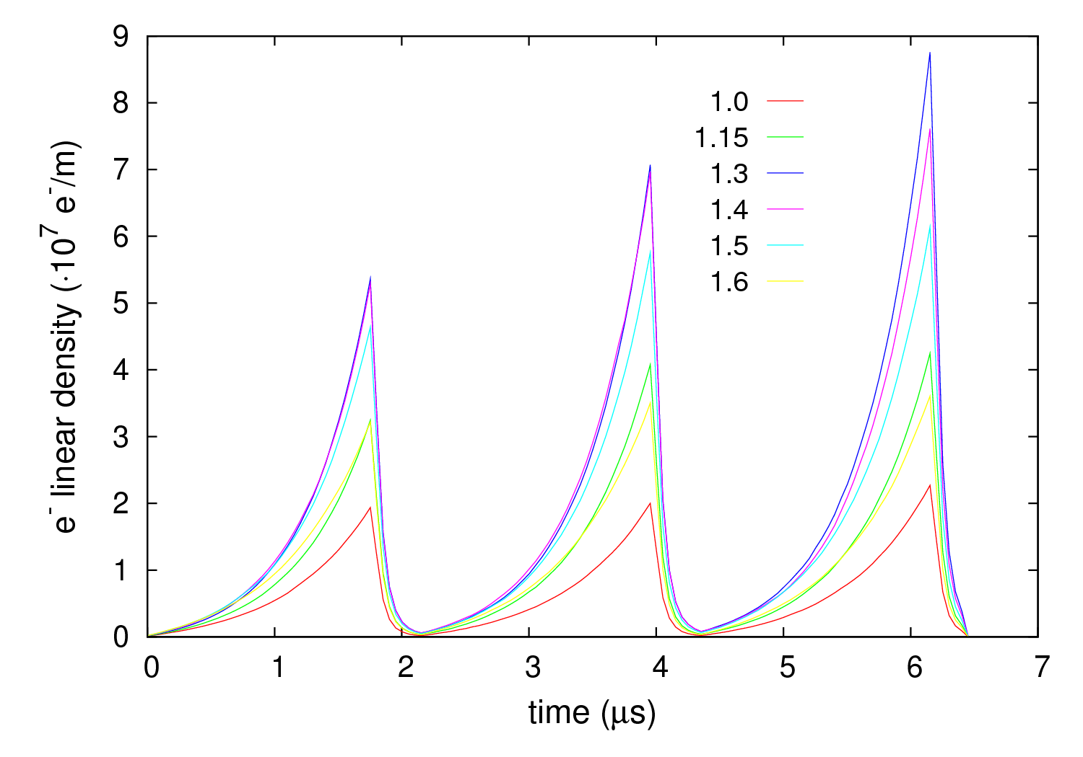
50 ns - Thresholds
450 GeV
δ_{max} = 1.55
δ_{max,thres} < 1.55
22 July 2013 - e⁻ cloud meeting

Slide 30
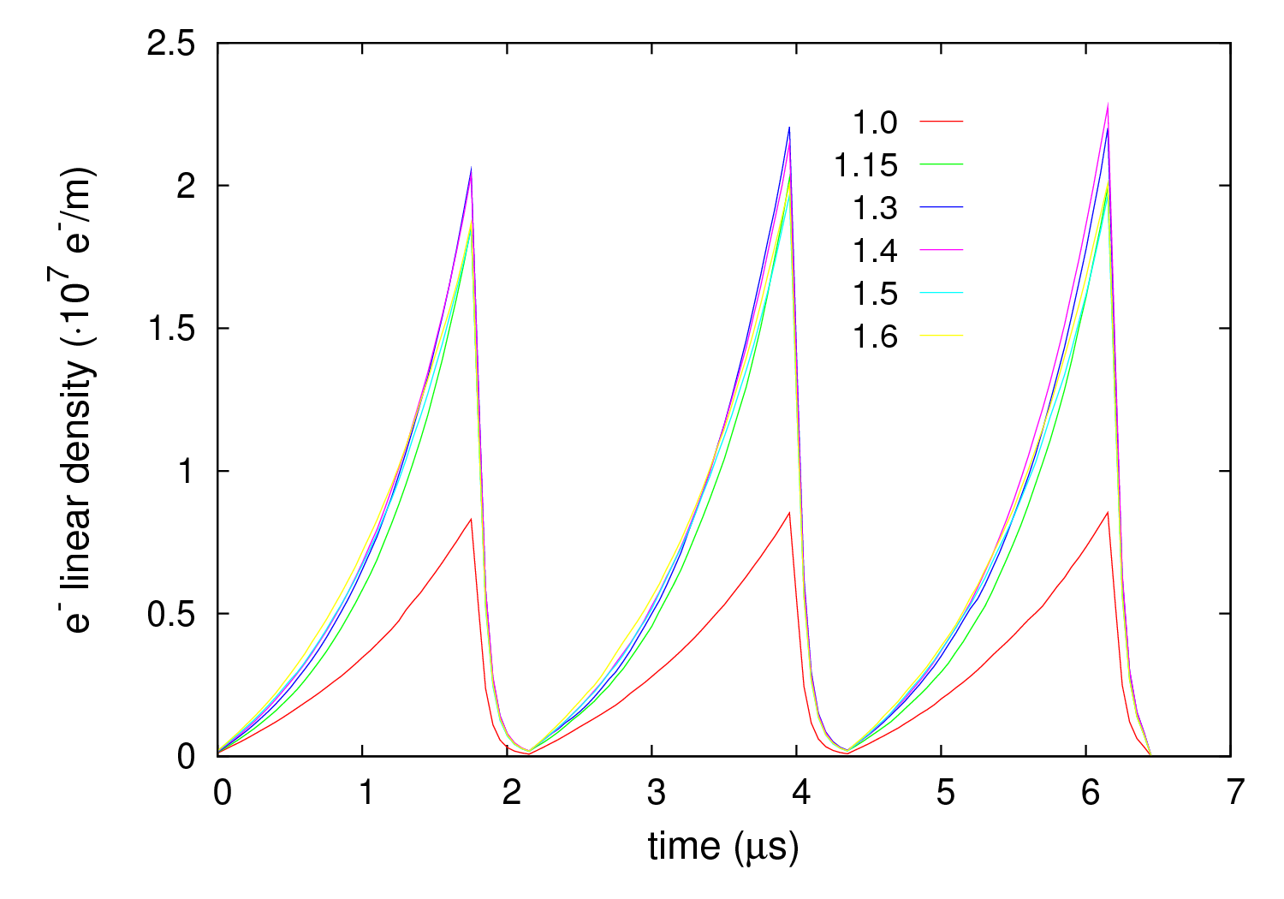
50 ns - Thresholds
450 GeV
δ_{max} = 1.50
δ_{max,thres} < 1.50 for N_{b}=1.3-1.4
δ_{max,thres} ≈ 1.50 for N_{b}=1.0,1.15, 1.5 and 1.6
22 July 2013 - e⁻ cloud meeting

Slide 31
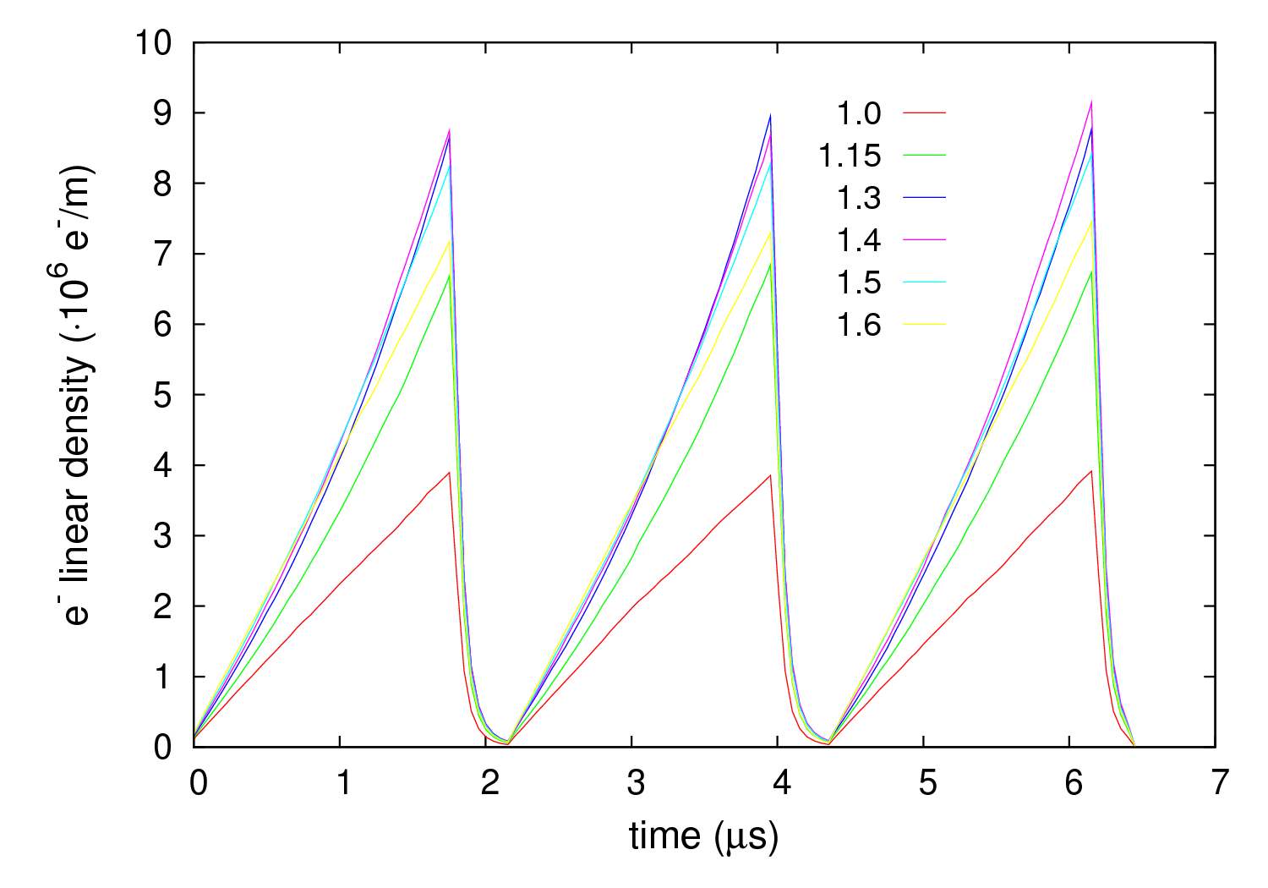
50 ns - Thresholds
450 GeV
δ_{max} = 1.45
δ_{max,thres} ≈ 1.45 for N_{b}=1.3-1.4
22 July 2013 - e⁻ cloud meeting

Slide 32
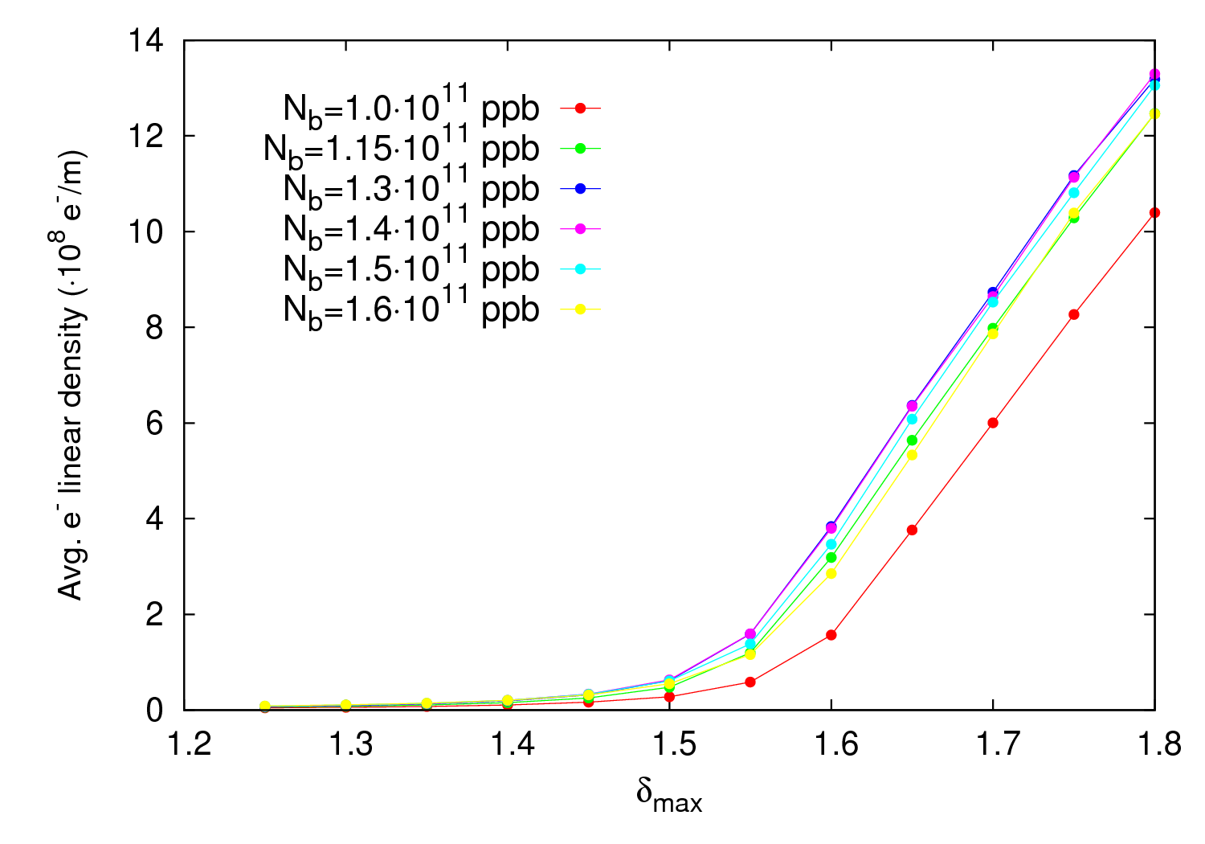
50 ns – N_{b} threshold
4 TeV
Maximum activity for N_{b}=1.3-1.4
Thresholds around δ_{max} ≈ 1.45 – 1.55
N.B: The PY* has been reduced by a factor 10 to better assess de multipactig threshold
22 July 2013 - e⁻ cloud meeting

Slide 33
50 ns - Thresholds
Nb (∙10¹¹ ppb) | δ_{max,thres} (450 GeV) | δ_{max,thres} (4 TeV)
1.0 | 1.50 | 1.50
1.15 | 1.50 | 1.45
1.3 | 1.45 | 1.45
1.4 | 1.45 | 1.45
1.5 | 1.50 | 1.45
1.6 | 1.50 | 1.50
ε_{max}=230 eV
σ_{z,450 GeV}= 10 cm
σ_{z,4 TeV}= 9.5 cm
ε_{x}= 2.4 μm
ε_{y}= 2.9 μm
Ø = 80 mm
The maximum e-cloud activity occurs at N_{b} = 1.3-1.4 ∙10¹¹ ppb.
Why ΔP_{Fill3000}> ΔP_{Fill2736} in most gauges → some deconditioning without 25 ns beams?
Thresholds are quite similar for all bunch populations.
Despite a stronger activity at 4 TeV (photoelectrons), threshold values are very similar at both energies
22 July 2013 - e⁻ cloud meeting

Slide 34
Outline
Pressure rise observations with 25 and 50 ns beams
Bunch intensity thresholds for 50 ns
Behavior during pre-ramp and energy ramp
Interpretation using PyECLOUD simulations
Conclusions
22 July 2013 - e⁻ cloud meeting

Slide 35
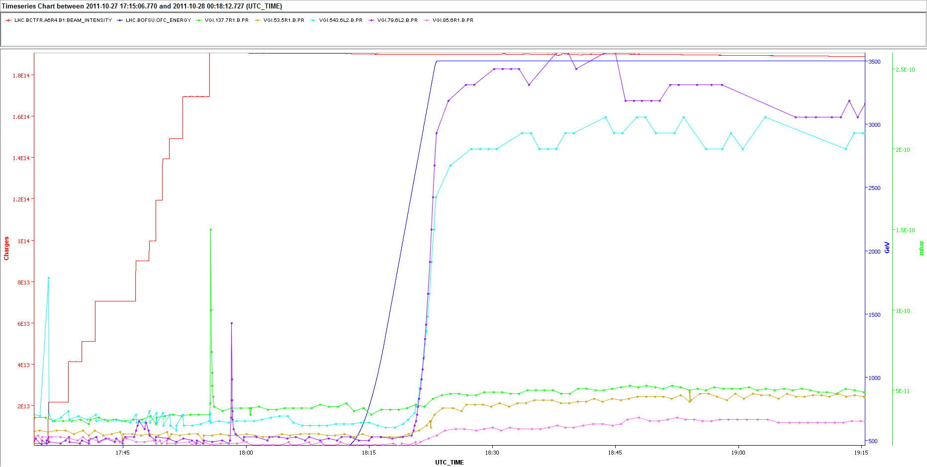
Pre-ramp and ramp
Sector 1-2
Fill 2261
In this example, none of the gauges exhibit ΔP during injection and all detect some ΔP during the ramp (at about 2.4 TeV)
22 July 2013 - e⁻ cloud meeting

Slide 36
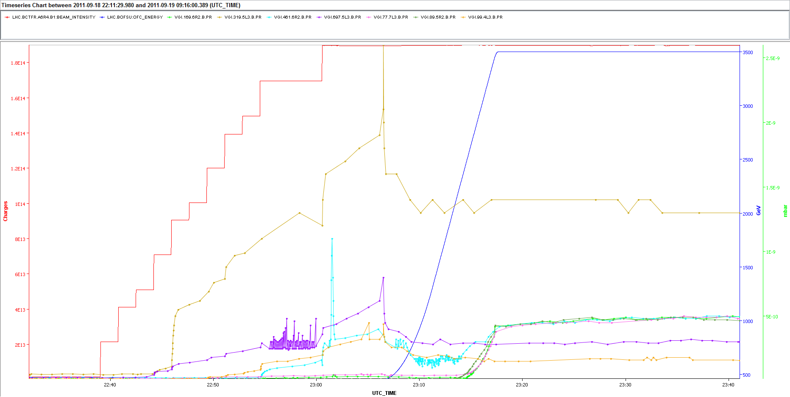
Pre-ramp and ramp
Sector 2-3
Fill 2124
No clear response to the ramp
Not all gauges show a response to the ramp (especially the most active at injection)!
“Funny” ΔP behavior before the ramp
22 July 2013 - e⁻ cloud meeting

Slide 37
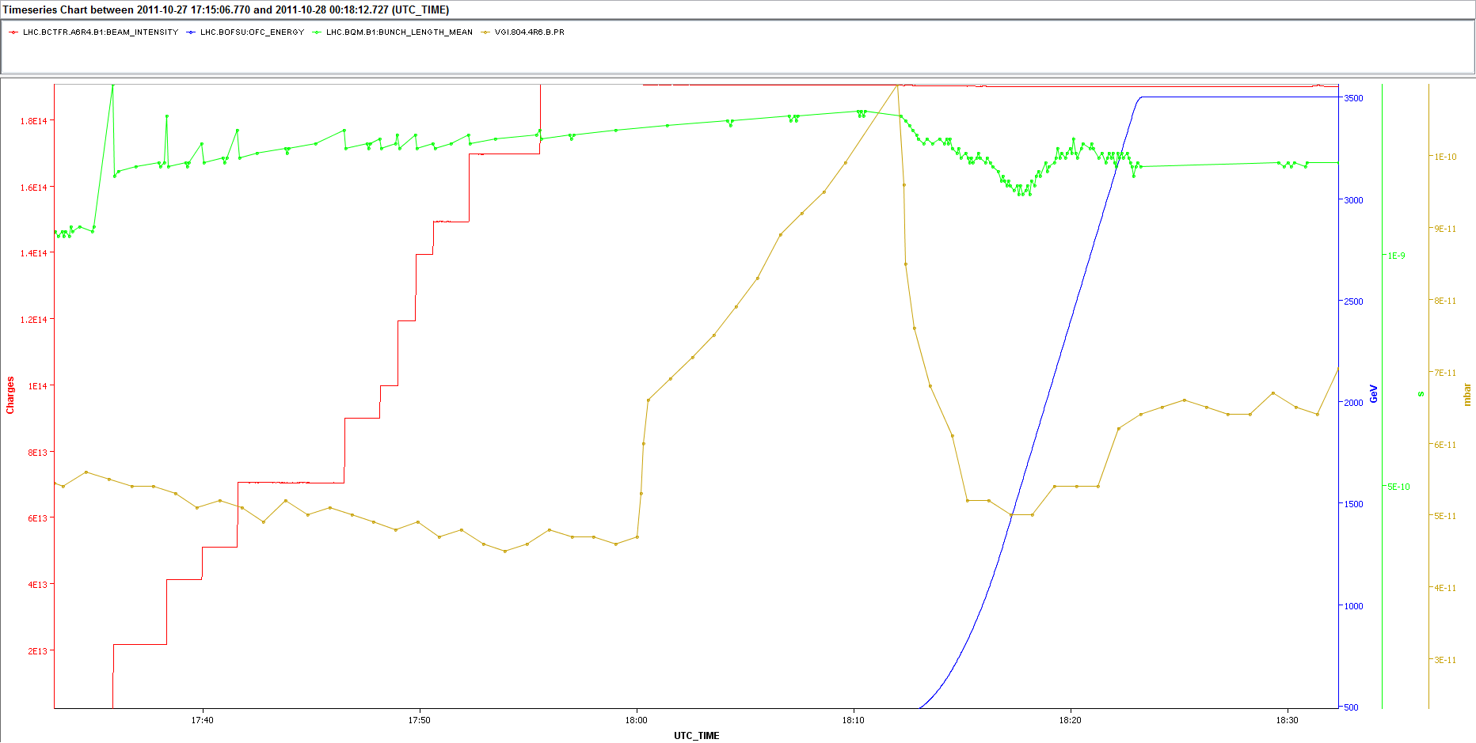
Pre-ramp and ramp
Gauge VGI.804.4R6.B in sector 6-7
Fill 2261
Good example of the “funny” prototype pre-ramp ΔP
No e-cloud signs during injection and suddenly, before the ramp, there is an important ΔP
22 July 2013 - e⁻ cloud meeting

Slide 38
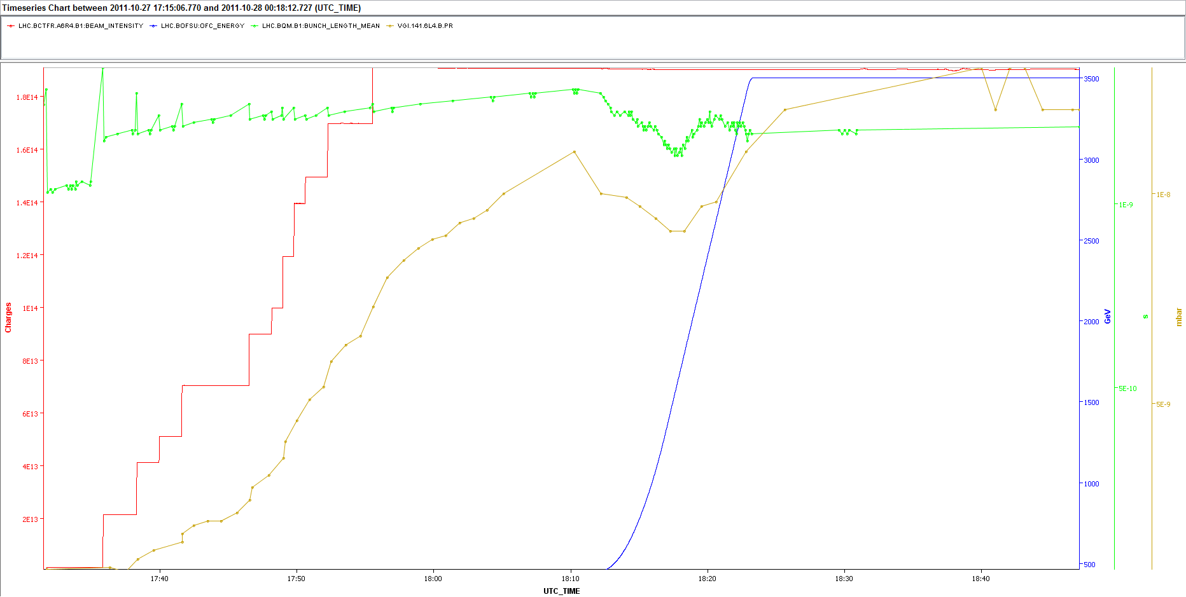
Pre-ramp and ramp
Gauge VGI.141.6L4.B in sector 3-4
Fill 2124
“funny” pre-ramp behavior
P follows σ_{z} (usual behavior for many guages)
22 July 2013 - e⁻ cloud meeting

Slide 39
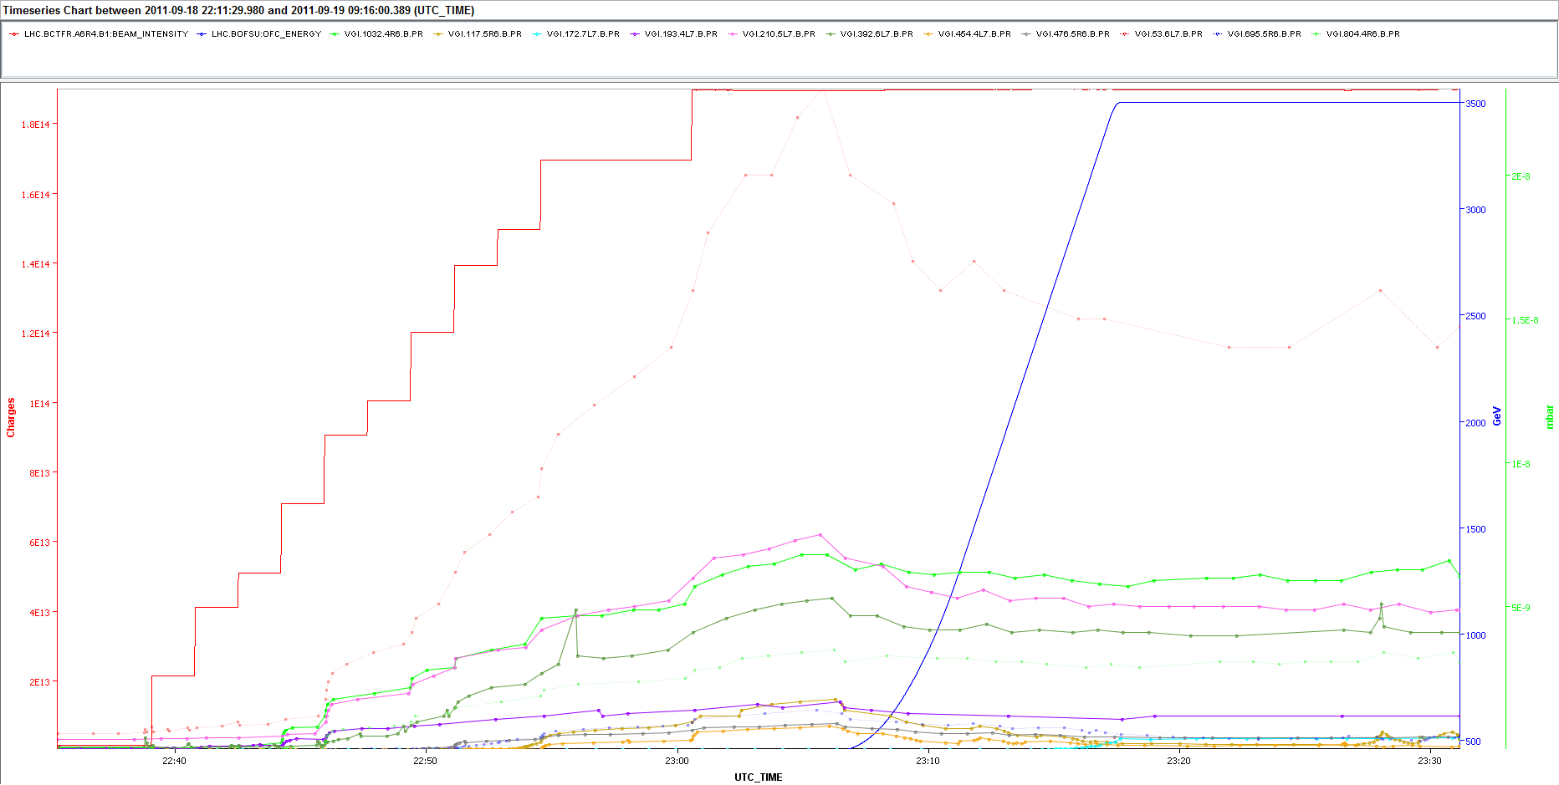
Pre-ramp and ramp
Sector 6-7
Fill 2124
No effect during the energy ramp! (only a bit for gauge VGI.172.7L7.B)
22 July 2013 - e⁻ cloud meeting

Slide 40
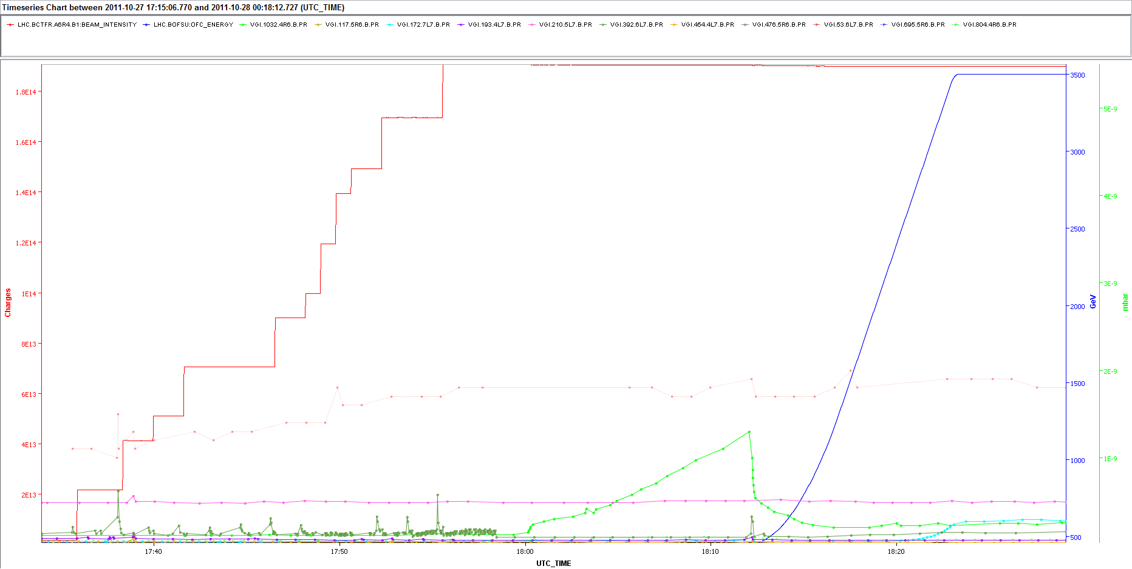
Pre-ramp and ramp
Sector 6-7
Fill 2261
22 July 2013 - e⁻ cloud meeting

Slide 41
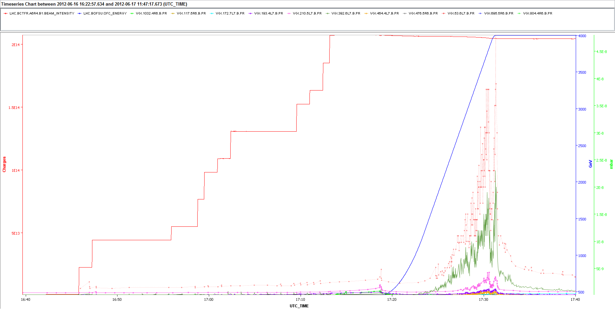
Pre-ramp and ramp
Sector 6-7
Fill 2736
The DP during the ramp occurs earlier than “usual” (≈1.5 TeV)
For this fill there is a ΔP with the ramp in gauges that never showed it
22 July 2013 - e⁻ cloud meeting

Slide 42
Pre-ramp and ramp
Are these effects really generated by e-cloud?
Very different responses for different gauges
Very different responses for different fills (same gauges)
Different starting points (form 1.2 TeV to 2.9 TeV)
Thresholds at 450 GeV and 4 TeV are very similar
Alternative explanations
Photodesortion: does it present a threshold effect? Maybe:
  The SR monitor switches at about 1.5-2 TeV from ondulator to D3 [2,3]
Heating?
Orbit excursions?
Losses in collimators?
22 July 2013 - e⁻ cloud meeting

Slide 43
Outline
Pressure rise observations with 25 and 50 ns beams
Bunch intensity thresholds for 50 ns
Behavior during pre-ramp and energy ramp
Interpretation using PyECLOUD simulations
Conclusions
22 July 2013 - e⁻ cloud meeting

Slide 44
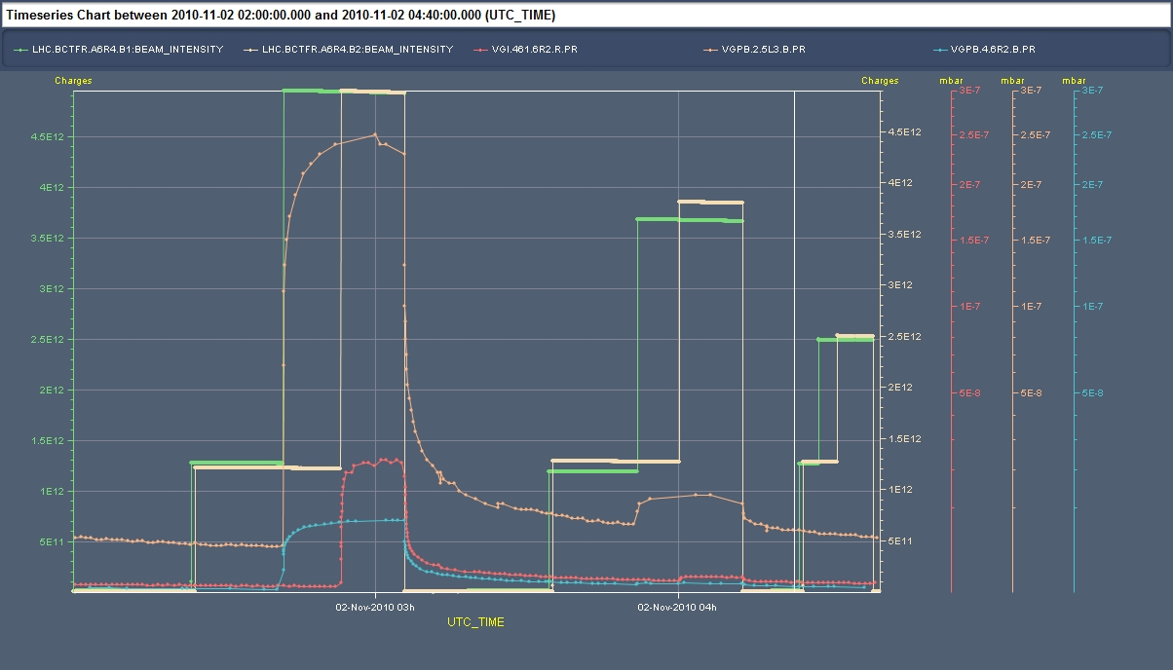
Benchmarking
First 50 ns MDs in November 2010:
  Exploration of e-cloud effects with train length
12+36
12+24
12+12
22 July 2013 - e⁻ cloud meeting

Slide 45
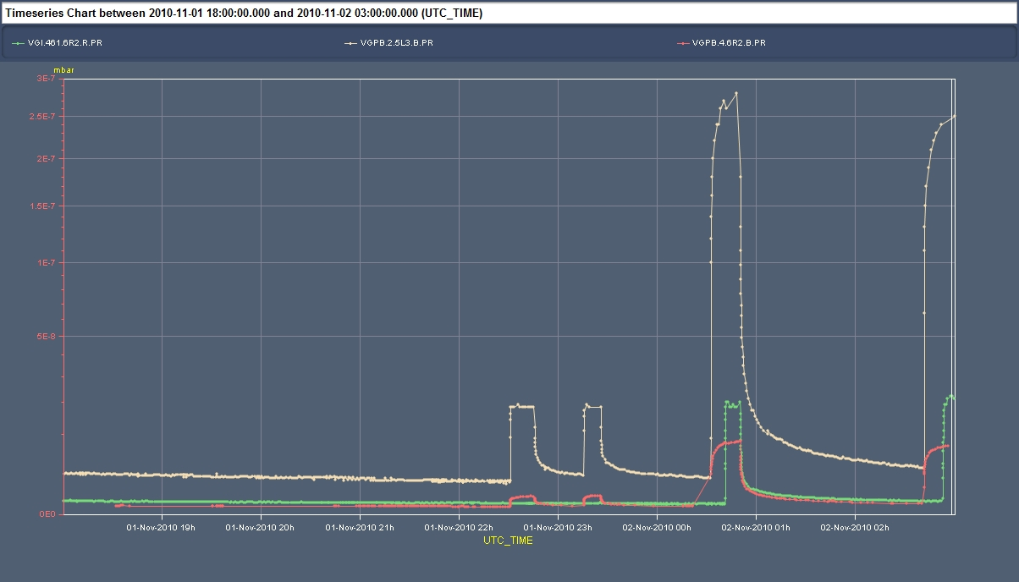
Benchmarking
First 50 ns MDs in November 2010:
  Exploration of e-cloud effects with train length
  Exploration of e-cloud effects with bunch intensity
1.1x10¹¹ p/bunch
0.8x10¹¹ p/bunch
0.6x10¹¹ p/bunch
22 July 2013 - e⁻ cloud meeting

Slide 46
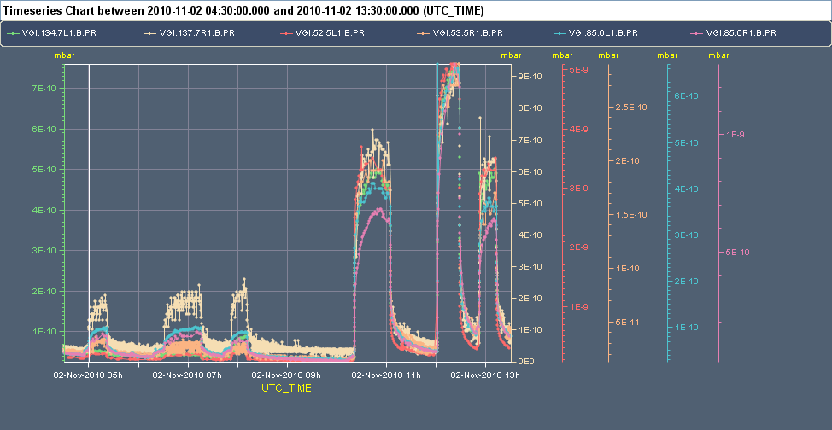
Benchmarking
First 50 ns MDs in November 2010:
  Exploration of e-cloud effects with train length
  Exploration of e-cloud effects with bunch intensity
  Exploration of e-cloud effects with the spacing between trains
1 μs
1.85 μs
1.35 μs
28.85 μs
38.85 μs
8.85 μs
22 July 2013 - e⁻ cloud meeting

Slide 47
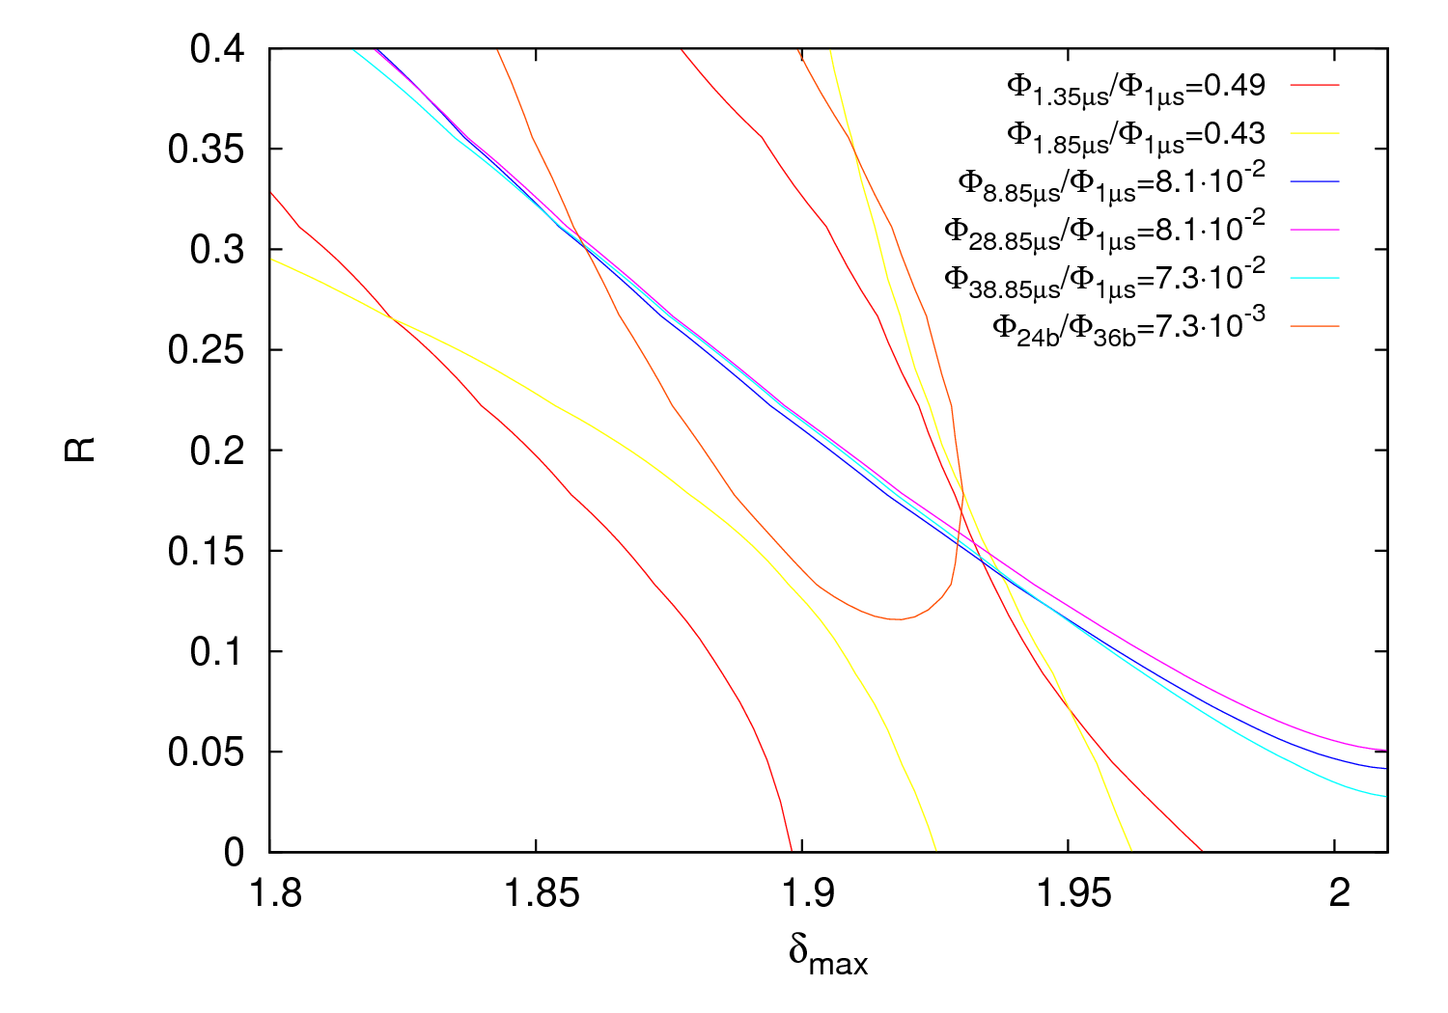
Benchmarking
Following the methodology explained in [4], we get for gauge VGI.141.6L4.B:
22 July 2013 - e⁻ cloud meeting

Slide 48
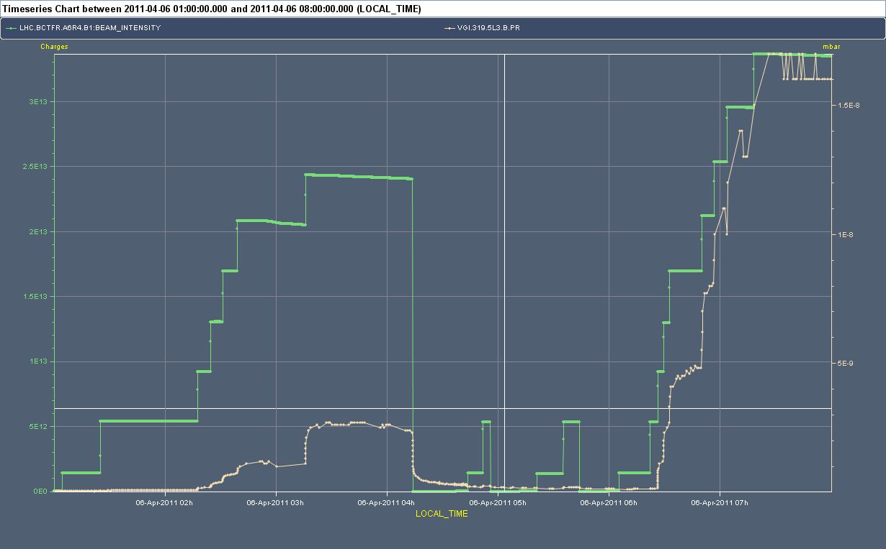
Benchmarking
Scrubbing run in April 2011 with 50 ns
2μs
2.125 μs
4μs
6μs
With constant spacing between trains we would expect a linear behavior
22 July 2013 - e⁻ cloud meeting

Slide 49
Benchmarking
We observe a transient before the linear behavior is achieved
10/4/2011
19/5/2011
22 July 2013 - e⁻ cloud meeting

Slide 50
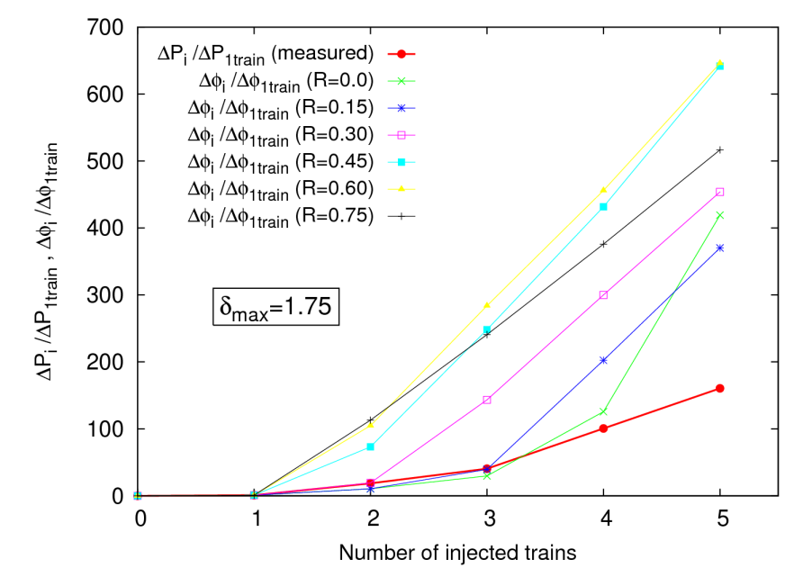
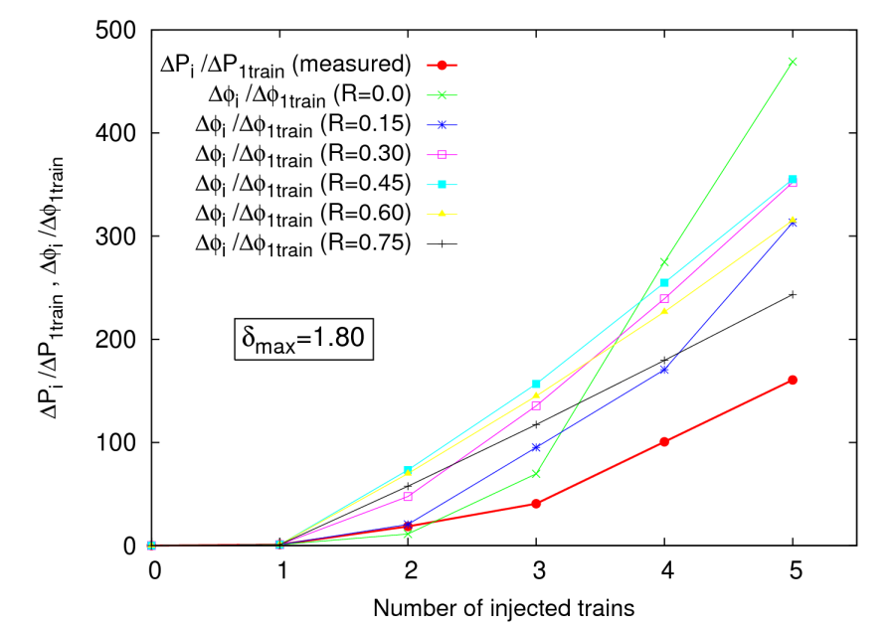
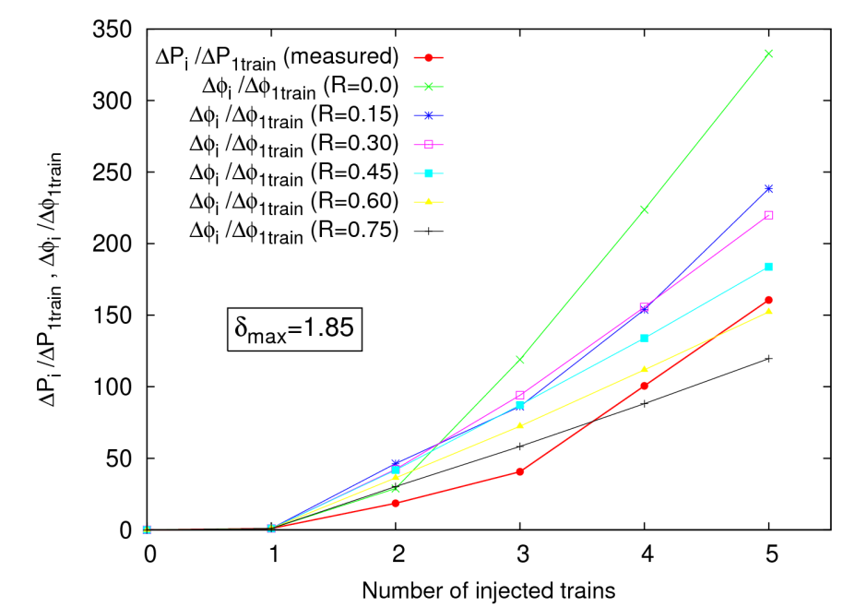
Benchmarking
We observe a transient before the linear behavior is achieved
This behavior cannot be fully reproduced by simulations:
22 July 2013 - e⁻ cloud meeting

Slide 51
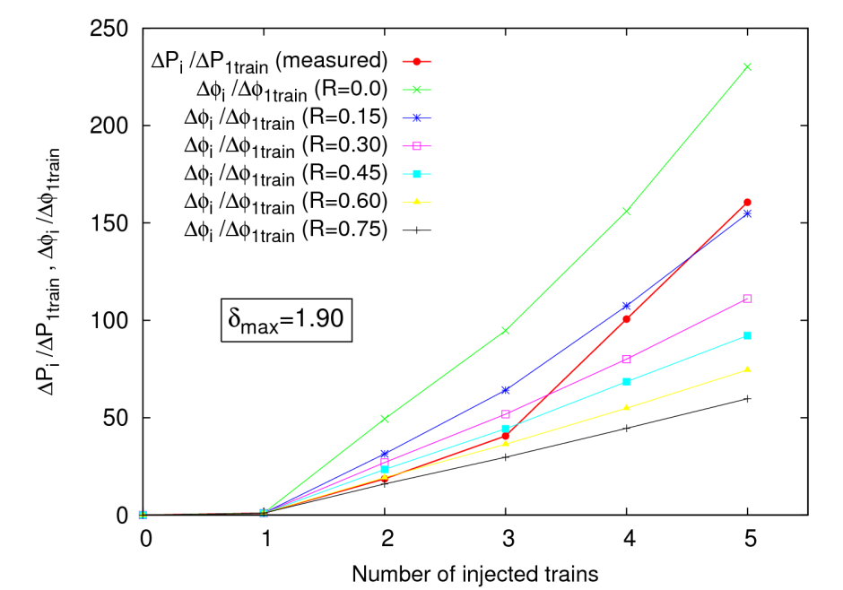
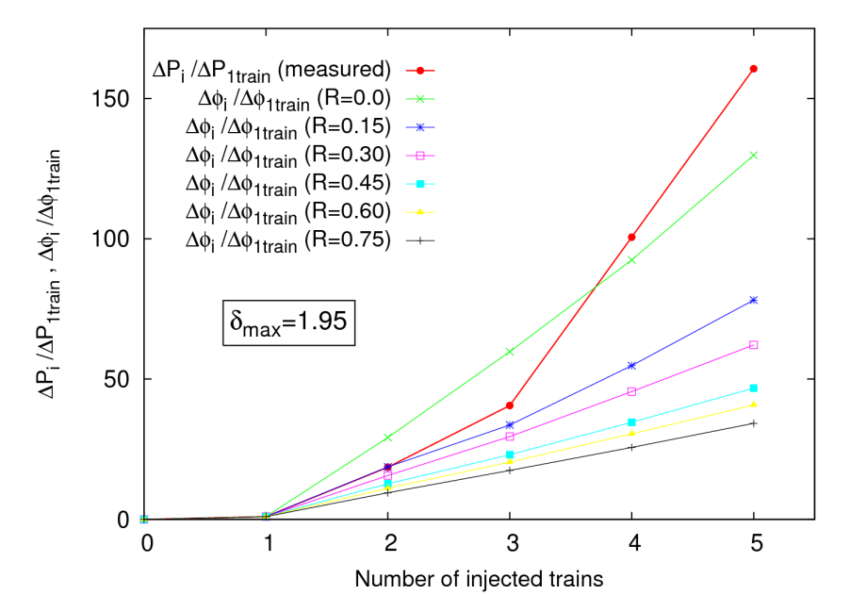
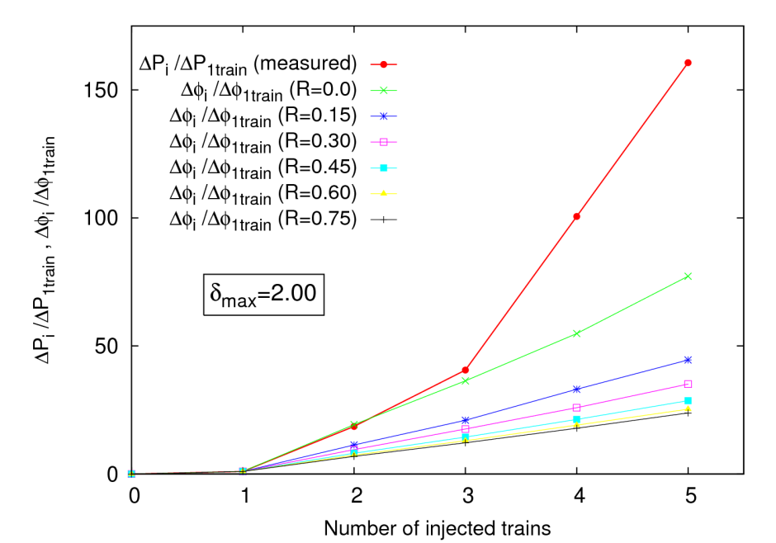
Benchmarking
We observe a transient before the linear behavior is achieved
This behavior cannot be fully reproduced by simulations:
22 July 2013 - e⁻ cloud meeting

Slide 52
Benchmarking
We observe a transient before the linear behavior is achieved
This behavior cannot be fully reproduced by simulations:
The exact behavior for the first trains is not well reproduced by the simulations, whereas the linear dependence after some trains disregarding the concrete δ_{max} and R values used is well reproduced.
Lower values of R give a better agreement for the shape presented by the first trains (change of slope). High values of R always exhibit a linear behavior from the first trains.
In the linear part, flux ratio lines for the benchmarking are expected to be ideally equal since there is not enough information to infer the reflectivity (due to a constant train spacing and the linear increases).
22 July 2013 - e⁻ cloud meeting

Slide 53
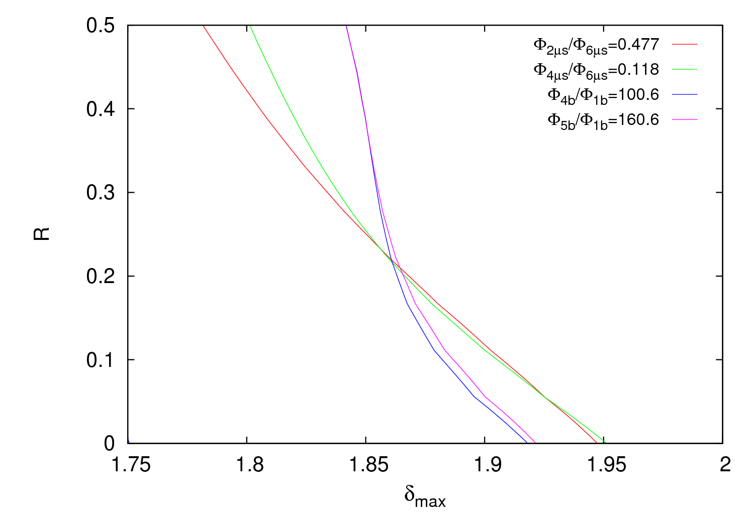
Benchmarking
Following the methodology explained in [4], we get for gauge VGI.141.6L4.B:
22 July 2013 - e⁻ cloud meeting

Slide 54
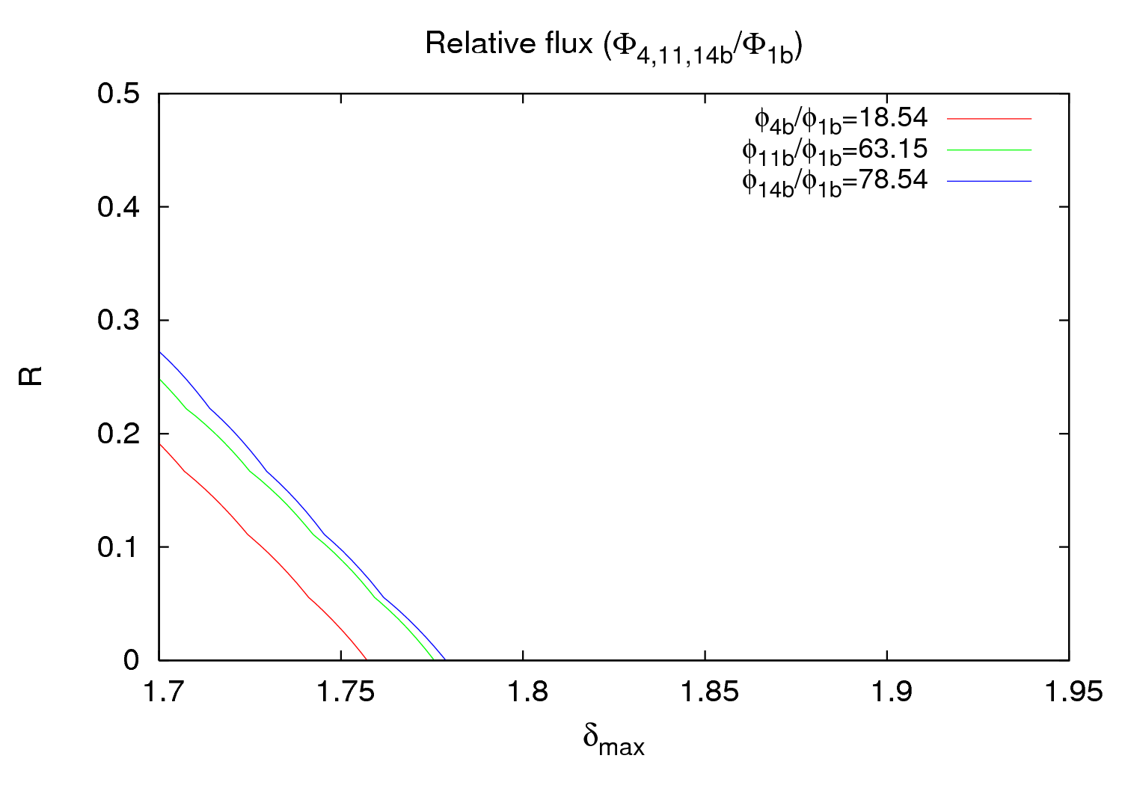
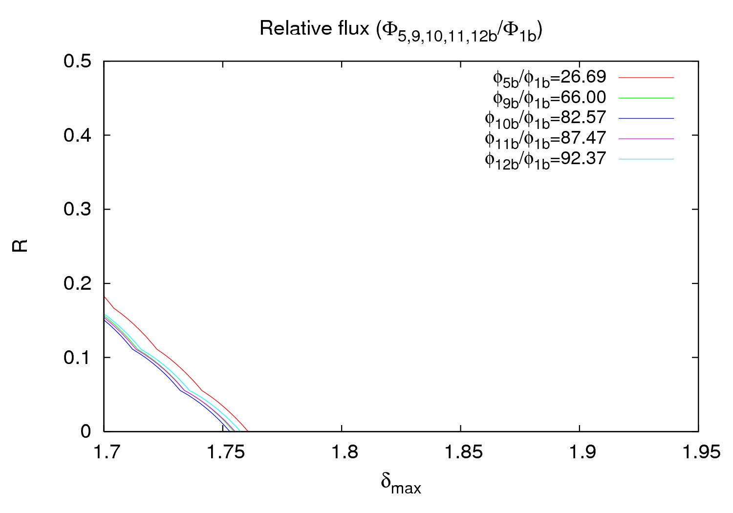
Benchmarking
Following the methodology explained in [4], we get for gauge VGI.141.6L4.B:
10 April 2011
19 May 2011
Clear conditioning effect
(RESULTS WITH ECLOUD)
22 July 2013 - e⁻ cloud meeting

Slide 55
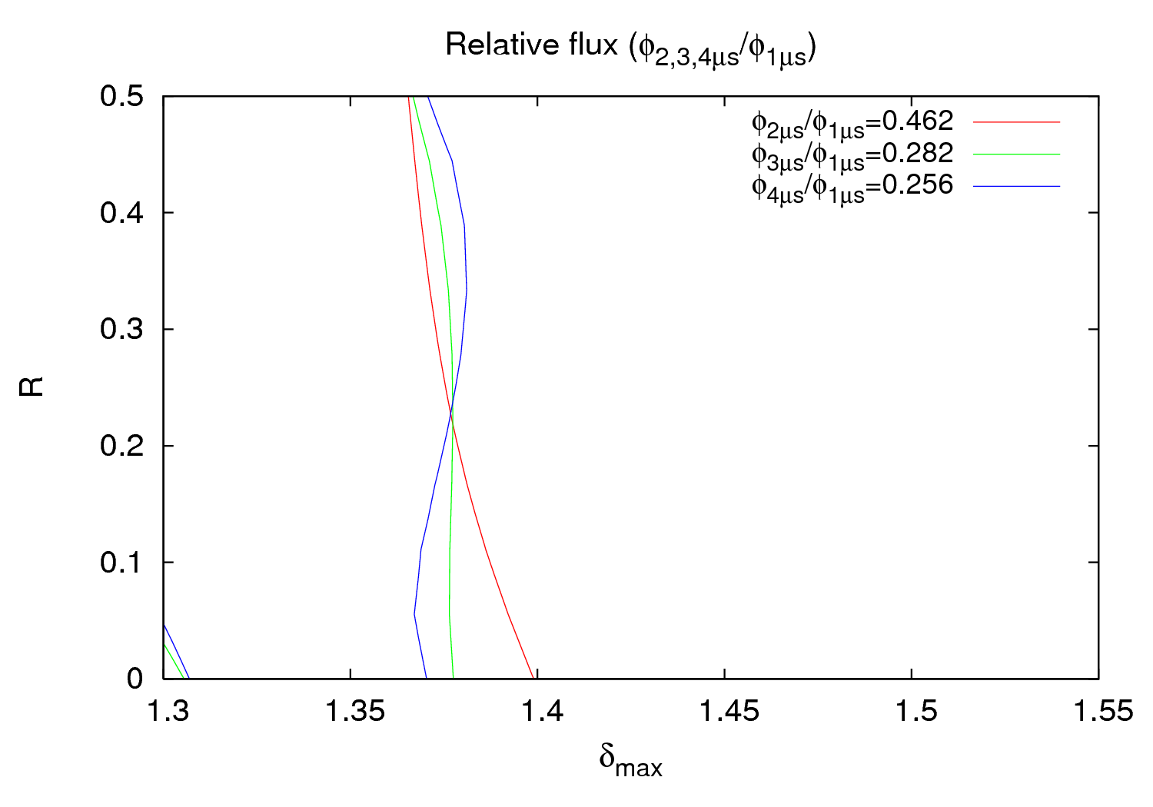
Benchmarking
Following the methodology explained in [4], we get for gauge VGPB.2.5L3.B:
25 October 2011
(RESULTS WITH ECLOUD)
22 July 2013 - e⁻ cloud meeting

Slide 56

Benchmarking
Gauge VGPB.2.5L3.B
27 October 2011 – Physics fill 2261
22 July 2013 - e⁻ cloud meeting

Slide 57
Outline
Pressure rise observations with 25 and 50 ns beams
Bunch intensity thresholds for 50 ns
Behavior during pre-ramp and energy ramp
Interpretation using PyECLOUD simulations
Conclusions
22 July 2013 - e⁻ cloud meeting

Slide 58
Conclusions
Different gauges in the warm-warm straight sections show different behaviors
Conditioning effects seem to be stronger for some gauges
Thresholds are between 1.45 and 1.5 for N_{b}=1.0-1.6∙10¹¹ ppb
Thresholds at 450 GeV and 4 TeV are very similar
There are some behaviors during pre-ramp and ramp that are not explained yet and cannot be reproduce with simulations
Benchmarking simulated flux and measured pressure can help monitoring the evolution of δ_{max} and can explain some vacuum observations due to e-cloud
22 July 2013 - e⁻ cloud meeting

Slide 59
THANK YOU
FOR YOUR ATTENTION
22 July 2013 - e⁻ cloud meeting

Slide 60
References
[1] M. Facchini, R. Jung, R. Maccaferri, D. Tommasini and W. Venturini Delsolaro,
“The 5 T Superconducting Undulator for the LHC Synchrotron Radiation Profile Monitor,”
EPAC-2004-WEPKF017.
[2] T. Lefevre, E. Bravin, G. Burtin, A. Guerrero, A. Jeff, A. Rabiller, F. Roncarolo and A. Fisher, “First Beam Measurements with the LHC Synchrotron Light Monitors,”
Conf. Proc. C 100523 , IPAC’10, Kyoto, 2010, MOPE057.
[3] O. Dominguez and F. Zimmermann, “Benchmarking electron-cloud simulations and pressure measurements at the LHC,” CERN-2013-002, pp. 79-83.
22 July 2013 - e⁻ cloud meeting

